Slide 1
Evading your protection and exfiltrate the data
Out of Band Data Exfiltration

Slide 2
About Me
~# whoami&&id
root\n uid=0(root) gid=0(root) groups=0(root)
Work and education:
Pentester @Atos Romania
BEng @University “Politehnica” of Bucharest
MEng. @University “Politehnica” of Bucharest
MSc @Bucharest Academy of Economic Studies
Member @Romanian Security Team community
Speaker @DefCamp 2017
CEH
Interests:
Web App Security
Infra Security
IoT Device Security
Contact: @matasareanu13

Slide 3
What is data exfiltration?
Data exfiltration is the unauthorized transfer of data from a computer. The transfer of data can be manual by someone with access to the computer or automated, carried out through network protocols.

Slide 4
Out Of Band Data Exfiltration
Out-Of-Band (OOB) techniques are methods by which an attacker has an alternative way to confirm and use an otherwise “blind” vulnerability.
The OOB techniques often require a vulnerability to generate a connection to the outside world.

Slide 5
Why should I care?

Slide 6
Why should I care?
Safe User Data
=
Happy
Users

Slide 7
What protocols are used (abused) usually:
TCP
HTTPS
FTP
SMB
SMTP
UDP
DNS
ICMP
ping
802.11
Wi-Fi SSID

Slide 8
Making your own environment for testing
Get a Linux VM from a provider that offers you a static public IP
Buy a short domain name from your favorite registrar.
Transfer DNS records from the registrar to your own DNS server/ point it to the IP of the Linux VM

Slide 9
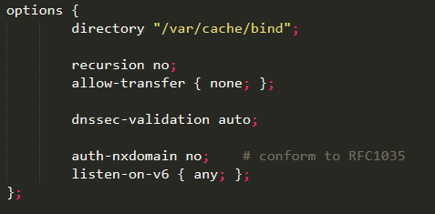
Making your own environment for testing
Open port 53 udp/tcp for any incoming connection in your firewall
Open ports 20,21,80,443,8080 tcp also.
Install named/bind9 on the Linux VM
configure bind to be an authoritative server for the acquired domain
edit /etc/bind/named.conf.options
edit /etc/bind/named.conf.local
*replace example.com with your domain name

Slide 10
Making your own environment for testing
Copy the example zone and reverse zone files and rename them:
Edit the db.example.com file and edit the SOA record and edit the serial number
Edit the db.example.com file and add a NS record that translates to ns1.example.com
Add A records that translate your public IP to example.com
Add A, AAAA, CNAME records that translate your public IP to *.example.com
Check the config of the zone like this:
You can check the info it gets asked about in /var/log/syslog. I recommend changing this so as to be easier to check the interrogations.

Slide 11
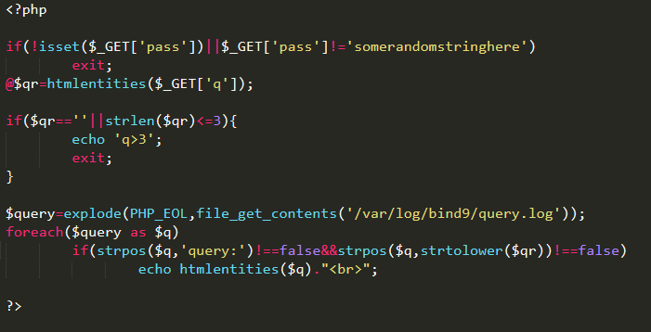
For a simpler way to check the DNS records you could use a simple PHP script with the following lines:

Slide 12
DNS Limitations
A domain name can have maximum of 127 subdomains.
Each subdomains can have a maximum of 63 character length.
Maximum length of a full domain name is 253 characters.
Due to DNS records caching add unique value to URL for each request.

Slide 13
Quick ICMP Example:
I.E. To catch ICMP requests we can use tcpdump with a filter:
Now that we have a listener open on our server we can send the data we want to exfiltrate from the server

Slide 14
We can use a quick Python scrip to encode the data to hex format and send it.

Slide 15
What vulnerabilities do attackers use to exfiltrate data?
The classics:
SQL injection
Remote Code Execution
SSRF
OS command execution
( the ICMP example from above might be useful in this case)
et al.
The (new) vulns on the block:
XXE

Slide 16
Blind SQLi example – MSSQL – DNS OOB:
To exfiltrate data from a MSSQL database we could just use the xp_dirtree built-in function
If xp_dirtree does not work we can use other functions like:
xp_fileexists
xp_subdirs

Slide 17
Blind SQLi example – MySQL – DNS OOB:
To exfiltrate data from a MySQL database we could just use the LOAD_FILE function:

Slide 18
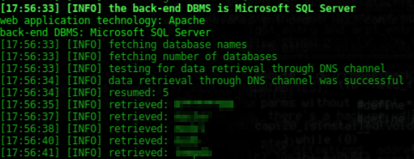
Blind SQLi OOB example – automated using Sqlmap:

Slide 19
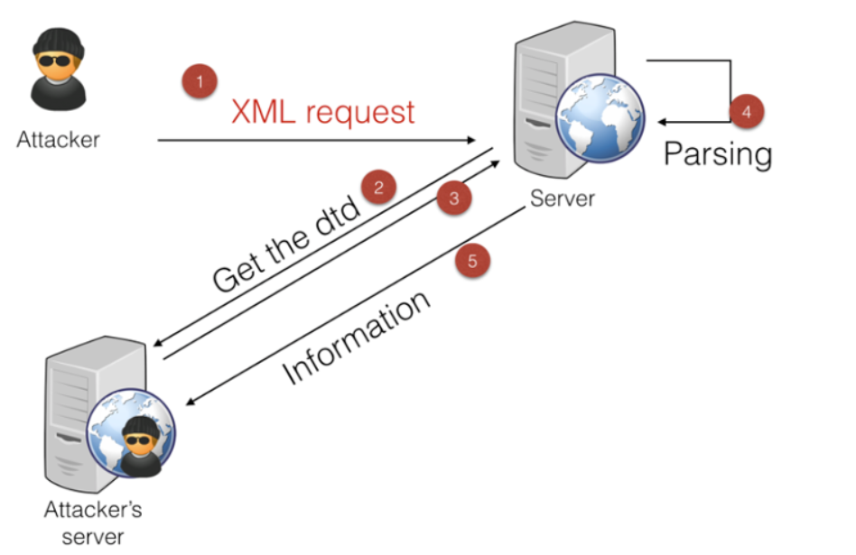
XXE
Confirming XXE via DNS

Slide 20
XXE
Confirming XXE via DNS

Slide 21
XXE
Getting files out via XXE
Can use HTTP/FTP/DNS for this
We will use FTP – most XML processors support it
We will host a file on our server that can be accessible via FTP:
sudo pip install pyftpdlib
python –m pyftpdlib -w

Slide 22
XXE
Getting files out via XXE
Tell the vulnerable server to request the file:
>> Magic:

Slide 23
XXE
Getting password hashes out via XXE
Start responder.py on your VM:
Setup the XXE vector
Acquired credential hash

Slide 24
Wi-Fi as an OOB data exfiltration channel
SSID is visible to the user
802.11 Probe requests are not ^^
The netsh command does this by first setting up a non existent access point using the data we want to send as the name.
send that data by trying to connect to the access point

Slide 25
Prevention recommendation:
Fix the vulnerabilities
Block egress traffic
Network micro-segmentation
Set-up rate limiting for requests
Set-up an IDS/IPS properly ☺

Slide 26
Quick Demo
May the demo gods be with us today!!!

Slide 27
Cool O-O-B tools:
https://www.xxe.sh/
https://github.com/sqlmapproject/sqlmap
https://github.com/yarrick/iodine
https://github.com/stealth/fraud-bridge
https://github.com/TryCatchHCF/Cloakify
https://github.com/ytisf/PyExfil

Slide 28
Questions??

Slide 30
References:
https://www.techopedia.com/definition/14682/data-exfiltration
https://www.notsosecure.com/oob-exploitation-cheatsheet/
http://bernardodamele.blogspot.com/2012/06/data-retrieval-over-dns-in-sql.html
https://www.slideshare.net/stamparm/ph-days-2012miroslavstampardataretrievaloverdnsinsqlinjectionattackspaper
https://blog.zsec.uk/out-of-band-xxe-2/
https://pentest.blog/data-ex-filtration-with-dns-in-sqli-attacks/
https://www.digitalocean.com/community/tutorials/how-to-configure-bind-as-an-authoritative-only-dns-server-on-ubuntu-14-04
https://blog.zsec.uk/out-of-band-xxe-2/
https://github.com/api0cradle/Powershell-ICMP/blob/master/Powershell-ICMP-Sender.ps1
https://github.com/lukebaggett/dnscat2-powershell/blob/master/dnscat2.ps1
https://ss64.com/nt/certutil.html
https://isc.sans.edu/forums/diary/Exfiltrating+data+from+very+isolated+environments/23645/
https://pentest.blog/data-ex-filtration-with-dns-in-sqli-attacks/
https://www.aldeid.com/wiki/File-transfer-via-DNS
https://www.dbrnd.com/2015/05/postgresql-cross-database-queries-using/
https://www.youtube.com/watch?v=e4_NLFZc-kw

