Slide 1
CTF Attack/Defense Ivan Bütler
https://www.owasp.org/index.php/OWASP_University_Challenge
ivan.buetler@owasp.org
1

Slide 2
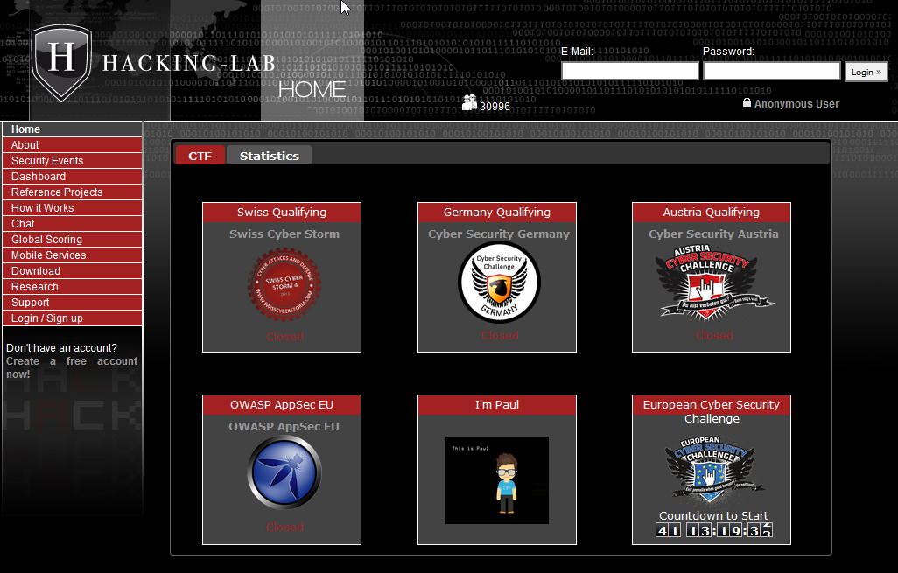
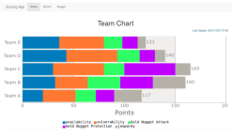
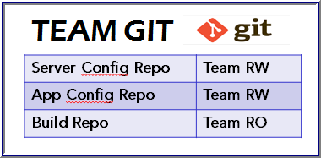
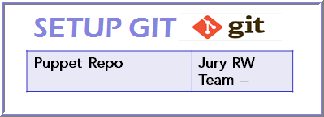
CTF Architecture
Mobile CTF App
Hacking-Lab
VPN to
HL
DHCP Server
DHCP Server
DHCP Server
DHCP Server
Internet
Uplink
1
2
1
2
1
2
1
2
3
4
3
4
3
4
3
4
Proxy
Proxy
Proxy
Proxy
DNS
DNS
DNS
DNS
Jeopardy CTF
Servers
Team 1
Team 2
Team 3
Team 4
CTF Proxy
Gold Nugget
Web App
Score Board
Web App
ISO Server
1
DHCP Server
4
4
1
1
Production
ESXi
4
4
Public CTF
ESXi
Mail Server
Private CTF
Services
1
CTF DNS
NTP Server
2
DIR Server
2
3
3
2
2
3
3
2

Slide 3
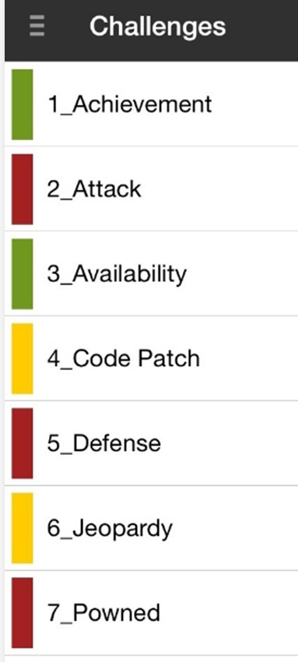
CTF Tasks
Setup and maintain a service like DNS, Proxy, E-Mail, Apache, WordPress, …
Hack in other CTF team servers and services and steal the gold nugget (EXPLOITATION)
Keep own services up and running (IT OPS)
Fix vulnerable software & services (IT DEV)
Safe guard own gold nuggets
Solving jeopardy challenges
Own a device/server and prove the attack by leaving a special gold nugget, known as evidence nugget (0-day)
CTF Tasks
3

Slide 4
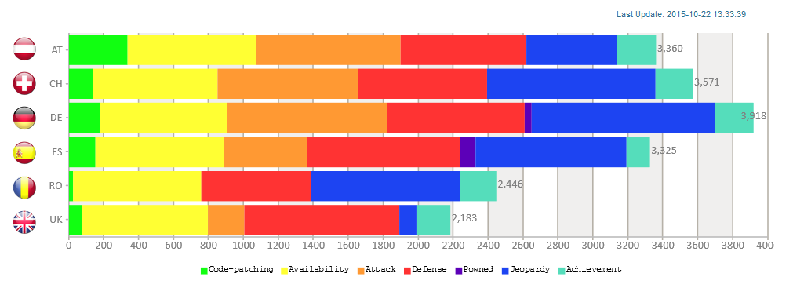
Scoring
Scoring Application
4

Slide 5
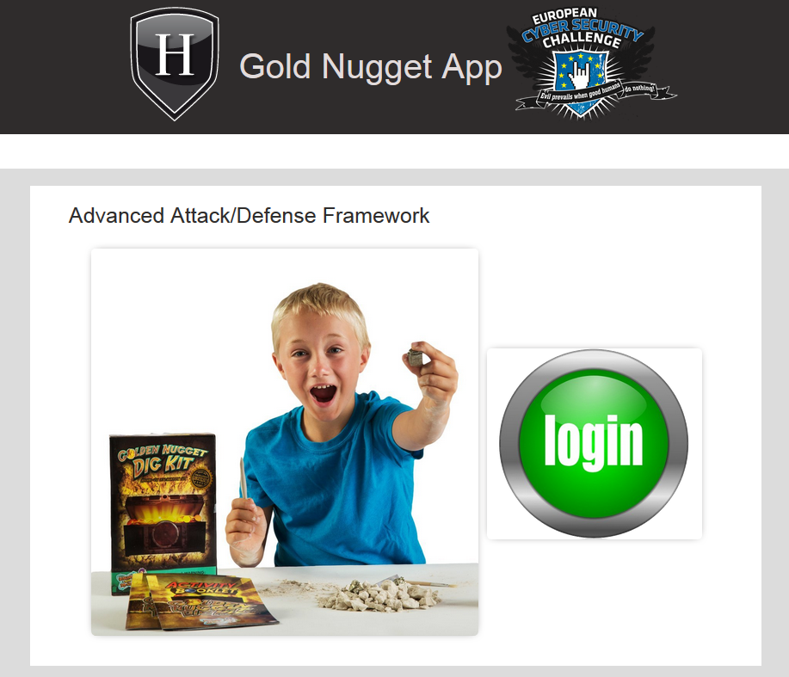
The CTF Glue
CTF players must find/hack/disclose a string, known as gold nugget, from the ‘vulnerable’ services of the other teams
The purpose of the gold nugget is to claim points for a successful attack
5

Slide 6
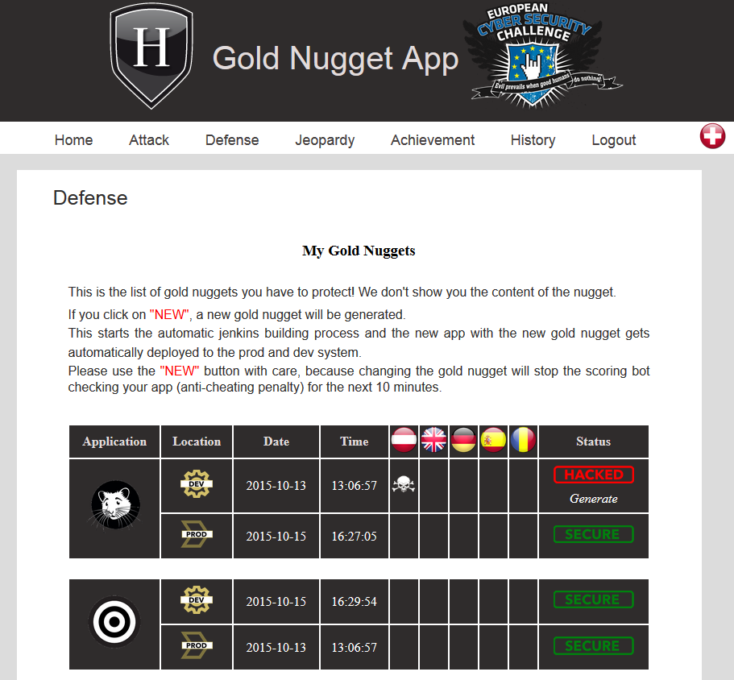
The CTF Glue Gold Nuggets
Gold Nuggets are digitally signed strings. The gold nugget app is issuing them. The gold nugget app knows, who owns which gold nugget
6

Slide 7
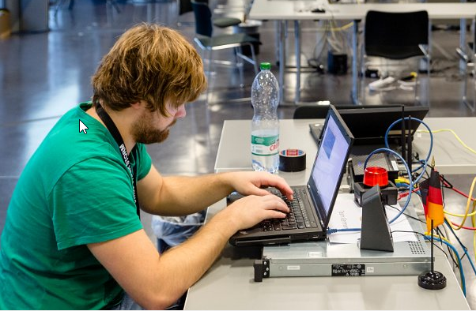
Team ESX = DEV SYSTEM
Every CTF team gets a physical server (ESXi) and the proper vSphere credentials
The ESXi is pre-configured with several pre-installed VM’s
The team ESXi is named as “DEV” system
7

Slide 8
CTF Architecture
Mobile CTF App
Hacking-Lab
DEV
VPN to
HL
DHCP Server
DHCP Server
DHCP Server
DHCP Server
Internet
Uplink
1
2
1
2
1
2
1
2
3
4
3
4
3
4
3
4
Proxy
Proxy
Proxy
Proxy
DNS
DNS
DNS
DNS
Jeopardy CTF
Servers
Team 1
Team 2
Team 3
Team 4
PROD
CTF Proxy
Gold Nugget
Web App
Score Board
Web App
ISO Server
1
DHCP Server
4
4
1
1
Production
ESXi
4
4
Public CTF
ESXi
Mail Server
Private CTF
Services
1
CTF DNS
NTP Server
2
DIR Server
2
3
3
2
2
3
3
8

Slide 9
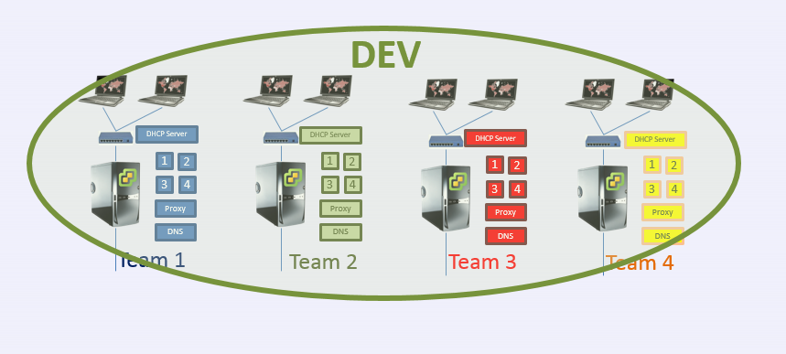
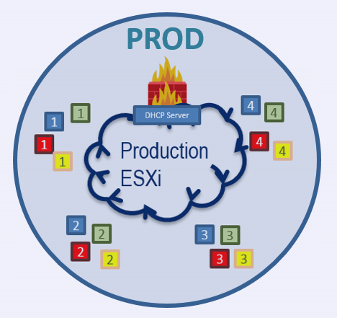
Production ESXi
The apps on DEV is ‘equal’ or ‘identical’ as on PROD
On DEV, teams have root access (SSH)
On PROD teams do *NOT* have root or interactive access
9

Slide 10
Attacking
 | Stealing Gold Nugget
10

Slide 11
Attacking
Every team is allowed to attack other teams on the DEV or PROD environment
On success, the attacking team discloses the gold nugget from the victim team
The gold nugget is different in DEV and PROD for any team and app (every gold nugget is unique)
The gold nugget must be used to claim points using the gold nugget app
11

Slide 12
Attacking
claim points for gold nugget
VPN to
HL
DHCP Server
DHCP Server
DHCP Server
DHCP Server
Internet
Uplink
1
2
1
2
1
2
1
2
3
4
3
4
3
4
3
4
Proxy
Proxy
Proxy
Proxy
DNS
DNS
DNS
DNS
Jeopardy CTF
Servers
Team 1
Team 2
Team 3
Team 4
CTF Proxy
Gold Nugget
Web App
Score Board
Web App
ISO Server
1
DHCP Server
4
4
1
1
Production
ESXi
4
4
Public CTF
ESXi
Mail Server
Private CTF
Services
1
CTF DNS
NTP Server
2
DIR Server
2
3
3
2
2
3
3
12

Slide 13
Scoring per Time Unit
Gold Nugget
Web App
team 2
ATTACK/DEFENSE
team2 is requesting an new gold nugget
the previous gold nugget becomes invalid
team 2
team 3
penalty period
SCORING BOT TIMELINE
team 2
team 3
3’
3’
3’
3’
3’
3’
13

Slide 14
Fixing Vulnerable Apps
 | Stealing Gold Nugget
 | Fix vulnerable software & services
 | Safe guard own gold nuggets
14

Slide 15
Fixing vulnerable apps
VPN to
HL
DHCP Server
DHCP Server
DHCP Server
DHCP Server
Internet
Uplink
1
2
1
2
1
2
1
2
3
4
3
4
3
4
3
4
Proxy
Proxy
Proxy
Proxy
DNS
DNS
DNS
DNS
Jeopardy CTF
Servers
Team 1
Team 2
Team 3
Team 4
CTF Proxy
Gold Nugget
Web App
Score Board
Web App
ISO Server
1
DHCP Server
4
4
1
1
Production
ESXi
4
4
Public CTF
ESXi
Mail Server
Private CTF
Services
1
CTF DNS
NTP Server
2
DIR Server
2
3
3
2
2
3
3
15

Slide 16
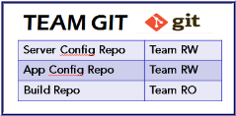
Fixing vulnerable apps
Teams have access to the source code of the vulnerable apps
Teams must fix the vulnerabilities and commit changes to the source code repository = GIT
The Jenkins-based building infrastructure is building the new release of the app
The Jenkins-based building infrastructure is packaging the current team’s gold nugget into the new release
The building infrastructure is automatically deploying the new app to DEV and PROD
16

Slide 17
Fixing vulnerable apps
player is issueing a new gold nugget for App 01 of team 2
player from team 2 is committing changes to Team 2 App RW Git Repo
DHCP Server
DHCP Server
DHCP Server
DHCP Server
1
2
1
2
1
2
1
2
3
4
3
4
3
4
3
4
Proxy
Proxy
Proxy
Proxy
DNS
DNS
DNS
DNS
Team 1
Team 2
Team 3
Team 4
git hook triggers
installation on DEV
read-only
read-write
git hook triggers
installation on PROD
GIT REPO
git hook triggers new
Jenkins build
Team 1 Build- RO
Team 1 App - RW
Team 2 App - RW
Team 2 Build - RO
Team 2 App - RW
1
DHCP Server
4
4
Team 3 Build - RO
Team 3 App - RW
1
Team 4 Build - RO
Team 4 App - RW
1
Production
ESXi
4
4
1
get nugget ()
Gold Nugget
Web App
2
2
3
3
2
2
3
3
17

Slide 18
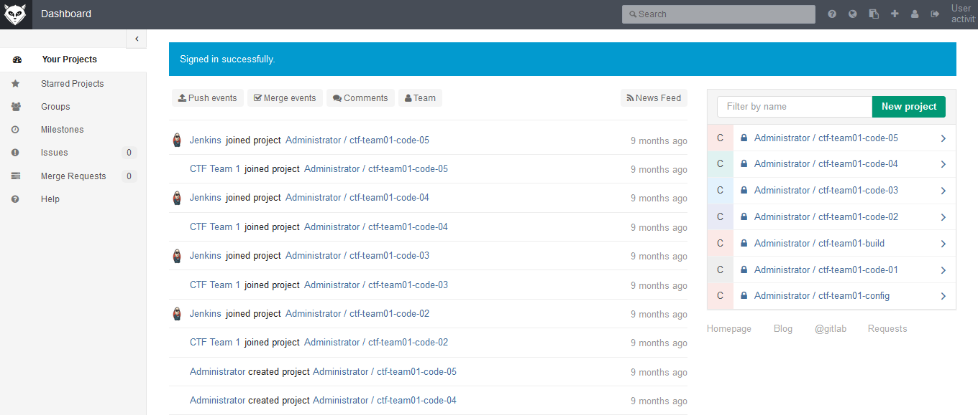
teamgit.hacking-lab.com

Slide 19
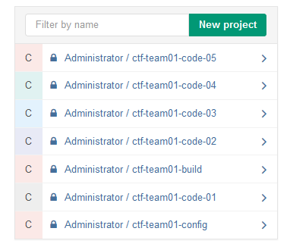
source repo
commit triggers build

Slide 20
build repo
build commits:
- log file - app (if ok)

Slide 21
Jeopardy Challenges
 | Stealing Gold Nugget
 | Fix vulnerable software & services
 | Safe guard own gold nuggets
 | Solving jeopardy challenges
21

Slide 22
Jeopardy-style CTF
Jeopardy-style CTFs have a couple of tasks in range of categories. For example, Web, Reverse Engineering, Crypto, Binary, Forensics, …
Gold Nugget app is introducing the task (mission)
Teams gain points for every solved task
More points for more complicated tasks
Teams are not fighting against each others
The earlier a team solves the challenge, the more points they get
22

Slide 23
Jeopardy-style CTF
Hacking-Lab
VPN to
HL
DHCP Server
DHCP Server
DHCP Server
DHCP Server
Internet
Uplink
1
2
1
2
1
2
1
2
3
4
3
4
3
4
3
4
Proxy
Proxy
Proxy
Proxy
DNS
DNS
DNS
DNS
Jeopardy CTF
Servers
Team 1
Team 2
Team 3
Team 4
CTF Proxy
Gold Nugget
Web App
Score Board
Web App
ISO Server
1
DHCP Server
4
4
1
1
Production
ESXi
4
4
Public CTF
ESXi
Mail Server
Private CTF
Services
1
CTF DNS
NTP Server
2
DIR Server
2
3
3
2
2
3
3
23

Slide 24
Scoring per Time Unit
Mission 1
Crypto
solved by
team 3
Mission 2
Stegano
solved by team 2
Mission 2
Crypto
solved by
team 3
team 3
team 2
team 3
team 2
team 3
3’
3’
3’
3’
3’
3’
24

Slide 25
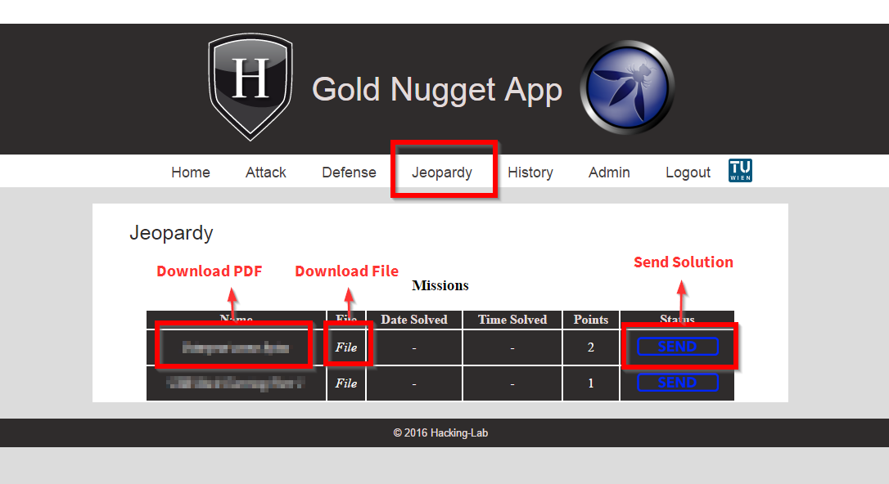

Slide 26
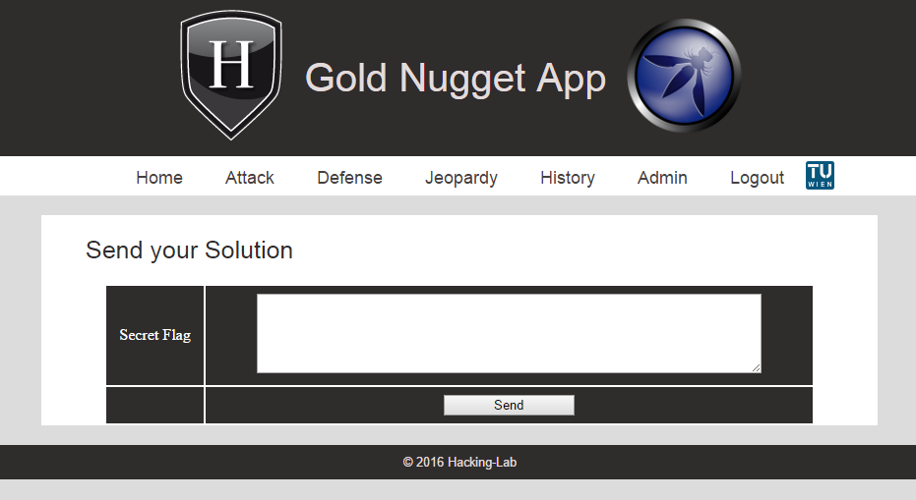
Jeopardy type 1: Secret flag

Slide 27
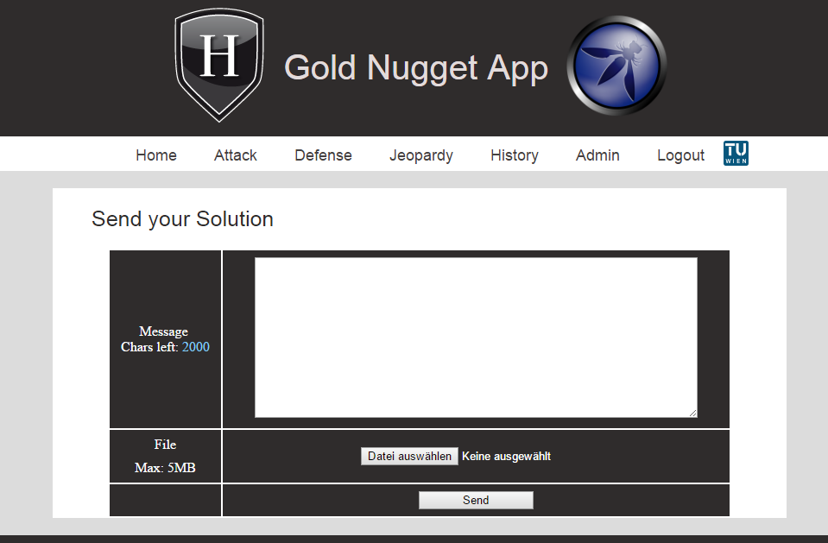
Jeopardy type 1: Solution Message / File

Slide 28
Achievements
 | Setup and maintain a service
 | Stealing Gold Nugget
 | Fix vulnerable software & services
 | Safe guard own gold nuggets
 | Solving jeopardy challenges
28

Slide 29
Achievements
Technical Achievements
Teams must setup and maintain services
DNS, Proxy, Apache, NodeJS, AngularJS, …
Non-Technical Achievements (Management)
Write press release
Announce news
Create crisis organization during CTF game
Presentation / Talk
29

Slide 30
Achievements
Hacking-Lab
VPN to
HL
DHCP Server
DHCP Server
DHCP Server
DHCP Server
Internet
Uplink
1
2
1
2
1
2
1
2
3
4
3
4
3
4
3
4
Proxy
Proxy
Proxy
Proxy
DNS
DNS
DNS
DNS
Jeopardy CTF
Servers
Team 1
Team 2
Team 3
Team 4
submit solution
CTF Proxy
Gold Nugget
Web App
Score Board
Web App
ISO Server
1
DHCP Server
4
4
1
1
Production
ESXi
4
4
Public CTF
ESXi
Mail Server
Private CTF
Services
1
CTF DNS
NTP Server
2
DIR Server
2
3
3
2
2
3
3
30

Slide 31
Scoring per Time Unit
Achievement 1
solved by
team 3
Achievement 1
solved by
team 2
Achievement 1
solved by
team 3
team 3
team 2
team 3
team 2
team 3
3’
3’
3’
3’
3’
3’
31

Slide 32
Pown’ed
 | Setup and maintain a service
 | Stealing Gold Nugget
 | Fix vulnerable software & services
 | Safe guard own gold nuggets
 | Solving jeopardy challenges
 | Own a device/server
32

Slide 33
Pown’ed
Teams may find vulnerabilities that are not known to the CTF jury
If a team could hack such a service, then the team could get a special gold nugget and leave it on the hacked server as ‘evidence’
This special gold nugget is defined as the “evidence gold nugget”
Teams can request such an evidence gold nugget from the gold nugget app, but only one at a time until it’s being verified by the jury
33

Slide 34
Pown’ed
Hacking-Lab
VPN to
HL
DHCP Server
DHCP Server
DHCP Server
DHCP Server
Internet
Uplink
1
2
1
2
1
2
1
2
3
4
3
4
3
4
3
4
Proxy
Proxy
Proxy
Proxy
DNS
DNS
DNS
DNS
Jeopardy CTF
Servers
Team 1
Team 2
Team 3
Team 4
CTF Proxy
Gold Nugget
Web App
Score Board
Web App
ISO Server
1
DHCP Server
4
4
1
1
Production
ESXi
4
4
Public CTF
ESXi
Mail Server
Private CTF
Services
1
CTF DNS
NTP Server
2
DIR Server
2
3
3
2
2
3
3
34

Slide 35
Scoring per Time Unit
team 3 found a 0-day exploit and left
an evidence nugget
on the server
team 3
team 2
team 3
3’
3’
3’
3’
3’
3’
35

Slide 36
Availability
 | Setup and maintain a service
 | Stealing Gold Nugget
 | Keep own services up and running
 | Fix vulnerable software & services
 | Safe guard own gold nuggets
 | Solving jeopardy challenges
 | Own a device/server
36

Slide 37
Availability
Mobile CTF App
Hacking-Lab
VPN to
HL
DHCP Server
DHCP Server
DHCP Server
DHCP Server
Internet
Uplink
1
2
1
2
1
2
1
2
3
4
3
4
3
4
3
4
Proxy
Proxy
Proxy
Proxy
DNS
DNS
DNS
DNS
Jeopardy CTF
Servers
Team 1
Team 2
Team 3
Team 4
CTF Proxy
Gold Nugget
Web App
Score Board
Web App
ISO Server
1
DHCP Server
4
4
1
1
Production
ESXi
4
4
Public CTF
ESXi
Mail Server
Private CTF
Services
1
CTF DNS
NTP Server
2
DIR Server
2
3
3
2
2
3
3
37

Slide 38
Scoring per Time Unit
one service from team 3 is not available
team 3 fixed the problem, everything ok
team 3
team 3
team 2
team 3
38

Slide 39
CTF Scoring
39

Slide 40
CTF Scoring
Gold Nugget App
Scoring DB
Scoring Bot Engine
40

Slide 41
ECSC Award Ceremony 2015
41

Slide 42
Thank You!
ivan.buetler@owasp.org
https://www.owasp.org/index.php/OWASP_University_Challenge
42

