Slide 1
WAFs in the Cloud
Ofer Shezaf
January 2010
A new direction for WAFs?

Slide 2
What is a WAF?

Slide 3
The two faces of information security:
Attack Detection:
Policy Enforcement:
Anti-Virus
IDS/IPS
Firewall
NAC
Scanners
Anti-Malware
Notes:
Also:
Positive vs. negative security
Block by default vs. allow by default.

Slide 4
Which one is a WAF?
It’s a firewall isn’t it? So it must be a policy enforcer.
But it does signatures, so it is probably an attack detector.

Slide 5
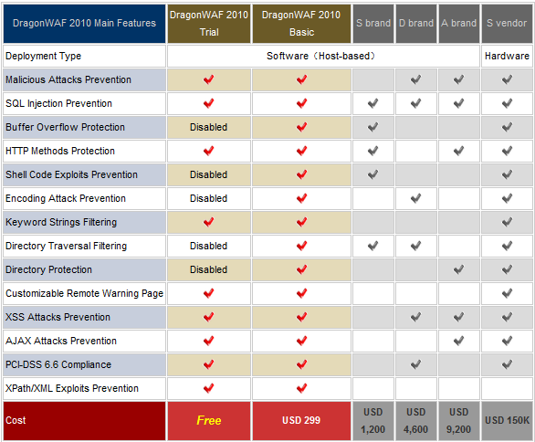
Depends
Notes:
Some lines are policy while other attacks.
And for so cheap….
Also depends on deployment.

Slide 6
The XIOM Definition
Intimate understanding of HTTP
A positive security model
Application layer rules
Session based protection
Fine grained policy management

Slide 7
What is a cloud?

Slide 8

This is a cloud

Slide 9


More Seriously
PaaS:
Shared Hosting
SaaS: SalesForce
IaaS:
Amazon EC2

Slide 10
What Role Can a WAF Play in the Cloud?

Slide 11
The Menu
Enterprise Security Gateway
WAF as a service
  For protecting a data center
  For protecting SaaS
WAF for a cloud deployment
  Host Based
  Infrastructure Based
WAF stubs
  For a data center
  For a cloud deployment

Slide 12
Enterprise Security Gateway

Slide 13
Enterprise Security Gateway
Protect in the cloud services through unified security gateway.
Pros:
Unified access control
Security for 3rd party code
Cons:
Double bandwidth
Hard to create positive security rules

Slide 14
WAF as a Service
For SaaS
For a Data Center

Slide 15
WAF as a service
Use an in the cloud WAF to protect enterprise data center.
Pros:
Very easy deployment.
Fast signature updates.
Cons:
Double bandwidth
Preventing direct access
Might be the only solution for a SaaS

Slide 16
WAF as a service - Akamai
Applies ModSecurity Core Rules to HTTP traffic.
Uses Akamai internal HTTP processing technology
Signatures only, hardly a WAF

Slide 17
WAF for Cloud Environment

Slide 18
WAF for Cloud Environment
Use an in the cloud WAF to protect enterprise data center.
Pros:
No Bandwidth Overhead
Cons:
Might be harder to deploy

Slide 19
Host based WAF

Slide 20
Host based WAF
The most mature approach to WAF in the cloud.
ModSecurity, SecureIIS, Applicure, PHPIDS….
However many times not more than an Host based IPS.

Slide 21
WAF stubs

Slide 22
WAF Stubs
Host based stub and a remote brain.
Different separation levels:
  Remote monitoring & configuration
  Remote learning
  Remote enforcement
  In-between.

Slide 23
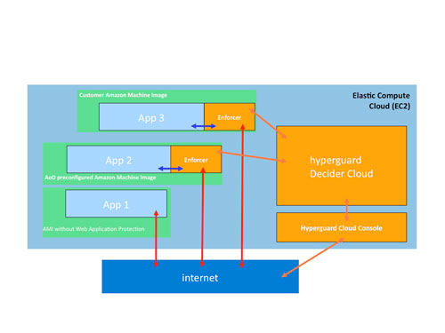
WAF Stubs
Art of Defence stub for AWS
Breach Global Event Manager
  Monitoring Only

Slide 24
Thank You!
shezaf@xiom.com

