Slide 1


Slide 2
What Is It ?
Platform for web research
  Web application penetration testing
  Web content mining
Reusable code library for rapid tool development
  Easy to create new tools without reinventing HTTP protocol modules and content parsers
An aggressive crawler and a framework for easily adding analysis modules
  Modular analysis for simple creation of experiments and algorithms
  Allows “Incorrect” traffic to be easily generated

Slide 3

Who Am I ?
Former SW development manager and architect for SPI Dynamics (HP) WebInspect
Former web security researcher in SPI Labs
Current member of GTRI Cyber Technology and Information Security Lab (CTISL)
Software enthusiast

Slide 4
Agenda
Motivation for Framework
Component Overview
Demo WebLab
Demo WebHarvest
Demo Rapid Prototyping with Visual Studio Crawler Tool Template
Interop Possibilities
Goals and Roadmap
Community Building and Q & A

Slide 5
Motivation
Web tools are everywhere but …
  Never seem to be *exactly* what you need
  Hard to change without a deep dive into the code base (if you have it)
  Performance and quality are often quite bad
  Different language, OS’s and runtime environments --> very little interoperability
Provide tools with low barriers to running “What if” types of experiments (WebLab)
Radically shorten the time interval from crazy idea to prototype
Strive for high modularity for easy reuse of code artifacts

Slide 6
Components
HTTP Requestor
  Proxy
  Authentication
  SSL
User Session State Web Requestor
  Follows redirects
  Custom ‘not found’ detection
  Track cookies
  Track URL state
High-performance Multi-threaded Crawler
  Flexible rule-based endpoint and folder targeting
  Aggressive link scraping
  Delegates link and text extraction to content-specific parsers (plug-ins)

Slide 7
Components (cont)
Plugin discovery and management
  Parsers
  Analyzers
  Views
Extensible set of response content parsers
  Http
  Html
  Generic text
  Generic binary
Extensible set of Message Inspector/Analyzers and Views
  Easy to write
  Not much code

Slide 8
Components (cont)
Reusable Views
  URL tree
  Syntax Highlighters
  Form views
  Sortable lists with drag-n-drop
Utilities
  Pattern matching
  Parsing
  Encoding
  XML
  Compression
  Import/export
  Google scraper
Endpoint Profiler

Slide 9
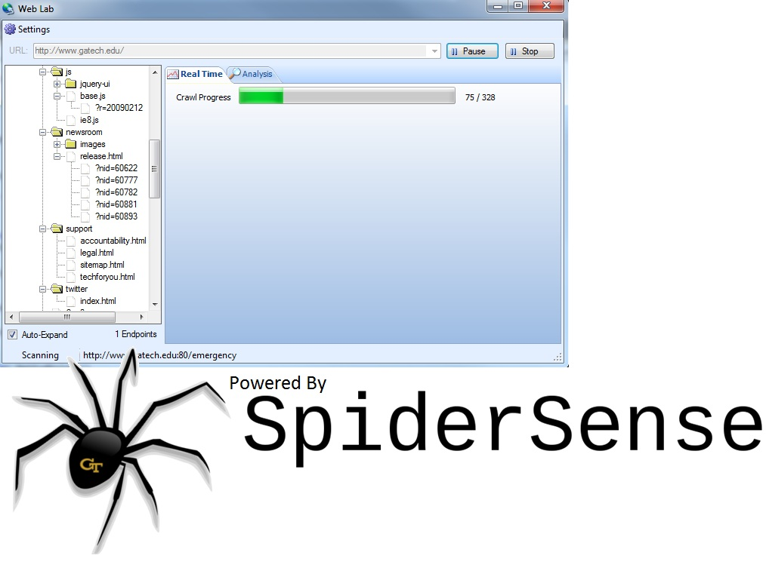
Web Lab

Slide 10
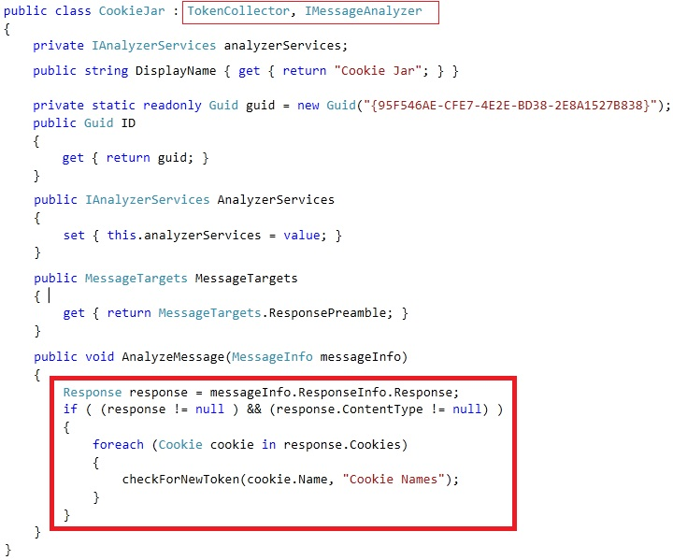
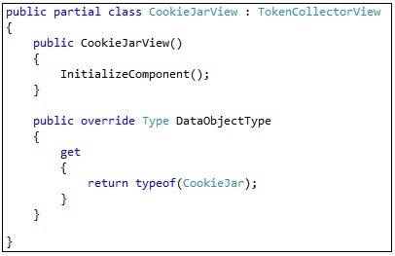
Cookie Analyzer Code

Slide 11
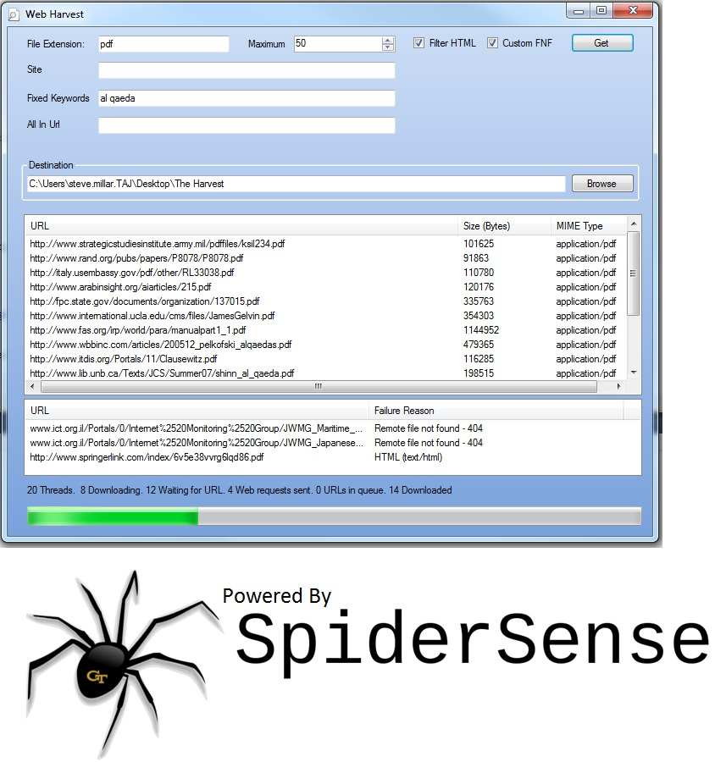
Web Harvest
Notes:
11

Slide 12
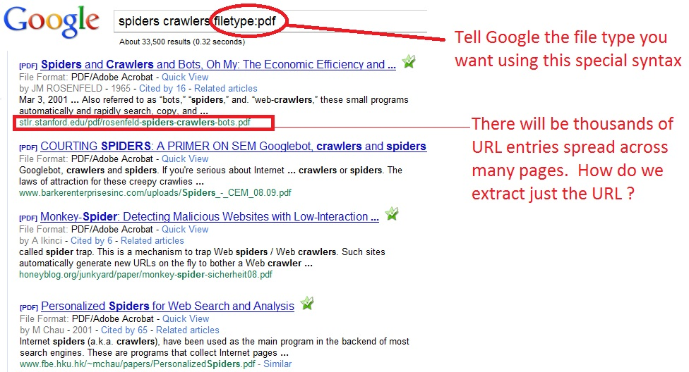
Asking Google for Urls

Slide 13
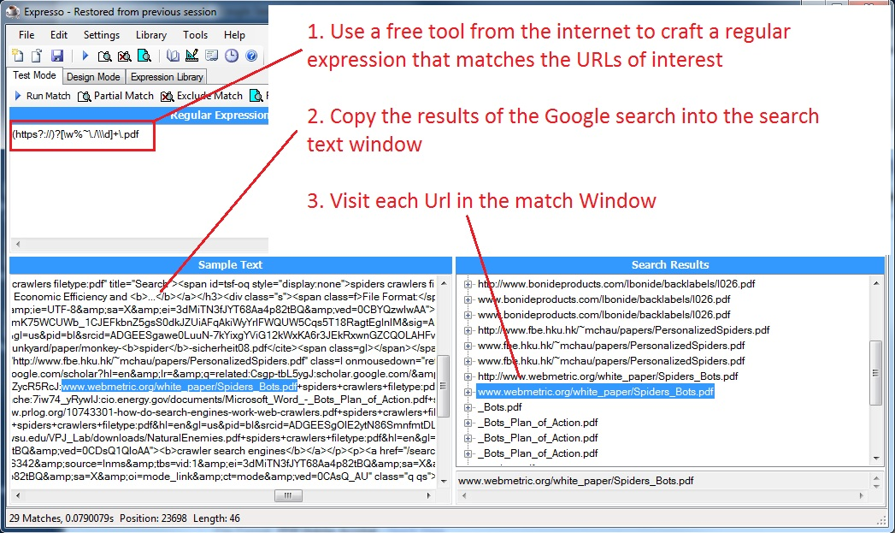
Pulling the URLs out of the HTML

Slide 14
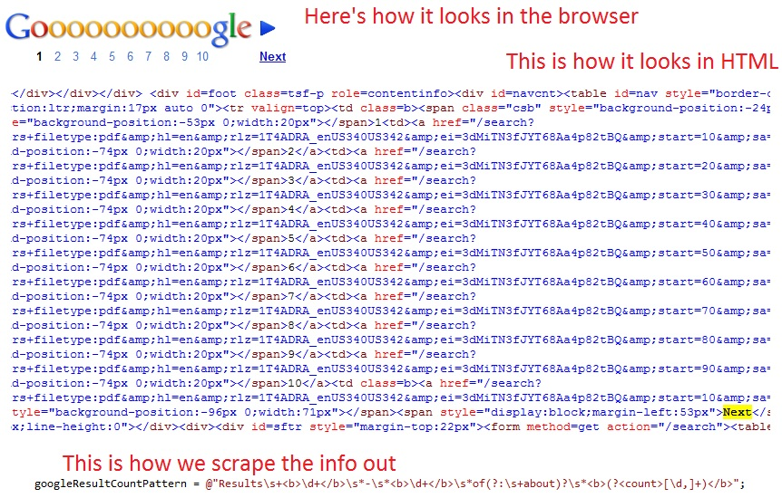
Handle multiple Pages

Slide 15
This is Tedious and Slow
Quick Recap of what to do:
Type a query in Google like “filetype:pdf al qaeda”
Right click and select ‘View Source’ in the browser window
Copy all text
Paste the text into another window in Expresso
Scroll to bottom of page in browser and select page 2 of results
Select View Source again
Copy all text again
Paste all text again
Repeat those steps until all Google results are in Expresso
Run the regular expression
Copy the result text
Paste text into word processor
Eliminate all duplicates
Type each URL into browser address bar to download it
Select save location each time

Slide 16
What if we could automate ALL of that ?
With Spider Sense web modules we can!
The trick is to avoid making Google mad.
Google will shut us out if it thinks we are a bot (which we are)
So we have to pretend to be a browser

Slide 17
How We Automate It
Make a search request to Google using HTTP
  Google will give us cookies and redirect us to other pages.
  We parse and track the cookies in a special cache as we request pages. That way we can submit the proper cookies when we do search requests. This emulates a browser’s behavior.
Save the response text into a buffer
Ask for page 2 of the results with another HTTP request. Then 3 and so on.
Append the result to the text buffer
Apply the regular expression to the text buffer to get a URL list
Eliminate duplicate URLs

Slide 18
How We Automate It (continued)
7. Store a list of the unique URLs
8. Run through a loop and download each URL on a separate thread
9. Save each HTTP response text string as a file. Use the URL name to form the file name.
That’s what WebHarvest does!
It works for any file extension (doc, ppt, jpg, swf, … )
Other search engine modules can be added

Slide 19
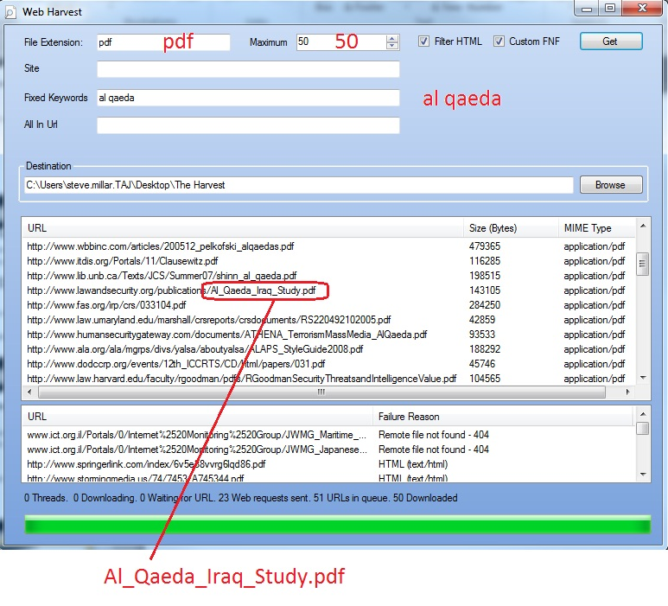
Sample Search Harvest (Al Qaeda)

Slide 20
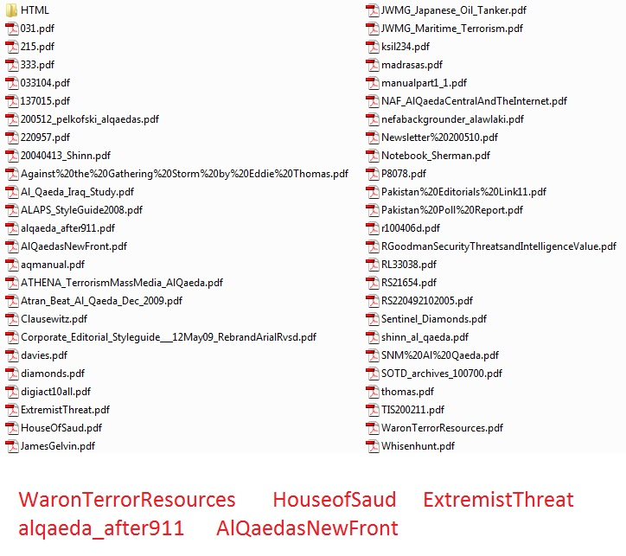
Results

Slide 21

Rapid Tool Prototype Demo

Slide 22
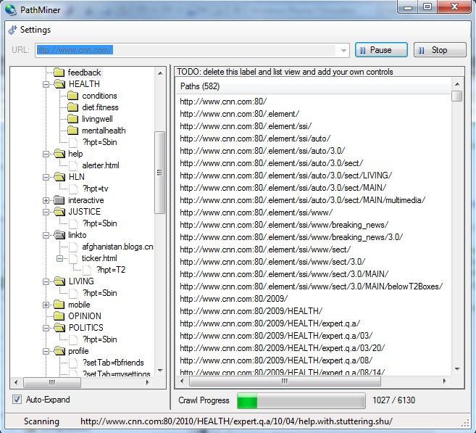
If the Demo Fizzled or Web Boom ...

Slide 23
Path Miner Tool Source Code Stats
MainForm.cs
Generated Lines of Code | 378
User-written Lines of Code | 6
AnalysisView.cs
Generated Lines of Code | 55
User-written Lines of Code | 10
SpiderSense DLLs
Non-UI Lines of Code | 16,372
UI Lines of Code | 5981

Slide 24
More Source Code Stats
WebLab
User-written Lines of Code | 466
WebHarvest
User-written Lines of Code | 1029
SpiderSense DLLs
Non-UI Lines of Code | 16,372
UI Lines of Code | 5981

Slide 25
Demo Path Enumerator Drag and Drop

Slide 26
Interop Mechanisms
File Export/Import (standardized formats)
  XML
  CSV
  Binary
Cross-language calls
  COM for C++ clients
  IronPython, IronRuby, F#, VB.NET
  Python, Ruby, Perl, Mathematica ? (maybe)
  Mono.NET
Cross-process calls
  WCF
  Sockets
Drag and Drop
Command line invocation
Web Services
AJAX Web Sites? (example: web-based encoder/decoder tools)
“Ask the Audience.” Need Ideas.

Slide 27
Interop Data
Need to come up with list of Information items and data types that should be exchangeable
A Starter List of Exports/Imports
  URLs
  Parameter values and inferred type info (URL, header, cookie, post data)
  Folders
  Extensions
  Cookies
  Headers
  Mime Types
  Message requests and bodies
  Forms
  Scripts and execution info (vanilla script and Ajax calls for a given URL)
  Authentication info
  Word/text token statistics (for data mining)
  Similar hosts (foo.bar.com --> finance.bar.com, www3.bar.com)
Let’s Talk more about this. I need ideas.

Slide 28
Interop Data (cont)
Profile Data (behavioral indicators from a given host)
  Server and technology fingerprint
  Are input tokens reflected? (potential XSS marker)
  Do unexpected inputs destabilize the output with error messages or stack trace? (potential code injection marker)
  Do form value variations cause different content? Which inputs? (potential ‘deep-web’ content marker)
  Does User-agent variation cause different content? (useful in expanding crawler yield)
  Does site use custom 404 pages?
  Does site use authentication? Which kinds?
  Speed statistics
Let’s Talk more about this. I need ideas.

Slide 29
Goals and Roadmap
Build online Community
DB persistence for memory conservation
User Session State Tracking (forms)
Script Handling in depth
  Links and Forms
  Ajax Calls captured
More Content Types
  Silverlight
  Flash
  XML

Slide 30
Goals and Roadmap
Parallel Crawler
Attack Surface profiling
    Full parameter and entry point mapping
    Type Inference
    Auto-Fuzzing
Pen Test Modules and Tools
  Plug-in exploits
Web Service Test Tools
  XSD Mutation based on type metadata
Visual Studio Integration
  More tool templates
  Unit Test Generation

Slide 31
Goals and Roadmap
Extensibility at every level
  Replace entire modules

Slide 32
Community Thoughts and Q & A
What else is needed?
How to get it out there?
How to engage module writers? (One-man band approach is slow-going)
How to define interop formats, schemas, and libraries?
Got any cool Ideas?

Slide 33
Contact Information
Steve.millar@windstream.net
404-407-7647 (office)

