Slide 1
The Open Web Application Security Project
Jeff Williams
Aspect Security, CEO
Volunteer OWASP Chair
jeff.williams@owasp.org
Twitter @planetlevel
June 25, 2009

Slide 2
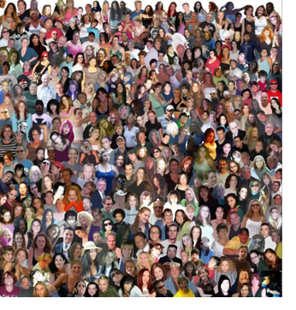
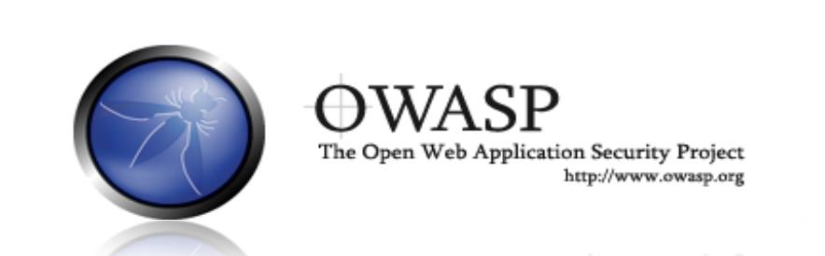
OWASP World
OWASP is a worldwide free and open community focused on improving the security of application software.
Our mission is to make application security visible so that people and organizations can make informed decisions about application security risks.
Everyone is free to participate in OWASP and all of our materials are available under a free and open software license.
The OWASP Foundation is a 501c3 not-for-profit charitable organization that ensures the ongoing availability and support for our work.
Notes:
REMEMBER… OWASP IS JUST PEOPLE
You are all probably familiar with OWASP, so I’d like to take this opportunity to share a few metrics and give you an idea of where OWASP is headed.
I’ve been the volunteer chair of OWASP since 2004, and I’ve spent quite a lot of time, effort, and my own money developing the organization. Why do I do all this? Why do I care?
AppSec is about not about tools or technology… it’s about people. OWASP is about community.
______________

Slide 3
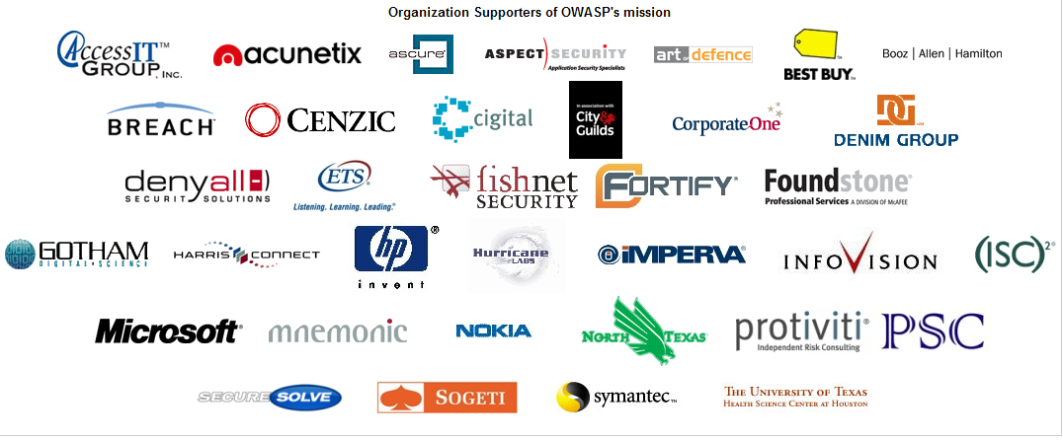
2009 OWASP Supporters

Slide 4
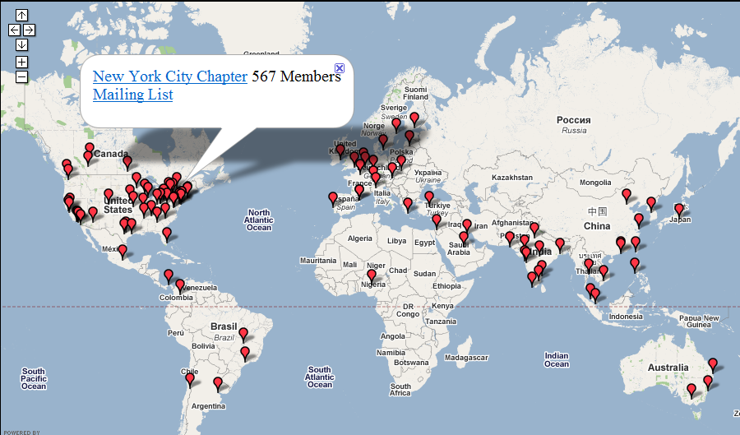
OWASP Worldwide Community
Notes:
Our worldwide community is growing rapidly too. I open 1 or 2 chapters every week and we now have over 145 around the world.
Here are some of the newest chapters…
Hong Kong, Thailand, China, Vietnam
Brazil, Portugal
South Africa, Nigeria
Slovakia, Qatar
Norway
There are now something like 21,000 people who are actively involved with OWASP. These are the folks who attend chapter meetings, participate in mailing lists, and have accounts on our wiki.

Slide 5
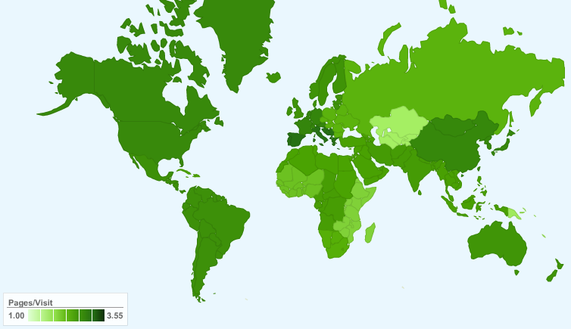
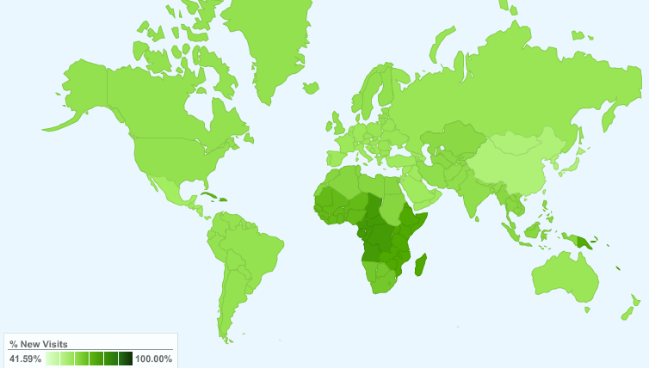

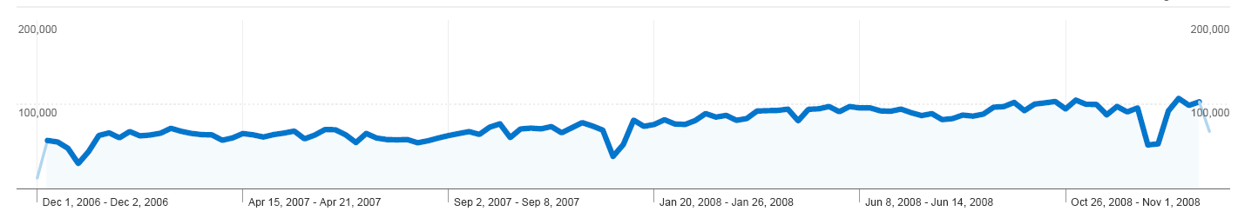

OWASP Dashboard
Worldwide Users
Most New Visitors
22,782,709 page views
Notes:
OWASP’s traffic is growing significantly
We get traffic from all over the world, and I find it interesting that Africa, where we’ve just created several OWASP Chapters, is the fastest growing region.
Here are our total monthly dodwnloads since very close to the beginning of OWASP. See the little bump in early 2003? That’s when we first released the OWASP Top Ten. We thought that was absolutely huge then, but now we’re seeing many times that level of interest constantly.
Probably the best measure of interest is our monthly pageviews, which have grown steadily over the last year. We’re over100,000 pageviews per week.

Slide 6
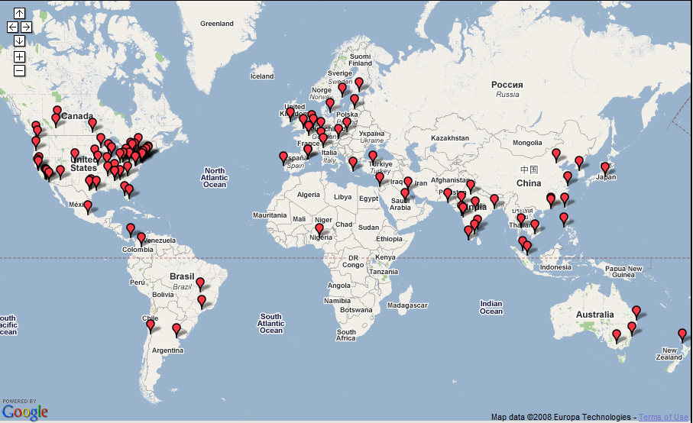
OWASP Conferences (2008-2009)
Germany
Nov 2008
Brussels
May 2008
Minnesota
Oct 2008
Poland
May 2009
NYC
Sep 2008
Denver
Spring 2009
Ireland 2009
DC
Sep 2009
Portugal
Summit
Nov 2008
Israel
Sep 2008
Taiwan
Oct 2008
India
Aug 2008
Gold Coast
Feb 2008
+2009
Notes:
Australia – Justin Derry
Gold Coast – 2008 March 29-31, similar time next year
Europe – Sebastien Deleersnyder
Brussels – May 19-22, 2008, Kracow Poland, May 2009
Israel – Ofer Shezaf
Taiwan – Wayne Huang
U.S. – NY – Tom Brennan - We are here!
2009 – probably San Jose – Hopefully at eBay again
India – Dhruv Soi, Puneet Mehta
OWASP Summit – Portugal – Paulo Coimbra/Dinis Cruz
Nov , 2008

Slide 7


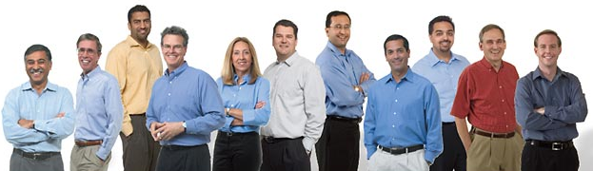

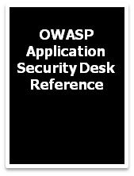









OWASP KnowledgeBase
6,381 total articles
427 presentations
200 updates per day
271 mailing lists
180 blogs monitored
19 deface attempts
Notes:
With almost 6,381 articles, OWASP is the largest knowledgebase of application security information anywhere. Now bigger is not always better, so let me explain a little bit about our process.
We put the wiki in place about 3 years ago – the same software wikipedia uses. OWASP gets about 200 updates to the wiki every day. Most of these are relatively minor, but some are entire new articles. A team of reviewers worldwide follows all of these updates via an RSS feed. In the two years, we’ve only had 19 attempts to deface the site, and we caught them all the same day. Please do not take this as a challenge – defacing a wiki is no accomplishment.
Our documentation projects are actively monitoring and digesting all the application security information we can find. We monitor presentations, mailing lists, white papers, and tons of feeds for useful information. We clean, sort, organize, tag, and structure the information and add it to our knowledgebase.
There is also one extremely important filter that is applied to all the information we can find. We try to eliminate all of the commercial bias. If we discuss commercial solutions, we steer clear of specific products and companies and try to focus on the different approaches to the problem. I’ll talk more about the finances in a minute, but although there are many product vendors who are members of OWASP, they do not control the agenda in any way.
We are also actively deleting information. Several projects are “refactoring” our knowledgebase to minimize duplication. To ensure the high quality of the materials, we are publishing parts of the knowledgebase as books. You can download the PDF’s of these books for free, or buy
a printed copy from Lulu for the cost of publishing – OWASP adds nothing to the cost.
I’d like to point out one very cool work that is being published later this year – the Application Security Desk Reference. Like the Physicians’ Desk Reference, this will be an extensive reference work, documenting all the fundamental concepts in application security: principles, threat agents, attacks, vulnerabilities, controls, technical impacts, and business impacts.
All of the knowledgebase, including the books, are available under the Creative Commons license.

Slide 8



OWASP AppSec News and Intelligence
Moderated AppSec News Feed
http://www.google.com/reader/public/atom/user/16712724397688793161/state/com.google/broadcast
OWASP Podcast
http://itunes.apple.com/WebObjects/MZStore.woa/wa/viewPodcast?id=300769012
OWASP TV
http://www.owasp.tv

Slide 9
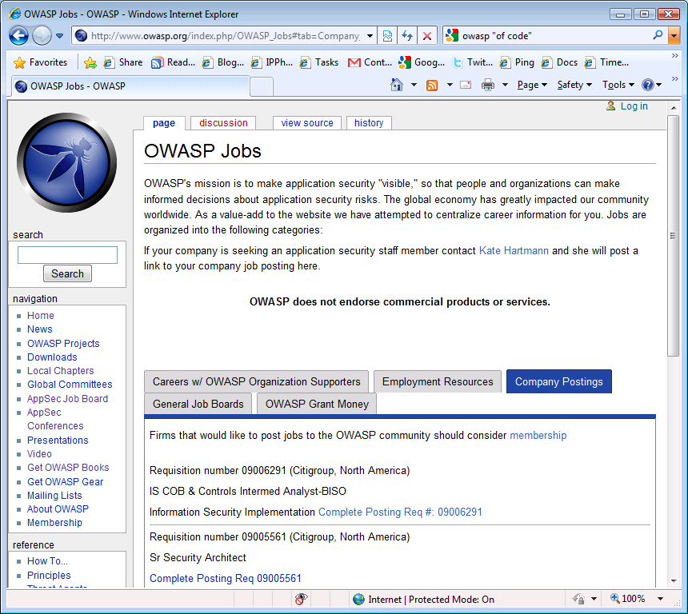
OWASP AppSec Job Board

Slide 10
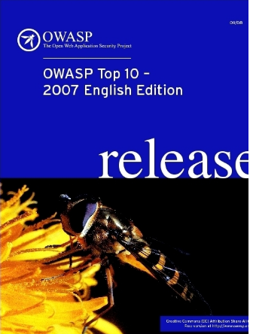


OWASP Top Ten Critical Vulnerabilities
A1: Cross Site Scripting (XSS)
A6: Information Leakage and Improper Error Handling
A2: Injection Flaws
A3: Malicious File Execution
A4: Insecure Direct Object Reference
A5: Cross Site Request Forgery (CSRF)
A7: Broken Authentication and Session Management
A8: Insecure Cryptographic Storage
A9: Insecure Communications
A10: Failure to Restrict URL Access
www.owasp.org/index.php?title=Top_10_2007
Notes:
Based on vulnerabilities in 2006.
But it got worse

Slide 11
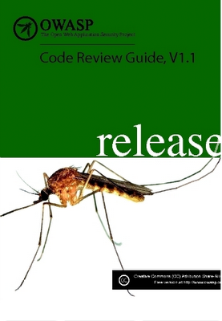
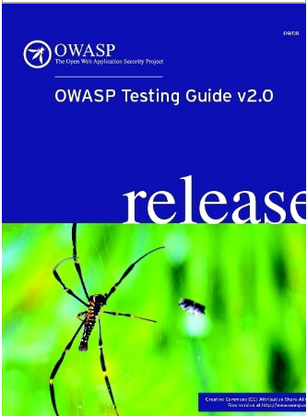
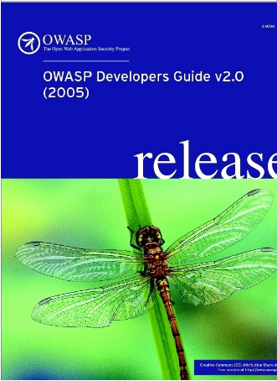
OWASP AppSec Guides
Free and open source
Cheap printed copies
Covers all critical security controls
Hundreds of expert authors
All aspects of application security

Slide 12
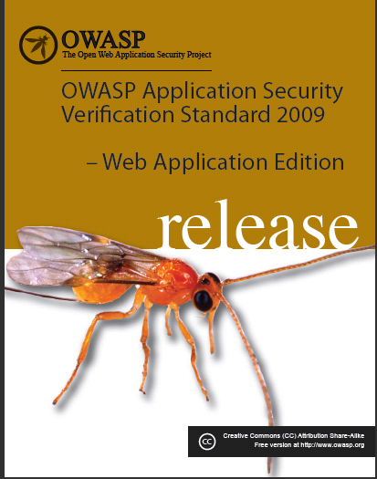
OWASP Application Security Verification Std
Standard for verifying the security of web applications
Four levels
Automated
Manual
Architecture
Internal

Slide 13
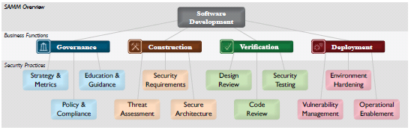
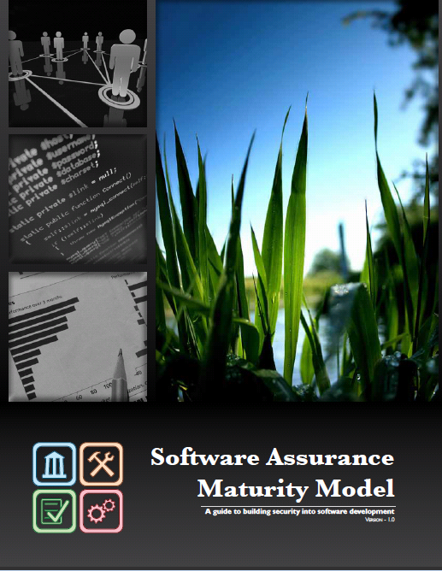
OWASP Software Assurance Maturity Model

Slide 14
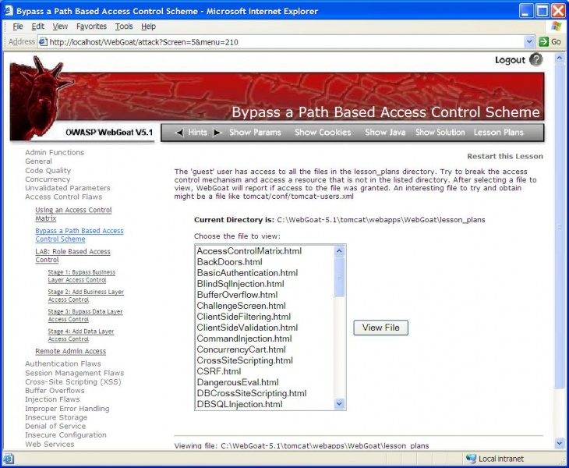
OWASP WebGoat
Notes:
WebGoat is a deliberately insecure J2EE web application maintained by OWASP designed to teach web application security lessons. In each lesson, users must demonstrate their understanding of a security issue by exploiting a real vulnerability in the WebGoat application. For example, in one of the lessons the user must use SQL injection to steal fake credit card numbers. The application is a realistic teaching environment, providing users with hints and code to further explain the lesson.

Slide 15
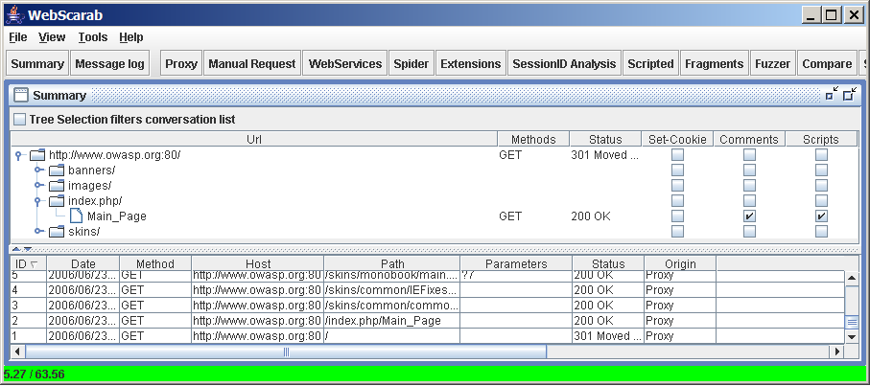
OWASP WebScarab
Notes:
WebScarab is a framework for analysing applications that communicate using the HTTP and HTTPS protocols. It is written in Java, and is thus portable to many platforms. WebScarab has several modes of operation, implemented by a number of plugins. In its most common usage, WebScarab operates as an intercepting proxy, allowing the operator to review and modify requests created by the browser before they are sent to the server, and to review and modify responses returned from the server before they are received by the browser. WebScarab is able to intercept both HTTP and HTTPS communication. The operator can also review the conversations (requests and responses) that have passed through WebScarab.

Slide 16
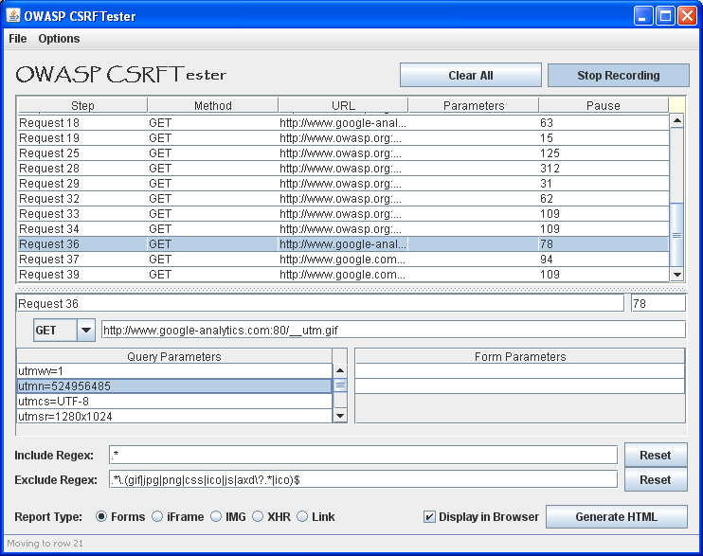
OWASP CSRFTester
Notes:
Just when developers are starting to run in circles over Cross Site Scripting, the 'sleeping giant' awakes for yet another web-catastrophe. Cross-Site Request Forgery (CSRF) is an attack whereby the victim is tricked into loading information from or submitting information to a web application for which they are currently authenticated. The problem is that the web application has no means of verifying the integrity of the request. The OWASP CSRFTester Project attempts to give developers the ability to test their applications for CSRF flaws.

Slide 17
OWASP CSRFGuard
User
(Browser)
OWASP CSRFGuard
Verify Token
Adds token to:
href attribute
src attribute
hidden field in all forms
Actions:
Log
Invalidate
Redirect
Business Processing
Add Token to HTML
http://www.owasp.org/index.php/CSRFGuard
Notes:
The OWASP CSRFGuard Project attempts to address this issue through the use of unique request tokens.

Slide 18

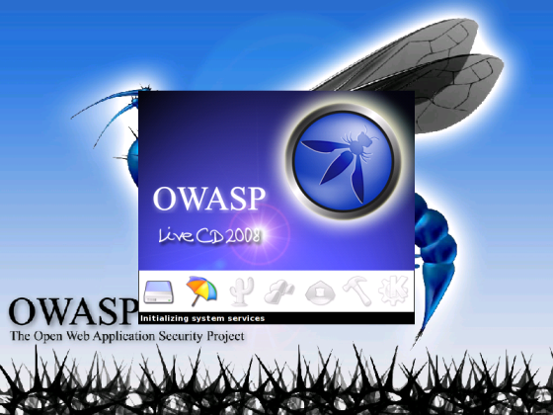
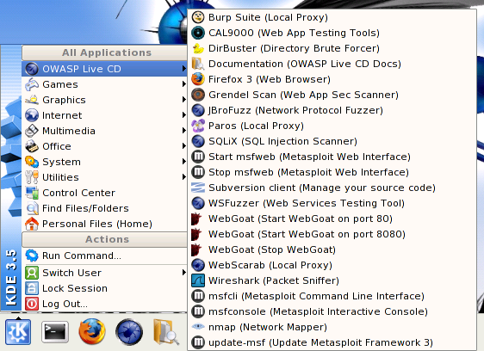
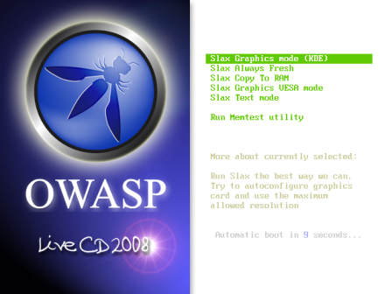
OWASP Live CD

Slide 19
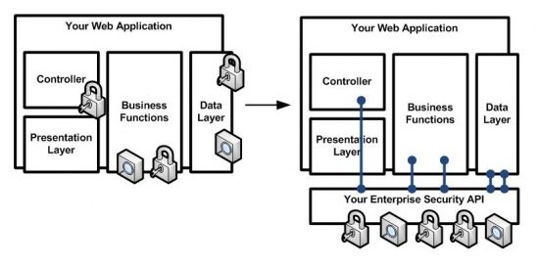
OWASP Enterprise Security API
Before After
Notes:
The ESAPI is a free and open collection of all the security methods that a developer needs to build a secure web application. You can just use the interfaces and build your own implementation using your company's infrastructure. Or, you can use the reference implementation as a starting point. In concept, the API is language independent. However, the first deliverables from the project are a Java API and a Java reference implementation. Efforts to build ESAPI in .NET and PHP are already underway.
Unfortunately, the available platforms, frameworks, and toolkits (Java EE, Struts, Spring, etc...) simply do not provide enough protection. This leaves developers with responsibility for designing and building security mechanisms. This reinventing the wheel for every application leads to wasted time and massive security holes.
The cost savings through reduced development time, and the increased security due to using heavily analyzed and carefully designed security methods provide developers with a massive advantage over organizations that are trying to deal with security using existing ad hoc secure coding techniques. This API is designed to automatically take care of many aspects of application security, making these issues invisible to the developers.

Slide 20
Want More OWASP?
OWASP .NET Project
OWASP ASDR Project
OWASP AntiSamy Project
OWASP AppSec FAQ Project
OWASP Application Security Assessment Standards Project
OWASP Application Security Metrics Project
OWASP Application Security Requirements Project
OWASP CAL9000 Project
OWASP CLASP Project
OWASP CSRFGuard Project
OWASP CSRFTester Project
OWASP Career Development Project
OWASP Certification Criteria Project
OWASP Certification Project
OWASP Code Review Project
OWASP Communications Project
OWASP DirBuster Project
OWASP Education Project
OWASP Encoding Project
OWASP Enterprise Security API
OWASP Flash Security Project
OWASP Guide Project
OWASP Honeycomb Project
OWASP Insecure Web App Project
OWASP Interceptor Project
OWASP JBroFuzz
OWASP Java Project
OWASP LAPSE Project
OWASP Legal Project
OWASP Live CD Project
OWASP Logging Project
OWASP Orizon Project
OWASP PHP Project
OWASP Pantera Web Assessment Studio Project
OWASP SASAP Project
OWASP SQLiX Project
OWASP SWAAT Project
OWASP Sprajax Project
OWASP Testing Project
OWASP Tools Project
OWASP Top Ten Project
OWASP Validation Project
OWASP WASS Project
OWASP WSFuzzer Project
OWASP Web Services Security Project
OWASP WebGoat Project
OWASP WebScarab Project
OWASP XML Security Gateway Evaluation Criteria Project
OWASP on the Move Project
Notes:
About 50 projects!

Slide 21
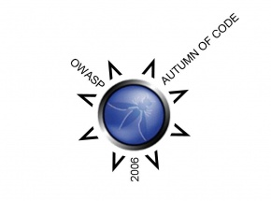



OWASP Research Grants
We support the research that keeps your organization safe!

Slide 22
OWASP SoC2008 selection
OWASP Code review guide, V1.1
The Ruby on Rails Security Guide v2
OWASP UI Component Verification Project (a.k.a. OWASP JSP Testing Tool)
Internationalization Guidelines and OWASP-Spanish Project
OWASP Application Security Desk Reference (ASDR)
OWASP .NET Project Leader
OWASP Education Project
The OWASP Testing Guide v3
OWASP Application Security Verification Standard
Online code signing and integrity verification service for open source community (OpenSign Server)
Securing WebGoat using ModSecurity
OWASP Book Cover & Sleeve Design
OWASP Individual & Corporate Member Packs, Conference Attendee Packs Brief
OWASP Access Control Rules Tester
OpenPGP Extensions for HTTP - Enigform and mod_openpgp
OWASP-WeBekci Project
OWASP Backend Security Project
OWASP Application Security Tool Benchmarking Environment and Site Generator refresh
Teachable Static Analysis Workbench
OWASP Positive Security Project
GTK+ GUI for w3af project
OWASP Interceptor Project - 2008 Update
Skavenger
SQL Injector Benchmarking Project (SQLiBENCH)
OWASP AppSensor - Detect and Respond to Attacks from Within the Application
Owasp Orizon Project
OWASP Corporate Application Security Rating Guide
OWASP AntiSamy .NET
Python Static Analysis
OWASP Classic ASP Security Project
OWASP Live CD 2008 Project

Slide 23

How Can You Help?
Join our community
Share and learn
Attend conferences
Push us to do better
Become a member!

Slide 24

Questions and Answers

Slide 26
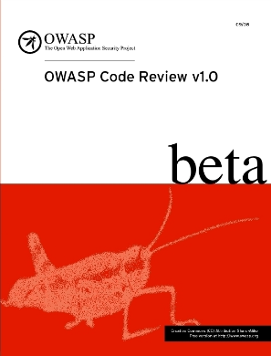
OWASP Projects Lifecycle
Define Criteria for Quality Levels
Alpha, Beta, Release
Encourage Increased Quality
Through Season of Code Funding and Support
Produce Professional OWASP books
Provide Support
Full time executive director (Kate Hartmann)
Full time project manager (Paulo Coimbra)
Half time technical editor (Kirsten Sitnick)
Half time financial support (Alison Shrader)
Looking to add programmers (Interns and professionals)

Slide 27
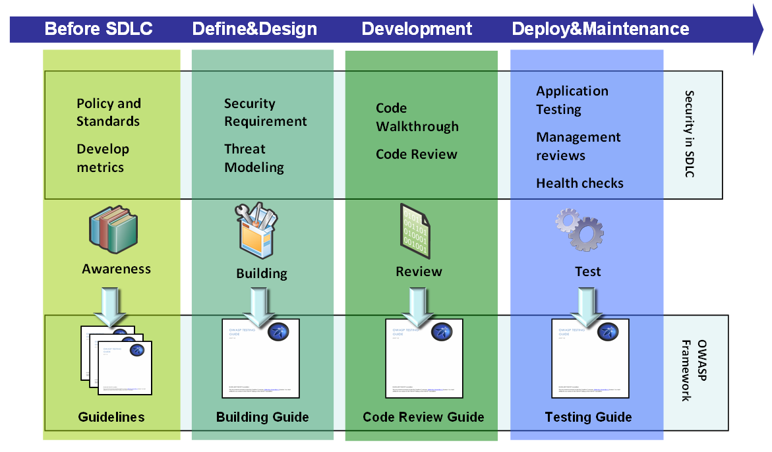
SDLC & OWASP Guidelines
OWASP Framework

Slide 28


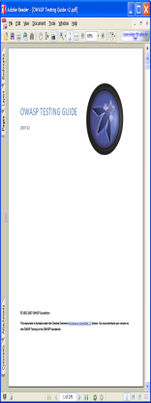







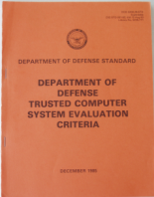

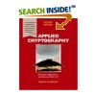






OWASP Projects Are Alive!
2009
…
2007
2005
2003
2001
28
Notes:
28
The Testing is alive…
When they say, “print is dead” they don’t mean it’s out of style – it’s static not living! Do you have a bookshelf of security books? When’s the last time you opened them? They don’t have answers to today’s problems because they’re dead.
It’s a process for translating security principles to the latest technologies and getting them to developers fast
It’s an evolving growing living thing

Slide 29
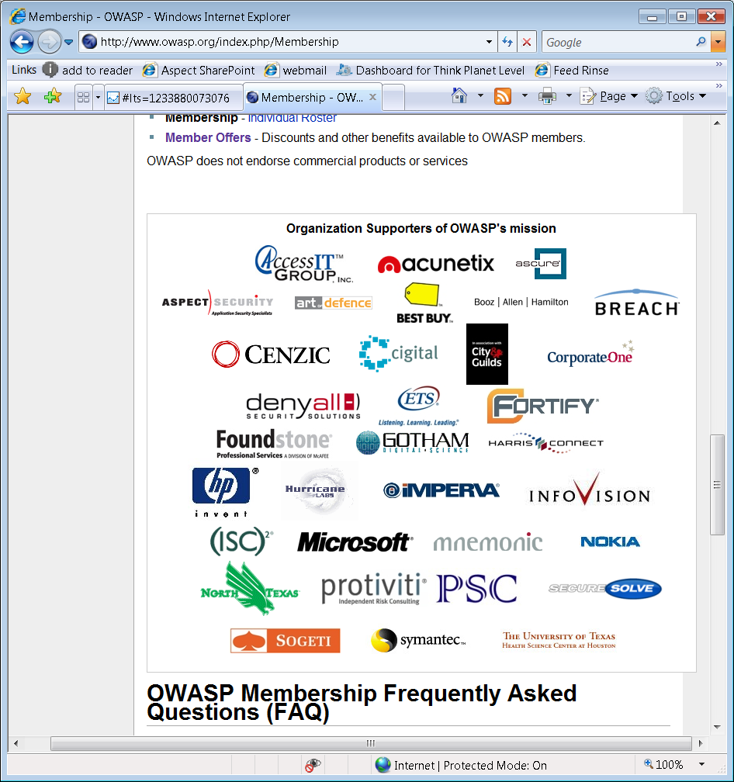
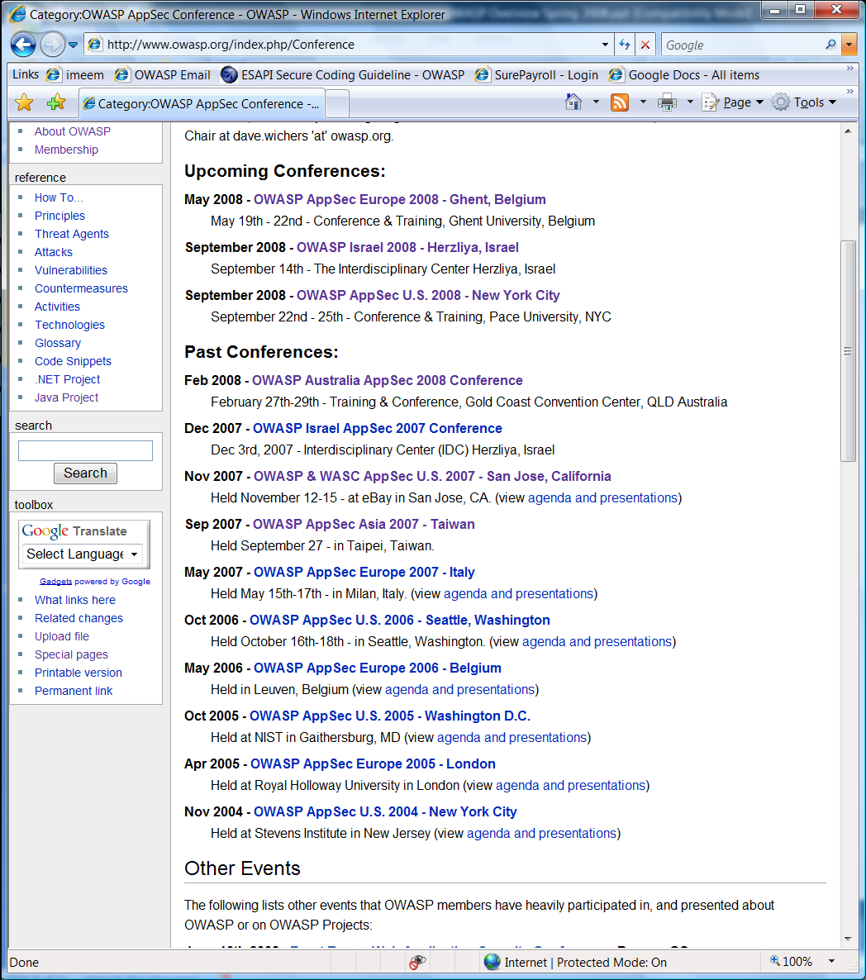




Finances and Grants
OWASP Grants
OWASP Autumn of Code 2006
$20,000 budget
OWASP Spring of Code 2007
$117,500 budget
OWASP Summer of Code 2008
$126,000 budget
100%
55%
45%
OWASP Foundation
Notes:
(FINANCE DATA BELOW NOT UPDATED for 2009)
2007
Roughly $329K income ($72K membership, $257K conf/training/sponsor)
Expenses $294K ($155K conferences, $76K SOC, $62K foundation)
Current:
Roughly $400K in the bank (before SOC 2008)

