Slide 1

Security Development Lifecycle: A History in 3 Acts
Mike Craigue
October 7, 2011

Slide 2
Speaker Bio
Joined Dell in 1999
Director of 14-member Security Consulting team, serving
IT
Product Group
Services
Prior to joining Dell’s information security team, spent over a decade building Web and database applications
CISSP and CSSLP from ISC²
Taught Database Management and Business Intelligence/Knowledge Management at St. Edward’s University in their MBA and MS CIS programs
PhD from the University of Texas at Austin in Higher Education Administration and Finance
2

Slide 3
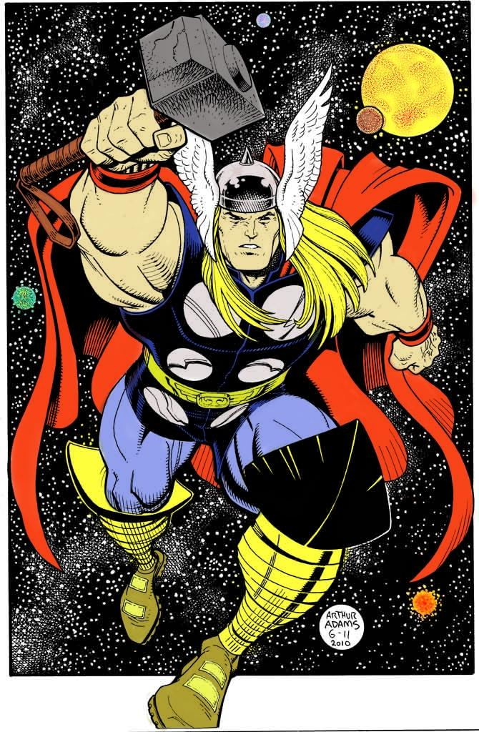
The Cast
Heroes: 25 consultants over the past 4 years
14 today, engaged on 500+ active projects
2 PhD’s (one in information security!)
Multiple MA’s, 2 MBA’s in progress
CISSP’s, CSSLP’s, CEH’s
10+ years professional experience typical; one team member has 17 years at the company
5 have transferred internally
6 have taken positions at MS, IBM, G-S, etc.
3

Slide 4
The Cast (continued)
Heroes: 3 local celebrities in web application security
Gustavo Barbato – Cloud Security R&D, Technical Architecture Global Standards, GSERB
Mauricio Pegoraro – CISSP training leader, 3rd party script/tag and cookie governance
Rafael Dreher – Software Development Lifecycle Process Review Board, Source Code Analysis expert
4

Slide 5

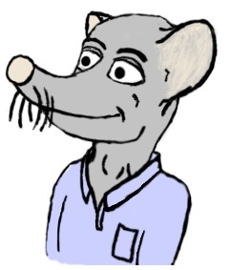
The Cast (continued)
Villains (you already know this list):
Nation-states
Collectives
Malicious insiders
Careless insiders
Script kiddies
Tight budgets
Re-orgs
5

Slide 6
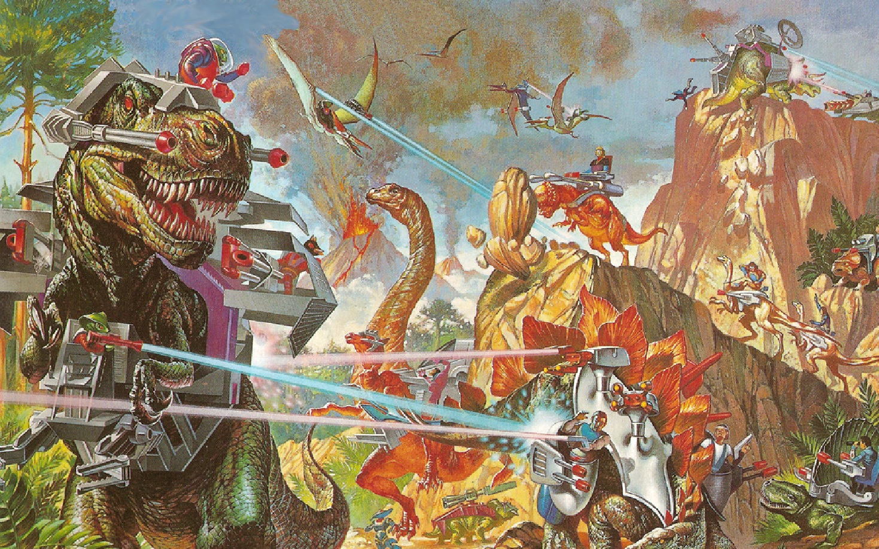
The Past
6

Slide 7
The Past
Modest beginnings, focused on SCA
300 projects in our initial year
Spreadsheets for risk calculation converted into a home-grown application
eComm developer adoption was key
PCI, SOX compliance were important drivers
MS made key contributions (SDL, Threat Modeling)
7

Slide 8
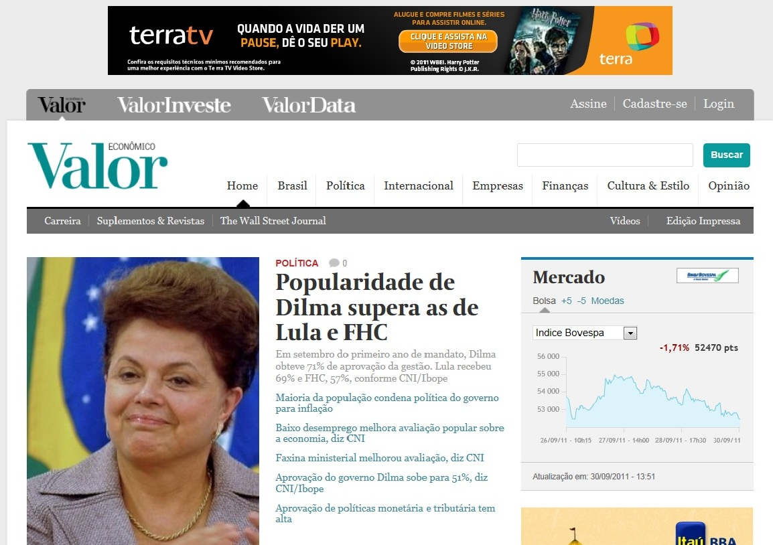
The Present
8

Slide 9
The Present
Holistic consulting (app, db, network, host)
Engaging with over 80% of projects (1,000 this year, 500+ currently active)
OpenSAMM Scoring of our SDL
Flexible approach to Traditional vs. Agile methods
Keeping our training curriculum fresh is a challenge
Finding and retaining team members is a challenge
The identity of the company is transforming
Cloud and mobile are forcing us to adapt
Customer satisfaction surveys help us measure quality
9

Slide 10
The Present (continued)
Java, C#.NET are the most typical languages used
Visual Studio 2010, Eclipse are the most common IDE’s
MS Anti-XSS library, Web Protection Library, OWASP ESAPI are part of our FAQ’s
3RD Party script & pixel tag reviews/due diligence
SDL
GSRM risk ranking
Source Code Analysis
Threat Modeling
Ethical Hacking
IPSA (legal)
10

Slide 11

The Future
11

Slide 12
The Future
Linking OpenSAMM strategy to overall security strategy
Increased use of threat modeling
Phase exit reviews
Expanding skill sets in mobile security, cloud security
Metrics that balance quantity and quality of engagements
Product Group, Services initiatives related to M&A
12

Slide 13
Lessons Learned
Build consensus among developers first; appeal to their love of writing high-quality software
Take early success stories to executives
Communicate to executives in terms of risk
Create a variety of awareness and education programs
Face-to-face seminars, celebrities welcome
General courseware, manager courseware, 30-minute refresher courses
We’re doing fundamentals, not cutting-edge security work
Existing SDLC; risk modeling tool was key touchpoint
Partnered with other groups
13

Slide 14
Lessons Learned (continued)
Added ourselves into an existing SDLC; risk modeling tool was key touchpoint
Partnered with other groups
Developers—key allies
Legal—contract templates, muscle
Enterprise Architecture—tools, technology standardization; SOA
Privacy—global background / EU representation
Compliance—policies/standards
Leveraged regulatory compliance for adoption
Global staff, time zone / business segment alignment initially
Acquisition challenges
Threat modeling is time-consuming; use sparingly
One step at a time, one org at a time, show metrics, build momentum
Developer desktop standardization is ideal, but hard to attain
Exception management process, executive escalation, roadmaps
14

Slide 15
Q&A, Acknowledgements, Thank you!
Thanks to:
Gustavo Barbato
Rafael Dreher
Mauricio Pegoraro
Tim Youngblood
Michael Howard
Contact:
michael_craigue dell.com
15

