Slide 1
DevFu!
The Inner Ninja in Every Application Developer

Slide 2
About Me
Danny Chrastil
Security Consultant
BT Assure
Ethical Hacking Center of Excellence
{ “Penetration Testing":[ "Web Applications", "iOS / Android Mobile Apps", "Internal / External Networks" ],
“Certifications”:[
“GIAC GWAPT”,
“GIAC GWEB” }

Slide 3
About Me
DisK0nn3cT
[root] # cat hobbies.txt
Twitter Fan
CTF Team Member – 0x5bd
DC303 Robot Mafia - Team Member
[root] # cat contributions.txt
OWASP CTF Contributor
SnowFROC CTF Contributor
Zen Cart (PHP) Security Contributor
CookieCatcher Project [in progress]

Slide 4
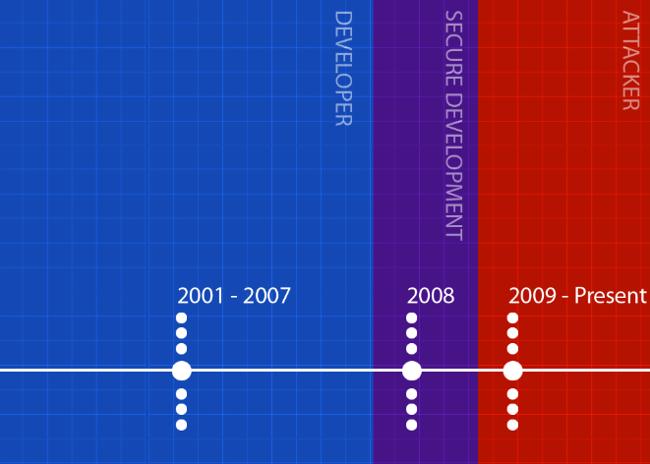
About Me

Slide 5
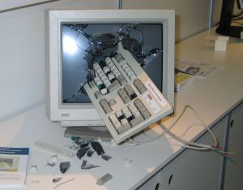
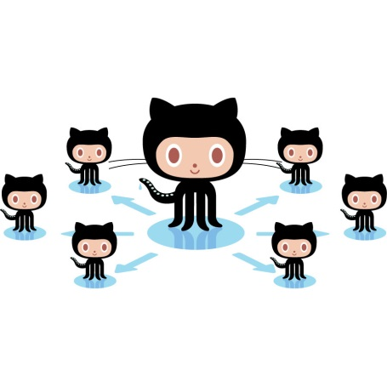
Hackers Developer
Arrogant
Ignorant

Slide 6
Hackers Developers

Slide 7
I Know DevFu!

Slide 8
DevFu!
Scripting
Application Development
Ins & Outs of Programming
Knowing the Lingo

Slide 9
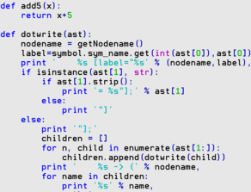
Scripting
Network / Firewall / WebApp
Automate Processes
Assist Tools
Scraping Websites
Manipulating Data
Examples!

Slide 10
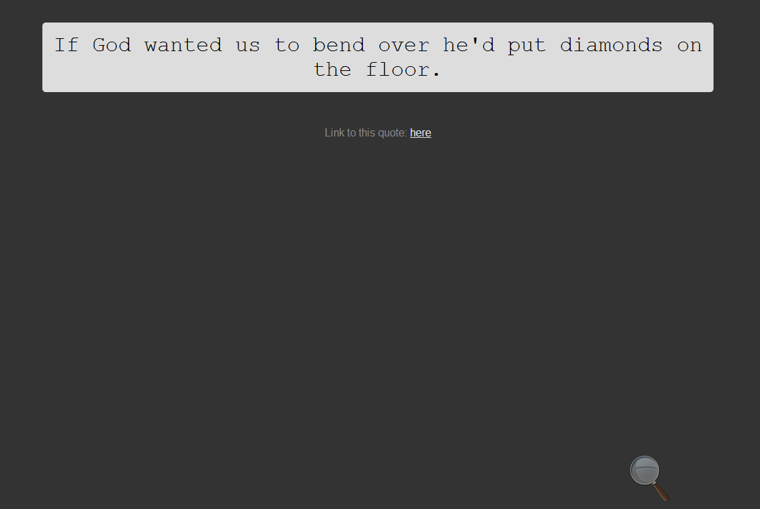
Scripting - Example 1

Slide 11
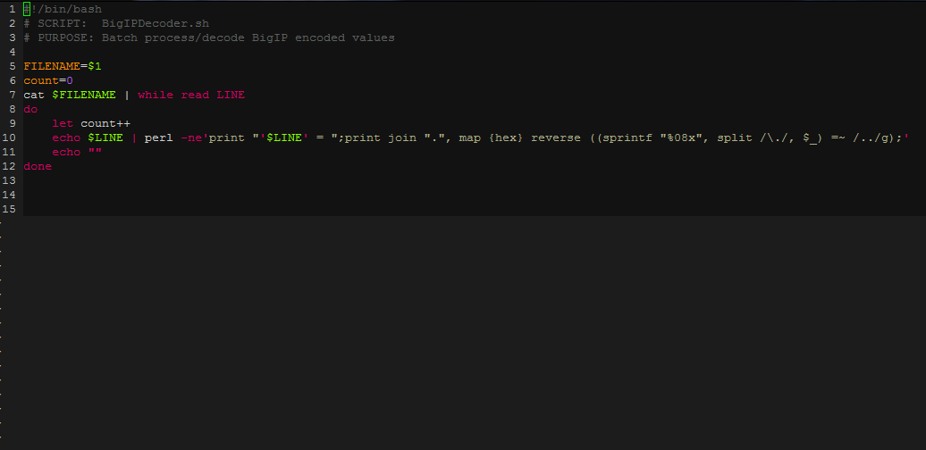
Scripting - Example 2

Slide 12
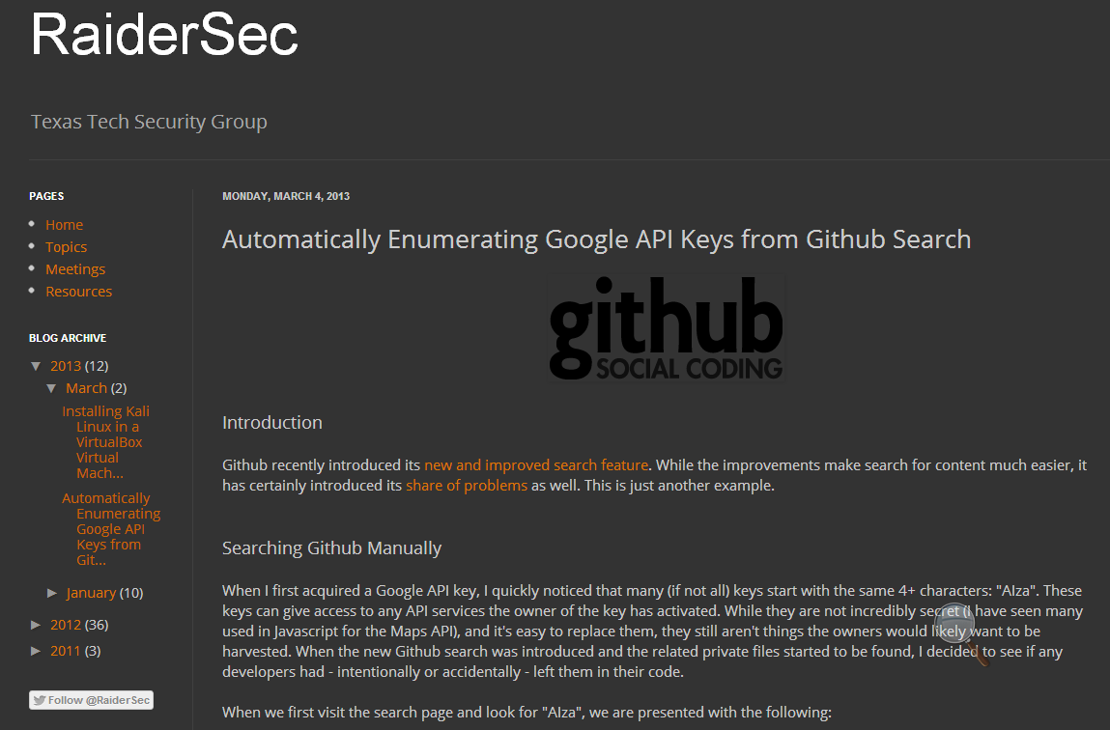
t
Scripting - Example 3
Jordan from RaiderSec Blog

Slide 13
Application Programing
Tools / Frameworks
Metasploit, w3af, sqlmap …
Contribute or Plugin!
Need for Developers

Slide 14
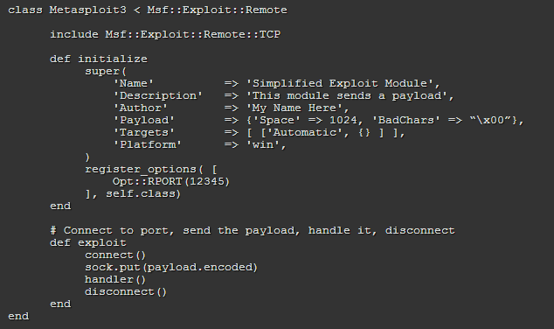
Application Programing
Metasploit – Exploit Skeleton (Ruby+git)
http://www.offensive-security.com/metasploit-unleashed/Exploit_Format

Slide 15
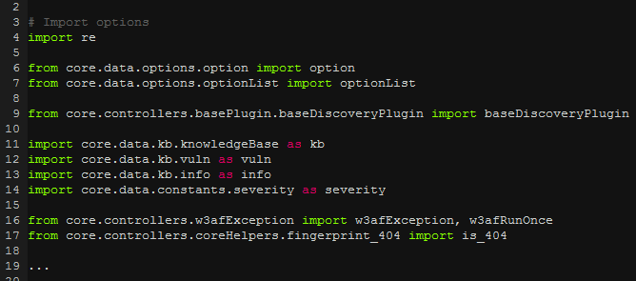
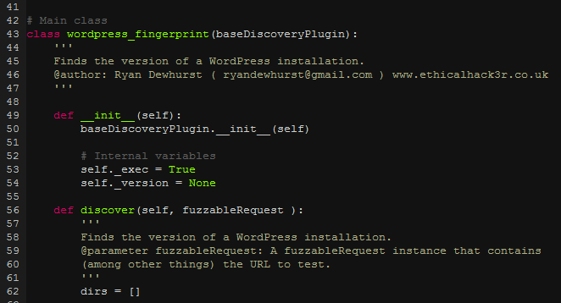
Application Programing
w3af – Example Plugin (Python+svn)
http://www.ethicalhack3r.co.uk/w3af/

Slide 16
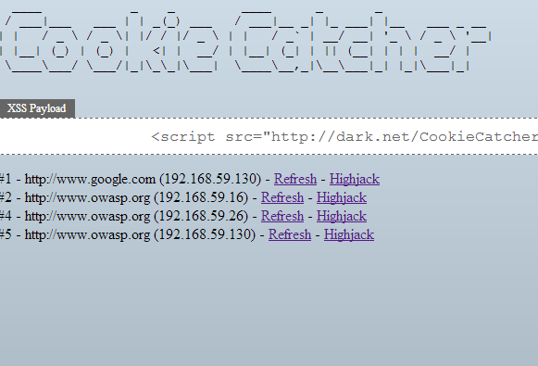
Application Programing
CookieCatcher (In progress)

Slide 17
Ins/Outs of Programming
Intimate knowledge of a language
Common pitfalls / limitations
Global variables, null bytes, open source
Core vulnerabilities: SQLi, remote code injection
Loose programming practices
You’re using ColdFusion …

Slide 18
Ins/Outs of Programming
Anticipate shortcuts during Development
Only as strong as its weakest link
Parameter sanitization
Business logic
Information Leakage

Slide 19
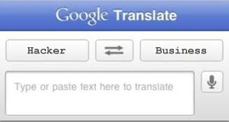
Speaking the Language
Need to be able to “talk the talk”
Great interviewing skill
Explain security in business terms
Bridge the gap to the development team

Slide 20
Summary
&
=

Slide 21
Questions

Slide 22
Contact Information
Twitter: @DisK0nn3cT
Email: danny.chrastil@gmail.com
Google+: @dchrastil

