Slide 1
OWASP BeNeLux Days 2010
Training
Sebastien Deleersnyder
OWASP Board

Slide 2

OWASP Top 10
The Ten Most Critical Web Application Security Vulnerabilities
April 19th 2010 Release
A great start, but not a standard
Notes:
The primary aim of the OWASP Top 10 is to educate developers, designers, architects and organizations about the consequences of the most common web application security vulnerabilities. The Top 10 provides basic methods to protect against these vulnerabilities – a great start to your secure coding security program.
Security is not a one-time event. It is insufficient to secure your code just once. By 2008, this Top 10 will have changed, and without changing a line of your application’s code, you may be vulnerable. Please review the advice in Where to go from here for more information.
A secure coding initiative must deal with all stages of a program’s lifecycle. Secure web applications are only possible when a secure SDLC is used. Secure programs are secure by design, during development, and by default. There are at least 300 issues that affect the overall security of a web application. These 300+ issues are detailed in the OWASP Guide, which is essential reading for anyone developing web applications today.
This document is first and foremost an education piece, not a standard. Please do not adopt this document as a policy or standard without talking to us first! If you need a secure coding policy or standard, OWASP has secure coding policies and standards projects in progress.

Slide 3
What’s Changed?
It’s About Risks, Not Just Vulnerabilities
OWASP Top 10 Risk Rating Methodology
2 Risks Added, 2 Dropped
New title is: “The Top 10 Most Critical Web Application Security Risks”
Based on the OWASP Risk Rating Methodology, used to prioritize Top 10
Added: A6 – Security Misconfiguration
Was A10 in 2004 Top 10: Insecure Configuration Management
Added: A8 – Unvalidated Redirects and Forwards
Relatively common and VERY dangerous flaw that is not well known
Removed: A3 – Malicious File Execution
Primarily a PHP flaw that is dropping in prevalence
Removed: A6 – Information Leakage and Improper Error Handling
A very prevalent flaw, that does not introduce much risk (normally)

Slide 4
Mapping from 2007 to 2010 Top 10
OWASP Top 10 – 2007 (Previous) | OWASP Top 10 – 2010 (New)
A2 – Injection Flaws | A1 – Injection
A1 – Cross Site Scripting (XSS) | A2 – Cross Site Scripting (XSS)
A7 – Broken Authentication and Session Management | A3 – Broken Authentication and Session Management
A4 – Insecure Direct Object Reference | A4 – Insecure Direct Object References
A5 – Cross Site Request Forgery (CSRF) | A5 – Cross Site Request Forgery (CSRF)
<was T10 2004 A10 – Insecure Configuration Management> | A6 – Security Misconfiguration (NEW)
A10 – Failure to Restrict URL Access | A7 – Failure to Restrict URL Access
<not in T10 2007> | A8 – Unvalidated Redirects and Forwards (NEW)
A8 – Insecure Cryptographic Storage | A9 – Insecure Cryptographic Storage
A9 – Insecure Communications | A10 – Insufficient Transport Layer Protection
A3 – Malicious File Execution | <dropped from T10 2010>
A6 – Information Leakage and Improper Error Handling | <dropped from T10 2010>
=
=
+
+
-
-

Slide 5
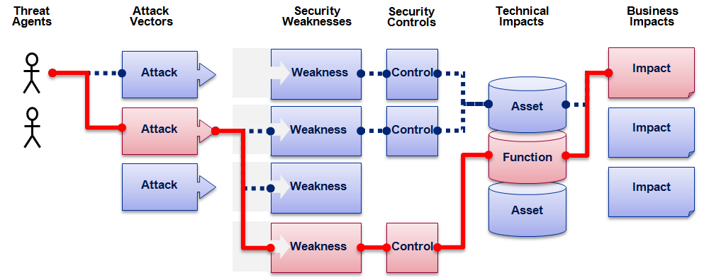

OWASP Top 10 Risk Rating Methodology
Threat Agent | Attack Vector | Weakness Prevalence | Weakness Detectability | Technical Impact | Business Impact
? | Easy | Widespread | Easy | Severe | ?
 | Average | Common | Average | Moderate
 | Difficult | Uncommon | Difficult | Minor
 | 2 | 1 | 1 | 2
 |  | 1.3 | * | 2
1
2
3
XSS Example
2.6 weighted risk rating

Slide 6

OWASP Top Ten (2010 Edition)
A1: Injection
A10: Unvalidated Redirects and Forwards
A7: Failure to Restrict URL Access
A6: Security Misconfiguration
A5: Cross Site Request Forgery (CSRF)
A4: Insecure Direct Object References
A3: Broken Authentication and Session Management
A2: Cross-Site Scripting (XSS)
A8: Insecure Cryptographic Storage
A9: Insufficient Transport Layer Protection
http://www.owasp.org/index.php/Top_10
Notes:
The red ones are the new ones.

Slide 7
A1 – Injection
Injection means…
Tricking an application into including unintended commands in the data sent to an interpreter
Interpreters…
Take strings and interpret them as commands
SQL, OS Shell, LDAP, XPath, Hibernate, etc…
SQL injection is still quite common
Many applications still susceptible (really don’t know why)
Even though it’s usually very simple to avoid
Typical Impact
Usually severe. Entire database can usually be read or modified
May also allow full database schema, or account access, or even OS level access

Slide 8
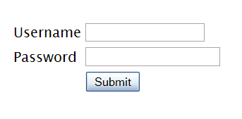
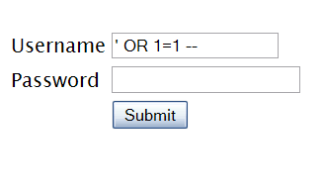

SQL Injection – Illustrated
"SELECT * FROM accounts WHERE acct=‘’ OR 1=1--’"
Account Summary
Acct:5424-6066-2134-4334
Acct:4128-7574-3921-0192
Acct:5424-9383-2039-4029
Acct:4128-0004-1234-0293
Account:
Account:
SKU:
DB Table 

SKU:
HTTP response 

HTTP request
Finance
SQL query
Transactions
Accounts
Administration
Communication
Knowledge Mgmt
E-Commerce
Bus. Functions
Databases
Legacy Systems
Web Services
Directories
Billing
Application Layer
Human Resrcs
APPLICATION
ATTACK
Custom Code
1. Application presents a form to the attacker
2. Attacker sends an attack in the form data
App Server
3. Application forwards attack to the database in a SQL query
Web Server
Hardened OS
4. Database runs query containing attack and sends encrypted results back to application
Network Layer
Firewall
Firewall
5. Application decrypts data as normal and sends results to the user
Notes:
Main Point
The flow of a SQL injection attack goes from attacker to application to database, then back.
Teaching Points
SQL injection is a simple attack that exploits the trust relationship between the database and the application. In essence, the attacker tricks the application into sending the wrong query to the database. The database trusts the application, and so complies with the request.
Even if the data is encrypted in the database, this type of attack can access the data. In the example depicted above, the attacker sends an attack in the data that tricks the database into returning all the credit cards from the database instead of only one. Normally, the application would decrypt the account owner’s credit card number (or other sensitive data) and display it. When attacked, the application decrypts all the card numbers and displays them all to the attacker.
Examples, Demonstrations, Stories, Notes

Slide 9
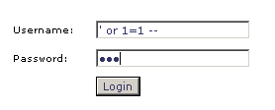
example : SQL-injection attack
Select user_information
from user_table
where username=’input username’ and password=’input password’
Select user_information
from user_table
where username=’’ or 1=1 -– ‘ and password=’abc’

Slide 10
Details of a SQL Injection Attack
Consider the following statement, userName is a variable that comes from a user
  "SELECT * FROM users WHERE name = '" + userName + "';“
set userName variable to
  a' or 't'='t
  a';DROP TABLE users; SELECT * FROM data WHERE 't' = 't
this potentially renders the following statements
  SELECT * FROM users WHERE name = 'a' OR 't'='t';
  SELECT * FROM users WHERE name = 'a';DROP TABLE users; SELECT * FROM DATA WHERE 't' = 't';

Slide 11
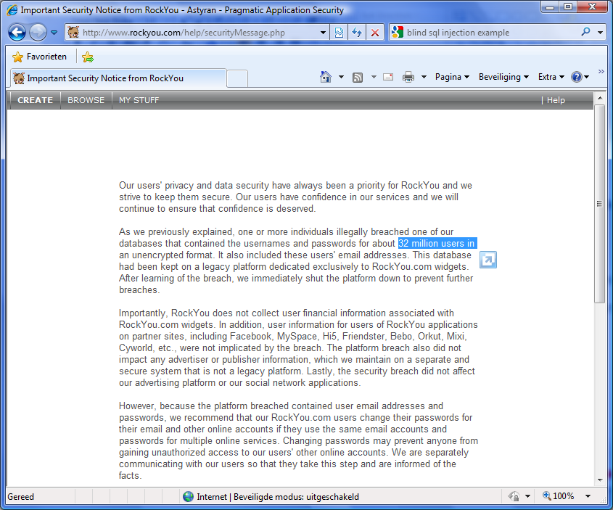
Sample Attack
December 2009
  a hacker used SQL Injection techniques
  to hack the database of RockYou
  RockYou creates applications for
  MySpace, Facebook, ...
Result
  data of 32.603.388 users and
  administrative accounts was
  compromised (credentials +
  clear text passwords)
  the data also contained
  email-addresses and passwords
  for 3rd party sites
Question: how many of those users use the same password for other sites too?
Notes:
http://igigi.baywords.com/rockyou-com-exposed-more-than-32-millions-of-passwords-in-plaintext/

Slide 12
A1 – Avoid Injection Flaws
Recommendations
  Avoid the interpreter entirely, or
  Use an interface that supports bind variables (e.g., prepared statements, or stored procedures),
    Bind variables allow the interpreter to distinguish between code and data
  Encode all user input before passing it to the interpreter
  Always perform ‘white list’ input validation on all user supplied input
  Always minimize database privileges to reduce the impact of a flaw
http://www.owasp.org/index.php/SQL_Injection_Prevention_Cheat_Sheet

Slide 13
SQL Injection Attack Techniques
Normal
  basically the attacker can append it’s query, and the results are shown by the application
  a commonly found weakness in “search” functionality
Blind
  the attacker will try to find responses where true/false can be deducted from the results of the query
    based on conditional responses
      SELECT booktitle FROM booklist WHERE bookId = 'OOk14cd' AND 1=1;
      SELECT booktitle FROM booklist WHERE bookId = 'OOk14cd' AND 1=2;
    based on conditional errors
      SELECT 1/0 FROM users WHERE username='Ralph'; (division is only done when the WHERE clause is true)
    timing based
      inject a delay when a WHERE clause becomes true
Notes:
Note: the goal is here not to go into great detail, but show the different tactics, so the importance of some of the countermeasures will be highlighted.

Slide 14

Example Automated Exploit Tool
SQLMap (partially sponsored by OWASP)
  command-line automated SQL injection tool
  download from http://sqlmap.sourceforge.net/
Capabilities
  banner, current user, current database, check if the current user is a database administrator, enumerate users, users password hashes, users privileges, databases, tables, columns, dump tables entries, dump whole database management system and run user's own SQL statement (MySQL, Oracle, PostgreSQL and Microsoft SQL Server)
  Support to read either text or binary files from the database server underlying file system (MySQL, PostgreSQL ,Microsoft SQL Server)
  Support to execute arbitrary commands on the database server underlying operating system (MySQL, PostgreSQL, Microsoft SQL Server)
  Support to establish an out-of-band stateful connection between the attacker box and the database server underlying operating system
  advanced OS and DBMS Fingerprinting
  Partial support for Microsoft Access, DB2, Informix, Sybase and Interbase
Notes:
Note: one still has to find the vulnerability first.
Note2: OWASP will be explained later
See http://sqlmap.sourceforge.net/
Capabilities based on web site dd 02/Jan/2010, version 0.8 RC1

Slide 15
SQL Injection Worm (also known as Asprox)
Many security specialists thought that a SQL Injection Attack always meant a targeted attack against a single application. They were proven wrong in January 2008
Automated self-replicating SQL Injection worm
  worm tries to inject a SQL statement that tried to inject JavaScript into every HTML page on the web site.
    redirect to site under control of attacker to install malware
      spam-bots, password stealing online games (e.g World of Warcraft)
    installation of malicious software that performed Google queries to search for signatures of vulnerable website
  this either fails or works if the application was vulnerable to SQL Injection
    even a low success rate can be devastating as they can still compromise hundreds of thousands of pages
  Goal was not to attack the web-site, but the visitors
Notes:
See SANS report http://www.sans.org/reading_room/whitepapers/incident/incident_handlers_guide_to_sql_injection_worms_33133
In 2008 a damaging SQL Injection attack took place which became known as the ASPROX Worm. During its height,
many hundreds of thousands of web sites were compromised, News sources were reporting grossly exaggerated
accounts of the attack, and real solid information to identify and combat this worm was scarce. Having
witnessed a number of security professionals overreact or apply panicked solutions to this attack motivated
this paper.

Slide 16
.NET Specific
Constrain and sanitize input data.
Use type-safe SQL parameters for data access.
Use an account that has restricted permissions in the database.
Avoid disclosing database error information.

Slide 17
Input validation
if (Regex.IsMatch(Request.Cookies["SSN"], "^\d{3}-\d{2}-\d{4}$"))
{
// access the database
}
else
{
// handle the bad input
}

Slide 18
Parameterized Queries
using System.Data;
using System.Data.SqlClient;
using (SqlConnection connection = new SqlConnection(connectionString))
{
DataSet userDataset = new DataSet();
SqlDataAdapter myDataAdapter = new SqlDataAdapter(
"SELECT au_lname, au_fname FROM Authors WHERE au_id = @au_id",
connection);
myCommand.SelectCommand.Parameters.Add("@au_id", SqlDbType.VarChar, 11);
myCommand.SelectCommand.Parameters["@au_id"].Value = SSN.Text;
myDataAdapter.Fill(userDataset);
}

Slide 19

File-Upload and Dangers
File-upload functionality is notoriously tricky and often a target for attackers
If file-upload is not implemented correctly, attackers might
  abuse your site as a file-server (porn, malware, ...)
  put files in the webroot of the server, to trick users (phishing, execute transactions, ...)
  upload malware or virus-infested files and attack your employees
  take-over the server
  fill the disk in order to perform a Denial-Of-Service Attack
First recommendations
  Prefer only accepting files from registered and authenticated users
  if you need to accept files from end-user; prefer NOT storing them on a disk, but in a database.
    attacking the OS will be impossible (or at least much more difficult)
    uploading a file in the webroot will also be impossible

Slide 20
Expect the Worst
Remember: with file-upload an attacker might have tampered with everything, expect (and prevent) the worst:
  full size paths where only a file-name is normal
  illegal lengths of names and paths (negative, zero, overlong, …)
  illegal characters in names and paths
  illegal types of files
  malware or virus-infected files …
More Recommendations
  Always implement virus-checks (on upload and thereafter)
  Prefer store the file with a random file-name (not coming from the user!)
    do not store it under the web-root (in that case the web server is in control instead of your application)
  with file-upload an attacker might have tampered with everything (name, size, …)
  before making security decisions (or going to the file-system), consider the following issues

Slide 21
Take into account the following
(blacklisting will be difficult)
Representation of long filenames under Windows:
  depending on configuration, the file-system might accept alternative 8.3 names as alternative for the long filename. This might enable an attacker to bypass your validation routines;
NTFS Alternate data-streams
  Windows file-systems can be accessed with alternate data-streams (e.g. file.jsp::$DATA). This might enable an attacker to bypass decisions made on file-extensions.
Trailing characters:
  the Win32 file system strips a trailing dot from the filename before accessing the file. This means ‘secret.config’ is the same as ‘secret.config.’.

Slide 22
Take into account the following (2)
\\?\
  Prepending \\?\ before the filename turns off path parsing.
  The result is that ‘C:\temp\myfile.txt’ is the same as ‘\\?\C:\temp\myfile.txt’
Parent paths (‘..’):
  this enables a user to walk outside the current directory to the directory above. If the directory structure is something as C:\dir\foo\files\secret, the file C:\dir\foo\myfile.txt is the same as C:\dir\foo\files\secret\..\..\myfile.txt, C:\dir\foo\files\..\myfile.txt, C:\dir\..\dir\foo\myfile.txt.
Filenames are case-insensitive under Windows
UNC Shares (UNC = universal naming convention, used to access file and printer resources). Using UNC one can map a dew disk letter to a local or remote resource. Example: Z:\myfile.txt might be the same as \\MyName\Files\myfile.txt
Notes:
Note that attackers could combine many of the above ‘alternative’ means of addressing a file.

Slide 23
Take into account the following (3)
Windows: CreateFile cannot just open files, but also named pipes and mail-slots for inter-process communications too. Syntax for a pipe is \servername\pipe\pipename and for a mailslot is \\servername\mailslot\mailslotname. Note that servername can be represented by a single dot too, representing the local machine.
Many operating systems, including windows, have support for naming devices from the console. Examples: CON, PRN, AUX, CLOCK$, NUL, COM1, LPT1.
  These are also reserved names and may not be used for a file-name.
  Devices can also be the reserved word followed by an extension: COM1.txt is also the device!
  And more: each of these devices exists in all directories: e.g. C:\dir\foo\COM1. If one blindly accepts a file and try to open it, you might be accessing a device.
On Unix systems one might take into consideration /dev/mouse, /dev/tty0, /dev/zero, …
Notes:
Note that attackers could combine many of the above ‘alternative’ means of addressing a file.

Slide 24
Canonicalization
Canonicalization means bringing something to its simplest representation.
  before making security decisions (or going to the file-system), bring the file back to it’s simplest form
  break the file into its components (root, path, filename, extension) by using standard functions
    do not create your own!
  perform sanity/security checks on those components

Slide 25
File Upload Summary
Prefer storing received files as an object in a database, not as a file on the file-system;
Accept only files from authenticated users, only authenticated users can download;
Check and limit the file-length, file-type and extension at the server-side
Never allow the user to control the file-name used to store the file: use unique and random filenames to store the file
Infrastructure level: apply anti-virus checks; store files on a separate partition, no direct reference to the uploaded file should be possible.

Slide 26
A1 – Conclusion
Injection Means...
  Tricking an application into including unintented commands in the data sent to an interpreter
Interpreters
  Take strings and interpret them as commands
  SQL, OS Shell, LDAP, XPath, Hibernate, ...
SQL Injection is still quite common
  Even though it is easy to avoid
Typical Impact
  Usually severe
  Entire database can be read or modified, OS attacked ...

Slide 27
A2 – Cross-Site Scripting (XSS)
Occurs any time…
Raw data from attacker is sent to an innocent user’s browser
Raw data…
Stored in database
Reflected from web input (form field, hidden field, URL, etc…)
Sent directly into rich JavaScript client
Virtually every web application has this problem
Try this in your browser – javascript:alert(document.cookie)
Typical Impact
Steal user’s session, steal sensitive data, rewrite web page, redirect user to phishing or malware site
Most Severe: Install XSS proxy which allows attacker to observe and direct all user’s behavior on vulnerable site and force user to other sites

Slide 28






XSS Definition
XSS = Cross-site Scripting
Web application vulnerability
Injection of code into web pages viewed by others
  XSS = new buffer overflow
  Javascript = new Shell Code
Notes:
Cross-site scripting (XSS) is a type of computer security vulnerability typically found in web applications which allow code injection by malicious web users into the web pages viewed by other users. Examples of such code include HTML code and client-side scripts. An exploited cross-site scripting vulnerability can be used by attackers to bypass access controls such as the same origin policy. Vulnerabilities of this kind have been exploited to craft powerful phishing attacks and browser exploits. Cross-site scripting was originally referred to as CSS, although this usage has been largely discontinued
This can be compared with the old buffer overflow: you achieve in injection data that will eventually be executed: here as javascript.
Javascript is the new Shell Code
Perform first demo here!

Slide 29
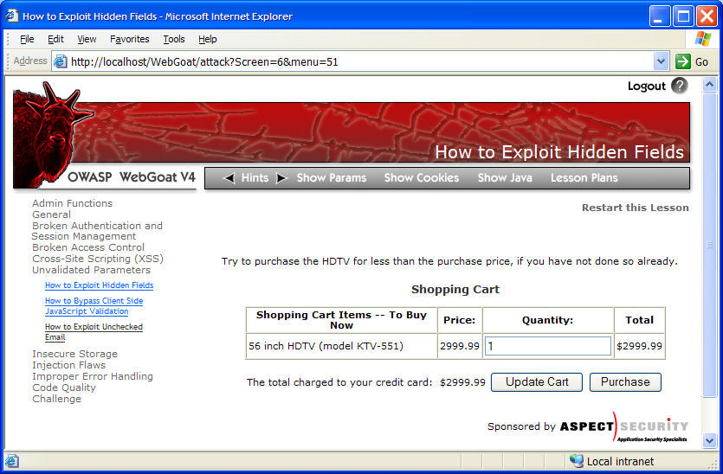
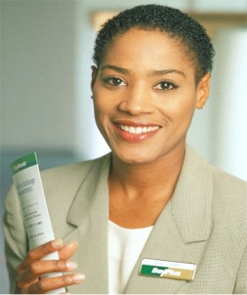
Cross-Site Scripting Illustrated
1
Attacker sets the trap – update my profile
Application with stored XSS vulnerability
Attacker enters a malicious script into a web page that stores the data on the server
2
Victim views page – sees attacker profile
Finance
Transactions
Accounts
Administration
Communication
Knowledge Mgmt
E-Commerce
Bus. Functions
Custom Code
Script runs inside victim’s browser with full access to the DOM and cookies
3
Script silently sends attacker Victim’s session cookie

Slide 30
A2 – Avoiding XSS Flaws
Recommendations
  Eliminate Flaw
    Don’t include user supplied input in the output page
  Defend Against the Flaw
    Primary Recommendation: Output encode all user supplied input
    Perform ‘white list’ input validation on all user input to be included in page
References
  For how to output encode properly, read the new http://www.owasp.org/index.php/XSS_(Cross Site Scripting) Prevention Cheat Sheet

Slide 31

Cross-Site Scripting: Protection
Best protection is a combination of the following
  Filter all user input. Only accept input (type, length, domain, …) that the application expects. Block everything else (preferred) or filter known bad input (difficult to do correctly, since characters may be encoded).
  Enforce a code-page (without this a browser will try to guess the character encoding used, or use local defaults) and encode all output.
    Use OWASP’s ESAPI or
    Use the Microsoft Anti-XSS library (Web Protection Library)
  For large chunks of user supplied HTML, use OWASP’s AntiSamy to sanitize this HTML to make it safe See: http://www.owasp.org/index.php/AntiSamy
  Use double quotes around HTML attributes and events.
  Protect the session cookie with the HttpOnly cookie flag
  Only accept POST requests, where possible (POST attacks are slightly more difficult to execute -> can be detected more easily)
(AntiSamy)
Notes:
Requirement for this to work:
Browser and application server need to agree about the ‘language encoding’ otherwise ‘dangerous’ characters might slip through
Problem: ‘language’ encoding can be on
HTTP Protocol level (configured on web server): Content-Type: text/html; charset=EUC-JP
HTML level (configured on application server): <META http-equiv="Content-Type" content="text/html; charset=EUC-JP">
Charset attribute on several HTML elements
Configuration standards and programmer guidelines/standards are necessary!
A way for preventing such attacks is by using the HttpOnly flag;^{[36]} this is an option, first introduced by Microsoft in Internet Explorer version 6^{[37]} and implemented in PHP since version 5.2.0^{[38]} that is intended to make a cookie inaccessible to client side script.

Slide 32
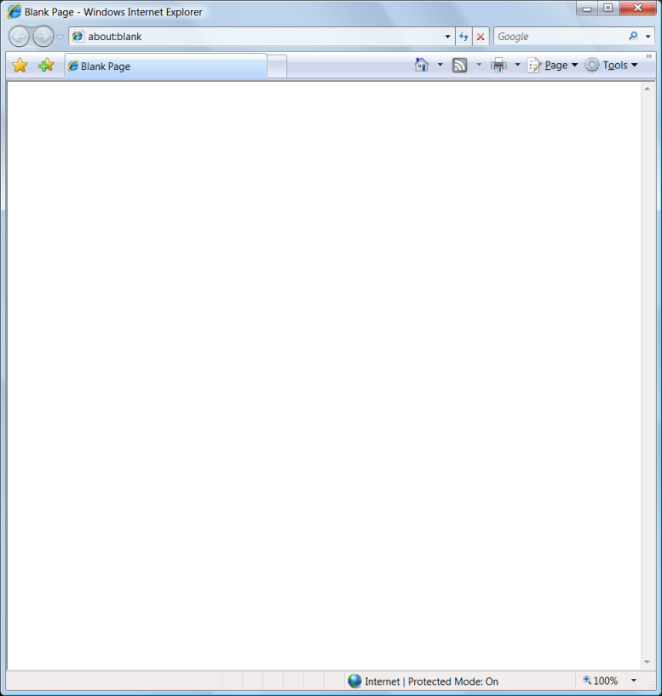
Safe Escaping Schemes in Various HTML Execution Contexts
#1: ( &, <, >, " ) → &entity; ( ', / ) → &#xHH;
ESAPI: encodeForHTML()
HTML Element Content
(e.g., <div> some text to display </div> )
#2: All non-alphanumeric < 256 → &#xHH
ESAPI: encodeForHTMLAttribute()
HTML Attribute Values
(e.g., <input name='person' type='TEXT' value='defaultValue'> )
#3: All non-alphanumeric < 256 → \xHH
ESAPI: encodeForJavaScript()
JavaScript Data
(e.g., <script> some javascript </script> )
#4: All non-alphanumeric < 256 → \HH
ESAPI: encodeForCSS()
HTML Style Property Values
(e.g., .pdiv a:hover {color: red; text-decoration: underline} )
#5: All non-alphanumeric < 256 → %HH
ESAPI: encodeForURL()
URI Attribute Values
(e.g., <a href="javascript:toggle('lesson')" )
Recommendation: Only allow #1 and #2 and disallow all othersSee: www.owasp.org/index.php/XSS_(Cross_Site_Scripting)_Prevention_Cheat_Sheet for more details
Notes:
Main Point
There are many escaping schemes supported in different elements of the browser.
Teaching Points
In order to defend against XSS, you need to escape all user supplied input using the proper escaping scheme before you include that input in that part of the page.
Each HTML execution context needs its own escaping scheme based on how the spec for that context defines how it handles character escaping.
ESAPI has an encoder for each of these contexts. They are:
encodeForHTML()
encodeForHTMLAttribute()
encodeForJavaScript()
encodeForCSS()
encodeForURL()
In each context you need to prevent certain dangerous characters if you can’t eliminate all user input to that context
HTML Elements – [This is simply the text on the page] – Defense against this is the big 5, because that prevents the introduction of close tags to break out of the Element (e.g., </div> or </span> or the introduction of script tags (<script) )
HTML Attributes – Content inside the quotes is inert, so preventing the introduction of single or double quotes is key. Typically encoding the big 5 ( &, ', ", <, >) is strongly recommended. Also encoding # is usually a good idea.
JavaScript Data – This context is executable in its own right, and therefore inherently dangerous. Ideally, you would not include user supplied input here ever. Otherwise, only input validation can really do anything to help you as output encoding is not sufficient.
HTML Style Properties (CSS) – This is very dangerous as it will execute content supplied – to prevent a breakout, you need to dissallow '}', but that may not be sufficient since content inside the brace can execute as well. Ideally, you would not include user supplied input here ever. Otherwise, only input validation can really do anything to help you as output encoding is not sufficient.
URI Attributes - This is very dangerous as it will (decode and) execute content supplied – to prevent a breakout, you need to dissallow ' " ', but that may not be sufficient since content inside the quotes can execute as well.
Examples, Demonstrations, Stories, Notes
See the page at OWASP for the full and latest details!!

Slide 33
.NET specific
Step 1. Check that ASP.NET request validation is enabled.
Step 2. Review ASP.NET code that generates HTML output.
Step 3. Determine whether HTML output includes input parameters.
Step 4. Review potentially dangerous HTML tags and attributes.
Step 5. Evaluate countermeasures.

Slide 34
Machine.config
<system.web>
<pages buffer="true" validateRequest="true" />
</system.web>

Slide 35
HTML Output Includes Input Parameters?
Response.Write(name.Text);
Response.Write(Request.QueryString["username"]);
SqlDataReader reader = cmd.ExecuteReader(); Response.Write(reader.GetString(1));
Response.Write( Request.Cookies["name"].Values["name"]);
Response.Write(Session["name"]);

Slide 36
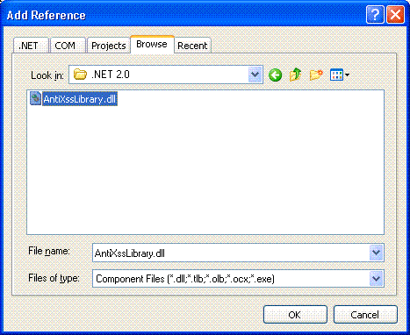
Anti-XSS Library
String Name = Request.QueryString["Name"];
=>
String Name = AntiXss.HtmlEncode(Request.QueryString["Name"]);

Slide 37
Evaluate Countermeasures
Encode HTML output.
  Response.Write(HttpUtility.HtmlEncode(Request.Form["name"]));
Encode URL output.
  Response.Write(HttpUtility.UrlEncode(urlString));
Filter user input.
  RegularExpressionValidator and RangeValidator

Slide 38
DOM Based XSS
Root cause:
  Insecure reference and use (in a client side code) of DOM objects that are not fully controlled by the server provided page
  DOM = Document Object Model of browser
    represents most of the page’s properties, as experienced by the browser.
    contains many sub-objects, such as location, URL and referrer. These are populated by the browser according to the browser’s point of view.
    example: document.location, document.URL

Slide 39
Example
http://www.example.com/welcome.html#name=<script>alert(document.cookie)<script>
everything after ‘#’ is called a fragment, and is not send to the server!
client side script
  var pos=document.URL.indexOf("name=")+5;
  document.write(document.URL.substring(pos,document.URL.length));

Slide 40
DOM Based XSS
Avoid client side document rewriting, redirection, or other sensitive actions, using client side data.
  Most of these effects can be achieved by using dynamic pages (server side).
Be careful with
  document.URL, document.location (and many of its properties), document.referrer,window.location (and many of its properties)
  document.write(…), document.writeln(…),document.body.innerHtml=…
  document.execCommand(…), eval(), window.execScript(…)
  window.setInterval(…), window.setTimeout(…)
  ...
Notes:
Write raw HTML, e.g.:
document.write(…)
document.writeln(…)
document.body.innerHtml=…
Directly modifying the DOM (including DHTML events), e.g.:
document.forms[0].action=… (and various other collections)
document.attachEvent(…)
document.create…(…)
document.execCommand(…)
document.body. … (accessing the DOM through the body object)
window.attachEvent(…)
Replacing the document URL, e.g.:
document.location=… (and assigning to location’s href, host and hostname)
document.location.hostname=…
document.location.replace(…)
document.location.assign(…)
document.URL=…
window.navigate(…)
Opening/modifying a window, e.g.:
document.open(…)
window.open(…)
window.location.href=… (and assigning to location’s href, host and hostname)
Directly executing script, e.g.:
eval(…)
window.execScript(…)
window.setInterval(…)
window.setTimeout(…)

Slide 41
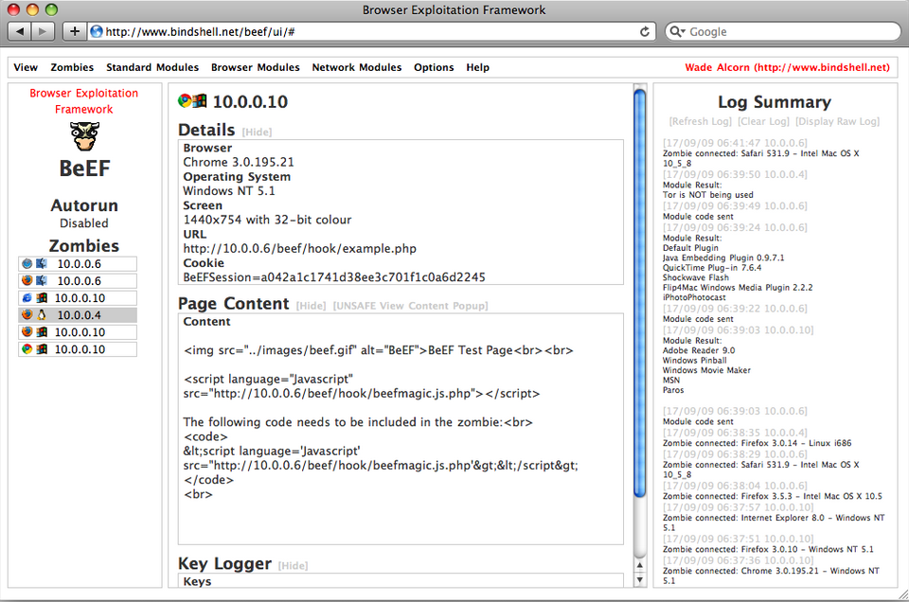
Example: BeEF Browser Exploitation Framework

Slide 42
A2 – Conclusion
Cross-Site-Scripting occurs any time
  Raw data from an attacker is sent to an innocent user’s browser
Raw data
  Stored in database
  Reflected from web input
Typical Impact
  Steal user’s session, steal sensitive data, rewrite web page, redirect user to phishing or malware site
  Install XSS proxy which allows attacker to observe and direct all user’s behavior on vulnerable site and force user to other sites
  Execute commands as the victim (without needing authentication or access to the session cookie)

Slide 43
A3 – Broken Authentication and Session Management
HTTP is a “stateless” protocol
Means credentials have to go with every request
Should use SSL for everything requiring authentication
Session management flaws
SESSION ID used to track state since HTTP doesn’t
and it is just as good as credentials to an attacker
SESSION ID is typically exposed on the network, in browser, in logs, …
Beware the side-doors
Change my password, remember my password, forgot my password, secret question, logout, email address, etc…
Typical Impact
User accounts compromised or user sessions hijacked

Slide 44
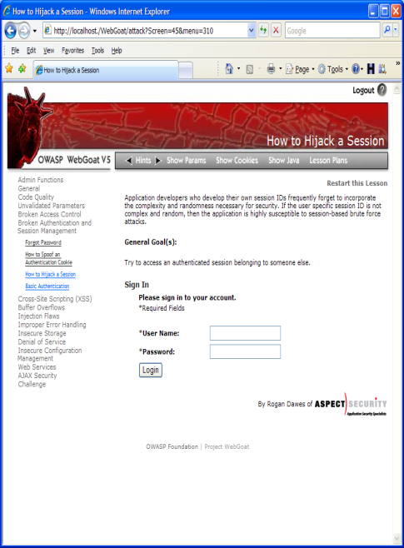
Broken Authentication Illustrated
1
User sends credentials
Finance
Transactions
Accounts
Administration
Communication
Knowledge Mgmt
E-Commerce
www.boi.com?JSESSIONID=9FA1DB9EA...
Bus. Functions
Site uses URL rewriting
(i.e., put session in URL)
2
Custom Code
3
User clicks on a link to http://www.hacker.com in a forum
Hacker checks referer logs on www.hacker.com
and finds user’s JSESSIONID
4
5
Hacker uses JSESSIONID and takes over victim’s account

Slide 45
A3 – Avoiding Broken Authentication and Session Management
Verify your architecture
  Authentication should be simple, centralized, and standardized
  Use the standard session id provided by your container
  Be sure SSL protects both credentials and session id at all times
Verify the implementation
  Check your SSL certificate
  Examine all the authentication-related functions
  Verify that logoff actually destroys the session
  Use OWASP’s WebScarab to test the implementation

Slide 46
A4 – Insecure Direct Object References
How do you protect access to your data?
This is part of enforcing proper “Authorization”, along with
A7 – Failure to Restrict URL Access
A common mistake …
Only listing the ‘authorized’ objects for the current user, or
Hiding the object references in hidden fields
This is called presentation layer access control, and doesn’t work
Attacker simply tampers with parameter value
Typical Impact
Users are able to access unauthorized files or data
… and then not enforcing these restrictions on the server side

Slide 47
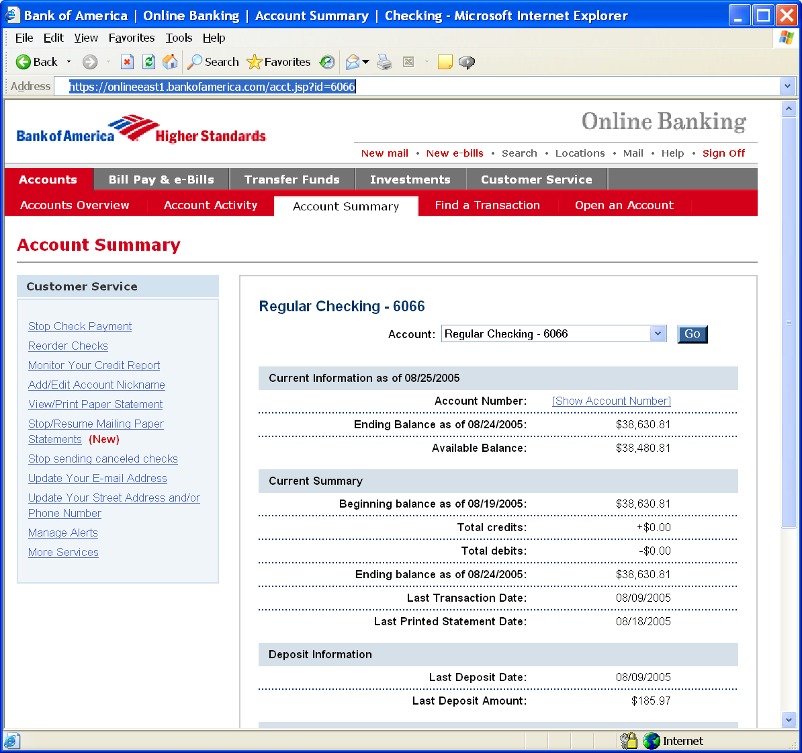
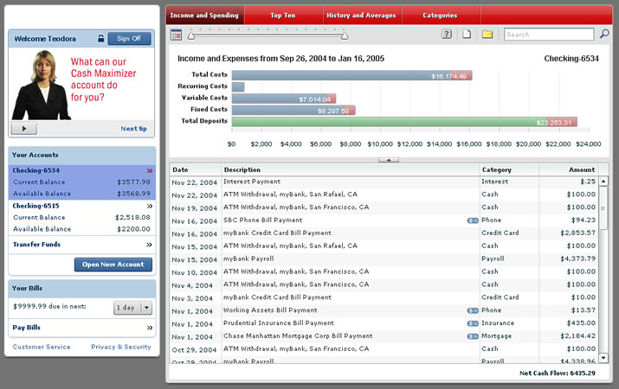
Insecure Direct Object References Illustrated
Attacker notices his acct parameter is 6065
?acct=6065
He modifies it to a nearby number
?acct=6066
Attacker views the victim’s account information
https://www.onlinebank.com/user?acct=6065
Notes:
Main Point
Here’s a concrete example of an access control problem to ensure that everyone understands what access control means.
Teaching Points
In this example, the attacker is simply manipulating the account id on the URL. The application should be getting the user’s account from a trustworthy source, not the user’s request.
There are many variations of this kind of attack. Many times they are not this obvious, relying on a hidden field, cookie, or header to make the access control decision. But the root cause is the same – never rely on anything from the user when making an access control decision.
Examples, Demonstrations, Stories
A healthcare application that processes xray and other medical imagery recently had this issue. They set a cookie called “privLevel” and used it to determine which functions to display. When we changed it from 4 to 10, we were given an administrator menu and could access many powerful unauthorized functions.

Slide 48
A4 – Avoiding Insecure Direct Object References
Eliminate the direct object reference
  Replace them with a temporary mapping value (e.g. 1, 2, 3)
  ESAPI provides support for numeric & random mappings
    IntegerAccessReferenceMap & RandomAccessReferenceMap
Validate the direct object reference
  Verify the parameter value is properly formatted
  Verify the user is allowed to access the target object
    Query constraints work great!
  Verify the requested mode of access is allowed to the target object (e.g., read, write, delete)
http://app?file=Report123.xls
Access
Reference
Map
Report123.xls
http://app?file=1
http://app?id=9182374
Acct:9182374
http://app?id=7d3J93

Slide 49
A5 – Cross Site Request Forgery (CSRF)
Cross Site Request Forgery
An attack where the victim’s browser is tricked into issuing a command to a vulnerable web application
Vulnerability is caused by browsers automatically including user authentication data (session ID, IP address, Windows domain credentials, …) with each request
Imagine…
What if a hacker could steer your mouse and get you to click on links in your online banking application?
What could they make you do?
Typical Impact
Initiate transactions (transfer funds, logout user, close account)
Access sensitive data
Change account details
Notes:
Main Point
CSRF is essentially an attack that essentially allows the attacker to drive your (the victim’s) browser. Wouldn’t that be bad? Of course. Its REALLY bad.
Teaching Points
CSRF attacks primarily target functions that cause state to change on the application. I.e., modify or delete something, initiate a transaction, etc.
However, CSRF attacks can simply be used to access sensitive data, and then transfer that sensitive data to the attacker.
Examples, Demonstrations, Stories

Slide 50
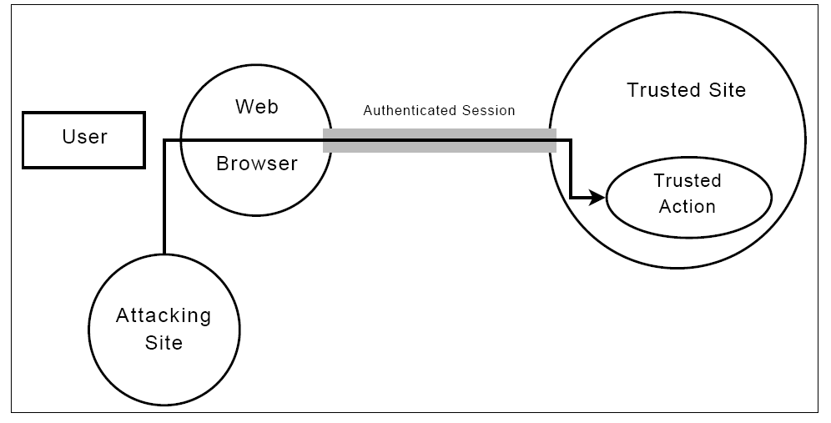
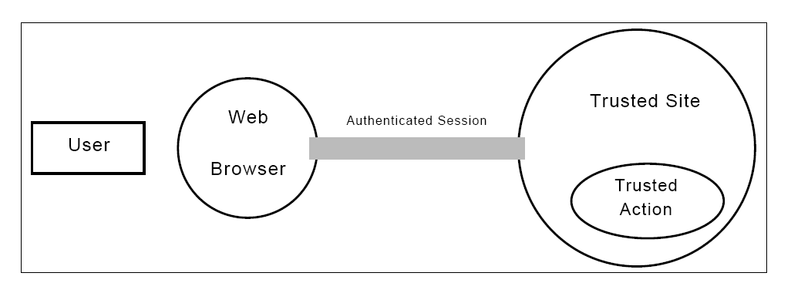
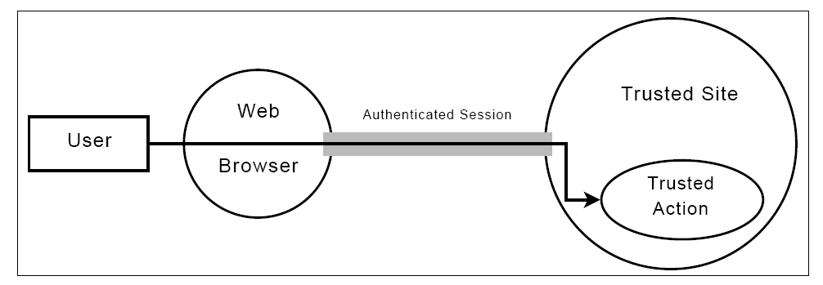
CSRF Illustrated

Slide 51
CSRF Vulnerability Pattern
The Problem
  Web browsers automatically include most credentials with each request
  Even for requests caused by a form, script, or image on another site
All sites relying solely on automatic
credentials are vulnerable!
  (almost all sites are this way)
Automatically Provided Credentials
  Session cookie
  Basic authentication header
  IP address
  Client side SSL certificates
  Windows domain authentication
Notes:
Main Point
CSRF is a big problem because browsers automatically send the user’s credentials and most sites rely solely on these automatically provided credentials.
Teaching Points
All this was, of course, done on purpose to make it easy to build web sites that track the user’s identity throughout the site.
No one thought that this level of automation could easily be abused to the attacker’s advantage.
Now we know this is problem, but how to fix it? See the rest of this section.
Examples, Demonstrations, Stories

Slide 52
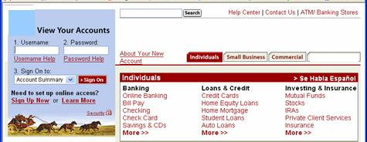
CSRF Illustrated
Attacker sets the trap on some website on the internet
(or simply via an e-mail)
1
Application with CSRF vulnerability
Hidden <img> tag contains attack against vulnerable site
Finance
Transactions
Accounts
Administration
Communication
Knowledge Mgmt
E-Commerce
Bus. Functions
2
While logged into vulnerable site,
victim views attacker site
Custom Code
3
Vulnerable site sees legitimate request from victim and performs the action requested
<img> tag loaded by browser – sends GET request (including credentials) to vulnerable site
Notes:
Main Point
This is how a CSRF attack works.
Teaching Points
1. Attacker lures victim to read some malicious content (in web site or e-mail)
2. Malicious request automatically sent to vulnerable site (if in IMG tag or something similar), or user might actually click on or submit something to initiate the request (i.e., phishing like attack).
3. IF THE CONDITIONS ARE RIGHT, then the malicious request will include the victim’s credentials when sent to the vulnerable site. If it works, the unauthorized transaction will be accepted, or the unauthorized request will return sensitive data to the attacker.
4. Regardless of success or failure of the attack, the attack itself is typically completely invisible to the potential victim.
Examples, Demonstrations, Stories

Slide 53
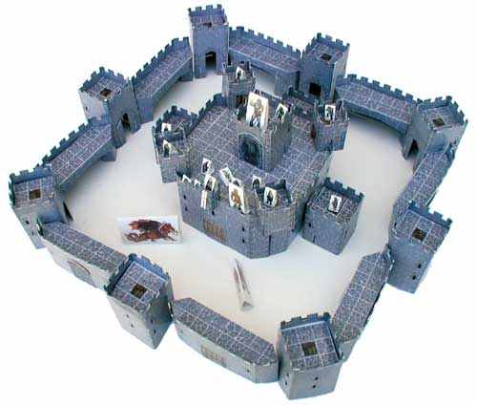
A5 – Avoiding CSRF Flaws
Add a secret, not automatically submitted, token to ALL sensitive requests
  This makes it impossible for the attacker to spoof the request
    (unless there’s an XSS hole in your application)
  Tokens should be cryptographically strong or random
Options
  Store a single token in the session and add it to all forms and links
    Hidden Field: <input name="token" value="687965fdfaew87agrde" type="hidden"/>
    Single use URL: /accounts/687965fdfaew87agrde
    Form Token: /accounts?auth=687965fdfaew87agrde …
  Beware exposing the token in a referer header
    Hidden fields are recommended
  Can have a unique token for each function
    Use a hash of function name, session id, and a secret
  Can require secondary authentication for sensitive functions (e.g., eTrade)
See the new: www.owasp.org/index.php/CSRF_Prevention_Cheat_Sheet
for more details
Notes:
Main Point
The only real solution is adding a secret token to each update command on a site.
Teaching Points
This token has to be stored in a location that is NOT automatically submitted with other requests by your browser. i.e., in a hidden field, or as another parameter.
Beware of including this token in the URL parameters, since it will get included in the referer field of future requests (thus exposing the token).
It would be ideal of a unique value was created for every single individual transaction, but that can be a pain to create.
Having a single unique value of the entire session would be way better than nothing, so we’d recommend you at least start with that.
Also, it is VERY IMPORTANT, that you not have XSS flaws on your site because such flaws can be used to steal or access your unique tokens and defeat any CSRF defense you put in place.
Examples, Demonstrations, Stories

Slide 54
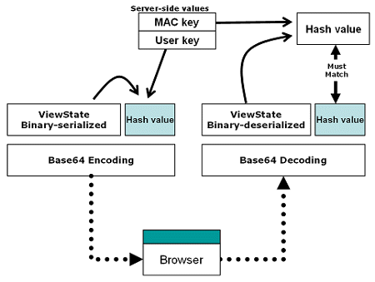
ViewStateUserKey
void Page_Init(object sender, EventArgs e)
{
ViewStateUserKey = Session.SessionID;
}
Notes:
The view state is used to persist the state of controls across two successive requests for the same page. By default, the view state is Base64-encoded and signed with a hash value to prevent tampering. Unless you change default page settings, the view state is not at risk of tampering. If an attacker modifies the view state, or even if he/she rebuilds the view state using the right algorithm, ASP.NET catches the attempt and throws an exception. A tampered view state is not necessarily harmful—it modifies the state of server
One of the very rich security feature and also one of the least known is the ViewStateUserKey. The key is used to add an identifier to the individual user in the viewstate variable for the page.
There are problems with relying on ViewState however:
Developers can disable ViewState per-page or on an entire ASP.Net application. They can also forget to enable it on a key page. Knowing you have protection becomes a laborious code-and-configuration-review-problem.
ViewState can result in hugely bloated page content if it is not cared for properly during development
Developers can inadvertently divulge sensitive date in ViewState that may go unnoticed since ViewState is Base64-encoded in the page content controls, though—but can become the vehicle of serious infections.
Only works for POST forms

Slide 55
A5 – Make it harder
Break out of frames
  A frame is a subdivision of a Web browser window and can act like a smaller window.
  Attackers often try to use HTML frames to make a user believe he is directly connected to an application, while every inch of the way he is monitored.
Break out of frames with JavaScript (note: if the user disabled JavaScript, this will not work):
  <script type="text/javascript">if (top != self) top.location.replace(self.location.href);</script>
  note: this is not a full protection
Include the HTTP header X-FRAME-OPTIONS with value DENY (Internet Explorer specific).
  Prevents your web-site form being framed
Notes:
Main Point
The only real solution is adding a secret token to each update command on a site.
Teaching Points
This token has to be stored in a location that is NOT automatically submitted with other requests by your browser. i.e., in a hidden field, or as another parameter.
Beware of including this token in the URL parameters, since it will get included in the referer field of future requests (thus exposing the token).
It would be ideal of a unique value was created for every single individual transaction, but that can be a pain to create.
Having a single unique value of the entire session would be way better than nothing, so we’d recommend you at least start with that.
Also, it is VERY IMPORTANT, that you not have XSS flaws on your site because such flaws can be used to steal or access your unique tokens and defeat any CSRF defense you put in place.
Examples, Demonstrations, Stories

Slide 56
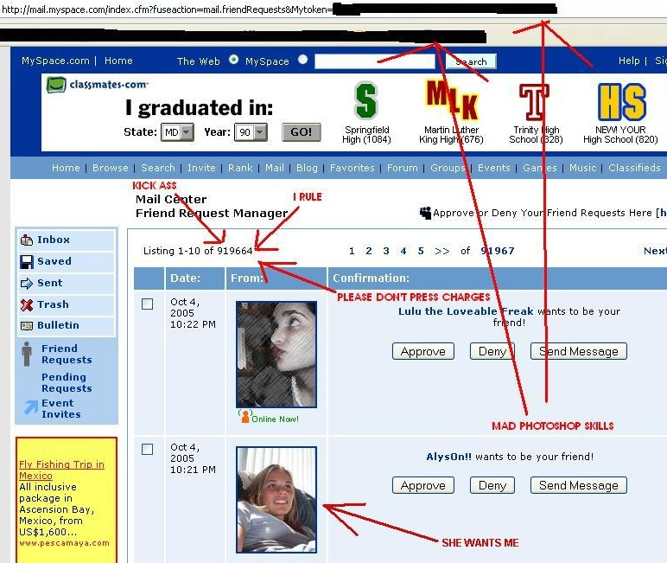
Example: SAMY XSS Worm

Slide 57
A6 – Security Misconfiguration
Web applications rely on a secure foundation
All through the network and platform
Don’t forget the development environment
Is your source code a secret?
Think of all the places your source code goes
Security should not require secret source code
Configuration Management must extend to all parts of the application
All credentials should change in production
Typical Impact
Install backdoor through missing network or server patch
XSS flaw exploits due to missing application framework patches
Unauthorized access to default accounts, application functionality or data, or unused but accessible functionality due to poor server configuration

Slide 58
Security Misconfiguration Illustrated
Finance
Database
Transactions
Accounts
Administration
Communication
Knowledge Mgmt
E-Commerce
Bus. Functions
Custom Code
App Configuration
Framework
Development
App Server
Web Server
QA Servers
Insider
Hardened OS
Test Servers
Source Control

Slide 59
A6 – Avoiding Security Misconfiguration
Verify your system’s configuration management
  Secure configuration “hardening” guideline
    Automation is REALLY USEFUL here
  Must cover entire platform and application
  Keep up with patches for ALL components
    This includes software libraries, not just OS and Server applications
  Analyze security effects of changes
Can you “dump” the application configuration
  Build reporting into your process
  If you can’t verify it, it isn’t secure
Verify the implementation
  Scanning finds generic configuration and missing patch problems

Slide 60
A7 – Failure to Restrict URL Access
How do you protect access to URLs (pages)?
This is part of enforcing proper “authorization”, along with
A4 – Insecure Direct Object References
A common mistake …
Displaying only authorized links and menu choices
This is called presentation layer access control, and doesn’t work
Attacker simply forges direct access to ‘unauthorized’ pages
Typical Impact
Attackers invoke functions and services they’re not authorized for
Access other user’s accounts and data
Perform privileged actions

Slide 61
Failure to Restrict URL Access Illustrated
Attacker notices the URL indicates his role
/user/getAccounts
He modifies it to another directory (role)
/admin/getAccounts, or
/manager/getAccounts
Attacker views more accounts than just their own

Slide 62
A7 – Avoiding URL Access Control Flaws
For each URL, a site needs to do 3 things
  Restrict access to authenticated users (if not public)
  Enforce any user or role based permissions (if private)
  Completely disallow requests to unauthorized page types (e.g., config files, log files, source files, etc.)
Verify your architecture
  Use a simple, positive model at every layer
  Be sure you actually have a mechanism at every layer
Verify the implementation
  Verify that each URL in your application is protected by either
    An external filter, like Java EE web.xml or a commercial product
    Or internal checks in YOUR code – Use ESAPI’s isAuthorizedForURL() method
  Verify the server configuration disallows requests to unauthorized file types
  Use WebScarab or your browser to forge unauthorized requests

Slide 63
A8 – Insecure Cryptographic Storage
Storing sensitive data insecurely
Failure to identify all sensitive data
Failure to identify all the places that this sensitive data gets stored
Databases, files, directories, log files, backups, etc.
Failure to properly protect this data in every location
Typical Impact
Attackers access or modify confidential or private information
Attackers extract secrets to use in additional attacks
Company embarrassment, customer dissatisfaction, and loss of trust
Expense of cleaning up the incident, such as forensics, sending apology letters, reissuing thousands of credit cards, providing identity theft insurance
Business gets sued and/or fined
e.g, credit cards, health care records, financial data (yours or your customers)

Slide 64
Insecure Cryptographic Storage Illustrated
Victim enters credit card number in form
1
Finance
Transactions
Accounts
Administration
Communication
Knowledge Mgmt
E-Commerce
Bus. Functions
Custom Code
Log files
4
Malicious insider steals 4 million credit card numbers
Error handler logs CC details because merchant gateway is unavailable
2
Logs are accessible to all members of IT staff for debugging purposes
3

Slide 65
A8 – Avoiding Insecure Cryptographic Storage
Verify your architecture
  Identify all sensitive data
  Identify all the places that data is stored
  Ensure threat model accounts for possible attacks
  Use encryption to counter the threats, don’t just ‘encrypt’ the data
Protect with appropriate mechanisms
  File encryption, database encryption, data element encryption
Use the mechanisms correctly
  Use standard strong algorithms
  Generate, distribute, and protect keys properly
  Be prepared for key change
Verify the implementation
  A standard strong algorithm is used, and it’s the proper algorithm for this situation
  All keys, certificates, and passwords are properly stored and protected
  Safe key distribution and an effective plan for key change are in place
  Analyze encryption code for common flaws

Slide 66
A09 – Insufficient Transport Layer Protection
Transmitting sensitive data insecurely
Failure to identify all sensitive data
Failure to identify all the places that this sensitive data is sent
On the web, to backend databases, to business partners, internal communications
Failure to properly protect this data in every location
Typical Impact
Attackers access or modify confidential or private information
e.g, credit cards, health care records, financial data (yours or your customers)
Attackers extract secrets to use in additional attacks
Company embarrassment, customer dissatisfaction, and loss of trust
Expense of cleaning up the incident
Business gets sued and/or fined

Slide 67


Insufficient Transport Layer Protection Illustrated
Business Partners
External Victim
Custom Code
Backend Systems
1
Employees
2
External attacker steals credentials and data off network
Internal attacker steals credentials and data from internal network
External Attacker
Internal Attacker

Slide 68
A09 – Avoiding Insufficient Transport Layer Protection
Protect with appropriate mechanisms
  Use TLS on all connections with sensitive data
  Individually encrypt messages before transmission
    E.g., XML-Encryption
  Sign messages before transmission
    E.g., XML-Signature
Use the mechanisms correctly
  Use standard strong algorithms (disable old SSL algorithms)
  Manage keys/certificates properly
  Verify SSL certificates before using them
  Use proven mechanisms when sufficient
    E.g., SSL vs. XML-Encryption
See: http://www.owasp.org/index.php/Transport_Layer_Protection_Cheat_Sheet for more details

Slide 69
A10 – Unvalidated Redirects and Forwards
Web application redirects are very common
And frequently include user supplied parameters in the destination URL
If they aren’t validated, attacker can send victim to a site of their choice
Forwards (aka Transfer in .NET) are common too
They internally send the request to a new page in the same application
Sometimes parameters define the target page
If not validated, attacker may be able to use unvalidated forward to bypass authentication or authorization checks
Typical Impact
Redirect victim to phishing or malware site
Attacker’s request is forwarded past security checks, allowing unauthorized function or data access

Slide 70

Unvalidated Redirect Illustrated
1
Attacker sends attack to victim via email or webpage
From: Internal Revenue Service
Subject: Your Unclaimed Tax Refund
Our records show you have an unclaimed federal tax refund. Please click here to initiate your claim.
3
Application redirects victim to attacker’s site
2
Victim clicks link containing unvalidated parameter
Finance
Transactions
Accounts
Administration
Communication
Knowledge Mgmt
E-Commerce
Bus. Functions
Custom Code
Request sent to vulnerable site, including attacker’s destination site as parameter. Redirect sends victim to attacker site
Evil Site
4
Evil site installs malware on victim, or phish’s for private information
http://www.irs.gov/taxrefund/claim.jsp?year=2006& … &dest=www.evilsite.com

Slide 71
A10 – Avoiding Unvalidated Redirects and Forwards
There are a number of options
  Avoid using redirects and forwards as much as you can
  If used, don’t involve user parameters in defining the target URL
  If you ‘must’ involve user parameters, then either
    Validate each parameter to ensure its valid and authorized for the current user, or
    (preferred) – Use server side mapping to translate choice provided to user with actual target page
  Defense in depth: For redirects, validate the target URL after it is calculated to make sure it goes to an authorized external site
  ESAPI can do this for you!!
    See: SecurityWrapperResponse.sendRedirect( URL )
    http://owasp-esapi-java.googlecode.com/svn/trunk_doc/org/owasp/esapi/filters/
    SecurityWrapperResponse.html#sendRedirect(java.lang.String)
Some thoughts about protecting Forwards
  Ideally, you’d call the access controller to make sure the user is authorized before you perform the forward
  With an external filter, like Siteminder, this is not very practical
  Next best is to make sure that users who can access the original page are ALL authorized to access the target page.

Slide 72
The End
http://www.owasp.org/index.php/Category:OWASP_Top_Ten_Project

