Slide 1
Defending the United States in the Digital Age
Information Security Transformation for the Federal Government
OWASP APPSEC DC 2010
November 11, 2010
Dr. Ron Ross
Computer Security Division
Information Technology Laboratory

Slide 2
Information technology is our greatest strength and at the same time, our greatest weakness…

Slide 3
The Perfect Storm
Explosive growth and aggressive use of information technology.
Proliferation of information systems and networks with virtually unlimited connectivity.
Increasing sophistication of threat including exponential growth rate in malware (malicious code).
Resulting in an increasing number of penetrations of information systems in the public and private sectors…

Slide 4
The Threat Situation
Continuing serious cyber attacks on public and private
sector information systems targeting key operations,
assets, and individuals…
Attacks are organized, disciplined, aggressive, and well resourced; many are extremely sophisticated.
Adversaries are nation states, terrorist groups, criminals, hackers, and individuals or groups with hostile intentions.
Effective deployment of malware causing significant exfiltration of sensitive information (e.g., intellectual property).
Potential for disruption of critical systems and services.

Slide 5

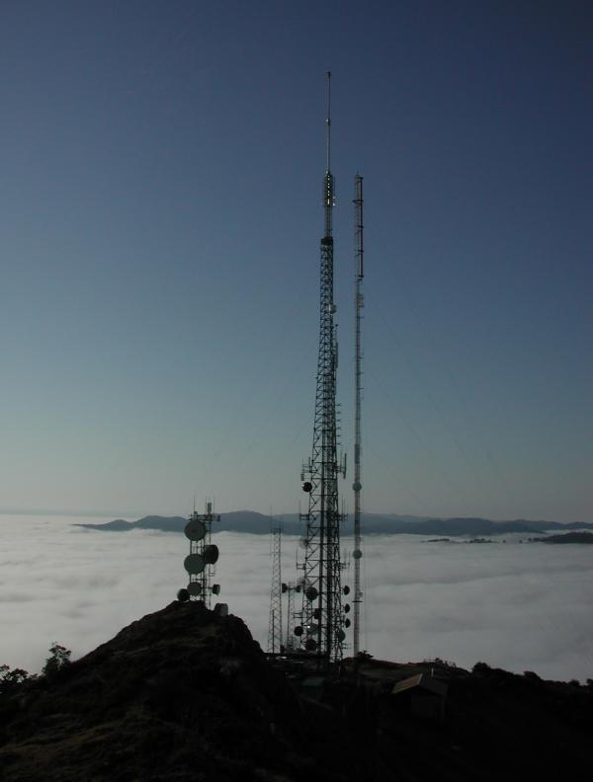
Unconventional Threats to Security
Connectivity
Complexity

Slide 6
Sometimes adversaries do it to us… and sometimes we do it to ourselves…

Slide 7
The Stuxnet Worm
Targeting critical infrastructure companies—
  Infected industrial control systems around the world.
  Uploads payload to Programmable Logic Controllers.
  Gives attacker control of the physical system.
  Provides back door to steal data and remotely and secretly control critical plant operations.
  Found in Siemens Simatic Win CC software used to control industrial manufacturing and utilities.

Slide 8
The Flash Drive Incident
Targeting U.S. Department of Defense—
  Malware on flash drive infected military laptop computer at base in Middle East.
  Foreign intelligence agency was source of malware.
  Malware uploaded itself to Central Command network.
  Code spread undetected to classified and unclassified systems establishing digital beachhead.
  Rogue program poised to silently steal military secrets.

Slide 9
The Stolen Laptop Incident
U.S. Department of Veterans Affairs—
  VA employee took laptop home with over 26 million veterans records containing personal information.
  Laptop was stolen from residence and information was not protected.
  Law enforcement agency recovered laptop; forensic analysis indicated no compromise of information.
  Incident prompted significant new security measures and lessons learned.

Slide 10
We have to do business in a dangerous world…
Managing risk as we go.

Slide 11
Risk and Security
What is the difference between risk and security?
  Information Security
  The protection of information and information systems from unauthorized access, use, disclosure, disruption, modification, or destruction in order to provide confidentiality, integrity, and availability.
  Risk
  A measure of the extent to which an entity is threatened by a potential circumstance or event, and typically a function of: (i) the adverse impacts that would arise if the circumstance or event occurs; and (ii) the likelihood of occurrence.
Types of Threats
Purposeful attacks, environmental disruptions, and human errors.

Slide 12
The Evolution of Risk and Security
The conventional wisdom has changed over four decades—
Confidentiality → Confidentiality, Integrity, Availability
Information Protection → Information Protection / Sharing
Static, Point-in-Time Focus → Dynamic, Continuous Monitoring Focus
Government-Centric Solutions → Commercial Solutions
Risk Avoidance → Risk Management

Slide 13
What is at Risk?
Federal information systems supporting Defense, Civil, and Intelligence agencies within the federal government.
Information systems supporting critical infrastructures within the United States (public and private sector).
Private sector information systems supporting U.S. industry and businesses (manufacturing, services, intellectual capital).
Producing both national security and economic security concerns for the Nation…

Slide 14
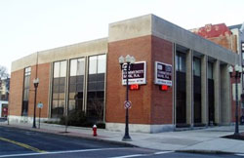

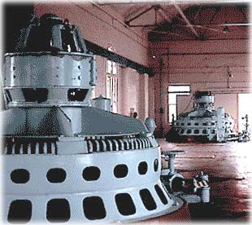
Need Broad-Based Security Solutions
Over 90% of critical infrastructure
systems/applications owned and
operated by non federal entities.
Key sectors:
  Energy (electrical, nuclear, gas and oil, dams)
  Transportation (air, road, rail, port, waterways)
  Public Health Systems / Emergency Services
  Information and Telecommunications
  Defense Industry
  Banking and Finance
  Postal and Shipping
  Agriculture / Food / Water / Chemical

Slide 15
Enough bad news…
What is the cyber security vision for the future?

Slide 16
The Fundamentals
Combating 21st century cyber attacks requires 21st century
strategies, tactics, training, and technologies…
Integration of information security into enterprise architectures and system life cycle processes.
Unified information security framework and common, shared security standards and guidance.
Enterprise-wide, risk-based protection strategies.
Flexible and agile deployment of safeguards and countermeasures.
More resilient, penetration-resistant information systems.
Competent, capable cyber warriors.

Slide 17
Federal Government Transformation
An historic government-wide transformation for risk
management and information security driven by…
Increasing sophistication and tempo of cyber attacks.
Convergence of national and non-national security interests within the federal government.
Convergence of national security and economic security interests across the Nation.
Need unified approach in providing effective risk-based cyber defenses for the federal government and the Nation.

Slide 18
Joint Task Force Transformation Initiative
A Broad-Based Partnership —
National Institute of Standards and Technology
Department of Defense
Intelligence Community
  Office of the Director of National Intelligence
  16 U.S. Intelligence Agencies
Committee on National Security Systems

Slide 19
Unified Information Security Framework
The Generalized Model
Unique Information Security Requirements
The “Delta”
Intelligence Community
Department of Defense
Federal Civil Agencies
C
N
S
S
Private Sector
State/Local Govt
Foundational Set of Information Security Standards and Guidance
  Risk management (organization, mission, information system)
  Security categorization (information criticality/sensitivity)
  Security controls (safeguards and countermeasures)
  Security assessment procedures
  Security authorization process
Common Information Security Requirements
National security and non national security information systems

Slide 20
Enterprise-Wide Risk Management
Multi-tiered Risk Management Approach
Implemented by the Risk Executive Function
Enterprise Architecture and SDLC Focus
Flexible and Agile Implementation
STRATEGIC RISK FOCUS
TACTICAL RISK FOCUS
TIER 1
Organization
(Governance)
TIER 2
Mission / Business Process
(Information and Information Flows)
TIER 3
Information System
(Environment of Operation)

Slide 21
Characteristics of Risk-Based Approaches
(1 of 2)
Integrates information security more closely into the enterprise architecture and system life cycle.
Promotes near real-time risk management and ongoing system authorization through the implementation of robust continuous monitoring processes.
Provides senior leaders with necessary information to make risk-based decisions regarding information systems supporting their core missions and business functions.

Slide 22
Characteristics of Risk-Based Approaches
(2 of 2)
Links risk management activities at the organization, mission, and information system levels through a risk executive (function).
Establishes responsibility and accountability for security controls deployed within information systems.
Encourages the use of automation to increase consistency, effectiveness, and timeliness of security control implementation.

Slide 23
Risk Management Process
Assess
Respond
Risk
Monitor

Slide 24
Risk Management Framework
Starting Point
CATEGORIZE Information System
Define criticality/sensitivity of information system according to potential worst-case, adverse impact to mission/business.
MONITOR
Security Controls
SELECT Security Controls
Continuously track changes to the information system that may affect security controls and reassess control effectiveness.
Select baseline security controls; apply tailoring guidance and supplement controls as needed based on risk assessment.
Security Life Cycle
AUTHORIZE Information System
IMPLEMENT Security Controls
Determine risk to organizational operations and assets, individuals, other organizations, and the Nation;
if acceptable, authorize operation.
Implement security controls within enterprise architecture using sound systems engineering practices; apply security configuration settings.
ASSESS
Security Controls
Determine security control effectiveness
(i.e., controls implemented correctly, operating as intended, meeting security requirements for information system).

Slide 25
Defense-in-Depth
Links in the Security Chain: Management, Operational, and Technical Controls
Risk assessment
Security planning, policies, procedures
Configuration management and control
Contingency planning
Incident response planning
Security awareness and training
Security in acquisitions
Physical security
Personnel security
Security assessments and authorization
Continuous monitoring
Access control mechanisms
Identification & authentication mechanisms
(Biometrics, tokens, passwords)
Audit mechanisms
Encryption mechanisms
Boundary and network protection devices
(Firewalls, guards, routers, gateways)
Intrusion protection/detection systems
Security configuration settings
Anti-viral, anti-spyware, anti-spam software
Smart cards
Adversaries attack the weakest link…where is yours?

Slide 26
How do we deal with the advanced persistent threat?

Slide 27
Cyber Preparedness
HIGH
THREAT LEVEL 5 | CYBER PREP LEVEL 5
THREAT LEVEL 4 | CYBER PREP LEVEL 4
THREAT LEVEL 3 | CYBER PREP LEVEL 3
THREAT LEVEL 2 | CYBER PREP LEVEL 2
THREAT LEVEL 1 | CYBER PREP LEVEL 1
HIGH
Adversary Capabilities
and
Intentions
Defender Security
Capability
LOW
LOW
An increasingly sophisticated and motivated threat requires increasing preparedness…

Slide 28
Dual Protection Strategies
Boundary Protection
Primary Consideration: Penetration Resistance
Adversary Location: Outside the Defensive Perimeter
Objective: Repelling the Attack
Agile Defense
Primary Consideration: Information System Resilience
Adversary Location: Inside the Defensive Perimeter
Objective: Operating while under Attack

Slide 29
Agile Defense
Boundary protection is a necessary but not sufficient condition for Agile Defense
Examples of Agile Defense measures:
  Compartmentalization and segregation of critical assets
  Targeted allocation of security controls
  Virtualization and obfuscation techniques
  Encryption of data at rest
  Limiting of privileges
  Routine reconstitution to known secure state
Bottom Line: Limit damage of hostile attack while operating in a (potentially)
degraded mode…

Slide 30
Defense-in-Breadth
RISK EXECUTIVE FUNCTION
Organization-wide Risk Governance and Oversight
Ongoing Authorization Decisions
Core Missions / Business Processes
Security Requirements
Policy Guidance
Ongoing Authorization Decisions
Security
Plan
Security
Plan
Strategic Risk Management
Focus
Tactical Risk Management Focus
INFORMATION SYSTEM
System-specific Controls
INFORMATION SYSTEM
System-specific Controls
Top Level Risk Management
Strategy Informs
Operational Elements Enterprise-Wide
Security Assessment Report
Security Assessment Report
Plan of Action and Milestones
Hybrid Controls
Hybrid Controls
Plan of Action and Milestones
RISK MANAGEMENT FRAMEWORK
(RMF)
COMMON CONTROLS
Security Controls Inherited by Organizational Information Systems
Security
Plan
Security Assessment Report
Plan of Action and Milestones
Ongoing Authorization Decisions

Slide 31
Security Requirements Traceability
30,000 FT
Legislation, Presidential Directives, OMB Policies
High Level, Generalized, Information Security Requirements
Federal Information Processing Standards
FIPS 200: Minimum Information Security Requirements
FIPS 199: Security Categorization
15,000 FT
5,000 FT
Management Security Controls
Technical
Security Controls
Operational Security Controls
Ground Zero
Information Systems and Environments of Operation
Hardware, Firmware, Software, Facilities

Slide 32
What’s in the game plan moving forward?

Slide 33
Joint Task Force Transformation Initiative
Core Risk Management Publications
NIST Special Publication 800-53, Revision 3
Recommended Security Controls for Federal Information
Systems and Organizations
NIST Special Publication 800-37, Revision 1
Applying the Risk Management Framework to Federal
Information Systems: A Security Lifecycle Approach
NIST Special Publication 800-53A, Revision 1
Guide for Assessing the Security Controls in Federal
Information Systems and Organizations: Building Effective Assessment Plans
Completed
Completed
Completed

Slide 34
Joint Task Force Transformation Initiative
Core Risk Management Publications
NIST Special Publication 800-39
Enterprise-Wide Risk Management: Organization, Mission, and Information Systems View
Projected November 2010 (Public Draft)
NIST Special Publication 800-30, Revision 1
Guide for Conducting Risk Assessments
Projected January 2011 (Public Draft)

Slide 35
Things to Watch in 2011
Major Update of NIST SP 800-53 (Revision 4)
  Security controls for applications (including web apps)
  Security controls for insider threats
  Security controls for advanced persistent threats
  Privacy controls
Applications Security Guideline
Systems and Security Engineering Guideline

Slide 36
Contact Information
100 Bureau Drive Mailstop 8930
Gaithersburg, MD USA 20899-8930
Project Leader Administrative Support
Dr. Ron Ross Peggy Himes
(301) 975-5390 (301) 975-2489 ron.ross@nist.gov peggy.himes@nist.gov
Senior Information Security Researchers and Technical Support
Marianne Swanson Kelley Dempsey
(301) 975-3293 (301) 975-2827
marianne.swanson@nist.gov kelley.dempsey@nist.gov
Pat Toth Arnold Johnson
(301) 975-5140 (301) 975-3247 patricia.toth@nist.gov arnold.johnson@nist.gov
Web: csrc.nist.gov/sec-cert Comments: sec-cert@nist.gov

