Slide 1
Where we are Where we are going
BeNeLux OWASP Day 2011
Seba Deleersnyder Eoin Keary seba@owasp.org eoin@owasp.org
OWASP Foundation Board Members
Notes:
Thx to organizers

Slide 2
Core Mission
The Open Web Application Security Project (OWASP) is a not-for-profit worldwide organization focused on improving the security of application software.
Our mission is to make application security visible, so that people and organizations can make informed decisions about true application security risks.
Everyone is free to participate in OWASP and all of our materials are available under a free and open software license.
Notes:
Open Web Application Security Project (OWASP) is a not-for-profit worldwide organization focused on improving the security of application software. Our mission is to make application security visible, so that people and organizations can make informed decisions about true application security risks.
OWASP is a new kind of organization.
Our freedom from commercial pressures allows us to provide unbiased, practical, cost-effective information about application security.
OWASP is not affiliated with any technology company, although we support the informed use of commercial security technology.
Similar to many open-source software projects, OWASP produces many types of materials in a collaborative, open way.
Everyone is free to participate in OWASP and all of our materials are available under a free and open software license.

Slide 3
Core Values
OPEN Everything at OWASP is radically transparent from our finances to our code
INNOVATION OWASP encourages and supports innovation / experiments for solutions to software security challenges
GLOBAL Anyone around the world is encouraged to participate in the OWASP community
INTEGRITY OWASP is an honest and truthful, vendor agnostic, global community

Slide 4
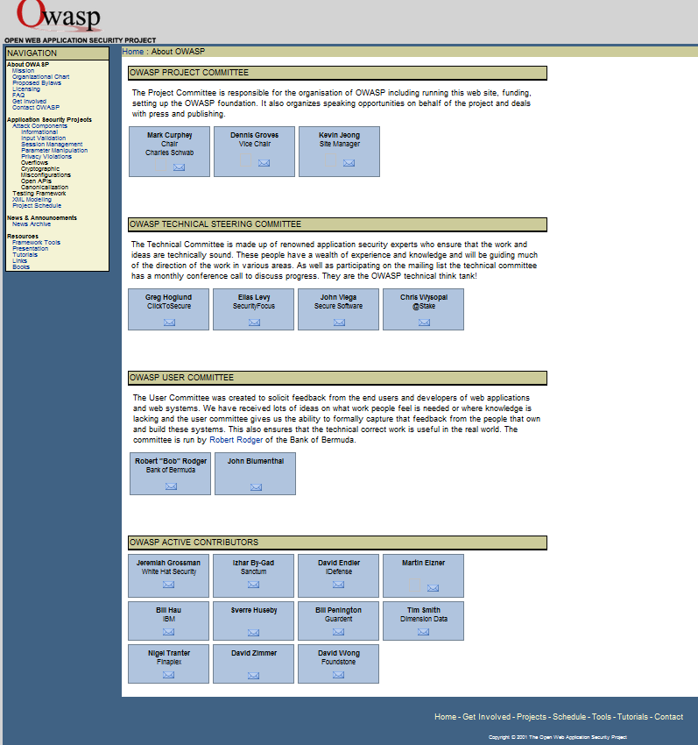
Celebrating 10 years
http://web.archive.org Dec 2011
Notes:
OWASP was started in 2001. This year we celebrate our 10th anniversary.

Slide 5
Numbers
OWASP tools and documentation:
~15,000 downloads (per month)
~30,000 unique visitors (per month)
~2 million website hits (per month)
OWASP community is blossoming worldwide
1500+ OWASP Members in active chapters worldwide
20,000+ participants
Notes:
During the last 10 years OWASP has had a tremendous impact on software security:
Our tools and documents set the standard in our industry
Our community is growing all over the world
Our conferences are making an impact all over the world
Our web site is the authoritative and most up to date source on software security
OWASP and its materials are used, recommended and referenced by many government, standards and industry organizations.

Slide 6
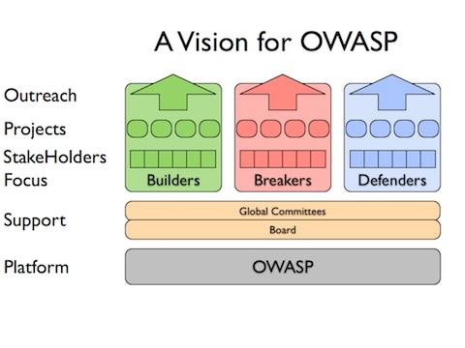
~140 Projects
PROTECT - These are tools and documents that can be used to guard against security-related design and implementation flaws.
DETECT - These are tools and documents that can be used to find security-related design and implementation flaws.
LIFE CYCLE - These are tools and documents that can be used to add security-related activities into the Software Development Life Cycle (SDLC).
Notes:
The reason of OWASP’s existance are our projects.
OWASP is the home of more than 140 projects
Unlike a lot of hacker resources, that focus on breaking software and web sites, OWASP projects focus on buildling secure software.
OWASP tools and documents are used to protect software, to detect security-related design and implementation flaws.
A lot of effort is made to provide tools and documents that can be used in all the stages of the Software Development Life Cycle.
Evolve https://www.owasp.org/index.php/Defenders

Slide 7
New projects – last months
Common Numbering Project
HTTP Post Tool
Forward Exploit Tool Project
Java XML Templates Project
ASIDE Project
Secure Password Project
Secure the Flag Competition Project
Security Baseline Project
ESAPI Objective – C Project
Academy Portal Project
Exams Project
Portuguese Language Project
Browser Security ACID Tests Project
Web Browser Testing System Project
Java Project
Myth Breakers Project
LAPSE Project
Software Security Assurance Process
Enhancing Security Options Framework
German Language Project
Mantra – Security Framework
Java HTML Sanitizer
Java Encoder Project
WebScarab NG Project
Threat Modelling Project
Application Security Assessment Standards Project
Hackademic Challenges Project
Hatkit Proxy Project
Hatkit Datafiddler Project
ESAPI Swingset Interactive Project
ESAPI Swingset Demo Project
Web Application Security Accessibility Project
Cloud ‐ 10 Project
Web Testing Environment Project
iGoat Project
Opa
Mobile Security Project – Mobile Threat Model
Codes of Conduct
Notes:
To give you an idea of how active our community is:
This slide provides you with an overview of new OWASP projects that have been started in the last 6 months

Slide 8
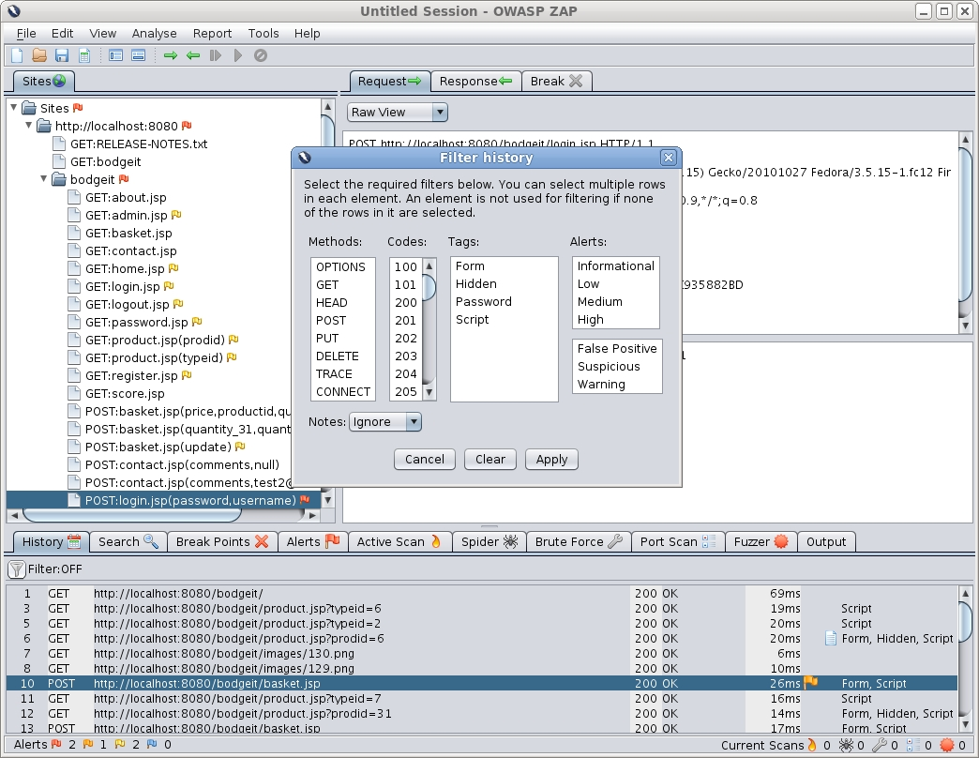
Spotlight
Zed Attack Proxy (ZAP):
Intercepting Proxy
Automated scanner
Passive scanner
Brute Force scanner
Spider
Fuzzer
Port scanner
Dynamic SSL certificates
API
Beanshell integration
5 main coders, 15 contributors
Fully internationalized
Translated into 9 languages: Brazilian Portuguese, Chinese, French, German, Greek, Indonesian, Japanese, Polish, Spanish
Notes:
Zap proxy
Simon bennet

Slide 9
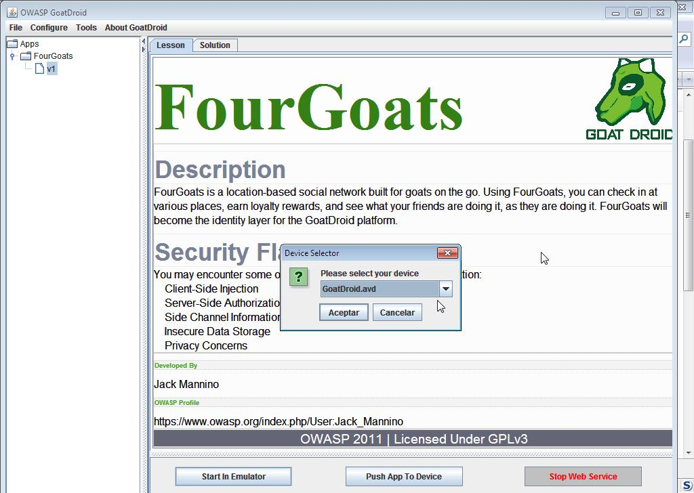
Spotlight
OWASP Mobile Security:
Security testing
Development guidance
Top 10 controls
Mobile threat model
GoatDroid
Top 10 risks
Top 10 Mobile Risks:
Insecure Data Storage
Weak Server Side Controls
Insufficient Transport Layer Protection
Client Side Injection
Poor Authorization and Authentication
Improper Session Handling
Security Decisions Via Untrusted Inputs
Side Channel Data Leakage
Broken Cryptography
Sensitive Information Disclosure
Notes:
OWASP Mobile Project

Slide 10
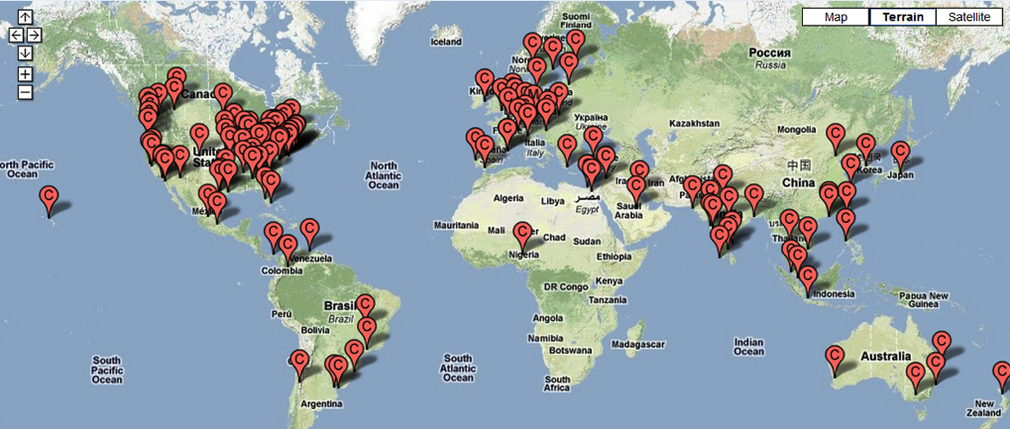
220 Chapters ~ 100 active
Notes:
OWASP chapters are active all over the world.
In the last months a lot of new chapters are started in South America, because of the lastest OWASP conference.
After AppSec Asia conference we will have a similar effect in that region

Slide 11
Conferences
Notes:
Global and regional conferences are growing in number and quality.

Slide 12
“I saw the ‘blossoming’ of OWASP in Portugal’s Spring. From an external viewpoint, OWASP has moved from niche to widely relevant, from localized to global, from pen testing to SDLC, from server to every component of the application’s delivery and use, from InfoSec to business process relevance.” – Colin Watson
Notes:
In February this year OWASP organized the 2011 OWASP Summit.
Over 180 application security experts from over 120 companies and 30 different countries joined forces to plan, build, and execute programs to improve the security of the world’s software applications.

Slide 13
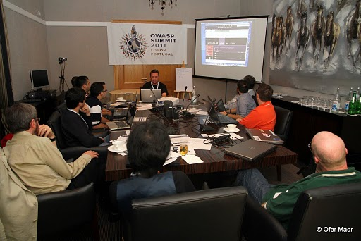
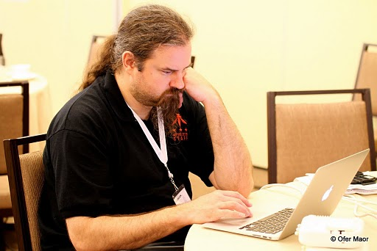
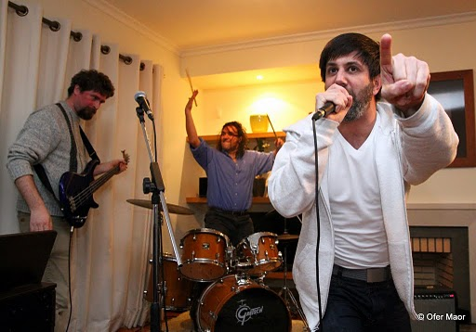
Massive Outreach
OWASP-Portugal Partnership
OWASP Outreach to Educational Institutions
OWASP Industry Outreach
OWASP Browser Security Project
OWASP-Apache Partnership
OWASP Mobile Security Initiative
OWASP Governance Expansion
International Focus
Application Security Programs
Application Security Certification
Notes:
The Summit was a significant step towards OWASP’s mission to ensure all types of organizations are empowered to build, select, and use software applications securely.
OWASP launched and advanced dozens of concrete initiatives to bring application security to governments, educational institutions, browser vendors, standards bodies, software development teams, and mobile platform vendors

Slide 14
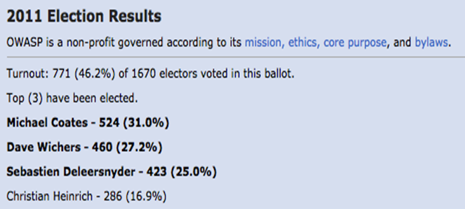
Board Election
OWASP Governance maturing – OWASP updated its Bylaws and worked out procedures for the Board elections. These governance updates support the dynamic and growing OWASP community.
Currently (5) board members are elected.
Notes:
Our governance is maturing and we need to keep up to speed with our dynamic and growing OWASP community.
We have updated our bylaws and the majority of the current board members are now officially elected.
I was re-elected this year on the board: I thank you for your confidence and hope to reach our foundation goals.

Slide 15
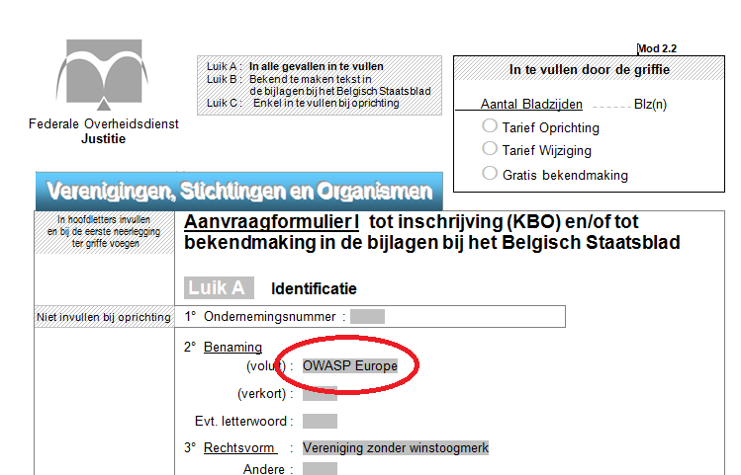
6 June 2011
OWASP Europe non-profit established
Global extension of organisation
Legal & financial support
Notes:
Seba

Slide 16
Global Committees
Notes:
OWASP recognized the extraordinary contribution of our most active leaders by engaging them to lead seven committees that focus on a key aspects of our organization, such as OWASP projects, conferences, local chapters, membership, education and industry outreach.

Slide 17
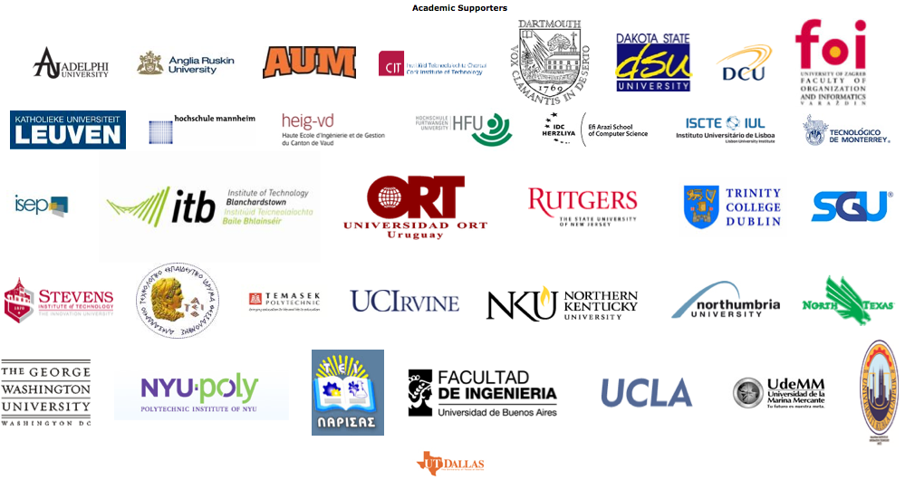
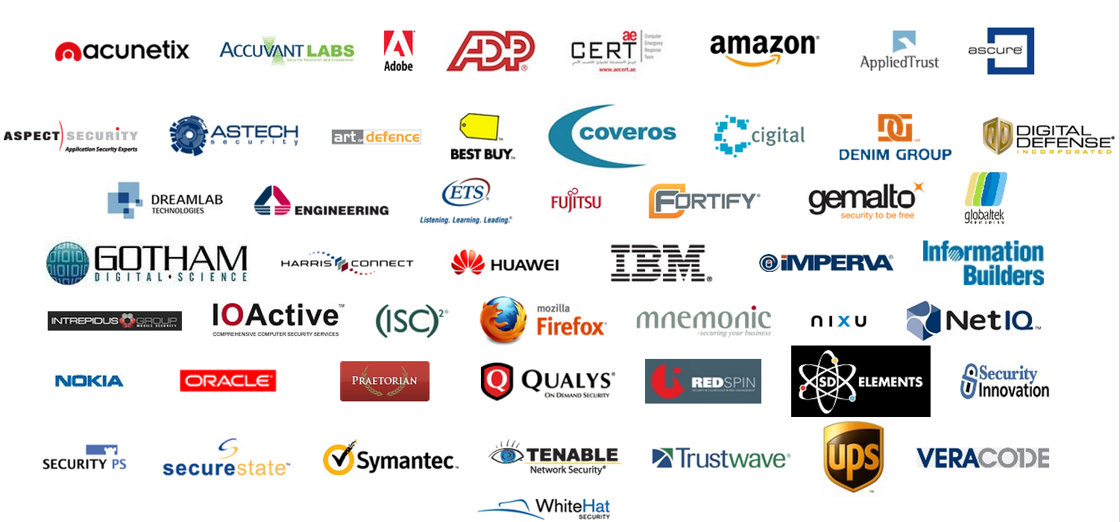
Individual, academic & corporate sponsors

Slide 18
Strategic Goals

Slide 19
2012 Strategic Goals
Build the OWASP platform
Expand communication channels
Grow the OWASP community
Financial stability

Slide 20
OWASP Platform
Define the processes, resources, and tools to enable volunteers to quickly join and contribute to OWASP in the areas of projects, chapters, education, conferences and connections

Slide 21
Communication Channels
Establish effective communication channels into developer groups, universities, and industry groups

Slide 22
OWASP Community
Build and grow the OWASP community throughout the world by focusing on the quality of chapters, conferences, and social technologies

Slide 23
Financial Stability
Further build out a stable financial foundation and create new sources of income for the organisation to achieve the goals of 2012 and future years.

Slide 24
Our Challenge

Slide 25
Application Security Is Just Getting Started
You can’t improve what you can’t measure
We need to…
Experiment
Share what works
Combine our efforts
Expect another 10 years!
Notes:
But, we are still far away from reaching OWASP’s goals: application security is just getting started.
We need get better in our mission and make application security better by making is more measurable.
We need to further experiment, share and combine our efforts to make insecure software something of the past.

Slide 26
Call for action
Start or join your OWASP chapter
Start or join OWASP projects
Translate material (documents, tool interfaces)
Join as member
Become active in OWASP organisation (committees, board election 2013)
Together we will achieve our mission!
Notes:
You can help us achieve the OWASP goals by:
Starting or joining your local OWASP chapter
Starting or join OWASP projects
Translate material (documents, tool interfaces) to your local language
Join as an individual, educational or corporate member
And most of all: become an active member of our OWASP community
I challenge you to achieve our mission together!

Slide 27
Enjoy BeNeLux OWASP Day 2011
Notes:
Feel free to ask questions.
Thank you!

