Slide 1
Web Application Security
Securing the application
Input validation | Session mgmt | Authentication
Authorization | Config mgmt | Error handling
Secure storage | Auditing/logging
Web server
App server
DB server
Firewall
Apps
Firewall
Apps
Database
Host
Host
Host
Securing the network
Router
Firewall
Switch
Securing the host
Patches/updates | Accounts | Ports
Services | Files/directories | Registry
Protocols | Shares | Auditing/logging
Notes:
Note that security is often begun in the network and host boxes, but application security requires work at the top box (application layer)

Slide 2
Web Application Behaviour
HTTP is stateless and hence requests and responses to communicate between browser and server have no memory.
Most typical HTTP requests utilise either GET or POST methods
Scripting can occur on:
Server-Side (e.g. perl, asp, jsp)
Client-Side (javascript, flash, applets)
Web server file mappings allow the web server to handle certain file types using specific handlers (ASP, ASP.NET, Java, JSP,CFM etc)
Data is posted to the application through HTTP methods, this data is processed by the relevant script and result returned to the user’s browser

Slide 3
HTTP POST HTTP GET
“GET” exposes sensitive authentication information in the URL
In Web Server and Proxy Server logs
In the http referer header
In Bookmarks/Favorites often emailed to others
“POST” places information in the body of the request and not the URL
Enforce HTTPS POST For Sensitive Data Transport

Slide 4
GET vs POST HTTP Request
GET request
POST request
GET /search.jsp?name=blah&type=1 HTTP/1.0
User-Agent: Mozilla/4.0
Host: www.mywebsite.com
Cookie: SESSIONID=2KDSU72H9GSA289
<CRLF>
POST /search.jsp HTTP/1.0
User-Agent: Mozilla/4.0
Host: www.mywebsite.com
Content-Length: 16
Cookie: SESSIONID=2KDSU72H9GSA289
<CRLF>
name=blah&type=1
<CRLF>

Slide 5
What are HTTP Headers?
HTTP headers are components of the message header of HTTP Requests and Responses
HTTP headers define different aspects of an HTTP transaction
HTTP headers are colon-separated name-value pairs in clear-text string format, terminated by a carriage return (CR) and line feed (LF) character sequence.
http://en.wikipedia.org/wiki/List_of_HTTP_header_fields

Slide 6
Security HTTP Response Headers
X-Frame-Options
X-Xss-Protection
X-Content-Type-Options
Content Security Policy
Access-Control-Allow-Origin
HTTPS Strict Transport Security
Cache-Control / Pragma
Notes:
// HTTP 1.1
response.setHeader("Cache-Control", "no-store, no-cache, must-revalidate");
// HTTP 1.0
response.setHeader("Pragma","no-cache");
response.setDateHeader("Expires", -1);

Slide 7
Security HTTP Response headers
X-Frame-Options 'SAMEORIGIN' - allow framing on same domain. Set it to 'DENY' to deny framing at all or 'ALLOWALL' if you want to allow framing for all website.
X-XSS-Protection '1; mode=block' - use XSS Auditor and block page if XSS attack is detected. Set it to '0;' if you want to switch XSS Auditor off(useful if response contents scripts from request parameters)
X-Content-Type-Options 'nosniff’ - stops the browser from guessing the MIME type of a file.
X-Content-Security-Policy - A powerful mechanism for controlling which sites certain content types can be loaded from
Access-Control-Allow-Origin - used to control which sites are allowed to bypass same origin policies and send cross-origin requests.
Strict-Transport-Security - used to control if the browser is allowed to only access a site over a secure connection
Cache-Control - used to control mandatory content caching rules

Slide 8
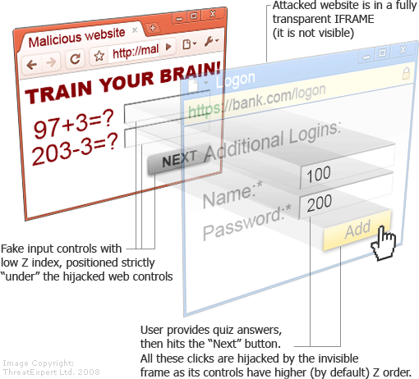
X-Frame-Options
Protects you from most classes of Clickjacking
X-Frame-Options: DENY
X-Frame-Options: SAMEORIGIN
X-Frame-Options: ALLOW FROM
Notes:
save resources since nothing is framed

Slide 9
X-XSS-Protection
Use the browser’s built in XSS Auditor
X-XSS-Protection: [0-1](; mode=block)?
X-XSS-Protection: 1; mode=block

Slide 10
X-ContentType-Options
Fixes mime sniffing attacks
Only applies to IE, because only IE would do something like this
X-Content-Type-Options = ‘nosniff’

Slide 11
Content Security Policy
Anti-XSS W3C standard http://www.w3.org/TR/CSP/
Move all inline script and style into external files
Add the X-Content-Security-Policy response header to instruct the browser that CSP is in use
Define a policy for the site regarding loading of content
Chrome version 25 and later (50%)
Firefox version 23 and later (30%)
Internet Explorer version 10 and later (10%)

Slide 12
Strict Transport Security
Strict-transport-security: max-age=10000000
Do all of your subdomains support SSL?
Strict-transport-security: max-age=10000000; includeSubdomains

Slide 13
Disabling the Browser Cache
Add the following as part of your HTTP Response
Cache-Control: no-store, no-cache, must-revalidate
Expires: -1

Slide 14
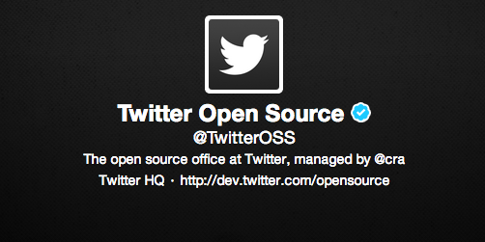
HTTP Security Headers Tool
Secure headers!
Open source
https://github.com/twitter/secureheaders

