Slide 1
AppSec Research 2013 Amsterdam
AppSec Europe 2013
OWASP BeNeLux Candidacy

Slide 2
Local Support Team
Martin Knobloch (Netherlands)
Ferdinand Vroom (Netherlands)
Steven van der Baan (Netherlands)
Jocelyn Aubert (Luxembourg)
André Adelsbach (Luxembourg)
Lieven Desmet (Belgium)
Bart De Win (Belgium)
Seba Deleersnyder (Belgium)
Herbert Bos (University Amsterdam)

Slide 3
Why AppSecEU13 @ Amsterdam?
Supported by 3 strong OWASP chapters: Belgium, Netherlands and Luxembourg
The team members have lots of experience in organizing international and European conferences:
AppSec Europe OWASP BeNeLux Day 2009, 2010, 2011
OWASP AppSec Europe 2008
OWASP AppSec Europe 2006
BruCON
Big, active and influential infosec and appsec community and academic communities
Support from local affiliations: L-SEC, (ISC)², ISSA, ISACA, SecAppDev, BruCON

Slide 4
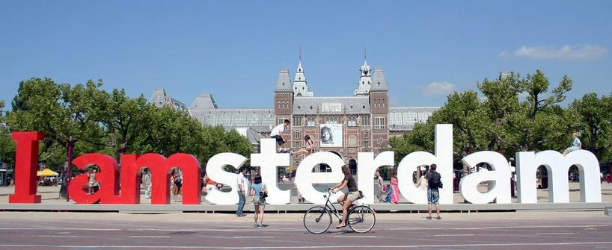
Why AppSecEU13 @ Amsterdam?
Undoubtedly one of the jewels of Europe, and not just because of the stunning 17th century canals.
International world city, rich cultural heritage, diverse and creative culture, commercial dynamism and high quality of life
Easy and comfortable transport, International airport (Schiphol) nearby
Great venue reachability: shuttle/train to the campus
Variety of hotel accommodation nearby
Part of the Euro zone
Notes:
Add hotel costs

Slide 5
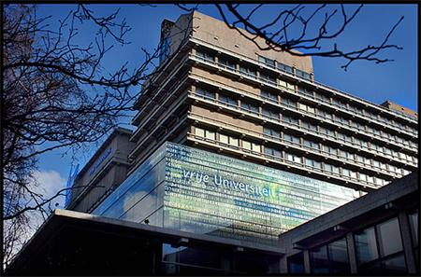
Why AppSecEU13 @ Amsterdam?
Hosted by University of Amsterdam
Support by professor Herbert Bos
Strong academic support in BeNeLux: University of Leuven, Luxembourg and Amsterdam
Will host AppSec Research Track with dedicated AppSec Research Program Committee

Slide 6
Program
3-5 June 2013:
1-, 2- or 3-day trainings
6-7 June 2013:
2 days of triple-track conference
OWASP Builder, Breaker & Defender track
Cybercrime track (Build eco-system with CERTS / European & local government)
AppSec Research track
Vendor Expo in Foyer

Slide 7
Venue
Venue cost for conference:
about € 10000, 3 biggest rooms, including WiFi and Foyer)
Catering cost
about € 50 per person per day
Vendor Expo in Foyer
Special prices can be arranged with hotels nearby http://www.vu.nl/en/about-vu-amsterdam/hotels-in-amsterdam/index.asp

Slide 8
Aula
Main Track
Up to 900 seats
modern audio-visual equipment

Slide 9
Other rooms
Auditorium: Up to 280 seats
Other multi-function rooms available

Slide 10
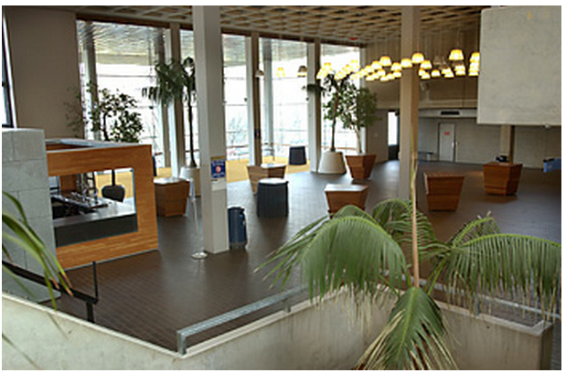
Foyer
Excellent for vendor expo
Up to 600 people
Bar and catering facilities

Slide 11
Promotion
A dedicated conference website
Active promotion through social media and media sponsors
Capture talks on video and push online streaming
Fly in Jim for on-site podcast sessions (Aloha!)

Slide 12
Budget(*)
Income
Conference tickets (160 paid, 164 compl.) | 47.250 EUR
Sponsors | 40.000 EUR
Training tickets (6 trainings, 45 attend.) | 42.000 EUR
TOTAL | 129.250 EUR
Spent
Catering (50 EUR pp/day) | 50.000 EUR
Venue (big & training rooms) | 15.000 EUR
Travel | 5.000 EUR
AV (basic equipment is included in rooms) | 10.000 EUR
Promotion | 5.000 EUR
Misc | 10.000 EUR
Training returns | 16.800 EUR
TOTAL | 111.800 EUR
Balance
Income | 129.250 EUR
Spent | 111.800 EUR
TOTAL NET | 17.450 EUR
(*) conservative budget plan / note: the Netherlands is part of the EURO zone

Slide 13
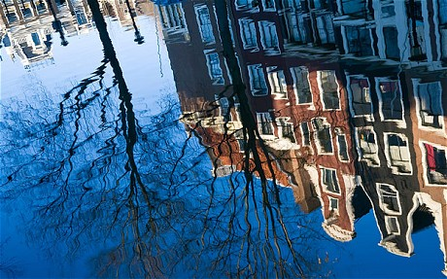
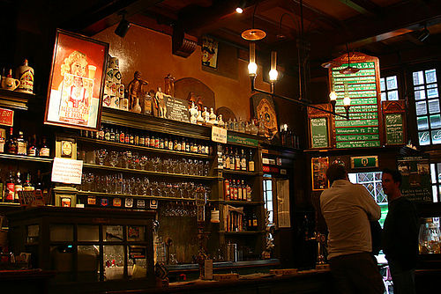
Social Events
Pre-conference social event
Official OWASP Dinner
Guided Tour for the speakers
Notes:
Ervaring toevoegen?

Slide 14
Strong points
Experienced and large local team
Big local OWASP communities
AppSec research track hosted at university (cfr Stockholm)
Cybercrime track (Build eco-system with CERTS / European & local government)
International Hub & attractive city in the heart of Europe
Inexpensive venue & lodging
Track record of positive budget events

Slide 15
Questions?
seba@owasp.org
+32 478 504 117

Slide 16
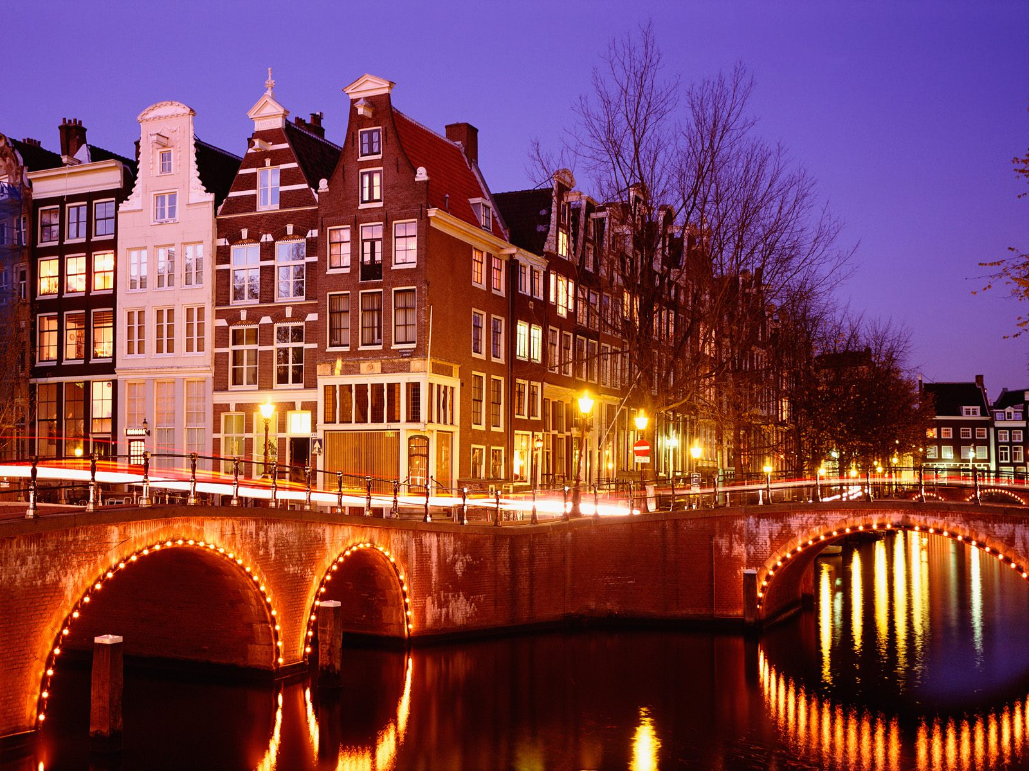
See you next year in Amsterdam!

