Slide 1

Do you… Legal?
OWASP BeNeLux Day
Luxembourg, 2 Dec 2011
Ludovic Petit
Chapter Leader OWASP France
Global Connections Committee Member
Ludovic.Petit@owasp.org

Slide 2

Remember this?

Slide 3

Member of the Tribe
Group Fraud & Information Security Adviser at SFR
Working on Security “Futurology”, Profiling, Behaviors
Paris in the heart, the World in mind. OWASP Folk since 2004
Certified Information Systems Security Professional (CISSP)
Certified Telecommunications Fraud Specialist (CTFS)
Chapter Leader OWASP France
OWASP Global Connections Committee
Contribution to OWASP Projects
TEAM stands for… Together Each Achieves More
Translator of the OWASP Top Ten (All versions)
OWASP Secure Coding Practices - Quick Reference Guide (Keith Turpin)
OWASP Mobile Security Project (Jack Mannino)
OWASP Cloud Top10 Project (Vinay Bensal)

Slide 4
Why this presentation? Why about Legal?
Digital environment, a Connected World, Webification +
Age of Application Security
Age of Network Security
Age of
Anti-Virus
3 web sites on 4 vulnerable to attacks (Source: Gartner)
75% of Attacks at the Application Layer(Source: Gartner)
Important % of sales via the Web (Services, Shop On Line, Self-care)

Slide 5
Once upon a Time…
The Voice of OWASP
We will, we will Rock You!
The Voice of Legal
We will Fall d000wn on You ;-)

Slide 6
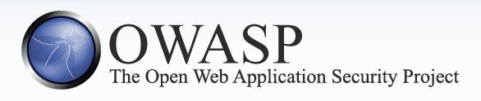
The Open Web Application Security Project (OWASP) is a 501c3 not for-profit worldwide charitable organization (also registered in Europe) focused on improving the security of application software.
Mission
Make application security visible, so that people and organizations
can make informed decisions about true application security risks
Everyone is free to participate in OWASP and all of our materials are available under a free and open software licence.

Slide 7
The OWASP Foundation
OWASP Tools & Documentation
15 000+ downloads (per month)
50 000+ visiteurs (per month)
~2 millions website hits (per month)
200 Chapters around the world
1 500+ OWASP Members
21 000+ Participants
Known everywhere in the world
OWASP AppSec Conferences
New-York , Washington D.C, Chicago, London, Dublin, Brazil, China, Germany, etc.
Portal of Content (www.owasp.org)
100+ Tools Developers
~140 Projects
The largest knowledge base about Web Application Security

Slide 8
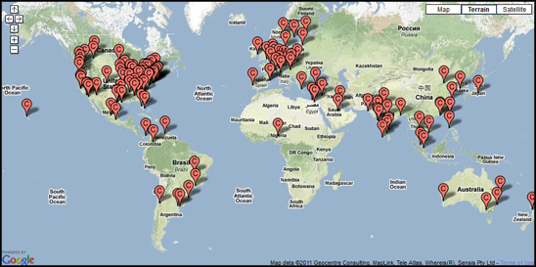
OWASP around the world
203 Chapters, 1 500+ Members, 20 000+ Participants

Slide 9
OWASP Conferences Web Application Security
Sweden
June 2010
Ireland
May 2011
Minnesota
Sept 2011
NYC
Sept 2008
Poland
May 2009
Brussels
May 2008
D.C
Nov2009
Greece
July 2012
Asia
Nov 2011
San Jose
Sept 2010
Israel
Sept 2008
Austin, TX
Oct 2012
Brazil
Oct 2011
Sydney
Mar 2012
Argentina
Nov 2012

Slide 10
~140 OWASP Projects
PROTECT: These are tools and documents that can be used to prevent any security-related design and implementation flaws.
DETECT: These are tools and documents that can be used to find security-related design and implementation flaws.
LIFE CYCLE: These are tools and documents that can be used to add security-related activities into the Software Development Life Cycle (SDLC).

Slide 11
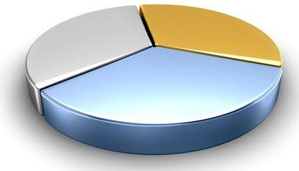
~140 OWASP Projects
Code
Tools
41%
9%
50%
Documentation

Slide 12
OWASP Repository Protect - Detect - Software Development Life Cycle (SDLC)
4 Main Documents
OWASP Top Ten
« The Ten Most Critical Web Application Security Risks »
OWASP Development Guide
OWASP Testing Guide
OWASP Code Review Project
+… OWASP Secure Coding Practices - Quick Reference Guide

Slide 13

The OWASP Top Ten
A1: Injection
A6: Security Misconfiguration
A3: Broken Authentication and Session Management
A4: Insecure Direct Object References
A5: Cross Site Request Forgery (CSRF)
A7: Failure to Restrict URL Access
A10: Insufficient Transport Layer Protection
A2: Cross Site Scripting (XSS)
A9: Insecure Cryptographic Storage
A8: Unvalidated Redirects and Forwards
A1: Injection
A6: Security Misconfiguration
A3: Broken Authentication and Session Management
A4: Insecure Direct Object References
A5: Cross Site Request Forgery (CSRF)
A7: Failure to Restrict URL Access
A10: Insufficient Transport Layer Protection
A2: Cross Site Scripting (XSS)
A9: Insecure Cryptographic Storage
A8: Unvalidated Redirects and Forwards
TOP 10 WEB APPLICATION SECURITY RISKS
TOP 3 WEB APPLICATION SECURITY RISKS
The OWASP Appsec Tutorial Series (Videos)

Slide 14
OWASP Cheat Sheet Series
Authentication Cheat Sheet
Cross-Site Request Forgery (CSRF) Prevention Cheat Sheet
Transport Layer Protection Cheat Sheet
Cryptographic Storage Cheat Sheet
Input Validation Cheat Sheet
XSS (Cross Site Scripting) Prevention Cheat Sheet
DOM based XSS Prevention Cheat Sheet
Forgot Password Cheat Sheet
SQL Injection Prevention Cheat Sheet
Session Management Cheat Sheet
HTML5 Security Cheat Sheet
Web Service Security Cheat Sheet
Application Security Architecture Cheat Sheet
Draft OWASP Cheat Sheets
Draft OWASP Cheat Sheets
PHP Security Cheat Sheet
Password Storage Cheat Sheet
Security Code Review Cheat Sheet

Slide 15










News
a Blog
A Podcast
Membership
Mailing Lists
A Newsletter
Apple App Store
Video Tutorials
Training Sessions
Social Networking

Slide 16
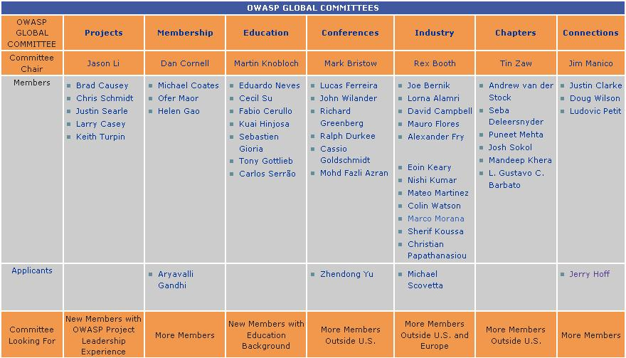
7 Global Committees

Slide 17

OWASP used all around the world

Slide 18
Okidokie, cool, but a couple of questions…
In case of problem, what’s going on from a Legal perspective?
Who could be accountable for what?
Who should be accountable for what?
Who would be accountable for what?
In fact, who is accountable for what?
Not an easy challenge isn’t it?...

Slide 19
The 8th Element (the 8th OSI Layer), the Human factor
Your Company
Your Business
Customers
Government
Regulator

Slide 20
Let’s go Back to the Future
…The OWASP Legal Project (2006)
Initiated by Jeff Williams, OWASP Chair

Slide 21
The OWASP Secure Software Contract Annex
ANNEX: Intended to help software developers and their clients negociate important contractual terms and conditions related to the security of the software to be developped or delivered.
CONTEXT: Most contracts are silent on these issues, and the parties frequently have dramatically different views on what has actually been agreed to.
OBJECTIVE: Clearly define these terms is the best way to ensure that both parties can make informed decisions about how to proceed.
https://www.owasp.org/index.php/OWASP_Secure_Software_Contract_Annex

Slide 22
… strongly suggested, but it’s ‘only’ a 1st step. Don’t stop at this Annex!

Slide 23
Stakes of Security: Status
The legal risk is a consequence of operational risk
The business risk is in fact induced by the informational risk
Information Systems Security aims four main objectives:
Availability
Data Integrity
Confidentiality
Non repudiation
The risk assessment of information systems can make it possible to reduce both business and legal risks

Slide 24
Computer-related Offenses
Computer-related offenses relate to
The Hacker: Criminal responsability++
… Employees, but also the Company itself:
Employee: Criminal responsibility within the framework of its daily mission
The Employer: Criminal and civil liability of its employees

Slide 25
Computer-related Offenses according the Penal Code (France)
Fraudulent access and maintaining in an Information System (Art. 323-1 C. Pénal)
Obstacle to the functioning of an information system (Art. 323-2 C. Pénal)
Fraudulent introduction of data into an information system (Art. 323-3 C. Pénal)

Slide 26
Computer Crimes
Legal risks in connection with the fraudulent use of Information Systems
Reminder
Any Commercial Web Application Service
is part of an Information System
Why?
Because we are talking about Information Security,
which means… Legal Compliance!

Slide 27
European Convention on Cyber Crime
Came into force in Jul 2004
Council of Europe adopted a Convention on Cyber Crime that identified and defined internet crimes:
Offenses against the Confidentiality, Integrity and Availability of computers, data and systems (illegal access, illegal interception, data interference, system interference, misuse of devices)
Computer-related Offenses (computer-related forgery, computer-related Fraud)
Content-related Offenses (offenses related to child pornography)
Offenses related to infringements of copyright and related rights

Slide 28
Directors Responsability
All organisations need to be aware of the Convention’s provisions in Article 12, Paragraph 2:
‘Ensure that a legal person can be held liable where the lack of supervision or control by a natural person… has made possible the commission of a criminal offenses, established in accordance with this Convention’.
In other words, Directors can be responsible for offenses committed by their organisation simply because they failed to adequately exercise their duty of care.
The Organisation of American States (OAS) and APEC have both committed themselves to applying the European Convention on Cyber Crime. More that seventy (70) countries have enacted.

Slide 29
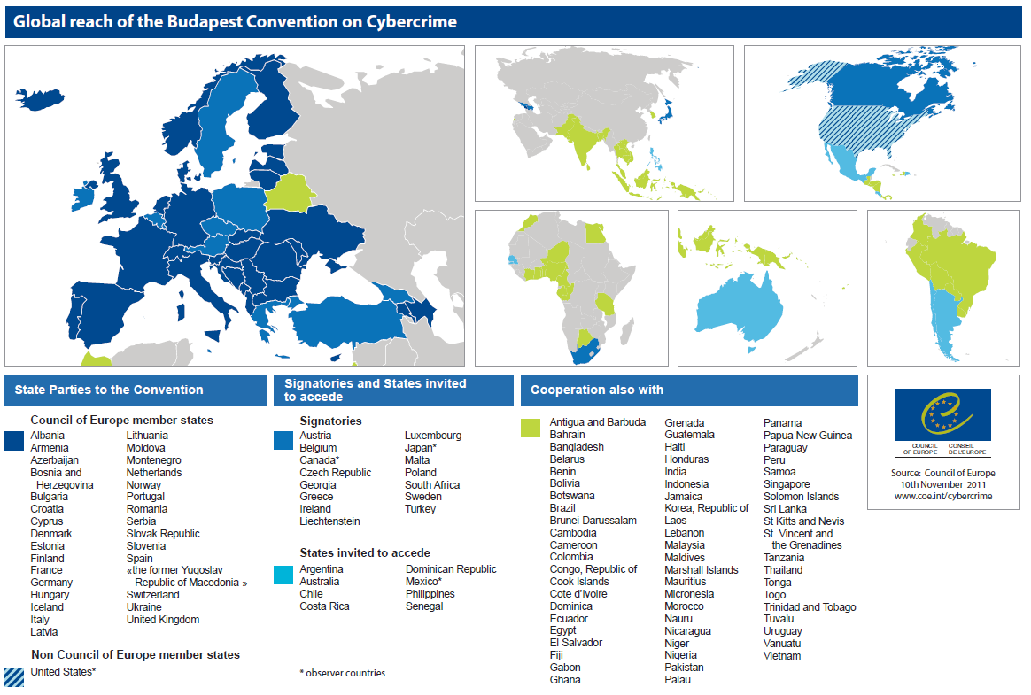

Slide 30
Which leads to… Privacy
France
Belgium
Netherlands
Luxembourg
CNIL (Commission Nationale Informatique et Liberté) www.cnil.fr
CPVP/CBPL (Commission de la Protection de la Vie Privée/Commissie voor de Bescherming von de Persoonlijke Levenssfeer) www.privacycommission.be
CBP (College Bescherming Persoonsgegevens) www.cbpweb.nl
CNPD (Commission Nationale pour la Protection des Données) www.cnpd.public.lu

Slide 31
Privacy & Information Security CNIL (FRANCE)
The Responsible of the Data Processing is required to take any useful precautions, au regard de la nature des données et des risques présentés par le traitement, pour préserver la sécurité des données et, notamment empêcher qu’elles soient déformées, endommagées ou que des tiers non autorisés y aient accès (Article 34 de la loi).
Article 226-17 du Code Pénal : Le fait de procéder ou de faire procéder à un traitement de données à caractère personnel sans mettre en œuvre les mesures prescrites à l'article 34 de la loi n° 78-17 du 6 janvier 1978 précitée est puni de cinq ans d'emprisonnement et de 300 000 Euros d'amende.

Slide 32
What is this obligation?
Take any useful precautions
In regard of the nature of Data
And the risks presented by the Processing
To preserve data security and, in particular, prevent that they are
Modified
Tampered
Or that unautorized third parties have access

Slide 33
Privacy Security within the Enterprise
The CEO is criminally responsible of the Data Processing
France: Obligations under the law of 6 Jan 1978 (modified in 2004)
Criminal Risk in case of Delegation of Authority
… for each person part of the Chain!
What about subcontracting
Enterprise: Data owner = Accountable
Subcontractor: Data processor = Accountable

Slide 34
Issues for the Enterprise Consequences
All these acts can have serious consequences for the Company
Financial Consequences
Consequences on the Reputation
Criminal Consequences for the Executives
Consequences on the Sustainability of the Company

Slide 35
Issues for the Enterprise Criminal Consequences (FRANCE)
Article 226-17 of the Penal Code also charges the disclosure of information… to the spyed!
The Entreprise (i.e. the Spyed) is responsible of consequences caused to third parties
The people « accountable » (of Security, or the CTO, even the CEO) can be personally involved (obligation of result), without prejudice to individual suits (non-compliance with the Corporate Information Security Policy…)
Law Godfrain - Penalty: 2 months to 5 years / 300 € to 300 K€
Protection of informations / Negligence: 5 years / 300 K€

Slide 36

Who are the victims?
Potentially almost all companies,
… including yours!

Slide 37
State of California, USA Data breach
California was the first state in USA to enact such a law.
California Senate Bill No. 1386 became effective on 1st July 2003, amending Civil Codes 1798.29, 1798.82 and 1798.84. It is a serious bill, with far reaching implications.
Essentially, it requires an agency, person or business that conducts business in California and owns or licenses computerized 'personal information' to disclose any breach of security (to any resident whose unencrypted data is believed to have been disclosed).
The statute imposes specific notification requirements on companies in such circumstances.
The statute applies regardless of whether the computerized consumer records are maintained in or outside California.

Slide 38
European Directive 2009/136/EC
DIRECTIVE 2009/136/EC OF THE EUROPEAN PARLIAMENT AND OF THE COUNCIL
of 25 November 2009
amending Directive 2002/22/EC on universal service and users’ rights relating to electronic communications networks and services, Directive 2002/58/EC concerning the processing of personal data and the protection of privacy in the electronic communications sector and Regulation (EC) No 2006/2004 on cooperation between national authorities responsible for the enforcement of consumer protection laws.
Article 2 (2) (4) (c) adds a requirement to notify Security breaches to “National Authority” and to those affected by this vulnerability, at least if the flaw is “likely to affect negatively” their personal data

Slide 39
Security Flaws
Is there an obligation to notify in case of Security Breach?
Answer: YES!
From the Responsible of the Data Processing with respect to the people concerned
From the Subcontractor with respect to the Responsible of the Data Processing
What about BeNeLux?
Ensure about Law Enforcement and the transposition of the European Directive 2009/136/EC

Slide 40
What about France?
Article 38 de l’ordonnance du 24 août 2011 : l’obligation d’une notification des failles de sécurité
«En cas de violation de données à caractère personnel, le fournisseur de services de communications électroniques accessibles au public avertit, sans délai, la Commission nationale de l'informatique et des libertés. Lorsque cette violation peut porter atteinte aux données à caractère personnel ou à la vie privée d'un abonné ou d'une autre personne physique, le fournisseur avertit également, sans délai, l'intéressé. »
Penalties in case of breach of the duty to report under the juridiction of the CNIL
150 K€
300 K€ for repeat offenses
Brand Impact!
Possibility of publication of the CNIL’s decision

Slide 41
What about BeNeLux?
Transposition of the Directive 2009/136/EC of the European Parliament and the Council of November 25th, 2009
into Belgian law
into Dutch law
into Luxembourg law
Ensure about the current Law Enforcement and the transposition of the European Directive 2009/136/EC

Slide 42
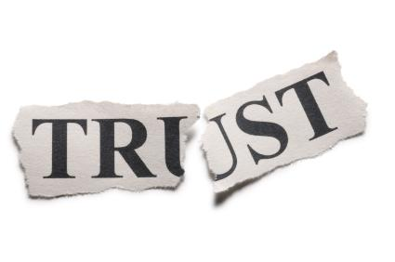
… Impact on the Business (including Brand)

Slide 43
We must learn to Think Differently
Security needs Proactivity.
To be Proactive… you will need to Anticipate
Think Security as Anticipation
Security as a Service
and …
Trust as a Business!
It's just a personal opinion ;-)

Slide 44

So, to sum up…
Who is accountable for what?
You could be accountable
But in fact, you guys are accountable
Each of us in this room is accountable

Slide 45
Last but not least, an Advice
TEAM stands for… Together Each Achieves More
Try to ‘bridge the gap’ between both your Legal and IT Departments
Organize meetings once a year to have an update about the evolution of the Legal framework related to Information Security (for your business)
Will allow everyone to have a better understanding of the challenges for the company
Will allow your company to optimize the internal value-added (i.e. YOU) for increasing its competitive advantage!

Slide 46
“If you think education is expensive,
try ignorance!”
Abraham Lincoln

Slide 47
Questions?
The OWASP Foundation
https://www.owasp.org
Thank you!

