Slide 1

The Security of SSL
Itsik Mantin
F5 ASM Team April 2014

Slide 2
Outline
Crypto Background
SSL/TLS
Attacks on SSL

Slide 3
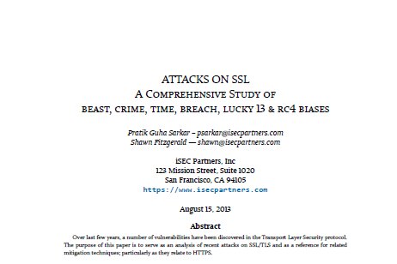
https://www.isecpartners.com/media/106031/ssl_attacks_survey.pdf

Slide 4
Outline
Crypto Background
SSL/TLS
Attacks on SSL

Slide 5



Cryptography Functions
Encryption
c=E_{K}(m)
ciphertext
D_{K}(c) = m
Enc
Dec
m
plaintext
EK
encryption key
Eavesdropping
Adversary
DK
decryption key
Authentication
m, s
Signed message
Check(m, s)
True/False
Sign
Ver
m
Plaintext
SK
Signature key
Tampering
Adversary
VK
Verification key

Slide 6
Symmetric vs. Asymmetric Cryptography
Asymmetric
≠
Symmetric
Encryption Key = Decryption Key
Signature Key = Verification Key
≠
Encryption
Authentication
Symmetric-Key Encryption
Message Authentication Code
Asymmetric-Key Encryption
Digital Signature
Symmetric
Asymmetric

Slide 7
Encryption
Authentication
Block Ciphers
DES (56-bit key; 8-byte block)
AES (128-bit key; 16-byte block)
…
Stream Ciphers
RC4 (40-2048-bit key)
…
HMAC (from hash function)
CBC-MAC (from block cipher)
CMAC (ditto)
RSA (1024+ bit keys)
El-Gamal (same as RSA)
Elliptic Curve Cryptography (200+ bit keys)
…
RSA (1024+ bit keys)
El-Gamal (same as RSA)
Elliptic Curve Cryptography (200+ bit keys)
…
Algorithms
Symmetric
Asymmetric

Slide 8
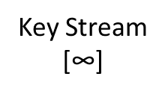
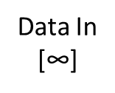
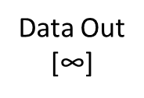
Block Ciphers and Stream Ciphers
Block Ciphers
Stream Ciphers
Key Expansion
Key Expansion
IV
[16]
Key
[16]
Key
[16]
Data In
[16]
Key
[16]
Data In
[$\text{∞}$]
Round Key
[16]
Key Expansion
Key Expansion
Diffusion
Data Out
[16]
State [16]
State [16]
State [16]
Key Stream
[$\text{∞}$]
Data Out
[$\text{∞}$]

Slide 9
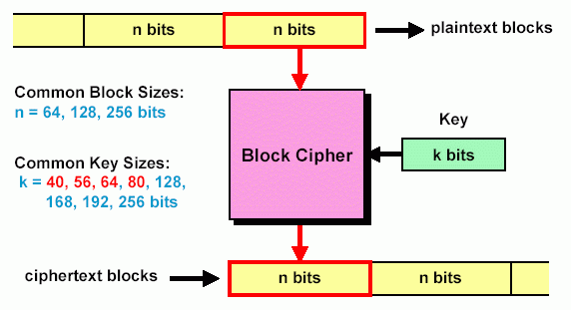
Block Cipher
Divide input bit stream into n-bit sections, encrypt only that section
In a good block cipher, each output bit is a function of all n input bits and all k key bits

Slide 10
Using Block/Stream Ciphers
Block Ciphers
Mode of operation:
How to encrypt more/less than blocksize bytes?
Key Derivation:
How to encrypt multiple messages (NEVER USE SAME KEY TWICE)
Stream Ciphers
ECB/CBC/OFB/CTR/…
Combine secret key with modifier IV (serial/random/timestamp) to get one-time keys
GCM (authenticryption)

Slide 11
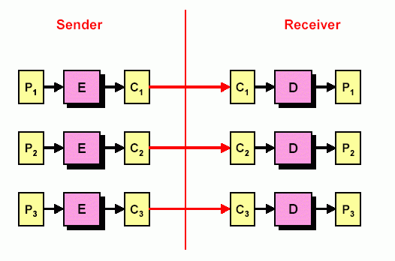
Encryption Mode (ECB)
Electronic Code Book (ECB) mode for block ciphers of a long digital sequence

Slide 12
ECB Leak

Slide 13
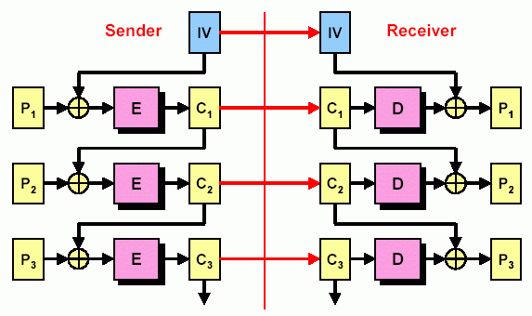
Encryption Mode (CBC)
Cipher Block Chaining (CBC) mode for block ciphers
Identical Plaintext prefix ➔ Identical Ciphertext prefix

Slide 14
SSL Ciphers
“100% Secure”
AES
RC4
Stream cipher (Never use same key twice)
Significant statistical weaknesses
DES/TDES, Camellia, RC2
Not recommended
In all conventional attack models
Time complexity of best attack:
2^{126.1} (!!!)

Slide 15

Conventional Attack Models
Plaintext
Ciphertext
Ciphertext
Plaintext
Known Plaintext Attack
Chosen Plaintext Attack
Chosen Ciphertext Attack
Adaptive Chosen Ciphertext Attack
Attacker knows some plaintexts and their encryption (under same key)
Attacker chooses plaintexts and sees their encryption (under same key)
Attacker chooses ciphertexts and see their decryption (under same key)
Same + attacker can change the chosen ciphertexts after seeing some corresponding plaintexts

Slide 16
Crytptanalysis Rule #1
(ALMOST) ANY LEAK OF
SECRET INFO CAN BE
AGGREGATED INTO AN
EFFECTIVE ATTACK

Slide 17
Asymmetric Key Cryptography
Idea
Authentication
What: Encryptor cannot Decrypt
Keys: 400 bits – 2048 bits
What: Verifier cannot Sign
Encryption
Sender/receiver have different “power”
Decryption > Encryption
Signature > Verification
Algorithms: RSA, ECC, El-Gamal
Key Exchange
Diffie-Hellman
Used when: Browser encrypts data for www.amazon.com
Used when: You-name-it
Algorithms: same as encryption
Keys: same as encryption

Slide 18
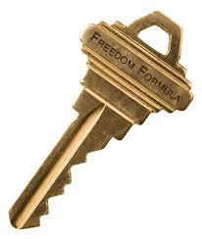
Public Key Cryptosystem
Public
Key
Cipher Text
Secret
Key
Plain Text
Cipher Text
Plain Text
E
Network
D
Trusting public keys
Inductive trust:
I trust public keys verifiable by public keys I have (CA keys; web server key)
(aka Chain of Trust)
I trust public keys I have (CA keys)
Notes:
Pictorially we mean by public key cryptosystem is shown in this slide.

Slide 19
Certificate
an entity’s description (name, type, etc.)
+ entity’s public key
+ expiration date, serial number, etc.
+ CA’s name
+ a signature issued by a CA
Notes:
Notes:

Slide 20
Certificates
Only Trusted Certificate Authorities (CAs) are ”allowed” to create/modify certificates
Certificates allows:
  Clients to authenticate servers
  Servers to authenticate clients (when used)
  Key exchange without Public Key Server
Chain-of-trust
Certificate Revocation List

Slide 21
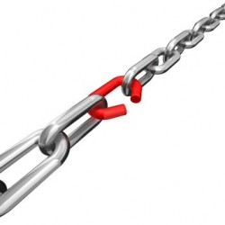
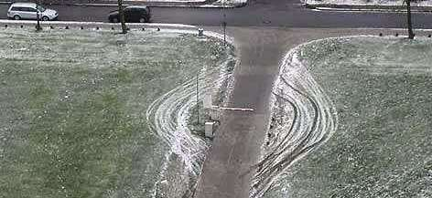
Security Rule #1
THE CHAIN IS AS STRONG
AS ITS WEAKEST LINK

Slide 22
Outline
Crypto Background
SSL/TLS
Attacks on SSL

Slide 23
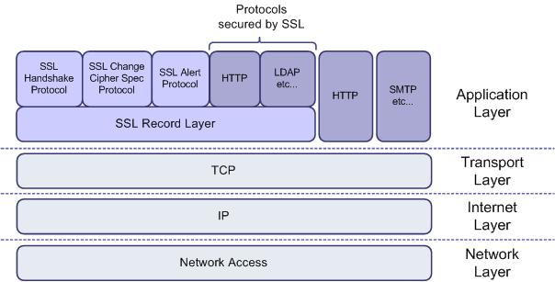
What is SSL?

Slide 24
SSL and TLS
SSL
TLS 1.0 (RFC 2246, 1999) enhances SSL3.0.
TLS 1.1 (4346, 2006) mitigates CBC attacks
TLS
Developed by Netscape for https communication
Most servers implement SSL3.0 and TLS1.0
Adoption
SSL 3.0 (RFC 6101) released in 1996.
TLS 1.2 (5246, 2008) removes weak algorithms and backward compatibility flaws
TLS1.1 and TLS1.2 have <35% adoption in servers
Latest versions of browsers support TLS1.1/2 (sometimes disabled by default)

Slide 25
SSL Objectives
Guarantees
Even in case of
(Client identification)
Data protection (Encryption and Signature)
Web server Identification
Eavesdropping passive attackers
Active Man-in-the-Middle attackers

Slide 26
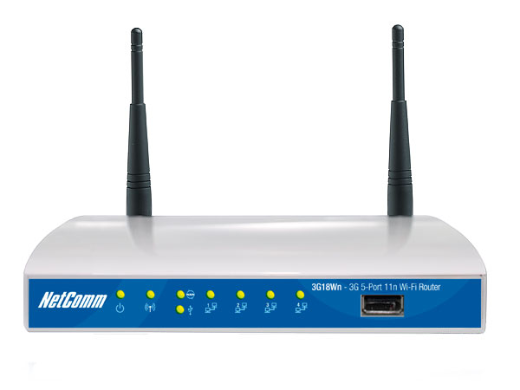
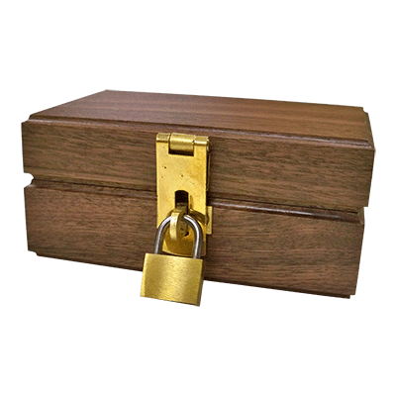
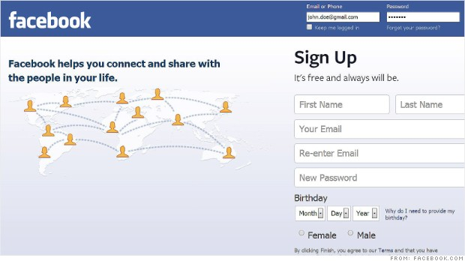

Man-in-the-Middle
ACTIVE
SSL Client
SSL Server
DNS
Poisoning
alice.wonder@gmail.com
Alice123!
alice.wonder@gmail.com
Alice123!
Browser
Web Application

Slide 27
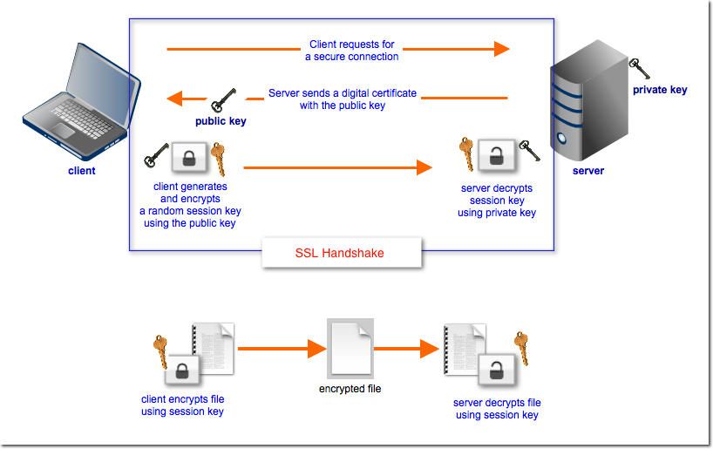
SSL HowStuffWorks (file transfer)

Slide 28
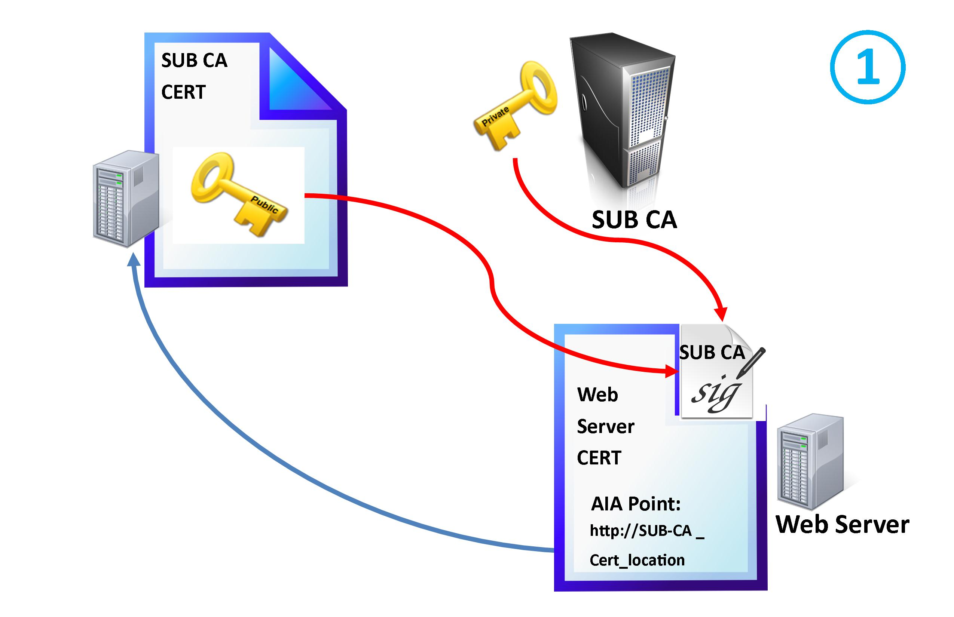
SSL Certificates

Slide 29
Server Identification Security
Algorithms
Authenticator
Verify certificate chain-of-trust (CA flag, continuity)
Verify Certificate Authenticity (signature)
Hash Function
Digital signature
Verify host identity

Slide 30
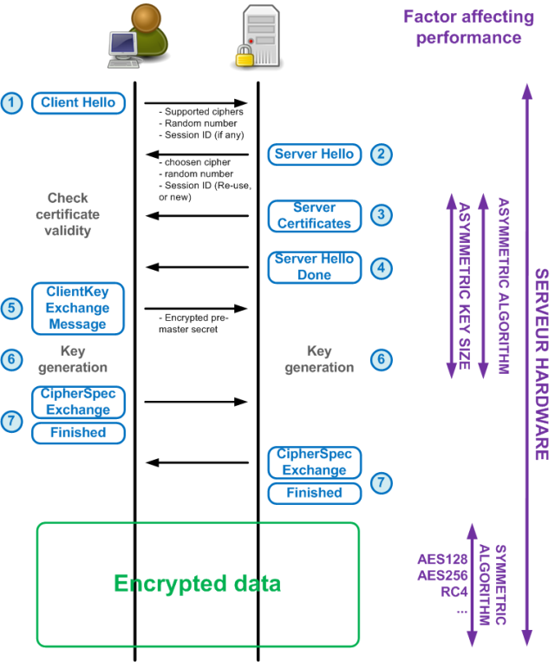

Slide 31
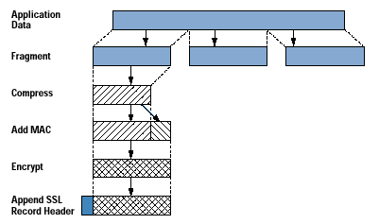
SSL-Protected Data

Slide 32
Record Protocol Security
Algorithms
Authenticator
MAC
Encryption

Slide 33
Outline
Crypto Background
SSL/TLS
Attacks on SSL

Slide 34
Hash Collision Attack - Background
2004
Collisions found for X509 certificates with different CA Flag
2008
Efficient MD5 collision finding algorithm
Many Collisions are found
Including Structured Collisions

Slide 35

Hash Collision Attack
Certificate
Authority (CA)
CERT_{A}
Build site certificate CERT_{A} and CA certificate CERT_{B} with same hash
Ask CA to sign CERT_{A}
And thus get signature on CERT_{B}
CERT_{A}
Sig
CERT_{CA}
CERT_{A}
CERT_{B}
CERT_{CA}
CERT_{GOOGLE}
CERT_{B}
CERT_{CA}
CERT_{GOOGLE}, CERT_{B}
Hello Google!!!
Verify CERT_{CA}
Verify CERT_{B}
Verify B is a CA
Verify CERT_{GOOGLE}
Trust connection
NEVER USE MD5!!!!!

Slide 36
“Validating SSL Certificates in Non-Browser Software” or Host Verification Attack
CERT_{DEVIL}
CERT_{DEVIL}
CERT_{DEVIL}
Sig
CERT_{DEVIL}
HOST=GOOGLE, CERT_{DEVIL}
Hello Google!!!
USE HOST NAME VERIFICATION!!!!!
Verify CERT_{DEVIL}
NEVER COMPARE HOST TO CERT

Slide 37
The Most Dangerous Code in the World: Validating SSL Certificates in Non-Browser Software (Boneh et-al)
Faulty authenticators (not browsers)
OpenSSL: Hostname verification must be managed by the application itself, or by data-transport wrapper (ex. cURL)
“The primary cause of these vulnerabilities is the developers’ misunderstanding of the numerous options, parameters, and return values of SSL libraries.”
Paper shows applications that depend on standard SSL libraries such as JSSE, OpenSSL, GnuTLS, etc. often accomplish SSL Certificate Validation incorrectly or not at all.
See http://www.cs.utexas.edu/~shmat/shmat_ccs12.pdf

Slide 38

SSL Security
Black-box Assumption
Verify certificate chain-of-trust (CA flag, continuity)
Verify Certificate Authenticity (signature)
Hash Function
Digital signature
Verify host identity
MAC
Encryption

Slide 39
Recent SSL Attacks
Padding Oracle
Browser Exploit Against SSL/TLS (BEAST)
Compression Ratio Info-leak Made Easy (CRIME)
Time Info-leak Made Easy (TIME)
LUCKY13
RC4
Browser Reconnaissance and Exfiltration via Adaptive Compression of Hypertext (BREACH)

Slide 40
HSR Model
Plaintext
Ciphertext
Ciphertext
Plaintext
NO ALGORITHM GUARANTEES ANY SECURITY IN THE HSR MODEL
Plaintext is a combination of secret info and known info (under same key)
(Header + Secret + Random)

Slide 41
HSR Attack
Chosen/Known
The Secret
Random (unknown)
H*
S*
R
C*
H₀
S*
R₀
C₀
H₁
S*
R₁
C₁
H₂
S*
R₂
C₂
H₂₅₅
S*
R₂₅₅
C₂₅₅
16 bytes
S*[0]=x if C*==C_{X}
Requires:
* SAME KEY
* SAME SECRET S*
* HSR
1 byte

Slide 42
Padding Oracle Attack
Target Ciphertext
Dummy Ciphertext
OK/NOK
Dummy Ciphertext
OK/NOK
Dummy Ciphertext
OK/NOK
Oracle “tells” the attacker whether or not a plaintext is properly structured (usually padded)
FACT: NO ALGORITHM GUARANTEES ANY SECURITY IN THE PADDING ORACLE MODEL

Slide 43
The Attack Setup
HttpOnly
Application Server
(2) Session
Cookie
User
(1) Login
(3) Request
DNS Poisoning, or open (malicious) Wifi
Cross-Site Scripting (XSS)
Non-https Response

Slide 44
BEAST (Browser Exploit Against SSL/TLS)
Fact
Man in the Middle (MiiM)
Man in the Browser (MiiB)
The attack
How it works
Arrange for known plaintext (after XOR with predicted chaining value) H to be combined with one character of unknown data in one block
HSR attack with known/predicted IV
Requires
The CBC IV for each record (except first) is the previous records' last ciphertext
Fixed key, fixed secret

Slide 45
BEAST Countermeasures
SOP
TLS 1.1/1.2
Randomize IV
Key refresh
Same origin policy
Uses GCM mode of operation (authenticryption)
Send empty MAC record + MAC
Use RC4

Slide 46
CRIME (Compression Ratio Info-leak Made Easy)
Fact
Advanced HSR attack
The attack
Man in the Browser (MiiB)
Man in the Middle (MiiM)
Fixed key, fixed secret
Requires
Compression ratio depends on similarity of data “segments”
Thus ‘ababab’ compresses better than ‘ababac’ (DEFLATE/gzip)
Encryption algorithms don’t claim to hide data length

Slide 47
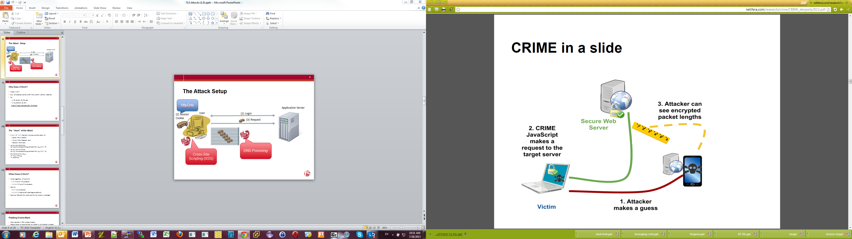

Slide 48
CRIME (Compression Ratio Info-leak Made Easy)
Disable compression
Countermeasure
Attacker crafts the known message part (H)
Use H of the form “ABC*ABC”
“ABCDABC”
“ABCEABC”
“ABCFABC”
….
How it works
Following compression, the size indicates the “similarity” of H to S
Regardless of cipher (!!!) AES/RC4
Attacker keeps request length close to packet boundaries
If S starts with “X”, “ABCXABC” will give better compression ratio

Slide 49
TIME (Time Info-leak Made Easy)
Facts
Man in the Browser (MiiB)
Fixed key, fixed secret
Requires
Compression ratio depends on similarity of data “segments”
Thus ‘ababab’ compresses better than ‘ababac’ (DEFLATE/gzip)
Encryption algorithms don’t claim to hide data length
The attack
Client-only CRIME (compression-based HSR)
May work also on compressed responses (assuming user input reflection)

Slide 50
TIME (Time Info-leak Made Easy)
Disabling compression
Countermeasure
Attacker sends HSR compressed messages to server
How it works
Attacker concludes compressed message size (number of packets) through time of response
Attacker keeps messages length (requests/responses) close to packet boundaries
Server-side countermeasures

Slide 51
Server-Side Countermeasures
Length Hiding
Masking Secrets
Monitoring
Adding garbage value to the compressed response
Use one-time random values to mask secrets
Rate-Limiting, statistics collection

Slide 52
BREACH (Browser Reconnaissance and Exfiltration via Adaptive Compression of Hypertext)
Fact
Disabling compression
Countermeasure
Attacker sends crafted inputs to server
How it works
Compression-based HSR on the response
The attack
Man in the Browser (MiiB)
Fixed key, fixed secret
Requires
Responses may include secret info
HSR!!!
Responses may also include request info (reflection, e.g., in forms)
Server embeds crafted inputs with secret data in response and then compresses the response
Attacker concludes secret data info from compressed message size
Server-side countermeasures

Slide 53
LUCKY13
Padding Oracle Attack
MAC verification is used to prevent padding oracle attack
MAC verification is done only on properly padded messages
Timing analysis indicates padding success
Padding Oracle Attack

Slide 54
LUCKY13
Seems to be impractical
Countermeasure
Attacker builds many dummy ciphertexts (from the target ciphertext), sends to the server and measures response time
Fixed secret (no assumption on key)
A target ciphertext
Requires
Complexity: 2²³ (8 million) TLS sessions(!!)
Access to the server
How it works

Slide 55
2012/2013
As a result of the CRIME/BEAST attacks, experts started to recommend using RC4 instead of AES
As a stream cipher, RC4 never uses the same key twice
RC4?????

Slide 56
RC4 Weaknesses
RC4 Initialization
When encrypting the same message with many RC4 keys, message parts leak (in particular the first bytes)
The Common Practice
Message Exposure Attack
Throw away the first generated hundreds of bytes
Known to be problematic
First hundreds of bytes are biased.
Second byte bias: double probability for being 0
Distinguishers of less than a million keystreams
Leaks key info into the stream (WEP)
Not done in SSL

Slide 57
RC4 Attack on SSL
Use AES
Countermeasure
MiiB initiates many messages
Statistical attack on the plaintext
The attack
Man in the Middle (MiiM)
Requires
How it works
Make the browser send many messages, e.g., MiiB
MiiM collects statistics until plaintext is recovered
Fixed secret (no assumption on key)
Works also for varying key!

Slide 58
Summary
 | Target | Example | Based on | Timeline
Padding Oracle | Steal request payload | Session cookie | Padding Oracle model | Somewhere in the 1990’s
Browser Exploit Against SSL/TLS (BEAST) | Steal request payload | Session cookie | HSR model | Described in 2002 (led to TLS1.1), demonstrated in 2011
Compression Ratio Info-leak Made Easy (CRIME) | Steal request payload | Session cookie | HSR model | Described in 2002, demonstrated in 2011
Time Info-leak Made Easy (TIME) | Steal response payload | CSRF token Session Cookie | HSR model | Demonstrated in 2012
LUCKY13 | Steal request payload | Session cookie | Padding Oracle model | Demonstrated in 2012
RC4 | Steal request payload | Session cookie | Cryptographic weakness | Demonstrated in 2013
Browser Reconnaissance and Exfiltration via Adaptive Compression of Hypertext (BREACH) | Steal response payload | CSRF token |  | Demonstrated in 2013

Slide 59

Heartbleed

Slide 60
SSL Heartbeats
RFC6520
used to keep a connection alive without the need to constantly renegotiate the SSL session

Slide 61
The Vulnerability
What?
Attackers can grab 64K chunks of memory contents
Not in application layer
Where?
What else?
In openssl memory region near the SSL heartbeat
When?
As long as the server accepts heartbeat messages, i.e., ANYTIME!!!!
As many times as the attacker likes!!!!
Attacker leaves no trails

Slide 62
Vulnerable Info (from worse to worst)
Sensitive Data
Short-lived Keys
Private data
Access control data
Session cookies
Session identifiers
Encryption keys
Holy grail
Record protection keys
Private crypto keys
Usernames and Passwords

Slide 63
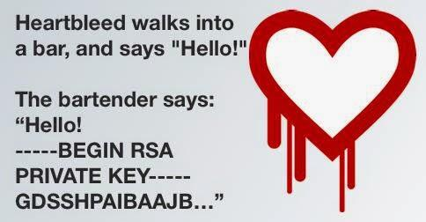
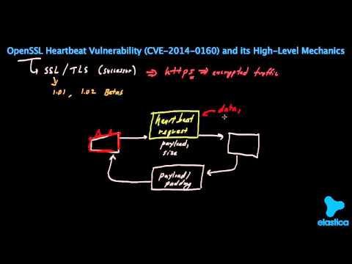
How?

Slide 64
CVE-2014-0160
Bug was introduced into OpenSSL version 1.0.1 code (beginning of 2012)
Non-affected versions: <= 1.0.0
Affected version 1.0.1 through 1.0.1f
Bug discovered in April 2014
Patched in 1.0.1g

Slide 65
Recovery is a Headache
Update openssl version (easy)
Replace all secret info that could have been exposed (how?)
  Certificates private keys
  User passwords

Slide 66
References
Attacks On Ssl: A Comprehensive Study Of Beast, Crime, Time, Breach, Lucky 13 & Rc4 Biases
https://www.isecpartners.com/media/106031/ssl_attacks_survey.pdf
The Most Dangerous Code in the World: Validating SSL Certificates in Non-Browser Software
http://www.cs.utexas.edu/~shmat/shmat_ccs12.pdf
TLS (Wikipedia)
http://en.wikipedia.org/wiki/Transport_Layer_Security
Heartbleed:
http://heartbleed.com/
Padding Oracle Attack (Wikipedia):
http://en.wikipedia.org/wiki/Padding_oracle_attack
RC4 (Wikipedia)
http://en.wikipedia.org/wiki/RC4

Slide 67
Q & A
Find me in Linkedin
http://www.linkedin.com/in/imantin

