Slide 1
OWASP
Update 6-March-2012
OWASP Belgium
Chapter
Seba Deleersnyder
        Foundation Board, SAIT Zenitel Belgium
  seba@owasp.org

Slide 2
Agenda
Introduction
OWASP Near You

Slide 3
Introduction

Slide 4


OWASP World
OWASP is a worldwide free and open community focused on improving the security of application software.
Our mission is to make application security visible so that people and organizations can make informed decisions about application security risks.
Everyone is free to participate in OWASP and all of our materials are available under a free and open software license.
The OWASP Foundation is a 501c3 not-for-profit charitable organization that ensures the ongoing availability and support for our work.
Notes:
REMEMBER… OWASP IS JUST PEOPLE
You are all probably familiar with OWASP, so I’d like to take this opportunity to share a few metrics and give you an idea of where OWASP is headed.
I’ve been the volunteer chair of OWASP since 2004, and I’ve spent quite a lot of time, effort, and my own money developing the organization. Why do I do all this? Why do I care?
AppSec is about not about tools or technology… it’s about people. OWASP is about community.
______________
4

Slide 5







Thank you
Location / co sponsor OWASP supporter
Sponsors Belgium 2011/2012
OWASP cannot recommend the use of products, services, or recommend specific companies
5
Notes:
5

Slide 6
Program
18h45 – 19h00 OWASP update Seba Deleersnyder
19h00 – 20h00 Common iOS Pitfalls vs. OWASP's iGoat
Ken van Wyk, KRvW Associates
20h00 – 20h15 Break
20h15 – 21h15 Access Control Design Best Practices
Jim Manico, WhiteHat Security
6

Slide 7
OWASP near you

Slide 8

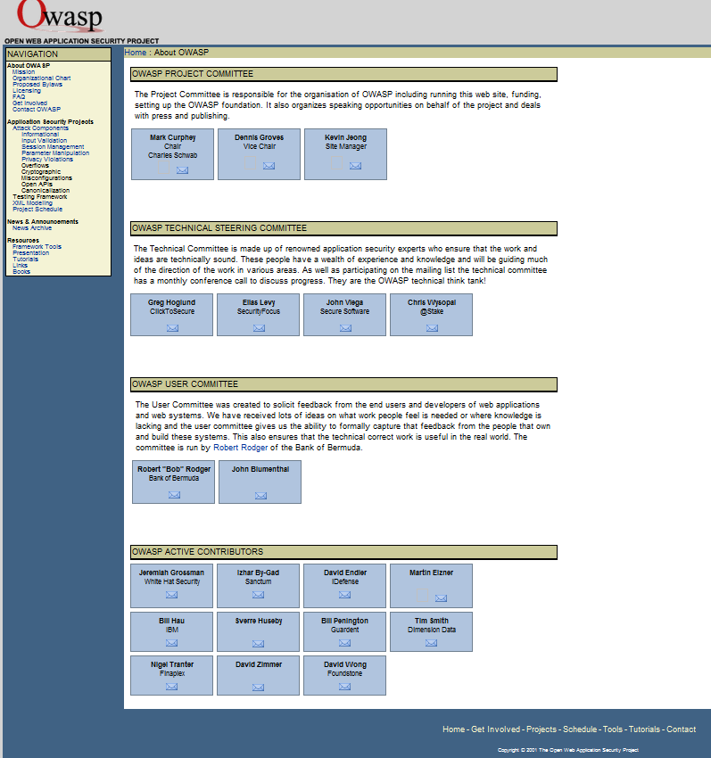
Celebrating 10 years
http://web.archive.org Dec 2011
Notes:
OWASP was started in 2001. This year we celebrate our 10th anniversary.

Slide 9
Next chapter meeting
May / Sep 2012
Topics / speakers / venue suggestions are welcome!

Slide 10

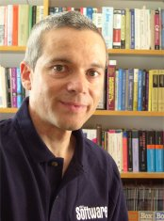
AppSecEU
Keynote: Prof. Diomidis Spinellis, Fatal Injection (and what you can do about it)
CFP: 15-April

Slide 11


BruCON 2012
@brucon: training subjects selected so far : pen testing, exploit development, red team, web app testing, IPv6 security. You like?
@brucon: 16 speaker slots to fill up … CFP ends March 15th ! http://blog.brucon.org/2012/01/cfpcft-is-open-start-submitting-your.html Submit now!

Slide 12
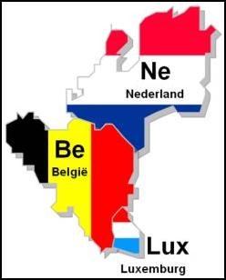
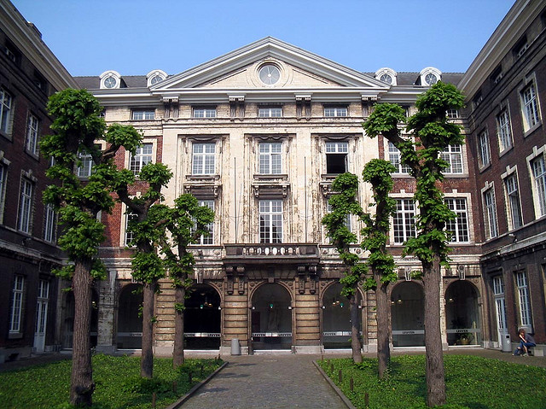
BeNeLux 2012
29-30 november 2012
  One day OWASP Training
  One day conference
College De Valk Leuven
Details to follow...

Slide 13

Subscribe mailing list
www.owasp.be
Keep up to date!
13

Slide 14
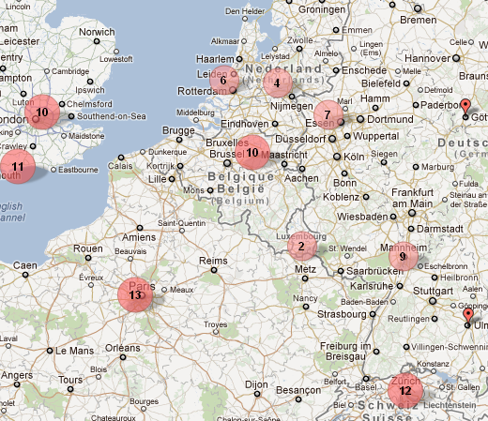
Want to support OWASP?
Become member, annual donation of:
$50 Individual
$5000 Corporate
Enables the support of OWASP projects, mailing lists, conferences, podcasts, grants and
global steering activities…
http://batchgeo.com/map/4f35033fd964eb692a5268d81d15e18c
14

