Slide 1
Learning Web Application Firewall – Benefits and Caveats
Dariusz Pałka Pedagogical University of Cracow
dpalka@up.krakow.pl Marek Zachara
University of Science and Technology (AGH) Cracow
mzachara@agh.edu.pl

Slide 2
Outline
Introduction – why we need extra security mechanisms for Web Applications
Learning Web Appliaction Firewall
Implementation
Learning WAF architecture
Data models used
Results
Summary

Slide 3
Introduction
72% of interviewed companies had their websites/applications hacked during the preceeding 24 months. Most successful attacks happen on the application layer (Barracuda Networks)
Web application vulnerabilities outnumber browser/OS vulnerabilities by ratio 1:10 (Microsoft Security Intelligence Report)
„More than 13% of all reviewed sites can be completely compromised automatically. About 49% of web applications contain vulnerabilities of high risk level (Urgent and Critical) detected during automatic scanning. However, detailed manual and automated assessment by a white box method allows to detect these high risk level vulnerabilities with the probability reaching 80-96%”. (Web Application Security Consortium)

Slide 4
Introduction
Unfortunately, governmental websites and applications are no exception. The access details are available for sale on the black market.

Slide 5
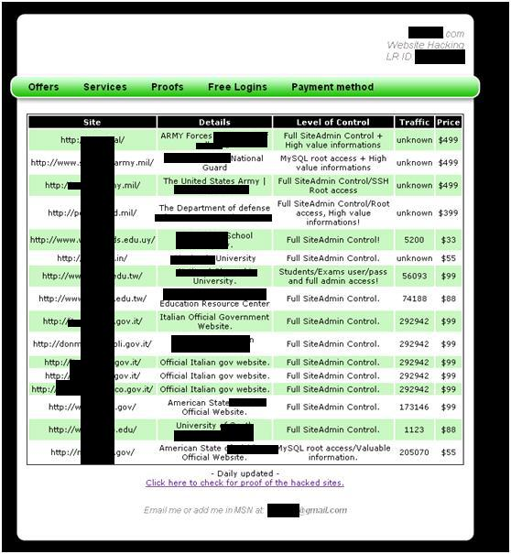
(source: blog.imperva.com)

Slide 6
Web Application Architecture

Slide 7
Common Attack Methods Against Web Applications
Script injections (especially SQL Injections)
Parameter tampering
Forceful browsing
Cross-site scripting

Slide 8
Security Levels

Slide 9
Rule-based Web Application Firewalls
Problems (disadvantages)
Difficulties in configuring a WAF
Duplication of protection rules
Constant adjustment of WAF rules

Slide 10
Learning Web Application Firewall
Black Box
WAF

Slide 11
Learning Patterns
Triggered (supervised) learning (TL)
Benefits:
No need to consider the data retention period size.
No need to store all historical data.
Resistant to attacks targeting its learning process.
Drawabacks
The learning process must be completed
A WAF must be manualy re-trained after changes in protected appliaction

Slide 12
Learning Patterns
Continuous (unsupervised) learning (CL)
A WAF will only accept parameter values that match recent users’ behavior patterns
The firewall may be susceptible to specially engineered attacks that target its learning process

Slide 13
Implementation
WAF is implemented as Apache Server module
The analysis of incoming POST and GET parameters
Data analysis is conducted on the basis of a multi model approach - similar to the one presented by Giovani Vigna (University of California) and Christopher Krugel (Technical University Vienna)

Slide 14
WAF Architecture
Client
Server
Req.
processing
CORE_IN
SSL_IN
Request
Data Validator
HTTP_IN
Data Validator
Data Collector
Model Generator
Data Decryptor / Encryptor
Req.
Data
Store
Data Models

Slide 15
Length of Parameter Values
Some attack attempts, such as cross-site scripting, directory traversal and buffer overflow, contain long character sequences, which might significantly exceede the number of characters in legitimate requests, and this feature allows for their easy detection.

Slide 16
Length of Parameter Values
Chebyshev's inequality: $P\left(\left|x−E\left(x\right)\right|≥ ε\right)≤ \frac{var(x)}{ε^{2}}$
where:
E(x) – expected value of x var(x) – variance of x
$ε>0$
If: $x≡l$(length of parameter value) $ε≡ \left|lobs−E\left(l\right)\right|$ where: $lobs$ – currently observed parameter value length
We obtain: $P\left(\left|l−E(l)\right|≥\left|lobs−E(l)\right|\right)≤\frac{var(l) }{{\left|lobs−E(l)\right|}^{2}}≝\tilde{p} (lobs)$

Slide 17
Length of Parameter Values
E(l)=14.97
var(l)= 6.25
E(l)=15.06
var(l)= 5.99
E(l)=15.15
var(l)= 13.02
E(l)=17.71
var(l)= 124.66

Slide 18
Length of Parameter Values
If $$\tilde{p} \left(lobs\right)=\frac{var(l) }{{\left|lobs−E(l)\right|}^{2}}≥1 \\ \overset{⇒}{}$$ $lobs≤E\left(l\right)+\sqrt{var(l)}≝lmax$ and $lobs≥E\left(l\right)−\sqrt{var(l)}$ $≝l_{min}$
Attacks cannot be detected

Slide 19
Belonging to Predefined Classes
Examples of classes of parameter values defined with the use of regular expressions:
A whole number with or without a sign (e.g. 123, +56, -78) ^[+-]?(0)|([1-9]\d*)$
A dot separated real number (e.g 123, 12.3, .3) ^([0-9]+\.[0-9]*)|([0-9]*\.[0-9]+)|([0-9]+)$
A comma separated real number ^([0-9]+,[0-9]*)|([0-9]*,[0-9]+)|([0-9]+)$
An email address (e.g. somebody@example.org) ^[A-Z0-9._%+-]+@[A-Z0-9.-]+\.[A-Z]{2,4}$
The US currency (e.g. $0.59, $1050, $2,596.99) ^\$(\d{1,3}(\,\d{3})*|(\d+))(\.\d{2})?$
Http(s) URL (e.g http://example.org, https://example.org/test/abc) ^https?\://[a-zA-Z0-9\-\.]+\.[a-zA-Z]{2,3}(/\S*)*$
One word ^[a-zA-Z]+$
A simple text ^[a-zA-Z0-9.!?,;”’- \t\n]+$

Slide 20
Belonging to Predefined Classess
Learning
If all values from a learning set belong to k-th regular expression class, this class is added to set C (parameter constrains set) $C=\{c_{1},c_{2},…,c_{n}\}$
Testing
The observed value is tested if it belongs to classes $c_{1},c_{2},…,c_{n}$ - the number of classes (from set C) to which the observed value belongs is i
$p_{c}=\frac{i}{n}$

Slide 21
The Character Distribution
For every character ${ch}_{k}$in parameter values (from a learning set) we calculate an expected value of relative frequency ${E(fr}_{chk})$ and variance of relative frequences ${var(fr}_{chk})$
${fr}_{i,chk}$ (relative ${ch}_{k}$ character frequency in i-th parameter value) = number of occurences ${ch}_{k}$ character in i-th parameter value / length of i-th parameter value

Slide 22
The Character Distribution

Slide 23
The Character Distribution

Slide 24
The Character Distribution
Testing
for every character ${ch}_{k}$:
$$P\left(ch_{k}\right)= \left\{\begin{matrix}\tilde{P}\left(ch_{k}\right) if\tilde{ P}\left(ch_{k}\right)<1 \\ 1 if\tilde{ P}\left(ch_{k}\right)≥1\end{matrix}\right.$$
$$P\left(ch\right)=\prod_{k}{P(ch_{k})}$$

Slide 25
Parameter Structural Inference
Structural inference may help if simple models described earlier are not sufficient
In this approach the structure of legitimate parameter values is modelled as a regular language
We use Hidden Markov Model to describe this regular language

Slide 26
Ergodic HMM

Slide 27
Parameter structural inference
Definitions
O^{(k)} = O^{(k)}₁O^{(k)}₂…O^{(k)}_{N} – k-th observation sequence
λ = (A,B,π) – HMM model
$P(O|\text{λ}\text{)=}\prod_{k=1}^{K}{P(O^{\left(k\right)}|\text{λ})}$
Learning - adjusting the model parameters λ to maximize $P(O|\text{λ}\text{)}$
Baum-Welch algorithm (finds the local minima of the likelihood function)
Generating k HMMs with a number of states from 2 to sqrt(N), where N is the number of characters in the longest observation sequence
A, B and π matrices are randomly initialised
The HMM with max($P(O|\text{λ}\text{) ) }\text{are} \text{chosen}$

Slide 28
Parameter Structural Inference
Testing
O_{obs} = O₁O₂…O_{N} – observation sequence (from incoming requests)
Calculate P(O_{obs}|$\text{λ}$) using Forward-Backward Procedure ($P\left(O_{obs}\right| \text{λ}\text{) = }\sum_{i=1}^{N}{α_{T}(i)}$)

Slide 29
Anomaly Detection
After defining particular models, we can determine the anomaly score for an observed parameter value
$$Anomaly score= \frac{1}{n}\sum_{m ∈Models}{ (1−P_{m})}$$ where: $P_{m}$ - probability of an observed parameter value for a given model m
n – number of models

Slide 30
Results
Dataset
3 independent production Web Servers
10 total web applications
3853 parameters analysed with a total number of values 527070
Attack queries
73 queries collected from our Web Servers
12 queries selected from „HTTP-delivered attacks against web servers” Database (http://www.i-pi.com/HTTP-attacks-JoCN-2006/)

Slide 31
Results

Slide 32
Types of Attacks Found by WAF
Examples of attack attempts found by our Learning WAF (in parameter values):
../../../../../../../../../../../../../../../../../../../../../../../etc/passwd (Directory Traversal)
phpinfo(); (Parameter Tampering)
' or 1=1 – (SQL Injection)
//phpMyAdmin2/config/config.inc.php (Forceful Browsing)
/../../winnt/system32/logfiles/w3svc1/ex000121.log
cd /tmp;rm -rf font-nix;wget 67.58.79.162/font-nix;perl font-nix

Slide 33
Summary
Benefits of a Learning WAF
Can be easily extended with new Data Models to improve security
Requires minimal configuration efforts
Can be a supplement for exisiting security systems
Still TO DO…
Add data models that take into consideration correlations between parameters in a request (not to treat each parameter as a single one)
Improve structural inference (B-W algorithm in a current form is time-consuming, which may be a problem in production enviroments with high traffic)
Improve support for a request context (e.g. try to detect and utilse session IDs)

Slide 34
THANK YOU

