Slide 1
Integrating Security in Application Development
20 August 2009
Jon C. Arce – jonarce@microsoft.com

Slide 2
Agenda
What is the SDLC?
  In the beginning
  Waterfall to Agile Methodologies
  Scrum
  Roles (Security)
Security Development Lifecycle
  Microsoft SDL
  Phases to incorporate
  How are the software giants doing?
Threat Models
  What is STRIDE?
  What is DREAD?
  Microsoft Application Threat Modeling
How to justify?
  Statement
  Economic Impact

Slide 3
Agenda
What is the SDLC?
  In the beginning
  Waterfall to Agile Methodologies
  Scrum
  Roles (Security)
Security Development Lifecycle
  Microsoft SDL
  Phases to incorporate
  How are the software giants doing?
Threat Models
  What is STRIDE?
  What is DREAD?
  Microsoft Application Threat Modeling
How to justify?
  Statement
  Economic Impact

Slide 4
Definition of SDLC
A software development process is a structure imposed on the development of a software product. Synonyms include software life cycle and software process.
There are several models for such processes, each describing approaches to a variety of tasks or activities that take place during the process.
Security should be one of those activities / tasks

Slide 5
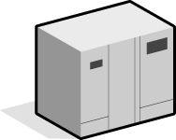
In the beginning …
Waterfall Model
Requirements
Where was security?
Design
Implementation
Verification
Each phase “pours over” into the next phase.
Notes:
On classical monolithic systems security was integrated into the Operating system and its components. Security of the fortress.
And then they add Physical Security secure the mainframe.
Security: Every mainframe customer that I spoke to recognizes that mainframe security has never been successfully hacked. One big reason for this is that mainframe architecture has fewer entry points (points of attack)-as well as the highest commercial server security rating in the world.

Slide 6
Security and the System Development Lifecycle
There are three important aspects of computer security in relation to the systems development lifecycle:
Security must be considered from the first phase of the systems lifecycle.
Development of computer security is an iterative process. The identification of vulnerabilities and the selection and implementation of safeguards continue as the system progresses through the phases of the lifecycle, including after the system has been released into production.
3. All computer security considerations should be documented in the standard systems development lifecycle documents.

Slide 7
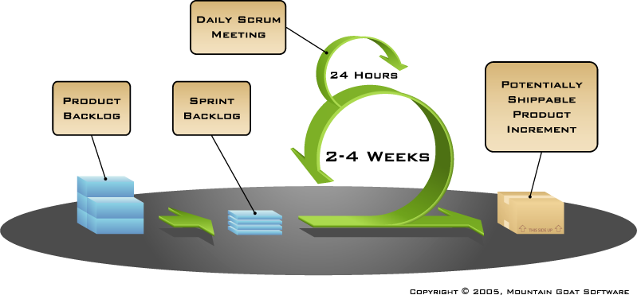
Present times …
Agile - Scrum
Security
Notes:
We try to be the lest invasive possible and just integrate 2x formal steps that does not alterate :
we integrate Security requirements
We formalize security testing as acceptance requirement
We respect the controlled chaos inside the development cycle/ Now the outcome will depend on the knowledge on the development team about security.

Slide 8
Roles from Generalist to Specialist
Project Manager
  Business Project Owner
  Development Manager
  Business Analyst
Architect
  Solution Architect
  Infrastructure Architect
  Database Architect
  Integration Architect
Developer
  Senior
    Business Objects & Entities
  Junior
    UI / Web Interface
Integration Developer
  EAI / SOA
Database Developer
  DB schema / Reports
  Business Intelligence
Tester
  Product Quality
  Performance
Security Analyst
Model Consultant
Notes:
This model doesn’t work as well. Since it make the Security Analyst the ONLY responsible for SECURITY in the project.

Slide 9
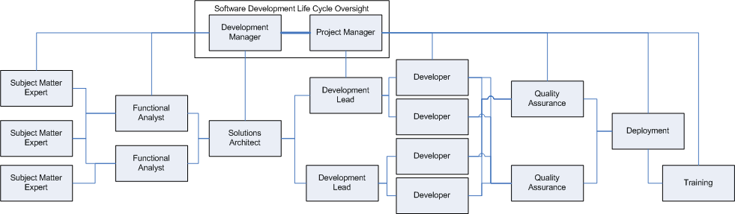
Security Analyst by phase
Model Consultant
Developer UI
Performance
Testing
Developer
Business Logic
Developer
Database
Infraestructure Architect
Developer
Integration
Security
Analyst
Security
Analyst
Security
Analyst
Critical Skills for Every Role
  Understanding Business
  Broad Understanding (like Infrastructure)
  Multiple Perspectives
  People Skills / Lifelong Learning
Notes:
Critical Skills for Every Role
In the articles describing each role there is a section, much like this one, which is designed to support a bulleted list of items that are critical to the success of the role. During the creation of the series a common set of skills was identified that were essential business skills that professionals in nearly every role needed to consider during their career. Rather than repeat them within the individual articles describing each role, they have been brought together here so that you could consider the impact of these roles in whole no matter where you are in the software development process. The common skills to all roles are:
Understanding Business - Although some roles are focused very specifically around certain aspects of understanding and converting business requirements, every role in the process should have an awareness and sensitivity to the business processes and needs which require technology in the first place. Without this technology may be implemented but it may not solve the real needs and will therefore be considered a failure.
Broad Understanding - Although an understanding of software development is critical there are other areas where an understanding can be invaluable. For instance, understanding how computers work internally including memory, cache, hard drives, etc., can help you learn how to more appropriately conserve those resources. Similarly understanding networking can help in the development of applications, which are compatible or even friendly to the networks that they're working across. SMEs broad understanding of the industry can be invaluable in terms of creating solutions that fit both the organization and the industry. The QA team can benefit the project by a broad understanding by minimizing QA costs while improving testing coverage. In short, a broad understanding can help every role.
Multiple Perspectives - The ability to approach solutions from multiple perspectives is critical to software development. Understanding how each person who is working on a problem views an issue - or how different customers will view the solution is important to be able to find the best solution based on all of the information. There are always multiple ways of viewing - and solving - a problem. The trick is to find the best one from the list of possible options. The larger the list of options (perspectives) the better the solution.
People Skills - Also known as soft skills, the ability to interact with other people and to be a part of a team is essential to nearly every role in a software development project. The lower the overall people skills of the team the higher the likelihood that the project will end in some explosion.
Lifelong Learning - Although some might argue that the perspective of being a life long learner is more of an attitude than a skill, it is a critical part of being in a high-change industry like IT in general and software development specifically. What is learned today will be obsolete tomorrow. The only way to stay ahead of the game is to approach life from the perspective of continuous learning. Each new experience is a new opportunity to learn and each new year brings with it the need for skills renewal.
SECURITY ANALYST moves around and try to integrate SECURITY at different points, however still is just a POLICE work, not deeply integrated if we want to succeed.

Slide 10
Agenda
What is the SDLC?
  In the beginning
  Waterfall to Agile Methodologies
  Scrum
  Roles (Security)
Security Development Lifecycle
  Microsoft SDL
  Phases to incorporate
  How are the software giants doing?
Threat Models
  What is STRIDE?
  What is DREAD?
  Microsoft Application Threat Modeling
How to justify?
  Statement
  Economic Impact
Notes:
"Hackers have realized that because networks are secure, the application is the weakest link."

Slide 11
S-SDL
Secure Software Development covers those activities which lead to the development of better quality software from a security perspective.
This software would be expected to have fewer exploitable software flaws and fewer security design vulnerabilities.
Notes:
As no software is 100% perfect, we aim to reduce the possible problems of the software.

Slide 12
SD³ + C
Secure
by Design
Secure architecture
Improved process
Reduce vulnerabilities in the code
Secure
by Default
Reduce attack surface area
Unused features off by default
Only require minimum privilege
Secure in Deployment
Protect, detect, defend, recover, manage
Process: How to’s, architecture guides
People: Training
Communications
Clear security commitment
Full member of the security community
Microsoft Security Response Center
Notes:
Organization for Internet Safety announced 9/26 some indication that TWC is becoming an industry initiative
The Organization for Internet Safety press release is now live online at http://www.oisafety.org/test/index.html and has been sent out across the wires. Microsoft is not providing a spokesperson for this announcement (for the first 48hrs) so press inquires will be handled by Keri P. Mattox FitzGerald Communications (617) 488-9500 kmattox@fitzgerald.com.
Security Team Core/MSRC are owning this announcement for Microsoft/Waggener.
Background:
The Organization for Internet Safety (OIS), a unique alliance between leading technology vendors, security researchers and consultancies, today announced its formation. The OIS was formed to propose and institutionalize industry best practices for handling security vulnerabilities to ensure that security and technology vendors, and security researchers, can more effectively protect Internet users. Founding members of the OIS include @stake, BindView Corp., Caldera International, Inc. (The SCO Group), Foundstone, Guardent, Internet Security Systems, Inc., Microsoft Corp., Network Associates, Oracle, SGI and Symantec.
General OIS Talking Points:
Microsoft, along with industry leading companies, supports the common practice of responsible disclosure when dealing with security response issues.
On Thursday September 26th, The Organization for Internet Safety was formally announced (press release: http://www.oisafety.org/). The OIS was formed to propose and institutionalize industry best practices for handling security vulnerabilities to ensure that security and technology vendors, and security researchers, can more effectively protect Internet users.
Founding members of the OIS include @stake, BindView Corp., Caldera International, Inc. (The SCO Group), Foundstone, Guardent, Internet Security Systems, Inc., Microsoft Corp., Network Associates, Oracle, SGI and Symantec.
The OIS held its first official meeting at the RSA Conference 2002 in San Jose, Calif., in February. The group has completed its charter and bylaws, and is now working to prepare draft standards for vulnerability reporting. These standards will undergo public review before being finalized.

Slide 13










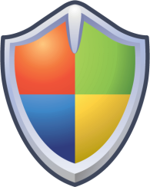





SDL Phases
Conception
Requirements Phase
Design Phase
Implementation Phase
Verification Phase
Release Phase
Support and Servicing Phase
Best Practices
and Learning
Product
Development
Incident Response
Secure
Design
Microsoft Security
Response Center
Final
Security Review
Secure
Implementation
Release
Beta Testing
Internal Testing
Verification
Notes:
Requirements Phase
Request Security Advisor
Security Milestones
Exit Criteria
Documentation
Security Feature Requirements
Design Phase
Define security architecture and design guidelines
Document the elements of the software attack surface
Conduct threat modeling
Define supplemental ship criteria
Implementation Phase
Apply coding and testing standards
Apply security-testing tools including fuzzing tools
Apply static-analysis code scanning tools
Conduct code reviews
Verification Phase
“Security push”
Security reviews
Testing of high priority code
Release Phase
Final security review
Independent Review
Performed by central security team
Penetration testing
Not pass/fail!
Support and Servicing Phase
Evaluate Reports
Release Security Advisories
Issue updates to fix problems
Update code scanning tools

Slide 14


Embedding Security
Into Software And Culture
At Microsoft, we believe that delivering secure software requires
Executive commitment → SDL a mandatory policy at Microsoft since 2004
Verification
Training
Design
Response
Implemen-tation
Release
Require-ments
Training
Require-ments
Design
Implemen-tation
Verification
Release
Response
Response execution
Analyze security and privacy risk
Define quality gates
Dynamic/ Fuzz testing
Verify threat models/ attack surface
Response plan
Final security review
Release archive
Specify tools
Enforce banned functions
Static analysis
Core training
Threat modeling
Attack surface analysis
Core training
Analyze security and privacy risk
Define quality gates
Threat modeling
Attack surface analysis
Specify tools
Enforce banned functions
Static analysis
Dynamic/Fuzz testing
Verify threat models/attack surface
Response plan
Final security review
Release archive
Response execution
Education
Technology and Process
Accountability
Ongoing Process Improvements → 6 month cycle
Notes:
Message of the slide in one line: The SDL is a holistic and comprehensive approach that leverages education, process, technology and executive commitment, to consistently create more secure software at Microsoft (and outside of Microsoft)
True to its name, the SDL was created to complement (rather than disrupt) the development life cycle. These are the core phases and principles of the SDL:
Education phase: Every Microsoft developer must go through mandatory security training, concerning secure development practices. Classes include topics such as threat modeling, secure development and testing practices and security for development managers. The mandatory security training was the means to reach every Microsoft developer and make security such an integral part of the Microsoft culture.
Requirements phase: requirements for security and privacy must accompany functional requirements of the software that is being created. Such requirements may include the use of encryption, authentication and other security measures based on the project’s environment, exposure and sensitive data. To that end, a security and privacy risk analysis is performed at this stage. In addition, the threshold for security and privacy is defined at this point, to ensure that bugs with certain severity must be fixed before release. This is called the bug-bar at Microsoft. Defining a clear threshold at the start of the project avoids potential “quality crawl” towards the end of the project, when the release date is looming.
Design phase: Eradicating coding bugs with security implications isn’t enough. Design flaws can have a much greater impact on security, and are much harder to deal with in the testing phase. To that end, threat modeling is a critical SDL requirement and a Microsoft security innovation which is recognized by analysts as the next evolution in creating more secure software. Through threat modeling, architects and developers at Microsoft are able to think about security in a structured way from the perspective of an attacker. This allows to identify and reduce attack surface and mitigate the risk of potential design security issues.
Implementation phase: When it comes to eliminating implementation errors that may lead to security bugs, tools are the most consistent and efficient mechanism. At Microsoft, there are internal tools that the development can choose to use, based on the project, environment etc…These tools perform static code analysis and special security debugging. Commercial tools with similar capabilities are available today from a number of vendors around the world. Additionally, library functions that were judged “unsafe” are blacklisted and replaced by more secure versions of the same functions.
Verification phase: This is the QA phase and security testing is required here, in addition to the typical functional testing. For web applications, dynamic or web scanning tools are required to test for potential security bugs such as Cross-Site-Scripting (XSS) or SQL injection. Fuzz testing is another important SDL requirement. Fuzzing is a general term for massive fault injection which often leads to uncovering security problems. Massive file fuzzing had a major role in the significant improvements that the Office team made with Office 2007.
Release phase: The final security review is the major milestone that a product team must pass in order to release a product under the SDL. During this meeting, security experts and the development team review all of the activities, mitigations and security artifacts that are relevant to the project, in order to make sure that the security quality gates are satisfied. During this phase, the product team defines a response plan, describing procedures, accountabilities and contact information in case a security vulnerability is discovered after the product is operational and used by customers.
Response phase: The Microsoft Security Response Center (MSRC) is responsible for handling security issues that are uncovered “in the wild” and for mobilizing product teams within Microsoft to provide timely fixes for security problems.
In summary, secure software development requires executive commitment, ongoing process improvement, education & training (from VPs to product managers to developers to testers), tools to aid detecting security flaws, and incentives & consequences to make sure everyone adheres to the process.

Slide 15
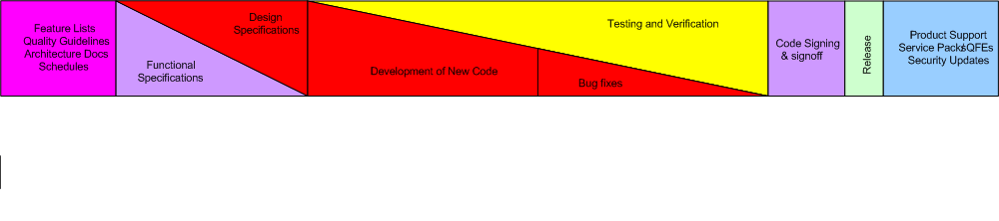
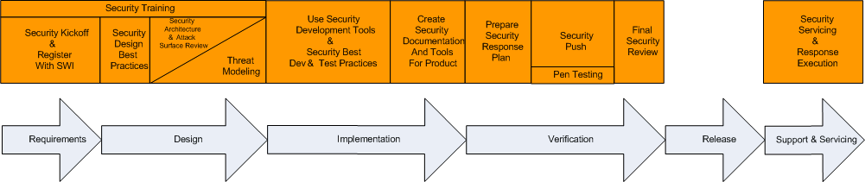
Processes
Figure 1. Baseline process and SDL Improvements

Slide 16
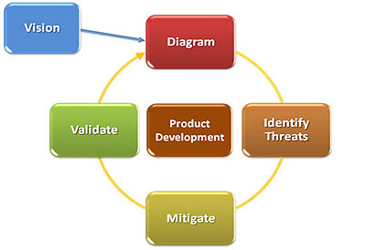
Deliverables by phases for S-SDL
The S-SDL has six primary components:
  Phase 1: Security guidelines, rules, and regulations
  Phase 2: Security requirements: attack use cases
  Phase 3: Architectural and design reviews / threat modeling
  Phase 4: Secure coding guidelines
  Phase 5: Black/gray/white box testing
  Phase 6: Determining exploitability

Slide 17
Deliverables by
Development Timeline
Security push/audit
Secure questions
during interviews
Threat
analysis
Learn &
Refine
External
review
Concept
Designs
Complete
Test plans
Complete
Code
Complete
Ship
Post
Ship
Team member
training
Data mutation
& Least Priv
Tests
Review old defects
Check-ins checked
Secure coding guidelines
Use tools
Security
Review
= on-going

Slide 18

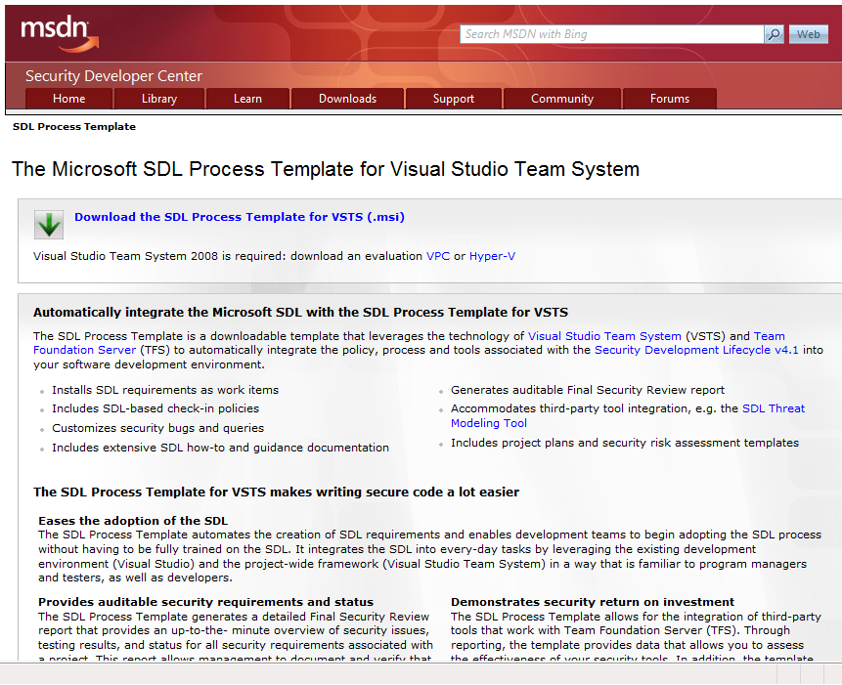
http://www.microsoft.com/sdl

Slide 19
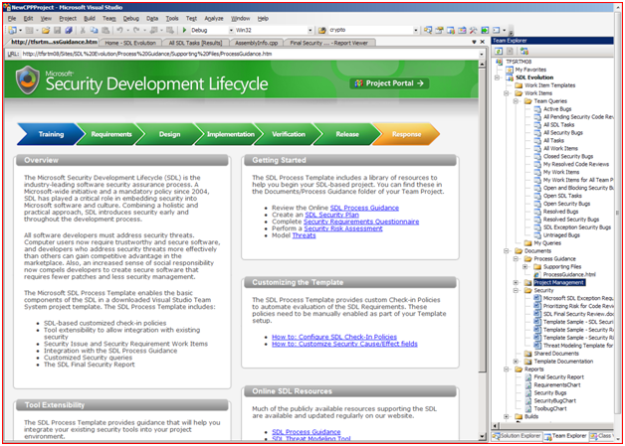
Microsoft S-SDL
Notes:
With the SDL Process Template, a security owner can easily tackle that initial question of “where do I start”? The Process Guidance page provides a security owner (and the entire team) with a brief overview of the SDL, five steps for Getting Started on an SDL project, and details on customizing the template and extending it for third party security tools. There is even more material supporting SDL implementation and customizing the SDL Process Template in the SharePoint library.
Image: The SDL Process Guidance “front page”

Slide 20
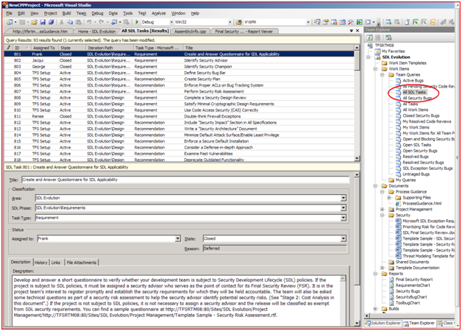
Microsoft S-SDL
Notes:
A security owner can accelerate the task of defining security requirements by opening up a query that includes all of the default SDL requirements – ready to triage and assign! There is also a custom work item to add your own requirements or recommendations.
Image: all SDL Requirements and Recommendations pre-loaded and ready to triage

Slide 21
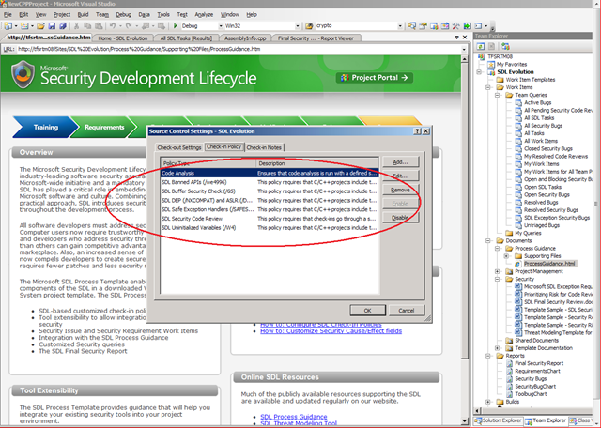
Microsoft S-SDL
Notes:
For Developers!
Developers care about security, but they want it to be intuitive. The SDL Process Template includes check-in policies that will ensure every checkin of code is taking advantage of the SDL required compiler/linker flags and Code Analysis features already in Visual Studio. This will eliminate entire classes of security weaknesses from your code!
Image: Setting Check-in policies

Slide 22
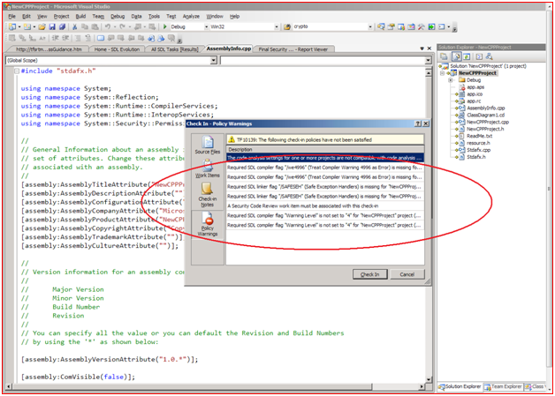
Microsoft S-SDL
Notes:
Image: Check-in policies in action

Slide 23
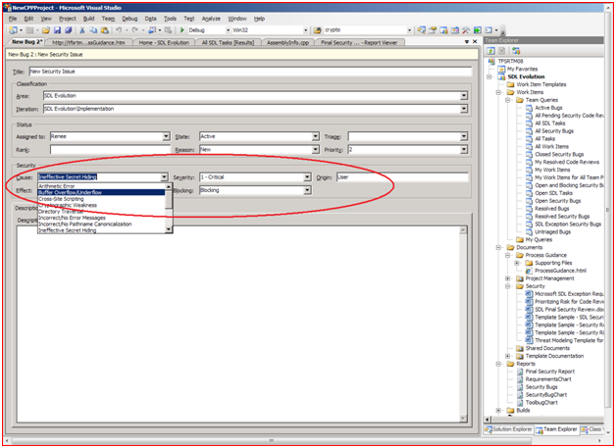
Microsoft S-SDL
Notes:
For Testers!
Testers want to be able to emphasize the importance of a security bug and properly communicate the impact to their product. The default “bug” work item now has customized security fields so you can identify security severity, and security cause/effect (using STRIDE), and mark a bug as “Blocking” or “Not Blocking.” This feature allows you to track and search for security-specific bugs.
Image: Identifying a bug as a security issue

Slide 24
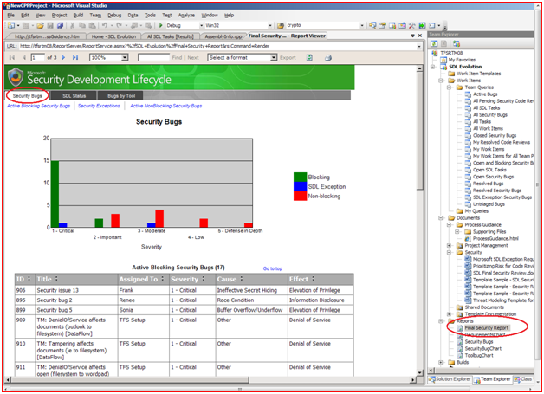
Microsoft S-SDL
Notes:
For management!
The management team wants an easy-to-read document that summarizes the security work completed. The Final Security Review Report and Security Bugs Report provide an auditable set of artifacts that details security work completed as well as deferred tasks.
· Page One: status of all bugs marked as Security Bugs
· Page Two: completion status for the SDL Requirements and Recommendations
· Page Three: security bugs found by all tools integrated with the template
Image: Page 1 of the Final Security Review

Slide 25
Phases added for SDL
Once it's been determined that a vulnerability has a high level of exploitability, the respective mitigation strategies need to be evaluated and implemented.
Secure deployment of the application - means that the software is installed with secure defaults. File permissions & secure settings of the application's configuration are used.
After the software has been deployed securely, its security needs to be maintained throughout its existence. An all-encompassing software patch management process needs to be in place. Emerging threats need to be evaluated, and vulnerabilities need to be prioritized and managed.
Notes:
Once it's been determined that a vulnerability has a high level of exploitability, the respective mitigation strategies need to be evaluated and implemented.
In addition, a process needs to be in place that allows for deploying the application securely. Secure deployment means that the software is installed with secure defaults. File permissions need to be set appropriately, and the secure settings of the application's configuration are used.
After the software has been deployed securely, its security needs to be maintained throughout its existence. An all-encompassing software patch management process needs to be in place. Emerging threats need to be evaluated, and vulnerabilities need to be prioritized and managed.

Slide 26

Software Giants on SDL
Major software makers fail security transparency test ( )
In March, we threw down the gauntlet and challenged leading software companies and organizations to show us what they are doing to write secure software. Not one of the 23 companies and organizations that we listed responded, and in a follow-up in April, only four provided us with answers.
Adobe, Amazon.com, the Apache Software Foundation, Apple, CollabNet, the Eclipse Foundation, the Free Software Foundation, IBM, Intel, the Linux Foundation, Oracle, Red Hat, Software AG, Sun Microsystems, Sybase, VMware and Yahoo did not respond to our inquiry.
Nokia and Salesforce.com acknowledged the request but were unable to provide comment by deadline.
Google, Hewlett-Packard, Novell, TIBCO have published to the web
Are those companies practicing security by obscurity?
April 24, 2009
Notes:
http://www.sdtimes.com/link/33340
April 24, 2009 —
A majority of the industry's leading software makers surveyed by SD Times lack transparency about the internal principles that they use for writing secure software. Analysts believe that those companies are either practicing security by obscurity, do not adequately perform security practices during software development, or are simply unwilling to talk about it.
In March, we threw down the gauntlet and challenged leading software companies and organizations to show us what they are doing to write secure software. Not one of the 23 companies and organizations that we listed responded, and in a follow-up in April, only four provided us with answers.
The question was inspired by the publication of Microsoft's Security Development Lifecycle software security assurance process in 2004, as well as the company's subsequent steps to share that blueprint with developers within enterprises or third-party application firms.
Microsoft does not ship software unless it has been put through the SDL process, and it credits the process for markedly reducing security vulnerabilities in its products.
Adobe, Amazon.com, the Apache Software Foundation, Apple, CollabNet, the Eclipse Foundation, the Free Software Foundation, IBM, Intel, the Linux Foundation, Oracle, Red Hat, Software AG, Sun Microsystems, Sybase, VMware and Yahoo did not respond to our inquiry. Nokia and Salesforce.com acknowledged the request but were unable to provide comment by deadline.
"There is such a disconnect between security experts and application development professionals that they probably lack the ability to respond in a coherent manner," said Mike Gualtieri, a senior analyst with Forrester Research.
"Security at many firms is done after the software development life cycle. Also, they probably don't want to reveal their app dev security process because it could be sub-par to where it should be and encourage hackers to attack, attack, attack."
Google has published a security resource on its Security and Privacy page for Google Apps. That resource includes a white paper that provides information about Google's general organizational and operational security practices to customers, partners and users, said spokesperson Jay Nancarrow.
Hewlett-Packard developed an automated method for threat modeling and security requirements, and it has applied that to its products for the past three to four years, said Caleb Sima, CTO of HP's Application Security Center.
"This eliminates a huge amount of security vulnerabilities very early in the cycle, and [it] is the first that I have seen that has been automated to a point where a security expert is not needed to do the analysis," he added. "It also does traceability of each security requirement to the line of multiple compliance areas such as PCI."
Novell has published a security development life cycle for its Linux-based products, said spokesperson Ian Bruce.
TIBCO Software follows a mature Product Lifecycle Management (PLC) process for product specification, development and life-cycle sustenance, according to Don Adams, vice president and chief security officer for worldwide government at TIBCO. The security and trustworthiness guidelines posed by the PLC reflect the sensitive nature of the information that TIBCO's customers transact in electronic trading systems, global commerce and many of the world's government secrets, he said.
"TIBCO engineering deepened this commitment to trustworthy development processes when they undertook their first Common Criteria evaluation," Adams added. Common Criteria evaluation is a program established by the U.S. National Security Agency to measure the security of commercial software products.
Many companies may have a reasonable technical story to tell about how they approach security, but many feel that the less said the better, said Rex Black, president of Rex Black Consulting Services. "In other words, they perhaps don't want their name featured in an article about security problems, no matter how it's mentioned."
Other companies aren't actually doing anything about security at a unified, company-wide level, he said. "Some individuals and project teams do things well from a quality and security point of view, but others do little if anything." These companies do not want to look disorganized or unconcerned about security, he added, "and neither is a good way to look at this point."
Some companies could be painted in a more flattering light, but they could have a policy not to discuss what they do for security, "so as not to enable hackers to figure out how to attack their products through analysis of their technique," Black said. However, he noted that few security experts have anything good to say about the practice of security by obscurity.

Slide 27
Social Security Adm. Policy
It is SSA's policy to integrate security into the systems development lifecycle reasons:
  It is more effective - easier to achieve when security issues are considered as a part of a routine development process
  It is less expensive - To retrofit security is generally more expensive than to integrate it into an application.
  It is less obtrusive - When security safeguards are integral to a system, they are usually easier to use and less visible to the user.

Slide 28

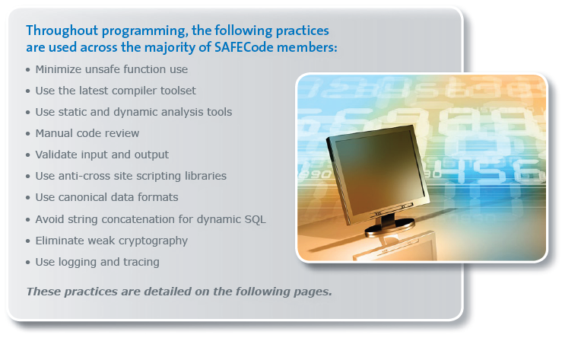
Members: EMC, Juniper Networks, Microsoft, SAP, Symantec, Nokia
Notes:
SAFECode's recommended practices across the lifecycle are as follows:
Requirements: Define a set of activities to formalize the security requirements for a specific product release.
Design: Conduct threat analysis (also called threat modeling or risk analysis) to identify architectural and design security flaws before code is committed.
Programming: Minimize unsafe function use, use the latest compiler toolset, use static and dynamic analysis tools, conduct manual code reviews, validate input and output, and more. (See the guide for additional secure programming practices.)
Testing: Recommendations include fuzz testing, penetration testing and third-party assessment, and use of automated testing tools. Code Integrity and Handling: Implement controls to address access, storage, and handling during the development process. Secure software development resources Build security into the SDLC and keep the bad guys out

Slide 29

Total Vulnerabilities Disclosed One Year After Release
Before SDL
After SDL
45% reduction in Vulnerabilities
Notes:
Message of the slide in one line: Windows Vista, the first OS to have been developed with SDL from the get go, has had significantly less vulnerabilities in its first year than its predecessor, Windows XP or from operating systems from other vendors.
I would love it if you walked away from this presentation thinking that Microsoft’s platform is the most secure in the industry, but that’s not why I’m sharing this slide, and that’s not the message I want to convey. The message I hope you will walk away with is that the SDL leads to significant improvements in the security of software. This shows just how seriously Microsoft takes the security of its products.
A few things you should consider as you look at the graph on this slide, which is otherwise pretty self-explanatory.
First, Windows has a far larger install base other operating systems. We are a big target. That’s both a plus and a minus. On the one hand, there are a lot of independent security researchers trying to find vulnerabilities on our software, so there’s less of a chance that a vulnerability is being missed. On the other hand, there are a lot of hackers trying to take advantage of our system.
Third, vulnerabilities are not a perfect measure of “security,” far from it. If it was possible to measure “security” in one metric, it would have to encompass a complex combination of factors including (but not limited to) the software quality, administrative controls, physical controls, and much more – and even then, it would all be in the context of whatever security policy was defined for the systems in question.
Fourth, this data comes from Microsoft. You can find the report on Jeff Jones security blog at http://blogs.technet.com/security, including all the sources used and a detailed description of Jeff’s methodology. Jeff says in the paper “Be skeptical! Assume I’m ‘spinning’ things if you wish and try to go find out for yourself. That is ultimately my goal – to get people to actively question and dig into why the results turn out the way they do.”

Slide 30

Microsoft SDL And Internet Explorer (IE)
Before SDL
After SDL
35% reduction in vulnerabilities
63% reduction in high severity vulnerabilities
Source: Browser Vulnerability Analysis, Microsoft Security Blog 27-NOV-2007
Notes:
Message of the slide in one line: Microsoft IE7, a widely targeted piece of software, has shown significant improvements following the SDL.
Similar to the Windows and SQL, SDL has led IE to significant security improvements. While a 35% reduction in total vulnerabilities is not as high as Microsoft would have liked, we see SDL’s success in significantly reducing the number of high severity vulnerabilities.
Note that these results are for IE on Windows XP. IE7 on Windows Vista is significantly more secure, with a 46% reduction in overall vulnerabilities after 1 year.

Slide 31
Agenda
What is the SDLC?
  In the beginning
  Waterfall to Agile Methodologies
  Scrum
  Roles (Security)
Security Development Lifecycle
  Microsoft SDL
  Phases to incorporate
  How are the software giants doing?
Threat Models
  What is STRIDE?
  What is DREAD?
  Microsoft Application Threat Modeling
How to justify?
  Statement
  Economic Impact

Slide 32
Threat Models
Asset - is a resource of value. (customer data)
Threat - is an undesired event. A potential occurrence, often best described as an effect that might damage or compromise an asset.
Vulnerability - is a weakness in some aspect or feature of a system that makes an exploit possible. Vulnerabilities can exist at the network, host, or application levels and include operational practices.
Attack (or exploit) - is an action taken that utilizes one or more vulnerabilities to realize a threat.
Countermeasure - address vulnerabilities to reduce the probability of attacks or the impacts of threats.

Slide 33
Threat Models
You cannot build secure applications unless you understand threats
  “We use SSL!” - Since the network is secure attacks are moving to the application itself
Find different bugs than code review and testing
Approx 50% of issues come from threat models
Threat Modeling Web Applications
Notes:
Because 50% comes from the models that’s why we need to focus on creating them

Slide 34
Threat Modeling Process
Create model of app (DFD, UML etc)
Categorize threats to each attack target node with STRIDE
  Spoofing, Tampering, Repudiation,
  Information Disclosure, Denial of Service, Elevation of Privilege
Build threat tree (use tools)
Rank threats with DREAD
  Damage potential, Reproducibility, Exploitability, Affected Users, Discoverability
Notes:
STRIDE stands for:
● Spoofing. Spoofing is attempting to gain access to a system by using a false identity. This can be accomplished using stolen user credentials or a false IP address. After the attacker successfully gains access as a legitimate user or host, elevation of privileges or abuse using authorization can begin.
● Tampering. Tampering is the unauthorized modification of data, for example as it flows over a network between two computers.
● Repudiation. Repudiation is the ability of users (legitimate or otherwise) to deny that they performed specific actions or transactions. Without adequate auditing, repudiation attacks are difficult to prove.
● Information disclosure. Information disclosure is the unwanted exposure of private data. For example, a user views the contents of a table or file he or she is not authorized to open, or monitors data passed in plaintext over a network. Some examples of information disclosure vulnerabilities include the use of hidden form fields, comments embedded in Web pages that contain database connection strings and connection details, and weak exception handling that can lead to internal system level details being revealed to the client. Any of this information can be very useful to the attacker.
● Denial of service. Denial of service is the process of making a system or application unavailable. For example, a denial of service attack might be accomplished by bombarding a server with requests to consume all available system resources or by passing it malformed input data that can crash an application process.
● Elevation of privilege. Elevation of privilege occurs when a user with limited privileges assumes the identity of a privileged user to gain privileged access to an application. For example, an attacker with limited privileges might elevate his or her privilege level to compromise and take control of a highly privileged and trusted process or account.

Slide 35
Countermeasures
Threat | Countermeasures
Spoofing user identity | Use strong authentication. Do not store secrets (for example, passwords) in plaintext. Do not pass credentials in plaintext over the wire. Protect authentication cookies with Secure Sockets Layer (SSL).
Tampering with data | Use data hashing and signing. Use digital signatures. Use strong authorization. Use tamper-resistant protocols across communication links. Secure communication links with protocols that provide message integrity.

Slide 36
Countermeasures
Threat | Countermeasures
Repudiation | Create secure audit trails. Use digital signatures.
Information disclosure | Use strong authorization. Use strong encryption. Secure communication links with protocols that provide message confidentiality. Do not store secrets (for example, passwords) in plaintext.
Denial of service | Use resource and bandwidth throttling techniques. Validate and filter input.
Elevation of privilege | Use least privileged service accounts to run processes and access resources.

Slide 37
DREAD classification in Microsoft
Critical: A vulnerability whose exploitation could allow the propagation of an Internet worm without user action.
Important: A vulnerability whose exploitation could result in compromise of the confidentiality, integrity, or availability of users data, or of the integrity or availability of processing resources.
Moderate: Exploitability is mitigated to a significant degree by factors such as default configuration, auditing, or difficulty of exploitation.
Low: A vulnerability whose exploitation is extremely difficult, or whose impact is minimal.
Notes:
Instead of having a rating system between 0 and 10 where most stuff is ranked as either a 1 or a 10 anyways, it is now broken down into 1 of 4 categories:

Slide 38
Threat Modeling tool
Application Demo / PPT Demo

Slide 39
Agenda
What is the SDLC?
  In the beginning
  Waterfall to Agile Methodologies
  Scrum
  Roles (Security)
Security Development Lifecycle
  Microsoft SDL
  Phases to incorporate
  How are the software giants doing?
Threat Models
  What is STRIDE?
  What is DREAD?
  Microsoft Application Threat Modeling
How to justify?
  Statement
  Economic Impact
Notes:
"Hackers have realized that because networks are secure, the application is the weakest link."

Slide 40
A Short Quiz
Joe is a drug dealer
Steve is a cyber criminal
Who makes more money?
Notes:
Message of the slide in one line: Anecdotal evidence that cybercrime is a serious threat.
Let’s start with a short quiz…(get responses from the audience)…
Answer: According to some US government officials, cybercrime (>$100B according to FBI estimates) is now more profitable than the wholesale illegal U.S. drug trade ($94B, according to the 2005 U.N. World Drug Report).
If you take into account the chance of being arrested (much higher for drug dealers than cyber criminals), you realize just how big a threat cybercrime really is…

Slide 41









The Evolution Of Cybercrime
1986–1995
1995–2003
2004+
2006+
LANs
First PC virus
Motivation: damage
Internet Era
“Big Worms”
Motivation: damage
OS, DB attacks
Spyware, Spam
Motivation: Financial
Targeted attacks
Social engineering
Financial + Political
Source: U.S. Government Accountability Office (GAO), FBI
→ Cost of U.S. cybercrime: More than $100B
2007 Market prices:
Credit Card Number | $0.5-$20
Full Identity | $1-$15
Bank Account | $10-$1000
Notes:
Message of the slide in one line: Cybercrime has become a significant and sophisticated “market”, with financially motivated attacks moving up the stack to the application layer.
Cybercrime or computer crime has evolved significantly over the past 20 years. As the internet changed our lives in the past years, so has internet crime become a threat to the software that runs it. If you look at types of attacks and why they happen, you see a clear trend – attacks are moving up the stack and the motivation is increasingly financial and even political (there have been much news lately about cyber warfare between Estonia and Russia).
Click: The financial aspect of cyber crime is clear – if you can steal information, you will find a buyer for it. The resources behind cybercrime, make it into such a significant threat. Given the size of the market, sophisticated business models have emerged such as “botnets for rent” and “Crime as a Service (CaaS)”.
To put this dollar value in perspective, the size of the entire US software market is approximately $200B…

Slide 42

Attacks Are Moving To Application Layer
2004
2005
2006
2004
2005
2006
Operating Systems
Applications
Source: Microsoft Security Intelligence Report 2007
~90% are exploitable remotely
~60% are in web applications
Sources: IBM X-Force, Symantec 2007 Security Reports
Notes:
Message of the slide in one line: Applications, rather than operating systems, are a significant target for security researchers (hackers).
As software vendors like Microsoft, Oracle, Red Hat, etc., have worked hard to reduce the attack surface of their platforms, hackers have begun to focus on the greener pastures of YOUR applications. The vast majority of these vulnerabilities are exploitable from remote and most are focused on web applications.
Remember, No matter how good a job your IT team does in locking down vendor software, a poorly developed application can open the system wide to attack. You are not just a consumer of product security features, you are a full partner with Microsoft in the process of securing your applications and your customers’ and/or company’s sensitive data.

Slide 43
The Long Tail Of
Security Vulnerabilities…
Sources: IBM X-Force 2007 Security Report
Notes:
Message of the slide in one line: Contrary to what you might expect, the vast majority of vulnerabilities are found in software that is produced by small companies (hence the long tail) → cyber criminals are after your applications.
You may say: “ok, all these vulnerabilities are in the big companies’ software – why would anyone go after my application”?
The truth is that only 14% of vulns. Are in the 5 leading companies (Microsoft, Oracle, IBM, Cisco and Apple). In the age of targeted financial attacks, it makes financial sense to target all sorts of applications and find weak spots and holes where no one expects you to look…So the cyber criminals are after your applications.
By the way, Microsoft vulnerabilities in 2007 made up ~4% of the entire pool. It is important to note that this analysis did not come from Microsoft’s security team. It came from IBM’s security team.

Slide 44
ISO 9126
Quality Attributes
Portability - Will I be able to use on another machine?
Reusability - Will I be able to reuse some of the software?
Interoperability - Will I be able to interface it with another machine?
Maintainability - Can I fix it?
Flexibility - Can I change it?
Testability - Can I test it?
Product
Revision
Product
Transition
Product
Operations
Correctness - Does it do what I want?
Reliability - Does it do it accurately all the time?
Efficiency - Will it run on my machine as well as it can?
Integrity - Is it secure?
Usability - Can I run it?
Notes:
ISO 9126
The quality model established in the first part of the standard, ISO 9126-1, classifies software quality in a structured set of characteristics and sub-characteristics as follows:
Functionality - A set of attributes that bear on the existence of a set of functions and their specified properties. The functions are those that satisfy stated or implied needs.
Suitability
Accuracy
Interoperability
Compliance
Security
Reliability - A set of attributes that bear on the capability of software to maintain its level of performance under stated conditions for a stated period of time.
Maturity
Recoverability
Fault Tolerance
Usability - A set of attributes that bear on the effort needed for use, and on the individual assessment of such use, by a stated or implied set of users.
Learnability
Understandability
Operability
Efficiency - A set of attributes that bear on the relationship between the level of performance of the software and the amount of resources used, under stated conditions.
Time Behaviour
Resource Behaviour
Maintainability - A set of attributes that bear on the effort needed to make specified modifications.
Stability
Analyzability
Changeability
Testability
Portability - A set of attributes that bear on the ability of software to be transferred from one environment to another.
Installability
Replaceability
Adaptability
Conformance (similar to compliance, above, but here related specifically to portability, e.g. conformance to a particular database standard)

Slide 45

Cost to fix errors
Phase In Which Found Cost Ratio
Requirements 1
Design 3-6
Coding 10
Development Testing 15-40
Acceptance Testing 30-70
Operation 40-1000

Slide 46

Resources
The following papers and standards cover information security and secure coding and offer insight, principles, and processes that you can integrate immediately to improve software security
  NIST Special Publication 800-64—Security Considerations in the Information System
  NIST Special Publication 800-27—Engineering Principles for Information Technology Security
  NIST Special Publication 800-55—Security Metrics Guide for Information Technology Systems
  ISO/IEC 12207:1995—Information technology—Software life cycle processes
  ISO/IEC 17799:2005—Information technology—Security techniques—Code of practice for information security management

