Slide 1

OWASP London 18th September 2014

Slide 2
Agenda
Networking, food and refreshments
Welcome Colin Watson
Global Application Security Survey & Benchmarking John Smith
Anatomy of a Data Breach Joe Pelletier
OWASP Roundup Colin Watson
Networking

Slide 3
OWASP Roundup
Past conferences
Project updates
AppSec EU 2015
Supporters
Close

Slide 4
Past AppSec Conferences
AppSec EU 2014
23-26 June, Cambridge UK
https://2014.appsec.eu/
https://www.youtube.com/playlist?list=PLpr-xdpM8wG_KHsxepT9o6trkqDELhr3_
AppSec USA 2014
16-19 September, Denver USA
http://2014.appsecusa.org/2014/
http://2014.appsecusa.org/2014/about/live-streaming/
https://www.youtube.com/playlist?list=PLpr-xdpM8wG8jz9QpzQeLeB0914Ysq-Cl

Slide 5

Testing Guide
Version 4
17th September 2014
https://www.owasp.org/index.php/OWASP_Testing_Project

Slide 6

Proactive Controls
Version 1
10th March 2014
https://www.owasp.org/index.php/OWASP_Proactive_Controls

Slide 7

AppSensor
Website
11th September 2014
http://www.appsensor.org/
Reference implementation
13th September 2014
v2.0.0 beta
https://github.com/jtmelton/appsensor/releases/tag/v2.0.0-beta

Slide 8
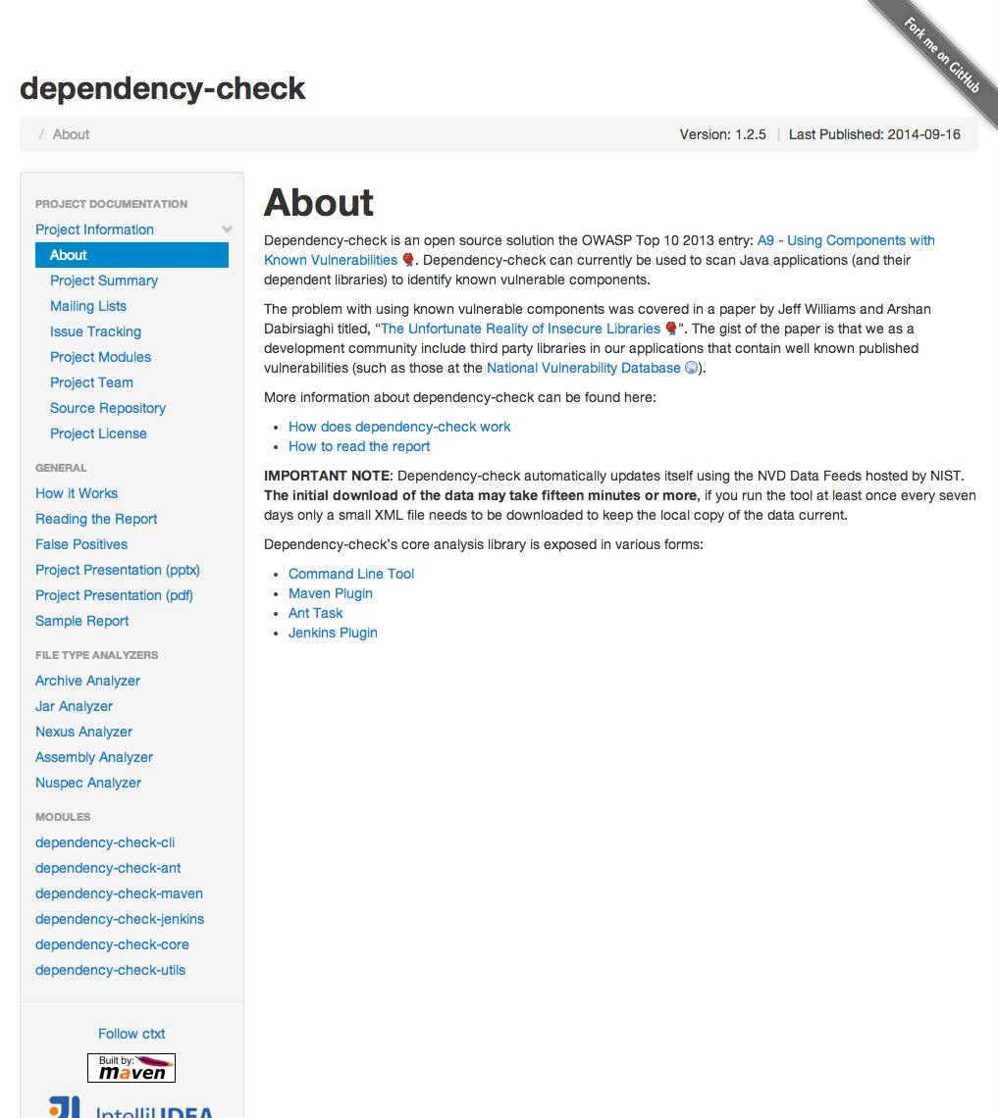
Dependency Checker
Version 1.2.5
17th September 2014
http://jeremylong.github.io/DependencyCheck/

Slide 9
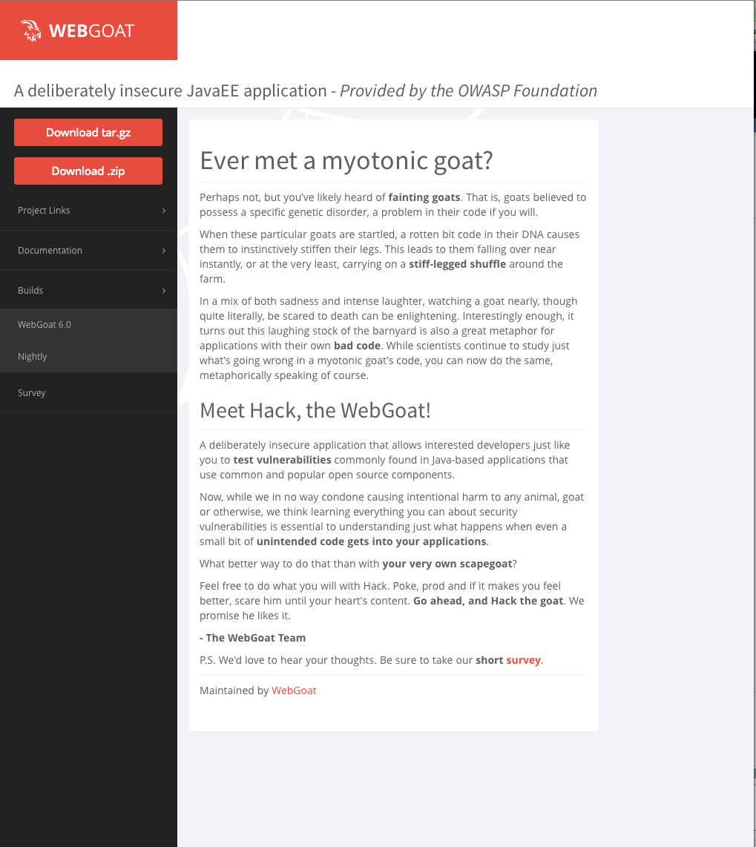
Web Goat
Version 6.0
12th September 2014
http://webgoat.github.io/

Slide 10

AppSec EU 2015
Envisioned program
4 applied talk tracks: Builder, Breaker, Defender, CISO
1 research track
19-22 May 2015
Amsterdam RAI The Netherlands

Slide 11
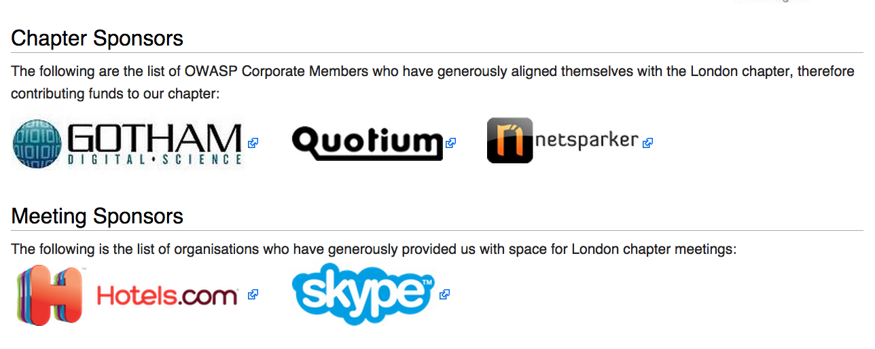
London Chapter Supporters

Slide 12

Thank You
Speakers
John Smith
Joe Pelletier
Chapter Leaders
Justin Clarke
Tobias Gondrom
Hosts for this evening
Skype
Attendees

Slide 13
OWASP
Volunteers
Project leaders
Project contributors
Chapter leaders
Members
Corporate supporters
Individual members
Other supporters

Slide 14

Corporate Sponsors

Slide 15
Staying in Touch
Chapter page
https://www.owasp.org/index.php/London
Mailing list
http://lists.owasp.org/mailman/listinfo/owasp-london
Twitter
http://twitter.com/owasplondon
Elsewhere in the UK
Birmingham, Bristol, Cambridge, East Midlands, Leeds, Manchester, Newcastle, Royal Holloway, Scotland, South Wales, Suffolk

Slide 16

The Melton Mowbray
18 Holborn

