Slide 1
Threat Modeling - An Overview All Your Data is Mine
Megha Anand
itsmeghaanand-at-gmail-dot-com
<date>

Slide 2
Agenda
Statistics
Terminology
Terminology Example
Threat Modeling
Benefits
Threat Modeling Steps
STRIDE & its Relation
Threat Tree
Risk Assessment
Case Study

Slide 3
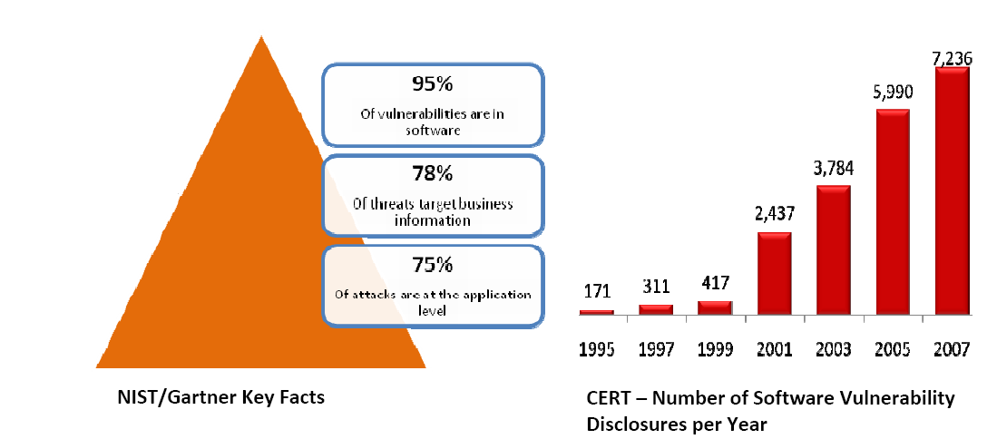
How bad it is?

Slide 4
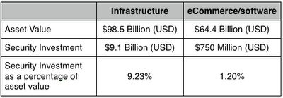
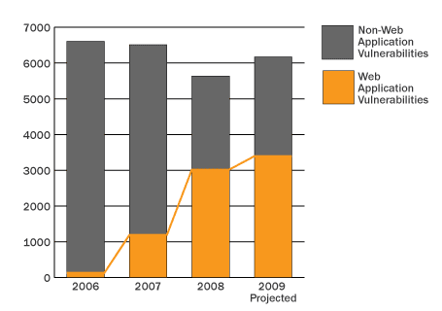
Look at Me!!!
Source: Jeremiah's Blog
Source: nCircle

Slide 5
Solutions

Slide 6
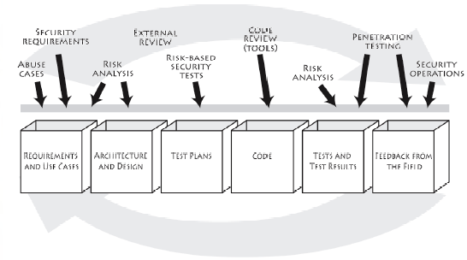
Security into SDLC
Source: Software Security, by Gary McGraw

Slide 7
Assumptions
You are an application architect or otherwise interested in understanding how to effectively create security design requirements
You have gone through the Michael Howard webinar before participating in threat modelling exercise

Slide 8
Terminology
Asset: Things to protect (tangible or intangible)
Entry/Exit Points: Ways to get at an asset
Threat: Risks to an asset
Attack / exploit: An action taken that harms an asset
Vulnerability: Specific ways to execute the attack
Risk: Likelihood that vulnerability could be exploited
Mitigation / Countermeasure: Something that addresses a specific vulnerability We can mitigate vulnerabilities… …but the threat still exists!!!

Slide 9
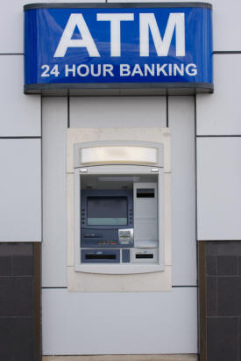

Terminology Example
Use Case
a) Customer withdraws cash from ATM
b) Checks balance in his/her account
c) Transfers cash to some other account
Asset – ATM
Closed
Attacker – Burglar
Threat – Denial of Service
Attack – Physically tempered
Vulnerability – Plastic made

Slide 10
Terminology Example
Security Controls
Guard
CCTV Cameras
ATM Machine should be made of Steel/Iron
But threat still persists!!!

Slide 11
Take Away!!!
Key Point:
We can reduce the risk but cannot rid of completely!!!
Assumption:
Lets engage in repetitive penetration testing
Question:
During Development? At deployment? After deployment?

Slide 12
Threat Modeling
Threat modeling is a procedure for optimizing application’s security by identifying objectives and vulnerabilities, and then defining countermeasures to prevent, or mitigate the effects of, threats to the system.
The key to threat modeling is to determine where the most effort should be applied to keep a system secure.

Slide 13
Benefits
In order to manage all risks efficiently
Security budget can be optimally utilized
Strengths & weakness of a system can be characterized
Flaws can be found at earlier stage
Rather than performing penetration testing for all cases, targeted penetration testing can be performed
Avoids CSD = Compulsive Security Disorder!!!

Slide 14
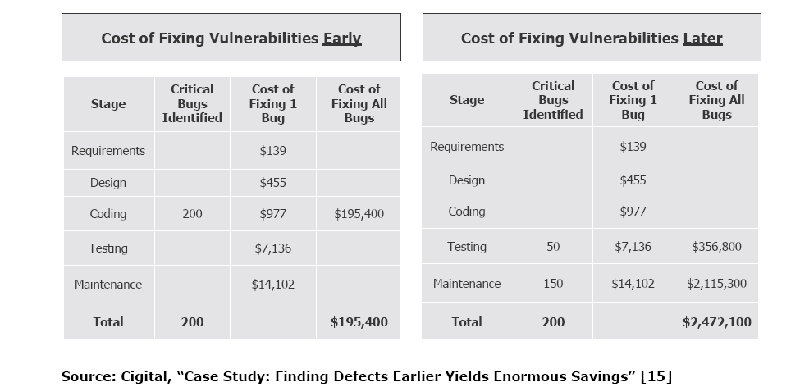
Cost

Slide 15
Another Way to Look At
Costs of an exploited vulnerability:
Cost of application is unavailable
Cost of deploying incident response team
Cost of developing patch
Cost of testing patch
Potential regulatory fines
Risk of litigation
Reputation risk to company

Slide 16
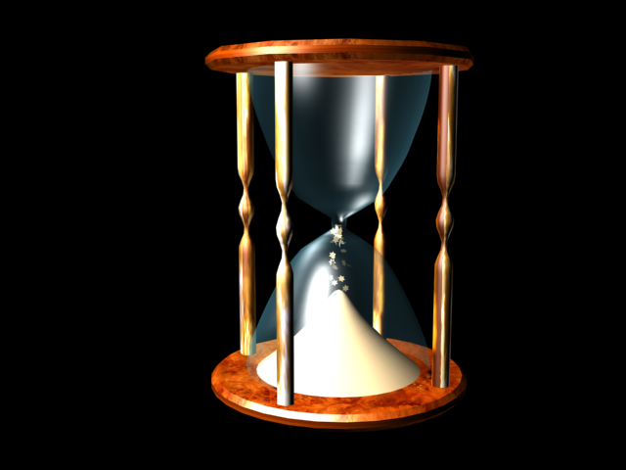
Pre- Production
Requirement Gathering
or
Early stages of SDLC

Slide 17
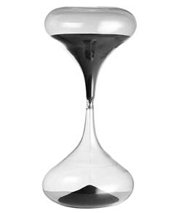

Post Production

Slide 18
Threat Modeling Steps
Information Gathering
Decompose Application
Understand attacker & abuse cases
Threat Analysis
Risk Analysis

Slide 19

Information Gathering
Sessions with
- Architects
- Developers
- Business Analyst
- Information Risk Officers
Review Architecture Document
Collect information about user roles, data sensitivity, Intranet/Internet, application components.
Identify Business Security Objectives

Slide 20
Business Security Objective
It’s a high level overview of what security issues need to be addressed in order to maintain business objective.
Generate security objective with help of
- Confidentiality
- Integrity
- Availability

Slide 21




Decompose Application
List Components
User – Admin/Normal User, Client
Web Server - Web Tier
App Server - Business Logic Tier
DB Server - Backend Tier

Slide 22
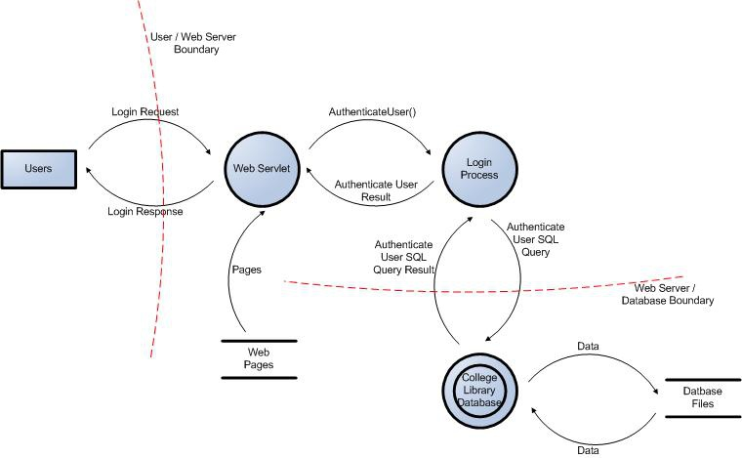
Data Flow Diagram
Visual representation of data flow between different components of an application.
- Level 0 DFD
- Level 1 DFD

Slide 23
DFD Components
Customer
Request
Web Server
Request
Data Store
Response
Response
External Entity - Entry point of application

Slide 24
DFD Components
Customer
Request
Web Server
Request
Data Store
Response
Response
Process - Perform an Action

Slide 25
DFD Components
Customer
Request
Web Server
Request
Data Store
Response
Response
Data store - Where data is stored

Slide 26
DFD Components
Customer
Request
Web Server
Request
Data Store
Response
Response
Data Flows - Direction of Data Movement

Slide 27
DFD Components
Customer
Request
Web Server
Request
Data Store
Response
Response
Trust Boundary – Physical or Logical

Slide 28

Simple Approach – Threat Profile
Request
Request
Middle Layer
Front -End
Backend Layer
Response
Response

Slide 29
STRIDE – Threat Categories
Spoofing
Tempering
Repudiation
Information Disclosure
Denial of Service
Escalation of Privileges

Slide 30
Threat Categories & Security Control
Spoofing
Authentication
Tempering
Integrity
Repudiation
Non – Repudiation
Information Disclosure
Denial of Service
Escalation of Privileges
Confidentiality
Availability
Authorization

Slide 31
Threat – Element Relation
DFD Component | S | T | R | I | D | E
Entity | X |  | X
Process | X | X | X | X | X | X
Data Flow |  | X |  | X | X
Data Store |  | X | X | X | X

Slide 32
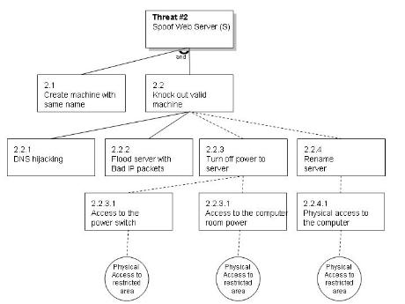
Threat Tree

Slide 33
Risk Assessment
Simplest Approach
Low, Medium, High
Impact/Likelihood Matrix
 | Low | Medium | High
Low | Low | Low | Medium
Medium | Low | Medium | High
High | Medium | High | High

Slide 34
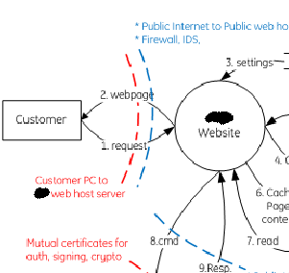
Case Study
Internet based application hosted on dedicated environment.
DFD Components
External Entity – Customer
Process - Web Server
Data Flows - b/w Client to Web Server
STRIDE Applicability
External Entity – Spoofing, Repudiation
Process - Spoofing, Tempering, Repudiation, Information Disclosure, Denial of Service, Escalation of privileges.
Data Flow – Tempering, Information disclosure, Denial of service

Slide 35
Now, raw material is ready.
Lets prepare gravy…

Slide 36
Lets Understand Threats
External Entity
Credentials held at the client are often disclosed or tampered with, leading to future spoofing attacks
Credentials on the wire are often subject to snooping attacks.
Dataflow without sequence numbers or timestamps are captured
Does your web server supports anonymous user.
What is username/password policy.
What makes logging triggered.
Type of data captured in logs
Access to log files.

Slide 37
Data Flows
Is the dataflow time stamped/sequenced and integrity protected?
Is there a cryptographically strong channel integrity system?
Is there a cryptographically strong message confidentiality system?
Are all endpoints mutually authenticated with keys obtained?
Does the app validate messages are arriving in the right order?
How channel/message integrity is been maintained?

Slide 38
Process
Credentials held at the server are often disclosed or tampered with, leading to future spoofing attacks.
Username/Password Policy.
Anonymous access allowed
Is all input verified (server side validation for all data)
What makes logging triggered.
Type of data captured in logs
Access to log files
Is there a cryptographically strong channel integrity system?
Is there a cryptographically strong message confidentiality system?
Is the dataflow time stamped/sequenced and integrity protected?

Slide 39
All your DATA is mine

Slide 40
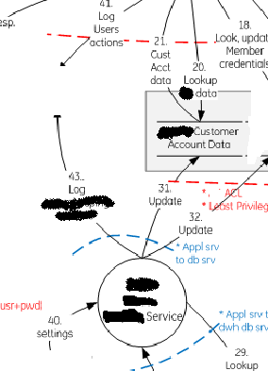
Continue…
DFD Components
Data Store – Customer Account data
Process - Service
Data Flows - b/w Process to Data Store
STRIDE Applicability
Data Store - Tempering, Repudiation, Information Disclosure, Denial of Service
Process - Spoofing, Tempering, Repudiation, Information Disclosure, Denial of Service, Escalation of privileges.
Data Flow – Tempering, Information disclosure, Denial of service

Slide 41
Data Store
Protection plan for data.
Permissions set for accessibility to DB.
Does log capture enough data.
How sensitive data is been stored
Configuration issues with DB.
DB credentials in .config file.

Slide 42


