Slide 1
Threat Modeling - Overview
Megha Anand
itsmeghaanand-at-gmail-dot-com
<date>

Slide 2
Agenda
Terminology
Terminology Example
Threat Modeling
Benefits
Who
Process Overview
Business Security Objectives
Model the System
Application Decomposition
Threat Profile
STRIDE & its Relation
Threat Tree
Risk Assessment
Example

Slide 3
Terminology
Asset: Things to protect (tangible or intangible)
Entry/Exit Points: Ways to get at an asset
Threat: Risks to an asset
  Attack / exploit: An action taken that harms an asset
  Vulnerability: Specific ways to execute the attack
Risk: Likelihood that vulnerability could be exploited
Mitigation / Countermeasure: Something that addresses a specific vulnerability
We can mitigate vulnerabilities…
…but the threat still exists!!!

Slide 4
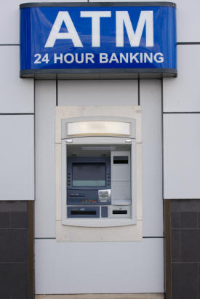
Terminology Example
Asset – ATM Machine

Slide 5
Terminology Example
Use Case
Customer withdraws cash from ATM
Checks balance in his/her account
Transfers cash to some other account

Slide 6

Terminology Example
Attacker – Burglar

Slide 7
Terminology Example
Threat – Denial of Service
Attack – Physically tempered
Vulnerability – Plastic made
Closed

Slide 8
Terminology Example
Security Controls
Guard
CCTV Cameras
ATM Machine should be made of Steel/Iron
But threat still persists!!!

Slide 9
Take Away!!!
Key Point:
We can reduce the risk but cannot rid of completely!!!
Assumption:
Lets engage in repetitive penetration testing
Question:
During Development? At deployment? After deployment?

Slide 10
Threat Modeling
Its an iterative process which helps in
Simplifies qualitative risk assessment
Identify security objective
Create security profile of application
Identify & prioritize threats
Visualizing & documenting threats

Slide 11
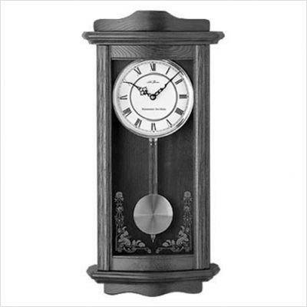

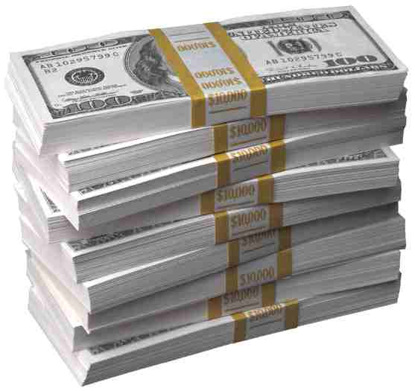
Benefits
Cost
Time
Quality

Slide 12
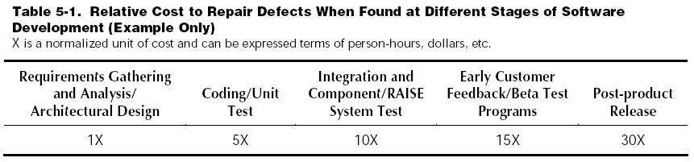
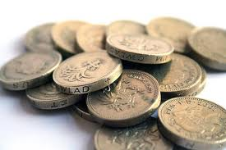
Cost
Less
Very High

Slide 13

Time
Requirement Gathering
or
Early stages of SDLC

Slide 14
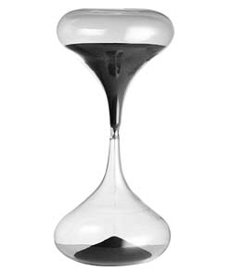

Post Production

Slide 15

Quality

Slide 16

Who
Developers
Security Consultants
Architects
IT Project Managers

Slide 17
Process Overview
Identify business security objectives
Decompose Application
Understand attacker & abuse cases
Threat Analysis
Risk Analysis
Security controls

Slide 18
Business Security Objective
It’s a high level overview of what security issues need to be addressed in order to maintain business objective.
Generate security objective with help of
- Confidentiality
- Integrity
- Availability

Slide 19
Model the System
Entry Points
Assets
Roles & Identities
Trust Levels

Slide 20
Decompose Application
DFD Components
Customer
Request
Web Server
Request
Data Store
Response
Response
External Entity - Entry point of application

Slide 21
Decompose Application
DFD Components
Customer
Request
Web Server
Request
Data Store
Response
Response
Process - Perform an Action

Slide 22
Decompose Application
DFD Components
Customer
Request
Web Server
Request
Data Store
Response
Response
Data store - Where data is stored

Slide 23
Decompose Application
DFD Components
Customer
Request
Web Server
Request
Data Store
Response
Response
Data Flows - Direction of Data Movement

Slide 24
Decompose Application
DFD Components
Customer
Request
Web Server
Request
Data Store
Response
Response
Trust Boundary – Physical or Logical

Slide 25
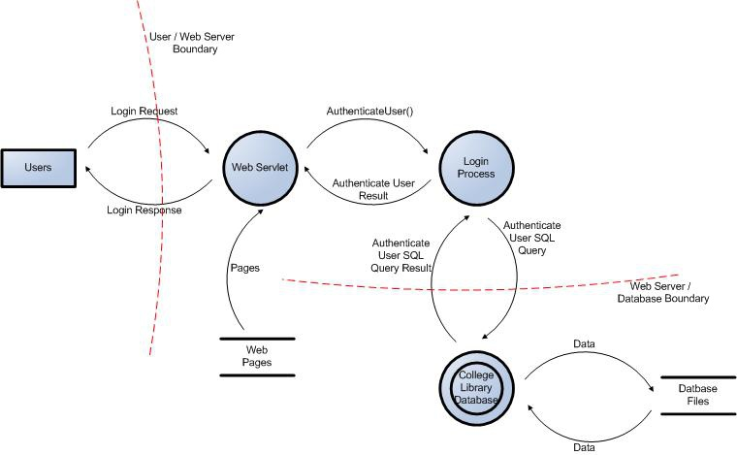
Example

Slide 26
Simple Approach - Threat Profile
Where to BEGIN???
 | Confidentiality (who can read) | Integrity (who can write) | Availability (who can access)
Network
Server
Application

Slide 27
STRIDE - Threat categories
Spoofing
Tempering
Repudiation
Information Disclosure
Denial of Service
Escalation of Privileges

Slide 28
Threat Categories & Security Control
Spoofing Authentication
Tempering Integrity
Repudiation Non – repudiation
Information Disclosure Confidentiality
Denial of Service Availability
Escalation of Privilege Authorization

Slide 29
Threat – Element Relation
DFD Component | S | T | R | I | D | E
Entity | X |  | X
Process | X | X | X | X | X | X
Data Flow |  | X |  | X | X
Data Store |  | X | X | X | X

Slide 30
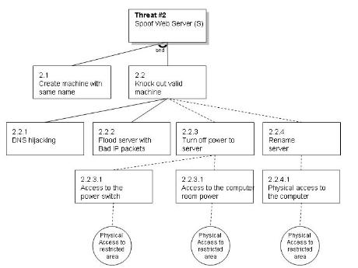
Threat Tree

Slide 31
Risk Assessment
Simplest Approach
Low, Medium, High
Impact/Likelihood Matrix
 | Low | Medium | High
Low | Low | Low | Medium
Medium | Low | Medium | High
High | Medium | High | High

Slide 32
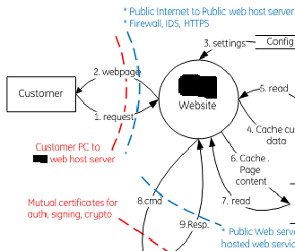
Practical Example

Slide 33


