Slide 1
OWASP Update 26-Sep-2012
OWASP Belgium
Chapter
David Mathy
BE Board
David.mathy@owasp.org

Slide 2
Agenda
Introduction
OWASP Near You

Slide 3
Introduction

Slide 4


OWASP World
OWASP is a worldwide free and open community focused on improving the security of application software.
Our mission is to make application security visible so that people and organizations can make informed decisions about application security risks.
Everyone is free to participate in OWASP and all of our materials are available under a free and open software license.
The OWASP Foundation is a 501c3 not-for-profit charitable organization that ensures the ongoing availability and support for our work.
Notes:
REMEMBER… OWASP IS JUST PEOPLE
You are all probably familiar with OWASP, so I’d like to take this opportunity to share a few metrics and give you an idea of where OWASP is headed.
I’ve been the volunteer chair of OWASP since 2004, and I’ve spent quite a lot of time, effort, and my own money developing the organization. Why do I do all this? Why do I care?
AppSec is about not about tools or technology… it’s about people. OWASP is about community.
______________
4

Slide 5







Thank you
Location / co hosting OWASP supporter
Sponsors Belgium 2011/2012
OWASP cannot recommend the use of products, services, or recommend specific companies
5
Notes:
5

Slide 6
Program
18h30 OWASP/ISSA update David Mathy / clément Herssens
18h30 – 19h15 Introducing the Smartphone Penetration Testing Framework Georgia Weidman, Bulb Security LLC
19h30 – 19h45 Break
19h45 – 20h45 Why your security products suck... Joe McCray, StrategicSec
20h45 – 21h15 Discussion: pentesting, legal aspects Steven Wierckx , pstestware
6

Slide 7
OWASP near you

Slide 8
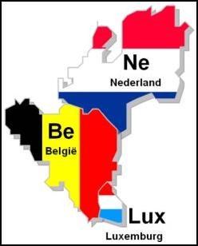
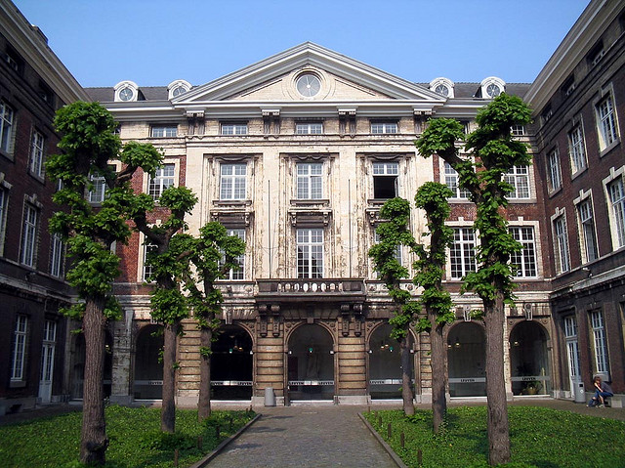
BeNeLux 2012
29-30 november 2012
One day OWASP Training
One day conference
College De Valk Leuven
Building agenda...

Slide 9

Subscribe mailing list
www.owasp.be
Keep up to date!
9

Slide 10
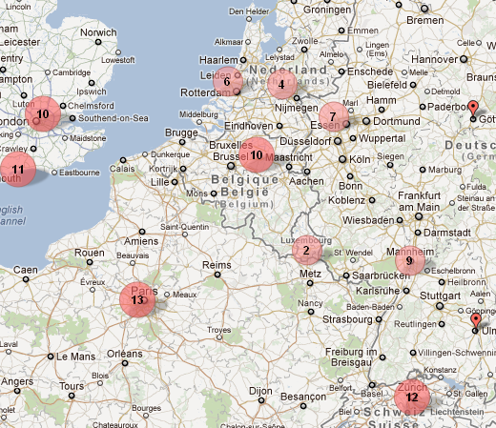
Want to support OWASP?
Become member, annual donation of:
$50 Individual
$5000 Corporate
Enables the support of OWASP projects, mailing lists, conferences, podcasts, grants and global steering activities…
http://batchgeo.com/map/4f35033fd964eb692a5268d81d15e18c
10

