Slide 1
A New Ontology of Unwanted Web Automation
Colin Watson
AppSec USA 2015, San Francisco, Thursday 24th September 2015

Slide 2



All high and medium vulnerabilities eliminated, OWASP Top 10 covered, and the S-SDLC ticking along nicely
You need to buy our new product as a service offering for that
Wait! My Ops team is battling against attacks all the time
Information Security Manager
Chief Operating Officer
Vendor Sales Rep
Problem Definition
Notes:
Most web applications are not under a constant state of compromise, regardless of whether weaknesses and vulnerabilities are present. However, attackers are still using the software in a manner that causes significant pain to the owners/operators, and sometimes also the users.

Slide 3
AppSensor
AppSensor Detection Points
Notes:
Previous work on OWASP AppSensor (application-specific attack detection and response) has identified 50 or so types of detection points, and I had speculated about which detection points would be most beneficial to implement first. All AppSensor detection points should have an extremely low false positive attack detection rate so that normal usage is never flagged as malicious, but I wondered which detection points might identify attackers sooner than others - before some potential vulnerability could be targeted. What I needed was a list of threats (probably automated threats) that were not just attempting to exploit individual implementation bugs or misconfigurations. In other words, what are attackers actually doing most of the time?
And here I came across a blocker - there did not seem to be a clear categorisation or quantification of the actual automated threats most web application owners have to deal with day to day. These are also mostly not included in “breach” statistics and discussions, even though breaches of security are occurring. Instead, there is a greater focus on individual types of weaknesses and vulnerabilities, root cause analysis of data confidentiality breaches, and capabilities from vendors about product/services.

Slide 4

Continuous application security
Automated static analysis
Security testing automation
Vulnerability scanning
Application instrumentation
Attack detection & automated response
AppSec dashboards
etc.
DevOps Lead
Good Automation

Slide 5

Account enumeration
Aggregation
Click fraud
Comment spam
Content scraping
etc.
Malicious Automation
Bad Automation
Notes:
Some business owners are submerged in technical details that lead to a lack of comprehension about the relationships between security requirements, security activities during development, deployment and operation, and the operational impact of attacks. It also seems to be the case there is too great a focus on individual weaknesses/vulnerabilities in technical assurance activities, especially where the severity rating of each issue in isolation fails to provide the overall picture. For example, it is common for a number of individual low or medium severity issues to contribute to a much more significant business impact.
The potential misuse of valid functionality is also a concern, as this is an aspect where early design decisions have a significant effect on operational risk.
In order to quantify these threats, it is necessary to be able to name them. This did not seem to exist in the usual dictionaries and classifications. Therefore, I decided to produce an ontology of automated threats from the perspective of defenders. To contain the scope somewhat, I decided to focus solely on web applications, reducing the size of the task.

Slide 6
Definition
Vocabulary
Guidance for developers and operators
Requirement and Objectives
Notes:
There is a significant body of knowledge about application vulnerability types, and some general consensus about identification and naming. But issues relating to the misuse of valid functionality(which may be caused by design flaws rather than implementation bugs) are less well defined. Yet these problems are seen day-in, day-out by web application owners.
Excessive abuse of functionality is commonly misreported as application denial-of-service (DoS) attacks, such as HTTP flooding or application resource exhaustion, when in fact the DoS is a side-effect. Most of these problems seen regularly by web application owners are not listed in any OWASP Top Ten or in any other top issue list or dictionary.
This has contributed to inadequate visibility, and an inconsistency in naming such threats, with a consequent lack of clarity in attempts to address the issues.
The aim was to produce an ontology that would provide a common language for developers, architects, operators, business owners, security engineers, purchasers, and suppliers/vendors, in order to facilitate clear communication and help tackle these issues. The project also intends to identify symptoms, mitigations and controls in this problem area. Like all OWASP outputs, everything is free and published using an open source licence.
The objectives defined in early 2015 were:
Provide a definition of the term “automated threat”
Create a common vocabulary of automated threats and their relationships to each other that maintains consistency with existing literature.
This would involve creating a listing of vendor-neutral, technology-agnostic terms that describe real-world automated threats to web applications, at a level of abstraction suitable for application owners. The ontology and other supporting materials need to be practical and useful for a range of activities throughout a secure software development lifecycle (S-SDLC).

Slide 7

Defining application development security requirements
Sharing intelligence within a sector
Exchanging threat data between CERTs
Enhancing application penetration test findings
Specifying service acquisition needs
Characterising vendor services
CISO
Use Case Scenarios

Slide 8

Threat events to web applications undertaken using automated actions
Abuse of functionality - misuse of inherent functionality and related design flaws, some of which are also referred to as business logic flaws
No coverage of implementation bugs
All the threats must require the web to exist for the threat to be materialised; thus attacks that can be achieved without the web are out of scope.
Malicious Automation
Scope
Notes:
The focus for the project is the abuse of functionality - misuse of inherent functionality and related design flaws, some of which are also referred to as business logic flaws. There is no coverage of implementation bugs. It is neither the case that implementation bugs are not the target of attacks, nor that their exploitation cannot be automated, but there is much more knowledge published in that area with a greater agreement on terminology. The intention was that all the threats must require the web to exist for the threat to be materialised; thus attacks that can be achieved without the web are out of scope.
The terms threat, threat event, web, applications and automated are defined in the glossary on the wiki page.
Some examples that are out of scope for this ontology are:
Native mobile apps (but web application endpoint threats are in scope)
Threats pre deployment (e.g. design, development, testing, deployment)
Threats that affect web application businesses, but that are not undertaken using the web (e.g. in e-commerce: return fraud, wear & return fraud, not delivered fraud, price arbitrage, nearby address fraud, cross-merchant no-receipt returns, friendly fraud)
Other layer 7 protocols including e.g. FTP, SMTP
Host addressing and identification
Attacks targeting network infrastructure
Network, HTTP and SSL/TLS denial of service
Physical and environmental attacks against components supporting web applications.
Therefore, attacks like phishing, pharming, and trojan distribution are excluded.

Slide 9
The threat events are scenarios which are seen commonly by real operating web applications, and are multi-step and/or highly iterative and/or multiple weaknesses involved, and not primarily about events that relate to the tool-based exploitation of single-issue vulnerabilities of individual web applications.
Essentially the ontology needs to be a list of concise answers to the operational question “what is happening right now?”.
CEO
Automated Threat Event Ontology
Notes:
The threat events are scenarios which are seen commonly by real operating web applications, and are multi-step and/or highly iterative and/or multiple weaknesses involved, and not primarily about events that relate to the tool-based exploitation of single-issue vulnerabilities of individual web applications. Essentially the ontology needs to be a list of concise answers to the operational question “what is happening right now?”.
The summary definition created to describe this is “Threat events to web applications undertaken using automated actions”.

Slide 10

Mitre Common Attack Pattern Enumeration and Classification (CAPEC)
Mitre Common Weakness Enumeration (CWE)
Web Application Security Consortium (WASC) Threat Classification
OWASP Top 10 [risks|controls|mobile|...]
Lists of attack methods
etc.
Malicious Automation
Other Lists

Slide 11
Literature review
  https://www.owasp.org/index.php/OWASP_Automated_Threats_to_Web_Applications#tab=Bibliography
Analysis
Comparison with other lists & taxonomies
Peer review
  Professional colleagues
  Web application owners
  Web application developers
  Delegates at AppSec EU 2015 via an online and printed survey form
  One-to-one interviews with participants of the OWASP Project Summit 2015 in Amsterdam
  Others who found the project by search, or from coverage relating to a presentation to be given at AppSec USA in San Francisco in September 2015.
Version 1
AppSec USA 2015
Manual Process
Notes:
Work began on the project in late January 2015. Over 150 sources of information were identified, read and relevant threat information extracted. The full list of academic papers, blog posts, briefings, conference presentations, dictionaries, news stories, reports, technical papers and white papers is published on the OWASP wiki.
This created over 600 data points describing a mixture of threats, attacks and some vulnerabilities. Updates were periodically posted to the project pages on the OWASP wiki.
Anything relating to exploitation of implementation bugs was excluded. Forty or so clusters of threats were extracted from this diagram, and this was reduced further to a slightly smaller number of candid threat event names. Work then began to identify inter-relationships, similarities, overlaps and unique aspects. This process was undertaken over 1-2 months and reduced the number of recommended threat event names to just over twenty. Further de-duplication reduced the final count to nineteen. See below for a discussion of some of the candidate names that did not make the list.
The project was announced in the OWASP Foundation’s Connector newsletter sent to 60,000+ recipients in April 2015. It was also highlighted in a two-side colour flyer included in every delegate’s bag at AppSec EU 2015 in Amsterdam. A limited amount of peer review has been undertaken over a couple of months. The peer review led to clearer scope, suggestions for additional threats, and changes to both the names and descriptions of the threat events. Further peer review would be welcome.

Slide 12
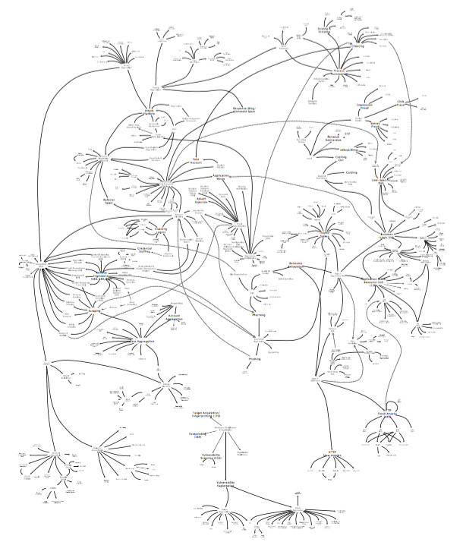
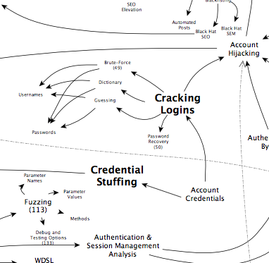
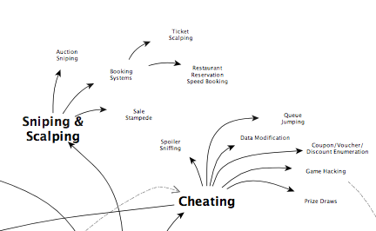
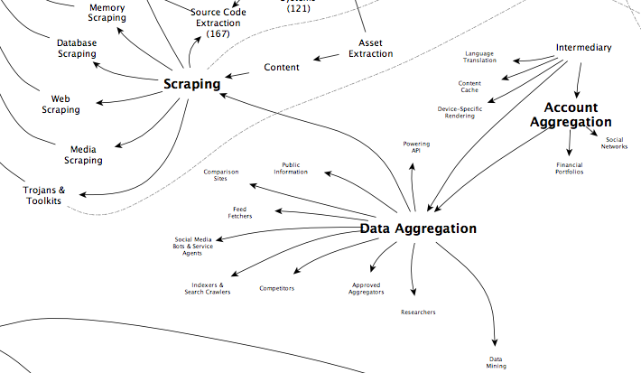
Threat Event Analysis
Notes:
Those 600 original data points were first converted into a large-scale diagram to aid with distilling them down. This attempted to remove duplication and highlight interrelationships. The diagram can be found on the OWASP wiki.
Threat events
Attack vectors
Vulnerabilities
Motives
Naming not important, overlaps and duplication, and also things out-of-scope. Some of the out-of-scope were useful to define boundaries or to identify where similarities and differences exist.

Slide 13
Blank
Blank

Slide 14
OAT-020 Account Aggregation
OAT-019 Account Creation
OAT-003 Ad Fraud
OAT-009 CAPTCHA Bypass
OAT-010 Card Cracking
OAT-001 Carding
OAT-012 Cashing Out
OAT-007 Credential Cracking
OAT-008 Credential Stuffing
OAT-015 Denial of Service
OAT-006 Expediting
OAT-004 Fingerprinting
OAT-018 Footprinting
OAT-005 Scalping
OAT-011 Scraping
OAT-016 Skewing
OAT-013 Sniping
OAT-017 Spamming
OAT-002 Token Cracking
OAT-014 Vulnerability Scanning
Ontology
Notes:
Full details of the finalised ontology threat events are provided shortly. A summary is provided below. Table 1 lists the threat events ordered by ascending identity code, and Table 2 lists them by ascending name.
The details at the end of this handbook categorise the threat events by:
Sectors Targeted - Sectors that are targeted more commonly than others for the specific threat event are highlighted in amber; this is currently just the author’s opinion, but the project is seeking information to define this aspect more accurately
Parties Affected - Whether individuals, groups of people, the application owner and other parties are most often affected adversely by the threat event; the threat event may affect other parties depending upon the application and its data; the parties affected, excluding subsequent further misuse
Data Commonly Misused - The types of data are web application specific; however, some threat events are more likely to occur for certain data types.
Each threat event is also cross-referenced with:
Mitre CAPEC - best full and/or partial match CAPEC category IDs and/or attack pattern IDs
WASC Threat Classification - best match to threat IDs
Mitre Common Weakness Enumeration - closely related base, class & variant weakness IDs
Matching pages defining terms classified as attacks on the OWASP wiki.

Slide 15
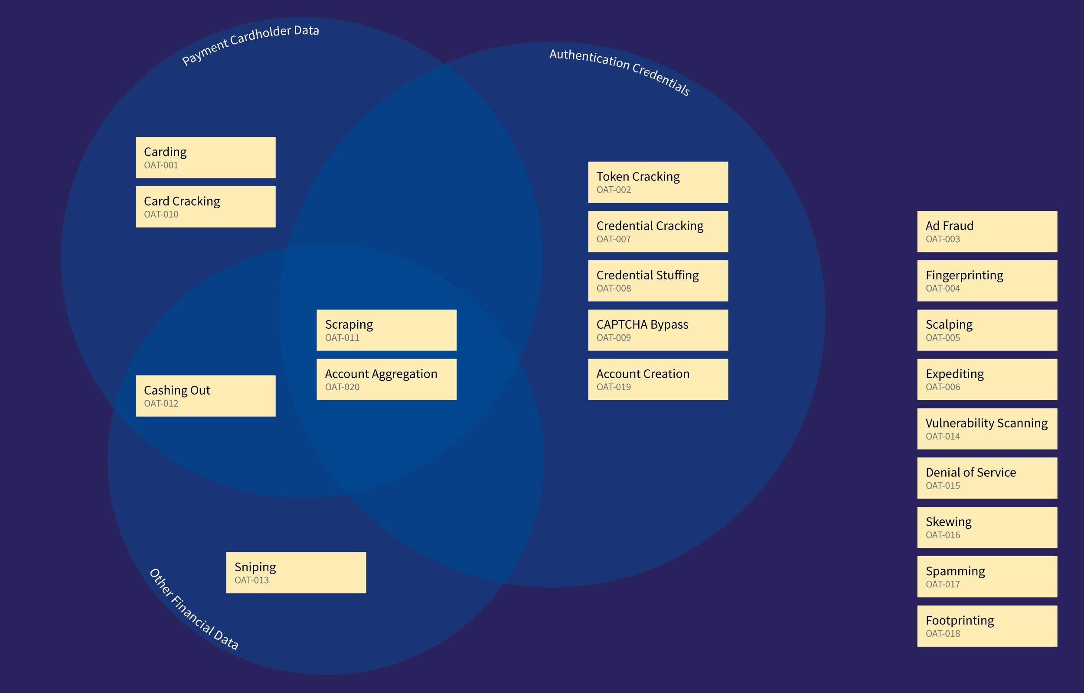
Data Misused View

Slide 16
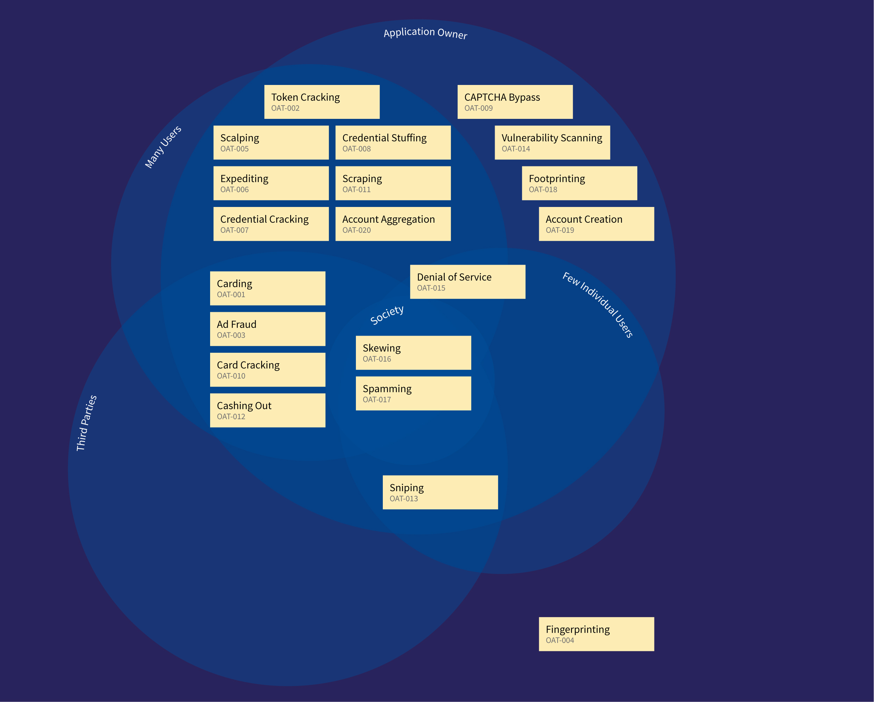
Affected Party View

Slide 17
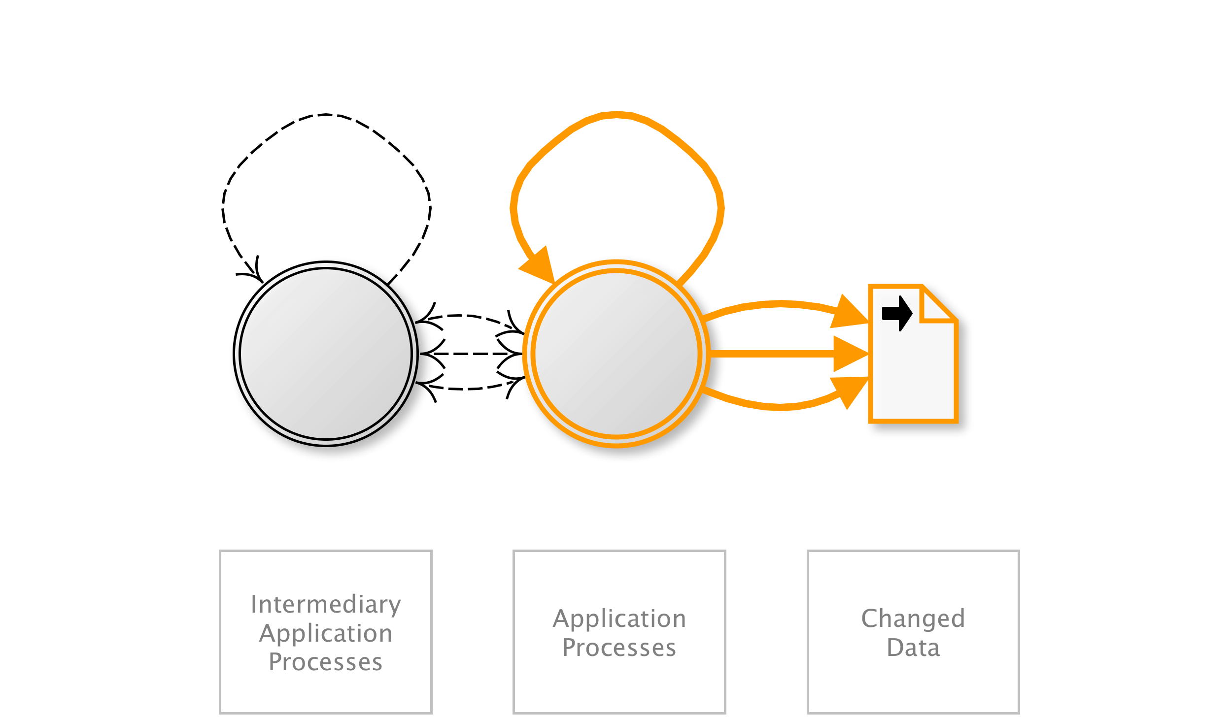
OAT-020 Account Aggregation
Use by an intermediary application to collect together accounts and interact on their behalves.
AKA Account automation; Aggregator; Client aggregator; Data aggregation; Financial account aggregator; Account aggregation; Aggregator; Client aggregator; Data aggregation; Financial account aggregator; Account aggregation; Aggregator; Client aggregator; Data aggregation; Financial account aggregator
OAT-020 Account Aggregation
Notes:
Compilation of credentials and information from multiple application accounts into another system. This aggregation application may be used by a single user to merge information from multiple applications, or alternatively to merge information of many users of a single application. Commonly used for aggregating social media accounts, email accounts and financial accounts in order to obtain a consolidated overview, to provide integrated reporting and analysis, and to simplify usage and consumption by the user and/or their professional advisors. May include making changes to account properties and interacting with the aggregated application’s functionality.
For other forms of data harvesting, including the distribution of content, see OAT-011 Scraping. For hastening progress, see OAT-006 Expediting instead.
Financial/Government/Social networking
Many users/Application owner
Authentication credentails/Payment cardholder data/Other financial data/Medical data/Other personal data/Other business data

Slide 18
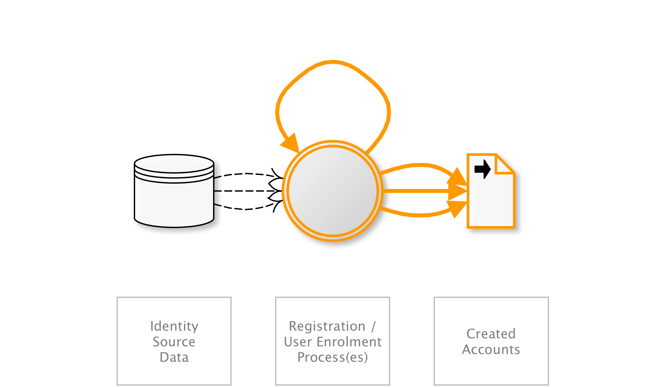
OAT-019 Account Creation
Create multiple accounts for subsequent misuse.
AKA Account pharming; Fake account; Fake social media account creation; Impersonator bot; Massive account registration; New account creation; Registering many user accounts
OAT-019 Account Creation
Notes:
Bulk account creation, and sometimes profile population, by using the application’s account sign-up processes. The accounts are subsequently misused for generating content spam, laundering cash and goods, spreading malware, affecting reputation, causing mischief, and skewing search engine optimisation (SEO), reviews and surveys.
Account Creation generates new accounts - see OAT-007 Credential Cracking and OAT-008 Credential Stuffing for threat events that use existing accounts.
Education/Entertainment/Financial/Retail/Social networking
Application owner
Authentication credentials/Other business data

Slide 19
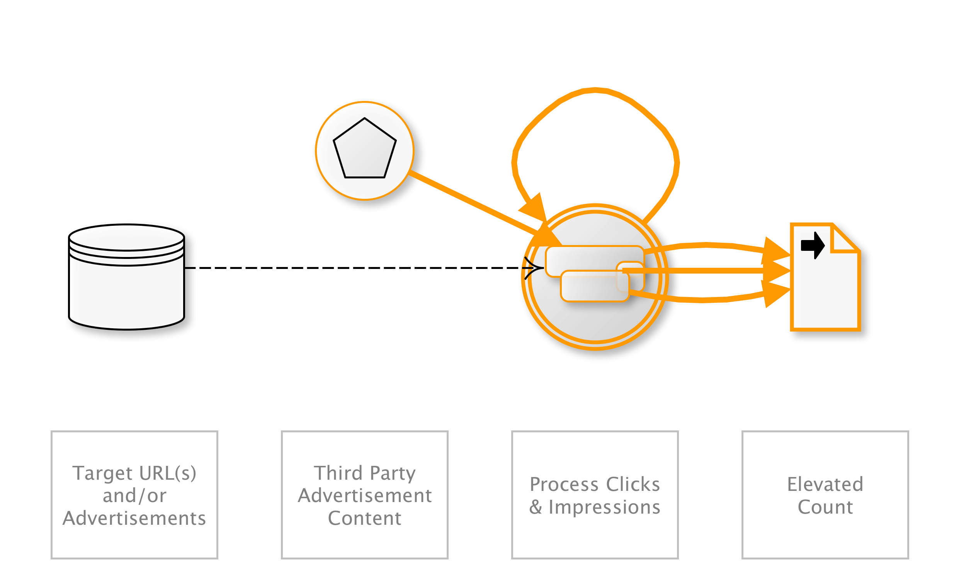
OAT-003 Ad Fraud
False clicks and fraudulent display of web-placed advertisements.
AKA Advert fraud; Adware traffic; Click bot; Click fraud; Hit fraud; Impression fraud; Pay per click advertising abuse; Phoney ad traffic
OAT-003 Ad Fraud
Notes:
Falsification of the number of times an item such as an advert is clicked on, or the number of times an advertisement is displayed. Performed by owners of web sites displaying ads, competitors and vandals.
See OAT-016 Skewing instead for similar activity that does not involve web-placed advertisements.
Entertainment/Financial/Health/Retail/Technology/Social networking
Application owner/Third parties
Other business data

Slide 20
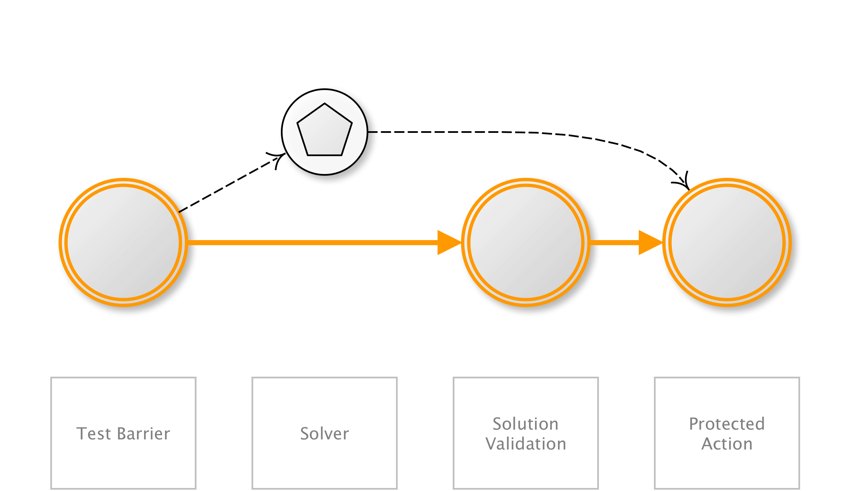
OAT-009 CAPTCHA Bypass
Solve anti-automation tests.
AKA Breaking CAPTCHA; CAPTCHA breaker; CAPTCHA breaking; CAPTCHA decoding; CAPTCHA solver; CAPTCHA solving; Puzzle solving
OAT-009 CAPTCHA Bypass
Notes:
Completely Automated Public Turing test to tell Computers and Humans Apart (CAPTCHA) challenges are used to distinguish normal users from bots. Automation is used in an attempt to analyse and determine the answer to visual and/or aural CAPTCHA tests and related puzzles. Apart from conventional visual and aural CAPTCHA, puzzle solving mini games or arithmetical exercises are sometimes used. Some of these may include context-specific challenges.
The process that determines the answer may utilise tools to perform optical character recognition, or matching against a prepared database of pre-generated images, or using other machine reading, or human farms.
Entertainment/Entertainment/Financial/Government/Retail/Social networking
Application owner
Authentication credentials

Slide 21
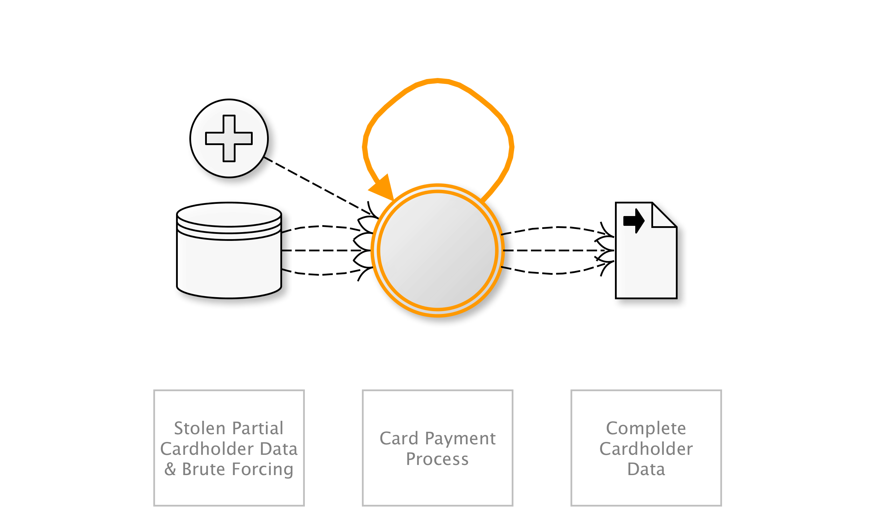
OAT-010 Card Cracking
Identify missing start/expiry dates and security codes for stolen payment card data by trying different values.
AKA Brute forcing credit card information; Card brute forcing; Credit card cracking
OAT-010 Card Cracking
Notes:
Brute force attack against application payment card processes to identify the missing values for start date, expiry date and/or card security code (CSC), also referred to in many ways, including card validation number 2 (CVN2), card validation code (CVC), card verification value (CV2) and card identification number (CID).
When these values are known as well as the Primary Account Number (PAN), OAT-001 Carding is used to validate the details, and OAT-012 Cashing Out to obtain goods or cash.
Retail
Many users/Application owner/Third parties
Payment cardholder data

Slide 22
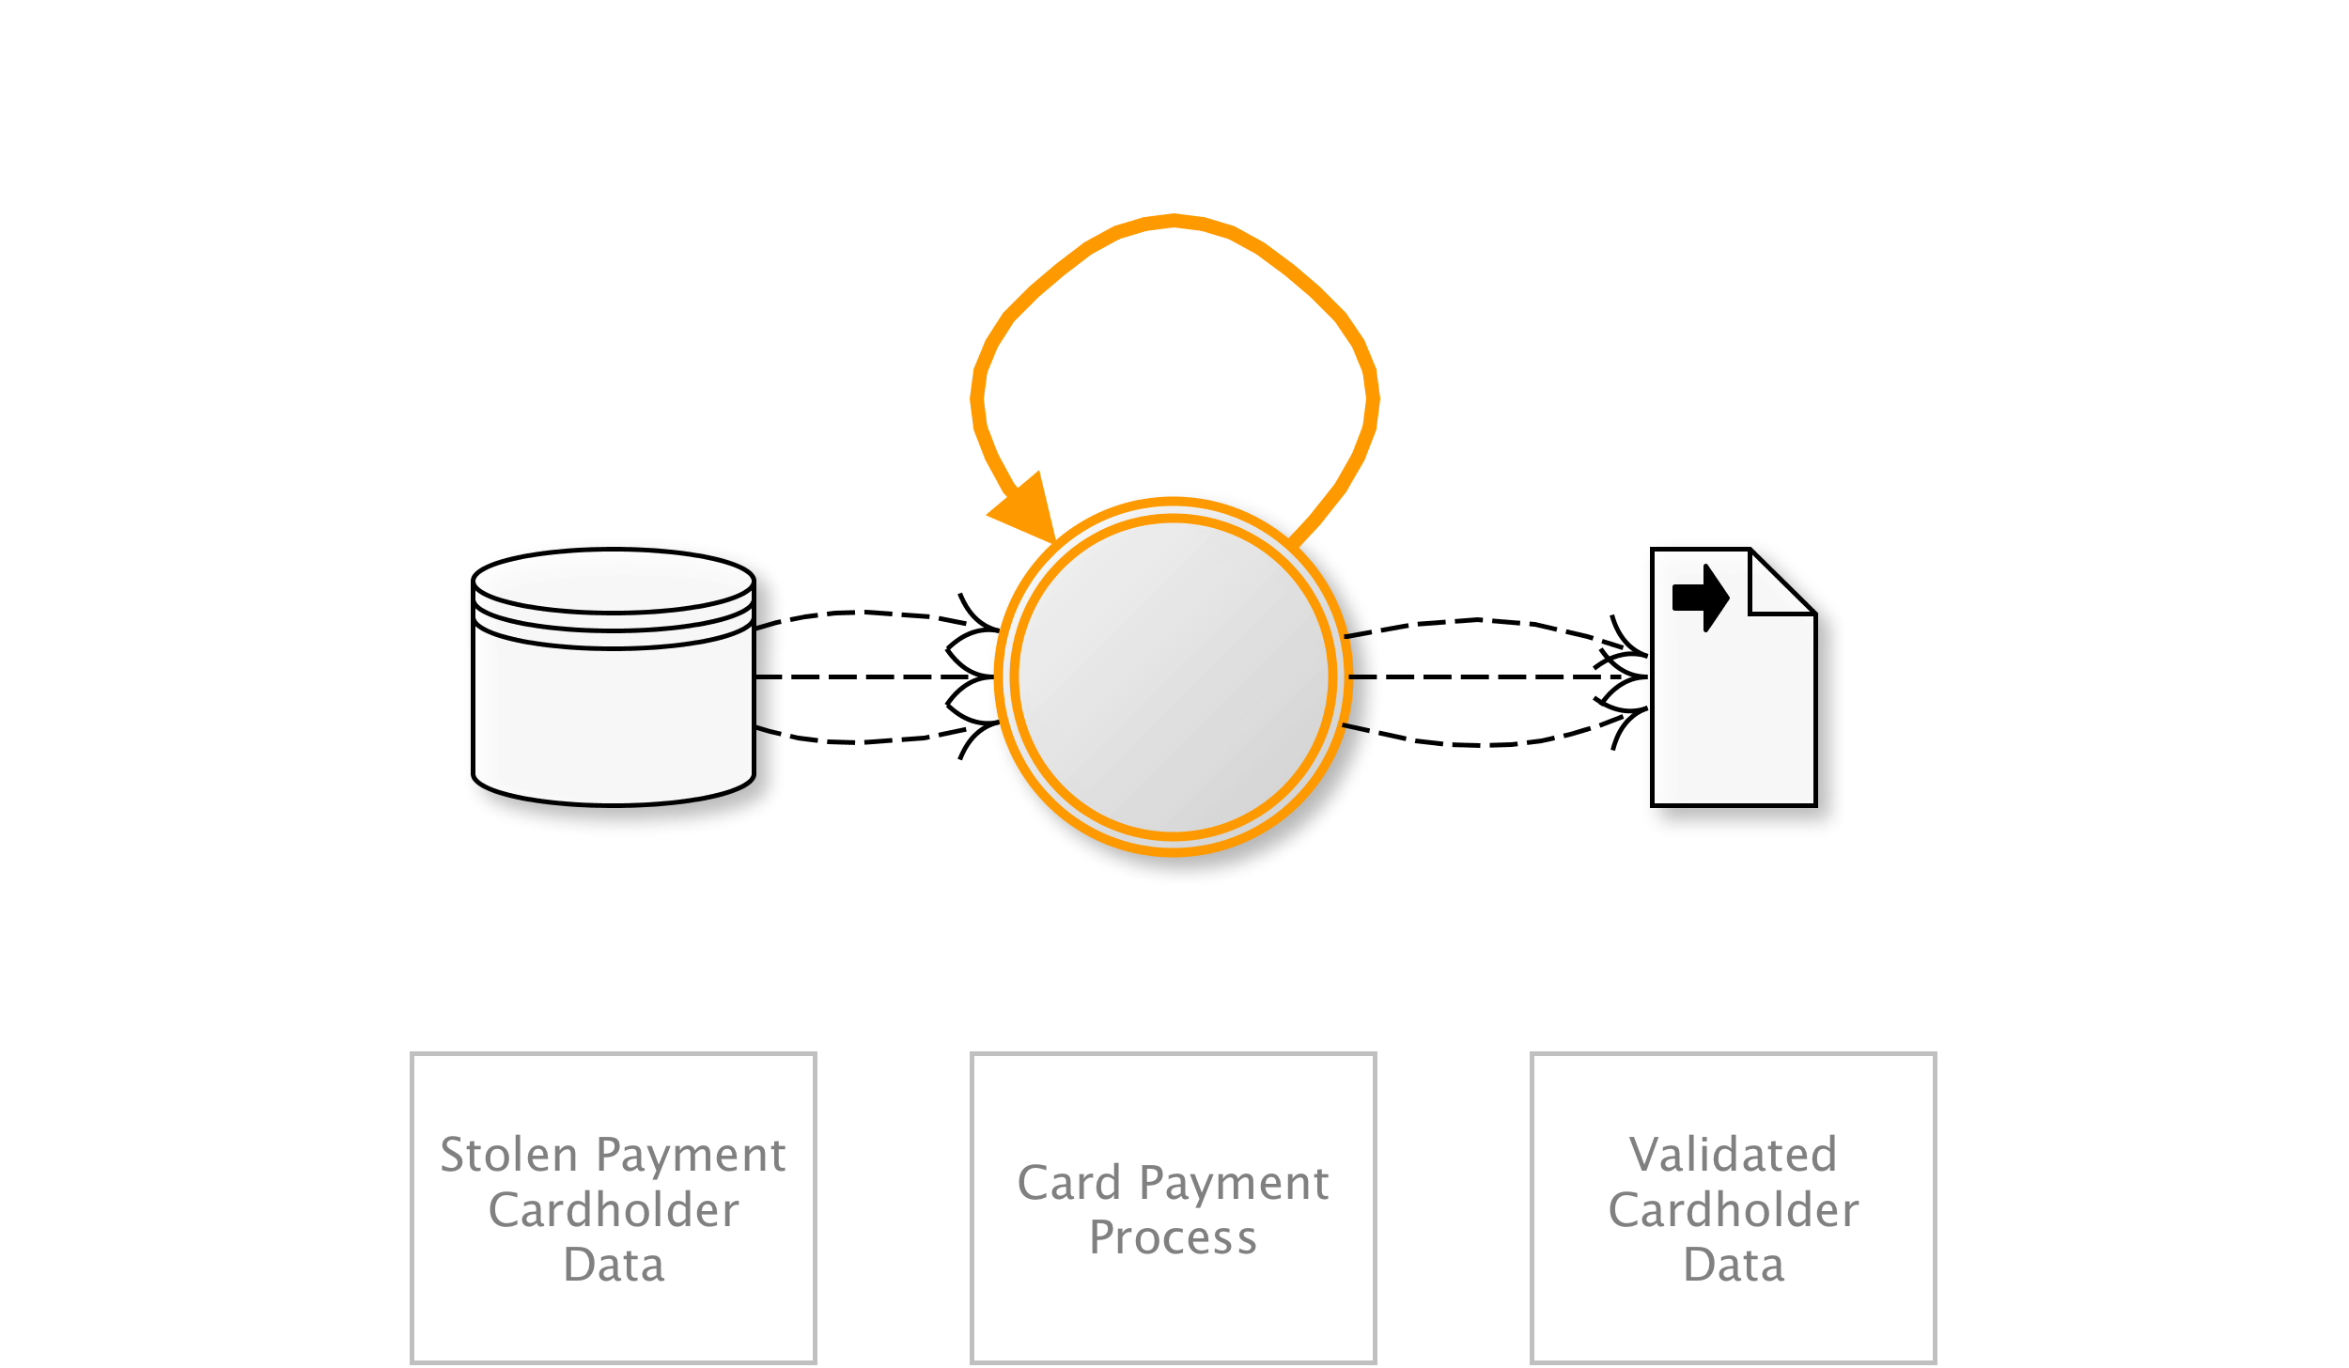
OAT-001 Carding
Multiple payment authorisation attempts used to verify the validity of bulk stolen payment card data.
AKA Card stuffing; Credit card stuffing; Card verification
OAT-001 Carding
Notes:
Lists of full credit and/or debit card data are tested against a merchant’s payment processes to identify valid card details. The quality of stolen data is often unknown, and Carding is used to identify good data of higher value. Payment cardholder data may have been stolen from another application, stolen from a different payment channel, or acquired from a criminal marketplace.
When partial cardholder data is available, and the expiry date and/or security code are not known, the process is OAT-010 Card Cracking instead. The use of stolen cards to obtain cash or goods is OAT-012 Cashing Out.
Entertainment/Retail
Many users/Application owner/Third parties
Payment cardholder data

Slide 23
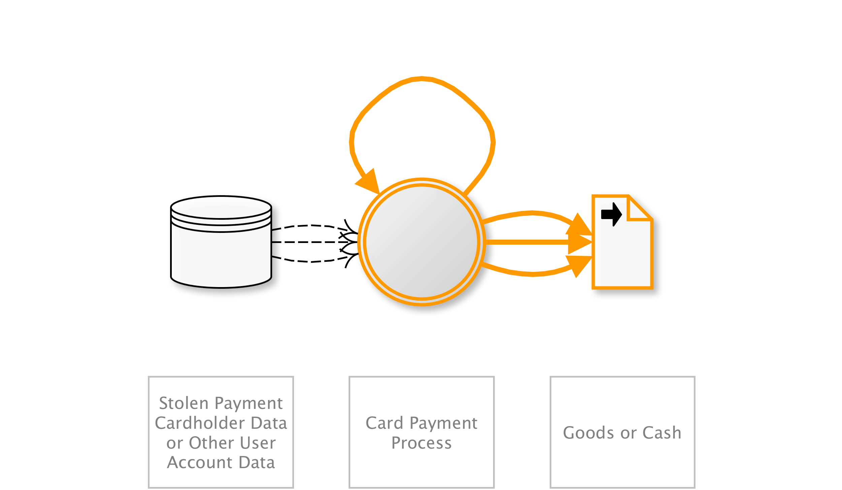
OAT-012 Cashing Out
Buy goods or obtain cash utilising validated stolen payment card or other user account data.
AKA Money laundering; Online credit card fraud; Online payment card fraud; Refund fraud; Stolen identity refund fraud (SIRF)
OAT-012 Cashing Out
Notes:
Obtaining currency or higher-value merchandise via the application using stolen, previously validated payment cards or other account login credentials. Cashing Out sometimes may be undertaken in conjunction with product return fraud. For financial transactions, this is usually a transfer of funds to a mule’s account. For payment cards, this activity may occur following OAT-001 Carding of bulk stolen data, or OAT-010 Card Cracking, and the goods are dropped at a reshipper’s address. The refunding of payments via non-financial applications (e.g. tax refunds, claims payment) is also included in Cashing Out.
Obtaining other information of value from the application is instead OAT-011 Scraping.
Entertainment/Financial/Government/Retail
Many users/Application owner/Third parties
Authentication credentials/Payment cardholder data/Other financial data

Slide 24
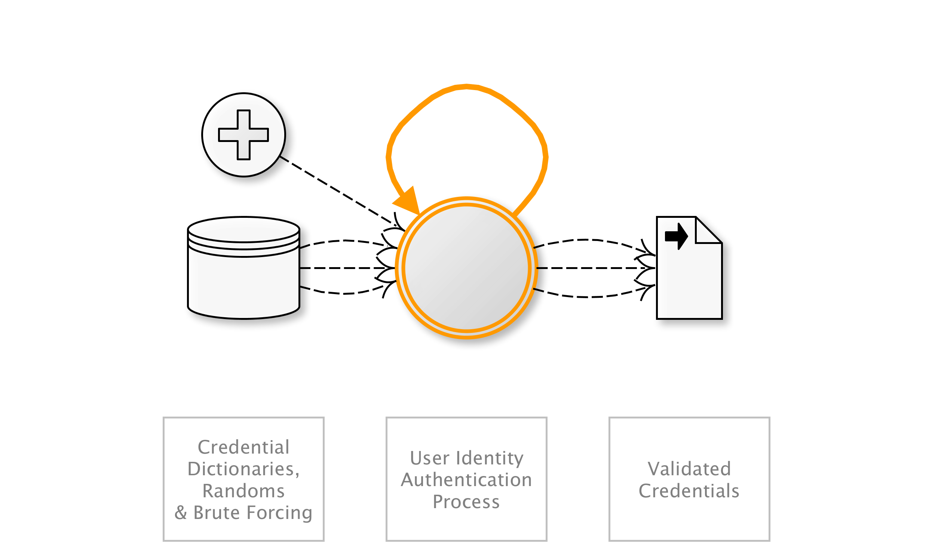
OAT-007 Credential Cracking
Identify valid login credentials by trying different values for usernames and/or passwords.
AKA Brute-force attacks against sign-in; Brute forcing log-in credentials; Brute-force password cracking; Cracking login credentials; Password brute-forcing; Password cracking; Reverse brute force attack; Username cracking; Username enumeration
OAT-007 Credential Cracking
Notes:
Brute force, dictionary (word list) and guessing attacks used against authentication processes of the application to identify valid account credentials. This may utilise common usernames or passwords, or involve initial username evaluation.
The use of stolen credential sets (paired username and passwords) to authenticate at one or more services is OAT-008 Credential Stuffing.
(all)
Many users/Application owner
Authentication credentials

Slide 25
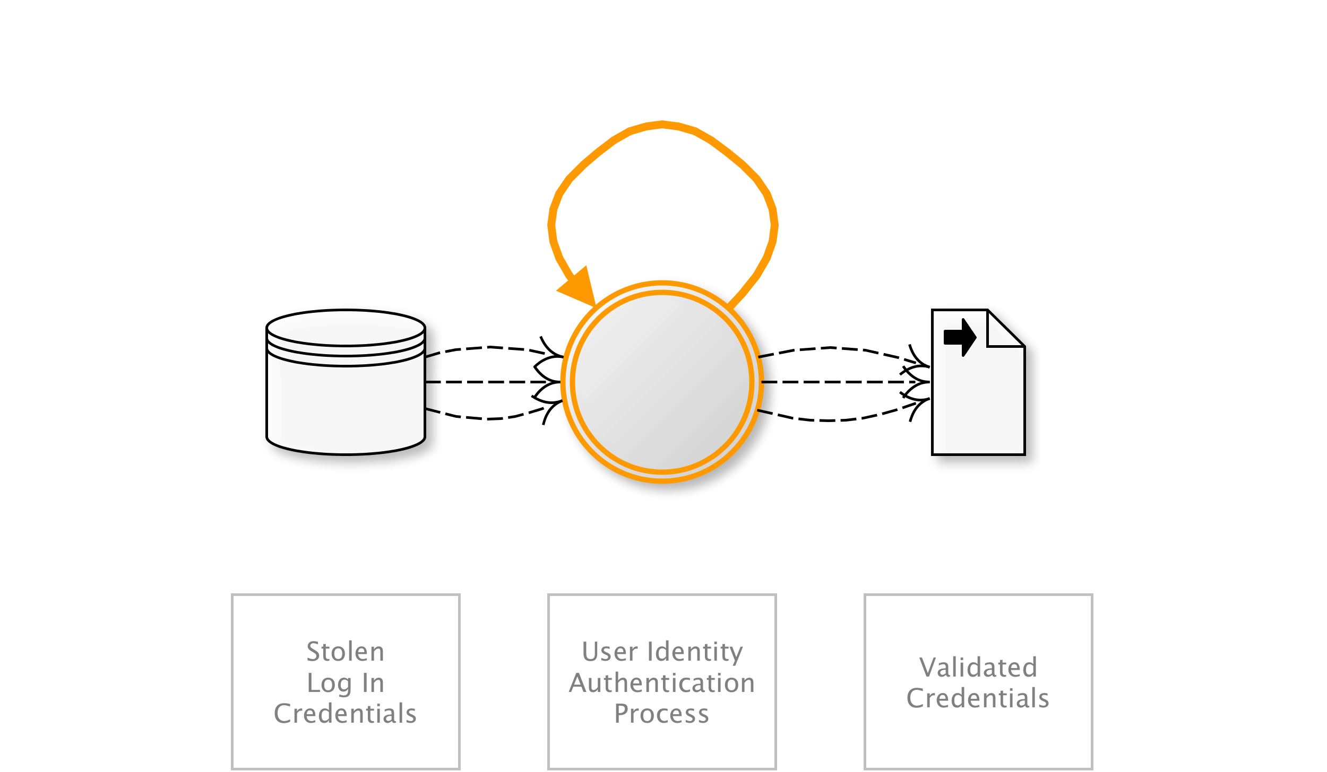
OAT-008 Credential Stuffing
Mass log in attempts used to verify the validity of stolen username/password pairs.
AKA Account checker attack; Account checking; Account takeover; Account takeover attack; Login Stuffing; Password list attack; Password re-use; Stolen credentials; Use of stolen credentials
OAT-008 Credential Stuffing
Notes:
Lists of authentication credentials stolen from elsewhere are tested against the application’s authentication mechanisms to identify whether users have re-used the same login credentials. The stolen usernames (often email addresses) and password pairs could have been sourced directly from another application by the attacker, purchased in a criminal marketplace, or obtained from publicly available breach data dumps.
Unlike OAT-007 Credential Cracking, Credential Stuffing does not involve any brute-forcing or guessing of values; instead credentials used in other applications are being tested for validity.
Entertainment/Financial/Government/Retail/Social networking
Many users/Application owner
Authentication credentials

Slide 26
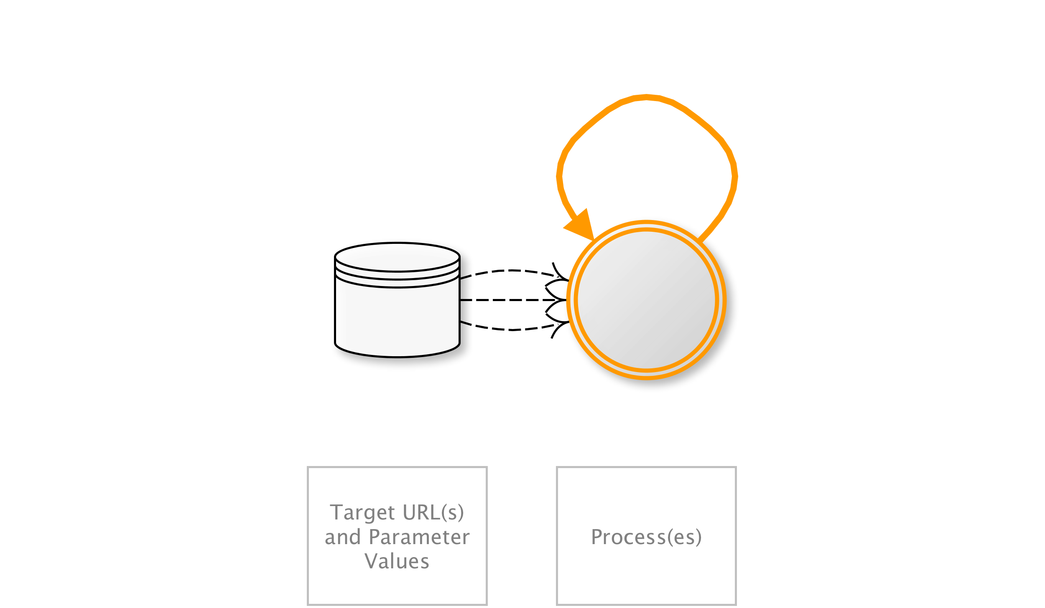
OAT-015 Denial of Service
Target resources of the application and database servers, or individual user accounts, to achieve denial of service (DoS).
AKA Account lockout; App layer DDoS; Asymmetric resource consumption (amplification); Business logic DDoS; Cash overflow; Forced deadlock; Hash DoS; Inefficient code; Indexer DoS; Large files DoS; Resource depletion, locking or exhaustion; Sustained client engagement
OAT-015 Denial of Service
Notes:
Usage may resemble legitimate application usage, but leads to exhaustion of resources such as file system, memory, processes, threads, CPU, and human or financial resources. The resources might be related to web, application or databases servers or other services supporting the application, such as third party APIs, included third-party hosted content, or content delivery networks (CDNs). The application may be affected as a whole, or the attack may be against individual users such as account lockout.
This ontology’s scope excludes other forms of denial of service that affect web applications, namely HTTP Flood DoS (GET, POST, Header with/without TLS), HTTP Slow DoS, IP layer 3 DoS, and TCP layer 4 DoS. Those protocol and lower layer aspects are covered adequately in other taxonomies and lists.
Entertainment/Financial/Government/Retail/Technology/Social networking
Few individual users/Many users/Application owner
NA

Slide 27
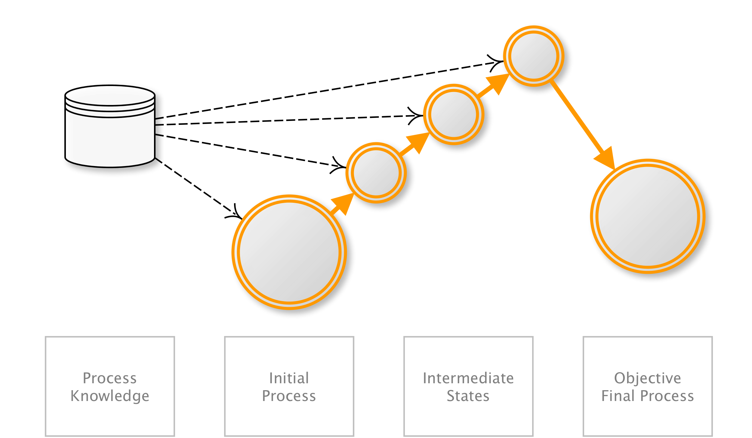
OAT-006 Expediting
Perform actions to hasten progress of usually slow, tedious or time-consuming actions on behalf of a person.
AKA Algorithmic trading; Automated stock trading; Betting automation; Game automation; Gaming bot; Gold farming; Financial instrument dealing; High frequency trading; Purchase automation; Ticketing automation; Trading automation; Virtual wealth generation
OAT-006 Expediting
Notes:
Using speed to violate explicit or implicit assumptions about the application’s normal use to achieve unfair individual gain, often associated with deceit and loss to some other party.
In contrast to OAT-016 Skewing which affects metrics, Expediting is purely related to faster progression through a series of application processes. And OAT-017 Spamming is different to Expediting, since the focus of spam is to add information, and may not involve the concept of process progression.
Entertainment/Financial/Government/Retail/Social networking
Many users/Application owner
Other business data

Slide 28
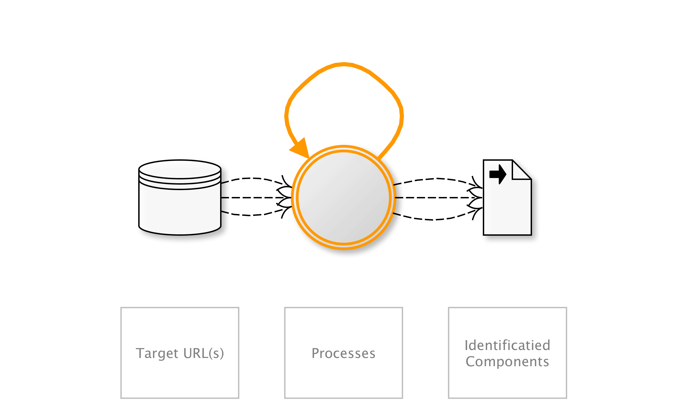
OAT-004 Fingerprinting
Elicit information from the web, application and database servers about the supporting software and framework types and versions.
AKA Google dorking; Google hacking; Shodaning; Target acquisition; Target scanning; Finding potentially vulnerable applications; Reconnaissance; URL harvesting; Web application fingerprinting
OAT-004 Fingerprinting
Notes:
Specific requests are sent to the application eliciting information in order to profile the application. This probing typically examine HTTP header names and values, session identifier names and formats, contents of error page messages, URL path case sensitivity, URL path patterns, file extensions, and whether software-specific files and directories exist. Fingerprinting is often reliant on information leakage and this profiling may also reveal some network architecture/topology. The fingerprinting may be undertaken without any direct usage of the application e.g. by quering a store of exposed application properties such as held in a search engine’s index.
Fingerprinting seeks to identity application components, whereas OAT-018 Footprinting is a more detailed analysis of how the application works.
All sectors
No specific party affected
Public information

Slide 29
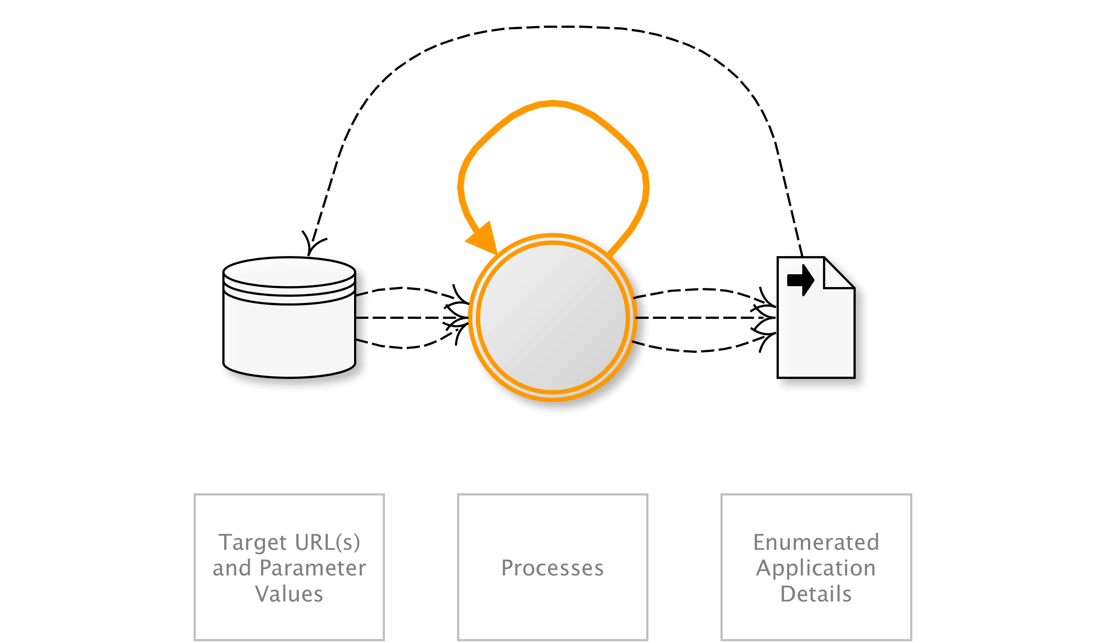
OAT-018 Footprinting
Probe and explore application to identify its constituents and properties.
AKA Application analysis; API discovery; Application enumeration; Automated scanning; CGI scanning; Crawler; Crawling; Excavation; Forced browsing; Forceful browsing; Fuzzing; Micro service discovery; Scanning; Spidering; WSDL scanning
OAT-018 Footprinting
Notes:
Information gathering with the objective of learning as much as possible about the composition, configuration and security mechanisms of the application. Unlike Scraping, Footprinting is an enumeration of the application itself, rather than the data. It is used to identify all the URL paths, parameters and values, and process sequences (i.e. to determine entry points, also collectively called the attack surface). As the application is explored, additional paths will be identified which in turn need to be examined.
Footprinting can also include brute force, dictionary and guessing of file and directory names. Fuzzing may also be used to identify further application resources and capabilities. However, it does not include attempts to exploit weaknesses.
(all)
Application owner
Other business data/Public information

Slide 30
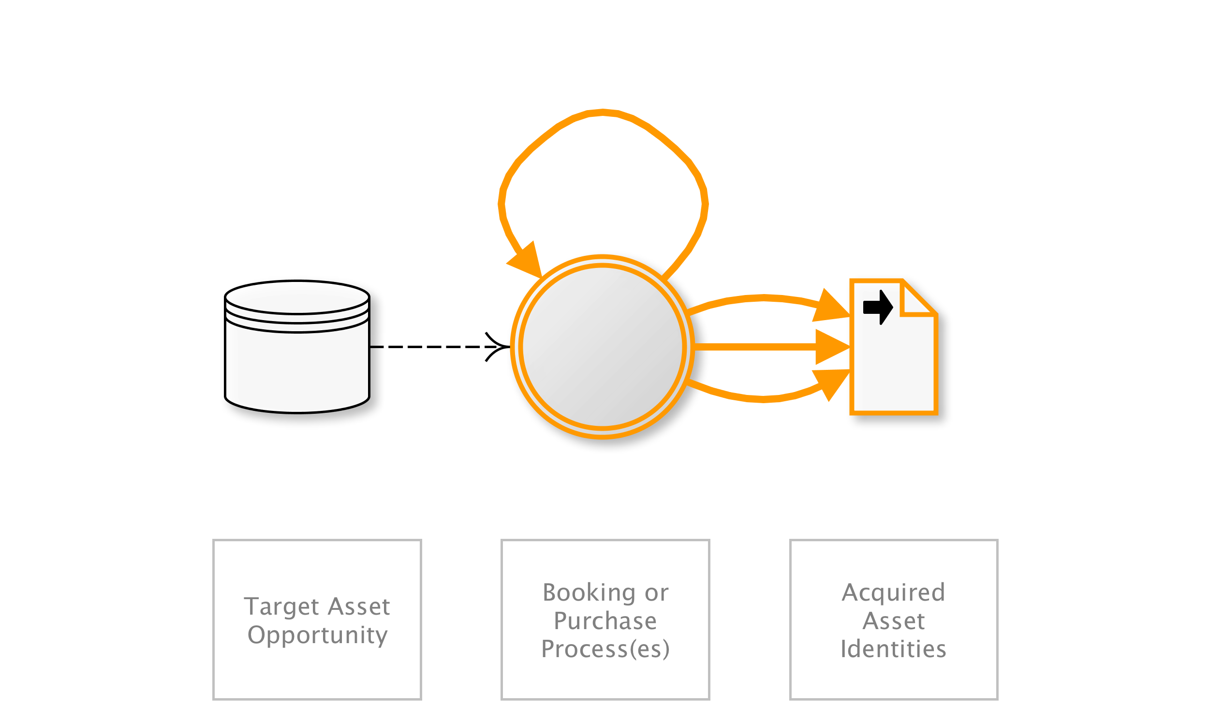
OAT-005 Scalping
Obtain limited-availability and/or preferred goods/services by unfair methods.
AKA Bulk purchase; Purchase automaton; Purchase bot; Restaurant table/hotel room reservation speed-booking; Queue jumping; Sale stampede; Ticket resale; Ticket scalping; Ticket touting
OAT-005 Scalping
Notes:
Mass acquisition of goods or services using the application in a manner that a normal user would be unable to undertake manually.
Although Scalping may include monitoring awaiting availability of the goods or services, and then rapid action to beat normal users to obtain these, Scalping is not a “last minute” action like OAT-013 Sniping, nor just related to automation on behalf of the user such as in OAT-006 Expediting. This is because Scalping includes the additional concept of limited availability of sought-after goods or services, and is most well known in the ticketing business where the tickets acquired are then resold later at a profit by the scalpers/touts. This can also lead to a type of user denial of service since the goods or services become unavailable rapidly.
Entertainment/Financial/Retail
Many users/Application owner
-

Slide 31

OAT-011 Scraping
Collect application content and/or other data for use elsewhere.
AKA API provisioning; Bargain hunting; Comparative shopping; Content scraping; Data aggregation; Database scraping; Farming; Harvesting; Meta search scraper; Mining; Mirroring; Pagejacking; Powering APIs; Ripping; Scraper bot; Screen scraping; Search engine bot; Social media bot
OAT-011 Scraping
Notes:
Collecting accessible data and/or processed output from the application. Some scraping may use fake or compromised accounts, or the information may be accessible without authentication. The scraper may attempt to read all accessible paths and parameter values for web pages and APIs, collecting the responses and extracting data from them. Scraping may occur in real time, or be more periodic in nature. Some Scraping may be used to gain insight into how it is constructed and operates - perhaps for cryptanalysis, reverse engineering, or session analysis.
When another application is being used as an intermediary between the user(s) and the real application, see OAT-020 Account Aggregation. If the intent is to obtain cash or goods, see OAT-012 Cashing Out instead.
(all)
Many users/Application owner
(all)

Slide 32
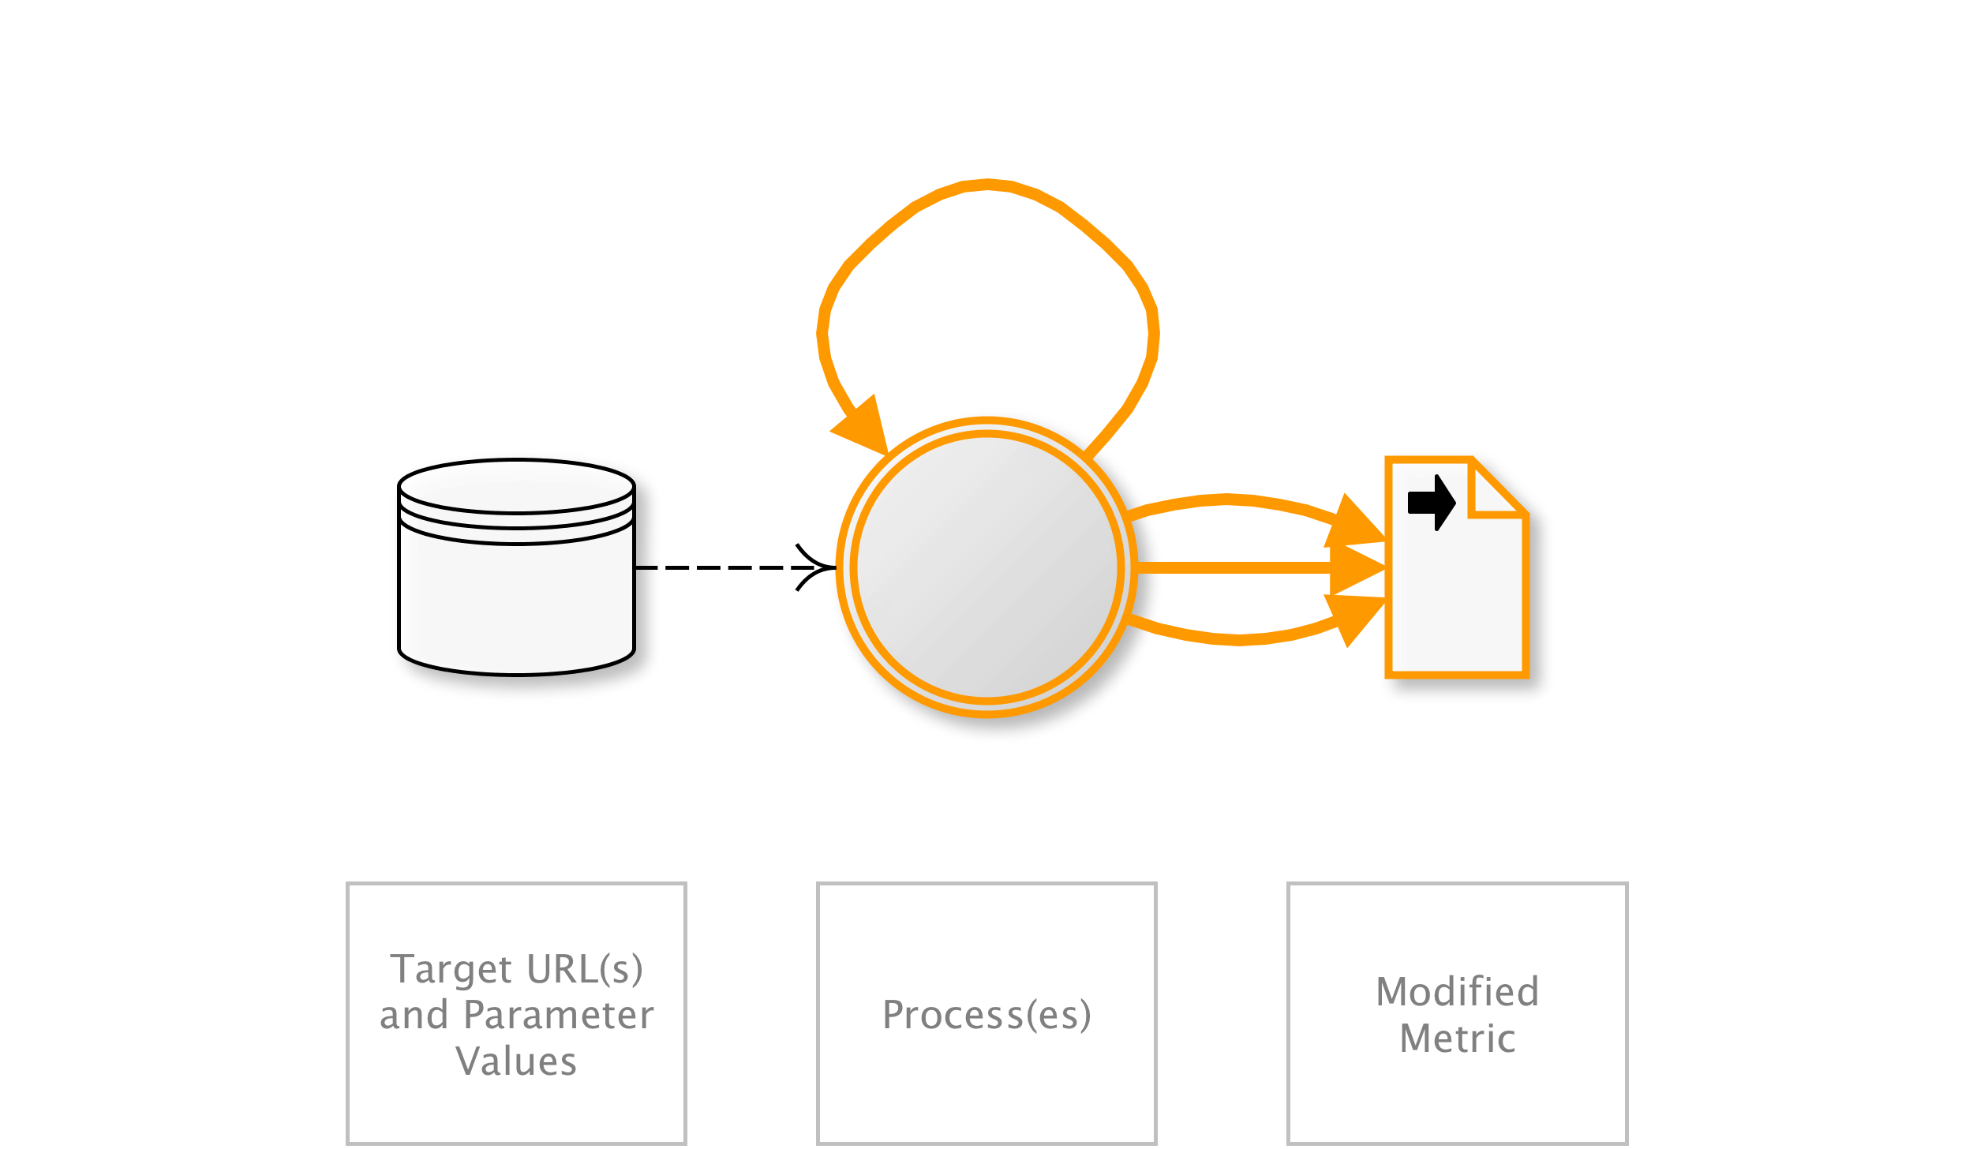
OAT-016 Skewing
Repeated link clicks, page requests or form submissions intended to alter some metric.
AKA Biasing KPIs; Boosting friends, visitors, and likes; Click fraud; Election fraud; Hit count fraud; Market distortion; Metric and statistic skewing; Page impression fraud; Poll fraud; Poll skewing; Poll/voting subversion; Rating/review skewing; SEO; Stock manipulation; Survey skewing
OAT-016 Skewing
Notes:
Automated repeated clicking or requesting or submitting content, affecting application-based metrics such as counts and measures of frequency and/or rate. The metric or measurement may be visible to users (e.g. betting odds, likes, market pricing, visitor count, poll results, reviews) or hidden (e.g. application usage statistics, business performance indicators). Metrics may affect individuals as well as the application owner, e.g. user reputation, influence others, gain fame, or undermine someone else’s reputation.
For malicious alteration of digital advertisement metrics, see OAT-003 Ad Fraud instead.
(all)
(all)
Other personal data/Other business data/Public information

Slide 33
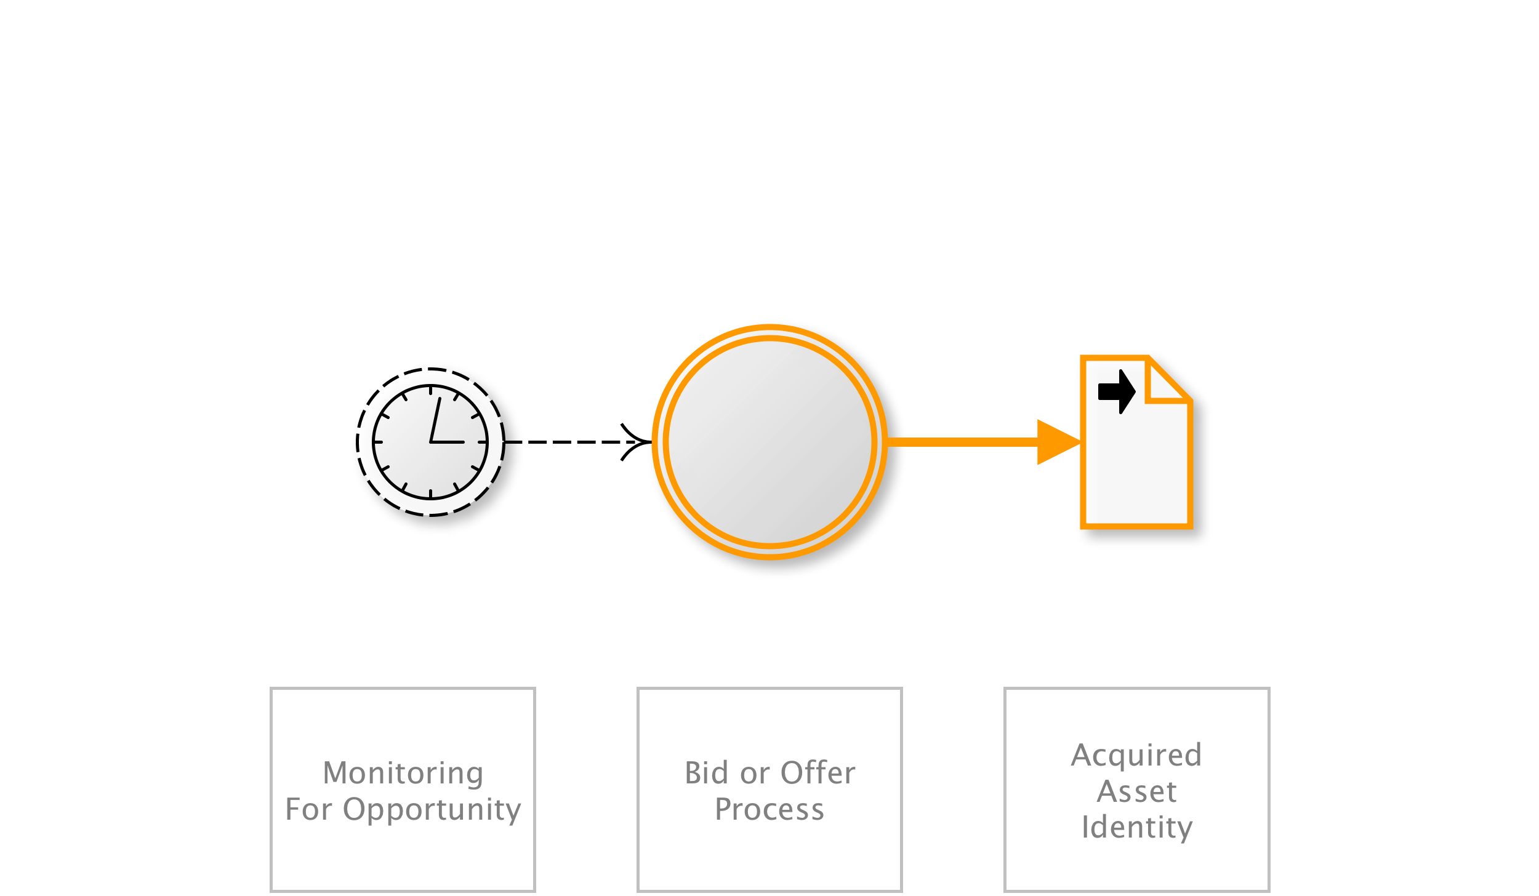
OAT-013 Sniping
Last minute bid or offer for goods or services.
AKA Auction sniping; Bid sniper; Front-running; Last look; Last minute bet; Timing attack
OAT-013 Sniping
Notes:
The defining characteristic of Sniping is an action undertaken at the latest opportunity to achieve a particular objective, leaving insufficient time for another user to bid/offer. Sniping can also be the automated exploitation of system latencies in the form of timing attacks. Careful timing and prompt action are necessary parts. It is most well known as auction sniping, but the same threat event can be used in other types of applications. Sniping normally leads to some disbenefit for other users, and sometimes that might be considered a form of denial of service.
In contrast, OAT-005 Scalping is the acquisition of limited availability of sought-after goods or services, and OAT-006 Expediting is the general hastening of progress.
Entertainment/Financial/Retail
Few individual users/Application owner/Third parties
Other financial data/Other business data

Slide 34
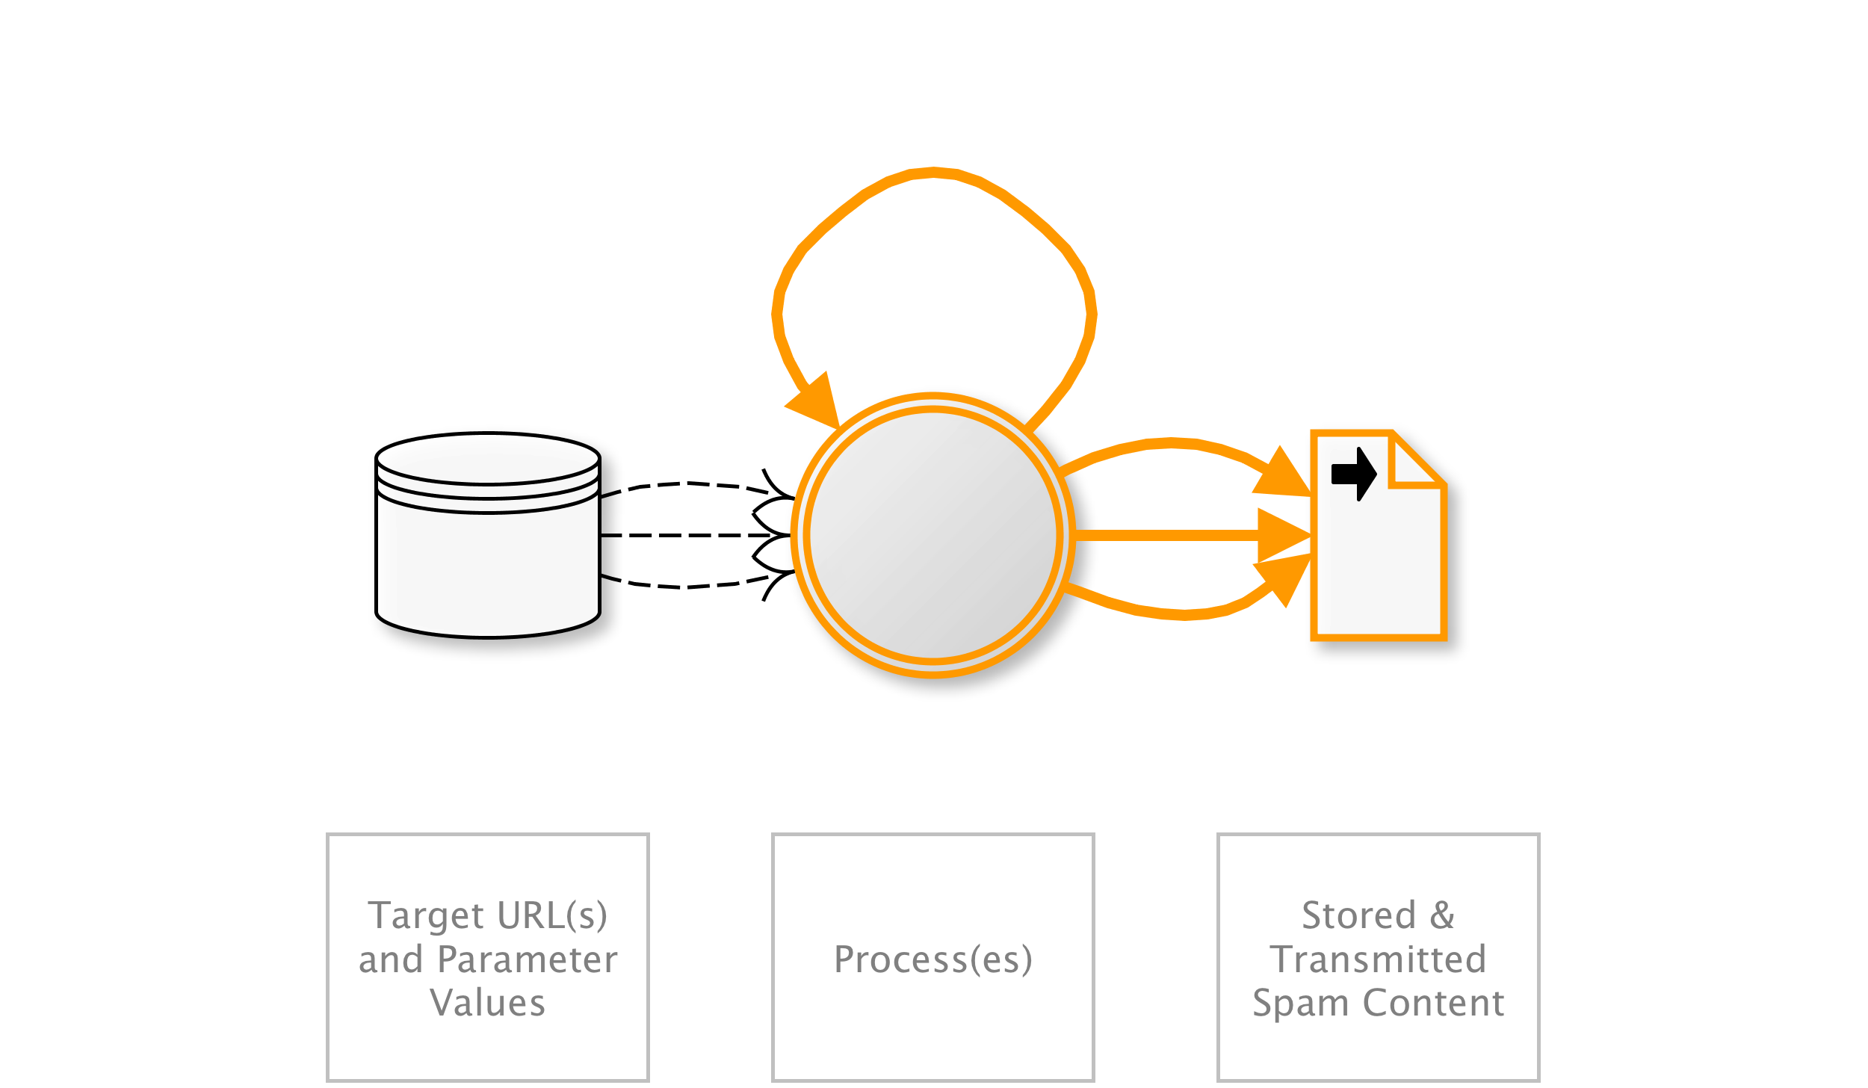
OAT-017 Spamming
Malicious or questionable information addition that appears in public or private content, databases or user messages.
AKA Blog spam; Bulletin board spam; Comment spam; Content spam; Content spoofing; Form spam; Forum spam; Guestbook spam; Referrer spam; Response form spam; Review spam; SEO spam; Spam crawlers; Spam 2.0; Spambot; Wiki spam; Twitter spam
OAT-017 Spamming
Notes:
Malicious content can include malware, IFRAME distribution, photographs & videos, advertisements, referrer spam and tracking/surveillance code. The content might be less overtly malicious but be an attempt to cause mischief, undertake search engine optimisation (SEO) or to dilute/hide other posts.
The mass abuse of broken form-to-email and form-to-SMS functions to send messages to unintended recipients is not included in this threat event, or any other in this ontology, since those are considered to be the exploitation of implementation flaws alone.
For multiple use that distorts metrics, see OAT-016 Skewing instead.
Entertainment/Retail/Social networking
(all)
Other business data/Public information

Slide 35
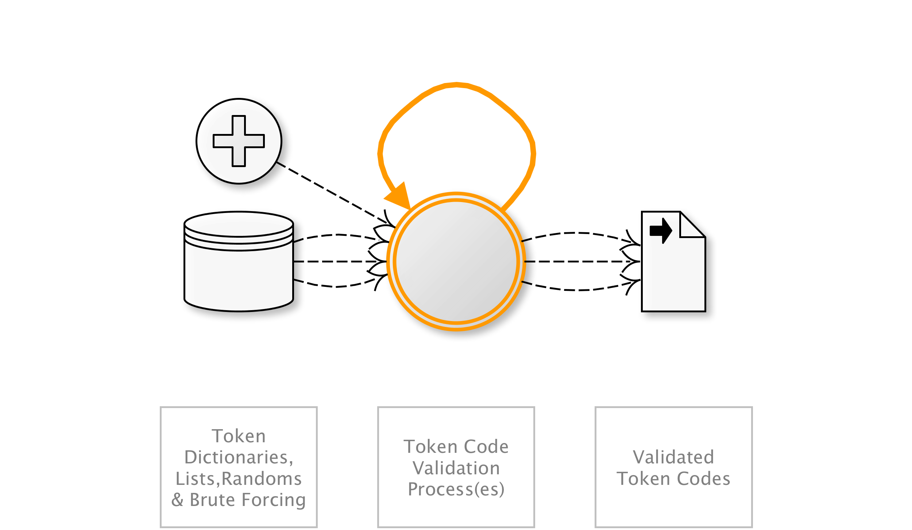
OAT-002 Token Cracking
Mass enumeration of coupon numbers, voucher codes, discount tokens, etc.
AKA Coupon guessing; Voucher, gift card and discount enumeration
OAT-002 Token Cracking
Notes:
Identification of valid token codes providing some form of user benefit within the application. The benefit may be a cash alternative, a non-cash credit, a discount, or an opportunity such as access to a limited offer.
For cracking of usernames, see OAT-007 Credential Cracking instead.
Entertainment/Financial/Retail
Application owner/Third parties
Other business data

Slide 36
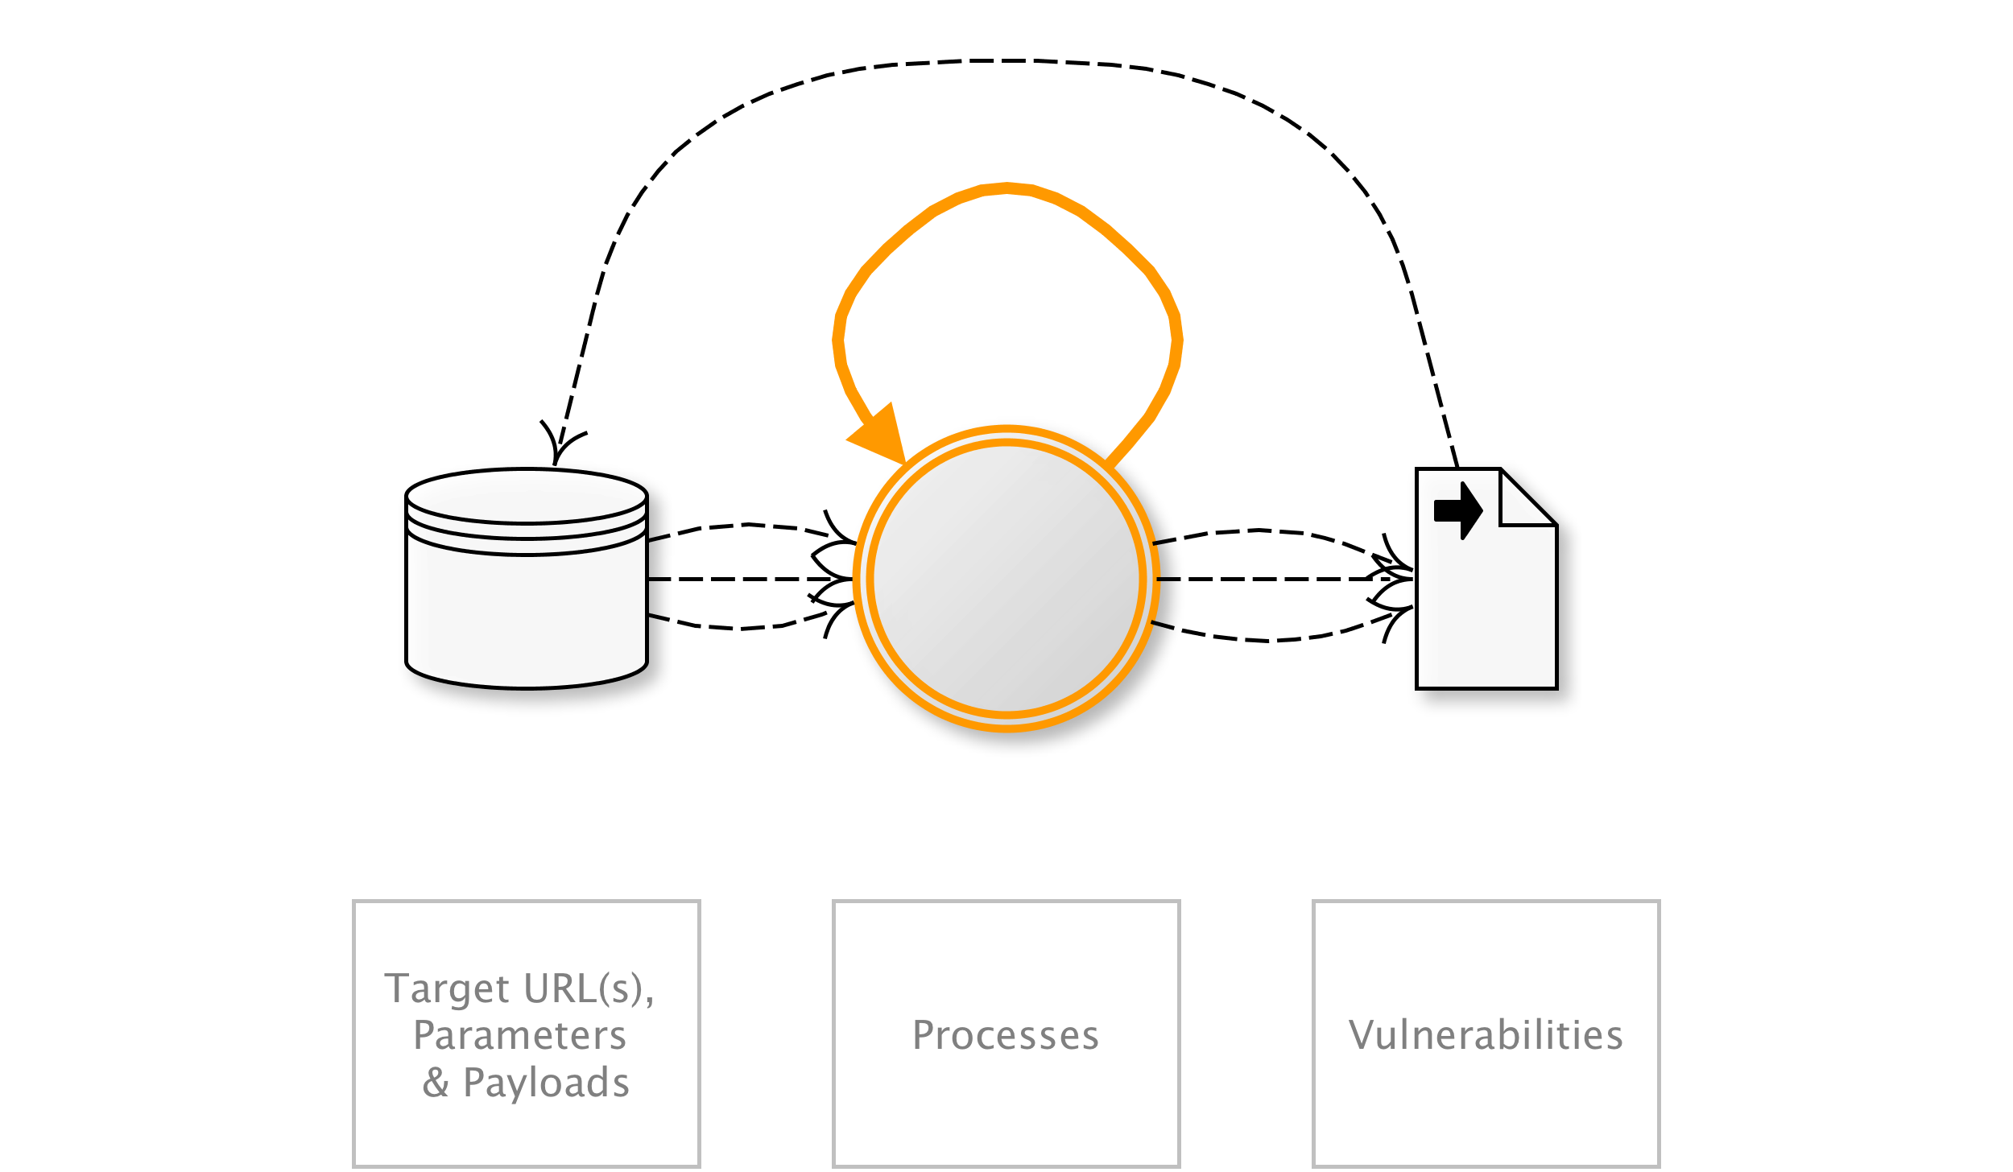
OAT-014 Vulnerability Scanning
Crawl and fuzz application to identify weaknesses and possible vulnerabilities.
AKA Active/Passive scanning; Application-specific vulnerability discovery; Identifying vulnerable content management systems (CMS) and CMS components; Known vulnerability scanning; Malicious crawling; Vulnerability reconnaissance
OAT-014 Vulnerability Scanning
Notes:
Systematic enumeration and examination of identifiable, guessable and unknown content locations, paths, file names, parameters, in order to find weaknesses and points where a security vulnerability might exist. Vulnerability Scanning includes both malicious scanning and friendly scanning by an authorised vulnerability scanning engine. It differs from OAT-011 Scraping in that its aim is to identify potential vulnerabilities.
The exploitation of individual vulnerabilities is not included in the scope of this ontology, but this process of scanning, along with OAT-018 Footprinting, OAT-004 Fingerprinting and OAT-011 Scraping often form part of application penetration testing.
(all)
Application owner
Other business data/Public information

Slide 37
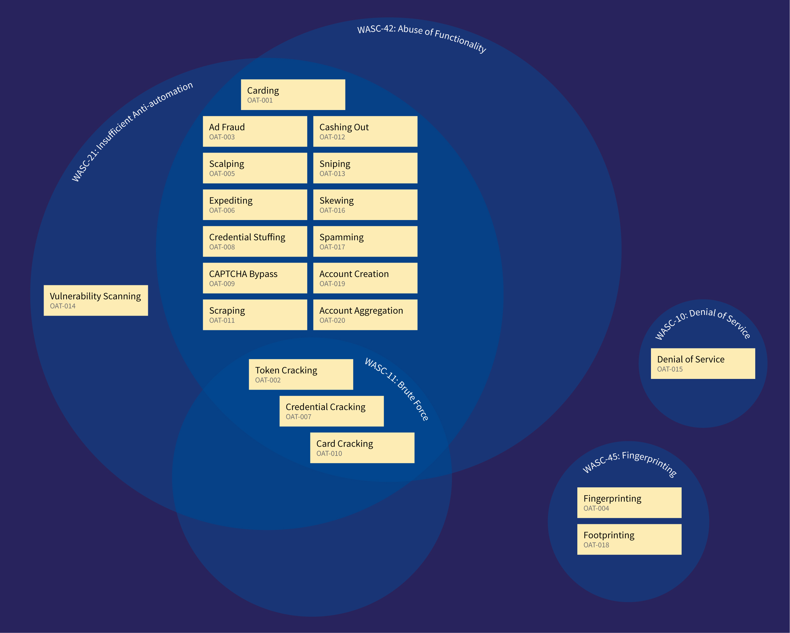
WASC Threat Classification View

Slide 38
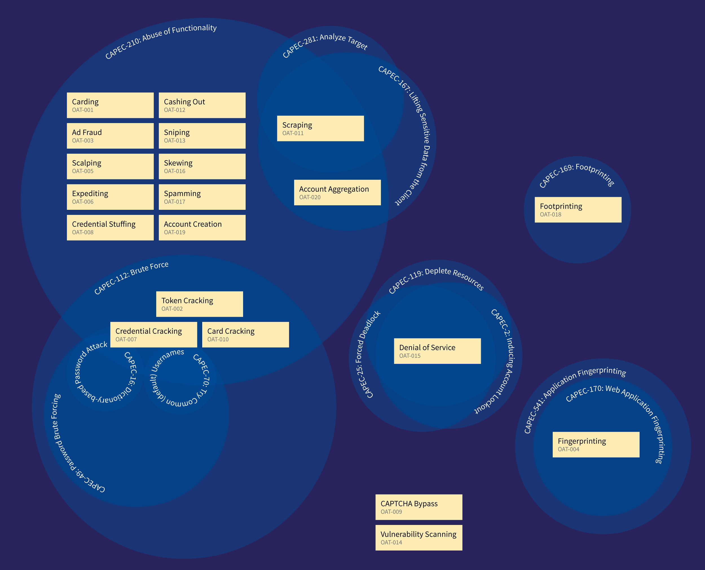
Mitre CAPEC View

Slide 39
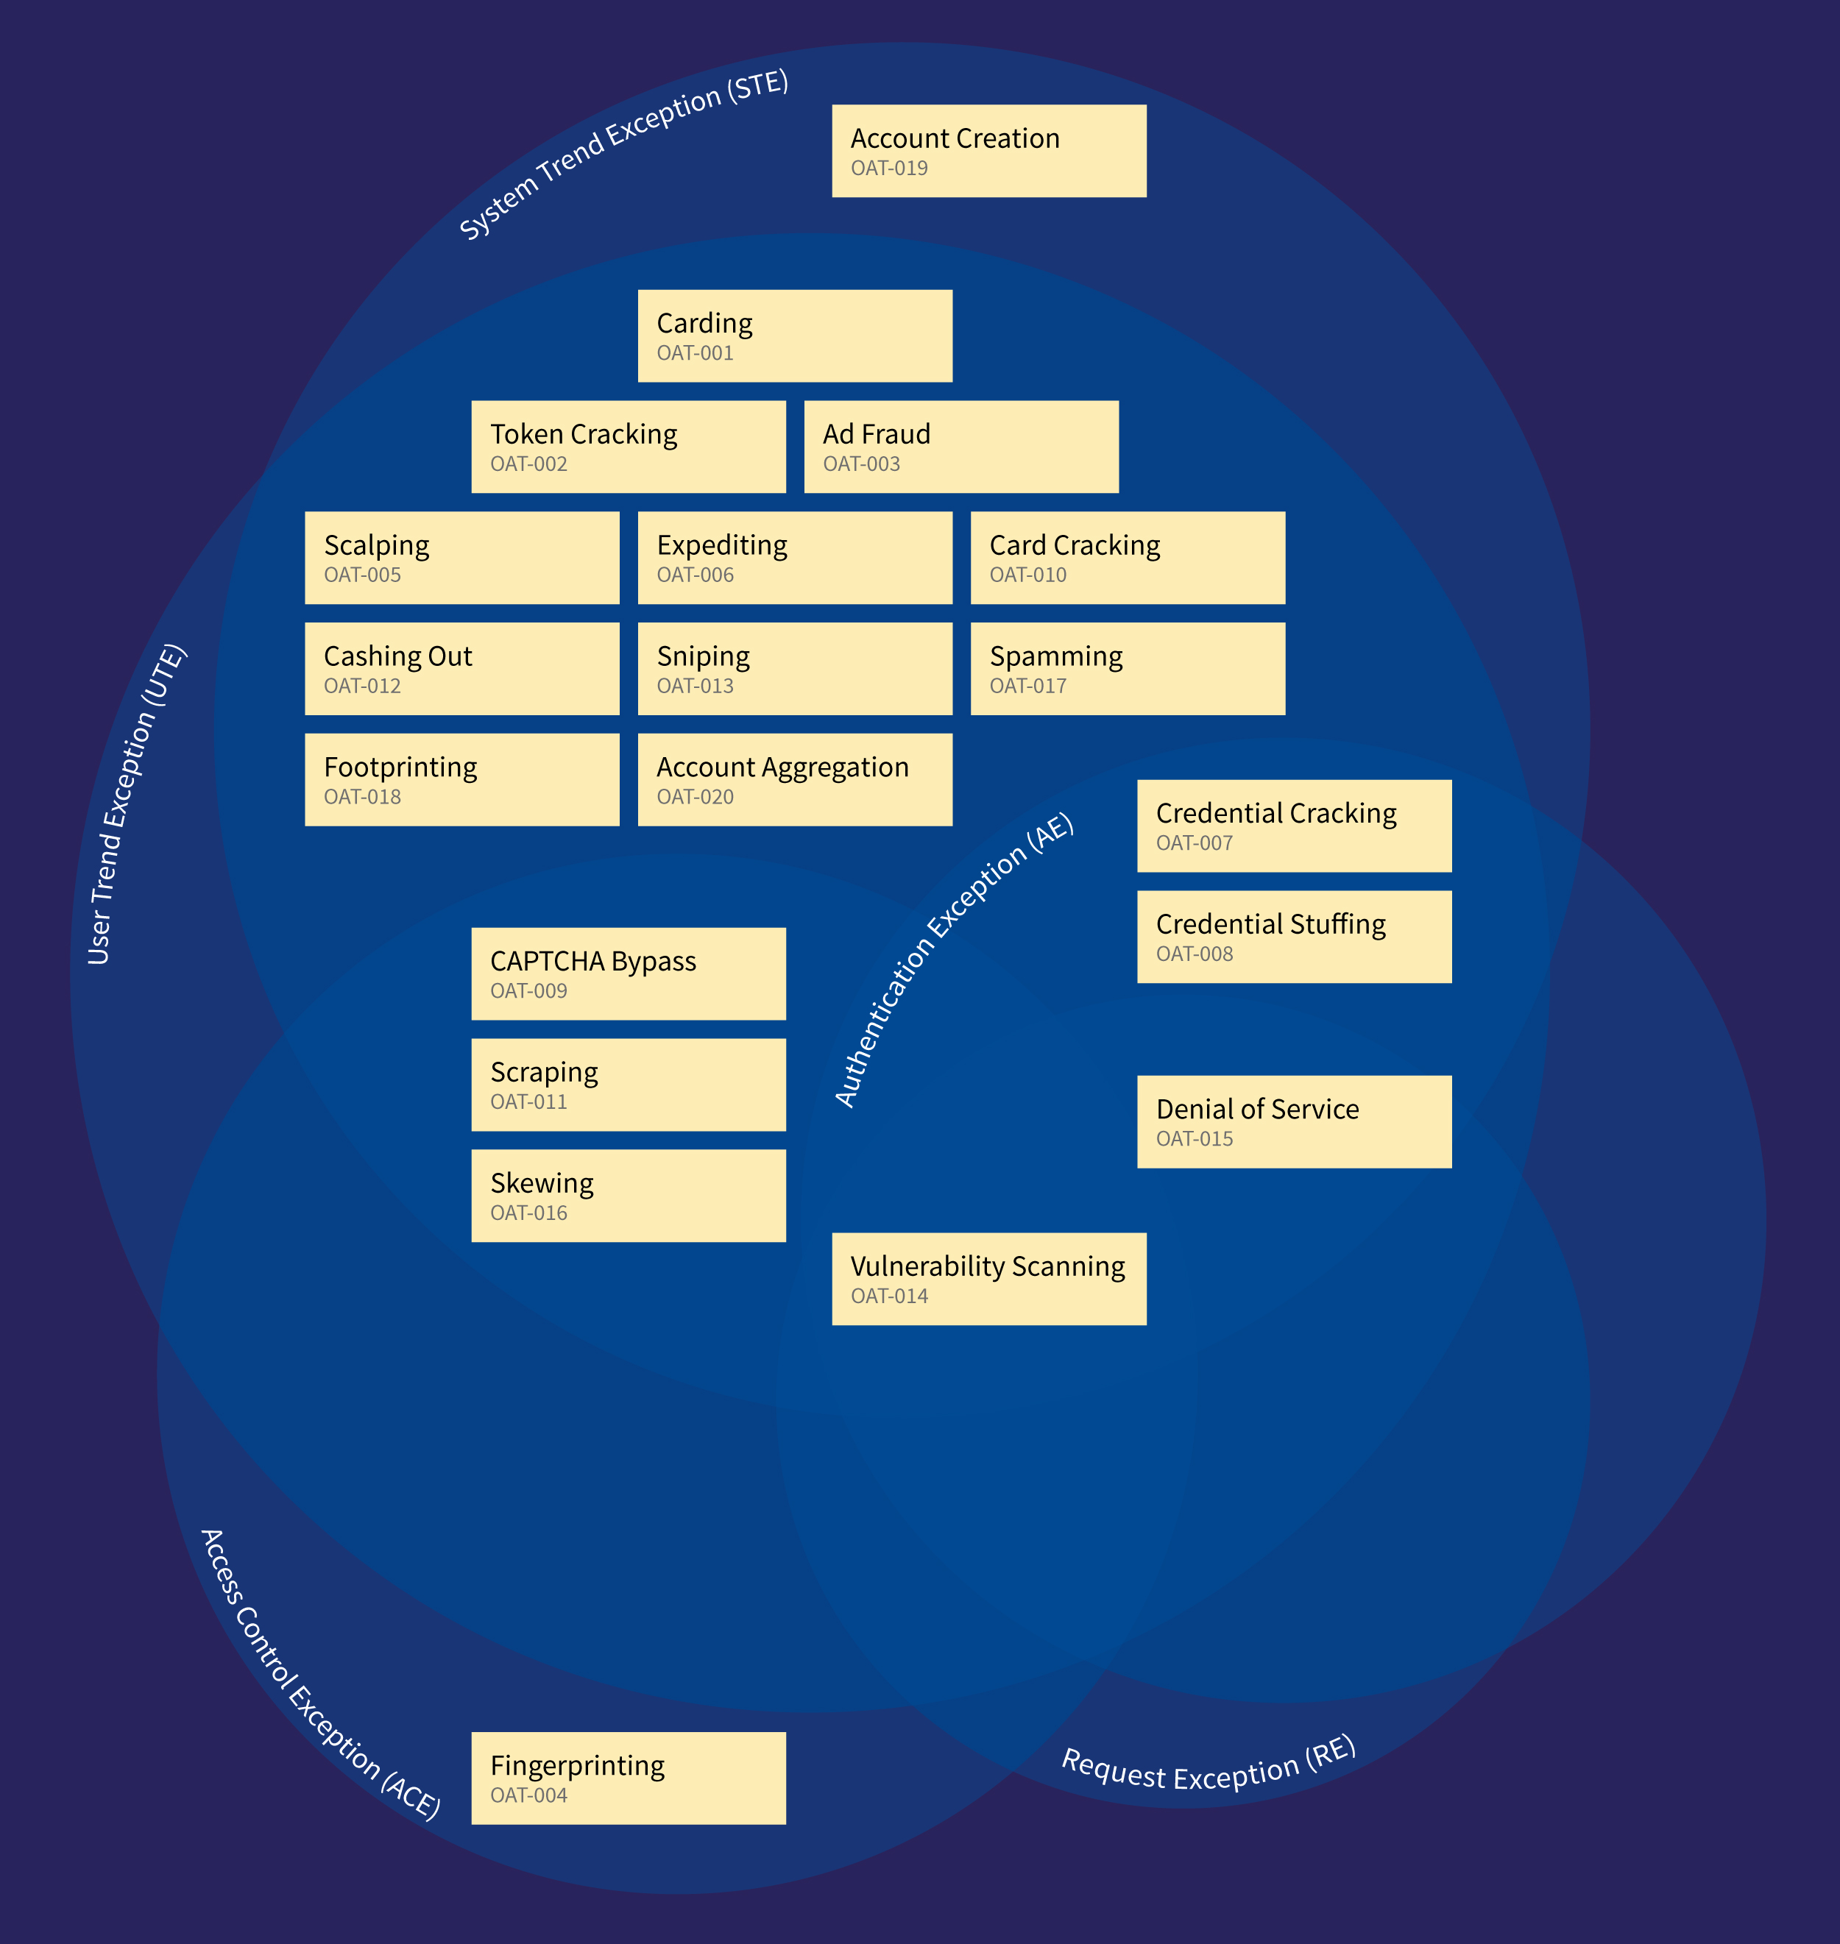
AppSensor Detection Point View
Notes:
14 Vulnerability scanning – also in:
Session Exception (SE)
Input Exception (IE)
Encoding Exception (EE)
Command Injection Exception (CIE)
Not included:
File input/output exception (FIO)
Honey trap (HT)
Reputaion (RP)

Slide 40

AppSensor
  https://www.owasp.org/index.php/OWASP_AppSensor_Project
John Melton at AppSec USA 2015
  Tomorrow at 2pm
  Room C
John Melton
More About AppSensor
Notes:
Work began on the project in late January 2015. Over 150 sources of information were identified, read and relevant threat information extracted. The full list of academic papers, blog posts, briefings, conference presentations, dictionaries, news stories, reports, technical papers and white papers is published on the OWASP wiki.
This created over 600 data points describing a mixture of threats, attacks and some vulnerabilities. Updates were periodically posted to the project pages on the OWASP wiki.
Anything relating to exploitation of implementation bugs was excluded. Forty or so clusters of threats were extracted from this diagram, and this was reduced further to a slightly smaller number of candid threat event names. Work then began to identify inter-relationships, similarities, overlaps and unique aspects. This process was undertaken over 1-2 months and reduced the number of recommended threat event names to just over twenty. Further de-duplication reduced the final count to nineteen. See below for a discussion of some of the candidate names that did not make the list.
The project was announced in the OWASP Foundation’s Connector newsletter sent to 60,000+ recipients in April 2015. It was also highlighted in a two-side colour flyer included in every delegate’s bag at AppSec EU 2015 in Amsterdam. A limited amount of peer review has been undertaken over a couple of months. The peer review led to clearer scope, suggestions for additional threats, and changes to both the names and descriptions of the threat events. Further peer review would be welcome.

Slide 41

Automated Threats to Web Applications
  https://www.owasp.org/index.php/OWASP_Automated_Threats_to_Web_Applications
Wiki content
  Summary
  Scope and definitions
  Bibliography
  FAQs
  Roadmap
  Getting involved
Malicious Automation
OWASP Project Details

Slide 42

Threats
  Prevalence data
  Symptoms
  Identification metrics
Mitigations
  Guidance for builders
  Guidance for defenders
  Effectiveness of controls
Sector-specific guidance
You
Acknowledgements

Slide 43

Colin Watson
Jason Chan, Mark Hall, Andrew van der Stock
Everyone else who contributed information anonymously, and the information from the reference sources used
OWASP Foundation
Me
Acknowledgements

Slide 44

Questions
  Now
  This evening and tomorrow
  Project mailing list
  https://lists.owasp.org/mailman/listinfo/automated_threats_to_web_applications
?
Questions

