Slide 1
Introduction to Application Penetration Testing
Robin Fewster

Slide 2
Introduction
Aim of this presentation to introduce basic application penetration testing techniques.
It is not as difficult to get into as you might think – hopefully we will bust some myths.
We will use OWASP projects, which will enable you to setup a safe home training lab.

Slide 3
Expectations
Limited time to cover what is a large topic, so this does not break any new ground.
  But we can go through interesting examples.
  And no penetration testing experience is required.
Notes:
Question – does anybody have any pen test experience?

Slide 4

About Me
Former DV security cleared CREST Certified Tester and CHECK Team Leader of 10 years.
Currently Security Principal at Sage (UK) working on secure software development.

Slide 5
Agenda
How to setup up your OWASP tools
Web App Attack Examples
  Authentication
  Session management
  Access controls
  Client controls
  Back-end interpreters
  Attacking the user

Slide 6
Legality
Computer Misuse Act 1990
  Issue of ‘consent’
  DON’T target anything for which you do not have explicit written consent
  DO try this at home BUT on your own network / virtual machine (e.g. using OWASP projects)

Slide 7
Setting Up Your Tools
We will use OWASP projects (of course).
We need
  a browser -> “Mantra”
  an intercepting proxy -> “ZAP”,
  and some target websites -> “Broken Web Apps”.
URLs will be supplied at the end

Slide 8
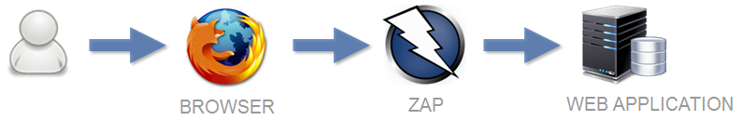
Setting Up Your Tools
An intercepting proxy works like below:
Using Mantra and ZAP, we intercept and manipulate traffic in both browser requests and web server responses to forge attacks.

Slide 9
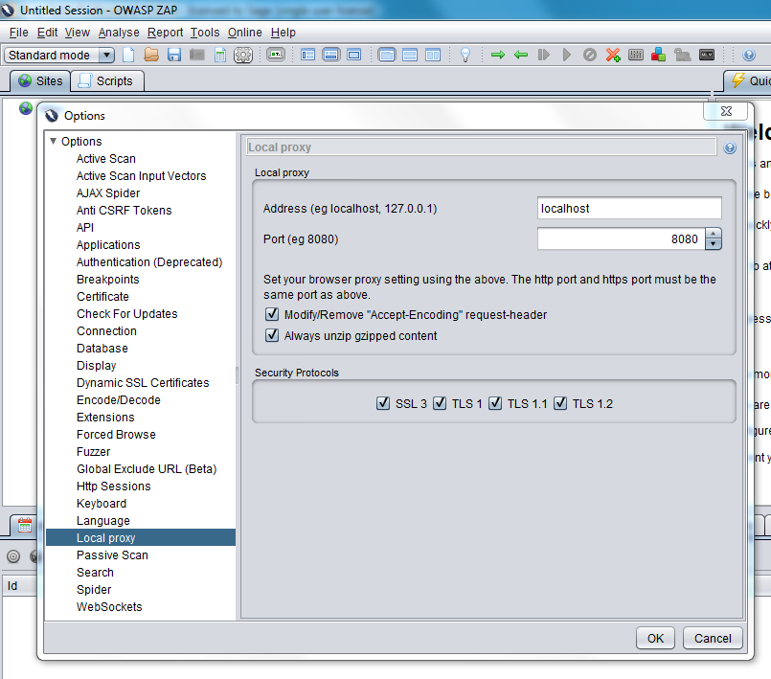
Configure ZAP

Slide 10
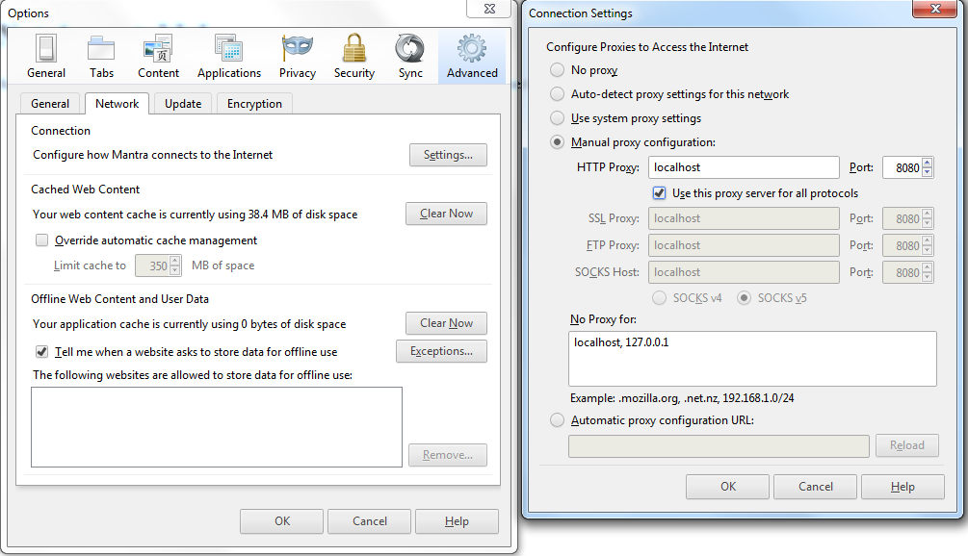
Configure Mantra

Slide 11
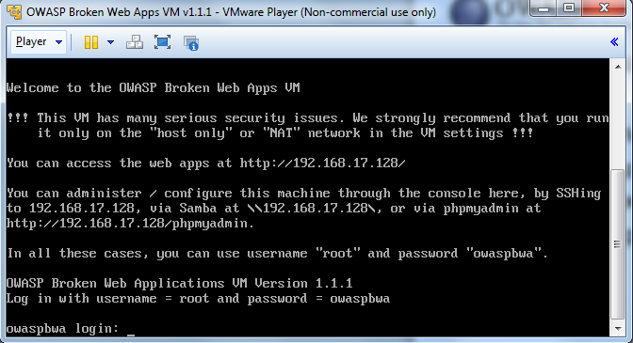
Configure Broken Web Applications

Slide 12
Authentication
The authentication of an application is a critical line of defence.
  If authentication fails, the application fails
  Primary target for attackers

Slide 13
Example Attacks
Default / weak passwords
User enumeration
Password hints
Brute force password guessing
Default pages
Robots.txt
Guessable admin pages (security through obscurity)
Notes:
Default Passwords: Google “default passwords”
Weak Passwords: OrangeHRM - login with admin/admin
User enumeration based on error: Getboo - login page with error message based user enumeration at http://owaspbwa/getboo/login.php
User enumeration at user registration:
Getboo – user registration allows user enumeration at http://owaspbwa/getboo/newuser.php
User enumeration at forgotten password:
Joomla - forgotten password allows user enumeration at http://owaspbwa/joomla/index.php?option=com_user&view=reset&Itemid=2
Password hint weakness: Getboo - can setup a user with “test” as password and the password hint can be the same as the password
Brute force risk: Wordpress - there is no account lockout for the admin user
Known default pages: DVWA – hidden (default) information at http://owaspbwa/mutillidae/phpinfo.php
Robots.txt directory leakage: Mutillidae – robots.txt reveals interesting locations at http://owaspbwa/mutillidae/robots.txt
Authentication omission for guessable admin page:
BodgeIt Store – guessing admin.jsp gives access without needing to authenticate at http://owaspbwa/bodgeit/admin.jsp
Change another user’s password: TikiWiki – password change (when you login as user/user) could allow you to change another user’s password (e.g. admin)

Slide 14
Session Management
Session management is fundamental to security as it uniquely identifies users.
  Enables assurance of user identity beyond login.
  Session management is a prime target for attacks.

Slide 15
Example Attacks
Cookie meaning
Decoding cookie values
Cookie pseudo-randomness
The ‘secure’ flag
Session timeouts
Duplicate logins
Session fixation
Notes:
Cookie meaning: OrangeHRM – setup a separate login as user1/user1 piping through ZAP in IE, switch the PHPSESSID with the admin one from before to show how access can be gained to Admin
Cookie meaning using Repeater: Wordpress – meaning of cookies and how they can be observed; login via 2 separate browsers both going through the same proxy (user/user, admin/admin), two cookies are set, show how in burp repeater that substituting the cookie values means everything in terms of access to the application.
Decoding: Joomla - show how a cookie response might be captured and decoded using burp decoder and also in ZAP (login with author/author); this won’t decode but principle is there to see
Decoding: Session token - dXNlcj1ib2I7YXBwPWFkbWluO2RhdGU9MTAvMDkvMTQ – Base64
Cookie Entropy (1): Web calendar – login as user/user, send the login POST request to sequencer and demonstrate an analysis
Cookie Entropy (2): Web calendar – continue demo above by now sending a post-auth request to intruder and show the use of number substitution
Secure Flag: Mutillidae over SSL – show how a cookie is set without the secure flag by capturing a response
Timeouts: Pick a previously logged in example and attempt to replay a request (e.g. you should have logged into Wordpress a while back)
Duplicate Logins: Wordpress – show how you can login as user/user from two separate browsers
Session Fixation: OrangeHRM – capture PHPSESSID before login, change it, show it was accepted, and then login as admin/admin to show that it was also not changed after login

Slide 16
Access Controls
Access controls check authorisation to do something.
Defective access controls
  allow a user to perform an action that should not be allowed.
  account for a significant proportion of web application issues.

Slide 17
Example Attacks
Vertical privilege escalation
Horizontal privilege escalation
Forced browsing
Notes:
Vertical privilege escalation: BodgeIt Store – guessing admin.jsp gives access without needing to authenticate at http://owaspbwa/bodgeit/admin.jsp
Vertical privilege escalation: OrangeHRM – login as admin user first then a lower privileged user so you can see here there is an admin tab that does not appear for most users
Vertical privilege escalation: Mutillidae – web server allows access to passwd file here http://owaspbwa/mutillidae/index.php?page=source-viewer.php if you intercept the request and change the file name to /../../etc/passwd
Horizontal privilege escalation: Wordpress – attempt if you login as user/user, try to change the password for the admin user (guessing UID=1); doesn’t work but demonstrates how to attack this
Horizontal privilege escalation: Peruggia – design flaw because any user can delete any other user, e.g. http://owaspbwa/peruggia/index.php?action=account&deleteuser=someoneiwanttodelete
Horizontal privilege escalation: AppSense – occurs when you enumerate or note the user ID of someone who is not a friend or a friend yet, respectively, e.g. http://owaspbwa/AppSensorDemo/viewProfile.jsp?profileID=<here>; so you can view other people’s profiles even though you are not a friend
Forced Browsing (Burp) : BodgeIt Store – demo the Engagement Tools -> Discover Content feature to locate the admin.jsp page
Forced Browsing (ZAP): Do the same as above but using ZAP’s ‘Forced Browsing’ feature

Slide 18
Client Controls
Applications pass important data to the client, read it back and then process it on the server.
  valuable source of attacks due to the various techniques that can be used to achieve it.
  all data sent from the client can be modified; it is outside our control.

Slide 19
Example Attacks
User Agent manipulation
JavaScript controls bypass
Hidden form fields
Notes:
User Agent manipulation: Mutillidae - User Agent manipulation to reveal extra content at http://owaspbwa/mutillidae/index.php?page=user-agent-impersonation.php; take example of mobile content but often mistakenly used as a means of access control. Search online for user agent strings, show the user agent switcher add-on, show how the user agent can be edited in the request, show how burp intruder has user agent payloads. Show how burp can remove all JavaScript from a response.
JavaScript Input length Bypass: Mutillidae – JavaScript input length bypass at http://owaspbwa/mutillidae/index.php?page=login.php, show the input field length limits then show how you can set burp to ‘remove input field length limits’ or simply catch a valid response and edit the values in the proxy
Hidden Form Fields: BodgeIt Store – Hidden form fields: register an account, login then browse to http://owaspbwa/bodgeit/product.jsp?prodid=26, then set burp to unhide hidden form fields, explain that hidden form fields can be used to affect pricing

Slide 20
Back-end Interpreters
Web apps can interact with back-end interpreters such as databases or XML parsers.
  user input is captured as variables which result in for example an SQL database query.
  malicious injected syntax can be used to taint code that “breaks out” of the intended purpose to implement arbitrary commands.

Slide 21
Example Attacks
SQL injection detection
SQL injection login bypass
SQLMAP
Notes:
Trivial SQL injection: Peruggia - login can be bypassed with user: admin ‘ or 1=1--<space at end> password: anything
http://owaspbwa/peruggia/index.php?action=comment&pic_id=2%20union%20all%20select%201,2,3,@@version
Trivial SQL injection: BodgeIt Store – login for the admin user admin@thebodgeitstore.com can be bypassed by entering username: admin@thebodgeitstore.com' or '1'='1
the query is intended to be: select * from users where username='tester@tester.com' and password='tester'
what you end up with is: select * from users where username=' tester@tester.com' or '1'='1' and password='anything'
SQL injection detection: BodgeIt Store – observe how in the login field a single tick causes a system error in the top left, whereas two ticks clear it
SQL injection detection: Mutillidae - https://owaspbwa/mutillidae/index.php?page=captured-data.php has a vulnerable ‘showhints’ cookie; explain that you only need add a tick to the end of it to generate a MySQL error for a manual test of this – thus demonstrating that automated scanners are not necessarily trying as much as you might think
SQLMAP: Mutillidae - sqlmap -u https://192.168.x.x/mutillidae/index.php?page=login.php --data="username=username&password=password&login-php-submit-button=Login" --passwords --flush

Slide 22
Attacking the Client
Recent shift in emphasis from server-side flaws to client-side flaws.
  server-side flaws are now better understood and less prevalent.
  attackers now look to exploit users by means of client-based flaws.

Slide 23
Example Attacks
Reflected XSS
Stored XSS
CSRF
Notes:
Reflected XSS: Simple ASP.Net Forms - http://owaspbwa/mono/simple-reflected-xss.aspx
Reflected XSS: GTD-PHP - Go to Lists -> Checklists, Check List title is vulnerable at http://owaspbwa/gtd-php/checklistReport.php?checklistId=2&checklistTitle=<script>alert('xss')</script>
Stored XSS: DVWA - Go to DVWA and Stored XSS section, login as user/user, add stored XSS to show document.cookie, verify, then logout and login as admin/admin for admin session hijack
Stored XSS: Webgoat.Net - trivial comments section example at http://owaspbwa/webgoat.net/Content/StoredXSS.aspx
CSRF: Bodge It – POST CSRF; login with test@thebodgeitstore.com/password, change password to password, go to burp log and show the engagement tools -> generate CSRF PoC example, request it in a browser
CSRF: Bodge It GET CSRF; login again then locate the request, send to repeater, change request method and copy the URL and show how it can be used to change a password. Now insert the following into the feedback <img src='bodgeit/password.jsp?password1=qwerty&password2=qwerty'>. Explain that this could be embedded in a blog website, fed via instant messaging or hidden as an image in an HTML email.

Slide 24
Links for a Home Test Lab
Web Browser - OWASP Mantra
https://www.owasp.org/index.php/OWASP_Mantra_-_Security_Framework
Intercepting Proxy - OWASP Zed Attack Proxy
https://www.owasp.org/index.php/OWASP_Zed_Attack_Proxy_Project
Target websites - OWASP Broken Web Applications
https://www.owasp.org/index.php/OWASP_Broken_Web_Applications_Project
How To - OWASP Testing Guide
https://www.owasp.org/index.php/OWASP_Testing_Guide_v4_Table_of_Contents

