Slide 1
OWASP Code Review
Eoin Keary
Code review Lead
Irish Chapter Lead

Slide 2

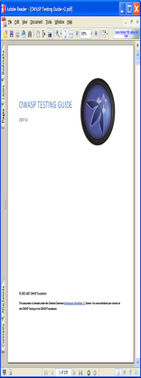
Agenda
What is the Code review guide?
Secure Code Review (who cares?)
Sister Projects

Slide 3
The Code review guide – What is it?
Most comprehensive open source secure code review on the web
One of the “OWASP Trinity” of guides
Available in WIKI, Free Download, “Real Book”
Is 3 years old, but never finished
Contributors from across the globe
#3 on the “OWASP best-seller list” (Yippee)

Slide 4
Guide 2008 (v1.1) Contents
Foreword by Jeff Williams, OWASP Chair
Welcome to the OWASP Code Review Guide 1.1
About The Open Web Application Security Project
Code Review Guide History
Introduction
Preparation
Security Code Review in the SDLC
Security Code Review Coverage
Application Threat Modeling
Code Review Metrics
Crawling code
Searching for code in J2EE/Java
Searching for code in Classic ASP
Code review and PCI DSS
Reviewing by technical control: Authentication
Reviewing by technical control: Authorization
Reviewing by technical control: Session Management
Reviewing by technical control: Input Validation
Reviewing by technical control: Error Handling
Reviewing by technical control Secure application deployment
Reviewing by technical control Cryptographic controls
Reviewing Code for Buffer Overruns and Overflows
Reviewing Code for OS Injection
Reviewing Code for SQL Injection
Reviewing Code for Data Validation
Reviewing Code for Cross-site scripting
Reviewing code for Cross-Site Request Forgery issues
Reviewing Code for Logging Issues
Reviewing Code for Session Integrity issues
Reviewing Code for Race Conditions
Additional security considerations:
Java gotchas
Java leading security practice
Classic ASP Design Mistakes
PHP Security Leading Practice
Strings and Integers
Reviewing MySQL Security
Reviewing Flash Applications
Reviewing Web services
How to write an application code review finding
Automated Code revieW
Tool Deployment Model
The Owasp Orizon Framework
The Owasp Code Review Top 9
Guide References
Guide V1.1 - 214 Pages (66% bigger!!)
Guide V1.0 – 143 Pages

Slide 5
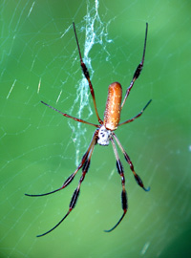
Sustainable Environment
BIOMIMICRY –
Nature's Manufacturing Genius Applied
to Industry / Engineering
Sustainable engineering model
Evolution of systems:
Robust/Strong DNA (Code) of a solution assures stability in the cyber environment.
Think Darwin, survival of the fittest
Organisms built correctly ensure stability and evolution.
Penetrate and Patch model does not adhere to the natural order, what we currently do….

Slide 6
Secure Code Review -
What it is :
Examination of developed source code for quality.
Security = Quality
Robust & Stable code
More Expensive
Can be more Accurate
Requires unique skill set to do properly
What it isn't:
Silver Bullet
Replacement for other security controls
Replacement for poor application development
Easy
Cheap (Not Manual anyways)

Slide 7
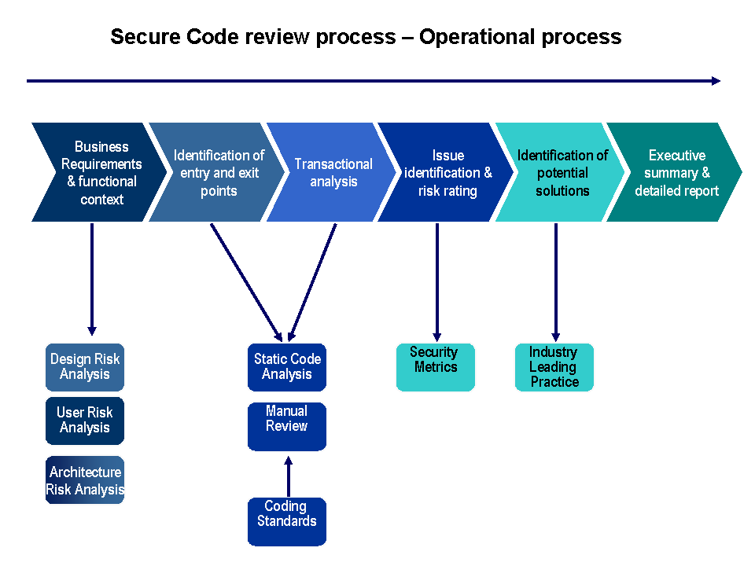

Slide 8
Automate = Good
Can we Automate Code review:
Yes!! (Its cheaper to do)
Higher Through-put, quicker return
But is it like a Web Application firewall in the case of runtime protection?
Limited protection, Catch many types of issues, but not all?

Slide 9
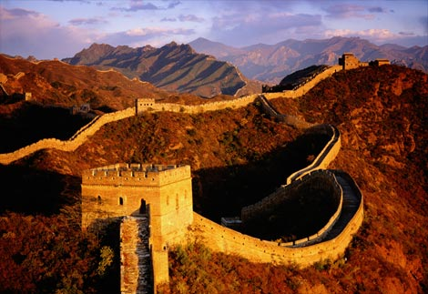
Web Application Firewall (WAF)
Catches attack Vectors very well
Protects against SQL Injection, XSS, OS Injection, CLRF, DoS, Dir traversal, etc
Not great against: Business Logic Flaws, CSRF attacks, Session Management issues/Hijacking…….

Slide 10

Automated Review
A fool with a tool, is still a fool”…..?

Slide 11
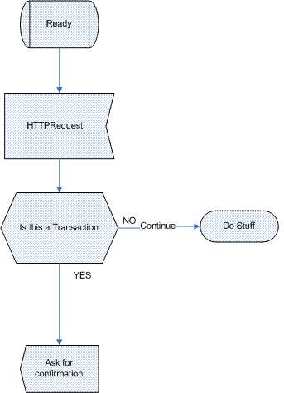
Example: CSRF Protection
Cross-Site Request Forgery (CSRF) –
causing an unsuspecting user’s browser to send requests they didn’t intend. (Funds Transfer, Form submission etc..)
Preferably an authenticated user (Banking, Ticket purchase). Without them knowing about it?
Can an automated scanner understand context here?:
Line
1 String actionType = Request.getParameter("Action");
2 If (actionType.equalsIgnoreCase("BuyStuff"){
3 Response.add("Please enter your password");
4 return Response;
5 }

Slide 12
New Layer of attacks:
Workflow disruption & Hijacking
Legal Cyber attacks
Booking systems
Transactional systems
Security Code review & application threat modelling required to identify weakness
Artificial Scarcity DoS – WhiteHat
1. Select a flight
2. Agree to the terms and conditions
3. Provide your personal details
4. Select seat
*Seat is reserved and no user may select it for a variable amount of time - few minutes to several hours
5. Enter payment information (Don’t submit obviously)
6. Repeat and automate for every seat on the flight
Jeremiah Grossmann/Arian Evans – BH 08

Slide 13
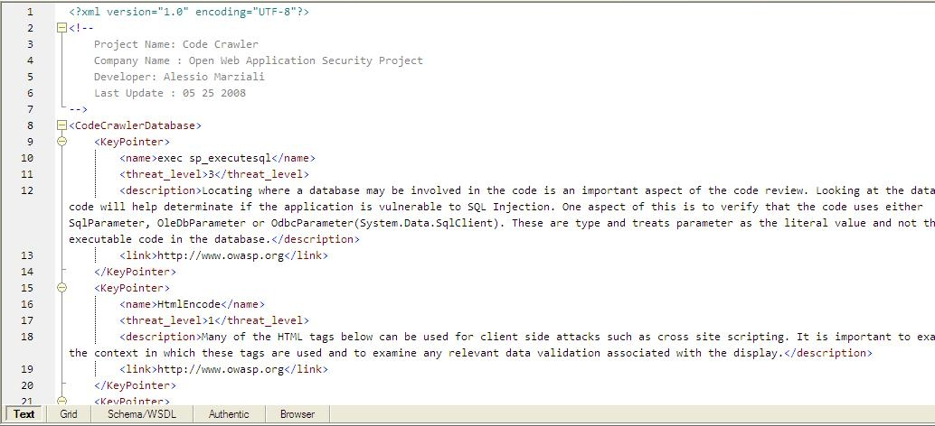
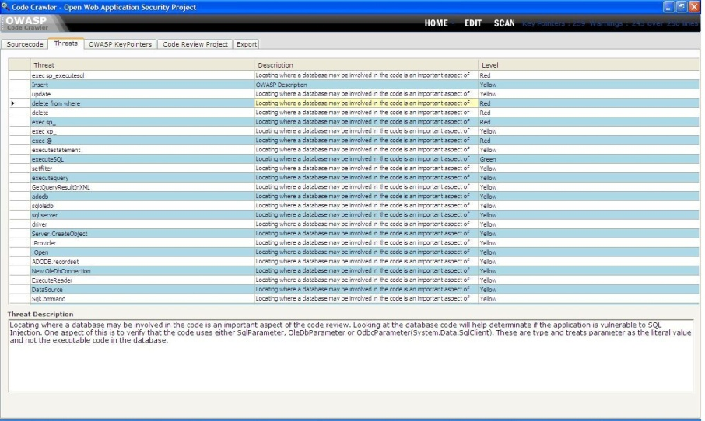
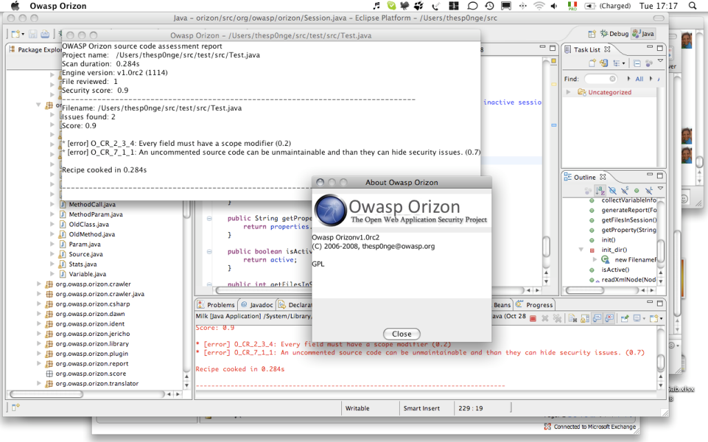
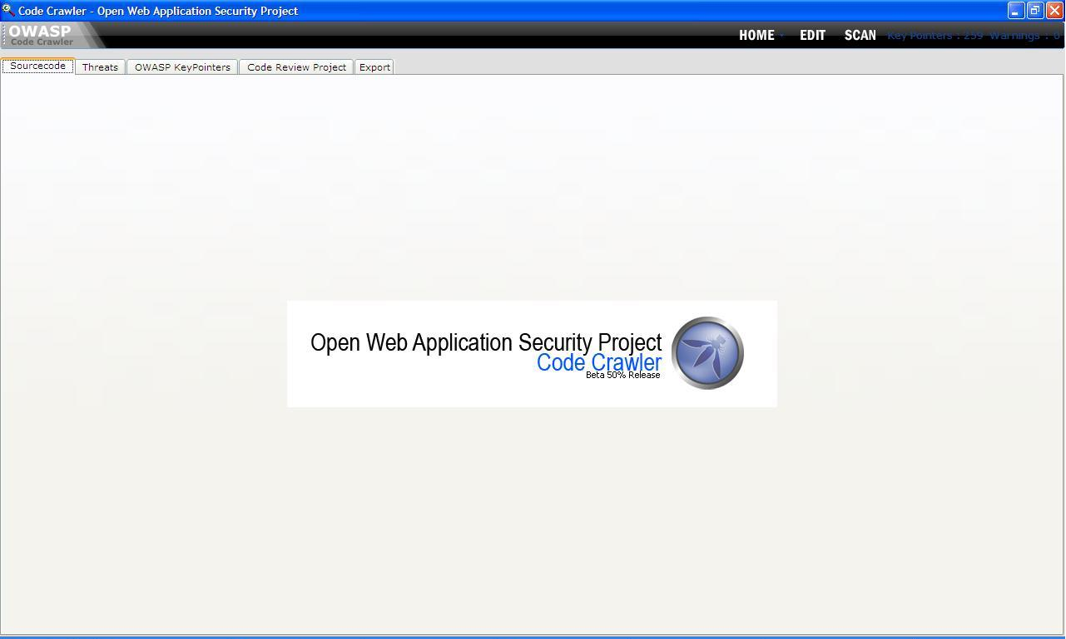
OWASP Code review tools
Code Crawler:
Alessio Marziali
Paulo Prego
Orizon Framework

Slide 14
Deployment models
Developer adoption model
Deploy automated tools to developers
Control tool rule base
Security review results and probe a little further.
Testing Department model
Test department include automated review in functional test.
Security review results and probe a little further.
Application security group model
All code goes through application security group
Group use manual and automated solutions

Slide 15
Help Required
OWASP Code Review Guide 2.0 – 2009
New Ideas approaches welcomed
Want to do more integration with tools

