Slide 1
Looking Forward… and Beyond
Distinctiveness
Through Security Excellence
Ludovic Petit
Ludovic.Petit@owasp.org
Chapter Leader OWASP France
Global Connections Committee

Slide 2
About Me
Group Fraud & Information Security Advisor at
SFR, 2nd largest French Telecom Operator, with subsidiaries in Brazil and Morocco
Working on Cybercrime, Behavioral Profiling and Security ‘Futurology’
Chapter Leader OWASP France
Member, Global Connections Committee
Member of the OWASP Tribe since 2004
Contribution to various OWASP Projects
Translator of the OWASP Top Ten (All versions)
Application Security Guide For CISOs (Marco Morana)
OWASP Mobile Security Project (Jack Mannino)
OWASP Cloud Top10 Project (Vinay Bensal)
OWASP Secure Coding Practices - Quick Reference Guide (Keith Turpin)

Slide 3
Why this presentation
Age of Antivirus
Age of
Network Security
Age of
Application Security
We are living in a Digital environment, in a Connected World
Most of websites vulnerable to attacks
75% of Attacks at the Application Layer (Source: Gartner)
Important % of web-based Business (Services, Online Store, Self-care)

Slide 4
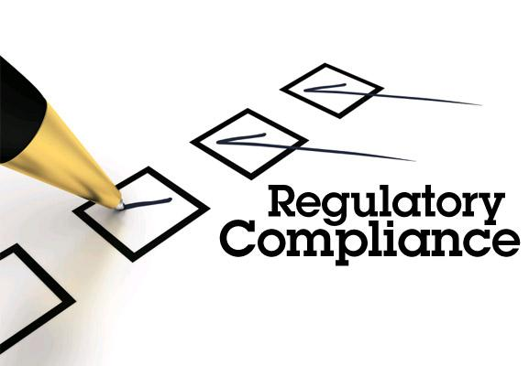
But also because…
The legal framework rules the technical means required to be compliant!

Slide 5
Agenda
What is OWASP, what we could bring
Update - OWASP Projects
Talking Legal
Evolutions of the legal framework
Developers, Software makers held liable for code?

Slide 6
The True Story
The Open Web Application Security Project
OWASP:
Swarms of WASPS: Local Chapters

Slide 7
Mission Driven
What is OWASP
Nonprofit | World Wide | Unbiased
OWASP does not endorse or recommend commercial products or services

Slide 8
Community Driven
What is OWASP
30,000 Mail List Participants
200 Active Chapters in 70 countries
1600+ Members, 56 Corporate Supporters
69 Academic Supporters

Slide 9
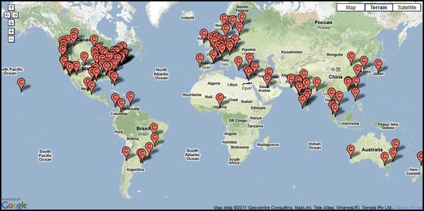
Around the World
200 Chapters, 1 600+ Members, 20 000+ Builders, Breakers and Defenders

Slide 10
Quality Resources
What is OWASP
200+ Projects
15,000+ downloads of tools, documentation
250,000+ unique visitors
800,000+ page views (monthly)

Slide 11
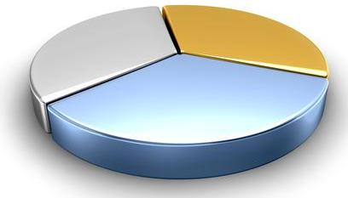
Quality Resources
Code
Tools
40%
10%
50%
Documentation

Slide 12
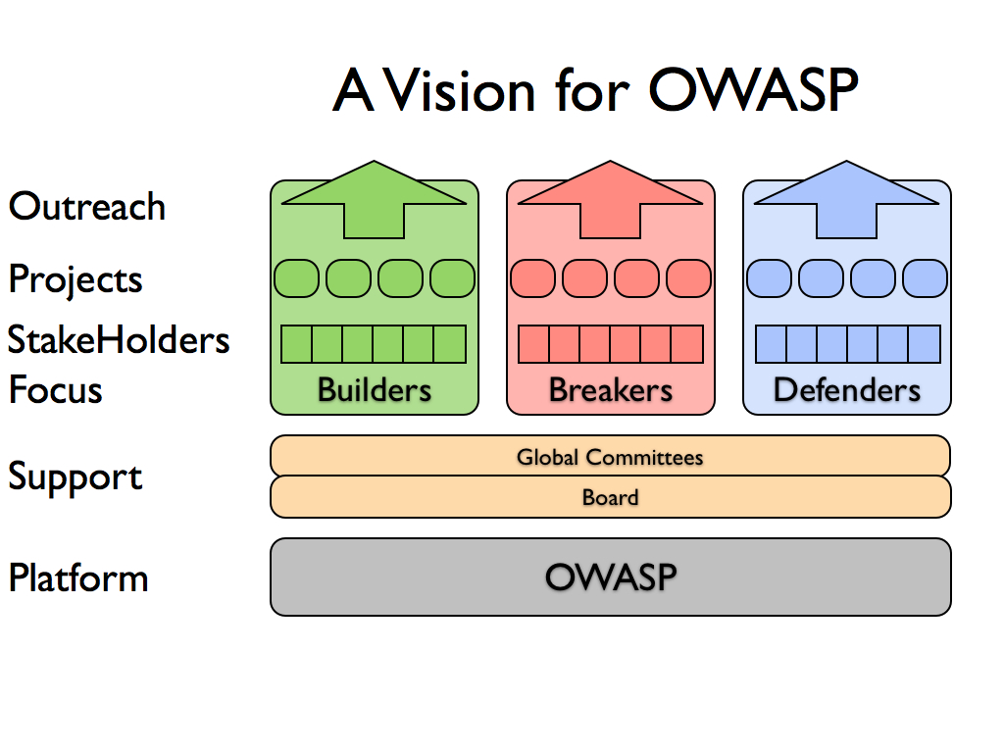
Security Lifecycle

Slide 13
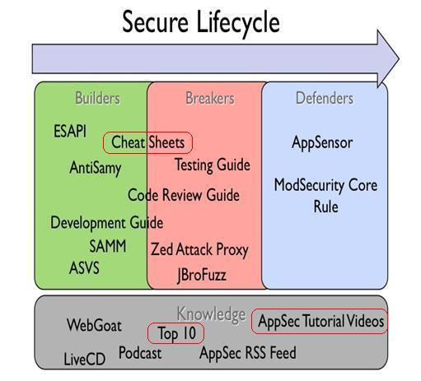
Security Resources

Slide 14
The OWASP Top Ten
A1: Injection
A6: Security Misconfiguration
A3: Broken Authentication and Session Management
A4: Insecure Direct Object References
A5: Cross Site Request Forgery (CSRF)
A7: Failure to Restrict URL Access
A10: Insufficient Transport Layer Protection
A2: Cross Site Scripting (XSS)
A9: Insecure Cryptographic Storage
A8: Unvalidated Redirects and Forwards
A1: Injection
A6: Security Misconfiguration
A3: Broken Authentication and Session Management
A4: Insecure Direct Object References
A5: Cross Site Request Forgery (CSRF)
A7: Failure to Restrict URL Access
A10: Insufficient Transport Layer Protection
A2: Cross Site Scripting (XSS)
A9: Insecure Cryptographic Storage
A8: Unvalidated Redirects and Forwards
TOP 10 WEB APPLICATION SECURITY RISKS
TOP 3 WEB APPLICATION SECURITY RISKS
The OWASP Appsec Tutorial Series (Videos)

Slide 15
News
a Blog
A Podcast
Memberships
Mailing Lists
A Newsletter
Apple App Store
Video Tutorials
Training Sessions
Social Networking

Slide 16
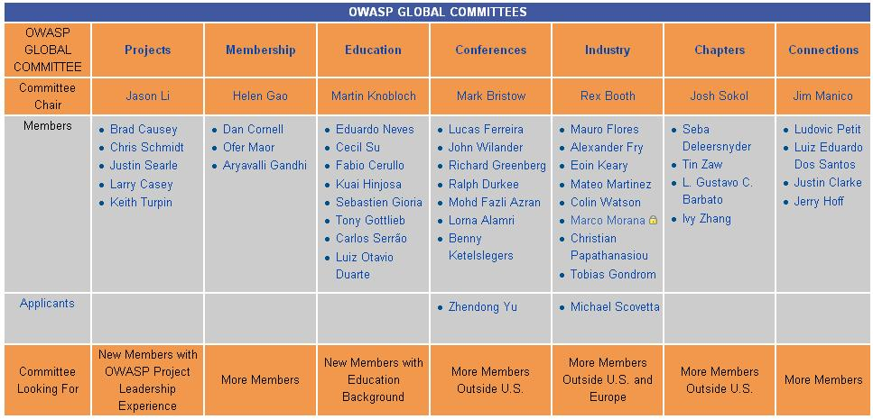
7 Global Committees

Slide 17
All over the world

Slide 18
OWASP Projects

Slide 19
Cheat Sheets
Developer Cheat Sheets
OWASP Top Ten Cheat Sheet
Authentication Cheat Sheet
Cross-Site Request Forgery (CSRF) Prevention Cheat Sheet
Cryptographic Storage Cheat Sheet
Input Validation Cheat Sheet
XSS (Cross Site Scripting) Prevention Cheat Sheet
DOM based XSS Prevention Cheat Sheet
Forgot Password Cheat Sheet
Query Parameterization Cheat Sheet
SQL Injection Prevention Cheat Sheet
Session Management Cheat Sheet
HTML5 Security Cheat Sheet
Transport Layer Protection Cheat Sheet
Web Service Security Cheat Sheet
Logging Cheat Sheet
JAAS Cheat Sheet
Mobile Cheat Sheets
IOS Developer Cheat Sheet
Mobile Jailbreaking Cheat Sheet
Draft Cheat Sheets
Access Control Cheat Sheet
REST Security Cheat Sheet
Abridged XSS Prevention Cheat Sheet
PHP Security Cheat Sheet
Password Storage Cheat Sheet
Secure Coding Cheat Sheet
Threat Modeling Cheat Sheet
Clickjacking Cheat Sheet
Virtual Patching Cheat Sheet
Secure SDLC Cheat Sheet
Web Application Security Testing Cheat Sheet
Application Security Architecture Cheat Sheet

Slide 20
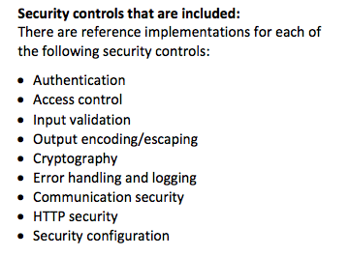
Enterprise Security API
Project Leader: Chris Schmidt, Chris.Schmidt@owasp.org
Purpose: A free, open source, web application security control library that makes it easier for programmers to write lower-risk applications
https://www.owasp.org/index.php/Category:OWASP_Enterprise_Security_API
for Reboot

Slide 21
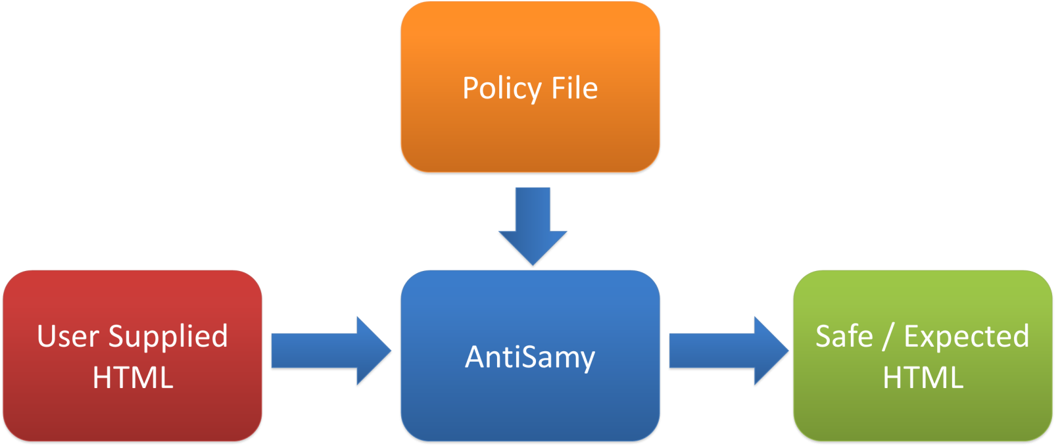
AntiSamy
Project Leader: Jason Li, jason.li@owasp.org
Purpose: An HTML validation tool and API to safely and gracefully handle rich html input, for ensuring user-supplied HTML/CSS is in compliance within an application's rules.
https://www.owasp.org/index.php/AntiSamy

Slide 22
Guides
Development Guide: comprehensive manual for designing, developing and deploying secure Web Applications and Web Services
Code Review Guide: mechanics of reviewing code for certain vulnerabilities & validation of proper security controls
Testing Guide: understand the what, why, when, where, and how of testing web applications
https://www.owasp.org/index.php/Category:OWASP_Guide_Project
https://www.owasp.org/index.php/Category:OWASP_Code_Review_Project
https://www.owasp.org/index.php/Category:OWASP_Testing_Project
for Reboot

Slide 23
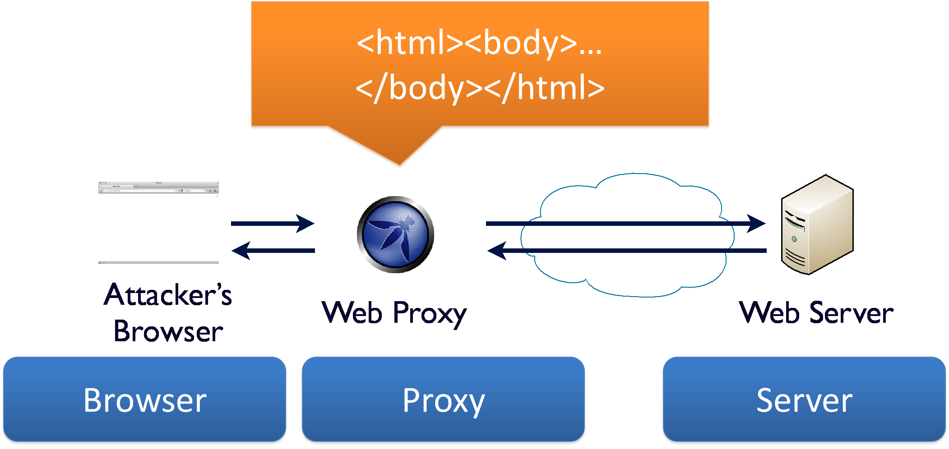
Zed Attack Proxy
Project Leader: Simon Bennetts (aka Psiinon), psiinon@gmail.com
Purpose: The Zed Attack Proxy (ZAP) provides automated scanners as well as a set of tools that allow you to find security vulnerabilities manually in web applications.
Last Release: ZAP 1.4.0 - 08/04/2012
https://www.owasp.org/index.php/OWASP_Zed_Attack_Proxy_Project
for Reboot

Slide 24
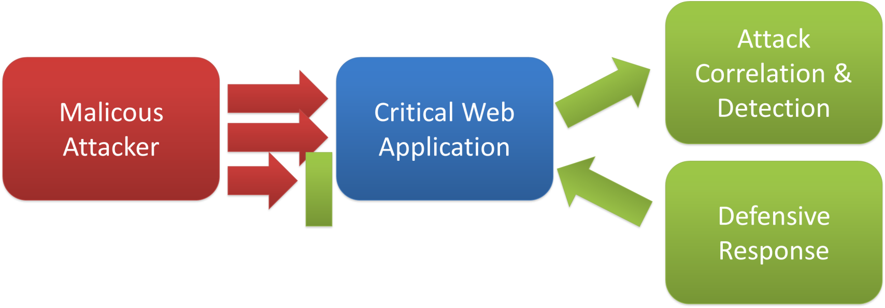
AppSensor
Project Leader(s): Michael Coates, John Melton, Colin Watson
Purpose: Defines a conceptual framework and methodology that offers prescriptive guidance to implement intrusion detection and automated response into an existing application.
Release: AppSensor 0.1.3 - Nov 2010 (Tool) & September 2008 (doc)
https://www.owasp.org/index.php/AppSensor
Create attack aware applications

Slide 25
Cloud Top10 Project
Project Leader: Vinay Bansal, Vinaykbansal@gmail.com
Purpose: Develop and maintain a list of Top 10 Security Risks faced with the Cloud Computing and SaaS Models. Serve as a Quick List of Top Risks with Cloud adoption, and Provide Guidelines on Mitigating the Risks.
Deliverables
Cloud Top 10 Security Risks (Draft expected for early 2013)
https://www.owasp.org/index.php/Category:OWASP_Cloud_%E2%80%90_10_Project

Slide 26
Cloud Top10 Security Risks
R1. Accountability & Data Risk
R2. User Identity Federation
R3. Legal & Regulatory Compliance
R4. Business Continuity & Resiliency
R5. User Privacy & Secondary Usage of Data
R6. Service & Data Integration
R7. Multi-tenancy & Physical Security
R8. Incidence Analysis & Forensics
R9. Infrastructure Security
R10. Non-production Environment Exposure

Slide 27
Mobile Security Project
Project Leader: Jack Mannino, Jack@nvisiumsecurity.com
Purpose: Establish an OWASP Top 10 Mobile Risks. Intended to be platform-agnostic. Focused on areas of risk rather than individual vulnerabilities.
Deliverables
Top 10 Mobile Risks (currently Release Candidate v1.0)
Top 10 Mobile Controls (OWASP/ENISA Collaboration)
OWASP Wiki, ‘Smartphone Secure Development Guidelines’ (ENISA)
Mobile Cheat Sheet Series
OWASP GoatDroid Project
OWASP Mobile Threat Model Project
https://www.owasp.org/index.php/OWASP_Mobile_Security_Project
for Reboot

Slide 28
Top 10 Mobile Risks
M1. Insecure Data Storage
M2. Weak Server Side Controls
M3. Insufficient Transport Layer Protection
M4. Client Side Injection
M5. Poor Authorization and Authentication
M6. Improper Session Handling
M7. Security Decisions via Untrusted Inputs
M8. Side Channel Data Leakage
M9. Broken Cryptography
M10. Sensitive Information Disclosure

Slide 29
Threat Modeling Project
Project Leader: Anurag "Archie" Agarwal, anurag.agarwal@owasp.org
Purpose: Establish a single and inclusive software-centric OWASP Threat modeling Methodology, addressing vulnerability in client and web application-level services over the Internet.
Deliverables (1st Draft expected for end of 2012 / early 2013)
An OWASP Threat Modeling methodology
A glossary of threat modeling terms
https://www.owasp.org/index.php/OWASP_Threat_Modelling_Project

Slide 30
Projects Reboot 2012
Refresh, revitalize & update Projects, rewrite & complete Guides or Tools.
Current Submissions
OWASP Application Security Guide For CISOs - Selected for Reboot
OWASP Development Guide - Selected for Reboot
Zed Attack Proxy - Selected for Reboot
OWASP WebGoat
OWASP AppSensor
OWASP Mobile Project - Selected for Reboot
OWASP Portuguese Language Project
OWASP_Application_Testing_guide_v4
OWASP ESAPI
OWASP Eliminate Vulnerable Code Project
OWASP_Code_Review_Guide_Reboot
Projects selected via first round of review
OWASP Development Guide: Funding Amount: $5000 initial funding
OWASP CISO Guide: Funding Amount: $5000 initial funding
OWASP Zed Attack Proxy: Funding Amount: $5000 initial funding
OWASP Mobile Project: Funding Amount: $5000 initial funding
Ongoing discussions about the Code Review and the Testing Guides
https://www.owasp.org/index.php/Projects_Reboot_2012

Slide 31
Agenda
What is OWASP, what we could bring
Update - OWASP Projects
Talking Legal
Evolution of Legal framework
Developers, Software makers held liable for code?

Slide 32
Do you…Legal? 1/2
In case of security breach, what’s going on from a Legal perspective?
Who could be accountable for what?
Who should be accountable for what?
Who would be accountable for what?
In fact, who is accountable for what?...

Slide 33
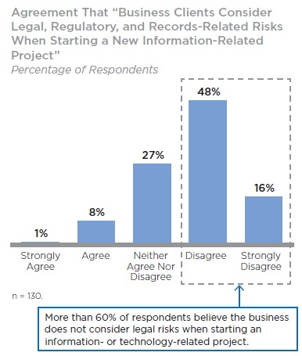
Do you…Legal? 2/2
Although Legal and Information Security need to work better together, they aren’t, and this is damaging companies’ ability to manage risk.
Over 60% of General Counsel are dissatisfied with the way information risks are being addressed and with their involvement in information risk management.
Source: The Information Risk Executive Council (IREC)

Slide 34
Law Enforcement
Three criteria of sensitivity of the information commonly accepted
Confidentiality: Confidentiality refers to limiting information access and disclosure to authorized users and preventing access by or disclosure to unauthorized ones.
Integrity: Integrity refers to the trustworthiness of information resources.
Availability: Availability refers, unsurprisingly, to the availability of information resources.
A fourth is also often used (under different names)
Traceability, Imputability, or Proof, i.e. Non-repudiation

Slide 35
Stakes of Security: Status
The legal risk is a consequence of operational risk
The business risk is in fact induced by the informational risk
Information Systems Security aims four main objectives:
Availability
Data Integrity
Confidentiality
Non-repudiation
The risk assessment of information systems can make it possible
to reduce both business and legal risks

Slide 36
A Difficult Equation
OBLIGATIONS OF THE ENTERPRISE
Point
of Balance
CUSTOMER REQUIREMENTS
LEGAL AND REGULATION REQUIREMENTS
Where is the ‘Border' between Customer Satisfaction and Interaction with the Authorities?

Slide 37
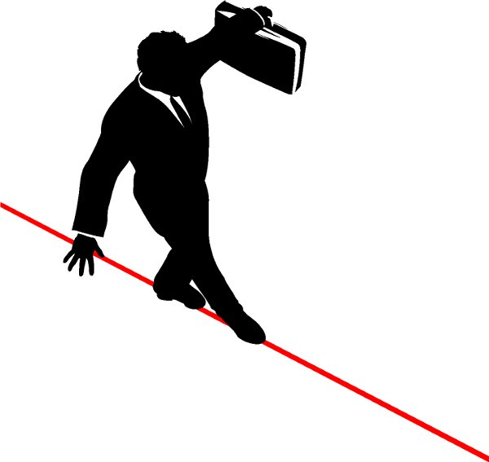
What’s at Stake? … also for Sotware Makers
Technologies
Implémentation
Usages
FRAUD SECURITY
Anticipate Security stakes and assist businesses in their efforts to maintain a balance.
FIND THE POINT OF BALANCE

Slide 38
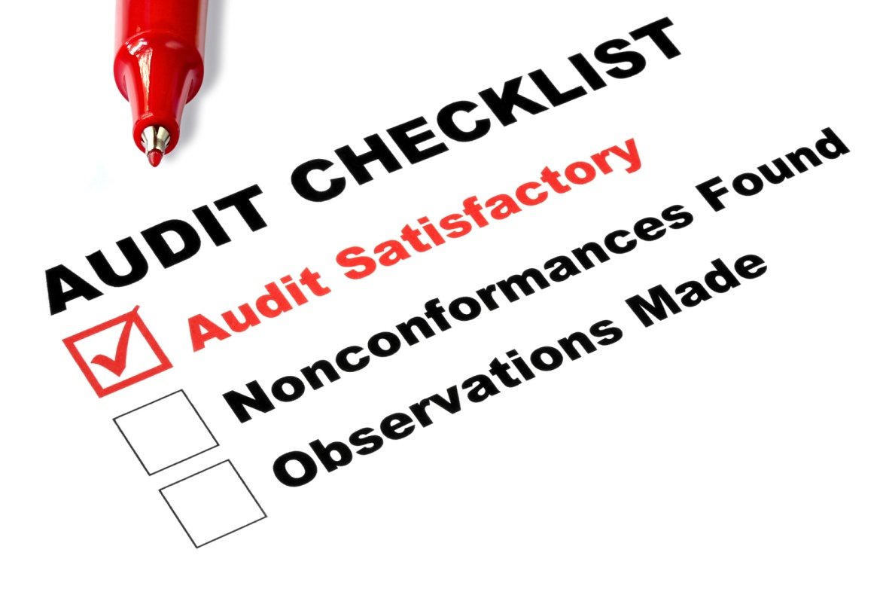

Slide 39
The OWASP Secure Software
Contract Annex
Intended to help software developers and their clients negociate important contractual terms and conditions related to the security of the software to be developped or delivered.
CONTEXT: Most contracts are silent on these issues, and the parties frequently have dramatically different views on what has actually been agreed to.
OBJECTIVE: Clearly define these terms is the best way to ensure that both parties can make informed decisions about how to proceed.
https://www.owasp.org/index.php/OWASP_Secure_Software_Contract_Annex

Slide 41
States of California, USA
Data Breach
California was the first state in USA to enact such a law.
California Senate Bill No. 1386 became effective on 1st July 2003, amending Civil Codes 1798.29, 1798.82 and 1798.84. It is a serious bill, with far reaching implications.
Essentially, it requires an agency, person or business that conducts business in California and owns or licenses computerized 'personal information' to disclose any breach of security (to any resident whose unencrypted data is believed to have been disclosed)
The statute imposes specific notification requirements on companies in such circumstances.
The statute applies regardless of whether the computerized consumer records are maintained in or outside California.

Slide 42
European Directive
2009/136/EC
DIRECTIVE 2009/136/EC OF THE EUROPEAN PARLIAMENT AND OF THE COUNCIL
of 25 November 2009
amending Directive 2002/22/EC on universal service and users’ rights relating to electronic communications networks and services, Directive 2002/58/EC concerning the processing of personal data and the protection of privacy in the electronic communications sector and Regulation (EC) No 2006/2004 on cooperation between national authorities responsible for the enforcement of consumer protection laws.
Article 2 (2) (4) (c) adds a requirement to notify Security breaches to “National Authority” and to those affected by this vulnerability, at least if the flaw is “likely to affect negatively” their personal data

Slide 43
European Convention on
Cyber Crime
Came into force in Jul 2004
The Council of Europe adopted a Convention on Cyber Crime that identified and defined internet crimes:
Offenses against the Confidentiality, Integrity and Availability of computers, data and systems (illegal access, illegal interception, data interference, system interference, misuse of devices)
Computer-related Offenses (computer-related forgery, computer-related Fraud)
Content-related Offenses (offenses related to child pornography)
Offenses related to infringements of copyright and related rights

Slide 44
Executive Management
Responsibility
All organisations need to be aware of the Convention’s provisions in Article 12, Paragraph 2:
‘Ensure that a legal person can be held liable where the lack of supervision or control by a natural person… has made possible the commission of a criminal offenses, established in accordance with this Convention’.
In other words, Directors can be responsible for offenses committed by their organisation simply because they failed to adequately exercise their duty of care.

Slide 45
European Convention on
Cyber Crime
The Organisation of American States (OAS) and the Asia-Pacific Economic Cooperation (APEC) have both committed themselves to applying the European Convention on Cyber Crime.
70+ countries have enacted.
http://www.coe.int/t/DGHL/cooperation/economiccrime/cybercrime/default_en.asp
http://www.oas.org/en/default.asp
http://www.apec.org/

Slide 46
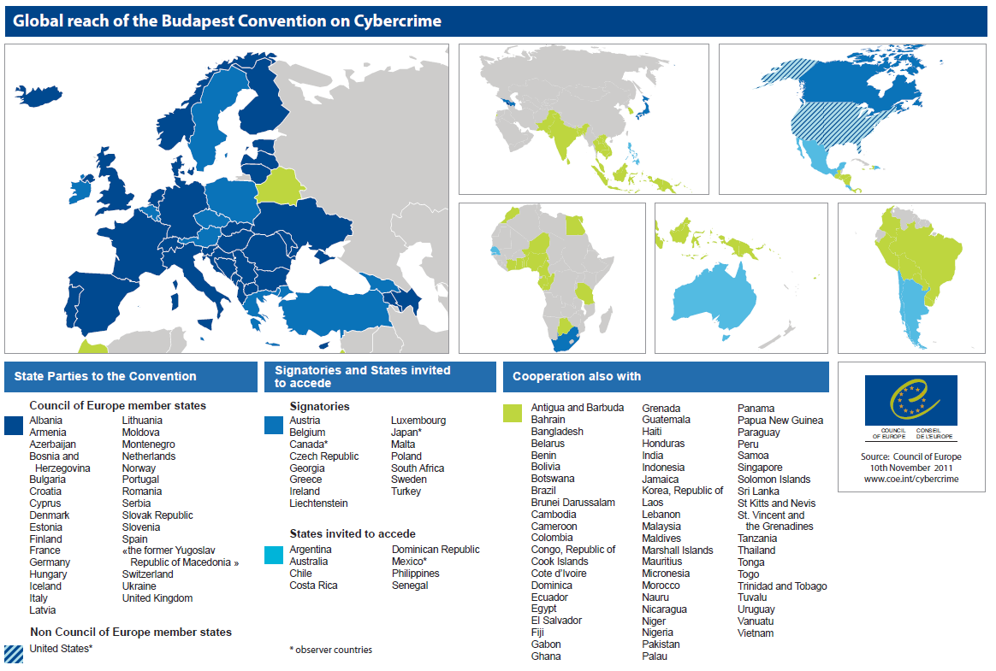

Slide 47
What about France? 1/2
Reporting of violations of personal data to the CNIL
New obligation to notify security breaches or the integrity of Networks and Services
Consequences in case of non-compliance with legal obligations
The Commission Nationale de l’Informatique et des Libertés (CNIL) is responsible for ensuring that information technology remains at the service of citizens, and does not jeopardize human identity or breach human rights, privacy or individual or public liberties.
http://www.cnil.fr/english/the-cnil/

Slide 48
What about France? 2/2
Article 38 de l’ordonnance du 24 août 2011 (aka ‘Telecom Packet’): l’obligation d’une notification des failles de sécurité
«En cas de violation de données à caractère personnel, le fournisseur de services de communications électroniques accessibles au public avertit, sans délai, la Commission nationale de l'informatique et des libertés. Lorsque cette violation peut porter atteinte aux données à caractère personnel ou à la vie privée d'un abonné ou d'une autre personne physique, le fournisseur avertit également, sans délai, l'intéressé. »
Penalties in case of breach of the duty to report under the juridiction of the CNIL
150 K€, 300 K€ for repeat offenses
Brand Impact!
Possibility of publication of the CNIL’s decision

Slide 49
Computer-related Offenses
According the French Penal Code
Fraudulent access and maintaining in an Information System (Art. 323-1 C. Pénal)
Obstacle to the functioning of an information system (Art. 323-2 C. Pénal)
Fraudulent introduction of data into an information system (Art. 323-3 C. Pénal)

Slide 50
Computer Crimes
Legal risks in connection with the fraudulent use of Information Systems:
Reminder: Any Commercial Web Application Service is part of an Information System
Why: Because we are talking about Information Security, which means… Legal Compliance!

Slide 51
Privacy & Information Security
The Responsible of the Data Processing is required to take any useful precautions, au regard de la nature des données et des risques présentés par le traitement, pour préserver la sécurité des données et, notamment empêcher qu’elles soient déformées, endommagées ou que des tiers non autorisés y aient accès. (Article 34 de la Loi 78-17 du 6 janvier 1978 modifiée - CNIL)
Article 226-17 du Code Pénal : Le fait de procéder ou de faire procéder à un traitement de données à caractère personnel sans mettre en œuvre les mesures prescrites à l'article 34 de la loi n° 78-17 du 6 janvier 1978 précitée est puni de cinq ans d'emprisonnement et de 300 000 Euros d'amende.

Slide 52
What is this obligations?
Take any useful precautions
In regard of the nature of Data
And the risks presented by the Processing
To preserve data security and, in particular, prevent that they are
Modified
Tampered
or that unauthorized third parties have access

Slide 53
Privacy Security within
the Enterprise
The CEO is criminally responsible of the Data Processing
France: Obligations under the law of 6 Jan 1978 (modified in 2004)
Criminal Risk in case of Delegation of Authority
… for each person part of the Chain!
What about the subcontracting?
Enterprise: Data owner = Accountable
Subcontractor: Data processor = Accountable

Slide 54
Proposed European Regulation on the protection of personal data
Will to harmonization of the regulations at EU level by the use of a Regulation, for greater harmonization of rules between actors and countries:
Same framework for all players regardless of their location:
The proposed regulation provides that EU rules apply to any provider that handles data from a EU user
Same framework throughout Europe:
The choice of a Regulation, not a Directive, reduces the risk of differences in interpretation between Member States (national transposition not required).
Same framework, whatever the activity of the controller

Slide 55
New obligations for the persons in charge of the treatment
Privacy by design, impact analysis and documentation:
Principles of “privacy by design” and "accountability": new internal governance rules for companies to integrate the protection of personal data in the design of the product / service.
Reporting of violations of personal data

Slide 56
Real Sanctions!
Art. 79 - Penalties:
A 2% annual turnover fine
Administrative penalties may be up to 2% of total revenues
1 000 000 Euros
A 2% annual turnover fine would have meant
1.2 Billion dollars in 2008 for a company like Microsoft!

Slide 57
Issues for the Enterprise
& Consequences
All these acts can have serious consequences for the Company
Financial Consequences
Consequences on the Reputation
Brand impact
Criminal Consequences for the Executives
Proceedings to the civil courts: Claims for damages by customers

Slide 58
Criminal Consequences
(France)
Article 226-17 of the Penal Code also charges the disclosure of information… to the spyed!
The Entreprise (i.e. the Spyed) is responsible of consequences caused to third parties
The people ‘accountable’ (IT, Security, or the CTO, even the CEO) can be personally involved
Law ‘Godfrain’ - Penalty: 2 months to 5 years / 300 € to 300 K€
Protection of information / Negligence: 5 years / 300 K€

Slide 59
What about Sotware Makers, Developers?

Slide 60
Don’t forget!
A Software Maker, a Developer, is recognized as a subject-matter expert in its field.
As such, Software Makers and Developers
have a Duty to Advise
… including about Web Application Security.

Slide 61
Back to the Future 1/2
EC wants software makers held liable for code
After identifying gaps in EU consumer protection rules, the European Commission is proposing that software makers give guarantees about the security and efficiency of their code.
http://news.cnet.com/8301-1001_3-10237212-92.html

Slide 62
Back to the Future 2/2
Should developers be sued for security holes?
Dr Richard Clayton, security researcher at the University of Cambridge, is arguing for regulations that remove the developer’s right to waive any responsibility for security flaws in their software.
It’s an argument that has already won support from officials across Europe, with a House of Lords committee (UK) recommending such a measure be implemented in 2007 and European Commissioners arguing for the requirement in 2009 - however agreements to this effect have not been passed.
http://www.publications.parliament.uk/pa/ld200607/ldselect/ldsctech/165/165i.pdf (see page 38, Vendor liability)
http://www.techrepublic.com/blog/european-technology/should-developers-be-sued-for-security-holes/1109

Slide 63
Here is the Question
Developers, Software makers held liable for code?
From a global point of view and in essence, YES.
From a Legal point of view: YES, you could.
Depends on the circumstances
Depends on the Contract
Depends on the eventual License
Depends on the Product
Depends on the Customer (reputation, business, large account, etc.)

Slide 64
So, is your Software company concerned?
(Answers below from lawyers specialized in IT)
YES, you could also be held liable in case of Security Breach in a Customer’s Information System, as well as the company concerned.

Slide 65
The Knowledge is wealth,
Knowledge must flow
“If you think education is expensive,
you should try ignorance!”
Abraham Lincoln

Slide 66
Teamwork
TEAM stands for… Together Each Achieves More
You guys are welcome to attend our meetings
and have talks at OWASP.
The OWASP French Chapter welcomes you!

Slide 67
Ludovic Petit Ludovic.Petit@owasp.org +33 (0) 611 726 164
Q&A

