Slide 1
OWASP Update
Seba Deleersnyder
seba@owasp.org
BE Board
OWASP Belgium Chapter Meeting 17-Dec-2013

Slide 2


OWASP World
OWASP is a worldwide free and open community focused on improving the security of application software.
Our mission is to make application security visible so that people and organizations can make informed decisions about application security risks.
Everyone is free to participate in OWASP and all of our materials are available under a free and open software license.
The OWASP Foundation is a 501c3 not-for-profit charitable organization that ensures the ongoing availability and support for our work.
Notes:
2

Slide 3






Thank you
Location / co hosting OWASP Supporter Catering
Sponsors Belgium 2013/2014
OWASP cannot recommend the use of products, services, or recommend specific companies
3
Notes:
3

Slide 4
Program
18h45 OWASP – ISC2 update
Seba Deleersnyder (OWASP)
Lode Vanstechelman (ISC2)
19h00 – 20h00 Augmented reality in your Web Proxy
Roberto Suggi Liverani
Break
20h15 – 21h15 If You Tolerate This, Your Child Processes Will Be Next Bart Leppens
4

Slide 5
2014
Conference | Dates | Location
AppSec APAC 2014 | 17-20 March | Tokyo, Japan
OWASP AppSec EU 2014 | 23-26 June | Cambridge, UK
AppSec USA 2014 | 15-18 September | Denver, US
BeNeLux 2014 | 27-28 November | Luxembourg

Slide 6
Next Belgium chapter meetings
Planning:
  February 2014
  May 2014
  October 2014
  December 2014
Suggestions for speakers / venues are always welcome!
6

Slide 7


Corelan Live! by Peter Van Eeckhoutte
Offensive HTML, SVG, CSS and other Browser-Evil by Mario Heiderich
Rapid Reverse Engineering by Russ Gideon
Pentesting Smart Grid and SCADA with SamuraiSTFU by Justin Searle
Assessing and Exploiting Web Apps with SamuraiWTF by John Sawyer

Slide 8

Get involved
Use and donate (feed)back!
Attend chapter meetings
Contribute to projects
Donate resources
Sponsor chapters / projects
Become Member

Slide 9
Enjoy the chapter meeting!
owasp.be
@owasp_be

Slide 10
(ISC)² Belgium Chapter

Slide 11
(ISC)² Belgium Chapter
Who are we?
Local chapter of (ISC)²
Who is (ISC)²?
  International Information Systems Security Certification Consortium, Inc., (ISC)²®
  a global, not-for-profit leader in educating and certifying information security professionals
Notes:
CISSP - Certified Information Systems Security Professional
SSCP - Systems Security Certified Practitioner
CAP - Certified Authorization Professional
CSSLP - Certified Secure Software Lifecycle Professional
CISSP-ISSAP Information Systems Security Architecture Professional
CISSP-ISSEP - Information Systems Security Engineering Professional
CISSP-ISSMP - Information Systems Security Management Professional

Slide 12
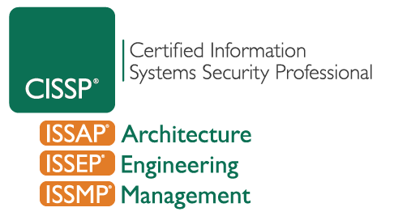

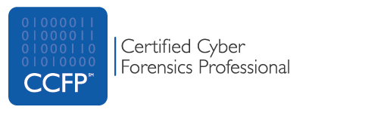



(ISC)² certifications
Notes:
CISSP - Certified Information Systems Security Professional
SSCP - Systems Security Certified Practitioner
CAP - Certified Authorization Professional
CSSLP - Certified Secure Software Lifecycle Professional
CISSP-ISSAP Information Systems Security Architecture Professional
CISSP-ISSEP - Information Systems Security Engineering Professional
CISSP-ISSMP - Information Systems Security Management Professional

Slide 13
(ISC)² Belgium Chapter
What do we offer?
Your local point of contact to (ISC)²
  Questions on certification, CPE credits, …
Organize events focused on information security
Offer opportunities to gain CPE credits
  A certificate can be requested if you are audited
  Credits are automatically submitted to (ISC)² for paying members

Slide 14
(ISC)² Belgium Chapter
How can you help?
Support us and become a member
Join the chapter board → upcoming elections
Present something at one of our events
  Send us your proposal
Host an event
  Let us know if you or your organization can host an event
Send your ideas/interests for future events/presentations

Slide 15
Events organized in 2013
(upcoming) ISO standards:
  ISO/IEC 30111 - Vulnerability handling processes
  ISO/IEC 29147 - Vulnerability disclosure
Vulnerability management using Qualys and Rapid 7
Privacy legislation and the impact on logging
  Belgian and European privacy legislation
  How to handle privacy data when logging it

Slide 16
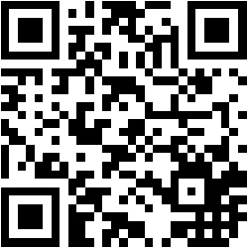
(ISC)² Belgium Chapter
Stay in touch
Visit our website regularly for updates:
https://www.isc2chapter-belgium.be/
Follow us on LinkedIn or join our group on LinkedIn
Follow us on Twitter: @ISC2BEChapter

