Slide 1
Reducing Your Data Security Risk Through Tokenization
Josh Sokol

Slide 2
#whoami
Josh Sokol (josh.sokol@ni.com)
B.S. in Computer Science
Cisco Certified Network Associate (CCNA)
SANS GIAC in Web Application Security (GWAS)
Web Systems Engineer for National Instruments
Own the Web Systems “Security Practice”
Just passed the CISSP exam!!!

Slide 3
Disclaimer
I am by no means an expert on Tokenization. I have never actually implemented Tokenization in an enterprise environment. This presentation is based off my experience evaluating Tokenization with regards to PCI and various presentations I’ve seen on the topic including a presentation by Dave Marsh of nuBridges. That said, it is a very interesting topic and one we haven’t seen anything like before at an OWASP meeting. I’d like this to be an open discussion where others who may have more experience than I do feel free to contribute to the topic at hand.

Slide 4
Today’s Topic: Tokenization
What is tokenization?
Business drivers for data protection
Approaches to data security
Tokenization to reduce audit scope and lower risk
Examples
Questions

Slide 5
What Tokenization is NOT
Before we can talk about what tokenization is, we have to understand what it is not.

Slide 6
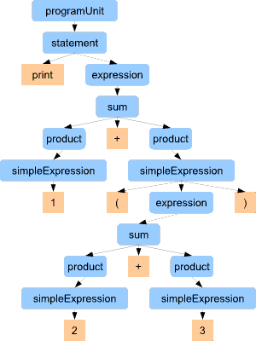
Tokenization is not…
Wikipedia Definition
Tokenization is the process of breaking a stream of text up into meaningful elements. This is useful both in linguistics (where it is also known as "Text segmentation"), and in computer science, where it forms part of lexical analysis.
Notes:
We are not talking about tokenization in terms of lexical analysis.

Slide 7
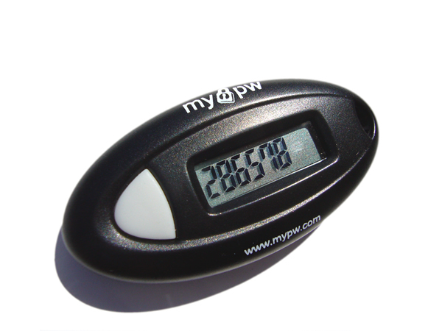
Tokenization is not…
Notes:
We’re not talking about RSA tokens or any sort of key fob.

Slide 8
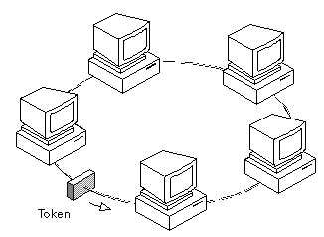
Tokenization is not…
Notes:
We’re not talking about token ring networks.

Slide 9
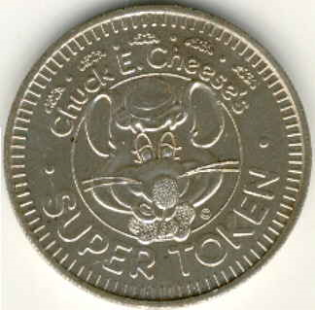
Tokenization is not…
Notes:
We’re not talking about coins…

Slide 10
Tokenization is not…
Notes:
That kid from South Park…

Slide 11
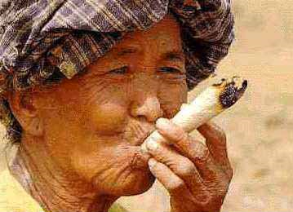
Tokenization is not…
Notes:
Or smoking illicit substances.

Slide 12
Now that we have that out of the way…
Tokenization is the process of replacing sensitive data with unique identification symbols that retain all the essential information without compromising its security.
Tokenization technology can, in theory, be used with sensitive data of all kinds including bank transactions, medical records, criminal records, vehicle driver information, loan applications, stock trading, and voter registration.

Slide 13
Business Drivers for Data Protection

Slide 14
International Data Security Mandates
Countries
United Kingdom: Companies Bill, Data Protection Act
European Union: European Union Privacy Act (EUPA)
Japan: Japanese Personal Information Act 2003 (JPIPA)
Canada: Personal Information Protection and Electronic Documents Act (PIPEDA)
Industries
Payment Card Industry Data Security Standard (PCI DSS)
Code of Practice on Data Protection for the Insurance Sector (UK)

Slide 15
More if you do business in the U.S.
Government
Sarbanes Oxley Act
Gramm Leach Bliley Bill
Healthcare Insurance Portability & Accountability Act (HIPAA)
Part 11 of the Title 21 Code of Federal Regulations
California State Bill 1386
Industry
Payment Card Industry Data Security Standard (PCI DSS)
Healthcare Insurance Portability & Accountability Act (HIPAA)
Company
Secure FTP – Bank of America, BankOne
AS2 – Walmart, Food Lion, McKesson

Slide 16
Data Security impacts a wide range of sensitive data
Other Personally Identifiable Information (PII)
Passport Number
Date/Place of Birth
Postal or Email Address
Telephone Numbers (home/mobile)
Mother’s Maiden Name
Biometric Data
Unique Electronic Number, Address, or Routing Code
Telecommunication Id Information or Access Device
Payment Card Industry Data Security Standard (PCI DSS)
Credit/Debit Card Numbers
Laws
National Insurance Number
Social Security Number
Driver’s License Number
Bank Account Numbers
Healthcare
Medical related information (Patient/Doctor, etc)

Slide 17
Approaches to Data Security

Slide 18
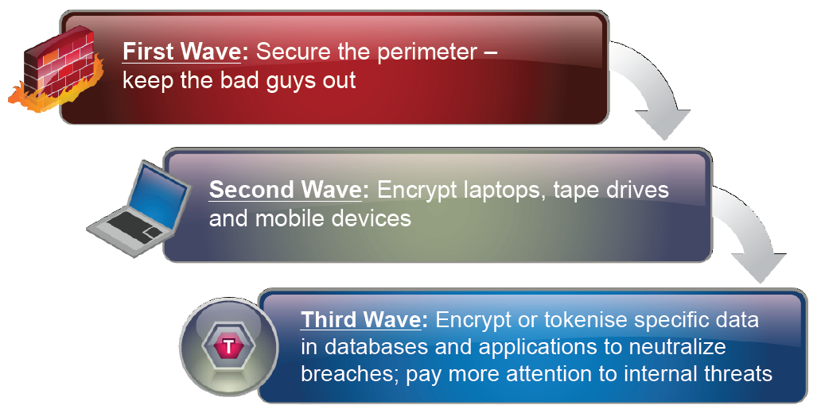
1st Approach: Waves of Data Protection Investment

Slide 19
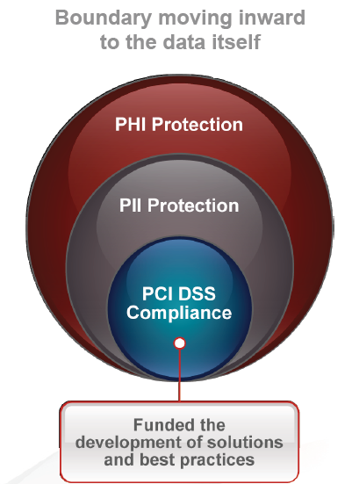
2nd Approach: Trend in Securing Sensitive Data
Notes:
PII = Personally Identifiable Information, PHI = Private Health Information

Slide 20
Time for a quick straw poll…

Slide 21
Question 1:
Is your organization subject to some sort of compliance regulation like PCI DSS, HIPAA, etc?

Slide 22
Question 2:
Did you evaluate Tokenization as an option for reducing the scope of compliance?

Slide 23
Question 3:
Have you actually implemented Tokenization?

Slide 24
PCI DSS Driving Best Practices

Slide 25
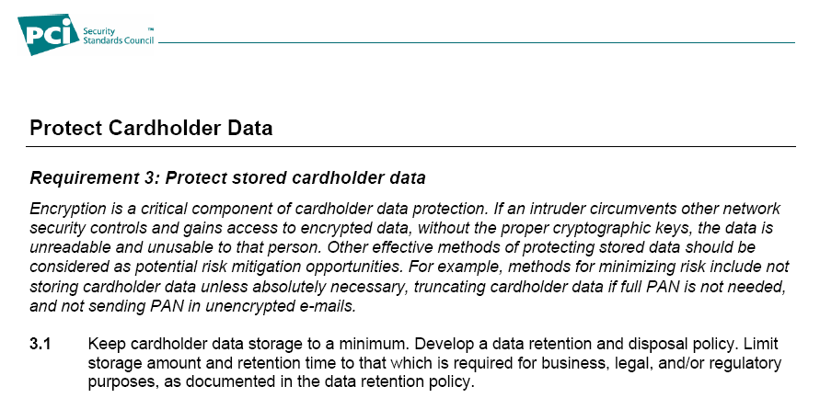
PCI DSS 3.1 – Minimize cardholder data storage

Slide 26
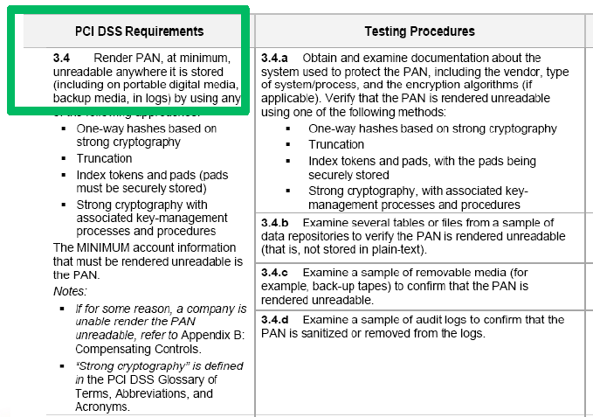
PCI DSS 3.4 – Render PAN unreadable
Options
Hashing
Truncation
Tokens
Strong cryptography
Notes:
PAN = Primary Account Number

Slide 27
PCI DSS 3.5 – Minimize key locations

Slide 28
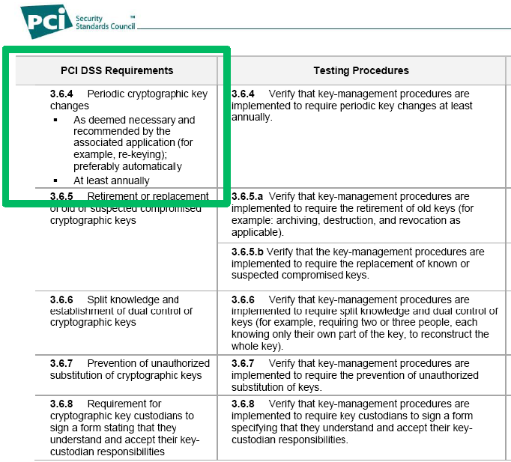
PCI DSS 3.6 – Rotate Keys Annually
and…
Secure the keys,
Know which keys are used for which data,
Run your business
…

Slide 29
Challenges of PCI DSS Compliance
Store Card Holder Data (CHD) in fewest number of places
Protect CHD wherever it is stored
Store cryptographic keys in fewest number of places
Rotate cryptographic keys at least annually

Slide 30
Tokenization to Reduce Audit Scope and Lower Risk

Slide 31
What is a token?
In data security, it’s a surrogate value which is substituted for the actual data (ex: credit card number) while the actual data is encrypted and stored elsewhere.

Slide 32
Tokens Act as Data Surrogates
Tokens maintain the length and format of the original data
After tokenization, tokens reside where sensitive data previously resided in the application infrastructure.
Input: sensitive data -> Output: token
Input: token -> Output: sensitive data
Limits or eliminates modifications to applications.

Slide 33
Format Preserving Tokenization
Tokens can be formatted to:
Preserve the format (length and data type), and leading/trailing
Preserve length but not data type, and leading/trailing
Mask a portion of the token when a full value is not needed or desirable (can’t be subsequently translated back)
Tokens generally maintain the length and format of the original data so that applications require little or no modification.

Slide 34
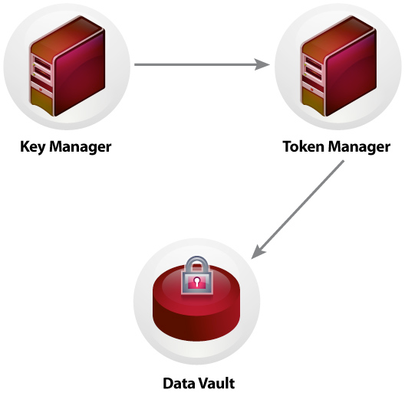
Centralized Data Vault
Protected Data Vault where sensitive data is encrypted and stored
Reduces the footprint where sensitive data is located
Eliminates points of risk
Simplifies security management

Slide 35
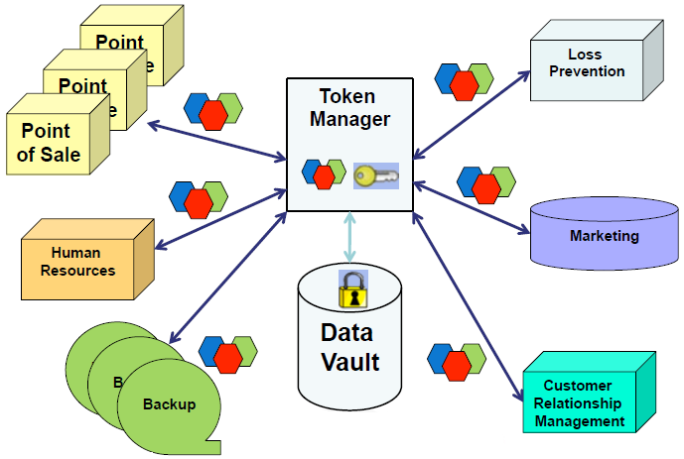
Tokenization Model

Slide 36
Tokens are Surrogates for Masked Data
Formatted tokens can be used wherever masked credit card information is required
Therefore wherever tokenized data suffices, risk is reduced

Slide 37
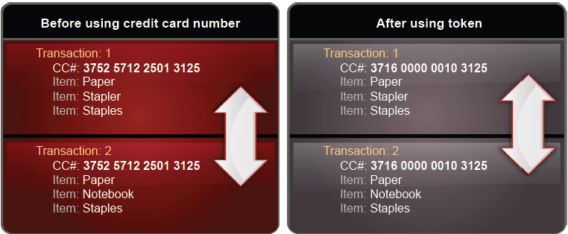
1:1 Token / Data Relationship
Same token value is consistent for same data across entire enterprise; maintains referential integrity across applications
Data analysis can be performed using token – ex: data warehouse

Slide 38
Tokens Not Derived from Data
Original data values cannot be mathematically derived from tokens
Tokens can be safely passed to databases, applications, mobile devices, etc.
Token has no intrinsic value
Solves the age-old problem of data for development and testing – it can be the same as production!

Slide 39
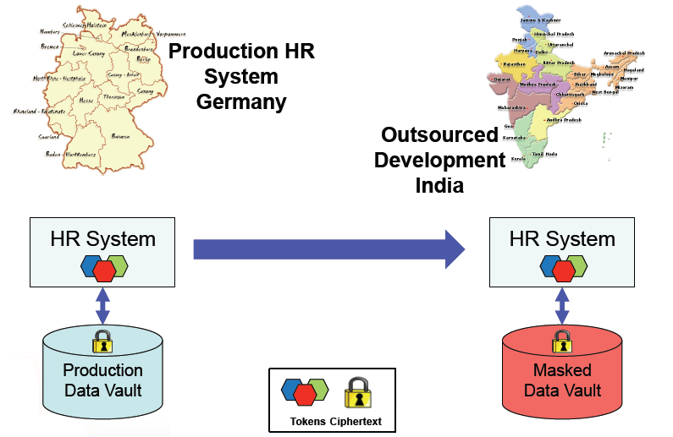
Test Systems Use Production Tokens

Slide 40
Centralized Key Management
Control over who accesses sensitive data
Rotate keys without having to decrypt and re-encrypt old data, and no system downtime
Keys are distributed to token server, not throughout enterprise

Slide 41
Let’s Compare the 3 Different Models

Slide 42
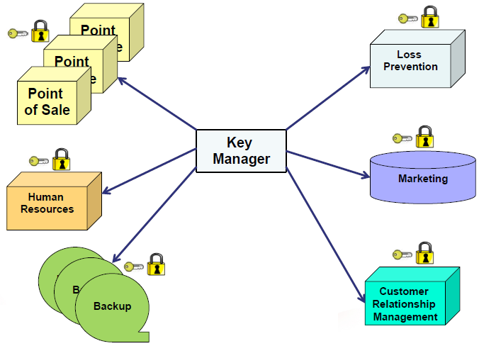
Localized Encryption Model (Old Skool)

Slide 43
Tokenization Model

Slide 44
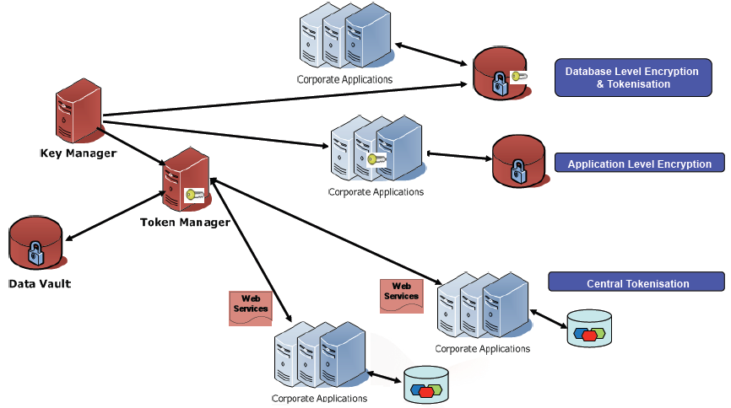
Hybrid Model – Tokenization and Localized Encryption
Hybrid architecture includes both Central and Local protection mechanisms working with the same Enterprise

Slide 45
Example #1

Slide 46
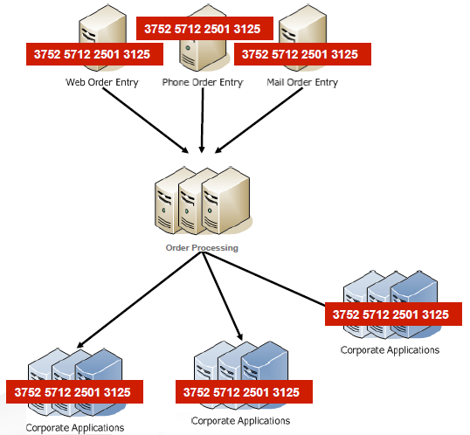
Before: Order Flow Without Tokenization
Dozens of systems in PCI DSS scope

Slide 47
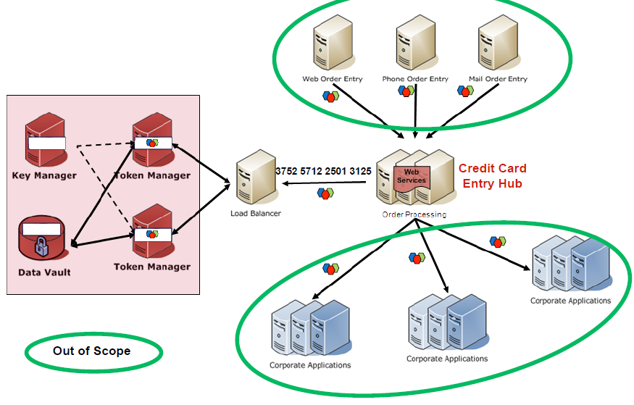
After: Order Flow with Tokenization

Slide 48
Example #2

Slide 49
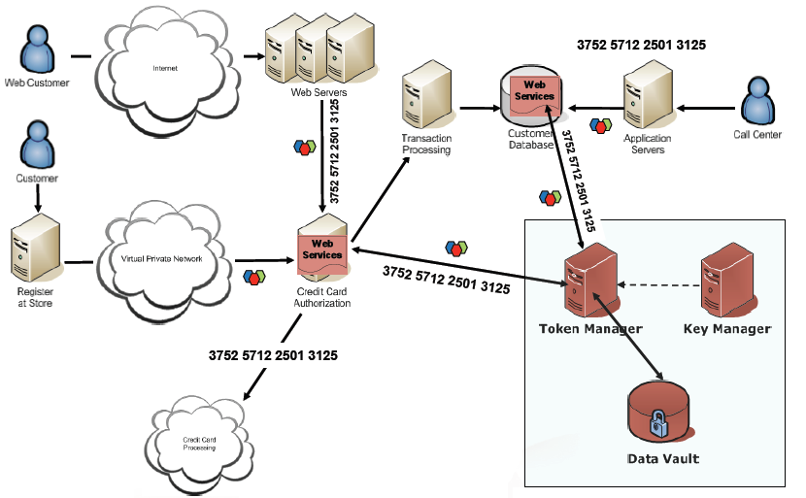
Order Flow with Tokenization

Slide 50
Tokenization Resources

Slide 51
Tokenization Vendors
nuBridges – http://www.nubridges.com
(the bulk of these slides came from Dave Marsh’s presentation)
RSA – http://www.rsa.com
Cybersource – http://www.cybersource.com

Slide 52
The End

