Slide 1
Don’t Write Security Code!
(The OWASP Enterprise Security API)
Jeff Williams
Aspect Security CEO
OWASP Foundation Chair
November 12, 2009
Notes:
Today I’m going to tell you about an exciting open source project that I’m leading at OWASP. Aspect is sponsoring the project and has provided significant support to the development.
Application security is way too complicated for developers, so we set out to simplify the API that they have to be familiar with in order to build a secure application.

Slide 2
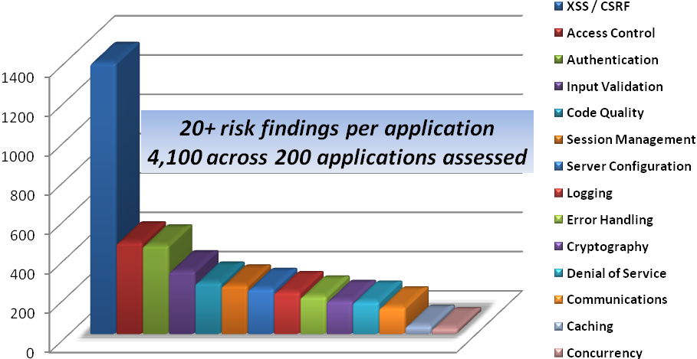

Reality Check
Financial
Government
Technology
Banking
Healthcare
Insurance
Publishing
Retail
Utilities
Education
90% of applications are vulnerable
Applications average 20 serious vulnerabilities
Notes:
At Aspect we review applications across a lot of different sectors.
We use a combination of manual code review, penetration testing, and advanced tools.
We do hundreds of assessments every year
And we assess several million lines of code every month
We have found that…
* Vulnerabilities pervasive – over 90% of the apps we review are vulnerable
* Over 55% of our findings higher risk (Critical, High, or Medium)
* On average we find 20 of these higher risk findings in each application
* There is not much difference between industry sectors
* In general, product code is in better shape than custom development
Over the last 10 years of doing this work, we’ve noticed something. Companies that have standardized on simple strong security controls watch the vulnerabilities in their portfolio drop dramatically. We have several large financial customers that simply don’t have SQL injection problems anymore. Not that we’re not looking, they just don’t happen. They’ve virtually stamped out problems with authentication and session management. And now they’re taking aim at XSS and will stomp that out too.
So today, I’m going to tell you about 5 controls that you have to put in place if you ever want to get in front of application security

Slide 3

OWASP ESAPI Project Charter…
To ensure that strong simple security controls are available to every developer in every environment
http://www.owasp.org/index.php/ESAPI

Slide 4
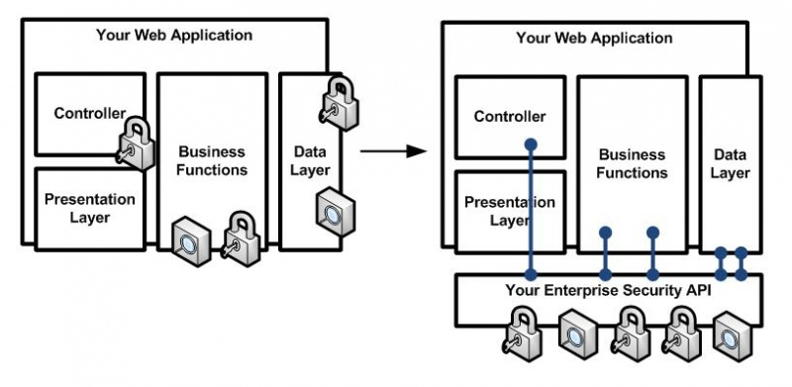
Before
After

Slide 5
Custom Application
Application
Framework
Enterprise Security API
ESAPI Adapters
ESAPI Core
Ent. Security
Services
Platform
LDAP, DB, Web
Services, etc..

Slide 6







2008 ESAPI Summit
Participants
The ESAPI Summit sparked innovation for version 2.0!
  Logging
  Access Control
  Input Validation
  Maven
  Internationalization
  ESAPI WAF!!

Slide 7








Project Scorecard
Authentication |  |  |  |  |  | 
Identity |  |  |  |  |  | 
Access Control |  |  | * |  |  | 
Input Validation |  |  |  | * |  |  | 
Output Escaping |  |  |  |  |  |  |  | 
Canonicalization |  |  |  |  |  |  | 
Encryption |  |  |  |  |  | 
Random Numbers |  |  |  |  |  | 
Exception Handling |  |  |  |  |  |  | 
Logging |  |  |  |  |  | 
Intrusion Detection |  |  |  |  |  | 
Security Configuration |  |  |  |  |  | 
WAF | 

Slide 8








Select ESAPI Early Adopters
Many unnamed
financial orgs…

Slide 9
Better Input Validation
// validate request against developer-defined patterns
ValidationErrorList errorList = new ValidationErrorList();
String name = ESAPI.validator().getValidInput(
"Name", form.getName(), “UserName", 255, false, errorList);
Integer weight = ESAPI.validator().getValidInteger(
“UserWeight", form.getWeight(), 1, 10000, false, errorList);
request.setAttribute(“VERROR”, errorList );
…
// get validation errors and update web page
ValidationErrorList errors = (ValidationErrorList)request.getAttribute(“VERROR");
// update page
Notes:
Works even better if this is encapsulated inside components!

Slide 10
Escaping Gone Wild
<
Percent Encoding
  %3c
  %3C
HTML Entity Encoding
  &#60
  &#060
  &#0060
  &#00060
  &#000060
  &#0000060
  &#60;
  &#060;
  &#0060;
  &#00060;
  &#000060;
  &#0000060;
  &#x3c
  &#x03c
  &#x003c
  &#x0003c
  &#x00003c
  &#x000003c
  &#x3c;
  &#x03c;
  &#x003c;
  &#x0003c;
  &#x00003c;
  &#x000003c;
  &#X3c
  &#X03c
  &#X003c
  &#X0003c
  &#X00003c
  &#X000003c
  &#X3c;
  &#X03c;
  &#X003c;
  &#X0003c;
  &#X00003c;
  &#X000003c;
  &#x3C
  &#x03C
  &#x003C
  &#x0003C
  &#x00003C
  &#x000003C
  &#x3C;
  &#x03C;
  &#x003C;
  &#x0003C;
  &#x00003C;
  &#x000003C;
  &#X3C
  &#X03C
  &#X003C
  &#X0003C
  &#X00003C
  &#X000003C
  &#X3C;
  &#X03C;
  &#X003C;
  &#X0003C;
  &#X00003C;
  &#X000003C;
  &lt
  &lT
  &Lt
  &LT
  &lt;
  &lT;
  &Lt;
  &LT;
  JavaScript Escape
  \<
  \x3c
  \X3c
  \u003c
  \U003c
  \x3C
  \X3C
  \u003C
  \U003C
  CSS Escape
  \3c
  \03c
  \003c
  \0003c
  \00003c
  \3C
  \03C
  \003C
  \0003C
  \00003C
  Overlong UTF-8
  %c0%bc
  %e0%80%bc
  %f0%80%80%bc
  %f8%80%80%80%bc
  %fc%80%80%80%80%bc
  US-ASCII
  ¼
  UTF-7
  +ADw-
  Punycode
  <-
Notes:
Why has XSS become so prevalent? One major factor is that browsers support a huge number of escaping and encoding schemes, that provide awesome cover for attackers. In this slide, I’m showing about 80 different valid ways to encode the < character in modern browsers. Different contexts within the browser have different escaping rules, which complicates the matter. More on that later.
And don't forget about the double encoding schemes. They make the combinations basically infinite.
Simple Double Encoding
< --> &lt; --> &#26;lt&#59 (double entity)
< --> %3c --> %253c (double percent)
etc...
Double Encoding with Multiple Schemes
< --> &lt; --> %26lt%3b (first entity, then percent)
< --> %26 --> &#25;26 (first percent, then entity)
etc...
Simple Nested Escaping
< --> %3c --> %%33%63 (nested encode percent both nibbles)
< --> %3c --> %%33c (nested encode first nibble percent)
< --> %3c --> %3%63 (nested encode second nibble percent)
< --> &lt; --> &&108;t; (nested encode l with entity)
etc...
Nested Escaping with Multiple Schemes
< --> &lt; --> &%6ct; (nested encode l with percent)
< --> %3c --> %&#x33;c (nested encode 3 with entity)
etc...

Slide 11
Stamping Out XSS
Rule #1: HTML Element Content
  ESAPI.encoder.encodeForHTML(input)
Rule #2: HTML Common Attributes
  ESAPI.encoder.encodeForHTMLAttribute(input)
Rule #3: HTML Javascript Data Values
  ESAPI.encoder.encodeForJavaScript(input)
Rule #4: HTML Style Property Values
  ESAPI.encoder.encodeForCSS(input)
Rule #5: HTML URL Attributes
  ESAPI.encoder.encodeForURL(input)
Use these in components and developers won’t even know!

Slide 12
Rich Content
String input = request.getParameter( "input" )
String safeMarkup = ESAPI.validator()
.getValidSafeHTML( "input", input, 2500, true );
…
<%=safeMarkup%>

Slide 13
Stopping Insecure Direct Object References
// setup a map and store somewhere safe - like the session!
Set fileSet = new HashSet(); fileSet.addAll(...);
AccessReferenceMap map = new AccessReferenceMap( fileSet );
...
// create an indirect reference to send to browser
String ref = map.getIndirectReference( file1 );
String href = "esapi?file=" + ref );
...
// get direct reference
String ref = request.getParameter( "file" );
File file = (File)map.getDirectReference( ref );

Slide 14
Identity Everywhere
// check the current user’s credentials
User user = ESAPI.authenticator().login();
// display their last login time
User user = ESAPI.authenticator().getCurrentUser() ;
out.println( “Login: “ + user.getLastLoginTime() );
// rotate their session id
ESAPI.httpUtilities().changeSessionIdentifier();
// kill their session and session cookie
ESAPI.authenticator().logout;
You can rotate your session without losing the contents

Slide 15


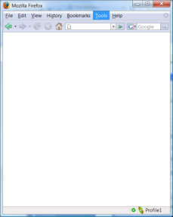

ESAPI Web App Firewall (WAF)
Critical Application?
PCI requirement?
3rd party application?
Legacy application?
Incident response?
WAF
attacker
ESAPI
user
Virtual patches
Authentication rules
URL access control
Egress filtering
Attack surface reduction
Real-time security
Notes:
Having the WAF and ESAPI together provides developers the tools the need to deal with a variety of situations. The WAF can provide immediate virtual patching, to give the developers the time they need to fix things ‘right’ at a more reasonable pace. ESAPI then gives the tools to fix things right. In some environments, the developers can’t change the code, so the WAF supports that situation.
We would almost always recommend solving most security issues in the app itself, rather than externalizing the security in a WAF, but the WAF is very useful to deal with security situations that come up after the application has been implemented.

Slide 16
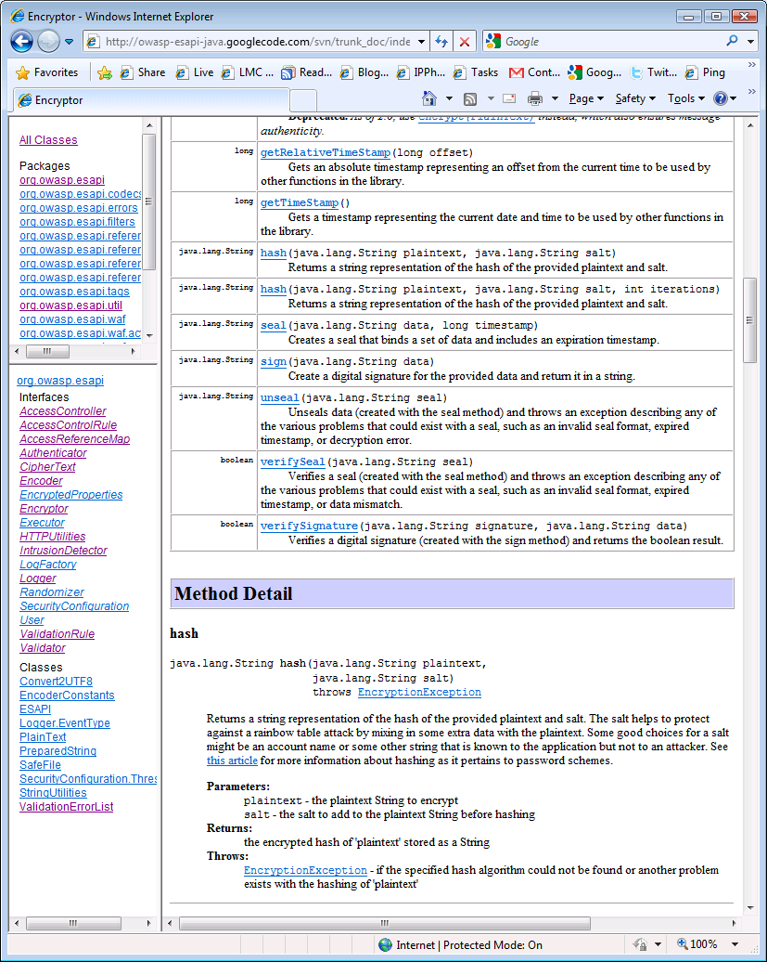
Documentation
Javadoc
  http://owasp-esapi-java.googlecode.com/svn/trunk_doc/index.html
Banned APIs
  http://www.owasp.org/index.php/ESAPI_Secure_Coding_Guideline
Release Notes
  http://www.owasp.org/images/d/d0/JavaEE-ESAPI_2.0a_ReleaseNotes.doc
Install Guide
  http://www.owasp.org/images/4/4c/JavaEE-ESAPI_2.0a_install.doc

Slide 17

Silver Bullet
Notes:
It’s easy to talk about the problems that ESAPI is good at addressing, but it’s important to realize that even a perfect set of security controls doesn’t automatically make applications secure.
Your architecture might contain challenges that the controls don’t address
Your threat model might be different than what the controls presume
You might avoid the need for security controls by making smart architecture choices
You still have to USE the controls in all the right places, and use them PROPERLY
All that said, there are many foundational security controls that it is hard to imagine a modern application doing without.

Slide 18

Monoculture
Notes:
Does ESAPI present a risk of monoculture. I think no for several reasons…
We already have a monoculture – everything is busted. Which is just as bad as what Dan Geer envisioned.
With ESAPI – we won’t really have a monoculture anyway, since companies will adapt the API to their internal security controls. What we’ll have is a monoculture of API, not implementation, which is not nearly as bad.
Even if I’m wrong, we can wait to deal with monoculture if and when we get close.

Slide 19

Questions and Answers
Jeff Williams
Aspect Security CEO
OWASP Foundation Chair
jeff.williams@aspectsecurity.com
http://www.aspectsecurity.com
twitter @planetlevel
410-707-1487
You can send me application security questions anytime!

