Slide 1
Collateral DDoS
Ido Leibovich, ADC

Slide 2
About Imperva
Founded in November 2002 by Shlomo Kramer, Amichai Shulman and Mickey Boodaei
~700 employees. R&D center in Tel-Aviv
SecureSphere protects web applications, databases, file access, cloud applications
Went public in 2011

Slide 3
Outline
BitTorrent Introduction
BitTorrent DDoS
Collateral DDoS
For Conspiracy Lovers
Conclusions

Slide 4
Introduction
1
The BitTorrent Protocol

Slide 5
The BitTorrent Protocol
Wikipedia: “BitTorrent is a protocol for the practice of peer-to-peer file sharing that is used to distribute large amounts of data over the Internet”
Allows simultaneous download from multiple peers
Orchestrated by a central ‘tracker’ server
Every download requires tracker communication (over HTTP)
Holds the file peer sources information
Based on ‘.torrent’ files
Contain the data files names and the tracker servers
Available on the internet in popular web sites
Anyone can create/edit and upload a file

Slide 6
The BitTorrent Protocol – Content Discovery
WWW
Torrent file

Slide 7
The BitTorrent Protocol – Content Delivery
WWW
BitTorrent SW
Torrent file
Peers
Tracker server
Peers
Notes:
Explain shortly about the client SW, good point for waiting and explaining
Methodic beak before moving on to DDoS. Ask if there are any Q’s?

Slide 8
The BitTorrent Protocol
2
BitTorrent DDoS

Slide 9
BitTorrent DDoS
Target: the so-called ‘tracker’ servers
Vulnerability: open source Torrent files
Very effective distribution

Slide 10
Attack method
Create a popular torrent
Add the targeted server as a ‘tracker’
Every user downloading the file will address the target server
Requests to servers are continuous, with a default interval
Notes:
Need a real tracker also
Requests are continuous even if the response is ‘file not found’.
Target server is not Bittorrent server!

Slide 11
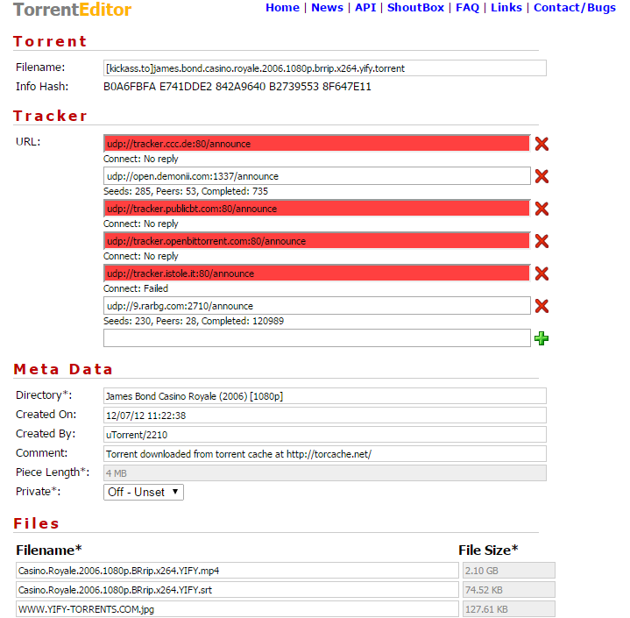
BitTorrent File
Notes:
Multiple trackers are possible!!
Very easy to add a new tracker.
New tracker immediately changes the Info hash

Slide 12
Triggering the Research
We use an attack data monitoring system
We perform regular scans for anomalies
Major abnormal activity to one of our customers

Slide 13
The Traffic Attributes
Unusually high number of requests
User-Agent: mostly ‘BitTorrent’
URL: announce/announce.php
IP: many different IP sources, most from China
Host header: mostly variations of the Pirate Bay
Notes:
Very important: this is a standard web server, not Bittorrent

Slide 14
The Attack
Notes:
Graph showing a month
Every bar is a day

Slide 15
An Example Day
Total number of requests that day: ~130,000.
90% with an HTTP host header of pirate bay. Almost 10% were with ‘appspot’ host
95% of the requests had ‘Bittorrent’ as their user agent. The other 5% also had different Torrent UA’s
Very distributed (9000 source IPs)
Notes:
Most active IP accounted for less than 1% of the entire traffic. A distributed attack indeed…
Appspot - , (Google Domain for cloud users, sometimes used for trackers)

Slide 16
Host Header Distribution
Notes:
Again – host is a standard web server (none of the above hosts!!!)

Slide 17
Why does a standard web server, receive that many BitTorrent requests, intended for a whole other host?

Slide 18
Collateral DDoS
3
The Great Firewall of China

Slide 19
The Great Firewall of China
The cyber nickname for the Chinese government censorship program
The program censors many western web applications
Facebook, Twitter etc.
And also: Pirate Bay, Appspot
Blocking method:
DNS filtering and Redirection
Specifically: Returning random IP addresses for blocked hosts
Result: Innocent web servers experiencing unexplained traffic from random Chinese clients
Notes:
Most recent tactic is returning random IP addresses

Slide 20
The Chinese BitTorrent DDoS Scenario
DNS server
BlockedHost.com?
Random IP of
Innocent.com:
10.20.30.40
Great Firewall of China

Slide 21
The Chinese BitTorrent DDoS Scenario
DNS server
BlockedHost.com?
Random IP of
Innocent.com:
10.20.30.40
Great Firewall of China

Slide 22
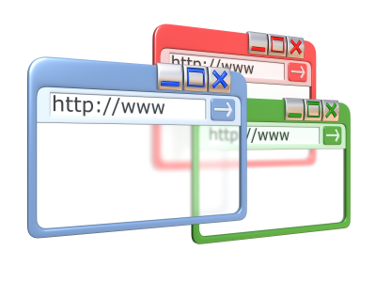
The Chinese BitTorrent DDoS Scenario
BlockedHost.com
Innocent.com
Notes:
DNS server are the soft spot of the internet. Once they are compromised, the entire base of the internet becomes unstable.
Also, it is enough to poison the DNS cache once, and the impact remains for a while.

Slide 23
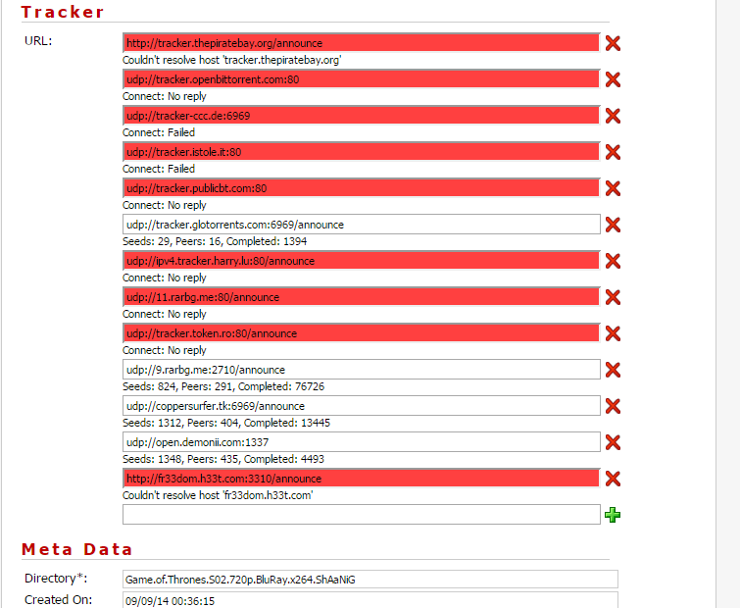
Pirate Bay
Not so much:

Slide 24
Collateral DDoS
The new Chinese policy, meant to block unwanted hosts, caused a very effective DDoS attack on innocent web applications

Slide 25
For Conspiracy Lovers
4
Really Collateral?

Slide 26
For Conspiracy Lovers
But wait! The pirate bay has stopped tracking torrents in 2009 (!)
Why is it still so popular?
The conspiracy theory: this is a Russian attack, originating in China, covered up as a BitTorrent DDoS attack

Slide 27
Why Would You Say That?
A web admin testifying that once he blocked Russia the attack stopped
He also claims that returning a 404 response did not stop the requester
Suspicious User Agent distribution and value (95% percent ‘BitTorrent’)
Pirate Bay is long dead as a tracker
Protocol discrepancies
Attack target is a food conglomerate, prone to DDoS attacks
Notes:
Protocol is very client-type dependent
Requests are very frequent from each source (even though response is faulty)
Not sure what happens when response is ‘file not found’

Slide 28
Conclusions
Server admins don’t care about the attack origins (BitTorrent DDoS, Chinese FW or Russian attack)
They are experiencing an aggressive DDoS attack
DDoS issues, unlike traditional web server vulnerabilities, cannot be prevented by smart coding and configuration
Solution must be external!
In this case: the WAF product identified the attack for several reasons, and prevented the damage
Web server admins/developers didn’t need to do anything!

