Slide 1
OWASP: An Introduction
&
Chapter Kickoff Meeting
By Somen Das
Sep 6, 2011
somen.das@owasp.org

Slide 2
Agenda
Introduction
Key Opening Notes by Industry Experts
What is OWASP
OWASP Publications
OWASP Bhubaneswar Local Chapter
Special Thanks
Questions
Refreshment
Notes:
We plan to start 1800 hrs and close the presentation at 1930 max

Slide 3
Key Notes
Srimant Acharya (Security CoE Lead TCS)
Venugopal Prabho (Manager Consultant ESSPL)

Slide 4
What is OWASP?
Open Web Application Security Project
  Promotes secure software development
  Support application security risk decision making
  Focused on the security of web applications as software products of the SDLC
  Provides free resources to development teams
  Encourages active participation and information sharing
Notes:
OWASP promotes secure software by sharing development knowledge and leading best practices
By making threats and countermeasures visible, OWASP supports security risk decision processes
The focus is web application security as a product of the SDLC,
The adoption of best practices across the SDLC is not just to test for common vulnerabilities but also secure code reviews
OWASP is the premiere application security organization in the world – sharing open source tools, documents, basic information, guidelines, and presentations worldwide
OWASP is a rich community of people, connected through mailing lists, participating in the local chapters, and attending conferences.

Slide 5
What is OWASP? : History
  OWASP was started on September 9, 2001 By Mark Curphey and Dennis Groves
  Since late 2003, Jeff Williams has served as the volunteer Chair of OWASP
  The OWASP Foundation, a 501(c)(3) organization (in the USA) was established in 2004
  Thousands of individual members, nowadays
  OWASP Foundation has over 80 Active Local Chapters
http://en.wikipedia.org/wiki/OWASP
Notes:
JEFF WILLIAMS
CEO, Aspect Security

Slide 6
What is OWASP? : Ecosystem
Volunteers
  Knowledge sharing
  People/Project Leadership
  Events presentations
  Administration
Sustained by
  Conferences
  Individual supporters
  Banner advertisements
  Corporate sponsors
http://www.owasp.org/images/0/0d/OWASP_ByLaws.pdf

Slide 7
What is OWASP?
Open Web Application Security Project
  Non-profit, volunteer driven organization
    All members are volunteers
    Some projects are supported by sponsors
  Provide free resources to the community
    Publications, Articles, Standards
    Testing and Training Software
    Local Chapters & Mailing Lists
  Supported through sponsorships
    Corporate support through financial or project sponsorship
    Personal sponsorships from members
Notes:
The OWASP Foundation is a 501c3 (IRS) not-for-profit charitable organization that ensures the ongoing availability and support for our work.
501(c)(3) — Various charitable, non-profit, religious, and educational organizations (see below) this include for example Wikipedia)
All members are volunteers that dedicate their time and energy to the organization
Some projects are supported by sponsors
OWASP's all-volunteer participants produce free, professional quality, open-source documentation, tools, and standards.
OWASP is oriented toward people (training) tools (projects) and processes (guidelines frameworks)
The OWASP chapters program helps to foster local discussion of application security around the world. Our local chapter is free and open to anyone. We have a mailing list which is available as well as access to projects and technology interest group (e.g. ajax, sql)
Sponsorship is available, OWASP encourages companies to sponsor conferences and projects. Some projects receives sponsorship via multiple vendors and are assigned to chapter leaders that manage the projects.
The sum for the OWASP Spring Code was 16 July 2007 – OWASP is funding over 27 new application security projects this Spring with over $115,000. Projects ranged from $2000 to $20000 per project

Slide 8
What is OWASP?
What do they provide?
  Publications
    OWASP Top 10
    OWASP Guides to Building/Testing Secure Web Applications
  Release Quality Tools/Documentation
    WebGoat
    WebScarab
    ESAPI
  Beta and Alpha Quality Tools/Documentation
    Beta Tools (16) ,Alpha Tools(10)
    http://www.owasp.org/index.php/Category:OWASP_Project
  Local Chapters
    Community Orientation
Notes:
An OWASP project is a collection of related tasks that have a defined roadmap and team members.
OWASP project leaders are responsible for defining the vision, roadmap, and tasks for the project. The project leader also promotes the project and builds the team.
To propose a new project, please send an email to owasp@owasp.org
For tools the alpha status is usually on development not fully tested, beta is when goals are achieved and completed and are fully tested and reviewed and then released when the documentation is made available

Slide 9
OWASP Publications
Release Publications
  Top 10 Web Application Security Vulnerabilities
  Guide to Building Secure Web Applications
  Legal Project
  Testing Guide
  AppSec Faq
Notes:
The OWASP Top Ten represents a broad consensus about what the most critical web application security flaws are. Project members include a variety of security experts from around the world who have shared their expertise to produce this list
The Guide for Building Web Application is aimed at architects, developers, consultants and auditors and is a comprehensive manual for designing, developing and deploying secure web applications.
This legal project provides materials related to the legal aspects of secure software, including contracting, liability, and compliance. The project should not be considered legal advice; OWASP strongly recommends that you find competent counsel to assist with contract negotiations, agreements, etc…
The OWASP Testing Project has been in development for many years. The aim is to help people understand the what, why, when, where, and how of testing their web applications. Web application security is more complex than just simple checklists. The focus of web application testing needs to shift from penetration testing to integrated testing in the software development life cycle.
Many industry experts and those responsible for software security at some of the largest companies in the world are validating the Testing Framework http://www.owasp.org/index.php/Testing_Guide_Introduction
The AppSec FAQ attempts to answer many of the questions that developers have about Web Application Security. The FAQ is not specific to a particular platform or language. It addresses the common threats to web applications which are applicable to any platform.

Slide 10
OWASP Top Ten 2010
A1: Injection
A10: Unvalidated Redirects and Forwards
A7: Failure to Restrict URL Access
A6: Security Misconfiguration
A5: Cross Site Request Forgery (CSRF)
A4: Insecure Direct Object References
A3: Broken Authentication and Session Management
A2: Cross-Site Scripting (XSS)
A8: Insecure Cryptographic Storage
A9: Insufficient Transport Layer Protection
http://www.owasp.org/index.php/Top_10
Notes:
https://www.owasp.org/index.php/Top_10
SQL injection still play most devastative role in application security area. Most of the application securities attack has been so far based on this particular method. Recently the most discussed ‘LizaMoon’ was actually a SQL code injection based attack, which so far has affected nearly 4 million websites.
The Top 10 List focuses on these issues:
Input validation issues such as XSS,
Injection flaws (particularly SQL injection),
Code vulnerable to remote file inclusion (RFI),
Exposing references to internal implementation objects (such as a file, directory, database record, or key), as a URL or form parameter,
Forcing a logged-on victim's browser to send a pre-authenticated request to a vulnerable web application, which then forces the victim's browser to perform a hostile action to the benefit of the attacker
Applications can unintentionally leak information about their configuration,
Account credentials and session tokens are often not properly protected
Web applications rarely use cryptographic functions properly to protect data and credentials
Applications frequently fail to encrypt network traffic
Frequently, an application only protects sensitive functionality by preventing the display of links or URLs to unauthorized users

Slide 11
OWASP Resources
Automated Security Verification
Secure Coding
AppSec Management
Vulnerability Scanners
Static Analysis Tools
AppSec Libraries
ESAPI Reference Implementation
Penetration Testing Tools
Code Review Tools
Reporting Tools
Guards and Filters
AppSec Education
Flawed Apps
Learning Environments
Live CD
SiteGenerator
Security Architecture
ESAPI
Fuzzing
Manual Security Verification
http://www.owasp.org/index.php/Category:OWASP_Project

Slide 12
ESAPI
(Enterprise Security API)
Custom Enterprise Web Application
Authenticator
User
AccessController
AccessReferenceMap
Validator
Encoder
HTTPUtilities
Encryptor
EncryptedProperties
Randomizer
Logger
IntrusionDetector
OWASP Enterprise Security API
Exception Handling
SecurityConfiguration
Your Existing Enterprise Services or Libraries
  http://www.owasp.org/index.php/ESAPI

Slide 13
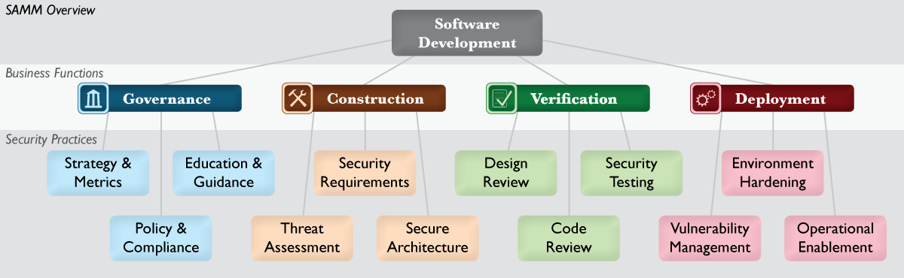
SAMM
(Software Assurance Maturity Model)
http://www.owasp.org/index.php/Software_Assurance_Maturity_Model

Slide 14
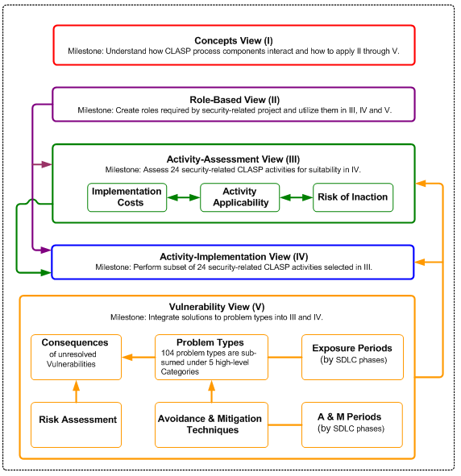
CLASP
(Comprehensive, Lightweight, Application Security Process)
https://www.owasp.org/index.php/Category:OWASP_CLASP_Project
Notes:
CLASP (Comprehensive, Lightweight Application Security Process) provides a well-organized and structured approach for moving security concerns into the early stages of the software development lifecycle, whenever possible.
CLASP is actually a set of process pieces that can be integrated into any software development process. It is designed to be both easy to adopt and effective. It takes a prescriptive approach, documenting activities that organizations should be doing. And, it provides an extensive wealth of security resources that make implementing those activities reasonable.

Slide 15
ASVS
(Application Security Verification Standard)
http://www.owasp.org/index.php/ASVS
Notes:
This standard can be used to establish a level of confidence in the security of Web applications. The requirements were developed with the following objectives in mind:
Use as a metric - Provide application developers and application owners with a yardstick with which to assess the degree of trust that can be placed in their Web applications,
Use as guidance - Provide guidance to security control developers as to what to build into security controls in order to satisfy application security requirements, and
Use during procurement - Provide a basis for specifying application security verification requirements in contracts.

Slide 16
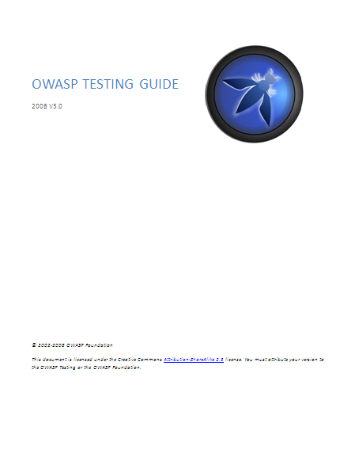
OWASP Testing Guide
http://www.owasp.org/index.php/OWASP_Testing_Project

Slide 17
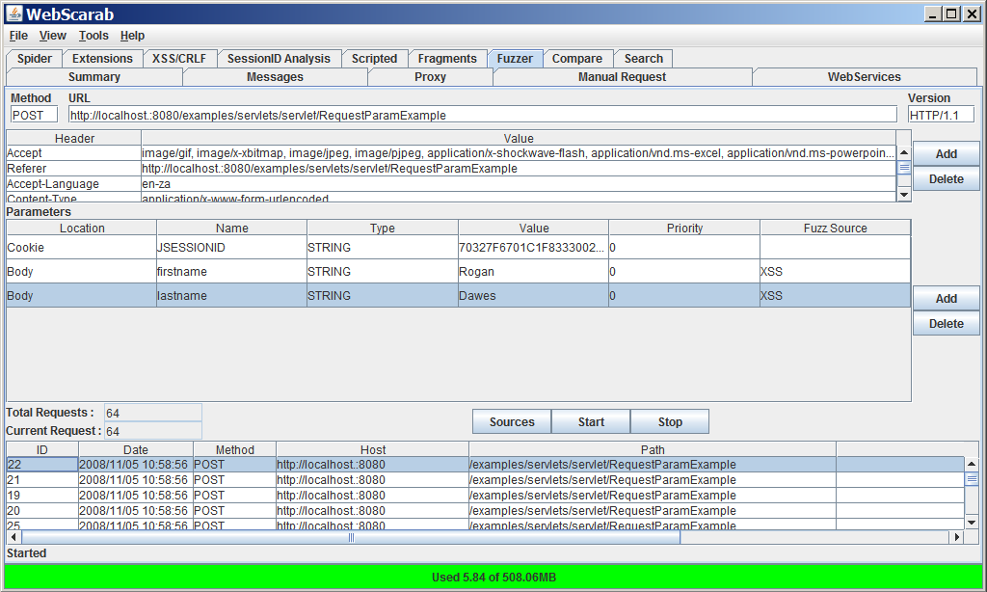
WebScarab
http://www.owasp.org/index.php/OWASP_WebScarab
Notes:
WebScarab is a framework for analysing applications that communicate using the HTTP and HTTPS protocols. It is written in Java, and is thus portable to many platforms.

Slide 18
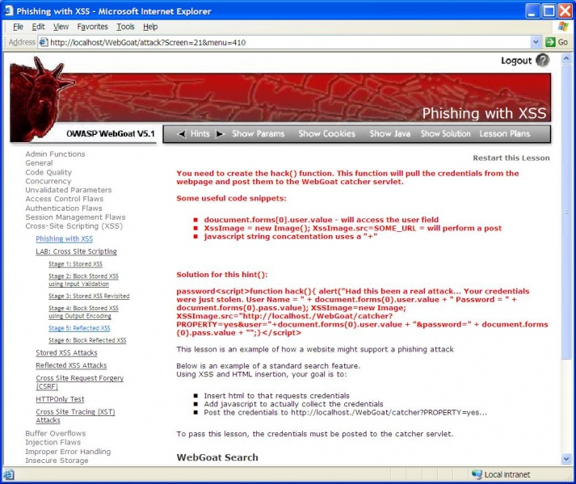
WebGoat
http://www.owasp.org/index.php/OWASP_WebGoat_Project

Slide 19
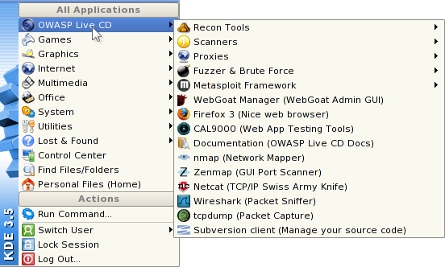
OWASP Live CD
http://www.owasp.org/index.php/Category:OWASP_Live_CD_Project
Notes:
this project is to make application security tools and documentation easily available

Slide 20














Books
http://stores.lulu.com/owasp

Slide 21
OWASP Bhubaneswar Local Chapter
The main objective it to building a community
  Local Chapters provide opportunities for OWASP members to share ideas and learn information security, several locations around the world: https://www.owasp.org/index.php/Category:OWASP_Chapter#Around_the_World
  Open to all; any level of proficiency
  Provide a forum to discuss issues based on local regulation and legislation
  Provide venue for invited guests to present new ideas and projects
  To join a chapter, simply sign up to the mailing list and introduce yourself.
Notes:
The OWASP chapters program helps to foster local discussion of application security around the world. Our local chapters are free and open to anyone. Sales activities are prohibited, although vendors who provide useful application security information are welcome.
We plan to meet at least quarterly, and have presentations and discussion of key application security topics. Many of the presentations are available for everyone to use
To join a chapter, simply sign up to the mailing list and introduce yourself.

Slide 22
OWASP Bhubaneswar Local Chapter
Started May 2011
  Need to establish a web application security community to serve security professionals
What do we have to offer?
  Quarterly Meetings
  Mailing List
  Presentations & Groups
  Open Forums for Discussion
  Vendor Neutral Environments
Notes:
We started the Bhubaneswar Chapter since there was no active Chapter in India’s eastern Coast.
We hope to have new members and establish a community of security professionals.

Slide 23
OWASP Bhubaneswar Local Chapter
What do we have to offer?
  Quarterly Meetings
    An opportunity to listen to presentations introducing OWASP (prior to regular meetings)
    An opportunity to attend special presentations focused on OWASP projects, and focusing on specific areas of interest
    An opportunity to work with organizers to show additional presentations and develop workshops to address specific issues
    An open environment for discussion of information security suitable for novices, professionals, and experts
    Free Refreshments :)

Slide 24
OWASP Bhubaneswar Local Chapter
What do we have to offer?
  Mailing Lists
    A wide selection of mailing lists are available from the OWASP main page, including specific mailing lists for all topics covered today https://lists.owasp.org/mailman/listinfo
    A local mailing list which can be used to arrange focus groups, monthly meetings, and discuss issues of importance locally https://lists.owasp.org/mailman/listinfo/owasp-Bhubaneswar
  Rules
    Keep it professional
    No sales or marketing materials
Notes:
Discuss any OWASP related topic; application security, information security related topics, etc

Slide 25
OWASP Bhubaneswar Local Chapter
What do we have to offer?
  Informative Presentations
    Every quarterly meeting will host a 60 minute presentation on a new topic or area of interest
    Strong focus on building understanding of technical issues
    If enough interest is generated, specialized presentations can be scheduled
  Focus Groups
    As the chapter grows, focus groups may form allowing for focused discussion outside of quarterly meetings
    Formalized focused groups can be created to tackle specific issues

Slide 26
OWASP Bhubaneswar Local Chapter
What do we have to offer?
  Vendor Neutral Environments
    Learn about security without the sales pitches
    OWASP does not sell: all revenue is generated from either website advertising or donations
    Vendor Neutral Environments
  Strict guidelines for chapter presentations and sponsorship
    All sponsors must be approved by The OWASP Foundation
    No product presentations
    Presentations that focus on a problem or set of problems and discuss solution approaches that may refer to or show examples of various products are allowed
    Sponsorship shall be in the form of donations to The OWASP Foundation in the name of the local chapter

Slide 27
OWASP Bhubaneswar Local Chapter
Proposed Meeting Schedule
  Every quarter – First Tuesday of the month
      Sep 6, 2011
      Oct 11, 2011 (4th Oct being a holiday)

Slide 28
OWASP Bhubaneswar Local Chapter
What can you offer?
  Mailing Lists
    Participate to the mailing lists, meetings, and focus groups are open forums for discussion of any relevant topics
    Mailing Lists
  Become a Member
    http://www.owasp.org/index.php/Membership
  Participate in OWASP projects
    Contribute to existing projects
    Propose new projects
    Spearhead new ventures
  Participate in the Local Chapter
    Reach out to the executive board (email contact information is available on local chapter site)
    Encourage others to subscribe to the email list (full contact information can be elicited via email)
Notes:
Benefits unique to members
A OWASP Commercial License to use the materials within your organization without the restrictions associated with the various open source licenses used by the OWASP projects.
Visibility for your organization's tangible commitment to application security through its inclusion in the members list on the OWASP website and promotional materials.
The right to use the OWASP name and membership mark to show that you are an OWASP Member. Note that the mark must not be used in any way that might indicate that OWASP supports a commercial product or service.
Discounts to the OWASP AppSec and other security conferences and events. See the OWASP Member Offers page for the most current discounts available to OWASP Members. NOTE: Some of these discounts are greater than or equal to the cost of an individual OWASP Membership.
Help building the organization as a free, open, and technically oriented resource for the general public and members

Slide 29
OWASP Bhubaneswar Local Chapter
Next Meeting
  October 11, 2011 6:00 PM – 7:30 PM
  Presentation:
    TBD
  Location:
    TBD
      Additional interest in participation may require a larger venue.

Slide 30
Special Thanks
Anshuman – For coordinating & arranging the venue

Slide 31
Final Questions
Further questions on OWASP organization, local chapter, tools demo

Slide 32
Refreshment
Presentation will be online:
http://www.owasp.org/index.php/Bhubaneswar
Thank you for attending!

