Slide 1



Continuous Application Security
“We’re Pulling Out All the Stops”
Jeff Williams
@planetlevel
Notes:
Hi – I’m Jeff Williams. For those who don’t know me, I helped start OWASP and was the Global Chair for 8 years. I contributed projects like WebGoat, Top Ten, ESAPI, and ASVS. By day I am the CTO at Contrast Security.
This talk is “sort of” a PART II – The first part is called “Application Security at DevOps Speed and Portfolio Scale” – you can find it online at http://youtube.com/watch?v=4B-HgsT_J_M

Slide 2
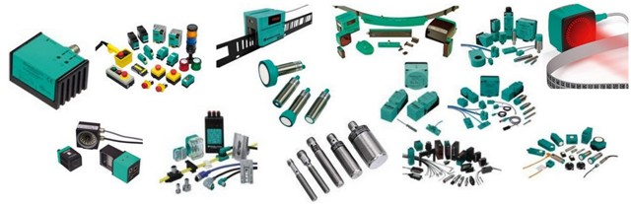
Factories Instrument Everything
Notes:
Have an of you visited an industrial factory recently?
They instrument everything…
These are sensors for all sorts of things… Vibration, sound, moisture, temperature, cameras, etc…

Slide 3
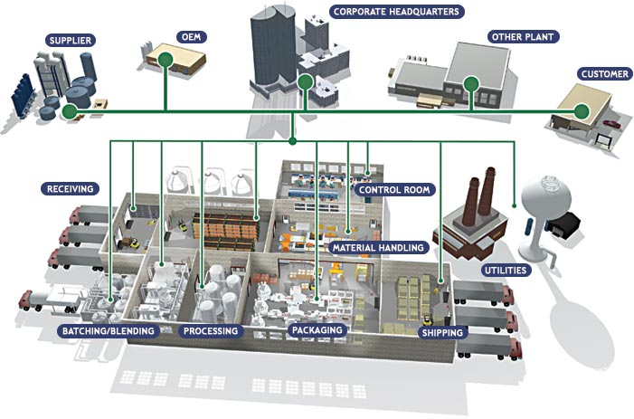
Programmable Controllers
Notes:
Now all those sensors are connected to Programmable Logic Controller (PLC) or Programmable Automation Controller (PAC)
They gather up all the raw data and they process it into standard forms.
They do realtime analytics to check for problems with the equipment AND the product.

Slide 4
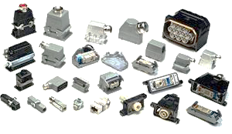
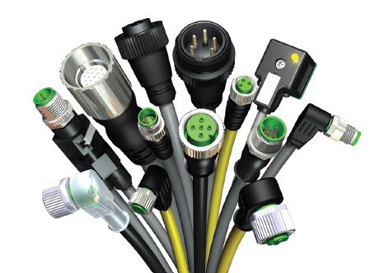
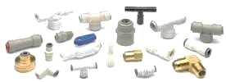
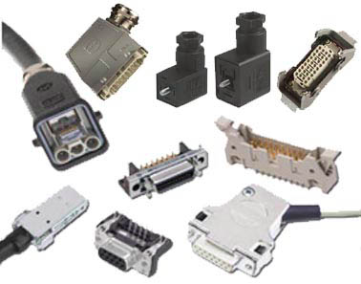
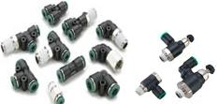
Connectors and Adapters
Notes:
Now imagine all the connectors and adapters that they have to have to do all this
They’ve got all kinds of signals and data to process
So a large chunk of the problem is getting the sensor data standardized

Slide 5
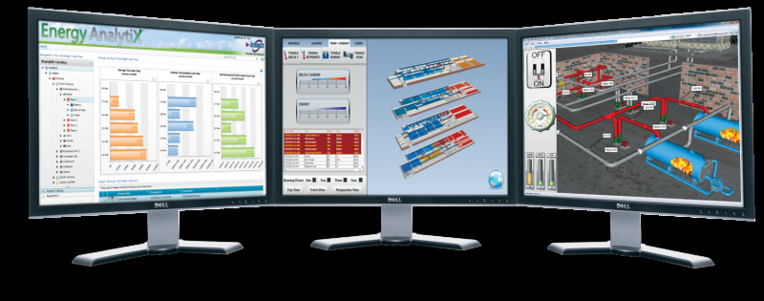
Live Dashboard
Identify problems before they become PROBLEMS
Notes:
And they they pull all this data together to create awesome dashboards
Now let me ask you…. How do you think they figure out what they want on their dashboard?
Do you think they just grab whatever sensors are on sale at Radio Shack that week
And then their dashboard is just a direct dump from those sensors?
Because that’s basically what we do in appsec.
I’m safe because I run a static analysis tool.

Slide 6
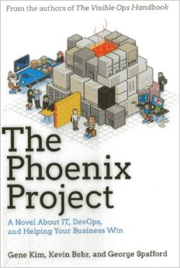
The Phoenix Project
Notes:
There are a lot of lessons that software development can can learn from Industrial Manufacturing
If you want to know more – check out THE PHOENIX PROJECT by my friend Gene Kim
I’m here to talk about how this applies to security.
My THESIS is that we can instrument the software development organization to CONTINUOUS APPSEC
-- better assurance at lower cost

Slide 7
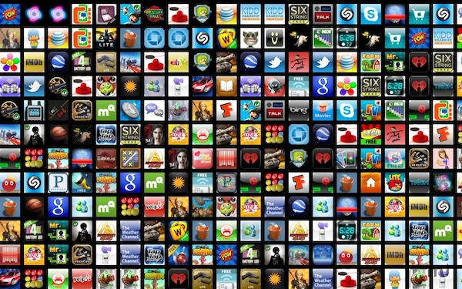
What Is Continuous AppSec?
What: The right defenses for every application are…
Present
Correct
Used Properly
How: Portfolio and enterprise security controls are verified…
Continuously
Automatically
In real time
Notes:
Continuous AppSec is both an outcome (A WHAT) and an approach for getting there (A HOW)
The WHAT is easy to imagine – I want to go to sleep at night with some confidence that my applications have the right defenses, that they are correctly implemented, and used properly by developers.
The HOW is more constraining. All evidence has to be generated automatically, continuously, and in basically real time. I want to know right away if anything goes wrong. This pretty much rules out anything that requires EXPERTS directly producing evidence.
That’s hard for me to say – but if you need an expert, it won’t scale. And if it won’t scale, I don’t care.
More on this at the end!

Slide 8
Building Continuous AppSec
Your IT Organization…
Continuous AppSec Analytics
DEV
CI
TEST
QA
STAG
SEC
OPS
Manual
Dynamic
Static
Interactive
JUnit
Transform our existing tools into SENSORS
2) Instrument entire software organization
3) Collect big data security analytics
Notes:
Most organizations look like this…
They have a security group that uses all the different security approaches somewhere before the code goes to production.
I want to:
Transform our existing tools into SENSORS
Instrument the entire software development organization
Collect all that evidence and pull it together – big data analytics style

Slide 9
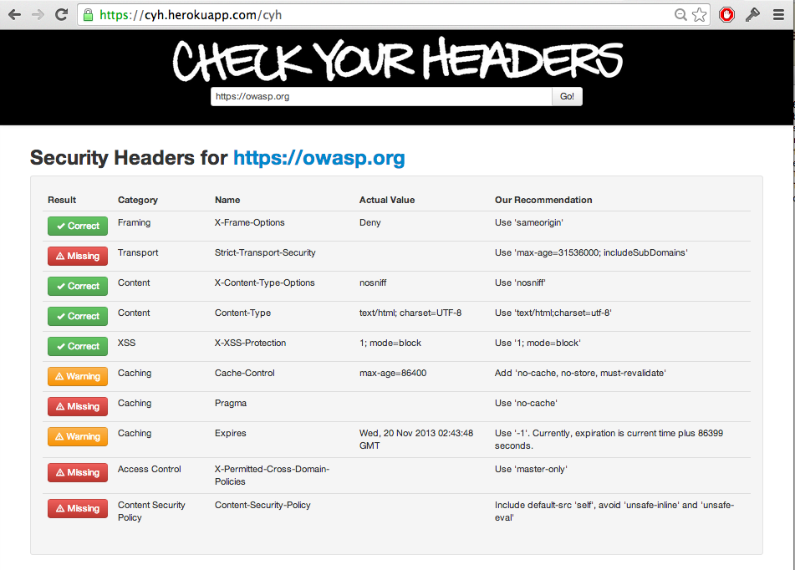

Check Your Headers
https://cyh.herokuapp.com/cyh
Notes:
The Beastie Boys brought you Check Your Head…. But I’m bringing you CheckYourHeaders!!!
It’s

Slide 10
Initial Sensors
CheckYourHeaders
  http://cyh.heroku.com/cyh
OWASP Dependency Check
  http://www.owasp.org/index.php/OWASP_Dependency_Check
Nmap
  http://nmap.org
Sslyze
  https://github.com/iSECPartners/sslyze
OWASP ZAP
  http://www.owasp.org/index.php/OWASP_Zed_Attack_Proxy_Project
Minion
Gauntlt

Slide 11
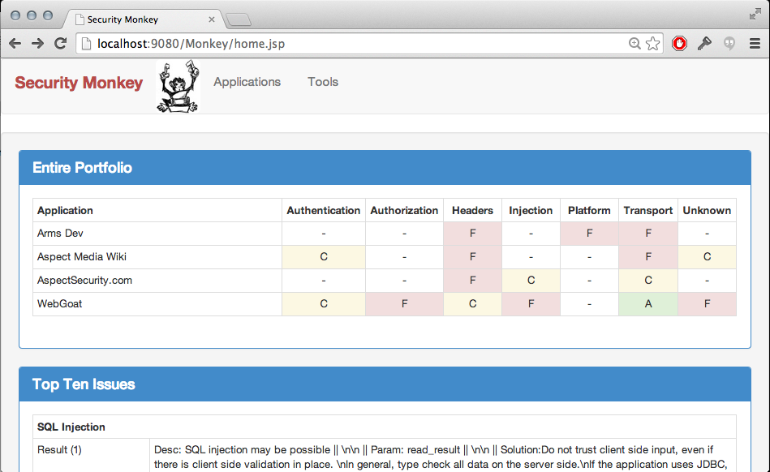
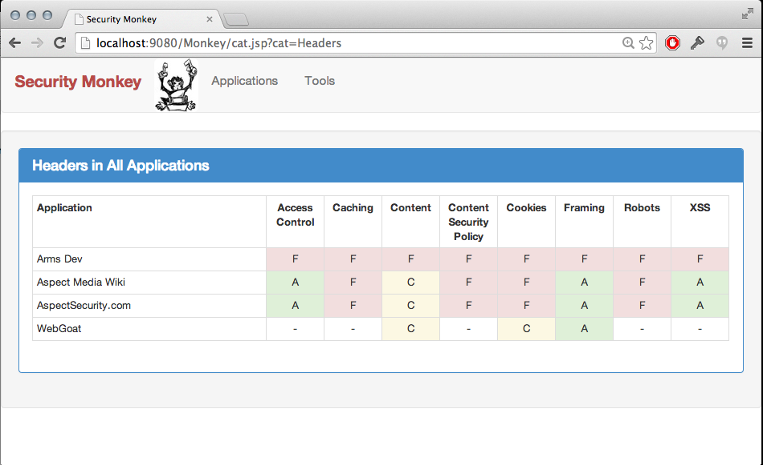
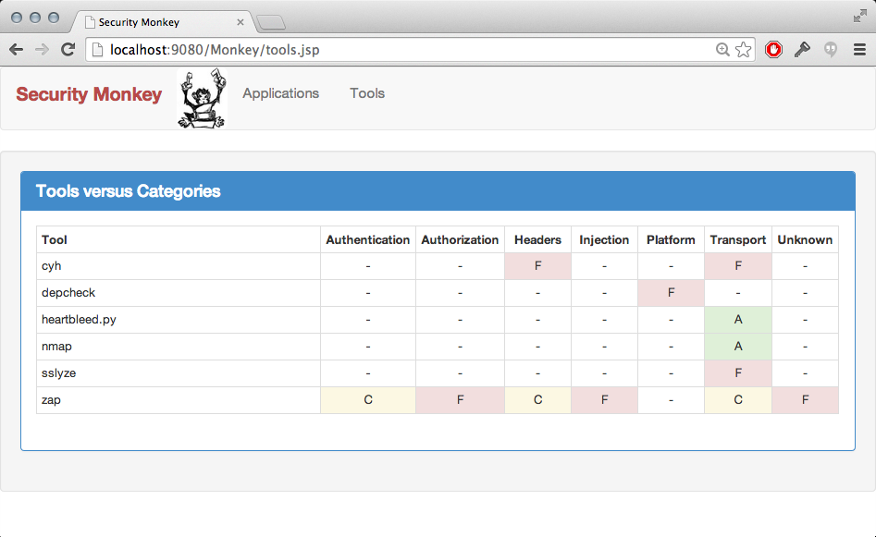
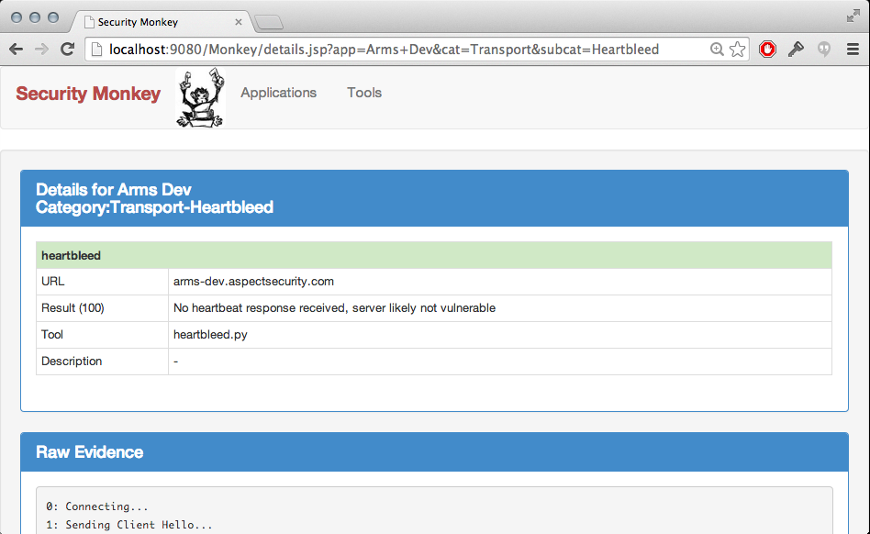
Results/Demo
I hate presentations that wait until the end to show me the result.
If you hate it, please feel free to check your email or play angry birds
If you like it, I’ll give you the details…
Notes:
The KEY is to make it VERY easy to create, deploy, and manage sensors.
Ok great – how did you get there…. Let’s take a look.

Slide 12
Monkey Architecture
Sensors
Speak Evil!
See Evil!
Hosts
Hosts
Monkey Server
Dashboard
Hosts
Digesters
Hear Evil!
Notes:
Some sensors get pushed to HOSTS -- like dependency check. Personally I believe this is the more powerful approach because they can get information directly from the APPLICATION
OTHERS run on MONKEY server – scanners

Slide 13
What’s In an AppSec Sensor
Launcher
Tool
Config
Sensor
Notes:
These sensors GET PUSHED out application servers. It’s really just a way to package a tool, a launcher, and a configuration.
A cron job is also pushed by PUPPET to run the tools periodically.
Currently we don’t support much PER APPLICATION configuration, but that’s coming.

Slide 14
Sensor Launcher and Config?
Launcher is a small script that runs tool with specified config
Config is stuff like
  Hostname
  Target URLs
  Perhaps full sitemap
  Credentials
  Tool options
    Recursive
    Output format
    Destination directory
  Etc…

Slide 15
Managing Sensors with Puppet
class depcheck {
  package { 'openjdk-7-jdk':ensure => installed, }
  exec { "/usr/sbin/update-alternatives
  --set java /usr/lib/jvm/java-7-openjdk-amd64/jre/bin/java": }
  exec { "/usr/sbin/update-alternatives
  --set javac /usr/lib/jvm/java-7-openjdk-amd64/bin/javac": }
  … check bash
  ssh_authorized_key { 'monkey': ….. }
  … check permissions
  file { "/home/monkey/agentmonkey/TOOLS/dependency-check-1.1.4-release":
  source => "puppet:///modules/depcheck/dependency-check-1.1.4-release",
  recurse => true,}
  file { "/home/monkey/agentmonkey/SCRIPTS/depcheck.sh":
  source => "puppet:///modules/depcheck/depcheck.sh", … }
  cron { "cronDepcheck":
  command => "/home/monkey/agentmonkey/SCRIPTS/depcheck.sh",
  user => monkey,
  minute => 0, }
}

Slide 16
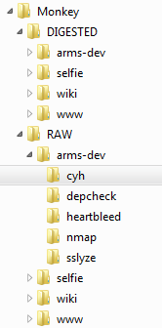
Handling Results
Monkey Server
ARMS Server (with Sensors)
rsync
Raw Sensor Data

Slide 17
Standardizing the Data
Digesters
XML
JSON
Text
PDF
CSV
Monkey Format*
*Currently CSV
Notes:
Okay, so how do we generate these MONKEY files?
We build digesters, one for each sensor. They just extract the data we need from each tool and format into CSV.

Slide 18
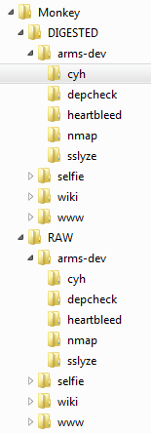
Digesters
DIGESTED
Python, XPath, etc…
RAW

Slide 19
Monkey Format
Timestamp – April 14, 2014 10:10 AM EDT
IPAddress – 192.168.2.234
Hostname – webgoat.internal
AppName – WebGoat
URL – http://webgoat.internal/WebGoat/attack
LOC – /filepath/Foo.java @ 123
Tool – DependencyCheck
Category – Platform
Subcategory – Libraries
TestName – CheckCVE
TestDesc – Verify library is…
TestResult – Library has CVE-2011-124
ASVS – V6.2
CWE – CWE-2013-03
Security – 40 (0 to 100)
Coverage – OOS
Confidence – 100
Notes:
Here is the simple MONKEY format. These are the columns in the CSV.
Pretty straightforward, but I want to draw your
Also, there is some more metadata that I want to collect – ANYTHING that you might want to search/sort on.

Slide 20
Initial Categories
Auth’z
Headers
Injection
Platform
Transport
Unknown
Auto-complete
Path Traversal
Access Control
Caching
Content
CSP
Cookies
Framing
Robots
XSS
CrossJS
SQL
XSS
Libraries
Algorithms
STS
Heartbleed
Certificates
Mixed Content
Auth’n
Notes:
Now this is really important. Here are the tests that Monkey currently supports.
Pretty good coverage of Headers, Libraries, and Transport.
But these other areas are pretty sketchy. We need to get more and better sensors hooked in.
But now that we have a SENSOR PLATFORM – this is much easier.

Slide 21
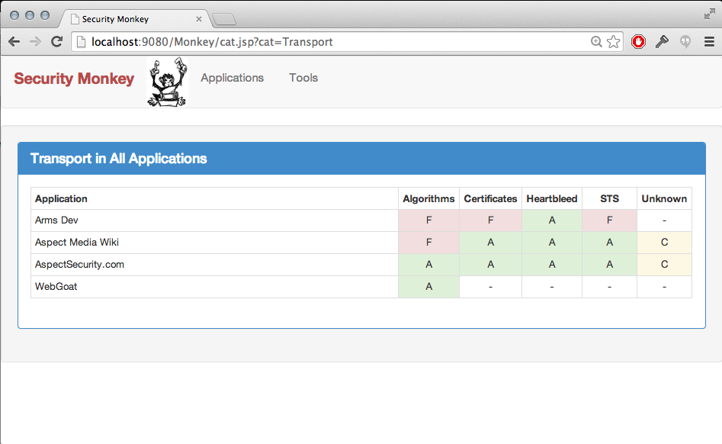
Dashboards
Monkey has a
self-organizing dashboard
Sensors report their own category, subcategory, and testname
Cat: Transport
SubCat: HeartBleed
TestName: heartbleed

Slide 22
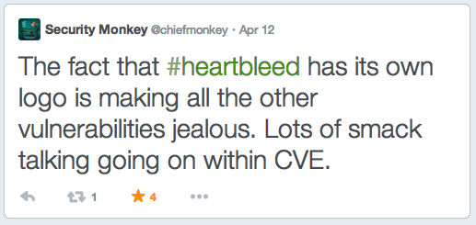

HeartBleed

Slide 23
Designing a HeartBleed Sensor
Data Sources
Analysis Technique
Experiment Style
Environment
Code
Manual

Negative
Dev
HTTP
SAST
Positive
CI
Configuration
Passive
Sampling

Test
Data Flow
IAST
Intelligence
QA
Control Flow

DAST
Staging

Platform
JUnit
Security
Connections
Prod
Choose based on:
Speed
Accuracy
Feedback
Scalability
Ease of Use
Cost
Notes:
Positive vs. negative?
SAST, DAST, IAST, Manual, Passive?
DEV, CI, TEST, QA, SEC, OPS?

Slide 24
Adding HeartBleed to Monkey
Download scanner
Realize it’s written in Go
Download Go compiler
Add Sensor to Monkey (20 minutes)
Build Digester (10 minutes)
Continuous monitoring enabled in 1 hour!
And then I realized my mistake…

Slide 25
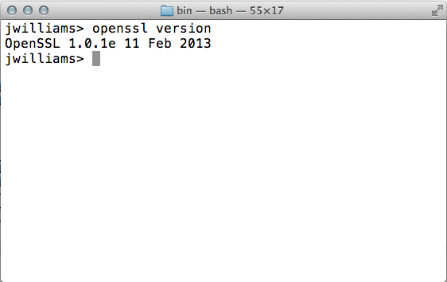
The Better Way to Test for HeartBleed

Slide 26
Sensors?
What sensors should we add next?

Slide 27
What’s In Your Expected Model?
Expected
Requirements
Threat Model
Abuse Cases
Policy
Standards…
There is no security without a model
Notes:
THIS IS WHAT SEPARATES REAL SECURITY ENGINEERS FROM HACKERS – You are VERIFYING your model.
Unfortunately, we don’t really have a clear picture of what we expect. Both our EXPECTED and ACTUAL are spotty. That means we don’t have a complete and clear EXPECTED model. We also don’t know exactly what was VERIFIED.
I’ve seen folks testing for SQL injection on applications that don’t even have a SQL database. That’s just WASTE. When our tests don’t match up to our EXPECTED model, we aren’t getting good coverage. And even worse are things in the EXPECTED model that aren’t even getting tested.
So we end up with a muddy, spotty picture of risks – which leads to bad decisions, exposure, breaches, etc…. This is not to say that we’re not adding value. BUT if we’re going to SCALE we have to get a lot more EFFICIENT.

Slide 28
What Are You Actually Testing?
Actual
Pentest
Code Review
Tools
Arch Review
…
Notes:
Unfortunately, we don’t really have a clear picture of what we expect. Both our EXPECTED and ACTUAL are spotty. That means we don’t have a complete and clear EXPECTED model. We also don’t know exactly what was VERIFIED.
I’ve seen folks testing for SQL injection on applications that don’t even have a SQL database. That’s just WASTE. When our tests don’t match up to our EXPECTED model, we aren’t getting good coverage. And even worse are things in the EXPECTED model that aren’t even getting tested.
So we end up with a muddy, spotty picture of risks – which leads to bad decisions, exposure, breaches, etc…. This is not to say that we’re not adding value. BUT if we’re going to SCALE we have to get a lot more EFFICIENT.

Slide 29
Unfortunately…
Expected
Actual
Not being tested
(aka RISK)
Doesn’t need testing
(aka WASTE)
Notes:
Unfortunately, we don’t really have a clear picture of what we expect. Both our EXPECTED and ACTUAL are spotty. That means we don’t have a complete and clear EXPECTED model. We also don’t know exactly what was VERIFIED.
I’ve seen folks testing for SQL injection on applications that don’t even have a SQL database. That’s just WASTE. When our tests don’t match up to our EXPECTED model, we aren’t getting good coverage. And even worse are things in the EXPECTED model that aren’t even getting tested.
So we end up with a muddy, spotty picture of risks – which leads to bad decisions, exposure, breaches, etc…. This is not to say that we’re not adding value. BUT if we’re going to SCALE we have to get a lot more EFFICIENT.

Slide 30
Are You Secure?
Secure?
Notes:
Unfortunately, we don’t really have a clear picture of what we expect. Both our EXPECTED and ACTUAL are spotty. That means we don’t have a complete and clear EXPECTED model. We also don’t know exactly what was VERIFIED.
I’ve seen folks testing for SQL injection on applications that don’t even have a SQL database. That’s just WASTE. When our tests don’t match up to our EXPECTED model, we aren’t getting good coverage. And even worse are things in the EXPECTED model that aren’t even getting tested.
So we end up with a muddy, spotty picture of risks – which leads to bad decisions, exposure, breaches, etc…. This is not to say that we’re not adding value. BUT if we’re going to SCALE we have to get a lot more EFFICIENT.

Slide 31
Aligning Sensors with Business Concerns
Data Protection
Role Based Access Control
Business Concern (category)
Defense Strategies (subcategory)
Actual Defenses
(testname)
Sensors
Encrypt Data in Storage and Transit
Minimize Sensitive Data
Logging and Intrusion Detection
Full Disk Encryption with TrueCrypt
Programmatic Encryption with ESAPI
TLS Everywhere with Venafi
Encryption Correctness with Junit Tests
ESAPI Used Properly
Libraries Present and Up-to-date
Fraud
Availability
Notes:
I strongly encourage you to break it down with a structured defense strategy.
You can achieve a LINE OF SIGHT. You CAN match up your sensors with Business Concerns, but not directly
Identify your most important business concerns
Work out defense strategies – PRIMARY, SECONDARY, PREVENTATIVE, REACTIVE
Once you specify your ACTUAL defenses, your sensors are OBVIOUS

Slide 32





Continuous Application Security!
Translate “expected” into sensors
Application
Portfolio
New Threats,
Business Priorities
Expected
A
A
A
A
A
A
A
A
A
Actual
A
A
A
A
A
A
A
A
A
Application security dashboards
Notes:
Talk about creating a cycle of evolve the model, deploy sensors, analyze results, make strategic decisions. This creates high-speed ITERATION and improvement.
This leaves the people to ACTUALLY figure out what they care about. Now you can have that principled discussion about whether to allow SHA-1. You’ll have data about how many instances of SHA-1 you actually have, and how hard it will be to update.
We lose 90% of the intelligence we gain during a penetration test… and we do it all over again next year.
Penetration tests are great at:
1) Identifying holes in the expected model
2) Figuring out how to test expected model
3) Defining (and maybe building) sensors
That’s a business case for security.

Slide 33

How to Get Started
Notes:
Later you can include in CI

Slide 34
Hit me up on twitter @planetlevel

Slide 35
Aspect 2013 Global AppSec Risk Report
Notes:
Here are Aspect’s results for MANUAL code review and penetration testing of 5,000,000 lines of code every month.

Slide 36
Access Control Intelligence Sensor
Source File | Result | @PreAuthorize
TestSBMBugtrackerController.java |  | @PreAuthorize("hasAnyRole('ROLE_BUG_CREATE','ROLE_BUG_EDIT')")
UpdateSBMBugtrackerController.java |  | @PreAuthorize("hasRole('ROLE_BUG_EDIT')")
SelectBugtrackerController.java |  | @PreAuthorize("hasRole('ROLE_BUG_CREATE')")
CheckAppStatusController.java | MISSING
ViewConsoleEventsController.java |  | @PreAuthorize("hasRole('ROLE_CONSOLE_VIEW')")
DeleteEngineConfigController.java |  | @PreAuthorize("hasRole('ROLE_ENGINE_PROFILES')")
DownloadEngineController.java |  | @PreAuthorize("hasRole('ROLE_ENGINE_DOWNLOAD')")
EngineConfigController.java |  | @PreAuthorize("hasRole('ROLE_ENGINE_DOWNLOAD')")
ErrorController.java | MISSING
InboxController.java |  | @PreAuthorize("isAuthenticated()")
InstallationWizardController.java |  | @PreAuthorize("isAuthenticated()")
InviteAFriendController.java |  | @PreAuthorize("isAuthenticated()")
LoginController.java | MISSING
DeleteMessageController.java |  | @PreAuthorize("isAuthenticated()")
GetSystemMessagesController.java |  | @PreAuthorize("isAdmin()")

Slide 37

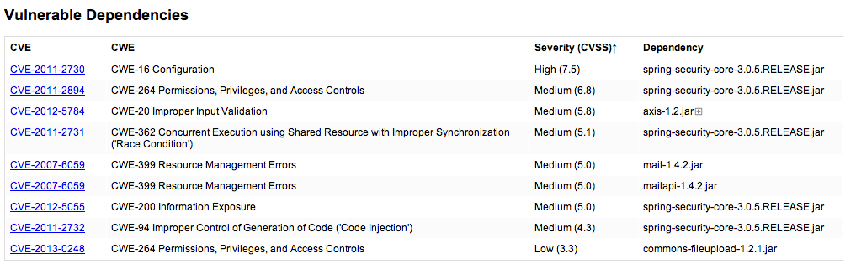
Known Vulnerable Libraries Sensor
Run DependencyCheck during every build
(and do a build once a month even if nothing changed)

Libraries

SAST

Negative

CI
Notes:
Run DependencyCheck during every build
Struts2
Need to find who has it fast
Not all apps are in development and test

Slide 38
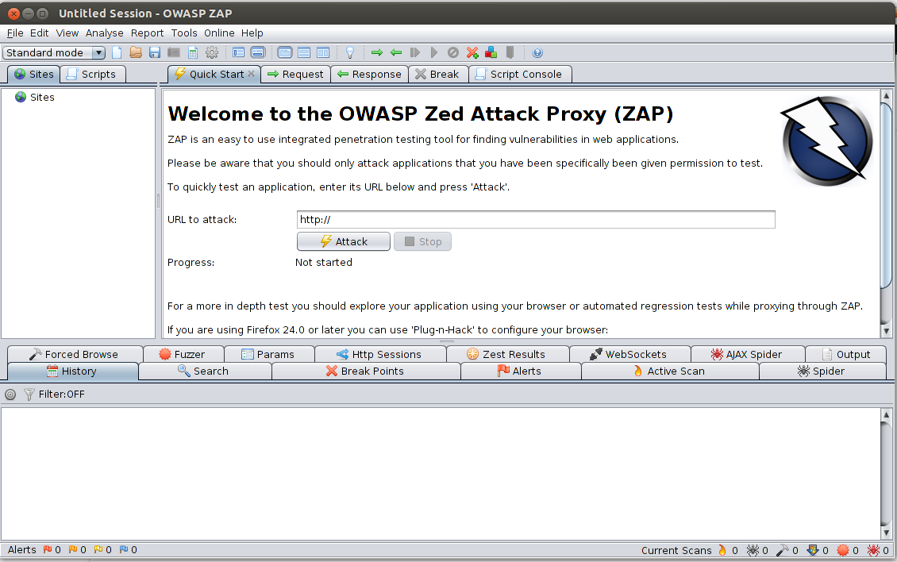
CSRF Defense Sensor

HTTP

Passive

Positive

QA
Run tests through ZAP
ZEST to check CSRF Token
Get results via ZAP REST API

Slide 39
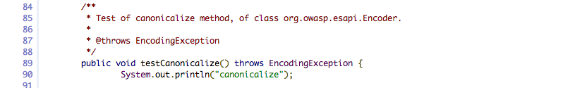
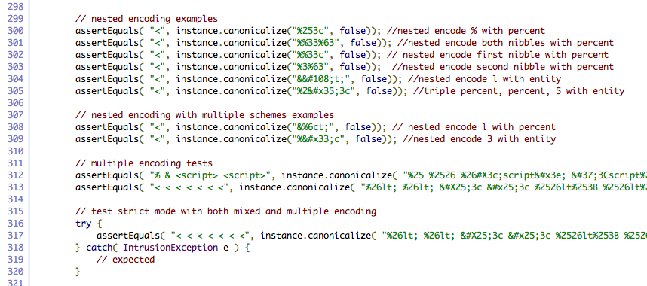
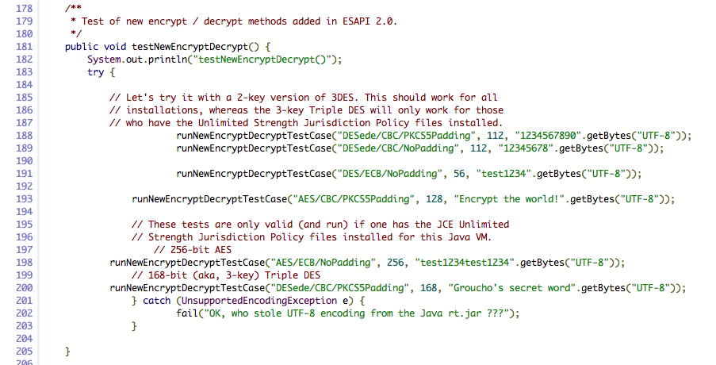
A Junit Sensor?
Notes:
For the Enterprise Security API project, we knew that we needed proof that the security controls we built were “CORRECT”
So we wrote thousands of test cases to prove that the controls:
* Performed their function
* Were tamperproof and non-bypassable
Today there are almost 5,000 companies using ESAPI. And we have had only 1 vulnerability identified. We immediately added a test case and we’ll never have that one again ☺
Here is a snippet of code from an ESAPI test case.

Slide 40
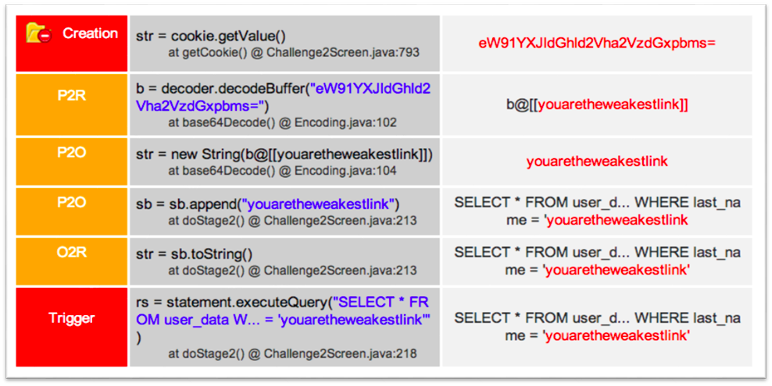
Injection Sensors
Use code instrumentation
tools for DFA vulnerabilities

Data Flow

IAST

Negative

Dev

Slide 41
Architecture, Inventory, and More…
What would you like to gather from all your applications?
Inventory? Architecture? Outbound connections? Lines of code? Security components?
All possible…. and all at devops speed and portfolio scale

Slide 42
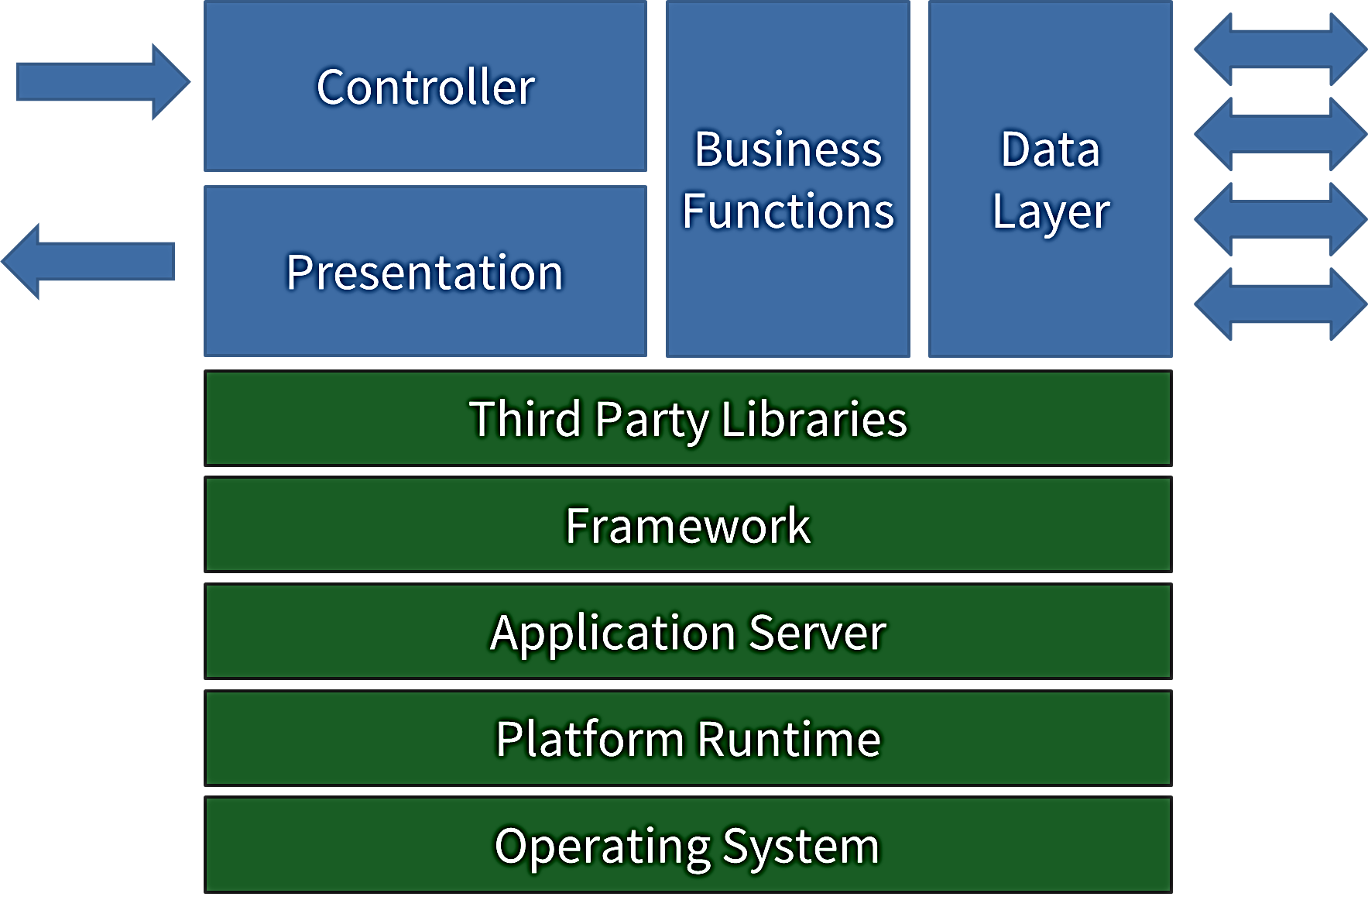
Security Intelligence Sources
HTTP
Traffic
Data Flow
Backend Connections
Vulnerability Trace
Control Flow
Libraries and Frameworks
Configuration Data
Notes:
You can’t point at a diagram like this and say, SECURITY GOES HERE.
SECURITY IS NOT just a single point in the code. It’s a PATH through an application that goes from custom code, to libraries, to frameworks, to platform and back again.
So when we VERIFY security, we need access to lots of different types of information.
What kinds of information are relevant? HTTP, Data Flow, Libraries, Control Flow, Configuration, and Backend Connections to name just a few.
So what kind of TECHNIQUES can we use to verify that this app does the right thing in stressful situations?

Slide 43
Enterprise Controls Dashboard
Expected Defense | Defense Present? | Defense Correct? | Applications Tested? | Training and Support
Authentication | 
Authorization | 
Cryptography
Validation |  |  |  | 
Escaping |  |  |  | 
Tokens |  | 
Logging | 
Intrusion Detection | 
Random Numbers
Browser Security
Safe API Wrappers
Object Reference Management
Error Handling

Slide 44
Basic Infrastructure
Sensor
Puppet
DEV
CI
TEST
QA
STAG
SEC
OPS
rsync
Raw Results
Notes:
Some requirements…
Get sitemap to tools
Manage sensor configurations
Get data back from remote tools securely
Organizing the data for dashboards
Discovery in dev is GOOD!!
Alerting
Show trends – track which environment it came from
Authentication
Access control – keep audit from early stuff

