Slide 1
Risks of Insecure Communication
High likelihood of attack
Open wifi, munipical wifi, malicious ISP
Easy to exploit
High impact to user
Clandestine monitoring of population
Injection of incorrect/malicious content
No protection from any defensive systems
Design flaw in application

Slide 2
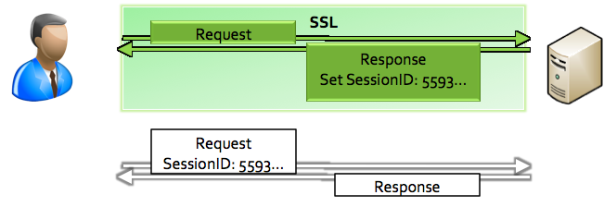
Ex 1: Insecure Session Management
Secure login over HTTPS
Password submitted encrypted
Immediate redirect to HTTP
Session ID sent cleartext <-- vulnerability point
https://site.com/login
http://site.com/profile

Slide 3
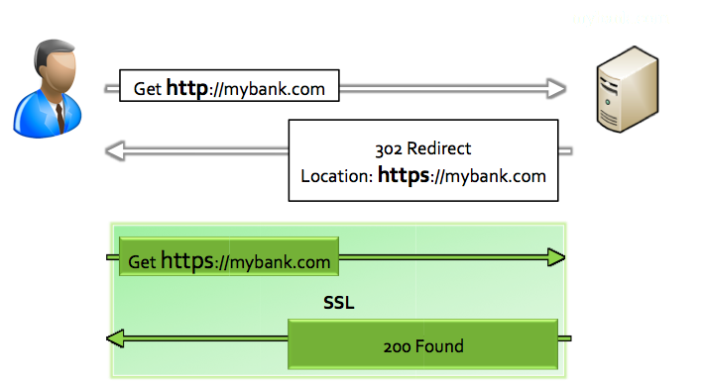
Ex 2: Insecure Redirects
User requests HTTP page, response redirects HTTPS
302 Response is HTTP <-- Vulnerability Point

Slide 4
HTTP Strict Transport Security (HSTS)
Browser prevents HTTP requests to HSTS site
Any request to site is “upgraded” to HTTPS
No clear text HTTP traffic ever sent to HSTS site
Browser assumes HTTPS for HSTS sites

Slide 5
HSTS – Strict Transport Security
HSTS (Strict Transport Security)
http://www.youtube.com/watch?v=zEV3HOuM_Vw
Strict-Transport-Security: max-age=31536000
Forces browser to only make HTTPS connection to server
Must be initially delivered over a HTTPS connection
You can request that Chromium preloads your websites HSTS headers by default
Tweet your domain to @agl__ to be automatically added to the default Chrome HSTS list!
http://dev.chromium.org/sts

Slide 6
HSTS In Code
Response Header added by application
Browser receives and remembers settings for domain
HSTS flag not easily cleared by user
http://en.wikipedia.org/wiki/HTTP_Strict_Transport_Security#Implementation

Slide 7
Benefits of HSTS
HTTP Strict Transport Security (HSTS)
Opt-in security control
Website instructs compatible browser to enable STS for site
HSTS Forces (for enabled site):
All communication over HTTPS
No insecure HTTP requests sent from browser
No option for user to override untrusted certificates

Slide 8
Protecting Outdated Users
HSTS supported in current browsers (Firefox, Chrome)
No impact to old / unsupported browsers – just no protection
Older browsers all support SECURE Cookie Flag
SECURE cookie flag
Instructs browser to only send cookie over HTTPS
Much less (and different) protection than HSTS, but good defense in depth control

Slide 9
Apple goto fail SSL bug
Major iOS/OSX SSL implementation bug
http://web.nvd.nist.gov/view/vuln/detail?vulnId=CVE-2014-1266
"...does not check the signature in a TLS Server Key Exchange message...."
"...allows man-in-the-middle attackers to spoof SSL servers by (1) using an arbitrary private key for the signing step or (2) omitting the signing step."

Slide 10
goto fail Apple SSL bug
static OSStatus
SSLVerifySignedServerKeyExchange(SSLContext *ctx, bool isRsa, SSLBuffer signedParams,
uint8_t *signature, UInt16 signatureLen)
{
OSStatus err;
...
if ((err = SSLHashSHA1.update(&hashCtx, &serverRandom)) != 0)
goto fail;
if ((err = SSLHashSHA1.update(&hashCtx, &signedParams)) != 0)
goto fail;
goto fail;
if ((err = SSLHashSHA1.final(&hashCtx, &hashOut)) != 0)
goto fail;
...
fail:
SSLFreeBuffer(&signedHashes);
SSLFreeBuffer(&hashCtx);
return err;
}

Slide 11
Fixing the CA (Certificate Authority) System
Certificate Pinning
https://www.owasp.org/index.php/Pinning_Cheat_Sheet
Browser Certificate Pruning
Etsy/Zane Lackey
Certificate Creation Transparency
http://certificate-transparency.org
HSTS (Strict Transport Security)
http://www.youtube.com/watch?v=zEV3HOuM_Vw
Strict-Transport-Security: max-age=31536000

Slide 12
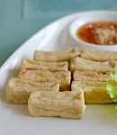
Certificate Pinning
What is Pinning
Pinning is a key continuity scheme
Detect when an imposter with a fake but CA validated certificate attempts to act like the real server
2 Types of pinning
1) Carry around a copy of the server’s public key;
Great if you are distributing a dedicated client-server application since you know the server’s certificate or public key in advance
Note of the server’s public key on first use
2) Trust-on-First-Use, Tofu pinning
Useful when no a priori knowledge exists, such as SSH or a Browser
https://www.owasp.org/index.php/Pinning_Cheat_Sheet
Notes:
Pinning is a key continuity scheme, and the idea is to either (1) carry around a copy of the server’s public key; or (2) note of the server’s public key on first use (Trust-on-First-Use, Tofu). The former is great if you are distributing a dedicated client-server application since you know the server’s certificate or public key in advance. The latter is useful when no a priori knowledge exists, such as SSH or a Browser. Both detect the unexpected change that occurs when an imposter with a fake certificate attempts to act like the real server.
While you have a choice to pin the certificate or public key, it’s often best to pin the public key. That is because some companies, such as Google, rotate its certificate regularly (every 30 days or so) but re-certifies the inner public key.

Slide 13
Browser-Based TOFU Pinning
Browser-Based TOFU Pinning
Trust on First Use
HTTP Public Key Pinning IETF Draft
http://tools.ietf.org/html/draft-ietf-websec-key-pinning-11
Freezes the certificate in the browser by pushing a fingerprint of the certificate chain to the browser.
Example:
Public-Key-Pins: pin-sha1="4n972HfV354KP560yw4uqe/baXc=";
pin-sha1="qvTGHdzF6KLavt4PO0gs2a6pQ00=";
pin-sha256="LPJNul+wow4m6DsqxbninhsWHlwfp0JecwQzYpOLmCQ=";
max-age=10000; includeSubDomains
Notes:
Thank you to Lieven Desmet and https://casecurity.org/2013/08/28/public-key-pinning/

Slide 14
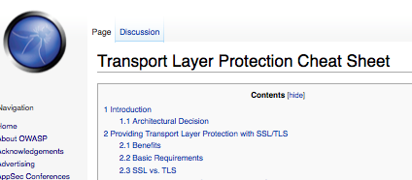
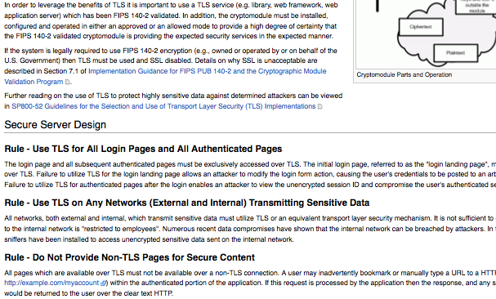
SSL Resources
OWASP TLS Protection Cheat Sheet
https://www.owasp.org/index.php/Transport_Layer_Protection_Cheat_Sheet
https://www.owasp.org/index.php/Pinning_Cheat_Sheet

