Slide 1
Where we are.. Where we are going
AppSecEU11
Tom Brennan, Eoin Keary, Seba Deleersnyder,
Dave Wichers, Jeff Williams, Matt Tesauro
Global Board of Directors OWASP Foundation
Notes:
Tom

Slide 2
CORE
The Open Web Application Security Project (OWASP) is a 501c3 not-for-profit worldwide charitable organization focused on improving the security of application software. Our mission is to make application security visible, so that people and organizations can make informed decisions about true application security risks. Everyone is free to participate in OWASP and all of our materials are available under a free and open software license.
Notes:
Tom

Slide 3
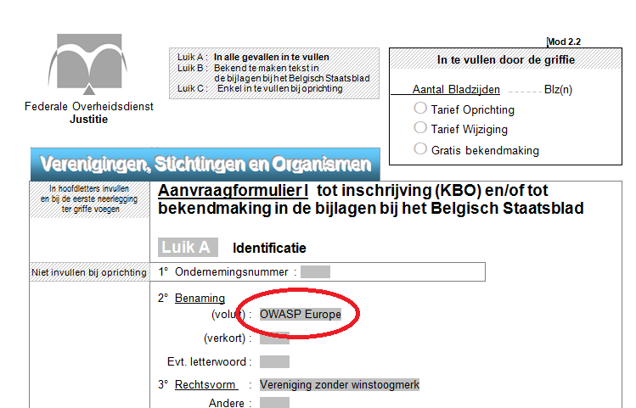
6 June 2011
OWASP Europe non-profit established
Global extension of organisation
Legal & financial umbrella
Your region to follow
Notes:
Seba

Slide 4
Mission
What causes?
Immediate causes – vulnerabilities themselves
Developers and operators
Organizational structure, development process, supporting technology
Increasing connectivity and complexity
Legal and regulatory environment
Asymmetric information in the software market
OWASP is dedicated to finding and fighting the causes of insecure software
Notes:
Tom - The point is that we are just getting started -- can tools address those causes?

Slide 5
Application Security Is Just Getting Started
You can’t improve what you can’t measure
We need to…
Experiment
Share what works
Combine our efforts
Expect another 10 years!
Notes:
Tom

Slide 6
Approach == “Open”
Open means everything is $free
Open means rough consensus and running code
Open means free to use and modify
Open means independent
Open means open information sharing
Open means wider audience and participation
Notes:
Tom - OWASP has the freedom to say and do what’s right because it’s not aligned with the money.

Slide 7
Global Comittees
Notes:
Tom – STOP!

Slide 8
Our Successes
OWASP Tools and Documentation
~15,000 downloads (per month)
~30,000 unique visitors (per month)
~2 million website hits (per month)
OWASP Chapters are blossoming worldwide
1389 OWASP Leaders in 70 active chapters worldwide
21,000 participants
OWASP AppSec Conferences
Chicago, New York, London, Washington D.C, Brazil, China, Germany, more…
Distributed content portal
100+ authors for tools, projects, and chapters
Global Citations
Professional Association of Information Security Peers
Notes:
Eoin

Slide 9
OWASP Individuals
1450+
Notes:
Eoin

Slide 10
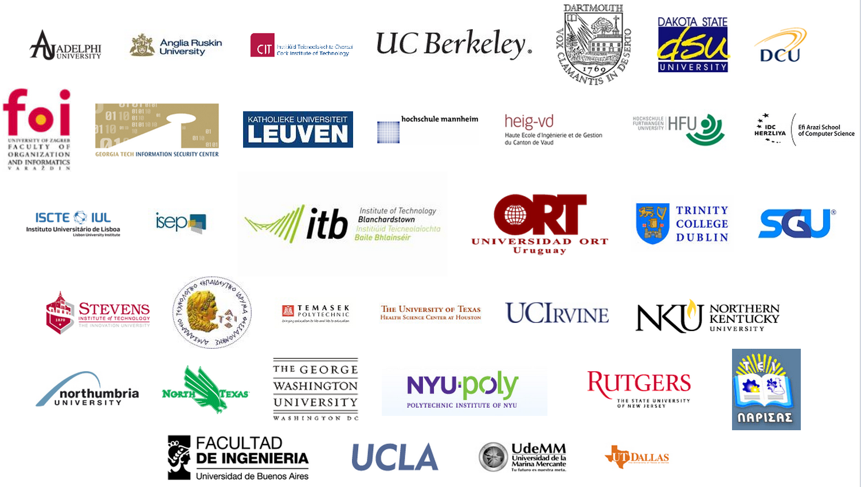
University Sponsors
Notes:
Eoin – take new screenshots

Slide 11
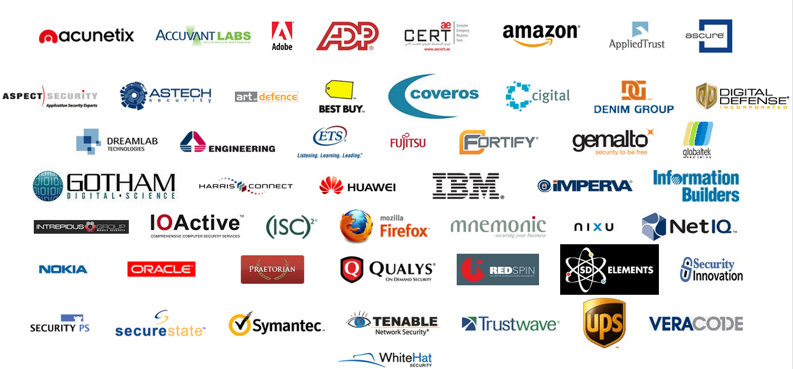
Global Corporate Supporters
Notes:
Eoin - ew: UPS, ADP, amazon

Slide 12
155 Projects!
PROTECT - These are tools and documents that can be used to guard against security-related design and implementation flaws.
DETECT - These are tools and documents that can be used to find security-related design and implementation flaws.
LIFE CYCLE - These are tools and documents that can be used to add security-related activities into the Software Development Life Cycle (SDLC).
Notes:
Seba – differentiate Stable / Beta / Alpha

Slide 13
New projects - last 6 months
Common Numbering Project
HTTP Post Tool
Forward Exploit Tool Project
Java XML Templates Project
ASIDE Project
Secure Password Project
Secure the Flag Competition Project
Security Baseline Project
ESAPI Objective – C Project
Academy Portal Project
Exams Project
Portuguese Language Project
Browser Security ACID Tests Project
Web Browser Testing System Project
Java Project
Myth Breakers Project
LAPSE Project
Software Security Assurance Process
Enhancing Security Options Framework
German Language Project
Mantra – Security Framework
Java HTML Sanitizer
Java Encoder Project
WebScarab NG Project
Threat Modelling Project
Application Security Assessment Standards Project
Hackademic Challenges Project
Hatkit Proxy Project
Hatkit Datafiddler Project
ESAPI Swingset Interactive Project
ESAPI Swingset Demo Project
Web Application Security Accessibility Project
Cloud ‐ 10 Project
Web Testing Environment Project
iGoat Project
Opa
Mobile Security Project – Mobile Threat Model
Codes of Conduct
Notes:
seba

Slide 14
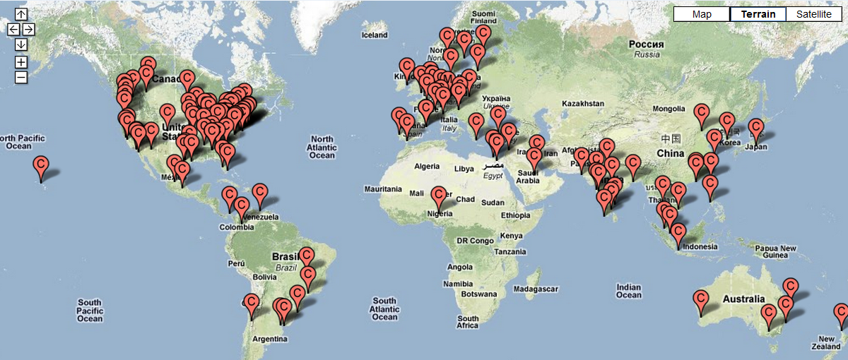
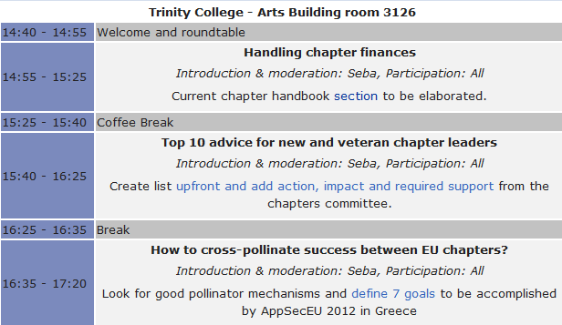
Chapters
AppSecEU 2011 chapters workshop
Notes:
Seba

Slide 15
“I saw the ‘blossoming’ of OWASP in Portugal’s Spring. From an external viewpoint, OWASP has moved from niche to widely relevant, from localized to global, from pen testing to SDLC, from server to every component of the application’s delivery and use, from InfoSec to business process relevance.” – Colin Watson
Notes:
Eoin

Slide 16
About the Summit
Over 180 application security experts from over 120 companies, 30 different countries, and 44 local OWASP chapters.
The Summit was NOT a conference – there were no talks, static presentations, or training seminars. Instead working sessions were used to author documents, create software, draft standards, and forge relationships.
Many of the working sessions were on a fixed schedule determined before the start of the summit. However, just as many were created “dynamically” by the attendees.
Notes:
Eoin

Slide 17
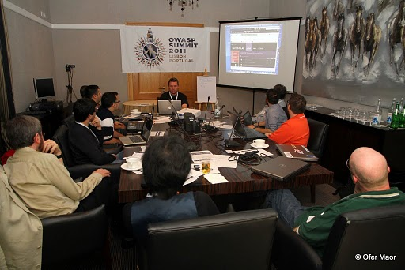
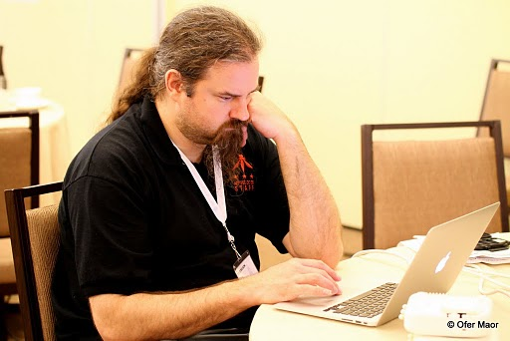
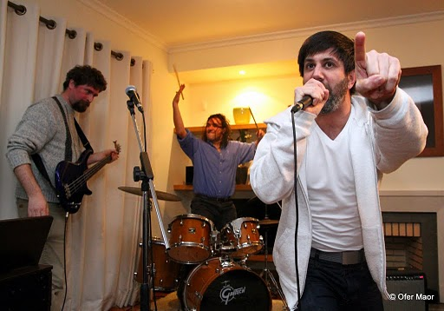
Massive Outreach
OWASP-Portugal Partnership
OWASP Outreach to Educational Institutions
OWASP Industry Outreach
OWASP Browser Security Project
OWASP-Apache Partnership
OWASP Mobile Security Initiative
OWASP Governance Expansion
International Focus
Application Security Programs
Application Security Certification
Notes:
Eoin
OWASP-Portugal Partnership – OWASP has been working to establish relationships with various governments around the world, particularly the United States, Brazil, Portugal, and Greece. At the Summit, OWASP representatives worked directly with senior Portuguese IT officials to establish a protocol for working with Portugal to improve their application security capabilities.
OWASP Outreach to Educational Institutions – Reaching students is a unique opportunity to reach developers early in their development. At the Summit, delegates drafted an OWASP Code of Conduct for Educational Institutions, created a detailed plan for OWASP Student Chapters and continued development of the OWASP “Academies” Portal with extensive education and training materials.
OWASP Industry Outreach – OWASP resolved to develop industry working sessions to be held at major OWASP conferences starting with OWASP EU 2011 in Dublin, Ireland. The objective of these sessions will be to solicit feedback from industry players to help better focus OWASP efforts and make sure OWASP deliverables are relevant to industry concerns.
OWASP Browser Security Project – The Summit brought representatives from browser vendors Mozilla, Google, and Microsoft together with leading security researchers to discuss, and strategize about browser security issues. Several new OWASP initiatives were launched, including a browser security scorecard project based on OWASP’s recently created browser testing framework. There were extensive discussions on browser initiatives such as Mozilla’s Content Security Policy (CSP) and browser sandboxes.
OWASP-Apache Partnership – OWASP forged a relationship with the Apache Software Foundation (ASF) to start the process of sharing OWASP software projects with the ASF with the intention of including OWASP-provided code in Apache projects. The intention of this collaboration is to improve the security of the widely-used ASF Open Source software, as well to improve visibility for OWASP efforts.
OWASP Mobile Security Initiative – OWASP made progress on their upcoming Top 10 Mobile Vulnerabilities and Top 10 Mobile Defenses lists. In addition, OWASP resolved to reach out to mobile platform vendors to work with them on integrating better security into their environments.
OWASP Governance Expansion – OWASP updated its Charter and worked out procedures for the upcoming Board elections. These governance updates will help best support the dynamic and growing OWASP community.
International Focus – OWASP reaffirmed a commitment to be a truly international organization. Delegations from several countries and regions around the world including Asia-Pacific and South America participated in outreach workshops. Addition focus has been given to expanding international representation on OWASP’s Board and Global Committees.
Application Security Programs – To help organizations actually implement application security programs, we are mapping OWASP projects to all major approaches, including OWASP OpenSAMM, Microsoft’s SDL, and BSIMM.
Application Security Certification – OWASP reaffirmed its commitment to avoid becoming a certification body. Instead, it created the OWASP Code of Conduct for Certification Bodies that defines what application security certification program should entail.

Slide 18
OWASP Industry Outreach
Let’s: Develop industry working sessions/tracks
Held at major OWASP conferences , starting right here!
Objective:
Listen: Solicit feedback from industry players to help better focus OWASP efforts.
Act: Make sure OWASP deliverables are relevant to industry concerns and really address problems.
Why:
OWASP needs to become more industry relevant in order to grow.
We need to “stop throwing pebbles into the lake of software insecurity and start throwing boulders”.
Notes:
Eoin
There is one right here in Dublin!

Slide 19
Board Election
OWASP is maturing and getting more democratic…
OWASP Governance Expansion – OWASP updated its Bylaws and worked out procedures for the upcoming Board elections. These governance updates will help best support the dynamic and growing OWASP community.
Currently 2 board members are democratically elected.
It was agreed to put a further 3 of the remaining 5 non elected board members up for election. Nominations by AppSec EU, election by AppSec US.
…………please stand up if you have the time and energy
Notes:
Tom

Slide 20
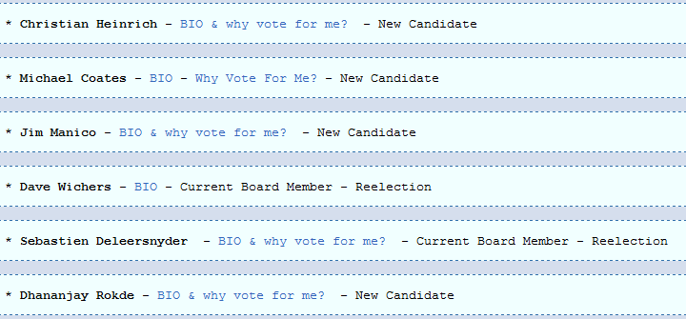
Candidates
Notes:
Tom

Slide 21
Enjoy AppSecEU!

