Slide 2
Sponsor Giveaways
Notes:
Fishnet - Jim Weiler - Ipod Touch (will send)
WhiteHat – Peter Steuer – Ipod (will mail)

Slide 3
Capture The Flag

Slide 4
Member Raffle

Slide 5
Special Presentation

Slide 6
Notes:
David Sachdev
Barry Austin
Jeremy Long
Wade Woolwine
Angel Contreras
Mike Smith
Jon Rose
Josh Feinblum
Lee Anne Hart
Martin Knobloch
All the many Red Shirts

Slide 7
Thank You
Notes:
The Board
Our sponsors
Platinum
Softek
HP
Gold
Art of Defense
Securicon
IBM
Silver
Aspect Security
Cenzic
Cigital
Core Security
Cross Check Networks
Fishnet Security
Grant Thorton
Mandiant
Teneble
VeraCode
Whitehat
Exhibitors & Small Business
LJ Kushner & Associate
Breach
Imperva
FYRM
Design
nClud
Probonafide

Slide 8
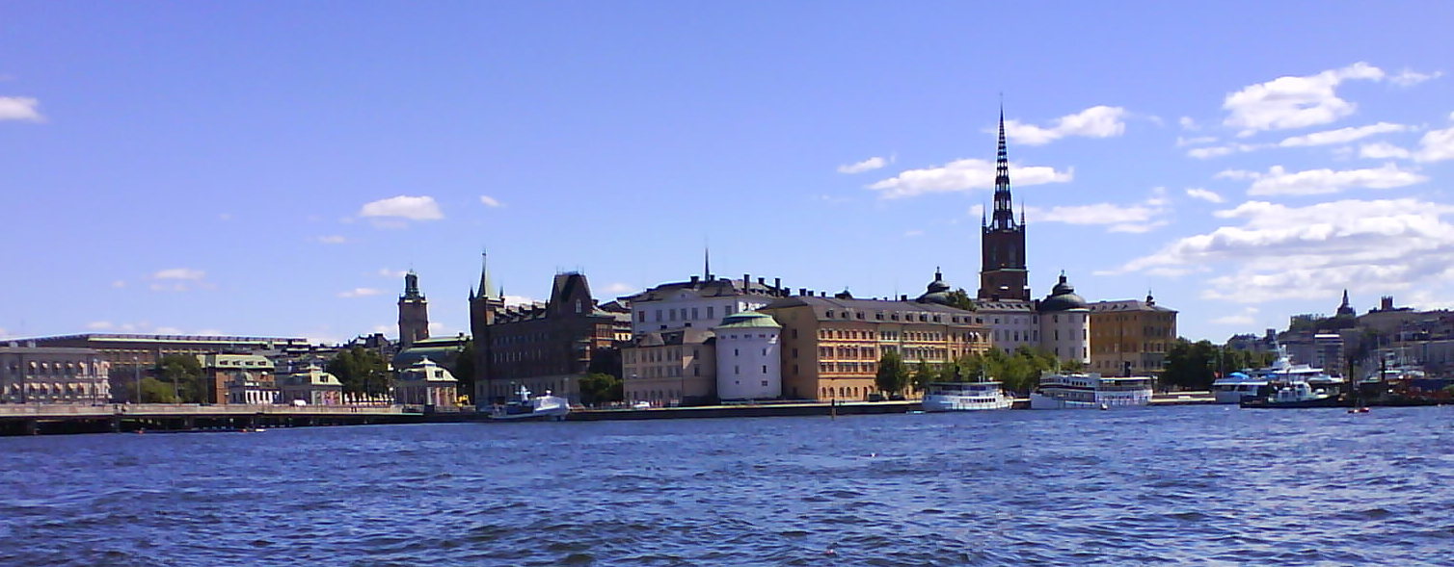
Next AppSec in Sweden!
OWASP AppSec Research
Stockholm June 21-24 2010
Notes:
Vacation in Scandanavia!
Daylight till 10:30 pm

