Slide 1
Ensuring Software Assurance (SwA) Process Maturity
Ed Wotring
Information Security Solutions, LLC
OWASP AppSec DC
November 10, 2010

Slide 2
Agenda
Problem
Maturity Model Crosswalk
Mapped Maturity Models
SwA Checklist
Design
Establishing a Baseline
Pitfalls
Questions

Slide 3
Problem
Acquiring or developing secure software requires a robust set of processes throughout the lifecycle.
How does an organization know it is:
Working with suppliers supporting similar assurance goals?
Implementing practices that address assurance goals?
Who is doing them?
How frequently?
Are they done well?
Are the practices reducing risk?
Improving its assurance capabilities?

Slide 4
Global Software Supply Chain Risks
Software must be able to withstand use, abuse, and attack.
Software will probably be used longer than intended in ways for which it was not designed.
Risks can stem from actions by suppliers and their respective supply chains.
Mitigating risks requires understanding and management of suppliers’ capabilities, products, and services.

Slide 5
“Fit for Purpose” Testing
Developers assume the role of an acquirer when they:
Reuse their own code
Reuse legacy code or code from other projects
Draw upon open source libraries
Reused code may re-introduce old bugs and add new ones
Code must be tested to determine it is “fit for purpose” in new projects

Slide 6
Taking a Comprehensive SwA Approach
Don’t wait for a SwA mandate.
Organizations must:
Manage and execute a risk-driven, yet rugged, robust, and thorough software lifecycle process
Focus on implementing the practices that address their assurance goals based upon their risk appetite
Add security “gates” throughout the software lifecycle
Not all gates need to be pass/fail, some can just measure
Ensure the entire organization is aware and on board (including CXOs, acquisitions, developers, managers, quality testers, etc.)
Perform necessary due diligence appropriate to the desired assurance level

Slide 7
Challenges
Organizations that are ready to improve their assurance capabilities may not be aware of how to begin an organized security initiative.
Several maturity models are freely available
Learning curves may inhibit adoption
Finding the right model(s) can be time consuming
Selecting model components can be difficult
Each model has a different approach and level of granularity

Slide 8
Maturity Model Crosswalk
Performed a model-agnostic analysis of several freely available maturity models
Identified agreements and differences among the models
Provided a consolidated view of how the models address similar assurance goals and practices

Slide 9
Mapped Maturity Models
The maturity models mapped within the crosswalk include:
Building Security In Maturity Model (BSIMM)
Software Engineering Institute (SEI) Capability Maturity Model Integration (CMMI) for Acquisitions
OWASP Open Software Assurance Maturity Model (SAMM)
SwA Forum Processes and Practices Working Group
Assurance Process Reference Model (PRM)
CERT Resilience Management Model (RMM)

Slide 10
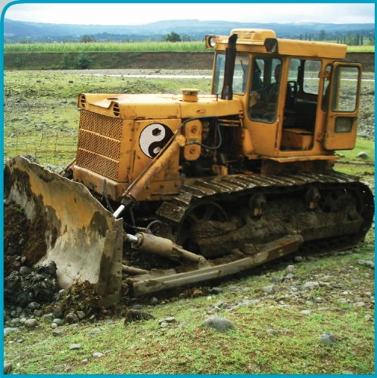
BSIMM
Scientific observation-based descriptive model
Uniquely qualified to be used as a measuring stick for software security

Slide 11
BSIMM
Based upon analysis of the software security initiatives of 30+ organizations including:
http://www.bsimm2.com
Adobe | AON | Bank of America | The Depository Trust & Clearing Corporation (DTCC)
EMC | Google | Intel | Microsoft
Nokia | QUALCOMM | Sallie Mae | SWIFT
Symantec | Telecom Italia | VMware | Wells Fargo

Slide 12
CMMI for Acquisitions
CMMI-ACQ provides guidance to acquisition organizations for initiating and managing the acquisition of products and services
Used to guide process improvement initiatives across a project, a division, or an entire organization.
http://www.sei.cmu.edu/cmmi/
www.sei.cmu.edu/cmmi/

Slide 13
CMMI for Acquisitions
Helps to:
Integrate traditionally separate organizational functions
Set process improvement goals and priorities
Provide guidance for quality processes
Provide a point of reference for appraising current processes
Designed to support the future integration of other disciplines.
www.sei.cmu.edu/cmmi/

Slide 14
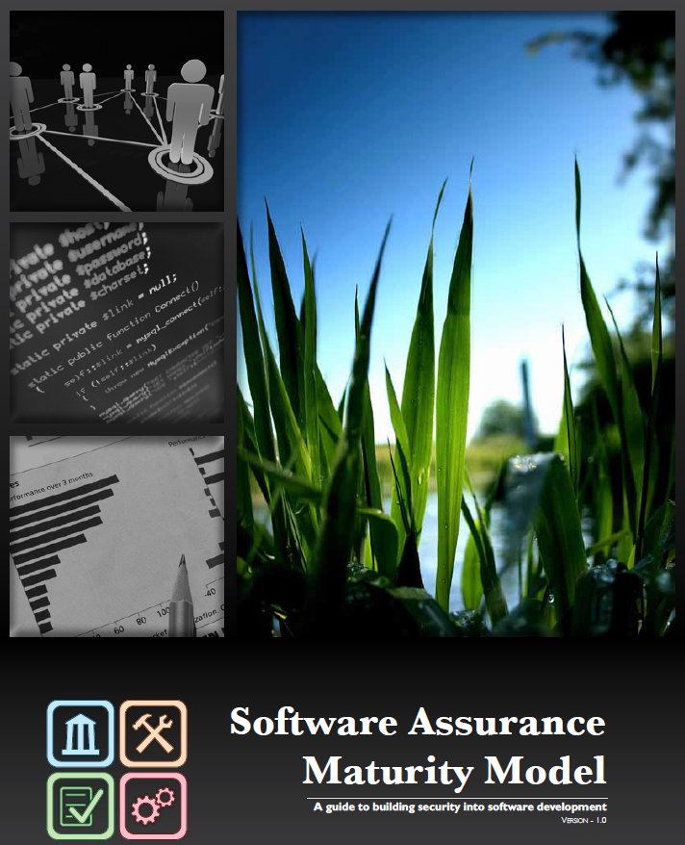
OpenSAMM
Open framework to help organizations formulate and implement a strategy for software security that is tailored to the specific risks facing the organization.

Slide 15
OpenSAMM
OpenSAMM can be utilized by small, medium, and large organizations using any style of development.
Can be applied organization-wide, for a
single line-of-business, or individual
projects.
www.opensamm.org

Slide 16
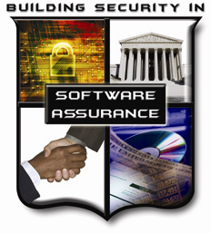
Assurance PRM
The Assurance PRM contains a set of assurance goals and supporting practices.
SwA Forum Processes & Practices Working Group synthesized from the contributions of leading government and industry experts.

Slide 17
Assurance PRM
Assurance for CMMI® defines the Assurance Thread for Implementation and Improvement of Assurance Practices that are assumed when using the CMMI-DEV.
Understanding gaps helps suppliers and acquirers prioritize organizational efforts and funding to implement improvement actions.
https://buildsecurityin.us-cert.gov/swa/proself_assm.html

Slide 18
Assurance PRM Tool
The SwA Self-Assessment incorporates the Assurance PRM goals and practices
Provides an assessment framework of the implementation of assurance practices
Contains mappings to other freely available maturity models
https://buildsecurityin.us-cert.gov/swa/proself_assm.html

Slide 19
CERT RMM
Process improvement model
Addresses the convergence of security, business continuity, and IT operations to manage operational risk and establish
www.cert.org
operational resilience
Supplies a process improvement approach through the definition and application of a capability level scale that expresses increasing levels of process improvement

Slide 20
CERT RMM
Based upon the Resiliency Engineering Framework (REF)
The REF described the range of processes that characterize the organizational capabilities necessary to actively direct, control, and manage operational resilience.
The REF has been used by Financial Services Technology Consortium organizations to:
Benchmark their performance against the framework to characterize industry performance
Validate the framework
Begin process improvement efforts
CERT created the RMM CAM (capability appraisal method) based on the SCAMPI appraisal method
www.cert.org/resilience/rmm.html

Slide 21
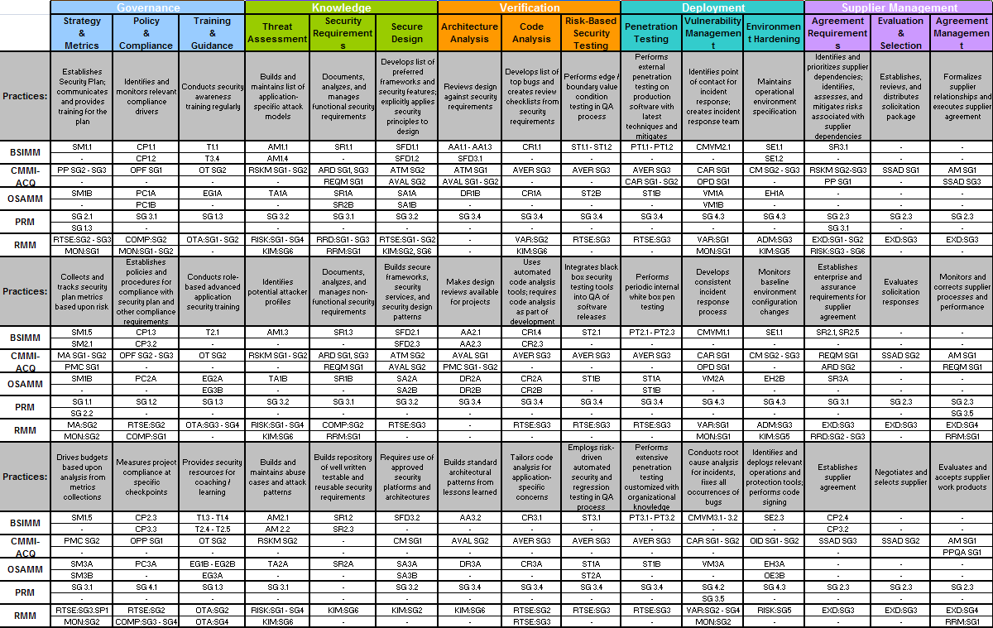
Maturity Model Crosswalk

Slide 22
SwA Checklist for Software Supply Chain Risk Management
The analysis became a framework depicting the agreement and differences among the models
Provides a valuable reference for those wishing to improve their assurance capabilities
Evolved into a more robust SwA tool
The SwA Checklist serves as a model-agnostic harmonized view of current software assurance guidance.

Slide 23
Intended Use
Useful to any organization that is currently or will soon be acquiring or developing software
Organizations can use the SwA Checklist to:
Guide their own development
Evaluate vendor capabilities
The checklist can facilitate an understanding of similar assurance goals and practices among the models
Guide the selection of the most appropriate model components

Slide 24
Design of the SwA Checklist
Currently implemented as a “hot linked” Microsoft Excel spreadsheet
Provides a cross-reference of goals and practices with side-by-side mappings to several freely available maturity models
Presents a list of consolidated goals and practices as well as additional detail illustrating where the maturity models agree and diverge
The consolidated format simplifies identification of the model components best suited for use

Slide 25
SwA Checklist Design
All fields are hyperlinked to specifically related areas in other tabs in the spreadsheet
This linking allows the user to read how different models address similar assurance goals and practices

Slide 26
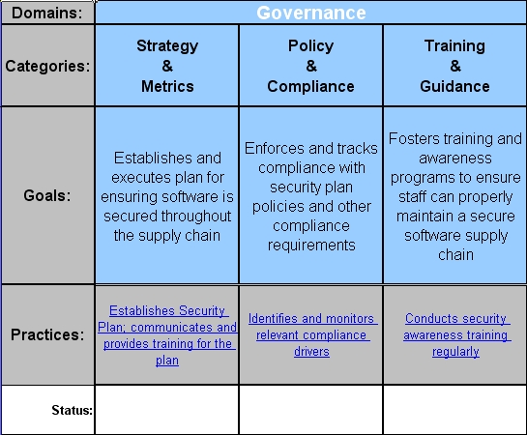
Design of the SwA Checklist
The SwA Checklist has five domains:
Governance
Knowledge
Verification
Deployment
Supplier Management
There are three categories under each domain, each having their own goal statement.
Each goal contains three practices.

Slide 27
Establishing a Baseline
Organizations can establish an assurance baseline using the SwA Checklist
Learn more about current software assurance best practices
Become increasingly familiar with the referenced maturity models
Select model components most applicable to specific needs or use the mappings as added value for the maturity model already in use

Slide 28
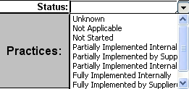
Establishing a Baseline
There is a “Status” cell under each practice in which to select an implementation status.
The aggregation of the status of each practice helps organizations understand their ability to execute on software assurance activities.

Slide 29
Implementation Status
Implementation status options vary based upon:
The degree to which the practice is implemented (i.e., not started, partially implemented, or fully implemented) and
The party responsible for each practice (i.e., internally, by the supplier, or by both).
Two other responses include “Unknown” and “Not Applicable.”
Follow up on these statuses
Unknown = increased risk
“Not Applicable” responses require justification
Thoroughly investigate the status of each practice
Users may discover:
Certain practices actually are applicable or
Practices are already being performed as part of other related practices

Slide 30
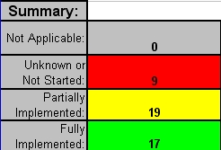
Baseline Summary
After establishing a baseline, a summary displays at the bottom
This system provides an easy-to-view dashboard for an organization’s overall implementation of assurance practices

Slide 31
Demonstration

Slide 32
Baseline Challenges
“Stop light” colors can be misleading
Do not focus solely on the “reds” and “yellows”
“Green” does not necessarily satisfy the organization’s assurance goals or adequately mitigate risks
A practice in green is one that is being performed, not necessarily one that is required
Analyze the entire checklist to determine if the correct entity performs each practice correctly and to a sufficient extent, and if each practice is actually mitigating risks according to the organization’s assurance goals

Slide 33
Baseline Challenges
Practices marked as “Fully Implemented” do not necessarily represent resources that are well allocated
Select components from the source models to improve the implementation of practices specifically required to meet assurance goals, then ensure their satisfactory completion
Measure not only the assurance activities, but also software lifecycle artifacts (e.g., code) to ensure both are improving
Determine the model components that help accomplish a coherent and cohesive set of activities that meet organizational goals based upon business objectives and risk appetite

Slide 34
SwA Checklist Benefits
Establishes an assurance baseline
Facilitates understanding and selection of maturity models and model components
Increases understanding of overall supplier assurance and implementation of practices
Enables more productive dialogue among all supply chain parties
Fosters better understanding of where risk is introduced during acquisition or development of software
Baseline provides an organized framework from which to discuss resource needs with senior leadership for assurance initiatives

Slide 35
Plans
The SwA Checklist will be available on the DHS SwA Community Resources and Information Clearinghouse website:
https://buildsecurityin.us-cert.gov/swa/index.html
The SwA Forum Processes & Practices Working Group plans to add mappings to additional models and update the SwA Checklist as newer versions of mapped models are released.
CrossTalk journal article

Slide 36
Acknowledgements
Joe Jarzombek, Department of Homeland Security
Don Davidson, OASD-NII / DoD CIO
Michele Moss, Booz Allen Hamilton
Lisa R. Young, CERT
Walter Houser, SRA
Doug Wilson, Mandiant
Rama Moorthy, Hatha Systems
Dr. Robin A. Gandhi, Nebraska University Centre for Information Assurance

Slide 37
Questions

Slide 38
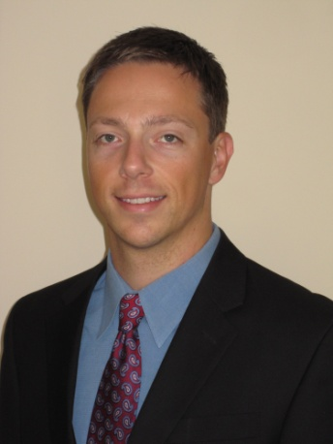
Contact
Ed Wotring
Information Security Solutions, LLC
ed.wotring@informationsecuritysolutionsllc.com
Sammy Migues
Cigital, Inc
smigues@cigital.com

