Slide 1
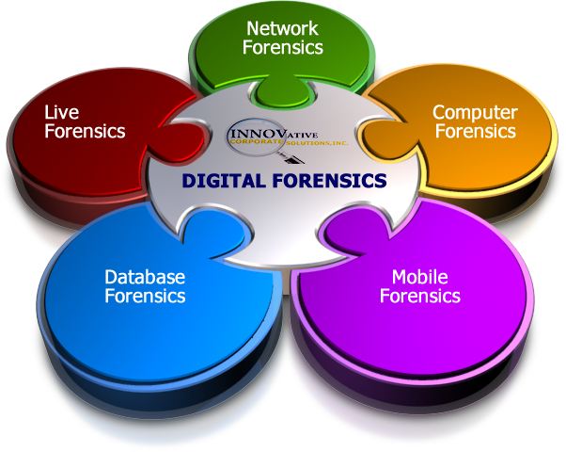

Incidents and Forensics
Morten Schiønning, Senior Security Investigator
TeliaSonera CERT CC

Slide 2

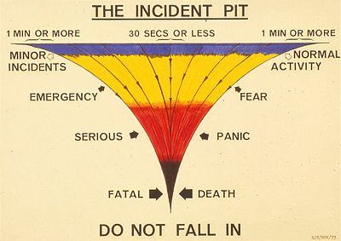
Agenda
Incidents
Incident handling
  Preparation
  Identification
  Containment
  Eradication
  Restoration
  Follow-up
Forensics
  .. more on this later

Slide 3


(Audience notification)
(From now on, 'incidents' are 'security incidents')

Slide 4

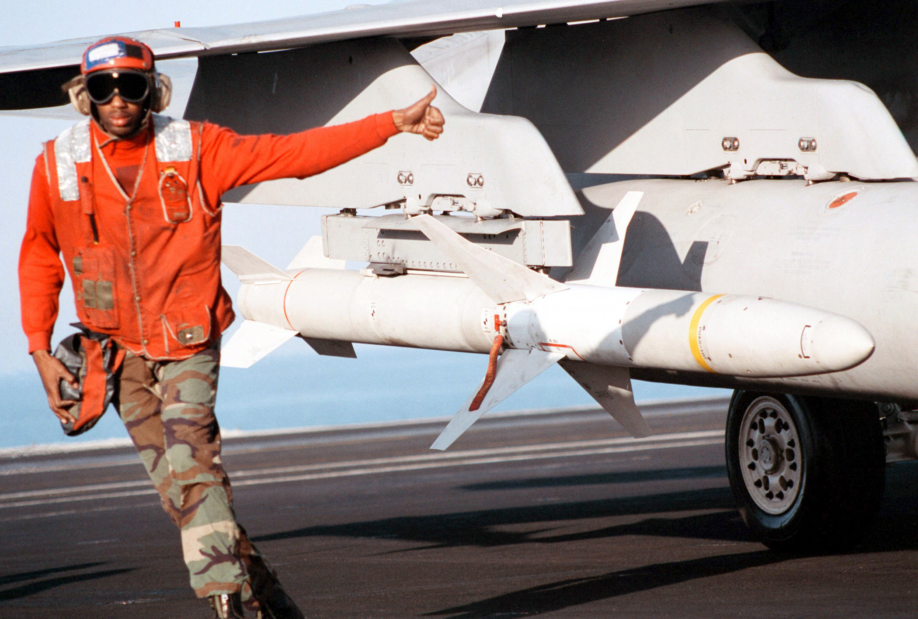
Incidents
www.sans.org
Incidents vs. Security incidents
  ”Does harm or has the intention to do harm”
AGM-88 HARM on a F-18

Slide 5
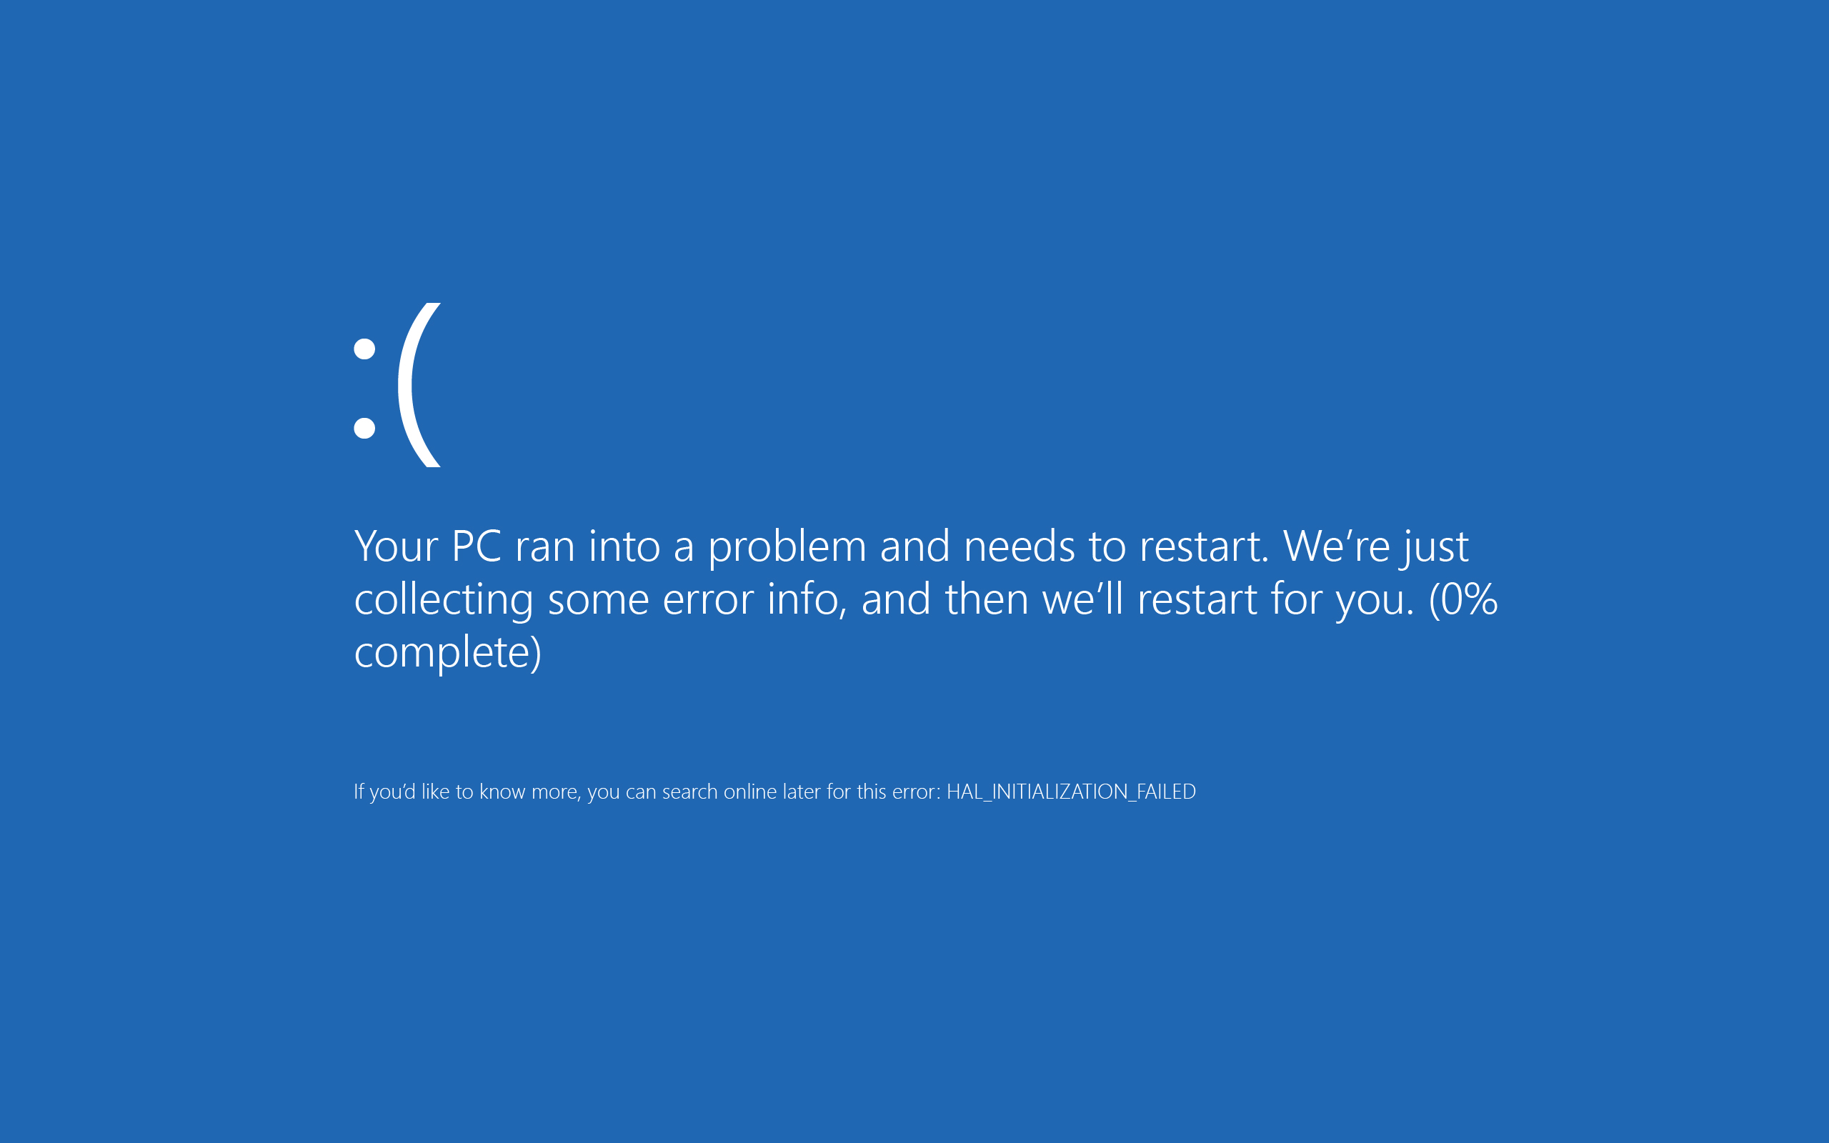

Slide 6
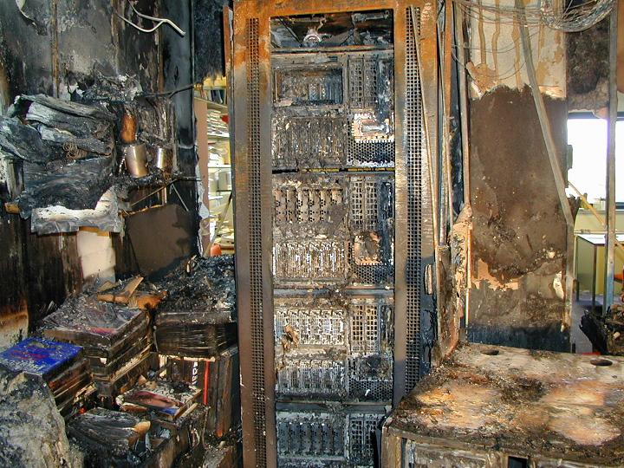

Slide 7
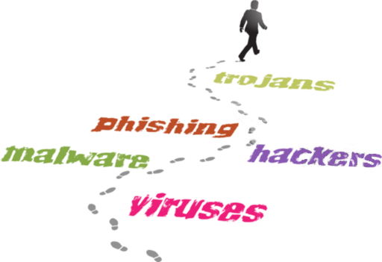
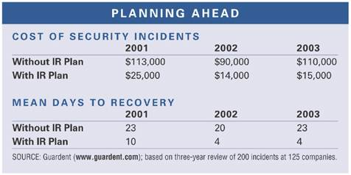
Preparation is (most) everything
Nothing can prepare you for the unexpected
Train for the expected
  Name your teammates
  Learn the current treat vectors from your peers
  Learn from the past (history is your friend)
  Do tabletop excersises

Slide 8

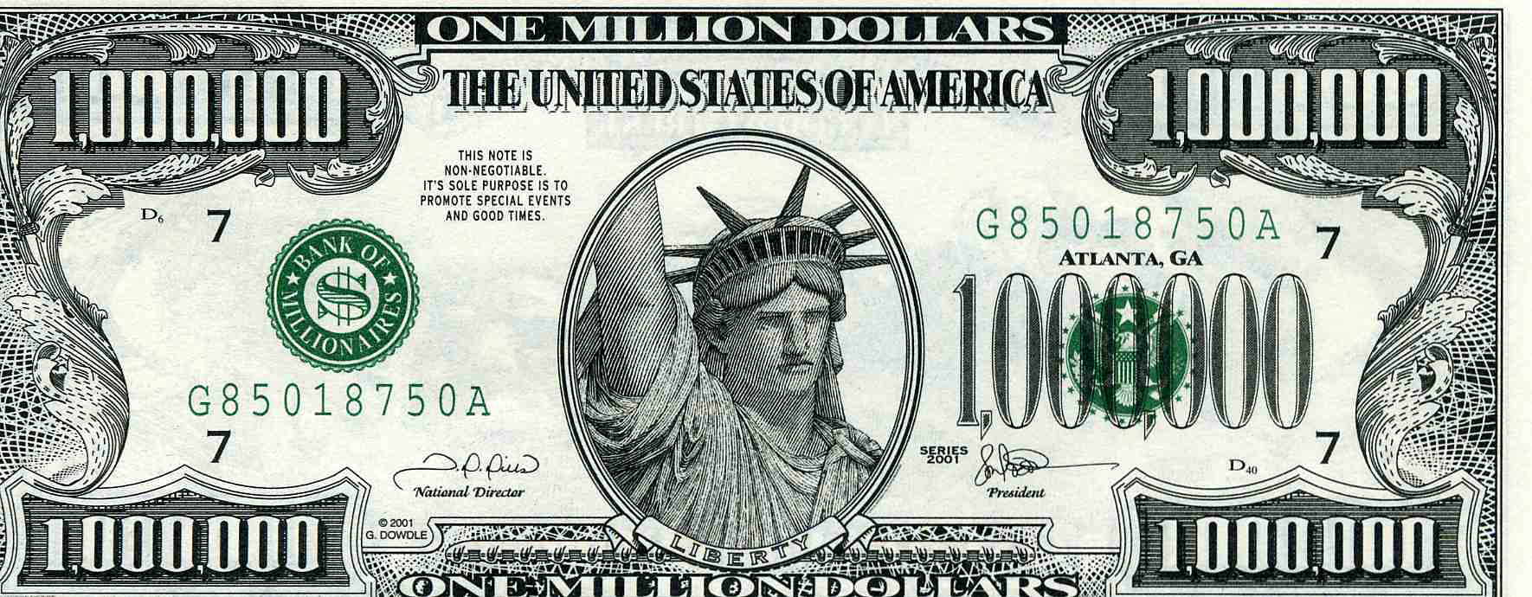
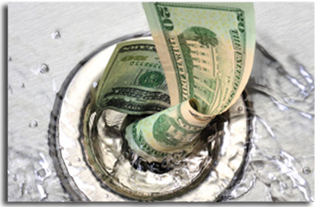
Talk 'Management'
Incident = x∙time + y∙money
time = z∙money
Incident = ((x∙z)+y)∙money
Preparation = <(x)∙time & <(y)∙money
Rule of thumb: >70% less of both

Slide 9
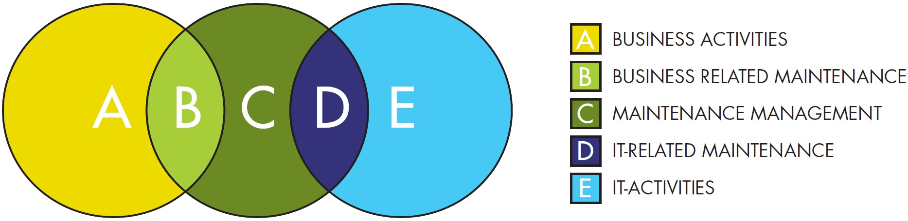
(TSM³)
Introduction of the TeliaSonera System Maintenance Management Model (TSM³)
  Business System Owner (department head)
  Business System Manager (facilitating demands & change)
  IT System Owner (department head, would-be indident owner)
  IT System Manager (sys admin)

Slide 10


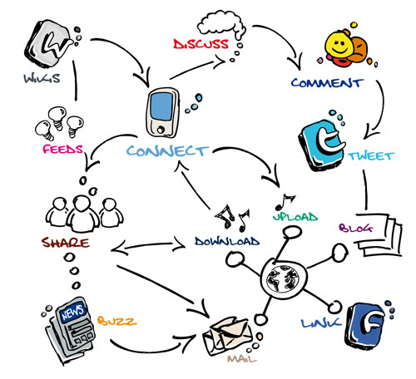
Indident handling
You have your team
  All the persons that you could need to work an incident
  Most have a virtual team across departments
You have your process(es)
  Input from 'incident detecting' sources
  Known way of working
  Clear roles and responsabilities
  Agreed communications strategy
  Appointed 'owners' of incident types

Slide 11


Slide 12

Incident - Identification
Something happend – and a lot of things needs to be done, most of them at once or sooner
KEEP YOUR COOL
Get the most pressing answers first:
  Is this really an incident?
  Yes! Will evidence need to be collected?
  Would you gain more info from letting it go on, rather than 'kill' it now? Would you loose anything (that you haven't already lost)?
In most organisations the incident owner decides and the incident handler acts accordingly

Slide 13
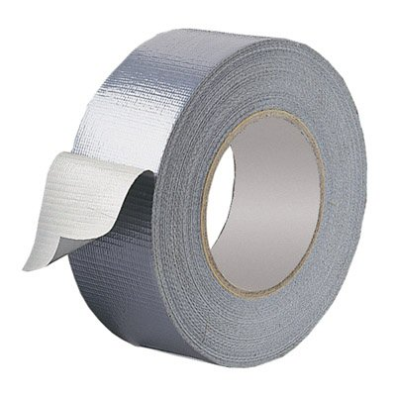
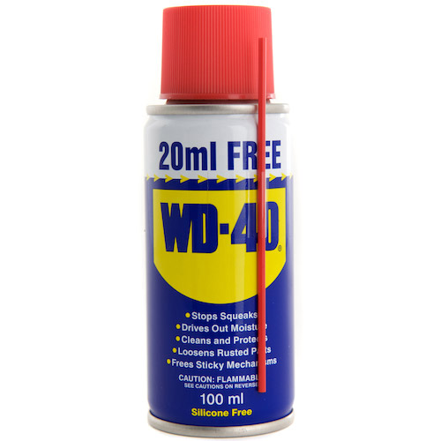
Security
Incident?
Yes
No

Slide 14
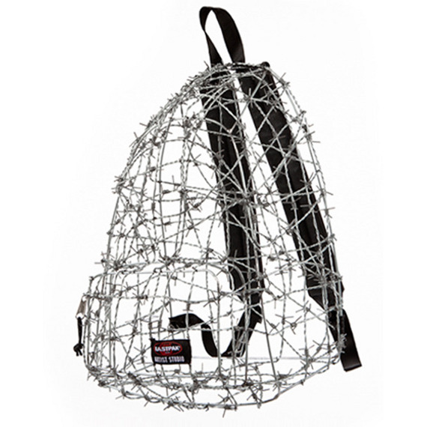

Incident - Containment
An incident has been declared!
Next step(s)
  (If the system is up) Can the system be taken down?
  (If the intruder is in) Can the intruder be shut out?
  Is evidence needed?
  Can you gain more if you let it go on? Can you loose more? Is it worth the risk?
The decision(s) is the incident owners, she or he takes advice from ISM, BSM and incident handler

Slide 15

Incident – Eradication
The incident has been contained – stopped, essentially.
  Just enough was done to prevent it from going on.
  It was doublechecked that it did in fact stop.
  The agreed plan of action(s) was followed.
    Usually this also means collecting evidence
The incident is, however, not gone.
Based on our findings:
  What needs to go (or go back) before the incident is no more?
  What do needs to be done to prevent it from happening again?

Slide 16
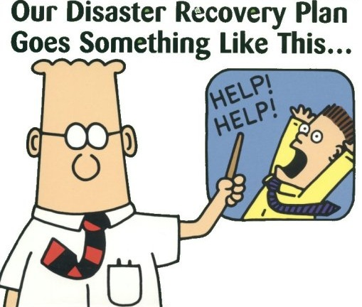
Incident - Restoration
Resume normal operations
  Did you get rid of the danm thing?
  Did you do proper testing?
  Have you got the defences right?
  Are you good to go?
  (In server operations you trust!?)

Slide 17

Incident - Follow-up
*phew* .. the dust settles .. catch you breath – and then:
(This is where some organisations will dismantle the incident response.)
Take the time to find the 'lessons learned' – make a root cause analysis.
Evaluate the incident handling.
Write a GOOD report – make a one page (max) executive summary (could also be a career move).
Make sure that the actionable points have owners!
Follow up on the follow-up!

Slide 18

Evidence as part of an Incident investigation
Can't I use the evidence I have aquired to help the incident investigation?
Yes ..! But ..
You will, of course, use all means at your disposal
Consider resource management
Evidence analysis is very time-consuming
May not be your best option, when the clock is ticking – but it IS an option

Slide 19

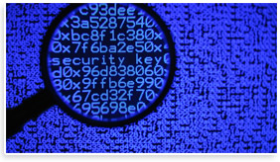
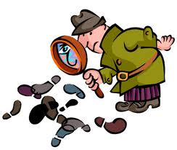
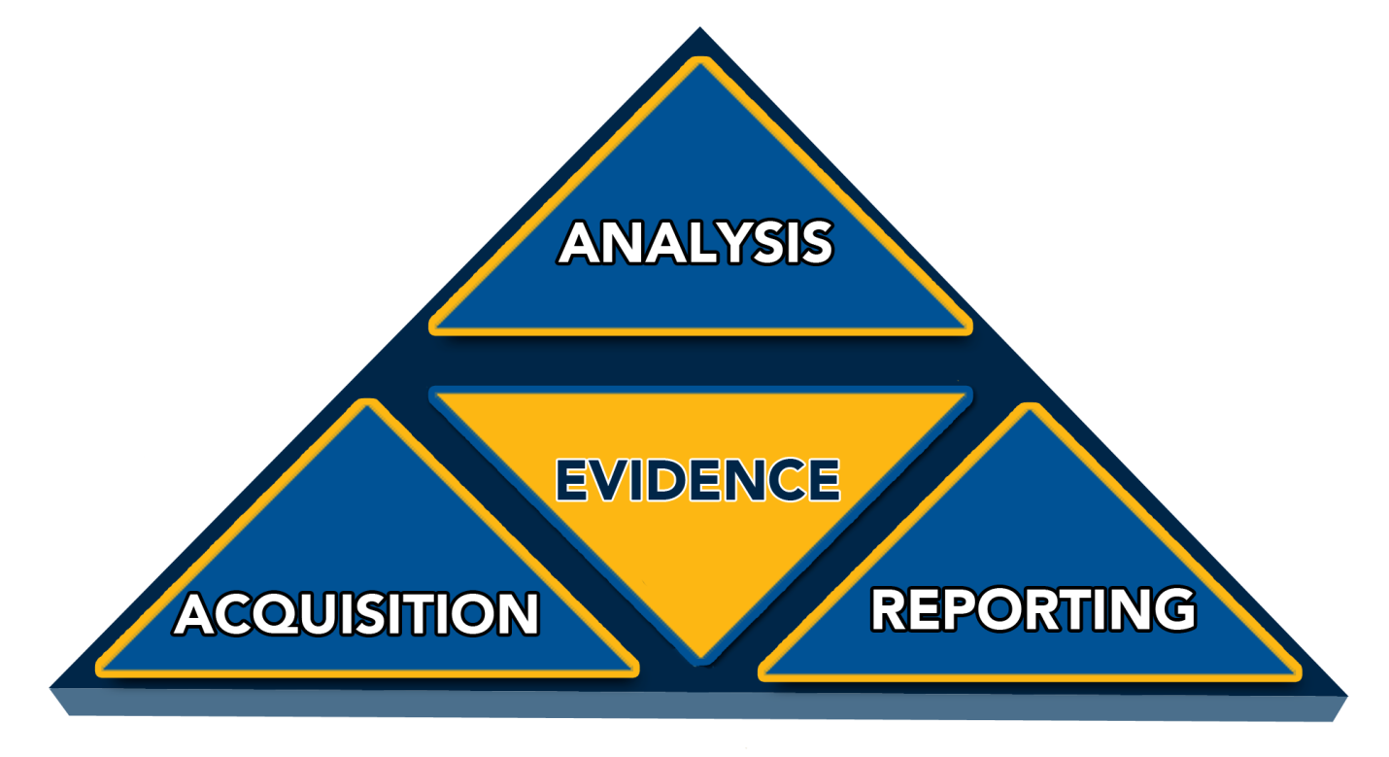
Forensics
Evidence
IT system basics
IT systems – what can you get?
  Warm
    Memory & storage
    Storage only
  Cold
    Storage
Pros and cons
Evidence analysis

Slide 20

Evidence – wikipedia.org
Evidence is and includes everything that is used to reveal and determine the truth, and therefore is presumed to be true and related to a case. Giving or procuring evidence is the process of using those things that are either (a) presumed to be true, or (b) were in fact proven to be true by earlier evidence (truths) and demonstrates the broadening of the truth of a case. And the collection of evidence is in fact the act of determining; what is evidence. Whereas, the word evidence carries with it the presumption of it (the evidence) being seen as true, the where and how it fits; its relationship in and to the other evidence. In short, it goes from determining what is evidence, to evidence is determined; determining truth, to truth determined. Evidence is the currency by which one fulfills the burden of proof.
Many issues surround evidence, making it the subject of much discussion and disagreement. In addition to its subtlety, evidence plays an important role in many academic disciplines, including science and law, adding to the discourse surrounding it.
An important distinction in the field of evidence is that between circumstantial evidence and direct evidence, or evidence that suggests truth as opposed to evidence that directly proves truth. Many have seen this line to be less-than-clear and significant arguments have arisen over the difference.

Slide 21


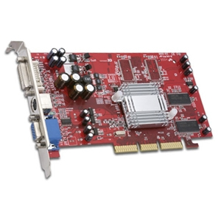

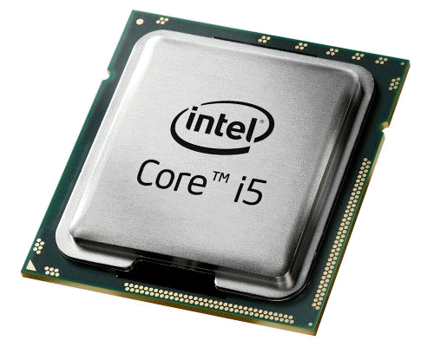
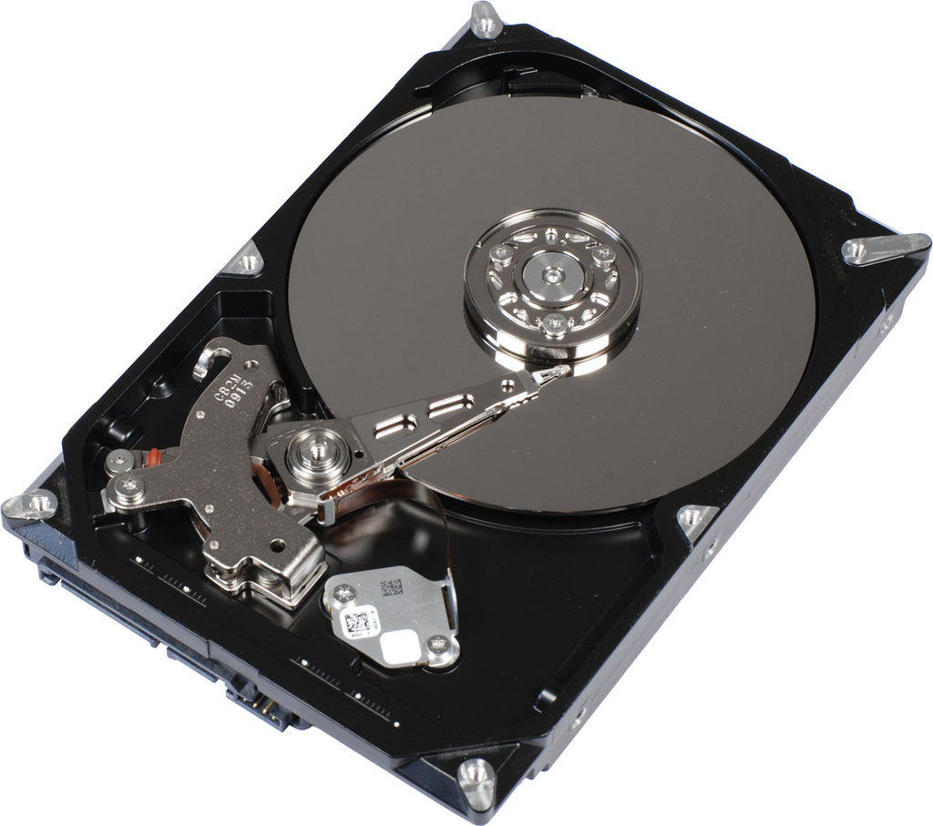
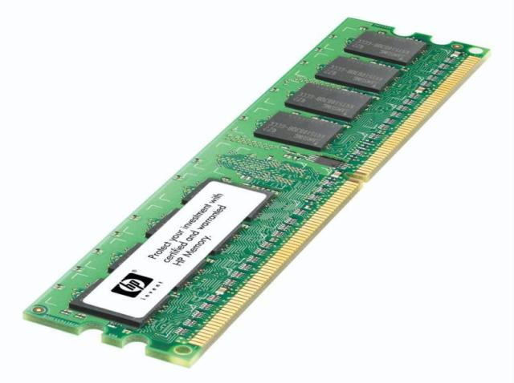
Forensics – IT system basics
Input/Output (I/O)
Storage

Slide 22

Forensics – what can you get?
- and what can't you get!
You can get
  Contents of (powered) memory
  Contents of harddisk
You can't get
  Much anything else
Remember, we destingiush between 'warm' and 'cold' systems

Slide 23
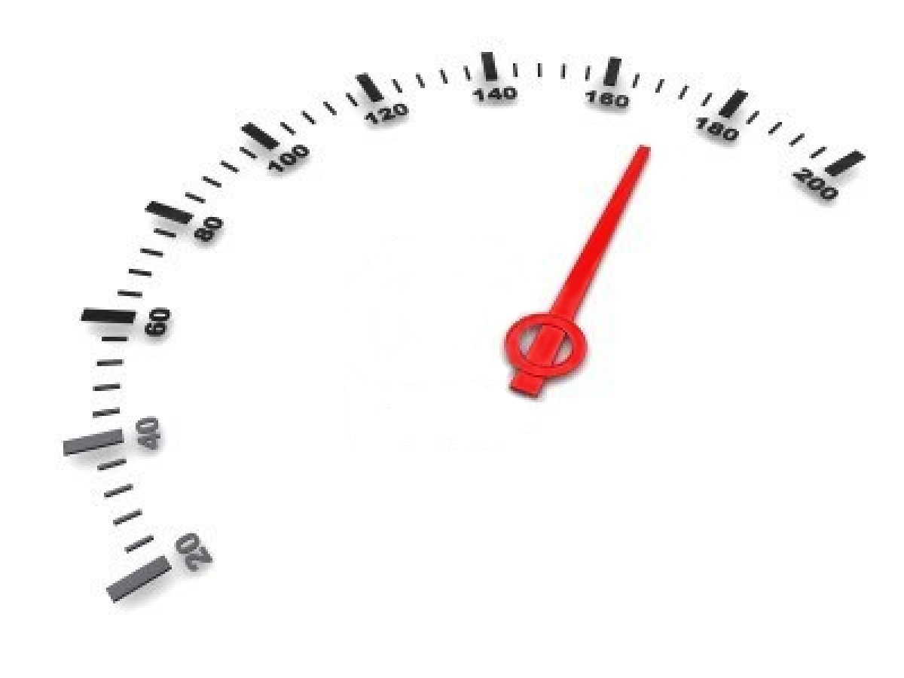
Forensics – warm systems
'Warm' systems are sytems that are running – and working
You have to tread carefully
Your evidence gathering will change the contents of the system (so record what you are doing)
Record the running processes
Copy the contents of memory – this will change as you go
Copy the contents of the harddrive(s) – this will also change as you go

Slide 24


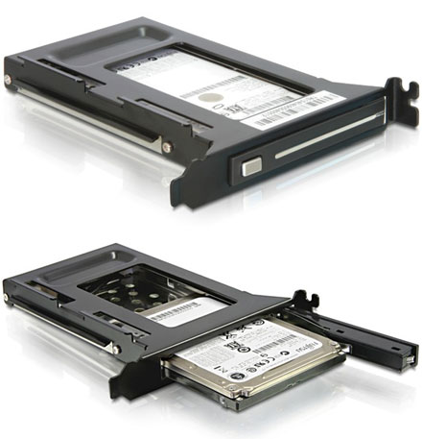
Forensics – cold systems
You may not be able to do warm aquisition – so you restart/power down (gracefully or not gracefully?)
Contents of memory is gone (or unreliable!)
Power up and boot from a forensics CD?
Dismantle harddisk(s) and use a write blocker?
Hash generation? (mathematical 'fingerprint')
Power up?
Restore backup on a new disk?
Reinstallation on a new disk?

Slide 25

Forensics – Pros and cons
Warm
Pros
  Less intrusive
  Faster (can be)
  No downtime
Cons
  Less reliable
  Repudiable
  No physical evidence
Cold
Pros
  More reliable
  Non-repudiable
  Store physical evidence
Cons
  Very intrusive
  Slower (can be)
  Downtime

Slide 26
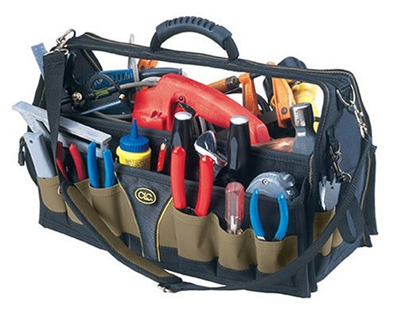
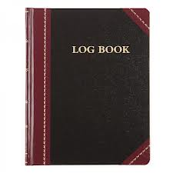
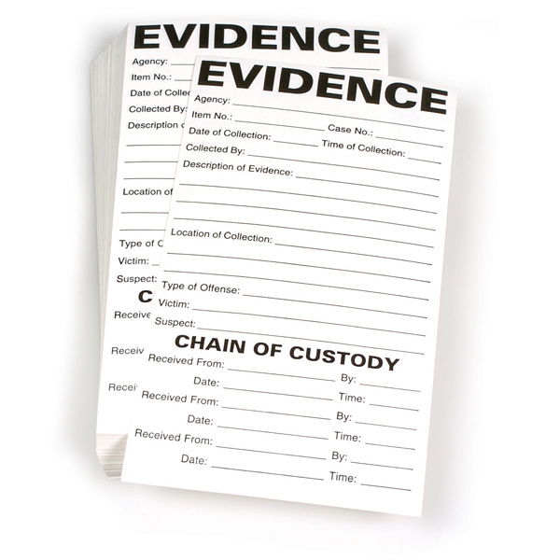

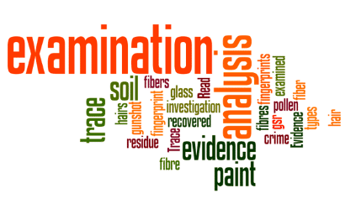
Forensics – Evidence analysis
Know your tools
Work on a copy (of the forensics copy)
Record everything you do (analysis log)
  I did this, it didn't work, then this and it worked
Just state the facts – let someone else draw conclusions
Maintain chain of custody (evidence log)
Non-repudiation (repeatability)

Slide 27

Incident handling and Forensics

