Slide 1
Summit 2011 Outcomes PRESENTED BY __________

Slide 2
About the Summit
Over 180 application security experts from over 120 companies, 30 different countries, and 44 local OWASP chapters.
The Summit is NOT a conference – there are no talks, static presentations, or training seminars. Instead working sessions are used to author documents, create software, draft standards, and forge relationships.
Many of the working sessions were on a fixed schedule determined before the start of the summit. However, just as many were created “dynamically” but the attendees.

Slide 3
Government Outreach
OWASP has been working to establish relationships with governments around the world: United States, Brazil, Portugal, & Greece.
OWASP leaders met with sr. Portuguese govt IT officials to establish a protocol for working with Portugal to improve their app sec capabilities.
Outcome: “The OWASP Application Security Code of Conduct for Government Institutions”
The OWASP “Green Book”

Slide 4
Details of The OWASP “Green Book”
The Government Institution MUST establish and enforce a standard that requires application security for organizations and applications under their jurisdiction.
The Government Institution MUST build application security into software acquisition guidelines.
The Government Institution MUST provide OWASP a “notice and comment” period when releasing laws and regulations that are relevant to application security.
The Government Institution MUST define or adopt a definition of application security.
The Government Institution MUST create and promote public service messages focused on application security.

Slide 5
OWASP Outreach to Educational Institutions
Reaching students:
OWASP Code of Conduct for Educational Institutions
“The OWASP Blue Book”
The Educational Institution MUST include application security content somewhere in the standard computer science curriculum.
The Educational Institution MUST offer at least one course dedicated to application security annually.
The Educational Institution MUST ensure that an OWASP Chapter is available to their students and support it.
Also………..
OWASP “Academies” Portal with extensive education and training materials. http://www.owaspa.org/

Slide 6
Details of The OWASP “Green Book”
The Government Institution MUST establish and enforce a standard that requires application security for organizations and applications under their jurisdiction.
The Government Institution MUST build application security into software acquisition guidelines.
The Government Institution MUST provide OWASP a “notice and comment” period when releasing laws and regulations that are relevant to application security.
The Government Institution MUST define or adopt a definition of application security.
The Government Institution MUST create and promote public service messages focused on application security.

Slide 7
OWASP Industry Outreach
Let’s:
Develop industry working sessions/tracks
Held at major OWASP conferences
Starting with OWASP EU 2011 in Dublin, Ireland.
Objective:
Listen: Solicit feedback from industry players to help better focus OWASP efforts.
Act: Make sure OWASP deliverables are relevant to industry concerns and really address problems.
Why:
OWASP needs to become more industry relevant in order to grow.
We need to “stop throwing pebbles into the lake of software insecurity and start throwing boulders”.

Slide 8
Code of Conduct for Standards Bodies
The OWASP “Yellow Book”
The Standards Body MUST include an “Application Security” section in each software related technical standard.
The Standards Body MUST provide OWASP a “notice and comment” period when releasing standards that include an application security aspect.

Slide 9
Application Security Certification?
The OWASP “Red Book”
We don’t do it:
OWASP reaffirmed its commitment to avoid becoming a certification body.
We have created the “OWASP Code of Conduct for Certification Bodies” that defines what application security certification program should entail and rules of engagement for using OWASP’s name on training materials.

Slide 10
OWASP Browser Security Project
Representatives from browser vendors
Mozilla, Google, and Microsoft together with leading security researchers to discuss, and strategize about browser security issues.
New OWASP initiatives were launched:
Browser security scorecard project
Mozilla’s Content Security Policy (CSP) and browser sandboxes

Slide 11
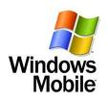
OWASP Mobile Security Initiative
Top 10 Mobile Vulnerabilities
Top 10 Mobile Defenses.
(2010 – more Smartphone's than laptops sold for first time)
OWASP resolved to reach out to mobile platform vendors to work with them on integrating better security into their environments.

Slide 12
OWASP-Apache Relationship
Relationship with the Apache Software Foundation (ASF)
Including OWASP-provided code in Apache projects. –ESAPI, AppSensor, AntiSamy,….
Intention:
Improve the security of the widely-used ASF Open Source software
Improve visibility for OWASP efforts.

Slide 13
OWASP is getting more democratic…
OWASP Governance Expansion – OWASP updated its Bylaws and worked out procedures for the upcoming Board elections. These governance updates will help best support the dynamic and growing OWASP community.
Currently 2 board members are democratically elected.
It was agreed to put a further 3 of the remaining 5 non elected board members up for election. Nominations by AppSec EU, election late summer.
…………please stand if you have the time and energy

Slide 14
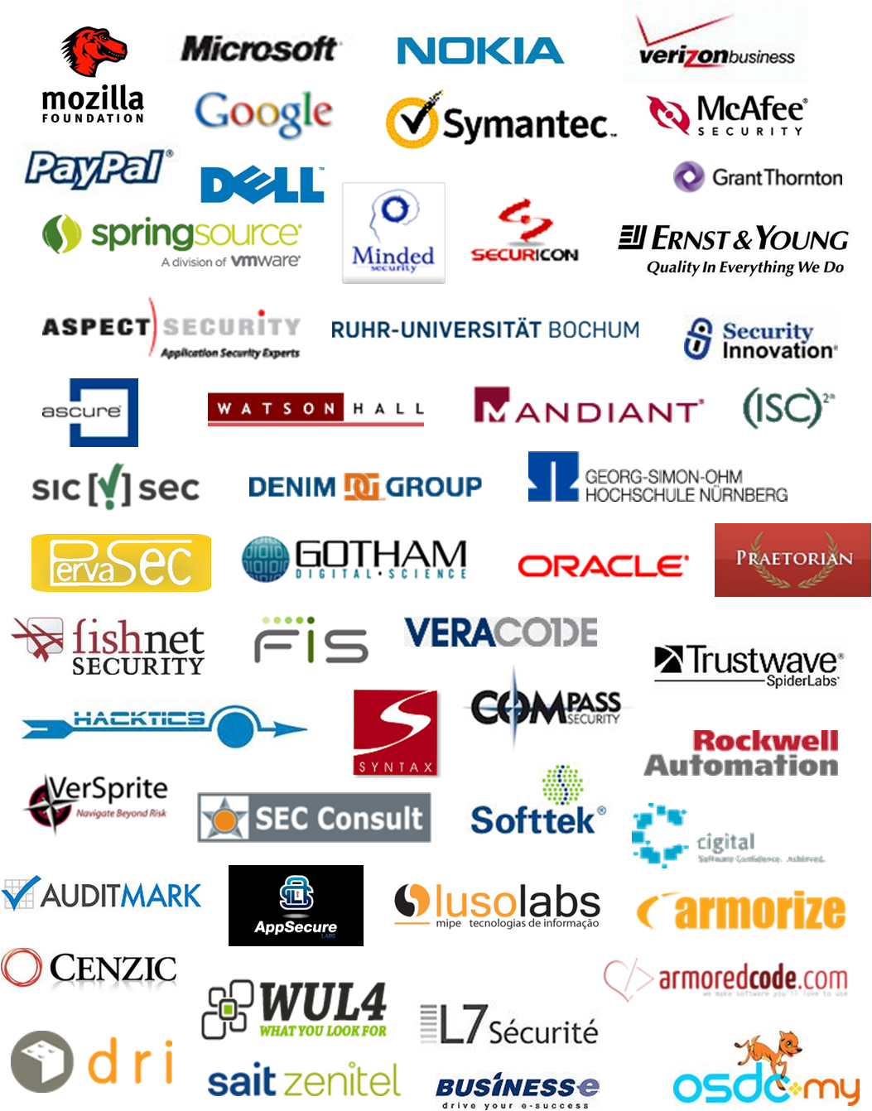
Summit Sponsors…Thanks!

