Slide 1
OWASP
Update
OWASP Belgium
Chapter
Sebastien Deleersnyder
        Foundation Board, Zenitel Belgium
  seba@owasp.org

Slide 2
Agenda
Introduction
OWASP Near You

Slide 3
Introduction

Slide 4
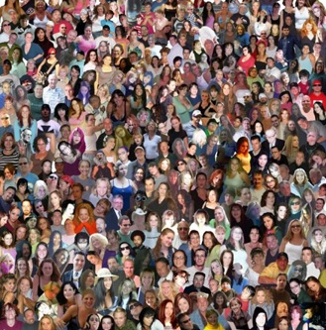

OWASP World
OWASP is a worldwide free and open community focused on improving the security of application software.
Our mission is to make application security visible so that people and organizations can make informed decisions about application security risks.
Everyone is free to participate in OWASP and all of our materials are available under a free and open software license.
The OWASP Foundation is a 501c3 not-for-profit charitable organization that ensures the ongoing availability and support for our work.
Notes:
REMEMBER… OWASP IS JUST PEOPLE
You are all probably familiar with OWASP, so I’d like to take this opportunity to share a few metrics and give you an idea of where OWASP is headed.
I’ve been the volunteer chair of OWASP since 2004, and I’ve spent quite a lot of time, effort, and my own money developing the organization. Why do I do all this? Why do I care?
AppSec is about not about tools or technology… it’s about people. OWASP is about community.
______________
4

Slide 5






Thank you
Location / Pizza sponsor OWASP supporter
Sponsors Belgium 2010
OWASP cannot recommend the use of products, services, or recommend specific companies
5
Notes:
5

Slide 6
Program
18h45 - 19h00 OWASP update Sebastien Deleersnyder
19h00 - 20h00 Attacking and Defending the Grid Justin Searle
20h15 - 21h15 How I Met Your Girlfriend Samy Kampkar
6

Slide 7
OWASP near you

Slide 8
Belgium Chapter
Meetings
Local Mailing List
Presentations & Groups
Open forum for discussion
Meet fellow InfoSec professionals
Create (Web)AppSec awareness
Local projects?

Slide 9



News and Intelligence
Moderated AppSec News Feed
  http://www.google.com/reader/public/atom/user/16712724397688793161/state/com.google/broadcast
OWASP Podcast
  http://itunes.apple.com/WebObjects/MZStore.woa/wa/viewPodcast?id=300769012
OWASP TV
  http://www.owasp.tv
9

Slide 10

OWASP AppSec Research 2010
OWASP Conferences
        All Video’s online!

Slide 11

BruCON 2010

Slide 12
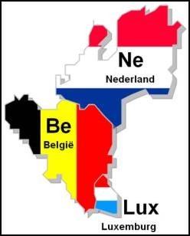
BeNeLux 2010
2 Days / December
  One day OWASP Training
  One day conference
Eindhoven
Details to follow...

Slide 13
That’s it…
13
Questions?
http://www.owasp.org/index.php/Belgium
belgium@owasp.org
Thank you!
Notes:
13

Slide 14

Subscribe mailing list
Post your (Web)AppSec questions
Keep up to date!
BE LinkedIn Group
Contribute to discussions!
14

