Slide 1
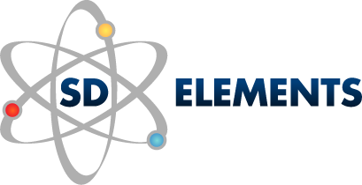
Avoiding the Pitfalls of Secure SDLC
Succeeding with Automation

Slide 2
Introductions

Slide 3
Status Quo

Slide 4
Look familiar?
Where we find flaws today
Highest ROI
Relative cost to fix, based on time of detection
Source: NIST

Slide 5
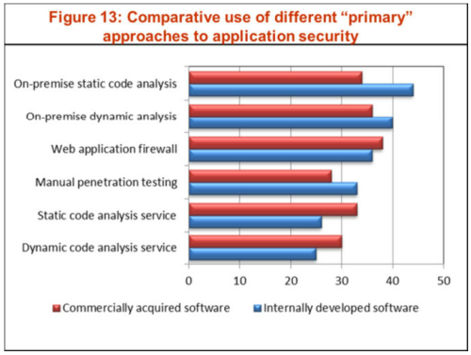
February 2012 Report from Quocirca

Slide 6
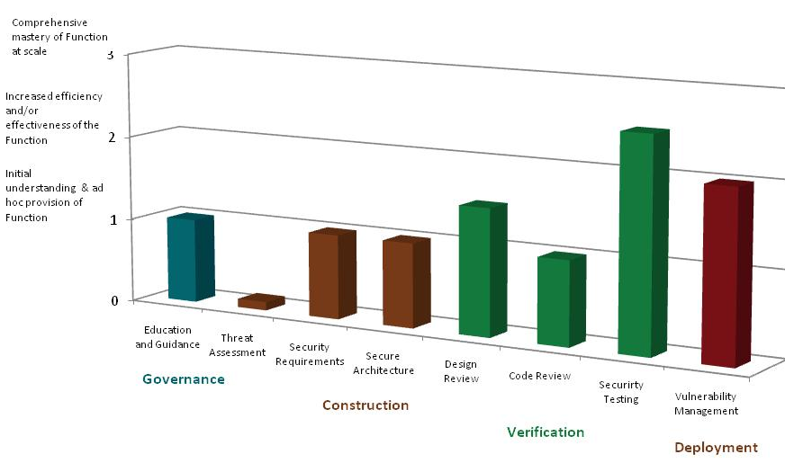
Results of an Open SAMM Assessment

Slide 7
Problems with Verification

Slide 8
Security Requirements

Slide 9
Scaling: Self-Serve
Notes:
20 people can’t list all the apps they have to support

Slide 10
Solution: Automated, Criteria-based Requirements Generation

Slide 11
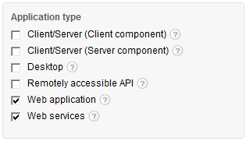
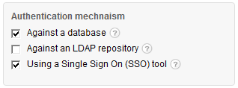
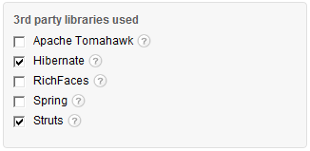
Context

Slide 12
Matched Against Rules
Notes:
Threats

Slide 13
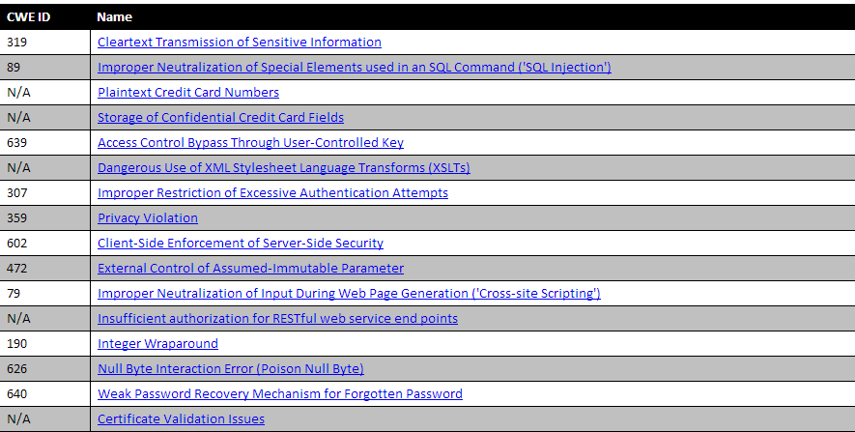
Generates Threats
Notes:
Threats

Slide 14
Matched Against Rules
Notes:
Threats

Slide 15
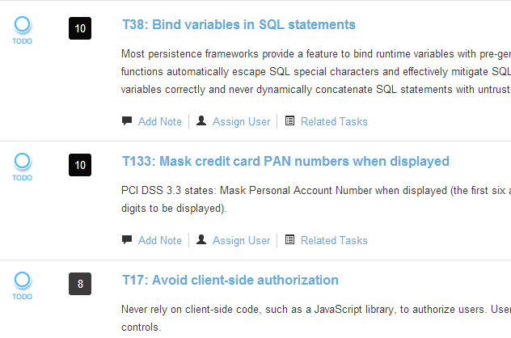
Which Have Countermeasures
Notes:
Threats

Slide 16
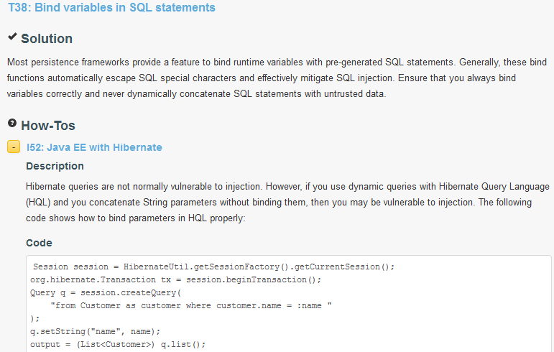
Apply the context for specific guidelines
Notes:
Threats

Slide 17
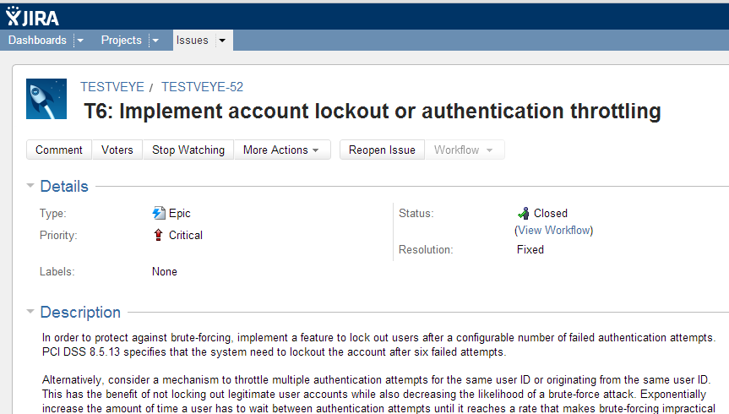
And (Optionally) Import into ALM
Notes:
Threats

Slide 18
Program Justification: $4k to find vuln in production

Slide 19
rohit@sdelements.com ehsan@sdelements.com

