Slide 1

Threat modelling: how to approach
security aspects in IT projects
Geneva, December 15th 2014
Notes:
In this presentation, we are going to cover the topic of threat modelling. We’ll present an overview of the methodology as well as a case study.
The prime objective, however, is not to explain how to perform threat modelling, but to demonstrate how threat modelling greatly contributes to addressing common issues regarding information security in IT projects

Slide 2

Speaker
Stéphane Adamiste
Information Security Consultant
+15 years of experience in the information security field
IT audit, gap analyses, pentesting
Security governance, risk management
Security consulting, coaching
Ad hoc advisory, long term mandates
Common denominator: Struggling to demonstrate the benefits of information security

Slide 3
Agenda
Security challenges and common pitfalls in projects
Information security in a nutshell
Threat modelling explained
Case study
Questions

Slide 4
Security in change
How well are security challenges addressed in your IT projects?
Challenges | Excellent | Good | Fair | Poor | Very poor
Senior management’s commitment to information security initiatives
Management’s understanding of information security issues
Information security planning prior to implementation of new technologies
Integration between business and information security
Alignment of information security with the enterprise’s objectives
Executive and line management’s ownership and accountability for implementing, monitoring and reporting on information security
?
Source: ISACA
Notes:
ISACA stands for Information Systems Audit and Control Association. Known for delivering the CISA certïfication and authoring the COBIT framework

Slide 5

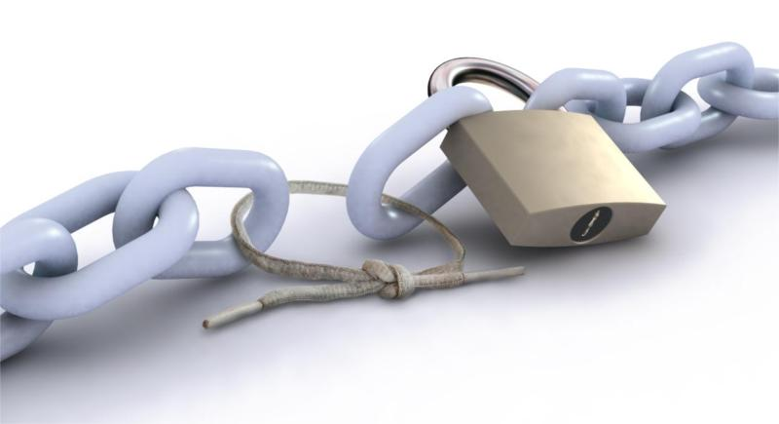
Security in change
How do you ensure that integrating a new component in your environment does not create security issues?
Existing IT environment
New IT system

Slide 6

The security deadly sins in IT projects
#1: The unsaid
I didn’t mention security aspects. She didn’t ask for it!
He didn’t mention security aspects. He must know what he’s doing…
Client
Supplier
Notes:
Let’s consider the example of a marketing department willing to launch a new corporate website. The requirements will focus on the design of the logo, the look and feel, user experience, fancy functionalities (picture carousel, social login, etc…).
But the marketing department will never mention requirements such as «we need https to make sure personal data transmited when creating an account are not intercepted», or «we need a network access list to ensure that the remote administration interface of the CMS be not exposed on Internet».
In such a context, threat modelling facilitates the communication around information security between the various stakeholder in an optimized way

Slide 7

The Security deadly sins IN IT projects
#2: Evaluating risk on behalf of the client
Don’t worry about security Ma’am. Our bulletproof framework is what you need!
I feel so secure…
Client
Presales engineer
Notes:
In this case, the risk is that the solution proposed by the supplier does not correspond to the customer’s effective security requirements. It’s the client’s role to set the level of protection required, because she will endorse responsibility in case of security incident
We will see later in this presentation how threat modelling helps determining the adequate level of protection required in an IT project

Slide 8

The Security deadly sins IN IT projects
#3: Not defining responsibilities
How come?? We are not in charge of components hardening.
The default password was not removed! It’s your fault…
Hacked client
Supplier
Notes:
If security aspects are not discussed, responsibilities will a fortiori not be defined. It may lead to a conflict situation.
Back to the example of the marketing department, will they consider the vulnerability disclosure made on the Wordpress CAPTCHA plugin which has been installed on their website?

Slide 9

The Security deadly sins IN IT projects
#4: Believe that you can deliver secure projects without specific activities
I should not have believed everything was under control.
I don’t understand… Normally, it never happens…
Hacked client
Supplier
Notes:
It is widely accepted that an application cannot be developed without any bug. Why do people think that it can be delivered without security bugs?
In fact, people know that sooner or later in a project, they will have to treat security aspects (how do we authenticate users, what is our authorization model, what actions do we log, etc…), but surprinsingly, there are hardly specific activities in the planning to deal with those issues seriously.
Pentesting is more and more performed just before the application release. But if no prior security activity has been performed, pentesting will lead to the discovery of security vulnerabilities. Fixing them will cause additional workload and delay in the project. In large companies, the project team’s bonus is distributed if time to market is respected. In this case, security issues are deliberately minimized or even hidden.
Pentesting is a valuable activity, but it should serve as a security assurance activity (i.e. verifying that the security controls defined during the design phase have been correctly implemented)

Slide 10
Agenda
Security challenges and common pitfalls in projects
Information security in a nutshell
Threat modelling explained
Case study
Questions
Notes:
We very often notice in the projects we deliver that discussing security aspects leads to endless debates. One of the reasons is the fact that there is no common understanding of what information security in a project means, and what information security management consists of.
Hence the need to quickly go through a number of definitions and concepts...

Slide 11
Information security in a nutshell
Systems process data
Systems process various types of data
Data have a value (and therefore are called information assets)
The value of data can be defined by evaluating the adverse impact caused to the owning organization if:
  Data is disclosed to unauthorized people (loss of confidentiality)
  Data is modified by unauthorized people (loss of integrity)
  Data is not accessible when needed (loss of availability) (=! performance)

Slide 12
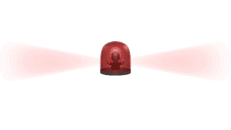
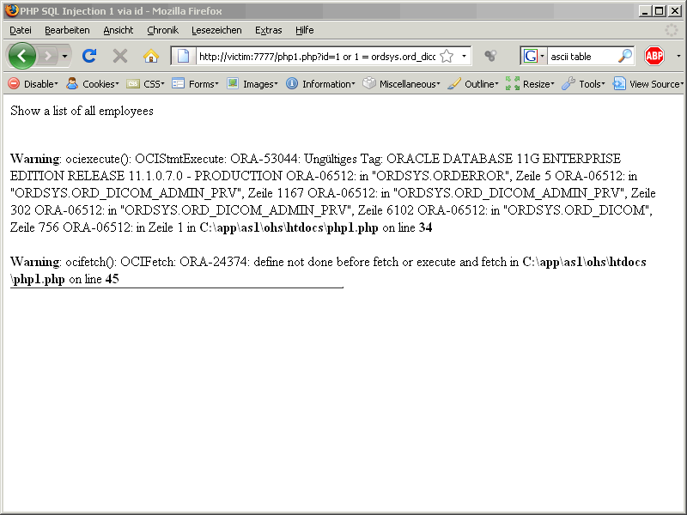
Information security in a nutshell
An adverse impact is caused by a threat that materializes
Threats materialize by exploiting vulnerabilities in a system
Information security consists in protecting information assets against threats that may affect their confidentiality, integrity and/or availability by implementing proportionate security controls.
Impact
The back-end database can be viewed, modified and deleted, leading to productivity, legal, reputa-tional and financial issues
Threat
Attack on website by Internet hacker
Security controls
Vulnerability
input validation, use of parameterized requests
SQL injection

Slide 13
Information security in a nutshell
Information Security Management is Risk Management
Information Risk (~ cyber-risk) = Operational risk linked to the use of information systems
  Hacking
  Denial of service
  Environmental hazard
  Insertion of malware
  Etc.
  Impact areas:
  Safety & health
  Reputation
  Finance
  Legal
  Productivity
Risk = Likelihood of a threat X Impact
  Attack surface?
  Target visibility?
  Reward for an attacker ($, fame)?
  Exploitability of vulnerabilities?
  Value of data?
  Security requirements?

Slide 14
What is the acceptable risk level in my company?
Security level
Risk appetite
  “We want to be protected against a maximum of threats”
  “We want to be compliant with existing industry regulations”
  “We rely on our suppliers”
  “We don’t need security, we’ve never been attacked”

Slide 15


Risk management illustrated
Threats
Risk appetite
Impact
Vulnerabilities
Likelihood

Slide 16
Information Security Management in projects
Managing information security aspects in a development or integration project implies:
  Identifying data types (a.k.a. information asset type) to be processed by the system
  Identifying confidentiality, integrity and availability requirements for each data type
  Identifying threats to the information assets
  Determining security measures (a.k.a. security controls) that will prevent threats from materializing
Information classification
Threat modelling

Slide 17
Information classification sample
Data type | Owner | Description | Security requirements |  |  | Rationales
 |  |  | C | I | A
Procurement data | Head of procurement | Procurement data include information involved in purchasing, contracting, and negotiating activities within CompanyX. | Medium | Basic | - | Procurement data have medium confidentiality requirements. Conditions granted to a supplier could be coveted by its competitors. Integrity of suppliers' list and associated bills is also important to avoid financial loss due to internal fraud.
Staff/job applicants personal data | Head of HR | This category includes all personal information related to CompanyX’s workforce and job applicants | Medium | - | - | Staff/job applicants data have medium security requirements in terms of confidentiality (with regards to the Swiss data protection law and given the sensitivity of remuneration levels).
 |  |  | Medium | Medium | - | Payroll data have specific integrity requirements as they are involved in the tax calculation process. The employer endorses penal liability if taxes are not duly paid to the State.
Financial data | CFO | Financial data comprise all elements necessary to manage CompanyX's performance in terms of profits, revenues, operating income, etc. and to issue its financial statements | Basic | High | Basic | These data have basic confidentiality requirements. The integrity criterion is high, as manipulation of data could lead to fraud and alteration could result in a biased perception of the company's financial health as well as to possible refinancing issues. Given the high transactions volume, unavailability of financial data may leads to bottlenecks in the corresponding workflows.
… | … | … | … | … | … | …
Notes:
A data type is a collection of data that share a common description and that are subject to similar security requirements
The «owner» column is important, as it brings an answer to the previously mentioned gap «

Slide 18
Agenda
Security challenges and common pitfalls in projects
Information security in a nutshell
Threat modelling explained
Case study
Questions

Slide 19
Threat modelling
Threat modelling is “a process to identify and document threats to a particular system and their most appropriate countermeasures”
It is an early risk detection and prevention process
  Conducted during the design phase
  Allows to prioritize the security efforts
  Allows to control security related costs
It is an editable process
  Should be updated along with the application
  Can be applied iteratively
It is an elastic process
  Focus on main threats vs. exhaustive approach
It is a simple process
  Pen and paper activity

Slide 20
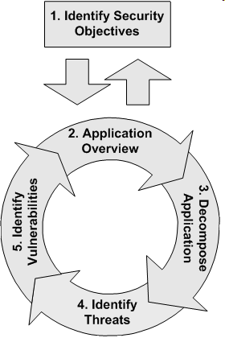
Threat modelling methodology
Threat modelling allows assessing and documenting a system’s security risks by examining it through the angle of hostile scenarios and abuse cases.
  What are the assets of value?
  What scenarios would harm the organization most?
  Are there regulatory constraints?
  Where are the most sensitive functions in your systems?
  Components data flows
  Trust boundaries
  → Data Flow Diagram (DFD)
  Threat trees
  DREAD
  Threat trees
  STRIDE

Slide 21
Threat Categories - STRIDE
STRIDE is a classification scheme for threats
Threat | Security property
Spoofing identity | Authentication
Tampering with data | Integrity
Repudiation (e.g. “I didn’t perform this transaction”) | Non-repudiation
Information disclosure | Confidentiality
Denial of service | Availability
Elevation of privilege | Authorization

Slide 22
Data Flow Diagrams (DFD) and STRIDE threats
STRIDE
SR
TID
TID
TRID
Process
External
entity
Data flow
Data flow
Data store
Data flow
Data flow
 | S Spoofing | T Tampering | R Repudiation | I Information disclosure | D Denial of service | E Elevation of privilege
External entity | ✓ |  | ✓
Process | ✓ | ✓ | ✓ | ✓ | ✓ | ✓
Data store |  | ✓ | ✓ | ✓ | ✓
Data flow |  | ✓ |  | ✓ | ✓

Slide 23
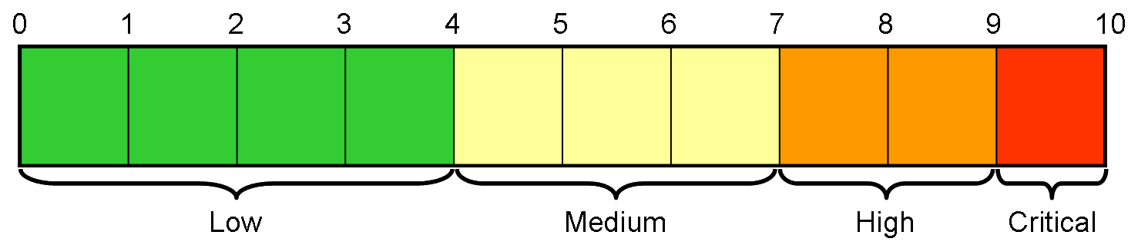
Risk estimation (DREAD)
DREAD_Risk = (Damage + Reproducibility + Exploitability + Affected users + Discoverability) / 5
DEPRECATED
Damage potential & Affected users → impact
Reproducibility, exploitability, discoverability → likelihood
Impact | High | Medium | High | Critical
 | Medium | Low | Medium | High
 | Low | Low | Low | Medium
 |  | Low | Medium | High
 |  | Likelihood

Slide 24
Agenda
Security challenges and common pitfalls in projects
Information security in a nutshell
Threat modelling explained
Case study
Questions

Slide 25

Case study
Internet of things: Home alarm

Slide 26
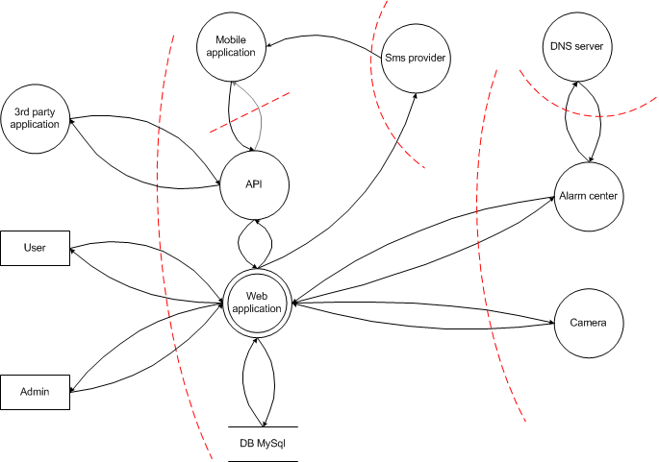

Data flow diagram

Slide 27
Information assets
Asset | Security requirements | Rationale
Clients’ personal data | confidentiality | Personal data shall be processed in compliance with applicable privacy law
Credentials | confidentiality | Credentials compromise leads to unauthorized access to the system
Alarm center configuration data | Integrity | Unauthorized modification of configuration data (e.g. intrusion notification email or phone number, sensors’ state) can annihilate the alarm system
Camera records | confidentiality | Can contain personal data. Useful to a thief to perform spotting activities
History of events | confidentiality, integrity, availability | Allows to identify alarm activation/deactivation habits Allows to control if suspicious deactivation has been performed
Alerts | Integrity, availability | Shall be transmitted in an accurate and timely manner

Slide 28
External dependencies
External dependencies are items external to the code of the application that may pose a threat to the application
Entity | Risk | Recommendation
Third party application | A weakness in a third party application using the solution’s API may lead to threat materialization | Limitation of liability clause
SMS provider | Service unavailability | SLA with SMS provider
External DNS servers | DNS cache poisoning | Use DNSsec
Client Infrastructure (router, computer, Wifi access point, careless user) | A weakness in the client infrastructure may lead to threat materialization | Limitation of liability clause

Slide 29
Main Threat scenarios
Threat agent | Motivation | Scenario
Internet hacker | Curiosity, challenge, fame, money | Access to confidential data (credentials, personal data, camera records) Alteration of alarm center configuration data Access to the solution admin functions Servers remote take over
Competitor | Reputation damage, clients’ database theft | Idem Internet hacker Denial of service
Burglar | Spot victims, deactivate home alarm center, intercept alerts | Idem competitor
Client | Add service options for free | Lure the alarm center
Malicious employee | Curiosity, nuisance | Access to confidential data (credentials, personal data, camera records)

Slide 30
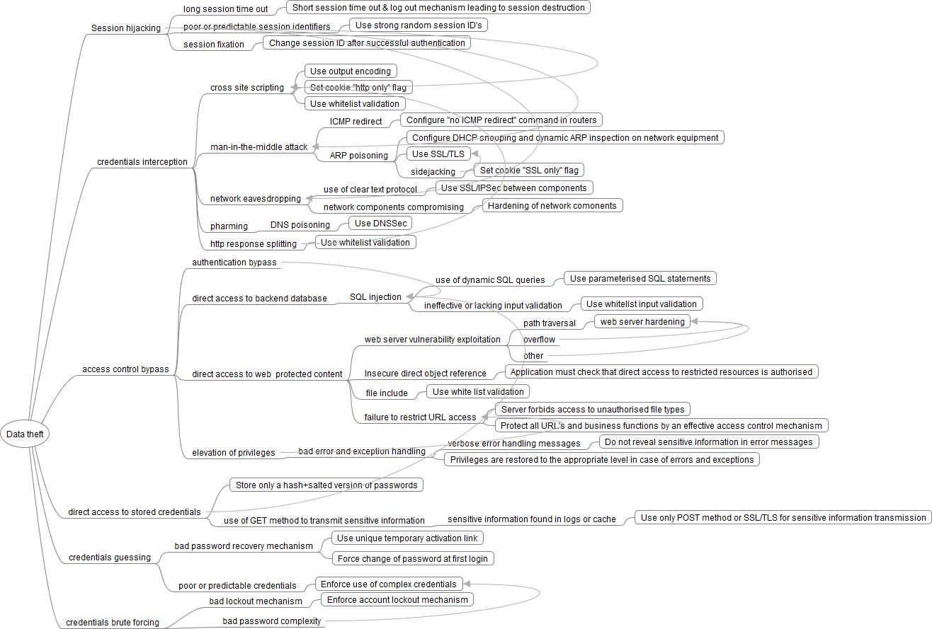
Threat tree
«Access to confidential data» and «Access to solution admin functions» scenarios

Slide 31

Benefits of Threat modelling
  Perform a risk assess-ment through threat modelling for all projects
  …So the typical “It’s too technical” CEO excuse is no longer valid !
  Threat scenarios are expressed in a compre-hensive language…
Challenges
Senior management’s commitment to information security initiatives
Management’s understanding of information security issues
Information security planning prior to implementation of new technologies
Integration between business and information security
Alignment of information security with the enterprise’s objectives
Executive and line management’s ownership and accountability for implementing, monitoring and reporting on information security
Source: ISACA
  Approach based on the value of data
  The security requirements for the different data types are set by business representatives (a.k.a. data owners)
  Security is aligned with the enterprise’s risk appetite

Slide 32
Agenda
Security challenges and common pitfalls in projects
Information security in a nutshell
Threat modelling explained
Case study
Questions

