Slide 1

The Information Ecosystem: Closing the GAPS

Slide 2
About Me
Founder and CEO of IDTLP
Personal Background
Company Accolades and History

Slide 3

Information is Currency
=

Slide 4
Information Exposure Trends

Slide 5
Information Exposure Statistics
As of March 4, 2013
Over 607,255,063 million records reported lost or stolen from higher education, health care, government, business, and the financial industry since January 2005. (www.privacyrights.org)
In 2005, an average of 71% of breaches were technology related.
By 2006, technology related breaches were reduced to 28%, however, operational and behavior incidents increased from 29% to 72%.

Slide 6
Higher Education Exposure Statistics
Source of the Breaches

Slide 7
Information Exposure Statistics
Every organization that reported breaches since January 2005, it is assumed that 100% of them had some degree of compliance, technology controls, and prevention measures in place.
Many also utilized “Industry Best Standards”

Slide 8
Information Exposure Statistics
From 2005 to 2010 roughly 350,000,000 records were lost or stolen.
From 2010 to current over 607,000,000 records have been lost or stolen.
NEARLY DOUBLED in half the time – Why?
( more laws, industry standards, education, etc.)

Slide 9
Issue #1 – The Focus
The Puzzling Truth about Compliance and Prevention

Slide 10
Issue #1 - Evidence
“The closet was secured by biometric and keycard scan security with a magnetic lock and an additional door with a keyed lock. In addition, the property management company for the leased spaced provided security services . . . In spite of these physical safeguards, HHS determined that the PHI contained on the hard drives was not protected well enough.”

Slide 11
Issue #1 - Evidence

Slide 12
Issue #2 – Compliance Efforts
The Puzzling Truth about Compliance and Prevention

Slide 13
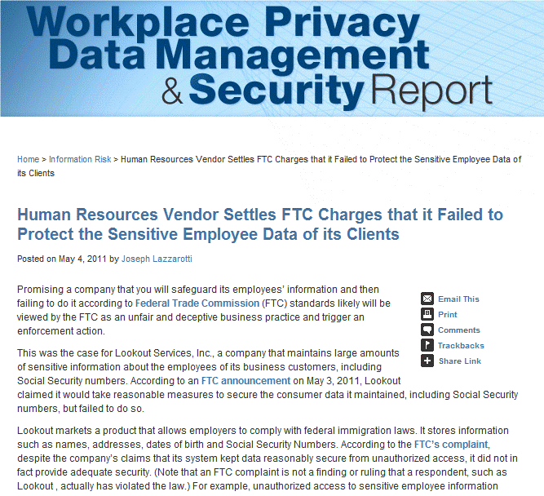
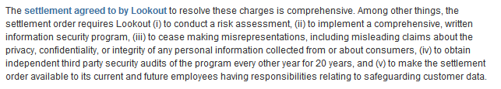
Issue #2 - Evidence

Slide 14

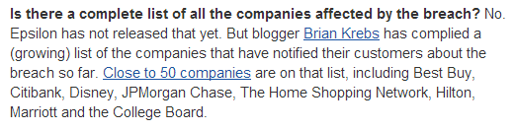
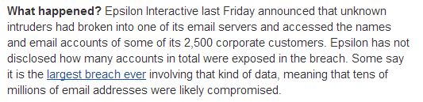
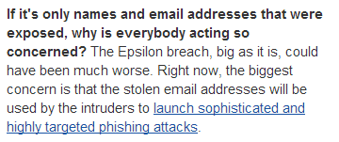
Issue #2 - Evidence

Slide 15
Issue #3 – Ecosystem
The Puzzling Truth about Compliance and Prevention

Slide 16

What is the Information Ecosystem?

Slide 17
Areas of Information
i

Slide 18




Areas of Information Control and Information Practices
Privacy
Security
Shared
iControl
No
iControl
No
iControl
iControl
Shared
iControl
Response
Usage

Slide 19
Information Processes and Flow
A Practice Management Approach to a Process
Lock Up
Log Off
Shred

Slide 20

Balance is KEY
Information Systems (BOT)
Information Flow
Information Compliance
Industry Standards
Case Study
DEFENSIBLE POSITION
More

Slide 21
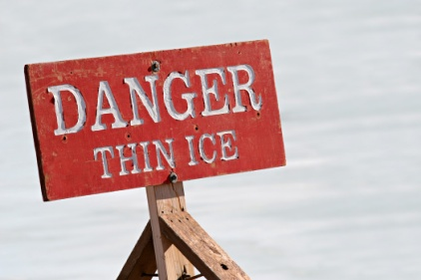
Where to Go From Here
Solid Steps
Establish an Identity Theft Prevention Team
Conduct an Operations-Driven Risk Assessment
Design a Written Identity Theft Prevention Program
Employee Behavior Modification (Training)
Service Provider Oversight
Response Plan for Loss or Breach
Evaluate and Update the Identity Theft Prevention Program
Possible Pitfalls

