Slide 1
Chris@CyberSparta.com
www.cybersparta.com
Neil@Cyberqgroup.com.com
www.cyberqgroup.com

Slide 2
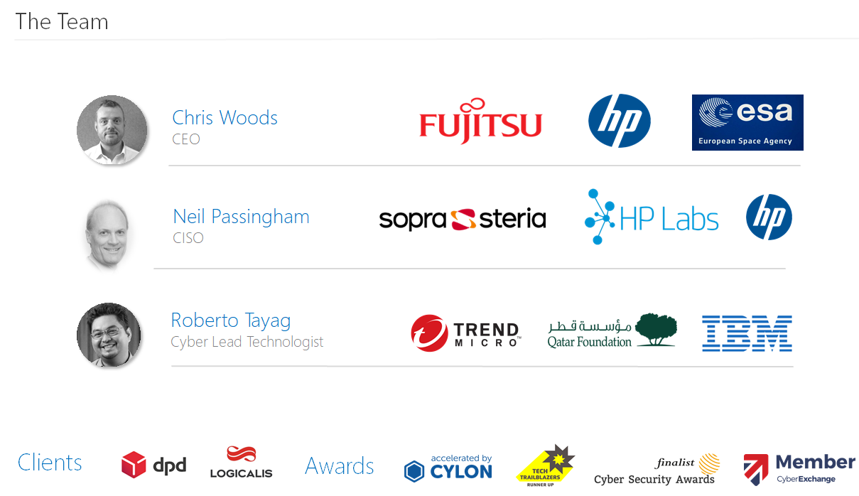

Slide 3
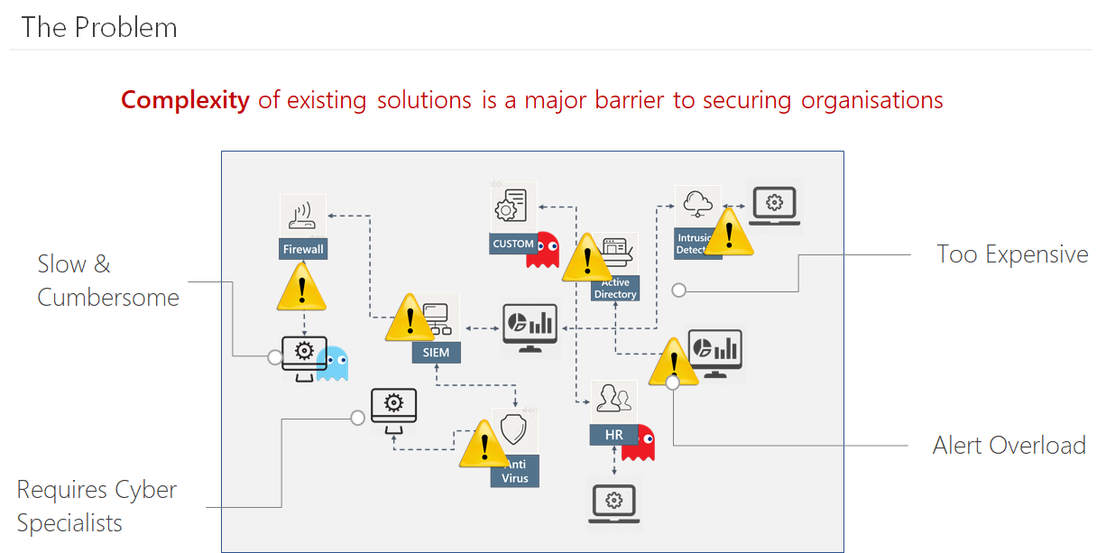
Notes:
146 days – the average time before an organisation discovers it has been internally compromised.
Organisations generate huge volumes of fragmented data. Understanding the security threats within the data is increasingly challenging.
You are only one zero day from being owned. Response and containment is critical

Slide 5
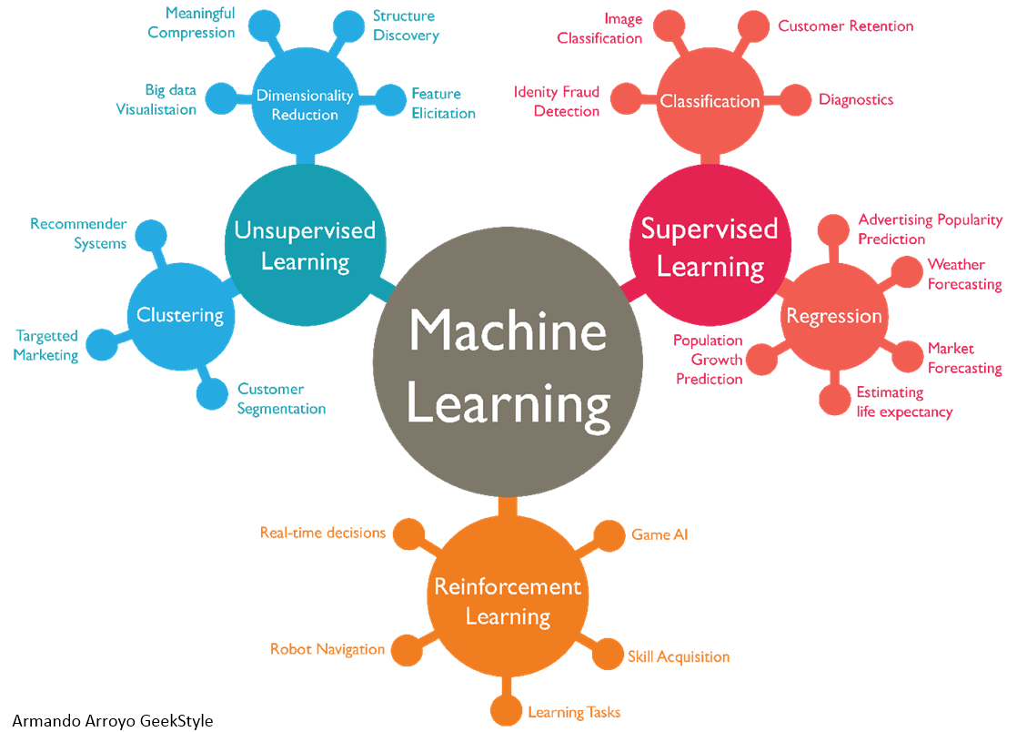
Why AI and ML?
Notes:
Artificial Intelligence is the broader concept of machines being able to carry out tasks in a way that we would consider “smart”.
Machine Learning is a current application of AI based around the idea that we should really just be able to give machines access to data and let them learn for themselves
Machine Learning is a subset of the larger field of Artificial Intelligence. At current levels of maturity, ML is mostly applied statistics.
Most ML algorithms process a set of data and create a matrix of the characteristics.
That matrix of characteristics is called your “model” and it will be used for evaluating
additional data against. The model is the output of training your ML algorithm with data and is what is used to evaluate other data to determine what it is. When you use your ML model in hunting, for instance, you run new data against the model and the results are things that an analyst should then look at closer.
Supervised machine learning uses labeled training data to make predictions about unlabeled data. Given a set of known good and known bad examples, you can create a binary classifier capable of taking in new transactions and deciding if they look more similar to the good training set or the bad training set.
Supervised - you’ll need a set of data separated between the types you are trying to build
your model to recognize.
Unsupervised ML is essentially anomaly detection. Unsupervised ML is extremely
powerful but usually better suited to broader use cases.

Slide 6
What are the key challenges in a SOC context?
Notes:
1.Resources
2.Big picture
3.Event info - structured & unstructured
4.Perspectives
1)Experts, dealing with bigger haystacks [BD4S]
2)Overwhelmed, trade-offs, inter-relationships between fixes [SPECTRE]
3)Top10 – why?
Much useful info is not structured – how to make sense? Risks?
4) Language needs to vary by persona – adaptive vizs?

Slide 7
A1.Resources

Slide 8
A2.The Big Picture

Slide 9
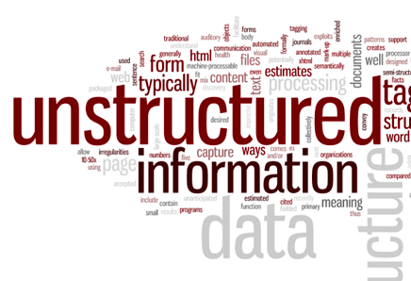
A3.Event/log info
Notes:
naive processing of event data - long term problem of storage of junk data

Slide 10
A4.Perspectives - Visualisations

Slide 11
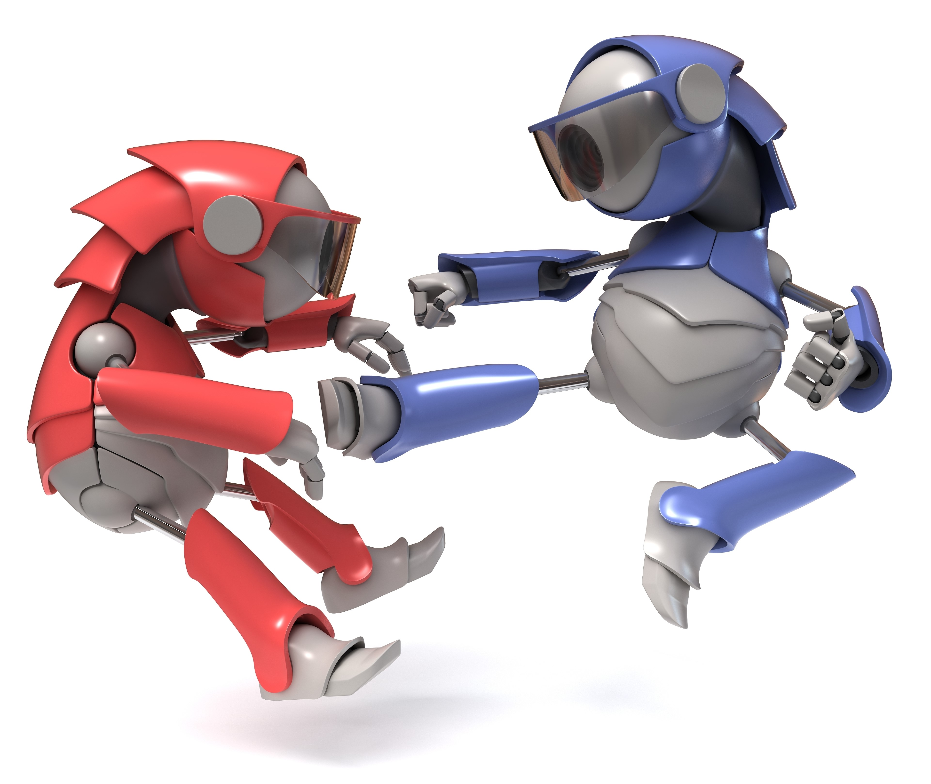
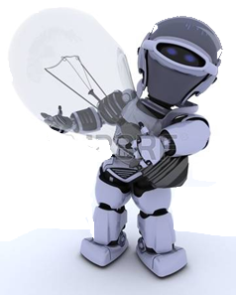
Conversation with AI Persona
I Can Destroy
You
I Will Protect You
Hacker
Defender
I Know My Risks
How Secure Are We?
CISO
CEO

Slide 12
What are opportunities for ML in Security Operations?
Notes:
1.Physical ML
2.Correlation
3.Enrichment
4.Incident Analysis
5.Malware Analysis
6.Anomalies
1)Switch camera example
2)Most common use. Closeness of fit? Degs of certainty? [BD4S]
3)“meta model” approach?
4)Learning from past incidents – trends?
5)Modelling/emulation, AMSEL, injection of symptoms
6)What is normal? Body temp vars?

Slide 13
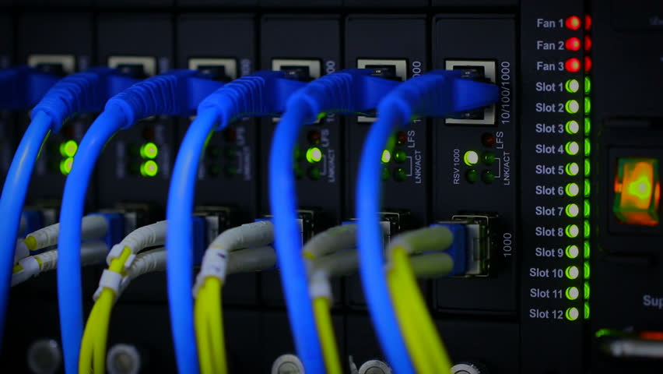
B1. Physical ML
Notes:
Camera vs switch

Slide 14
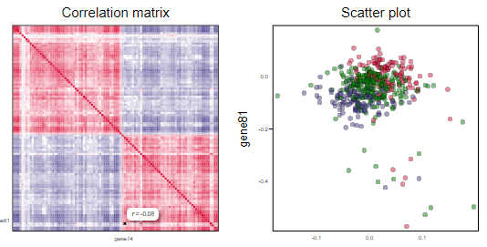
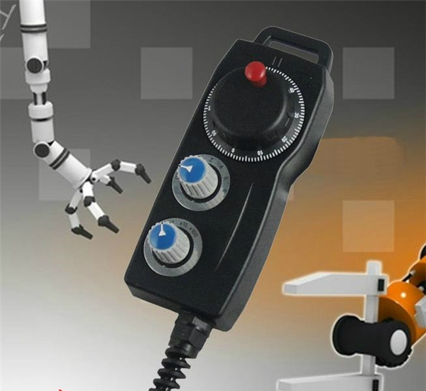
B2. Correlation

Slide 15
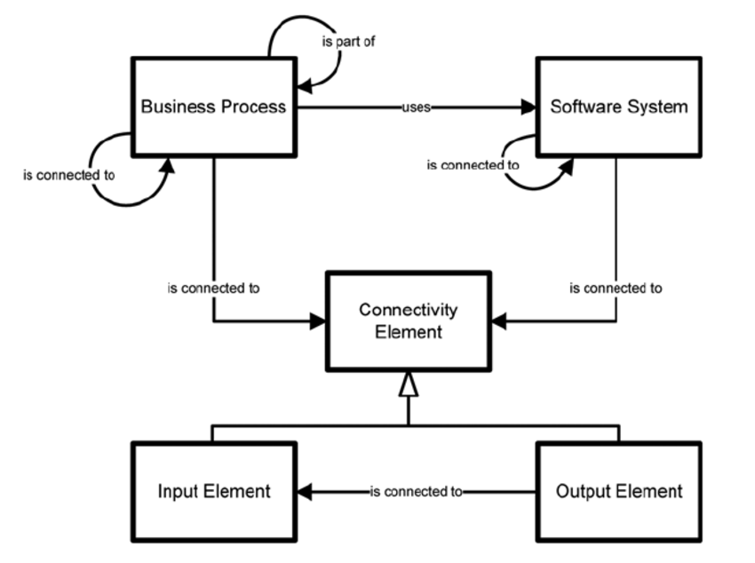
B3. Enrichment

Slide 16
B4. Incident Analysis

Slide 17
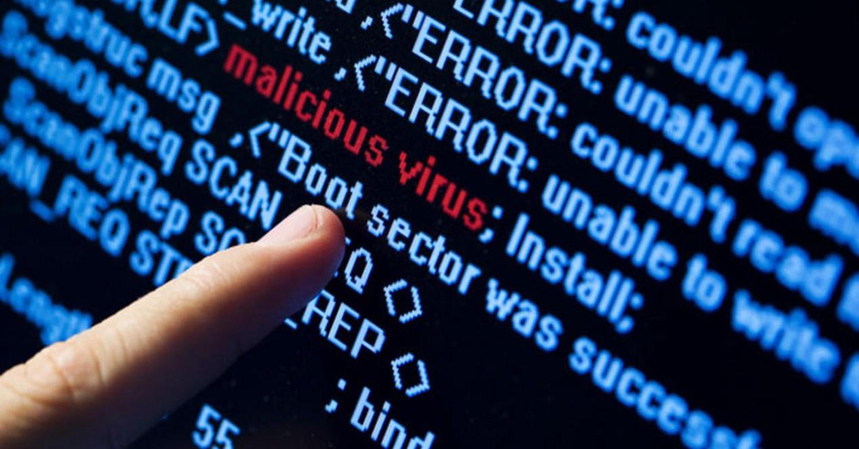
B5. Malware Analysis

Slide 18
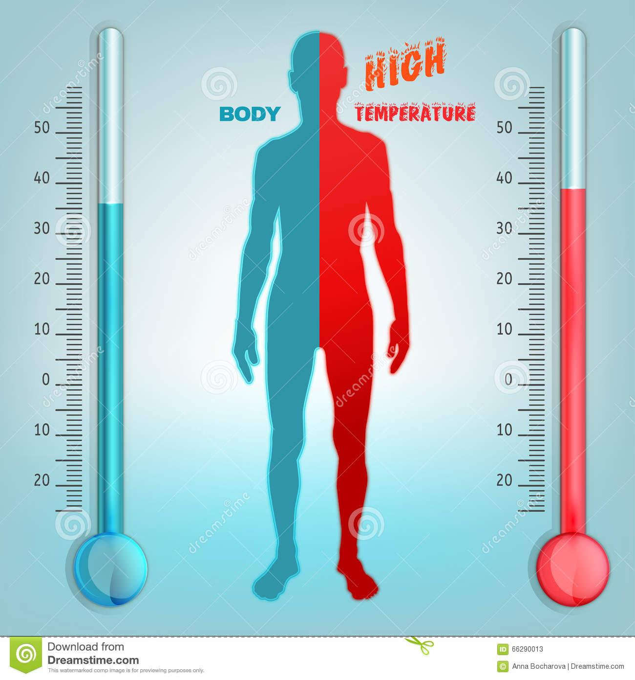
B6. Anomalies
Notes:
Understanding normality - sensitivity analysis cf temp changes

Slide 19
Current innovations – evaluating effectiveness
Notes:
1.Mock attacks
2.UEBA
3.Analyst behaviour
4.Intel Analysis
5.Method Analysis
1)Test envts, injection of malware symptoms
2)UEBA? Economics?
3)What are they good at – and not? Where support needed?
4)What sources of intel/info work best and when?
5)What methods have most success in detection and when?

Slide 20
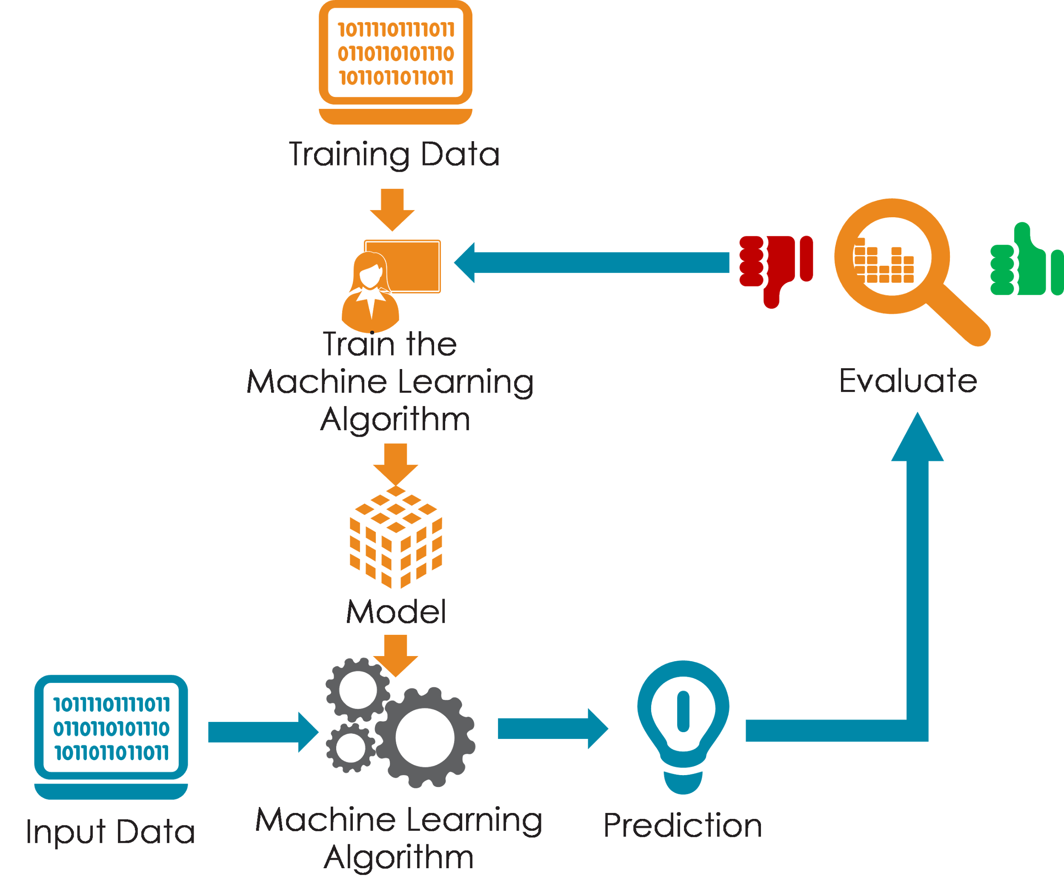
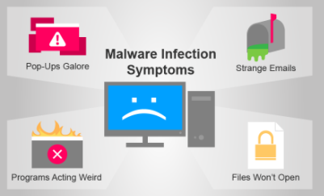
C1. Mock Attacks
Notes:
Computer is running extremely slow (seems like a VIRUS)
Antivirus and firewall protection is unexpectedly disabled
Modifications on the Registry
Unwanted toolbars on your Web Browser
Even if you remove them, they might return each time you restart your computer
Unfamiliar and peculiar error messages
Programs won’t run or files won’t open
Can’t access certain drives on your computer
File sizes

Slide 21
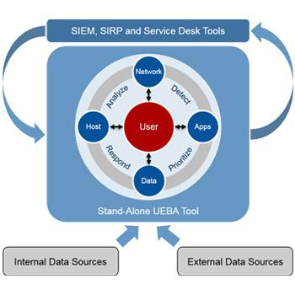
C2. UEBA
Notes:
UEBA detects and stops an insider threats
Account Compromise
Insider threats
Employee monitoring
Identity access management
Privileged account use
Cloud application security

Slide 22
C3. Analyst Behavior Analysis

Slide 23
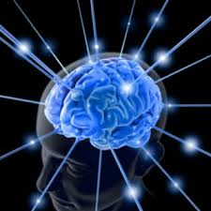
C4. Analysis of intelligence sources

Slide 24
C5. Analysis of Methods

Slide 25
Current innovations – continuous improvement
Notes:
1.Training ML algorithms
2.Resource prioritization
3. Flexible consumption
4. Adaptation
1)Sensitivity analysis etc
2)Switch to most effective resources
3) Use of intel resources e.g. CASBs?
4)AADSS approach

Slide 26
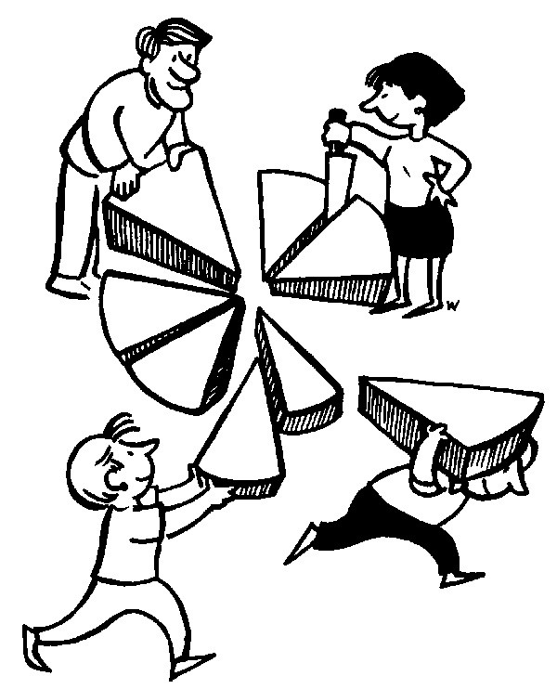
D1. Resource prioritisation

Slide 27
D2. Flexible consumption
Notes:
CASBs etc

Slide 28
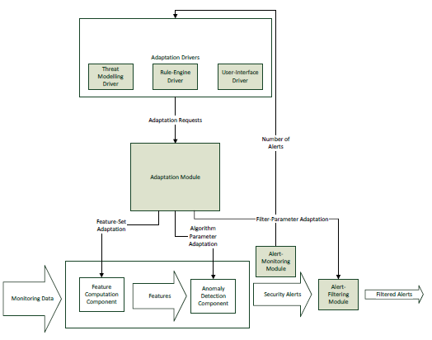
D3. ML Adaptation
Notes:
AADSS

Slide 29
Summary

Slide 30
Notes:
THANKS TO HELPERS !!!!!

