Slide 1
Application Security ISO
Tak Chijiiwa, CISSP, CSSLP
Principal Consultant,
Security Compass
Copyright 2012

Slide 2
Introduction

Slide 3
Speaker Introduction
Tak Chijiiwa has 12+ years of IT security experience
He has been involved in a wide spectrum of information security strategy and advisory engagements for various Fortune 500 clients
Prior to joining Security Compass, he worked at Deloitte & Touche, LLP as a Manager of the Vulnerability Management team in Toronto, Ontario for 6 years and at Kasten Chase Applied Research as a Development Manager in Mississauga, Ontario for 4 years

Slide 4
Abstract

Slide 5
Abstract
ISO/IEC 27034 - Part 1 was published in November 2011 and the remaining parts (Part 2-6) are expected to be published soon
What does this mean to your organization or your clients who wish to adopt or incorporate this ISO standard for their application?
This overview will walk through the sections of standard and highlight the process approach to specifying, designing, developing, testing, implementing and maintaining security functions and controls in application systems

Slide 6
Agenda

Slide 7
Agenda
ISO Series Background
ISO Stages
ISO 27034 Walkthrough
Q&A

Slide 8
ISO Series Background

Slide 9
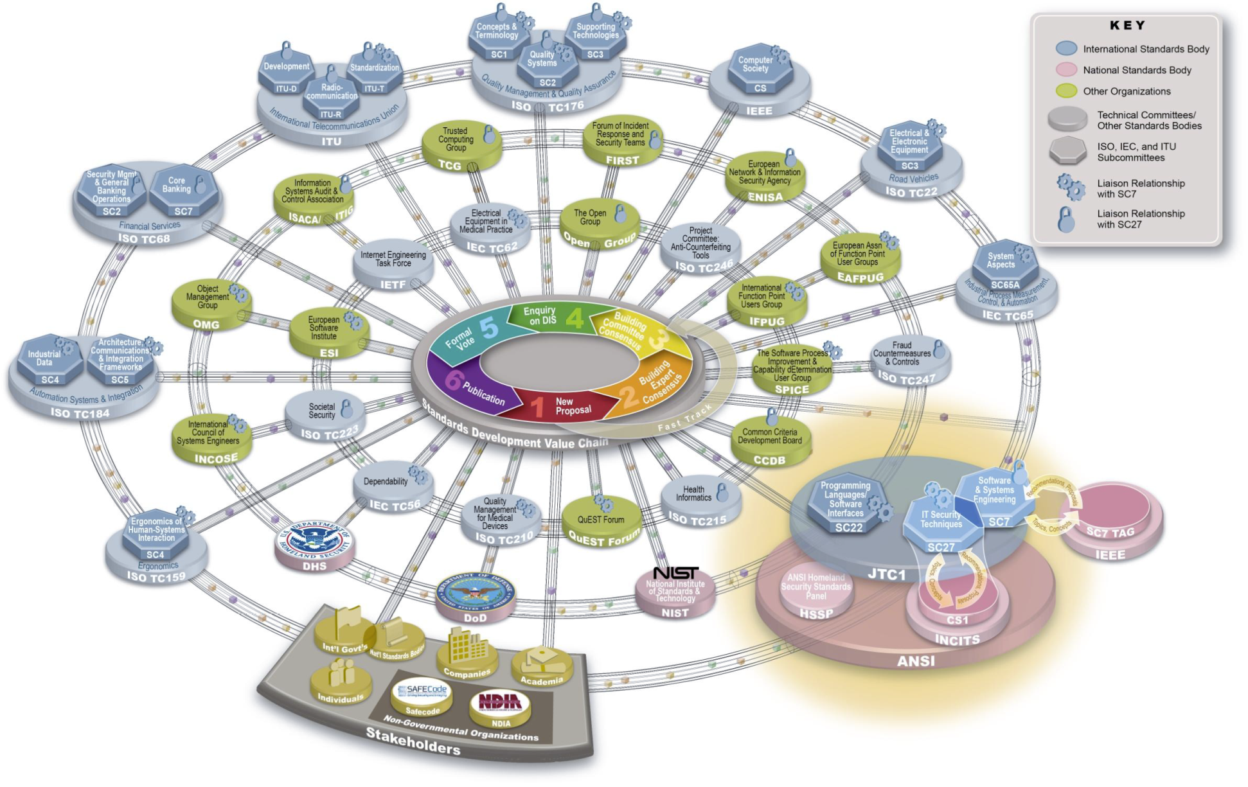
ISO Series Background
Image from: https://buildsecurityin.us-cert.gov/swa/presentations_032011/NadyaBartol-ICTSCRM-ISOStandardsUpdate.pdf

Slide 10
ISO Series Background - continued
Standards are essential for ensuring interoperability within an IT environment
Goal is to incorporate the views of all interested parties from manufacturers, vendors and users to research organizations and governments
ISO 27000 series involves various technical committees, subcommittees, and working groups

Slide 11
ISO Series Background - continued
International Organization for Standardization (ISO)
Non-governmental consensus-building network of the national standards institutes of 156 countries
Do NOT represent governments but closely works with both governments and industries

Slide 12
ISO Series Background - continued
International Electrotechnical Commission (IEC)
Develops international standards for government, business and society for all electrical, electronic and related technologies
These standards are relied upon for international commercial contracts and agreements

Slide 13
ISO Series Background - continued
Joint Technical Committee 1/Sub-committee 27
Draft International Standards from joint technical committees from around the world
Requires approval by at least 75% of the national bodies to publish as an International Standard
Secretariat is Deutschen Institut für Normung (DIN) in Germany

Slide 14
ISO Series Background - continued
Within JCT 1/SC 27, there are 5 working groups which further focuses on the elements of IT Security
Each working group (WG) has been assigned a national secretariat
ISO/IEC JTC 1/SC 27 Secretariat: Deutsches Institut für Normung (DIN)
WG 1
Information Security Management Systems
Secretariat: British Standards Institution (or BSI)
WG 2
Cryptography and security mechanisms Secretariat: Japanese Industrial Standards Committee (JISC)
WG 3 Security evaluation criteria
Secretariat: Swedish Standards Institute (SIS)
WG 5
Identity management and privacy technologies
Secretariat: Deutsches Institut für Normung (DIN)
WG 4
Security controls and services
Secretariat: Standards, Productivity and Innovation Board (SPRING Singapore)

Slide 15
ISO Series Background - continued
Objectives of Working Group 4 – Security Controls and Services
Unknown or emerging information security threats
Objective #1:
a. Prepare to respond
b. Ensure continuous monitoring
c. Reduce risk through identifying and understanding information security threats
Known or common information security threats
Objective #2:
a. Manage risks to the environment
b. Prevent occurrence (likelihood)
c. Reduce impact from occurrence
Information security incidents
Objective #3:
a. Investigate incident and collect facts
b. Identify who, what, where, why and how
c. Learn from incident

Slide 16
ISO Series Background - continued
Current published standards and projects in progress (review or draft)
Unknown or emerging information security threats
1. ISO/IEC 27031:2011 (Business Continuity)
2. ISO/IEC FDIS 27032 (Cybersecurity)
3. ISO/IEC 27035:2011 (Incident Management)
4. ISO/IEC WD 27039 (IDS) 5. ISO/IEC 24762:2008 (Disaster Recovery)
Known or common information security threats
1. ISO/IEC 27033 (Network Security)
2. ISO/IEC 27034
(Application Security)
3. ISO/IEC 27036 (Supplier Relationships)
4. ISO/IEC 27038 (Digital Redaction)
5. ISO/IEC 27040
(Storage Security)
Information security incidents
1. ISO/IEC 27037 (Guidelines for identification, collection, acquisition and preservation of digital evidence)

Slide 17
ISO Stages

Slide 18
ISO Stages
There are various defined stages and sub-stages during the development of International Standards
Other definitions include:
NP = New Work Item Proposal
WD = Working draft

Slide 19
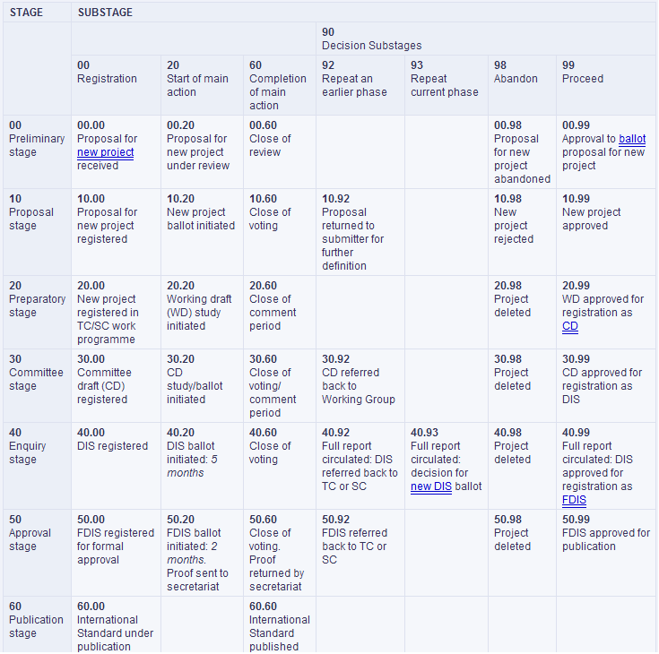
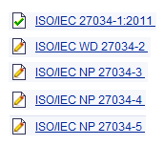
ISO Stages - continued

Slide 20
ISO 27034 Walkthrough

Slide 21
ISO 27034 Walkthrough
Part 1: Overview & concepts
Part 2: Organization normative framework
Part 3: Application security management process
Part 4: Application security validation
Part 5: Protocols and application security controls data structure
Part 6: Security guidance for specific applications (if needed)

Slide 22
Overview
Provides guidance for organizations in integrating security into the processes used for managing their applications
Explicitly takes a process approach to specifying, designing, developing, testing, implementing and maintaining security functions and controls in application systems
Defines application security not as a state of security but as “a process an organization can perform for applying controls and measurements to its applications in order the manage the risk of using them”

Slide 23
Overview - continued
ISO/IEC 27034 is not:
Development standard for software applications
Application project management standard
Software Development Lifecycle (SDLC) standard
ISO/IEC 27034 does not:
Provide guidelines for physical and network security
Provide controls or measurements (metrics)
Provide secure coding strategies for any programming language

Slide 24
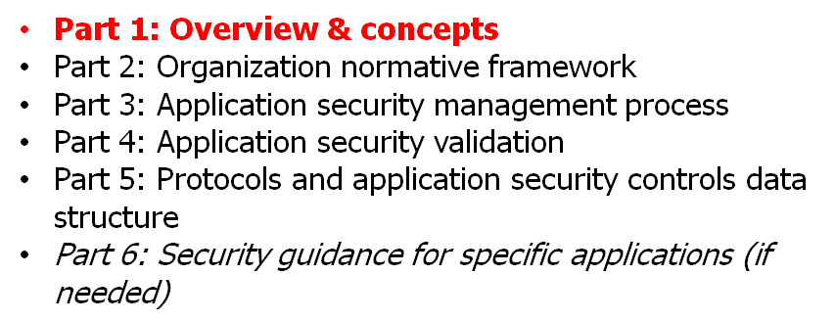
Part 1
ISO/IEC 27034-1:2011 – Overview & concepts
Published November 21, 2011
Provides and overview of application security
Introduces definitions, concepts, principles and processes involved in application security
Designed to be used in conjunction with other standards in the ISO27000 family

Slide 25
Part 1 - continued
Applicable to applications:
developed (in-house)
acquired from third parties
where development or operation is outsourced
The intended use and benefits are highlighted below:
Roles | Responsibility | Benefit
Managers | Manage the cost of implementing and maintaining application security | Leverage ISO/IEC 27034 processes to prove that the application has attained and maintained a targeted level of trust
Developers | Understand what security should be applied at each phase of the application life cycle | Leverage ISO/IEC 27034 processes to identify control points and safety functions to be implemented
Auditors | Verify controls to prove the application has reached the required level of trust | Leverage ISO/IEC 27034 processes to standardize the application security certification
End users | N/A | Assurance that it is deemed secure to use the application

Slide 26
Part 1 - continued
Key principles defined for this standard include:
“Security is a requirement”
Requirements should be defined and analyzed for each and every stage of the application's life cycle and managed on a continuous basis.
“Application security is context-dependent”
The type and scope of application security requirements are influenced by the risks associated with the application which come in the form of (1) business; (2) regulatory; and (3) technological.
“Appropriate investment for application security”
Costs for applying Application Security Controls and performing audit measurements should align with the Targeted Level of Trust.
“Application security should be demonstrated”
Auditing process leverage the verifiable evidence provided by Application Security Controls to confirm if it has reached management’s Targeted Level of Trust.

Slide 27
Part 1 - continued
“Target application level of trust” definition:
Confidence level required by the organization using the application
Defined when establishing the Organization Normative Framework (ONF)
Application Risk Analysis
Risk Management Process
Target Application Level of Trust

Slide 28
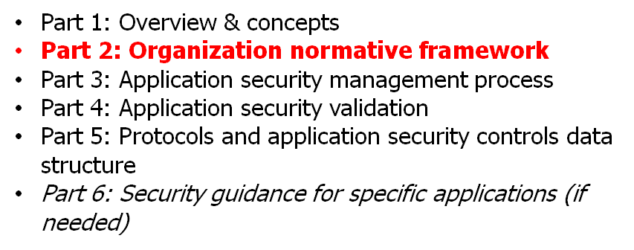
Part 2
ISO/IEC WD 27034-2 – Organization normative framework
Standards under development
Describes the relationships and interdependencies between processes in the Organization Normative Framework (ONF)
Processes include creating, maintaining and adapting it to the organization’s needs and contexts (e.g. business, regulatory, technological)

Slide 29
Part 2 - continued
Describes how to implement an Application Security Management Process (ASMP) for an organization
1. Establish an Organizational Normative Framework (ONF)
It will contain regulations, laws, best practices, roles & responsibilities accepted by the organization.
2. Application Security Risk Management (ASRM)
Obtain the organization’s approval on a target level of trust through specific application-oriented risk analysis.
3. Application Normative Framework (ANF)
Identify the relevant elements from the ONF which are applicable to the target business project.
5. Application Security Verification
Verify and provide evidence that an application has reached and maintained the targeted level of trust.
4. Business Application Project
Implement the security activities contained in the ANF.

Slide 30
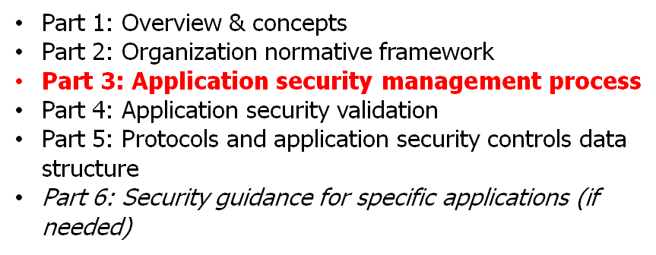
Part 3
ISO/IEC NP 27034-3 – Application security management process
Standards under development
Considered to be widely applicable and useful to organizations dealing with application security
Describes information security relevant processes within an application development project
Attempts to highlight process relationships and interdependencies

Slide 31
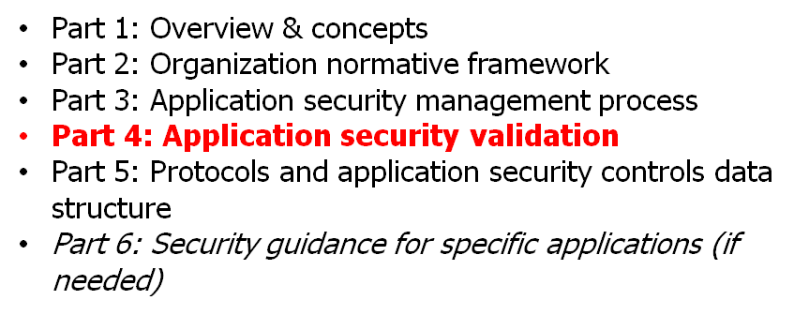
Part 4
ISO/IEC NP 27034-4 – Application security validation
Standards under development
Describes application security certification and validation processes
Methods for assessing and comparing the Level of Trust against information security requirements

Slide 32
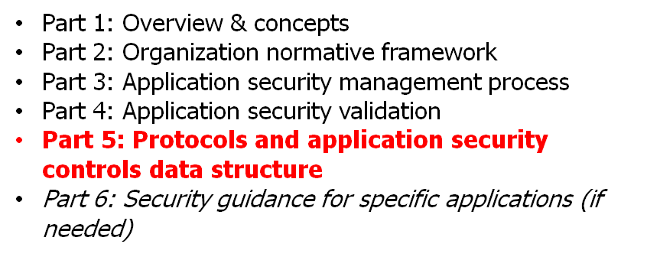
Part 5
ISO/IEC NP 27034-5 – Protocols and application security controls data structure
Standards under development (preliminary text released recently ~April 2012)
Defines the Application Security Control (ASC) data structure
Electronic business eXtensible Markup Language (ebXML) designated as the format to establish libraries of reusable security functions that may be shared both within and between organizations

Slide 33
Part 5 - continued
An Application Security Control (ASC) may satisfy various aspects of information security
ASCs
Target level of Trust
Verification method
Security Requirements
Security activity

Slide 34
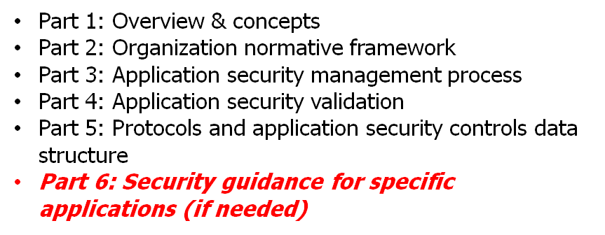
Part 6
ISO/IEC NP 27034-6 – Security guidance for specific applications (if needed)
Standards under development and may be considered for inclusion
Identifies Application Security Controls corresponding to “specific application security requirements” (if applicable)
For example:
N-Tier and web applications security
Client/Server applications security

Slide 35
Considerations
The requirements and processes specified in ISO/IEC 27034 are not intended to be implemented in isolation but rather integrated into an organization's existing processes
Annex A of ISO/IEC 27034-1 presents a case study on how to map an existing software development process to some of the components of ISO/IEC 27034 (to reduce overall effort to conform with this standard)

Slide 36
Q&A

Slide 37
Thank you!
tak@securitycompass.com
Security Compass
Please let me know your comments and thoughts!

