Slide 1
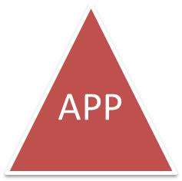
Don’t Judge an by its
ICON
Jeff Williams
Aspect Security CEO
OWASP Chair
jeff.williams@aspectsecurity.com
twitter @planetlevel
Notes:
Key Messages
I’ve witnessed the transformative power of visibility
Nutrition facts labels have transformed the food market
Companies will voluntarily use labels that help them market their product
Mandatory labels add ____
Internal Use of Labels!
Liability?
Certification?
Maturity Models?

Slide 2
iPhone
Android
tinyURL
installer

Slide 3
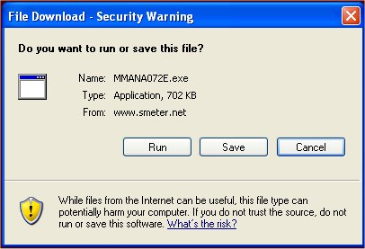
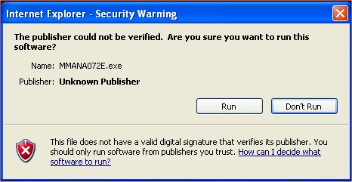

Slide 4
http://tinyurl.com/y6ddmqu

Slide 5
Notes:
Akerlof.
A SecurityFacts label helps to solve this information assymmetry.

Slide 6
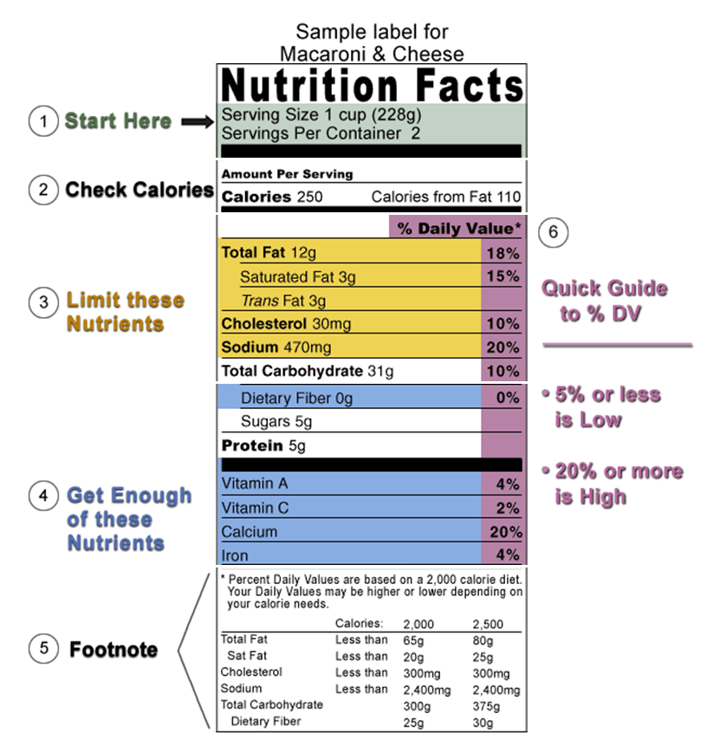
Notes:
Nutrition Facts
1906 - Food “misbranding” legislation goes back to 1906 era – just after Coca Cola removed cocaine from their product.
more legislation Upton Sinclair’s “The Jungle”.
1950 – the first mandatory labeling regime was created for Margarine.
1958 -- you had to declare all additives.
1990 – Nutrition Labeling and Education Act (NLEA) passed. Basically today’s Nutrition Facts label
1990’s -- Several updates including trans fat
Government sponsored MANDATORY label with lots of detail – it leverages other standards (US RDA)

Slide 7
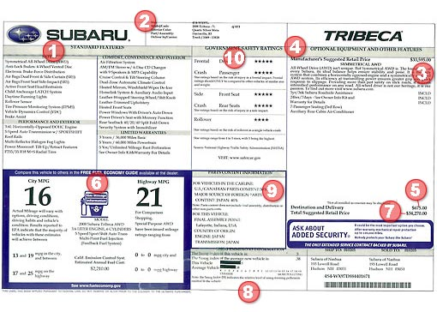
Notes:
Car labels
1958 - The Monroney sticker — as it is called in the auto industry — is named for the late Almer Stillwell "Mike" Monroney, a senator from Oklahoma who sponsored the federal Automobile Information Disclosure Act in 1958. This statute requires that a sticker be affixed to the side window or windshield of every new car sold in the United States. While the law does not specifically mandate Monroney stickers for some trucks, automakers affix them across their entire vehicle lineups. Failure to display one can result in a fine of $10,000 per vehicle to the dealership.
Mandatory government label with lots of detail (leverages EPA and NHTSA standards)
“The dealer who is honest about the so-called ‘list price’ cannot compete with the one who ‘packs’ several hundred dollars extra into it so he can pretend to give you more on your trade-in,” Monroney said when the bill was introduced in March 1958
“He believed in getting information out,”
The sticker must include the following information:
The manufacturer's suggested retail price (MSRP)
Engine and transmission specifications
Standard equipment and warranty details
Optional equipment and pricing
City and highway fuel economy ratings, as determined by the Environmental Protection Agency (EPA)
As of September 2007, crash test ratings as determined by the National Highway Traffic Safety Administration

Slide 8
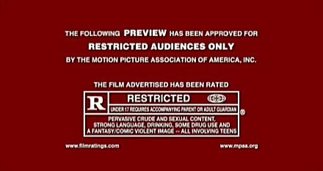
Notes:
1930 – the “Hays Code”
1968 - the voluntary MPAA file rating system was established with three groups to monitor. There were some changes over the years – most importantly adding PG-13. Many have accused the standards of slipping.
GOAL: Movie ratings do not determine whether a film is "good" or "bad." They simply provide basic information to parents about the level of various elements in the film, such as sex, violence and language so that parents can decide what their children can and cannot see.
Voluntary Closed standard, very simple
It’s private, non-standard, completely closed, anonymous, not the law
It’s totally voluntary – however all the major studios have agreed to submit all their movies.
No specific guidelines, just factors like …
“The MPAA does not release specific guidelines as to what content will receive which rating. However, they do state that many factors are considered including content such as sex, violence, nudity, language, adult topics and drug use.”

Slide 9
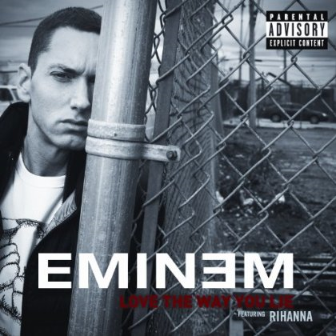
Notes:
1985 - Albums began to be labeled for "explicit lyrics" in 1985, after pressure from the Parents Music Resource Center (PMRC).
2000, the PMRC worked with the RIAA to standardize the label, creating the now-familiar black and white design. Tweaked fonts and wording as late as 2001.
MANDATE: Voluntary, No agreed on standards, very simple
In some cases, the stickers appear to have had the reverse effect to what was intended—the sticker can make an album more desirable, and the sticker has been called the musical equivalent of an "alcohol content" label. Indeed, the PAL notice itself has achieved a degree of cult status, with comedian George Carlin entitling an album Parental Advisory: Explicit Lyrics and numerous t-shirts^{[1]}, metal signs, and other paraphernalia bearing the logo.
It is not a rating; there are no agreed-upon standards for a parental advisory label. It is the record company's decision whether an album needs one or not.

Slide 10
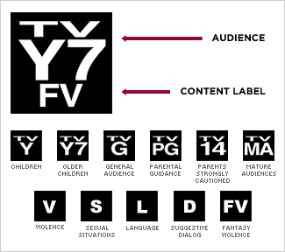
Notes:
1997 the broadcasting industry created the TV Parental Guidelines to forestall regulation. The TV Parental Guidelines Monitoring Board is responsible for ensuring there is as much uniformity and consistency in applying the Parental Guidelines as possible and is comprised of experts from the television industry and public interest advocates.
Voluntary (gov’t influenced) closed standard, very simple label
The rating system, TV Parental Guidelines, was established in 1997 by the National Association of Broadcasters, the National Cable Television Association, and the Motion Picture Association of America. Modeled after the rating system used for movies, the TV rating system focuses on age recommendations.
TIED into a technical control!! The V-Chip. The V-chip is a technology that lets parents block television programming they don't want their children to watch. The V-Chip electronically reads television-programming ratings and allows parents to block programs they believe are unsuitable for their children. (Ratings appear in the corner of your television screen during the first 15 seconds of a program and in TV programming guides). This rating is encoded into the program, and the V-chip technology reads the encoded information and blocks shows accordingly. Using the remote control, parents can program the V-chip to block certain shows based on their ratings.
Imagine a software security control that prevents my mom from using any software that isn’t really secure.

Slide 11
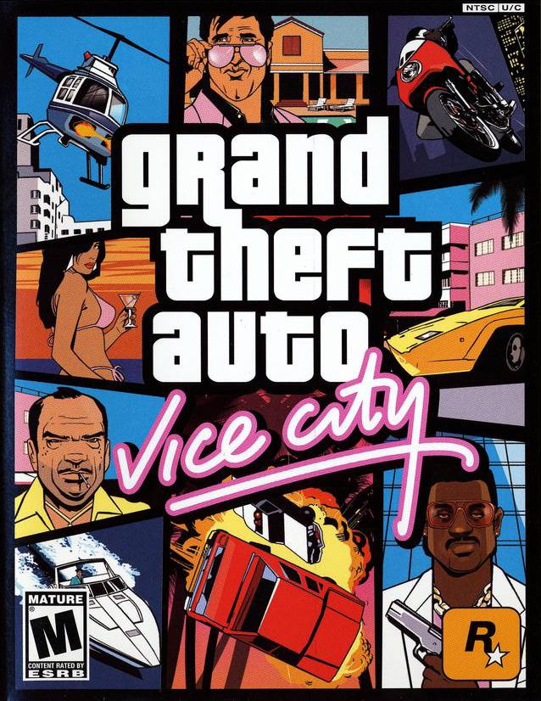
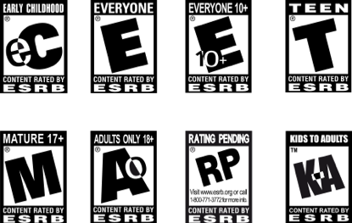
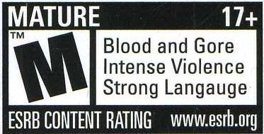
Notes:
When games moved from 8 bit to 16 bit the violence got a LOT more realistic.
1994 formed after 2 years of Congressional hearings on video game violence – to forestall legislation.
Voluntary standard (gov’t influenced) enforced by ESRB – very simple label
Entertainment Safety Ratings Board (ESRB) – Self regulatory organization (SRO) – no legal authority required
Aim is to guide consumers in determining a games suitability
Strictly voluntary, but virtually universal

Slide 12
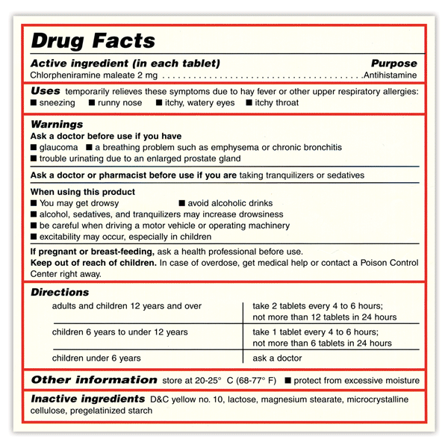
Notes:
Project started took 14 years before finishing in 1999. Now it applies to over 100,000 products.
Summary for the safe and effective use of the drug
Informative and accurate
Not promotional, false, or misleading
No implied claims or suggestions for use if evidence of safety or effective is lacking
Based whenever possible on data derived from human experience
Mandatory Govt Label – complex information
Not for patients! Primary purpose is to give healthcare professionals the information they need to prescribe drugs appropriately
The Food and Drug Administration (FDA) requires that drug labeling be balanced and not misleading. The label must be scientifically accurate and provide clear instruction to health care practitioners for prescription drugs and to consumers for over-the-counter drugs and supplements. Labeling regulations require that the statement of ingredients must include all ingredients, in the order in which they are used in the drug. These ingredients must also be identified by their established name.

Slide 13
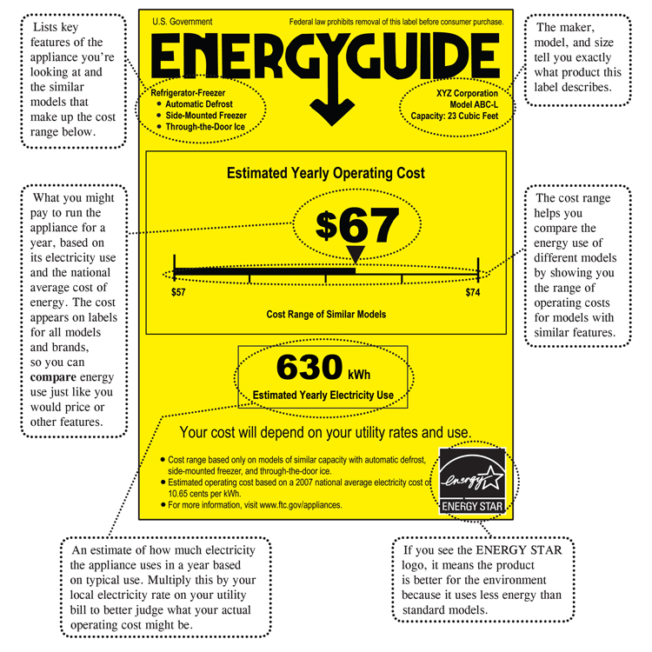
Notes:
FTC – weird… FTC doesn’t set environmental policy or standards
Mandatory govt label, open standard, pretty simple
Goal: To help consumers
Depends on EPA EnergyStar requirements, DOE Energy Test Procedures
1980 – Some appliances required to use sticker
2007 – New EnergyGuide label design after 2 years of rulemaking, focus groups, interviews, lots of alternative designs

Slide 14
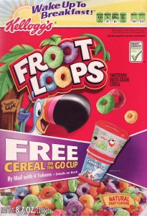
Notes:
2003 The FDA announced industry can now rely on “Some scientific evidence” or “Very limited and preliminary scientific research” to make a health claim. Opponents criticize it as opening the door to ill-founded claims. Advocates believe it will make more information available to the public.
Voluntary Industry label, open standard, simple label
2004 starts a stream of companies who are ADVERTISING nutrition – Pepsi, Kraft, Hannaford Supermarkets, Kellogs, Mars.
2008 – “Smart Choices” - pan-industry for front of package consumer information – General Mills, Con-Agra, Coca-Cola, PepsiCo, and Unilever launched in 2009. Froot Loops becomes the poster child for industry led rating systems.
“These are horrible choices,” said Walter C. Willett, chairman of the nutrition department of the Harvard School of Public Health.
He said the criteria used by the Smart Choices Program were seriously flawed, allowing less healthy products, like sweet cereals and heavily salted packaged meals, to win its seal of approval. “It’s a blatant failure of this system and it makes it, I’m afraid, not credible,” Mr. Willett said

Slide 15
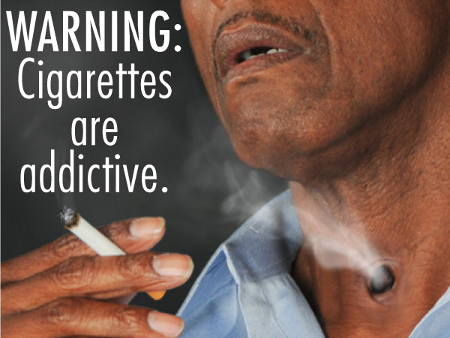
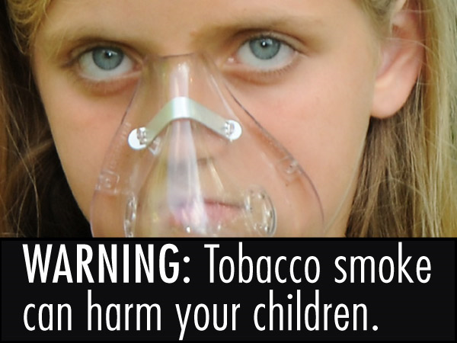
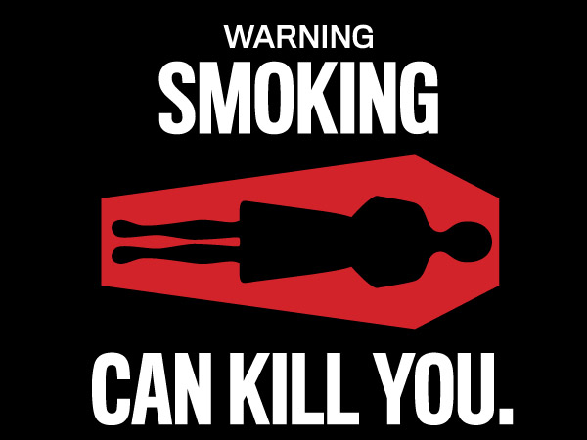
Notes:
Cigarettes
1966 - Caution: Cigarette Smoking May be Hazardous to Your Health (1966–1970)
1970 – 1985 Warning: The Surgeon General Has Determined that Cigarette Smoking is Dangerous to Your Health (1970–1985)
SURGEON GENERAL'S WARNING: Smoking Causes Lung Cancer, Heart Disease, Emphysema, And May Complicate Pregnancy. (1985-)
SURGEON GENERAL'S WARNING: Quitting Smoking Now Greatly Reduces Serious Risks to Your Health. (1985-)
SURGEON GENERAL'S WARNING: Smoking By Pregnant Women May Result in Fetal Injury, Premature Birth, And Low Birth Weight. (1985-)
SURGEON GENERAL'S WARNING: Cigarette Smoke Contains Carbon Monoxide. (1985-)
Though the United States started the trend of labeling cigarette packages with health warnings, today the country has one of the smallest, least prominent warnings placed on their packages.^{[18]} Warnings are usually in small typeface placed along one of the sides of the cigarette packs with colors and fonts that closely resemble the rest of the package, so the warnings essentially are integrated and do not stand out with the rest of the cigarette package.
However, this is subject to change as the Family Smoking Prevention and Tobacco Control Act of 2009 requires color graphics with supplemental text that depicts the negative consequences of smoking to cover 50 percent of the front and rear of each pack. The U.S. Food and Drug Administration will design the health warnings in 2011, and tobacco companies will begin to include them on their cigarette packaging and advertisements in 2012. One alternative many consumers are recommending is detachable graphic warning labels taped to the front of the pack or warning labels printed onto the plastic wrapping itself, so that the message still legally gets across, while people can choose to take it off when they purchase it.

Slide 16
 | BACKER | STANDARD | DETAIL | ENFORCED
Nutrition Facts | Gov’t | Open | Complex* | Mandatory
New Car Labels | Gov’t | Open | Complex* | Mandatory
Movie Ratings | Private | Closed | Simple | Voluntary
Music Labels | Private | Closed | Simple | Voluntary
Television Programs | Private | Closed | Simple | Mandatory
Video Games | Private | Closed | Simple | Voluntary
Drug Facts | Gov’t | Open | Complex* | Mandatory
Energy Guide | Gov’t | Open | Simple* | Mandatory
Smart Choices | Private | Open | Simple* | Voluntary
Smoking | Gov’t | Open | Terrifying | Mandatory
* Leverages significant other standards
Notes:
Every combination of
Gov’t vs. Private
Open vs. Closed
Simple vs. Complex
Mandatory vs. Voluntary

Slide 17
USDA - “The Economics of Food Labeling”
Voluntary labels – for promotion
Mandatory labels – fill information gaps
Mandatory labeling may initially have a larger impact on manufacturers’ production decisions than on consumers’ choices.

Slide 18
Security
Label
…
…
…
Software Producers
Software Consumers

Slide 19
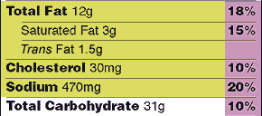
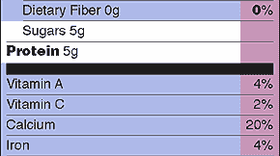
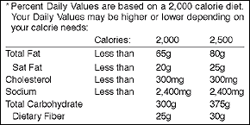
Software Facts
Expected Number of Users 15
Typical Roles per Instance 4
Modules 155 Modules from Libraries 120
% Vulnerability*
Cross Site Scripting 22
65%
Reflected 12
Stored 10
SQL Injection 2
Buffer Overflow 5
95%
Total Security Mechanisms 3
Modularity .035
Cyclomatic Complexity 323
Encryption 3
Authentication 15
Access Control 3
Input Validation 233
Logging 33
* % Vulnerability values are based on typical use scenarios for this product. Your Vulnerability Values may be higher or lower depending on your software security needs:
Ingredients: Sun Java 1.5 runtime, Sun J2EE 1.2.2, Jakarta log4j 1.5, Jakarta Commons 2.1, Jakarta Struts 2.0, Harold XOM 1.1rc4, Hunter JDOMv1
Usage Intranet Internet
Cross Site Scripting Less Than 10 5
Reflected Less Than 10 5
Stored Less Than 10 5
SQL Injection Less Than 20 2
Buffer Overflow Less Than 20 2
Security Mechanisms 10 14
Encryption 3 15
Notes:
2002

Slide 20
Hook: Starts Automatically
Dial: Places a Call
Modify: Alters OS
Monitors you when not active program
Displays Pop-Ups
Remote Control
Self-Updates
Stuck: Cannot be Uninstalled
Notes:
2003 - Garfield Simpson labels as part of Pure Software Act

Slide 21
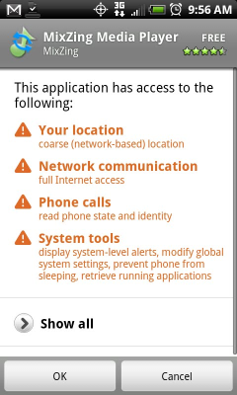

Slide 23
OWASP
Security Program
OWASP
Security Program
OPEN
SHARED
OWASP
Security Program
OWASP
Insecurity Program
PRIVATE
“TRUST US”
Notes:
Testing and Disclosure policy labels…
OWASP Open Security Program – Fully open code review and open testing + full disclosure
OWASP Shared Security Program – Open testing + responsible disclosure
OWASP Private Security Program – Staged Testing + private disclosure
OWASP “Trust Us” Insecurity Program – No testing + no disclosure

Slide 24
OWASP OpenSAMM
OWASP T10
http://www.aspectsecurity.com/SecurityFacts/

Slide 25
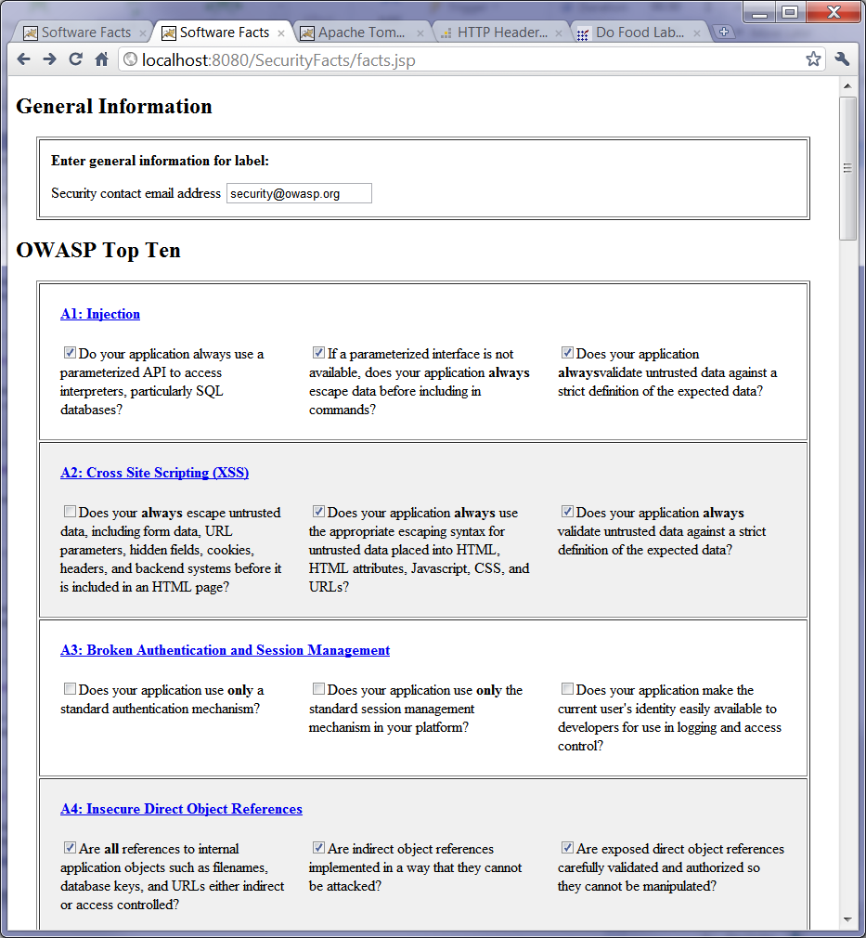
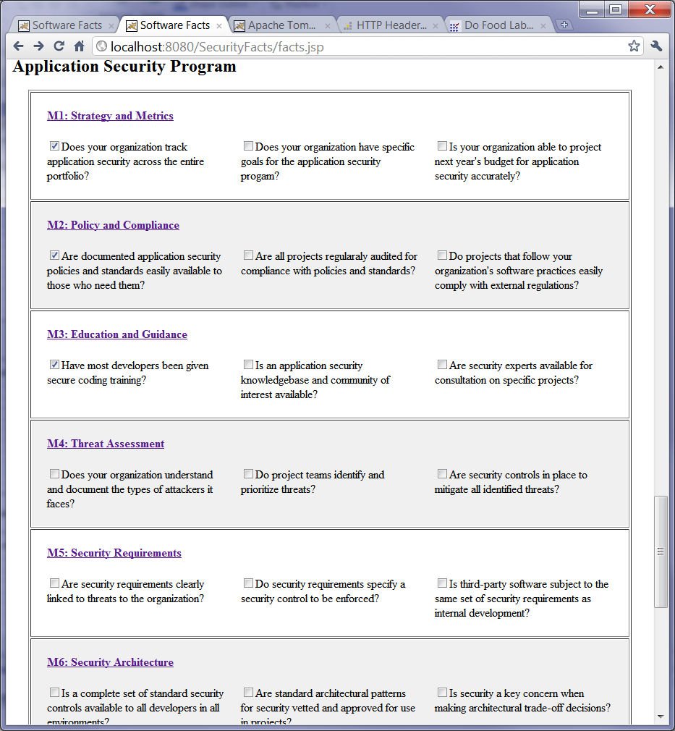
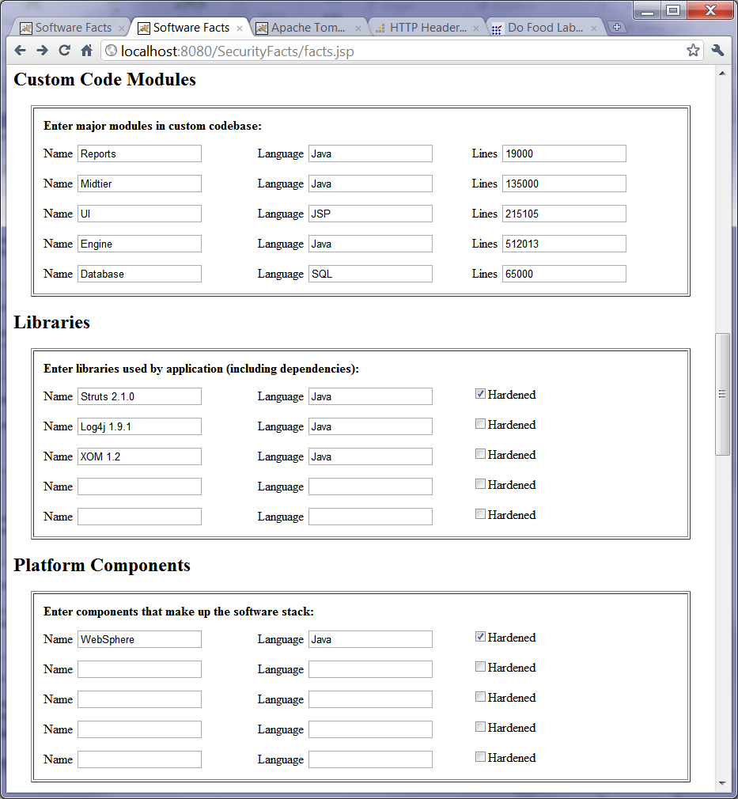

Slide 26
“Security in Sunshine”
Architects
Research
Create Security
Architecture
Define Security
Requirements
Developers
Monitor
Threat
Implement
Controls
AppSec Visibility
Cycle
Users
Infosec
Understand Stakeholders
Share
Findings
Business
Understand
Laws
Verify Compliance
Audit
Legal
Notes:
The first thing we have to do is create visibility. Once we’ve captured what we know, people can start to poke holes in it. Which will encourage others to think up solutions.
If you are working on a software project, what can you do to make security visible? Do you have a clear threat model and security architecture? Do you have coding patterns for using security controls?
Unless we make security concrete and visible, we won’t be able to make improvements and everything we do will be forgotten when the next new thing comes along.
Security ecosystems can’t evolve without sunshine.

Slide 27
Jeff Williams Aspect Security CEO OWASP Foundation Chair
jeff.williams@owasp.org http://www.owasp.org
twitter @planetlevel

