Slide 1
Man in the Cloud Attacks
Sagie Dulce, Amichai Shulman
August 5th, 2015

Slide 2
A Little Bit About Us
Amichai Shulman
CTO and Co-Founder of Imperva
>20 Years Information Security Experience
>25 Years Information Technology Experience
Sagie Dulce
Research Team Leader in Imperva
>10 Years Information Security Experience

Slide 3
Agenda
Motivation
What’s wrong with current botnets
Why cloud file synchronization services
Why use passwords when you can pass the token
MITC Attacks
Concept & details
Demo
Resilience of MITC attacks
How hard is it to detect and mitigate
Conclusions & Mitigation

Slide 4
Motivation (I)
1
What’s wrong with current botnets?

Slide 5
Infection Chain Vs. Kill Chain
Some things you allegedly need for a botnet
0-day exploit
Injection code
Malware persistence
Communication channel and protocol
C&C and Drop server infrastructure with your own code
Some things security solutions claim to do
Detect malicious code
Detect malicious code behavior
Identify malicious persistent code
Detect malicious communication channels
Detect unusual communication channels
Detect communication with bad servers
Take down malicious servers

Slide 6
The Holy Grail of Attackers
Don’t use complex exploits
Don’t need to install malicious software
Don’t need to build C&C infrastructure
Don’t use shady network protocols for exfiltration
Rely on existing software
Use standard communication channels
Rely on existing infrastructure for C&C and data collection

Slide 7
Motivation (II)
2
Why Use Cloud File Synchronization Services

Slide 8
Because It’s Cool

Slide 9
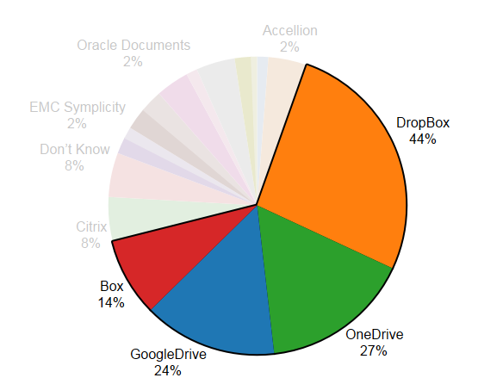
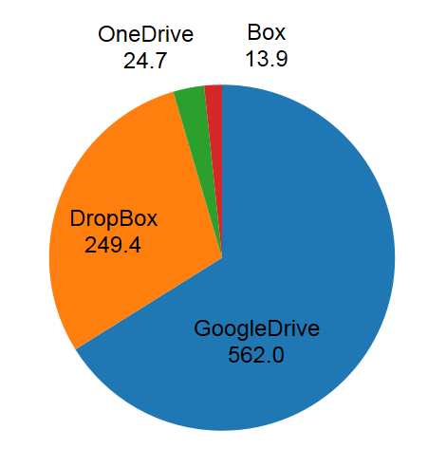
Because They are There
Gartner calls this EFSS
Enterprise File Sharing and Synchronization
42% of more than 300 surveyed IT professionals had a corporate account for online file sharing and collaboration services this year, compared to 28% in 2012, according to McClure
OneDrive, Google Drive, Box & DropBox > 65% of business usage
Business Usage Survey
451 Research
Mobile Downloads (Millions)
Xyo
Notes:
Let’s build this slide on the content of this URL:
http://searchcloudstorage.techtarget.com/news/2240237177/Enterprise-file-sync-and-share-expands-in-2014
Found more stats here
techcrunch.com/2014/11/27/the-most-popular-enterprise-storage-product-might-surprise-you/Pai

Slide 10
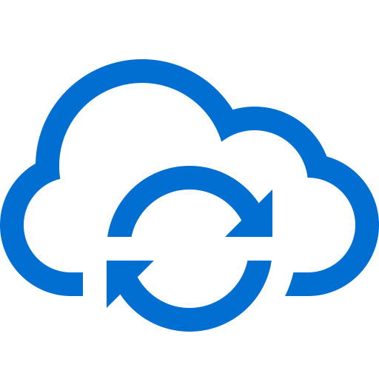
The Workings of EFSS
Corporate Data accessed within perimeter
Downloaded to Mobile
Accessed by 3rd party apps

Slide 11
EFSS Has All the Right Pieces
Global robust server deployment
C&C and data delivery protocols
Encrypted with TLS
Whitelisted by perimeter security
Local software agent for delivering data in and out of the machine
Whitelisted by any endpoint security software
Free entry level offerings ☺
Business and personal use
Global mindshare and recognition

Slide 12
Motivation (III)
3
Why use passwords when you can “Pass The Token”?

Slide 13
(OAuth) Tokens
Token is generated through interactive authentication (user name / password)
Token can be associated with limited set of privileges
Application access ≠ Account control
Token is provided to 3rd party application
Persistently stored as part of the application’s configuration
Authentication = Present Token
Revoking the token prevents further access by 3rd party application

Slide 14
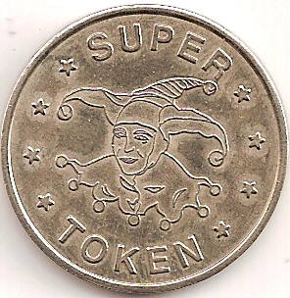
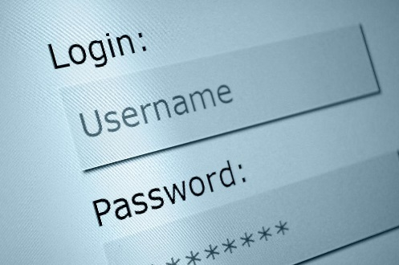
Passwords Vs. Tokens
Passwords are easy to remember – easy to crack
Passwords can and need to frequently change
Passwords are good for (human) interactive authentication
Tokens are difficult to guess (arbitrarily long and random)
Do not need to change frequently
Tokens can be revoked
Tokens should be used for application authentication

Slide 15
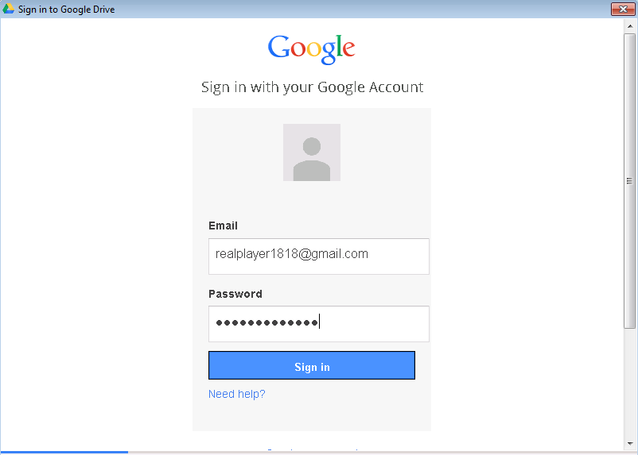
Getting Tokens

Slide 16
Passwords Vs. Tokens (Round 2)
Password authentication may require 2FA
Password authentication is sensitive to new device, new location protection
Password only available when user types it
Password is valid through a limited timeframe
Token authentication is seamless
Token authentication is (in practice) insensitive to new device / new location protection
Token is always available as part of the persistent configuration
Tokens are forever (sometimes literally)
Difficult to attribute

Slide 17
Man In The Cloud (MITC) Attacks
4
The Sky is Falling

Slide 18
Concept
Abuse cloud file synchronization services
Data compromise
Data exfiltration
C&C and remote access
Highlights of the attack plan
Synchronize victim’s machine with attacker controlled account
Obtain victim’s token through the synchronization mechanism
Retrieve sensitive data from the victim’s account using the victim’s token
Potentially send code for remote execution through the synchronization mechanism
Notes:
We have slides describing 3 parts of the attack plan. The 3rd one – retrieving data is trivial as it is provided by the platform.

Slide 19
Synchronize Victim’s Machine with Attacker Account
As a first step, attacker creates an account rather than compromise the victim’s account
The attacker obtains the authentication token for that account
Code executes on victim’s machine to “switch” synchronization account
Stop synchronization application
Replace the existing token with the attacker token
Restart synchronization application
Notes:
Attacker can anonymously create a free account with any of the major EFSS vendors.

Slide 20
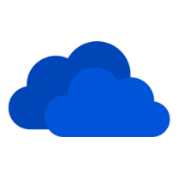
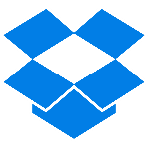
Finding and Replacing Tokens
More details available in our HII report
Synchronization Application
Token Type | OAuth Refresh Token | OAuth Refresh Token | OAuth Refresh Token | Proprietary
Location | Windows Credential Manager | Windows Credential Manager | Encrypted in Registry | Encrypted SQLite file
Notes:
Encryption uses current user context and therefore decryption does not require a key, but rather code running in the user’s context.

Slide 21
Obtain Victim’s Token
Put the original token in a file
Put the file in the synchronization folder
Wait for the file to appear on the other side of earth

Slide 22
Some Details – Google Drive
OAuth Refresh Token
Retrieve token
Decrypt registry using Windows CryptUnprotectData HKCU\Software\Google\Drive\OAuthToken_***unique**
Replace token (while app inactive)
Delete “old” registry entry & replace with harvested entry HKCU\Software\Google\Drive\OAuthToken_**new**
Encrypt harvested token using Windows CryptProtectData
Replace each row inside the data table in sync_config.db with the attacker’s data, except for the “local_sync_root_path” entry (which holds the path to the vicitm’s synced folder

Slide 23
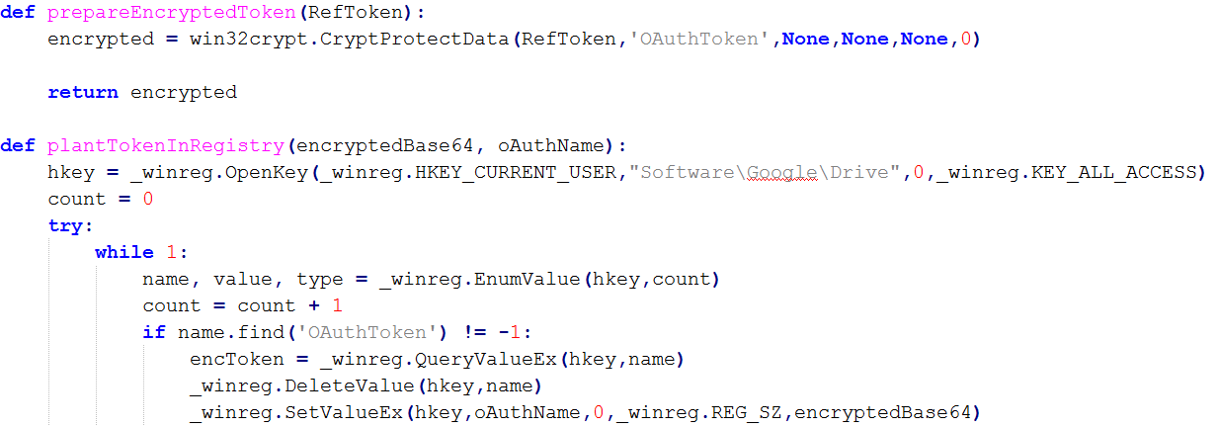
Some Details – The “Malicious” Code

Slide 24
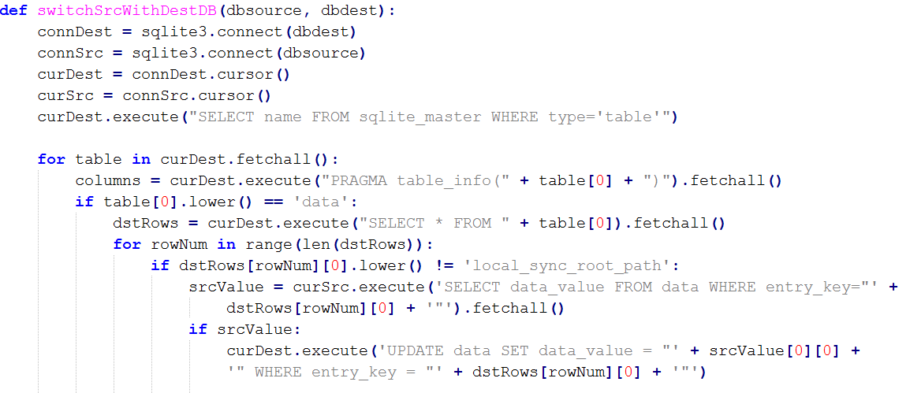
Some Details – The “Malicious” Code

Slide 25
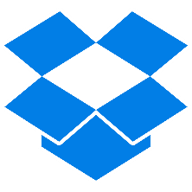
MITC Attack Scenarios – Quick Double Switch

Slide 26
MITC Attack Scenarios – Quick Double Switch

Slide 27
MITC Attack Scenarios – Quick Double Switch

Slide 28
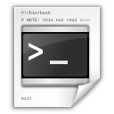
MITC Attack Scenarios – Remote Code Execution

Slide 29
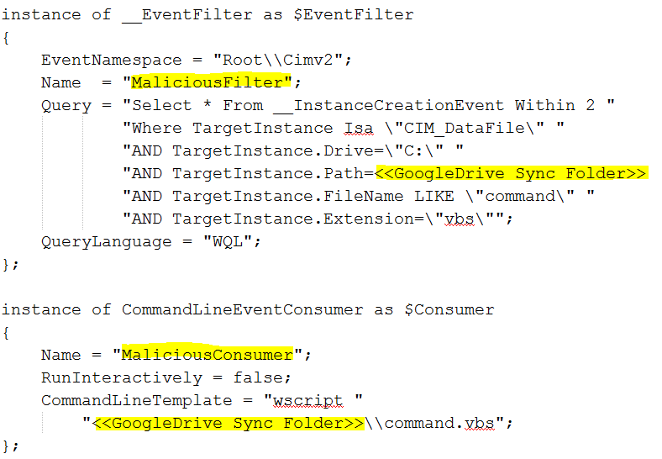
Remote Code Execution - Details
WMI event subscription
Waiting on file creation in sync folder
Created file is executed
“mofcomp config.mof”

Slide 30
Demo

Slide 31
Additional Attack Scenarios
Waiting for good things to come
Inject scripts and macros into synchronized documents
Hope that victim opens such a document
Increase probability by piggybacking on active documents
Cloud RansomWare
Encrypt victim’s data and demand ransom

Slide 32
Native Detection and Mitigation
5
How bad is it?

Slide 33
Detecting a Compromise
Synchronization Application
Proactive (alerts) | None | None | None | None (if attacker spoofs the device ID)
Reactive (forensics) | Review history of connected locations and devices | Review history of connected locations and devices | None | Constantly monitor last connected location

Slide 34
Recovery From a Compromise
Synchronization Application
Turn on 2FA | Not applicable to tokens | Not applicable to tokens | Not applicable to tokens | Not applicable to “host_id”
Revoke Stolen Token | Disconnecting devices doesn’t revoke token | Disconnect Devices | Disconnect devices | Disconnect Devices
Change Password | Revokes tokens. Opened “sessions” remain open | Specifically Request to revoke all tokens | Revokes all tokens | Not applicable to host_id
Notes:
It’s not clear how to disinfect an account in OneDrive

Slide 35
Takedown
IT infrastructure of the Botnet cannot be taken down
It’s a vital service most of us use
Attacker’s account is NEVER compromised
Even if token is exposed during initial infection it is extremely difficult to associate with an account (with the exception of DropBox ☺)
It is therefore extremely difficult to take down the specific account used for the initial compromise
Moreover, it has no actual effect on existing infections or future ones

Slide 36
Conclusions & Mitigations
6

Slide 37
Summary
Easy to turn EFSS into an infrastructure for endpoint compromise, providing a channel for C&C, data exfiltration, and remote access
Compromise with tokens rather than passwords
Tokens usage make compromise almost undetectable and sometimes irreversible (for an account)
Attacks based on the above architecture have been witnessed in the wild (for example, in “The Inception Framework ” – analysis by Blue Coat)

Slide 38
Mitigation
Endpoint and perimeter security won’t cut it
No malicious code persists on the endpoint
No abnormal outbound traffic channels are observed on the wire
Vendors could do better
Improve proactive detection (location alerts for tokens)
2FA for new devices (even with token access only)
Allow revocation of any existing application token
Vendor will always struggle though with the right balance of security and mobility

Slide 39
Mitigation – Improve Control of EFSS
Cloud Access Security Broker (CASB) Solutions
Anomaly detection and device control at the enterprise level rather than the individual service level
Apply enterprise wide policies to new devices
Block & alert on rapid changes in location
Alert on abnormal usage (file loaded from one device and deleted quickly on another for example)

Slide 40
Mitigation – It’s All About the Data Stupid!
Attackers are after enterprise data and not after individual endpoints
A successful attack (e.g. 145M user accounts, 70M credit card numbers, 300K medical records, 4M employee evaluation forms) must express itself in abusive data access
Deploy monitoring, detection and control solutions around data repositories
SQL databases, NoSQL repositories, File servers, SharePoint deployments
See everything, detect abnormal and abusive access patterns, react by denying further access to potentially compromised machines and accounts

Slide 41
Download HII report
Imperva.com

